Slide 1
Imagineering
Rebecca Caudill
Porter Elementary
Johnson County

Slide 2
FOCUS
The problem of practice is loss of engaging and hands-on experiences for students while transitioning in and out of the classroom due to lack of embedded technology as well as limited in class and take-home building resources.

Slide 3
Reimagining engineering in and out of the classroom
Research Question:
If schools continue in-person learning for the remainder of the school year, will increased blended learning instruction and additional building materials boost student engagement?
If the need arises for remote learning, will increased blended instruction in the classroom and supplemental take-home resources preserve engagement and make for an easier transition for students?
Imagineering:

Slide 4
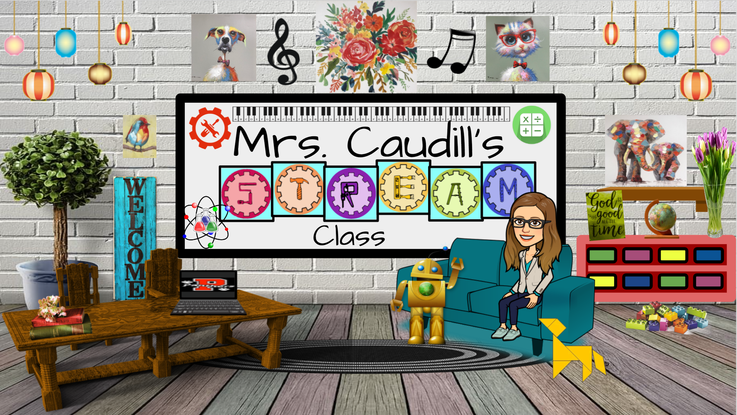

Slide 5
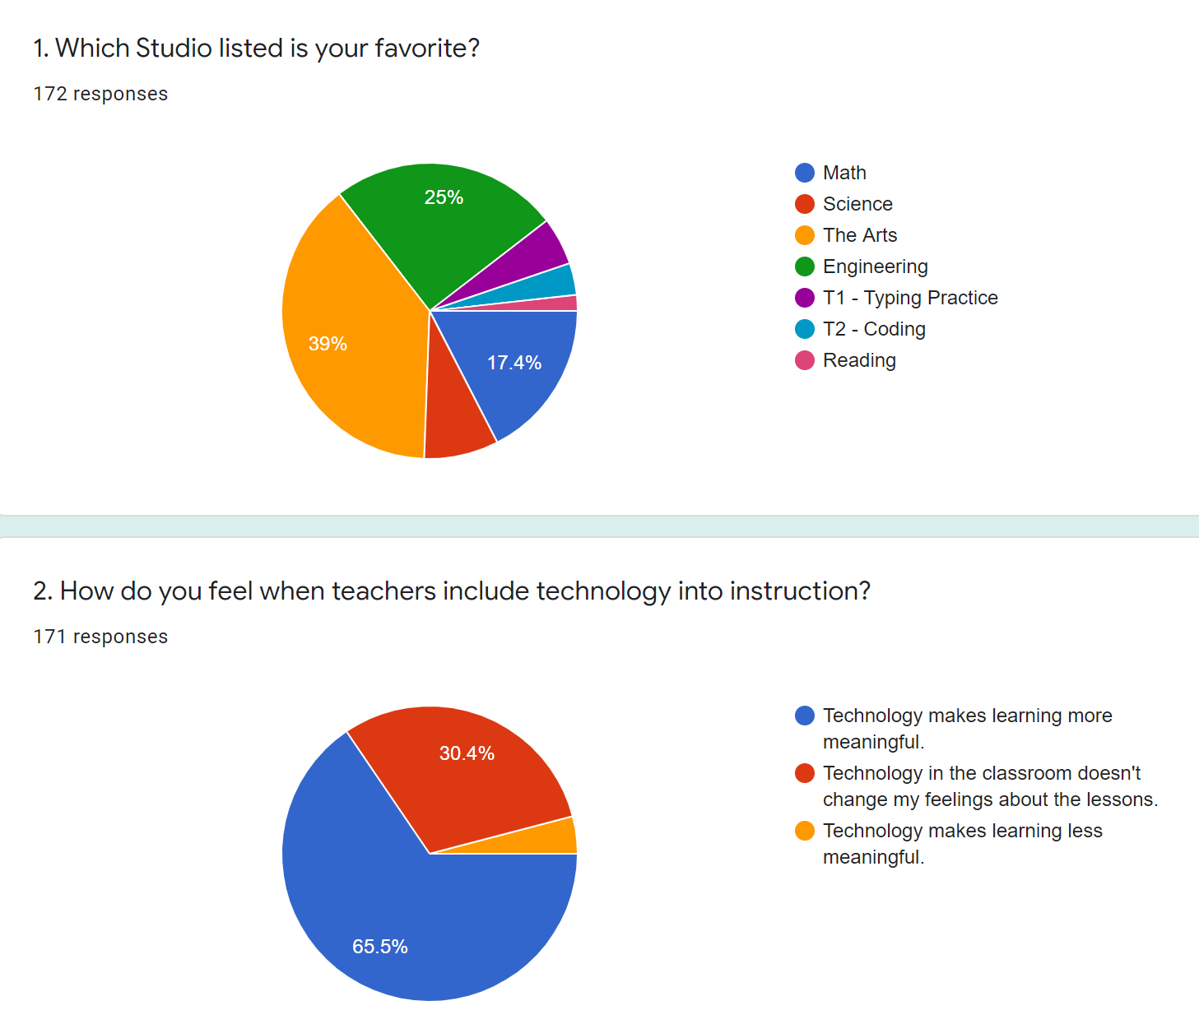

Slide 6
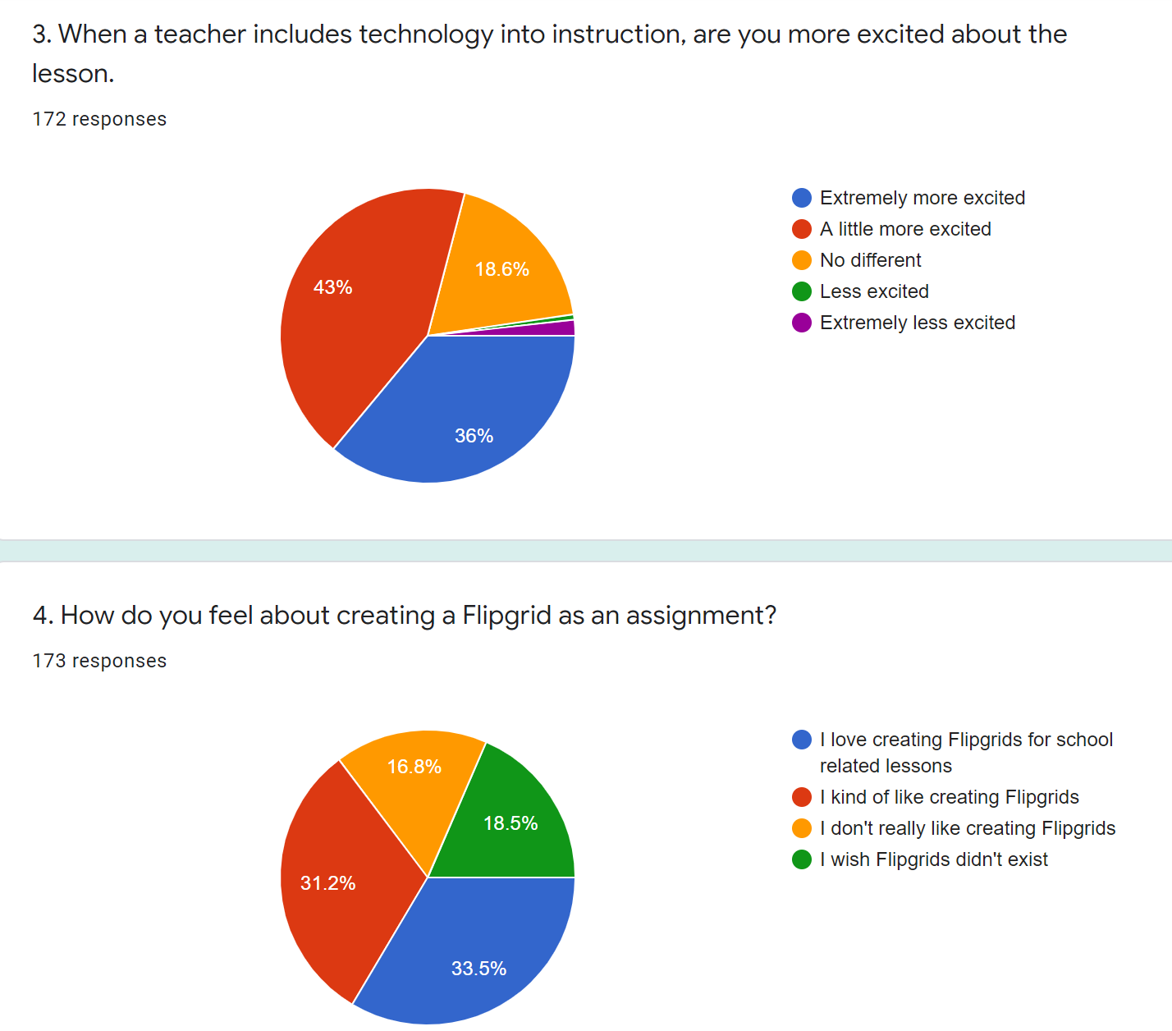

Slide 7
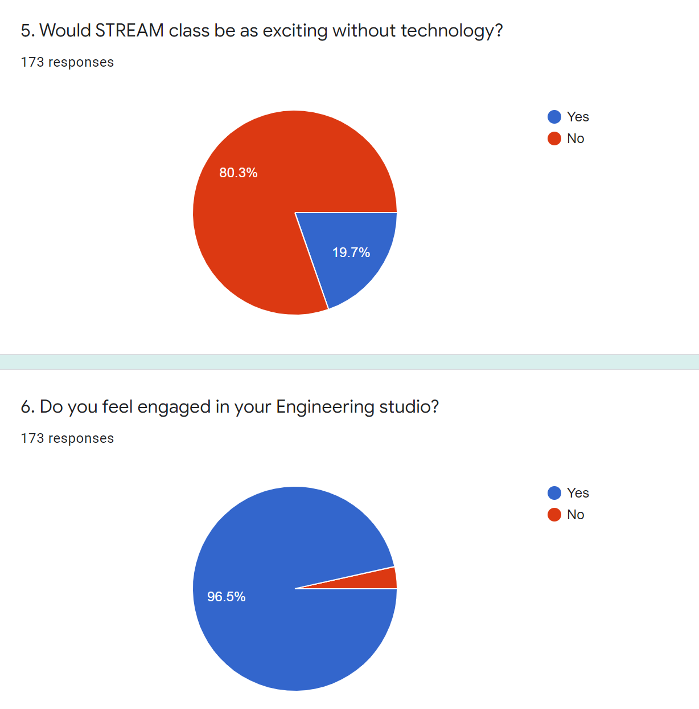

Slide 8
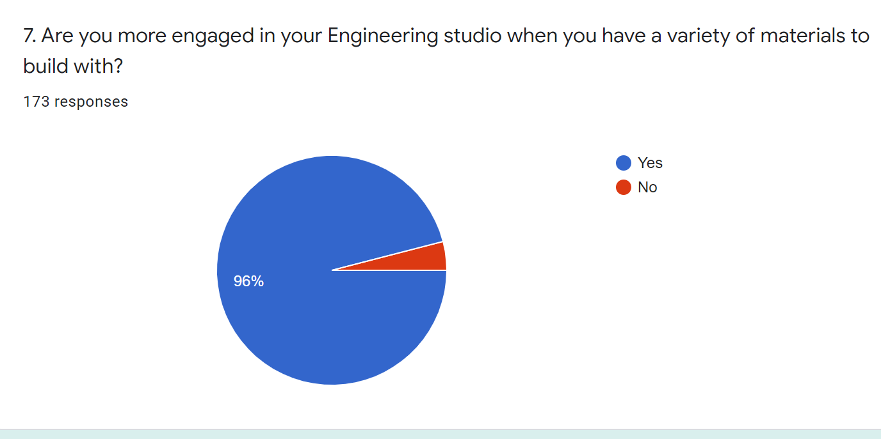

Slide 9
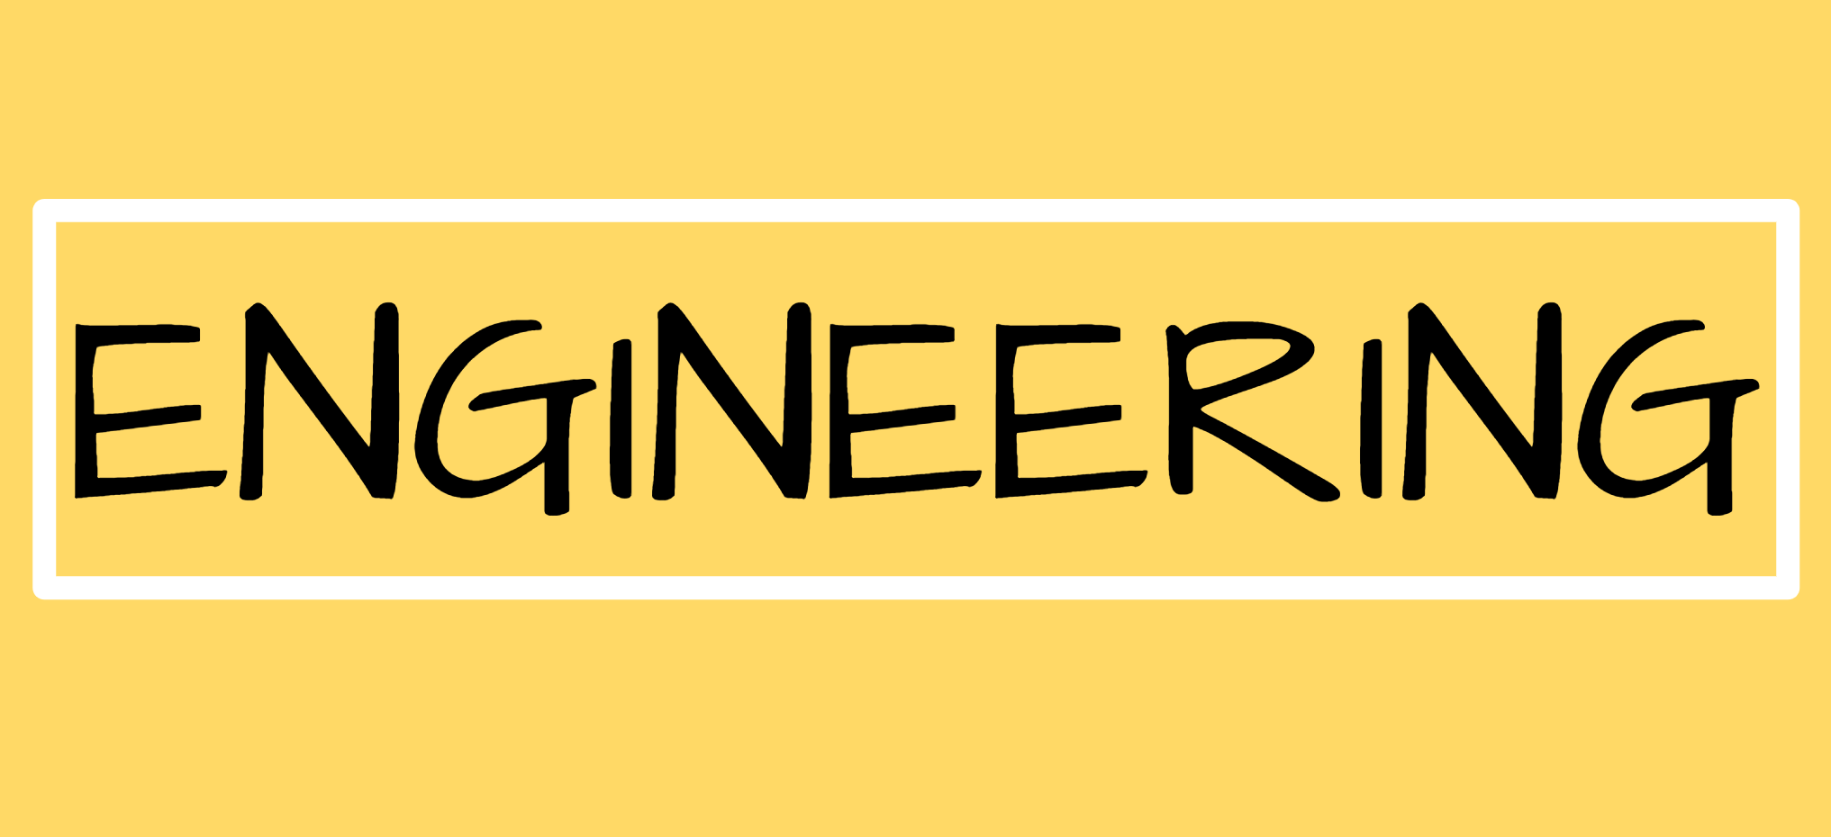

Slide 10
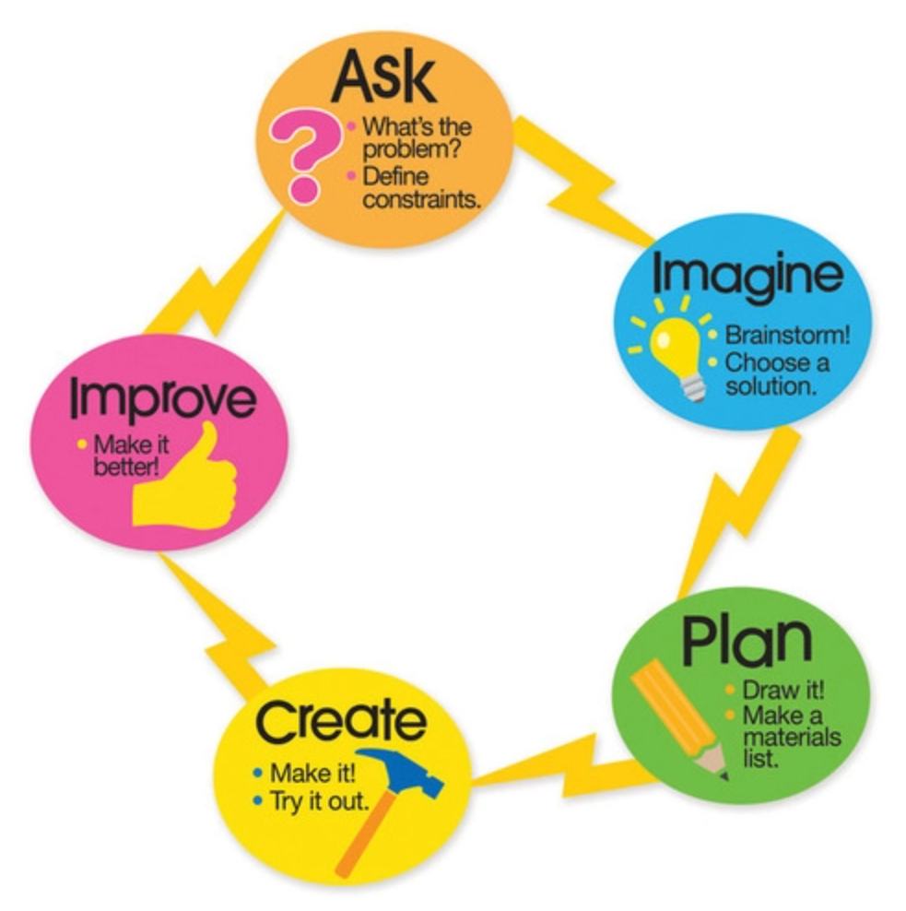

Slide 11
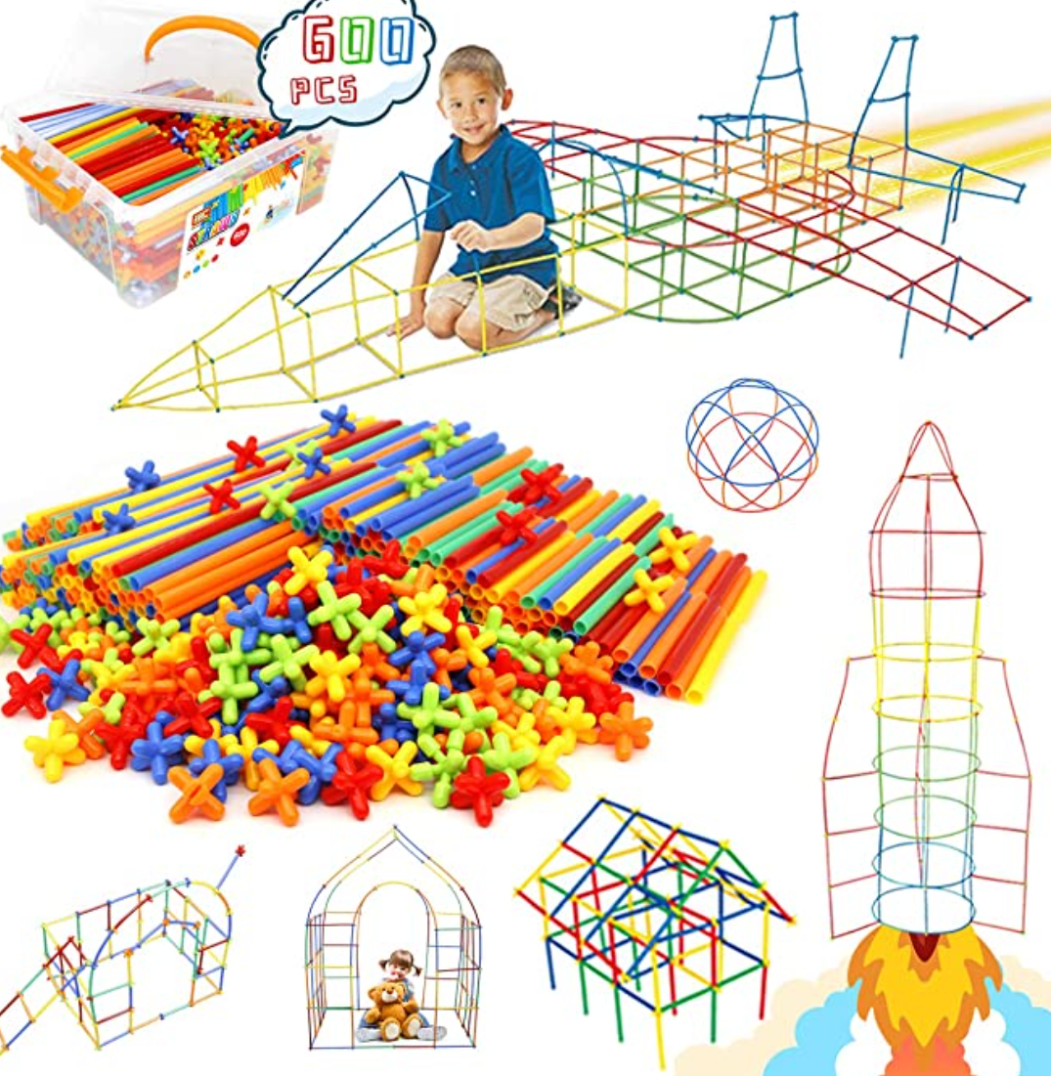
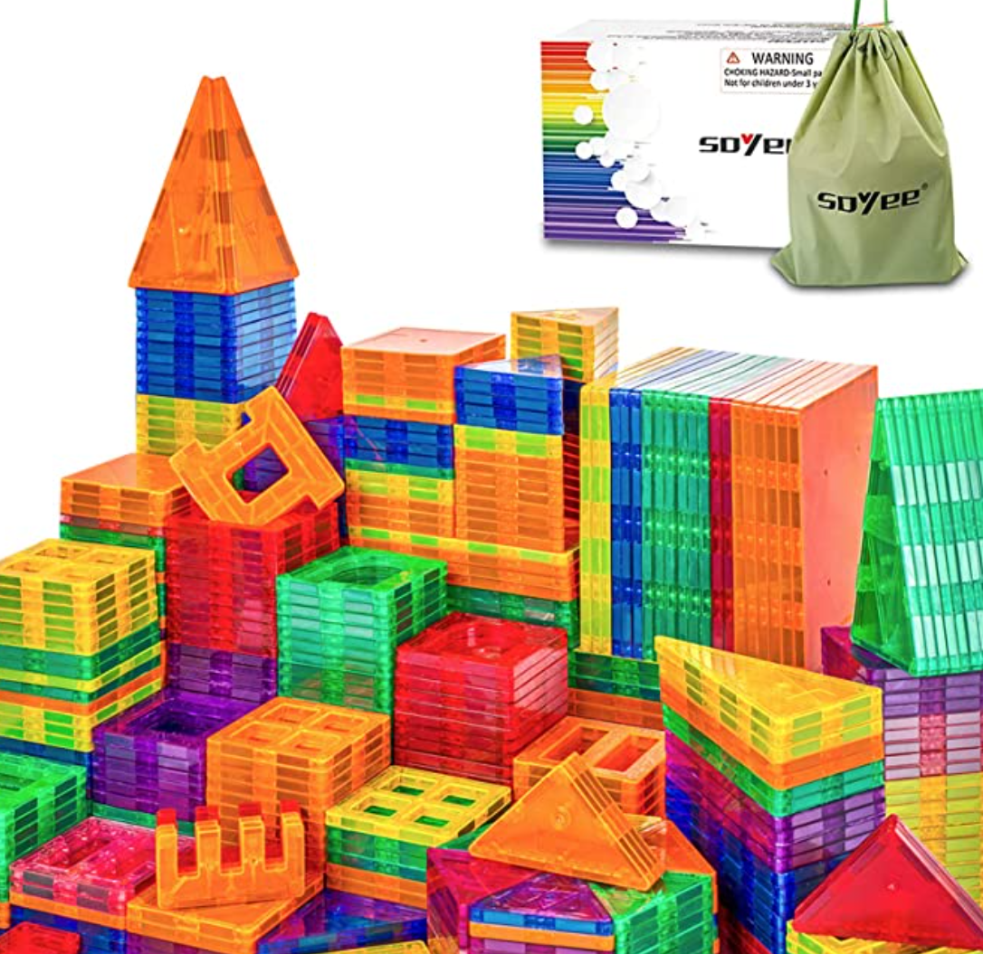
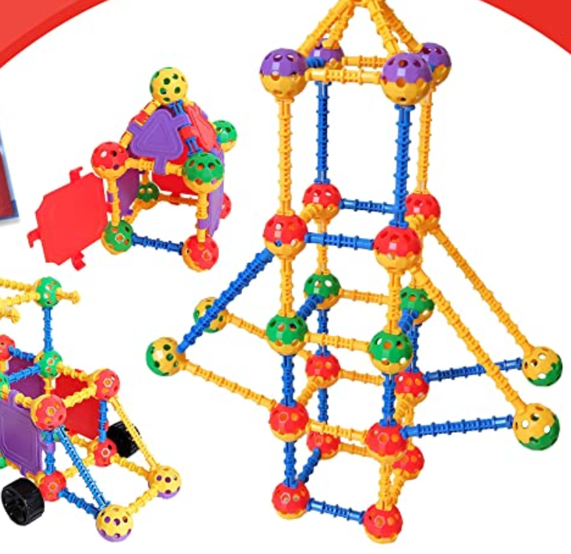
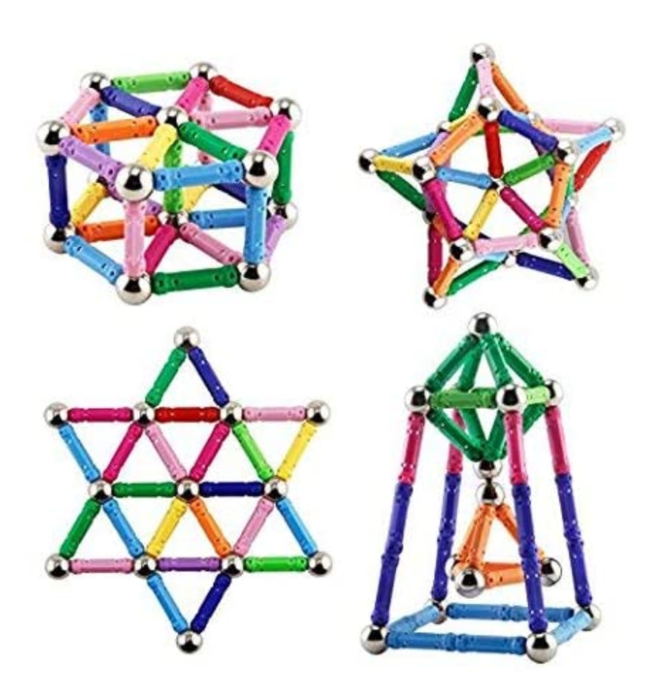
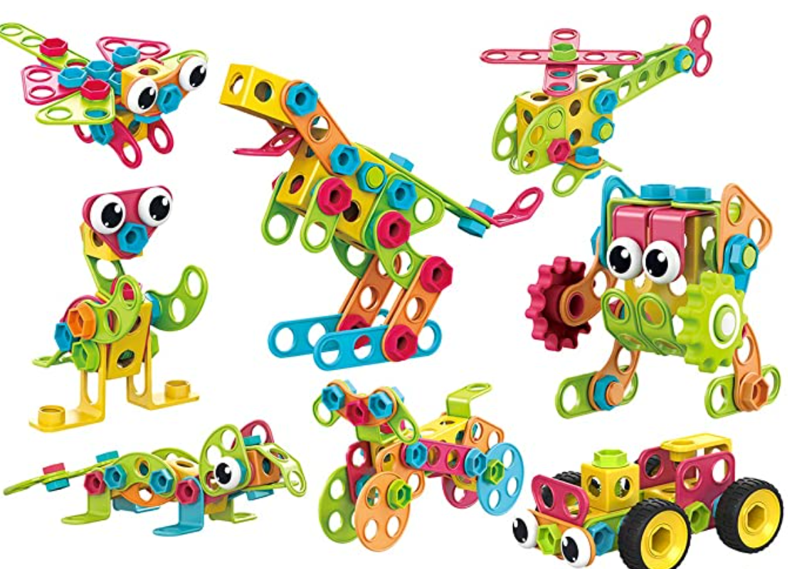
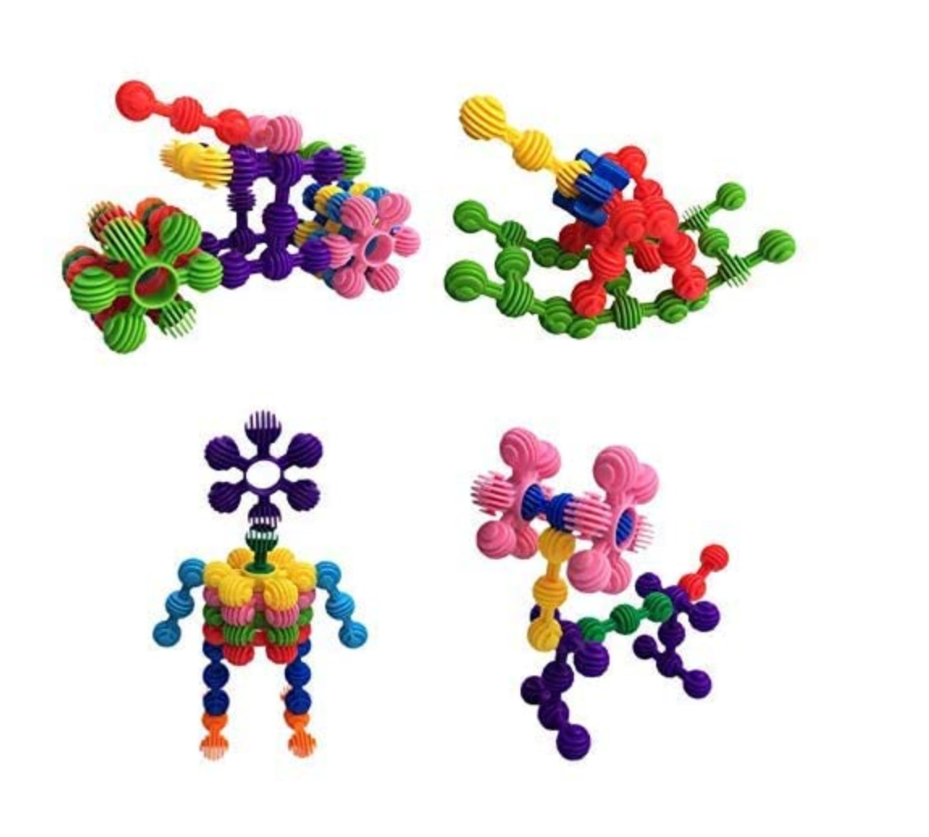

Slide 13
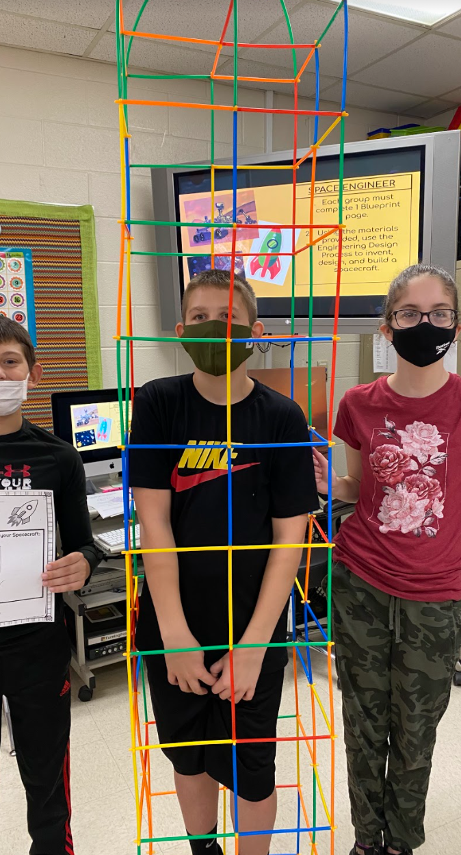
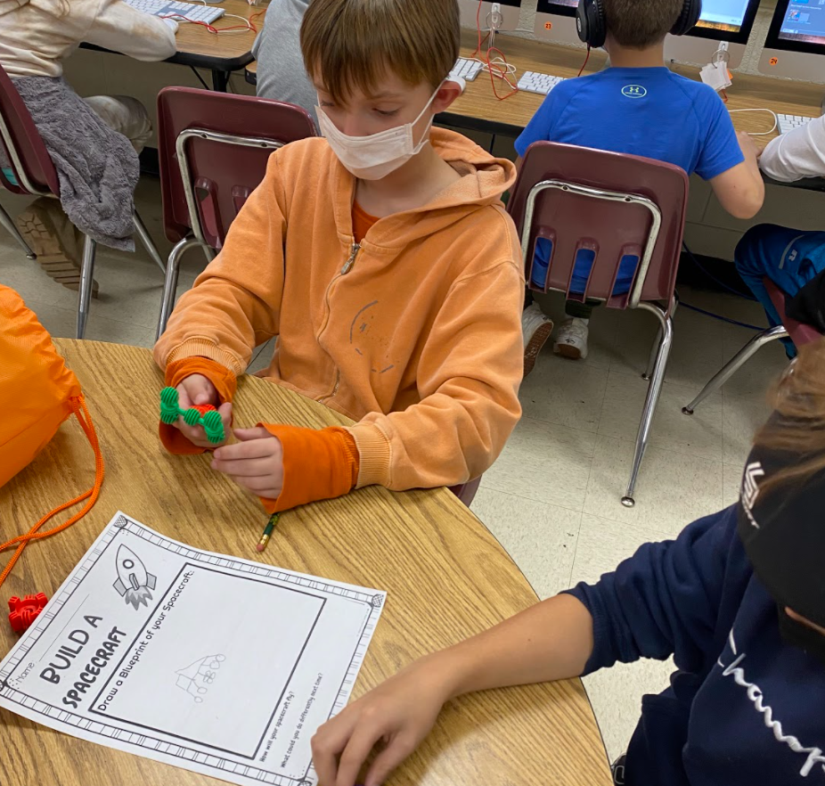

Slide 14
Katie Linder states, “Blended learning is not just a trend, and we’re starting to see technology integrated in really intentional ways.”

