Slide 1
Angie Cordle
Prestonsburg Elementary
Floyd County Schools

Slide 2
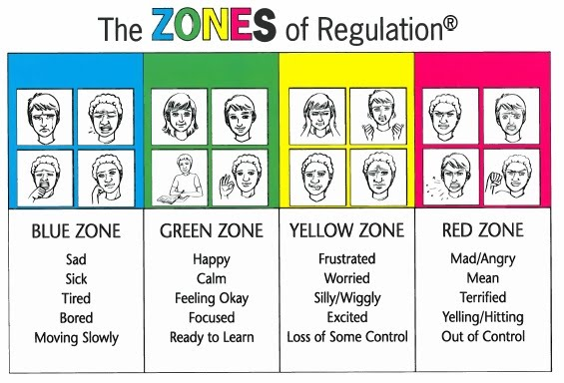
What are the current problems of practice that caused you to choose this topic?
Students dealing with trauma,
anxiety, loss, and other emotions.
Students with Autism or Emotional Behavior Disorders having difficulty understanding their feelings.
Students have difficulty knowing how to calm down.

Slide 3
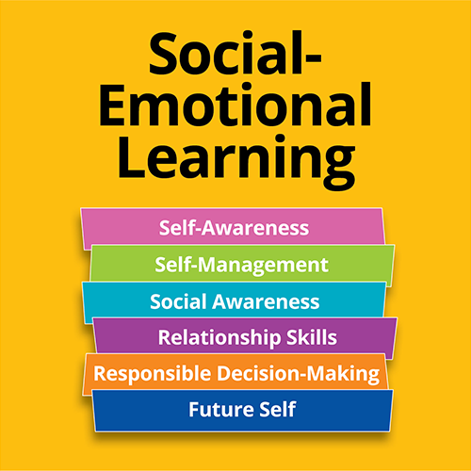
Explain you project…..
The Zones of Regulation is based on a metacognitive
framework, designed to help students become
aware of their feelings and build self management skills.
The program is designed to help students regulate their
actions so they can develop problem solving abilities and
self -control.

Slide 4
What are the anticipated results of your project?
My main goal of the Zones of Regulation is to add another resource for teachers. I want them to have the ability not only teach children how to identify their feelings and levels of alertness but also develop effective regulation tools. By using this program students can learn when and how to us the tools which will create a better learning environment.

