Slide 1
Voices of the Troublesome:
An Appalachian Literature Library
and podcast
Grant Recipient: Nikki Farler, Perry County Schools

Slide 2
Innovation Grant Recipient
Hello, I am Nikki Farler and this is my 13th year with the Perry County School. This is my fourth KVEC Innovation Grant.
I am a Learning Behavioral Disorders teacher in kindergarten to second grade. I also teach a resource setting for students with moderate to severe disabilities.

Slide 3
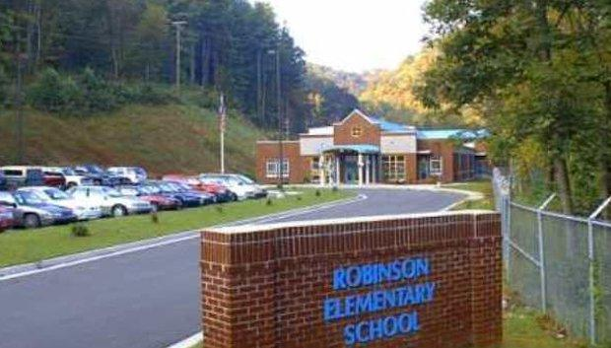
Welcome to Robinson Elementary
Robinson Elementary is located in Ary, Kentucky on the banks of the Troublesome Creek. Robinson is home to approximately 300 students preschool through eighth grade.
Robinson is unique in that it just celebrated its 100th anniversary of serving the students of the Ary community.

Slide 4
Grant Rationale
Our students have a limited knowledge of their region’s culture and have limited exposure of books that depict the world in which they live.
This generation has experienced a cycle of opioid abuse that has affected the family structures in throughout their community. While also experiencing a pandemic.

Slide 5
Research Question
How might increase the student of Robinson’s knowledge of Appalachian culture while also giving them the sense that their stories are being heard?

Slide 6
Plan of Action
After consulting with a local bookstore that focuses on Appalachian literature, an Appalachian literature classroom libraries will be cultivated for each section of Robinson Elementary.
In library class the students will be read books such as When I was Young in the Mountains, Silver Packages and The Book Lady.
Podcasts will be made as students describe their journeys while they have been young in the mountains.

Slide 7
Project Timeline
October
Books, podcast equipment and craft supplies will be ordered
November
Books are separated and categorized to grade
December
Students will be read Silver Packages
Students will make Appalachian themed Christmas ornaments for the community tree

Slide 8
Project Timeline
January
Students are read When I Was Young in the Mountain
Students in 3-8 will write their own versions of this book using their experiences
February
Podcasts will be recorded from the writings
March
Students will be read The Book Lady
Students will compare this book to their pandemic experiences
Podcasts will be recorded

Slide 9
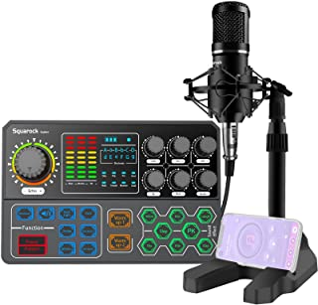
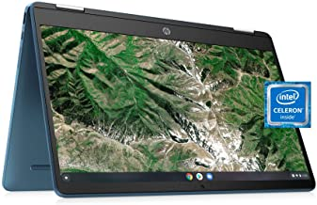
Project Budget
Touchscreen Chromebook
Podcast Equipment Bundle

Slide 10
Measuring Outcomes
Numbers of students taking and passing AR test from the Appalachian literature section will be tracked
Participation in Appalachian cultural events will be measured

Slide 11
Want to know more?
Contact Information
nikki.farler@perry.kyschools.us

