Slide 1
Professional
Action Network

Slide 2
Referral/Tiers
of Intervention
Stephanie Nichols, NBCT
Letcher Elementary & Middle School Letcher County Public Schools

Slide 3
Problem of Practice:
The 2021-2022 school year has seen many unprecedented changes in the field of education. One of these changes is the the employment of many new teachers, in the KVEC region, as well as my school district. Most new teachers do not understand the importance of, or the process for, implementing interventions and referring a student for an evaluation for a suspected disability.

Slide 4
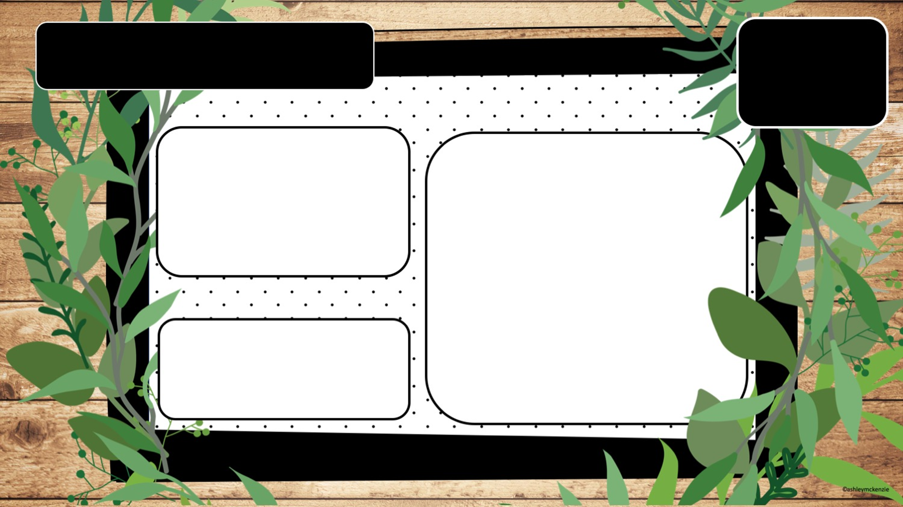
Description of Project
Success is the sum of small efforts repeated day in and day out.
- Robert Collier
Intervention Data Sheet
This PAN project is an Intervention Data Recording Sheet. It is not in lieu of a pre-referral or district intervention document. It is a sheet designed to assist teachers in the organization of intervention data. It will allow teachers to have a document that can be used quickly during the school day, when interventions are implemented. It will be beneficial when completing the district/state documents required for a referral.
If a child CAN’T learn the way we teach, maybe we should teach the way THEY learn.
- Ignacio Estrada

Slide 5
The results from my research are?
The research for this PAN project has yielded the following results:
All teachers now have a format to document student’s data from interventions, in a timely manner.
The data sheet assists teachers in understanding how often data is gathered throughout each tier of intervention.
Teachers have the knowledge of interventions, analyzing the data to determine if the student will proceed to the next tier of intervention, and if the student is to be referred for an evaluation of a suspected disability.

Slide 6
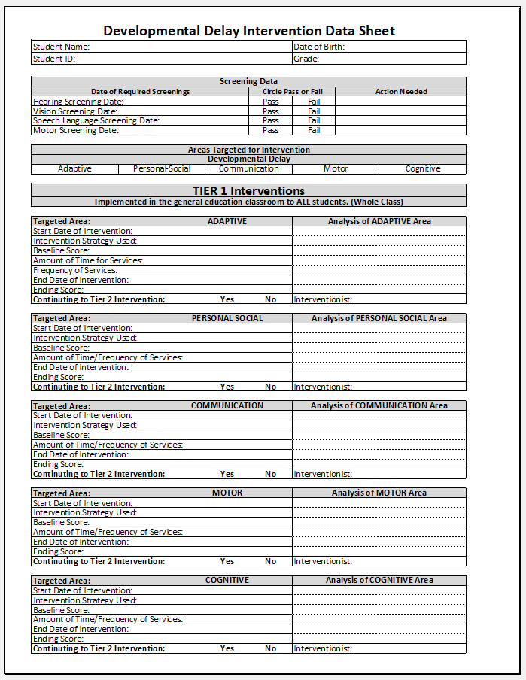
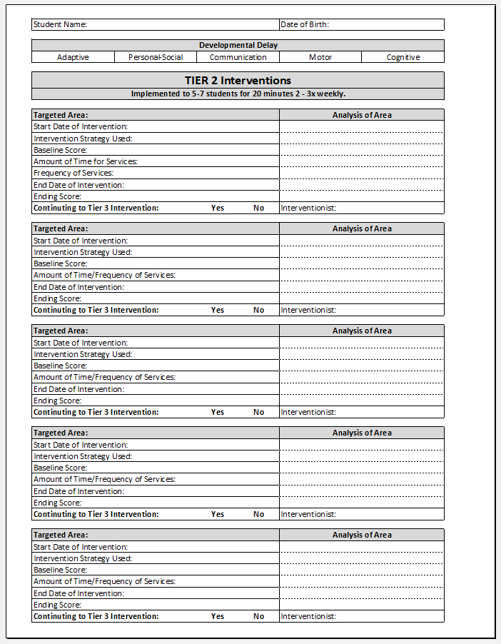
Developmental Delay
Intervention Data Sheet
Solutions
What artifact did you create?
Brochure
Presentation
Video
One Pager
Graphic organizer
Other

Slide 7
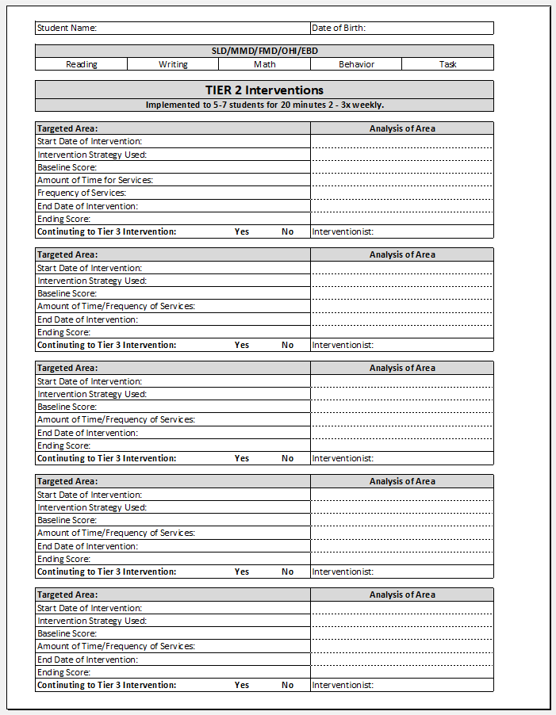
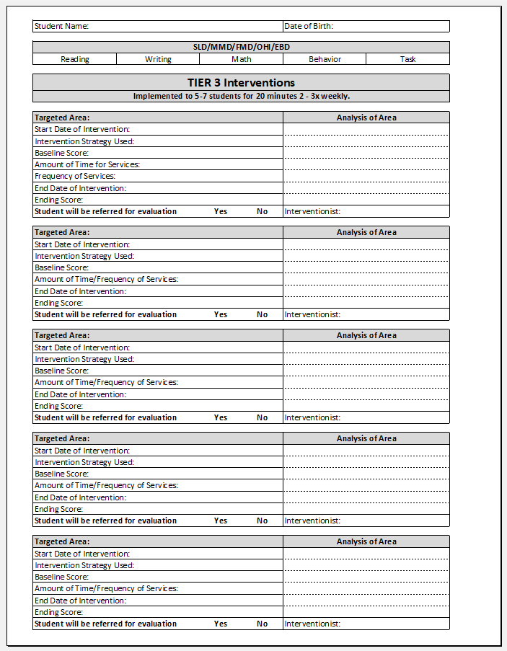
Academic & Behavior
Intervention Data Sheet
Solutions
What artifact did you create?
Brochure
Presentation
Video
One Pager
Graphic organizer
Other

Slide 8
I anticipate that my PAN project will assist teachers in documenting intervention results. I hope that the condensed data sheet will give teachers a place to effectively record intervention data during the school day, when time is of the essence.

Slide 9
Resources
Intervention
Websites
KVEC Child Find Interventions/Videos
Child Find & Tiers of Academic/Behavior Interventions.docx - Google Docs
Interventions by Subject
Reading - KVEC Reading Child Find Intervention Tool.docx - Google Docs
Writing - KVEC Writing Child Find Intervention Tool.docx - Google Docs
Math - KVEC Math Child Find Intervention Tool.docx - Google Docs
Behavior - KVEC Challenging Behavior Tool.docx - Google Docs
Samples of Tier 1,2,3 Interventions
https://www.letcher.kyschools.us/Administration/18

