Slide 1
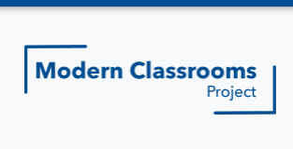
By: Jeffrey Coots
Jackson Independent
9th - 12th Mathematics

Slide 2
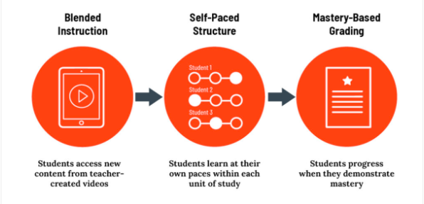
What is The Modern Classroom Project?
The Modern Classroom Project is a program that allows teachers to learn an effective new way of teaching. The Project gives teachers a new self-paced mastery-based plan to allow for student growth. By allowing students to learn at their own pace, it gives students control over their education and ensures that every student is working at the best of their ability.

Slide 3
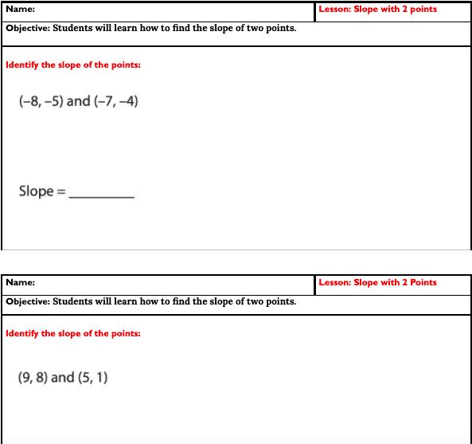
First Goal - Mastery Checks
The first bit of content covered within the Modern Classroom Project was Mastery Checks for students. After students are given virtual lessons, they are asked to practice on their own to ensure understanding of the material. If they feel they understand the content clearly, they are given a mastery check that ensures they do in fact understand the material.

Slide 4
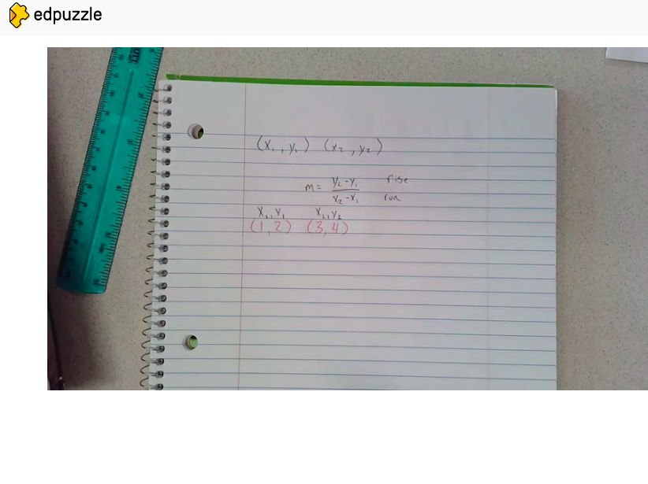
Second Step - Creating Instructional Videos
The second step within the Modern Classroom Summer Institute was learning to create short videos that would allow students to understand the material discussed in class. By always having these videos available, students were able to learn at their own pace and still be able to see curriculum if they were out of the classroom for extended periods of time. By creating the lessons, ourselves, students were able to ask questions when we were in class and use time in class solely for reviewing the material.

Slide 5
Third Step - Implementation of Self-Pacing in the Classroom
The most important thing that can happen for the students is having a solid foundation of what to expect within the classroom. By having a set-in-stone self-pacing guide for students to follow will allow them to know where they should be at and what to do as they progress through the classroom.

Slide 6
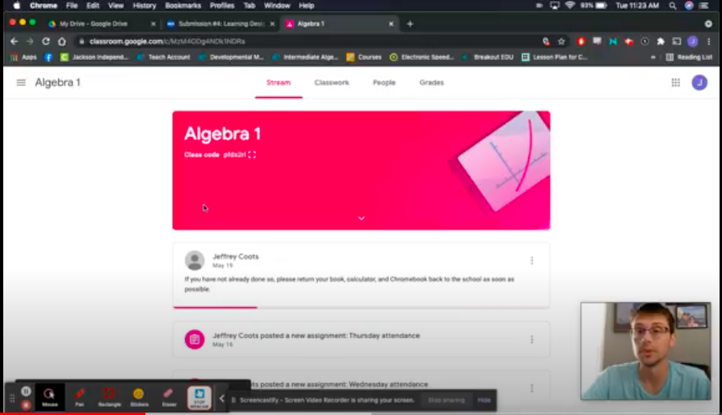
Fourth Step - Support of the Modern Classroom
The major and final step of the Modern Classroom is to have implementations within the classroom that support students as they progress through the program. By having physical and digital creations found within the classroom will allow students to effectively use a blended learning environment that will benefit them whether they are in the classroom or online.

Slide 7
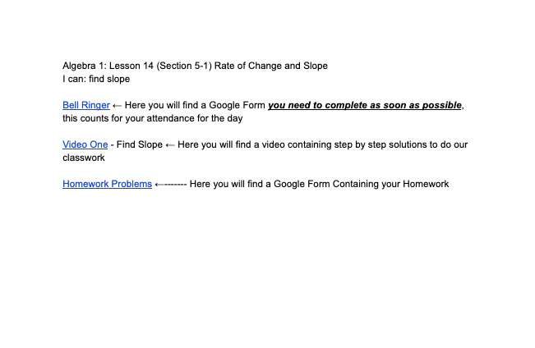
Benefits of the Modern Classroom - Opinions
Gave a condensed version of the classroom that was accessible for students who were in person or quarantined
Allowed there to be videos that allowed students to see the material and review the material any time they needed
Really works well for classes that had to quarantine due to COVID
Allowed more time for discussion of the material in class where students could ensure they knew the material discussed in the videos.

Slide 8
Cons of the Modern Classroom - Opinion
Does not work as well with more difficult concepts that require a lot of time, specifically Algebra 2 Concepts.
Students might get confused over a video uploaded and are unable to ask questions until the next day of class.
Students may disregard videos after not understanding one video and feel they are not going to make it through the class.

Slide 9
Overall Opinions of the Modern Classroom
Great resource for any teacher wanting to improve their teaching style and incorporate new things for students. While it may not work amazing for every class, it does do a great job at helping students in a time where they may have to quarantine at a moment's notice.

