Slide 1
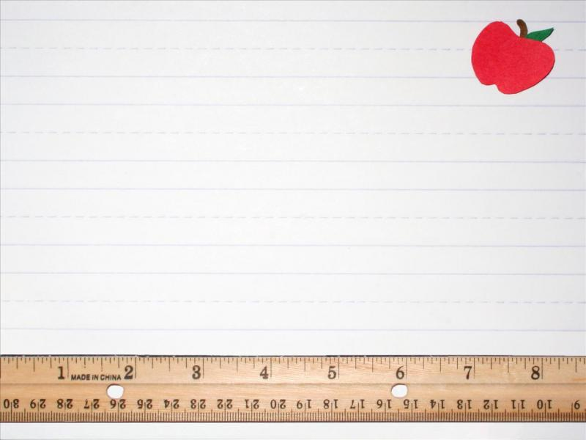
Play Based Learning
And Exploring 2
ARI Grant
Frankie M. Puckett
2021-2022

Slide 2
Project Question and Objective
How I can better serve all my students and meet their diverse learning needs?
The objective is to find out if using multi sensory hands-on projects/activities increase student engagement and learning.

Slide 3
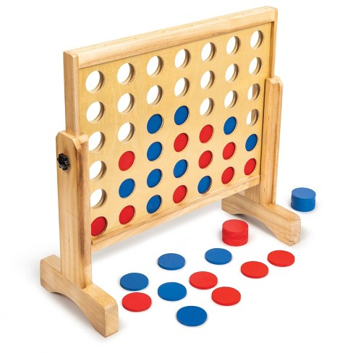
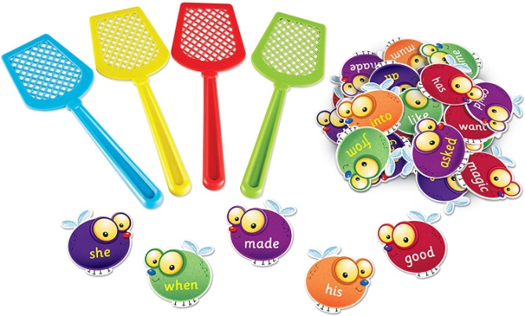
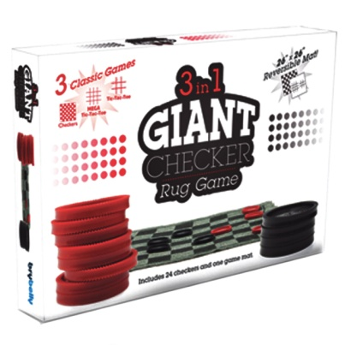
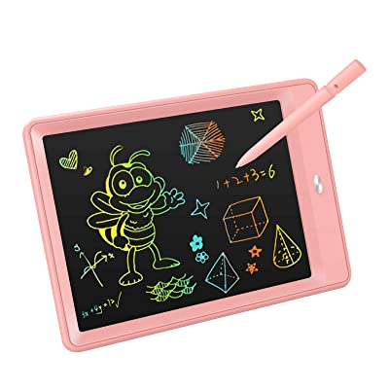
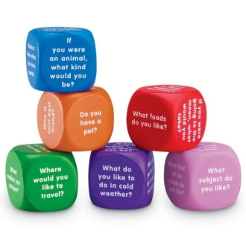
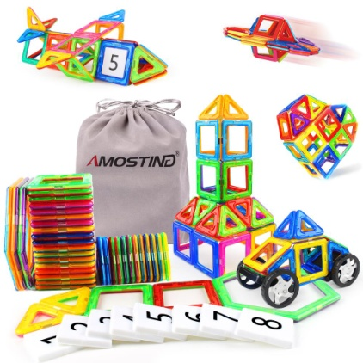
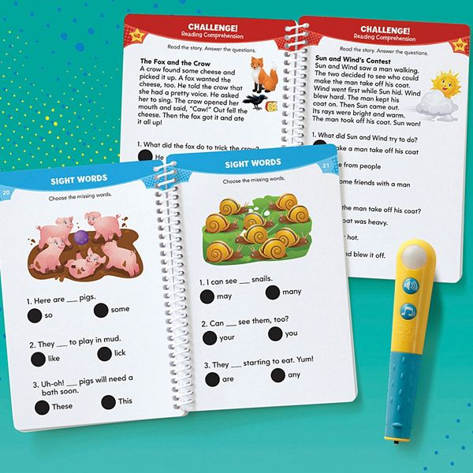
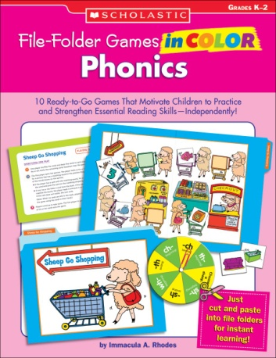
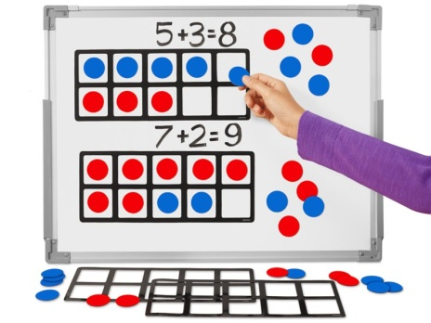
Items requested:

Slide 4
Number Balance Scale Monkey
LCD Writing Tablet
Social Skills File Folder Game
Educational games and supplies students will use to help with learning.
Alphabet Linking Letter and Word Building Cubes
Even Steven Odd and Even
Dry boards and erasers
VTech Write & Learn
?
TPT

Slide 5
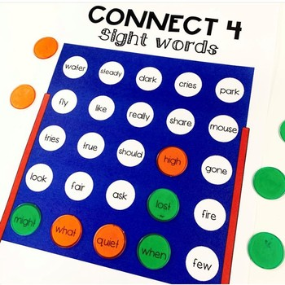
Students will place their playing chips on top of the game board and when they pick up a chip to play they must first answer the comprehension question beneath the chip they picked up.
It can be used as aliteracy center game which engages students in hands-on learning of sight words!

Slide 6
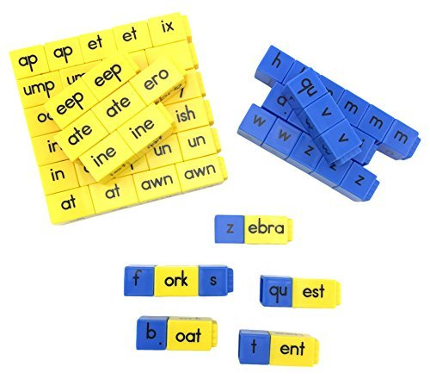
Students can practice the alphabet, spelling and word skills with this literacy tool.
Also learn words with color-coded cubes for easy identification: blue cubes are initial consonants; yellow cubes are short and long vowel word family chunks.

Slide 7
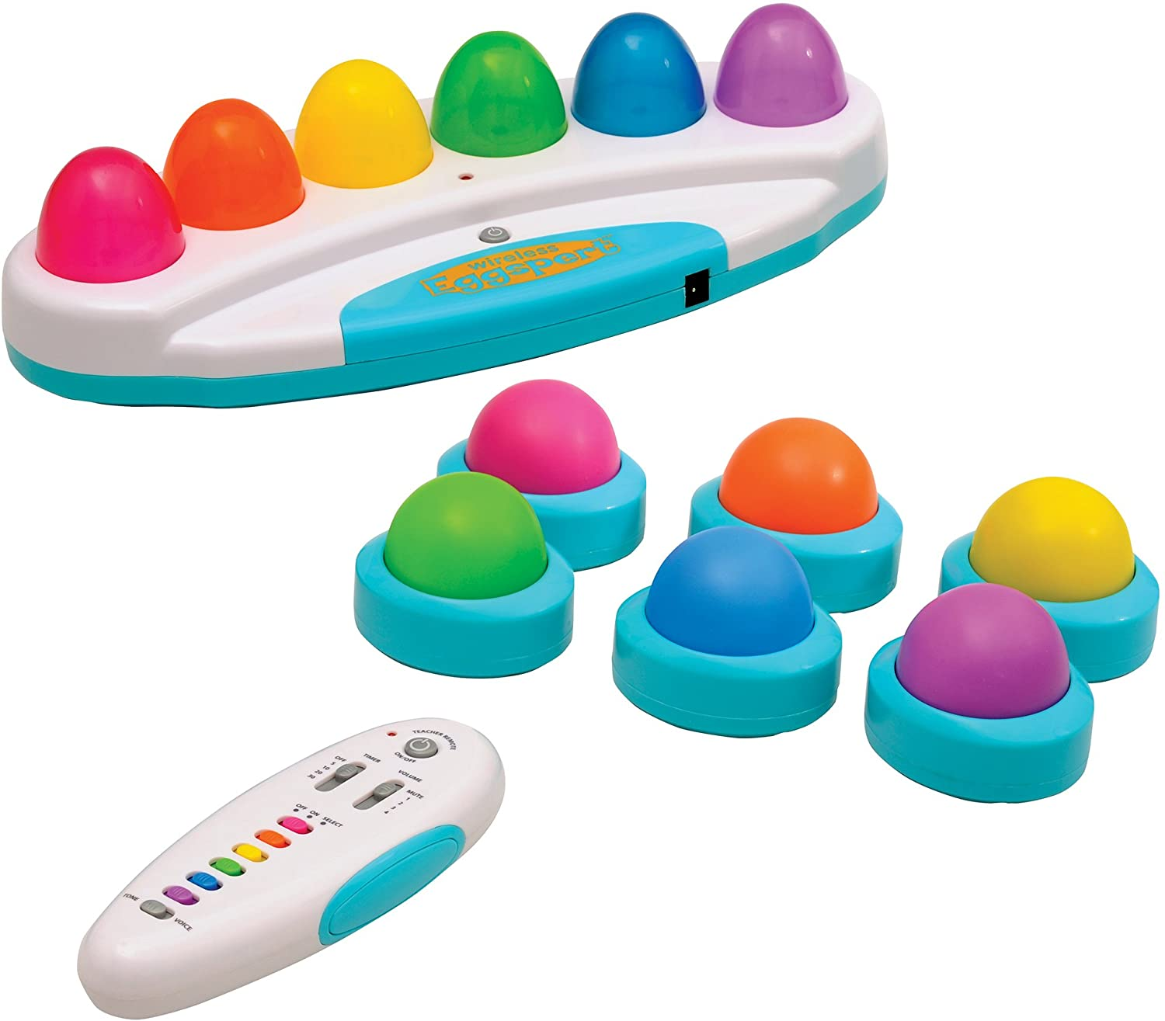
This will engage students by making review sessions and quizzes fun and interactive in math, spelling and reading!

Slide 8
Pre- and post-test, will be used to measure whether the expected changes took place in the participants in a program in the area of math fluency and sight word phrase fluency.

Slide 9
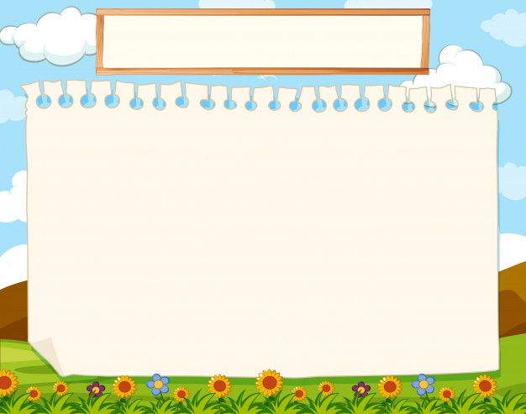
Thank you!
As we begin the school year, my goal is to help my students progress academically and socially utilizing multi-sensory tasks/games.
The goal is for my students to become enthusiastically engaged; actively reading and learning math facts and understanding concepts being taught. Students will increase letter/number/word fluency.
Hopefully increased time spent hands-on multi-sensory activities/tasks/games will increase students scores on curriculum-based probes.

Slide 10
Questions
Frankie.puckett@paintsville.kyschools.us

Slide 11
Clipart and background images:
Dreamstime.com
Free clipart.com
Clipartpanda.com
Walloftext.com

