Slide 1
Nanocrystalline Dye Sensitized Solar Cell
Madison Slone, Caleb Cole, Mason Lambert
Belfry High School
Belfry, KY 41514

Slide 2
Goals
The objective of this project is to create a dye sensitized solar cell that will allow us to capture solar energy to produce electricity in a cheaper more effective way. By doing this and learning how to do it we will be able to troubleshoot the assembly and calibrate a cell to get a consistent result for different trials.

Slide 3
Hypothesis
The goal with this specific project is to create and trap solar energy using the juice from various fruits and berries. The original thought is to use blackberries, but different berries could bring various results. By using different juice to stain the Titanium Dioxide with juice dye, we are hoping to measure electrical output captured within the slides of glass holding it together.

Slide 4
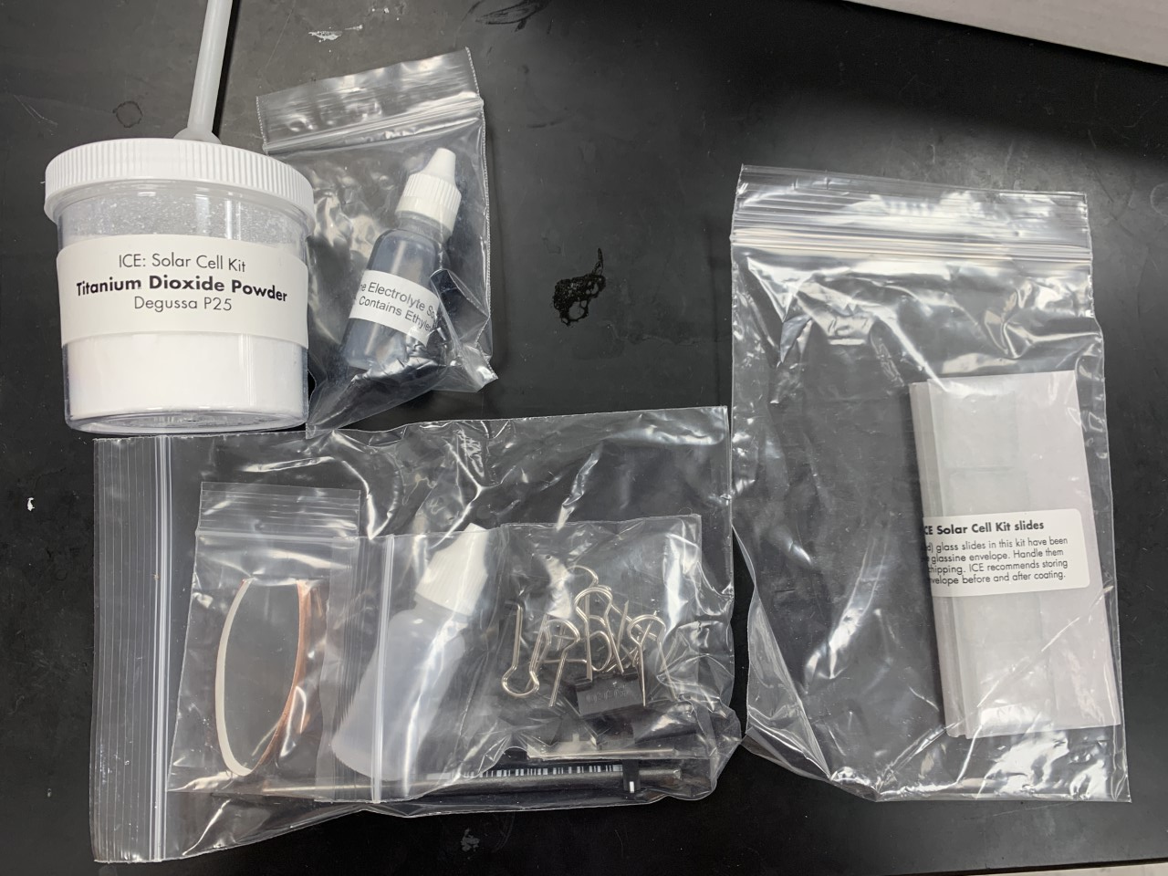
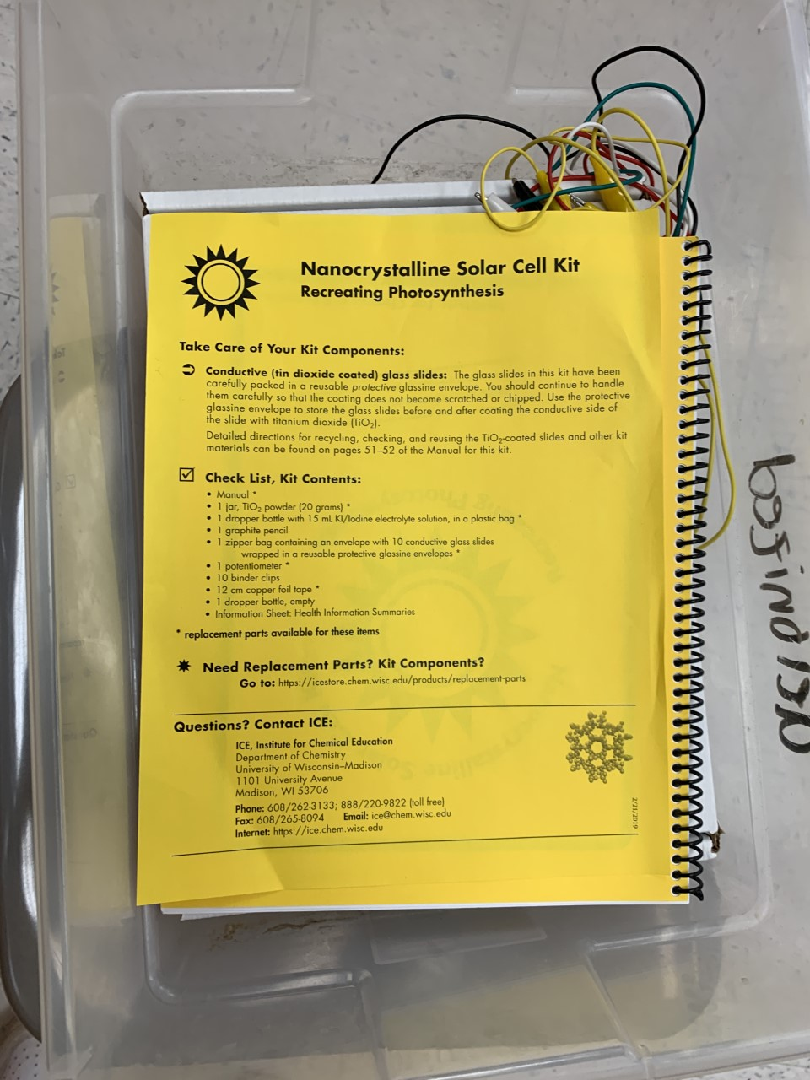
Materials
Conductive (tin oxide coated) glass slides enclosed in a protective glassine envelope
1 jar of TiO₂ (titanium dioxide) powder
1 dropper bottle with 15 mL Iodide electrolyte solution
1 graphite pencil
1000-Ohm potentiometer (1 potentiometer included)
12 cm copper foil tape
10 binder clips
1 dropper bottle, empty
Information sheet: Health information summaries

Slide 5
Experimental Procedure
Preparing the TiO₂ Suspension
Deposition of the TiO₂ film
Preparing chlorophyll dye (optional)
Staining the TiO₂ with Anthocyanin dye
Carbon coating the counter electrode
Assembling the solar cell device
Measuring electrical output characteristics
Constructing a solar module
Demonstrate the power produced by the solar cell or module

Slide 6
Expected Results
This project has a straightforward goal of creating a dye sensitized solar cell that will capture solar energy to produce electricity. Results will/may vary depending on the berry of choice for the experiment.

Slide 7
Acknowledgment
KVEC and included members
BHS Administration and staff
Dr. Haridas Chandran

