Slide 1
Modern Classroom Project
Grant provided by KVEC

Slide 2
Reasons for Applying
A need to modernize my classroom and also the subject matter.
I liked the self-paced mastery and mastery based grading
The blended instruction
Making the Videos

Slide 3
Mastery-Based Grading/Instruction
A lot of research I read concluded that, compared to students in conventional classes, students in mastery-based classrooms had more positive attitudes towards learning and more productive academic mindsets.
Research also showed that mastery-based learning reduced the variability in aptitude between students in a class, while substantially enhancing students' ability to retain their learning long-term.
Compared to teachers in traditional classrooms, Modern Classroom teachers were significantly more likely to report that they understand what each of their students has and has not mastered (93% vs. 74%) and that they use data to provide effective targeted supports to students (93% vs. 52%).
Compared to students in traditional classrooms, Modern Classroom students were significantly more likely to report that they really understand what they are learning (77% vs. 71%) and that they are capable of learning anything (80% vs. 73%).

Slide 4
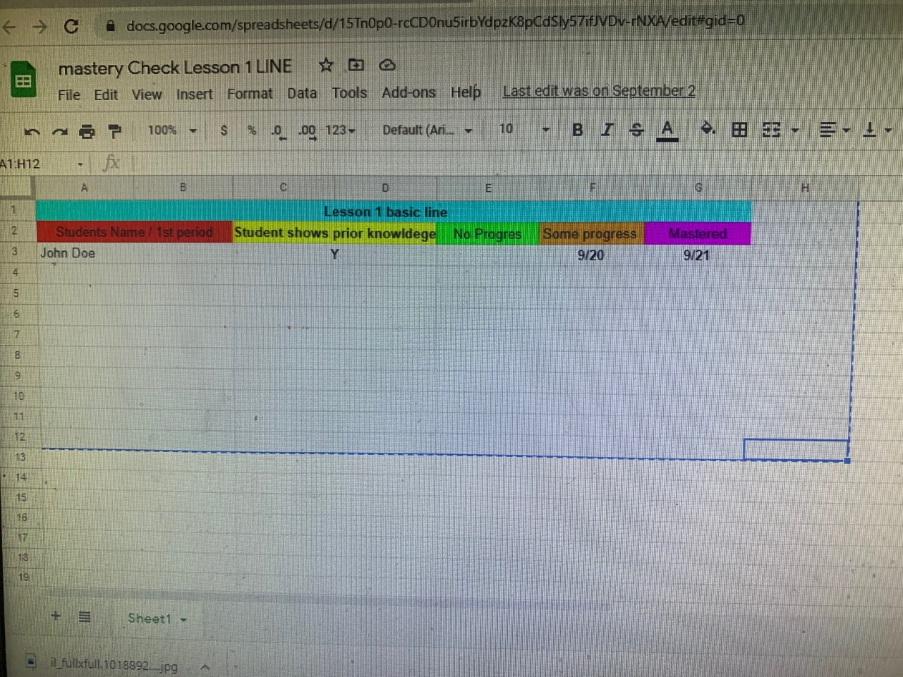
My Mastery Checks as Spread sheets

Slide 5
Blended Instruction
Helped significantly cut time lecturing and allowed me to move around the room and do more 1- on- 1 instruction .
Students had already been introduced to virtual instruction because of Covid-19
Research found that “online learning on average produces stronger student learning outcomes than learning solely through face-to-face instruction.”
Compared to teachers in traditional classrooms, Modern Classroom teachers were significantly more likely to report that they use technology effectively (89% vs. 70%) and that they are able to work closely with each of their students during class (100% vs. 78%).

Slide 6
Link to Edpuzzle/Canvas Video
https://edpuzzle.com/media/61311fabee8085413d9388a7
https://pikekyschools.instructuremedia.com/embed/b0a23e5f-b904-4a12-9647-278ebb6f5e77

Slide 7
Self-Paced Structures
Classify lessons as “must do,” “should do,” and “aspire to do,” and justify those decisions.
Helped me being an art class as I have students that like art and students who do not.
Create clear and easy-to-update systems for tracking student progress.
A 2017 study found that self-paced learning environments help develop planning and self-regulation skills, and that these skills were correlated with faster learning and higher achievement.
Compared to teachers in traditional classrooms, Modern Classroom teachers were significantly more likely to report that they provide students with adequate time to revise work (93% vs. 70%) and that they can easily help students who have missed class to catch up (100% vs. 11%).

Slide 8
Ipad/Apple Pencil
Program Enrollment
KVEC Provided materials

