Slide 1
Modern Classroom Project
Natasha Bowling

Slide 2
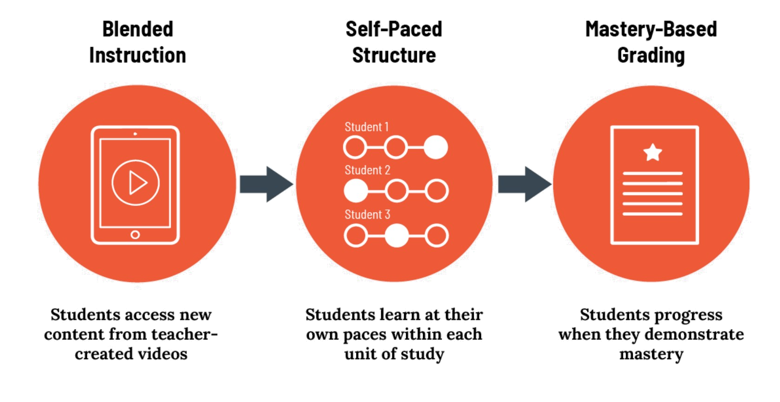
What is the
Modern Classroom Project?

Slide 3
Things to consider while making videos for your Modern Classroom.
Focus on ONE objective: Be concise and specific. Several short videos are better than one long one.
Be concise: Six minutes is an ideal video length for adolescent learners. Consider going even shorter with younger students.
Use visuals: Images and on-screen writing catch student attention. Avoid text wherever possible.
Incorporate animations: Bring new points or visuals out one-by-one, to hold student attention.
Build in opportunities for engagement: Identify moments where students can pause and think.

Slide 4
Blended Instruction Video Example
https://youtu.be/IPgGpPBHcOY

Slide 5
Self - Pacing Guide
Must Do: These activities cover essential skills and content, without which end-of-unit assessments cannot be completed. Mastering these lessons is non-negotiable.
Should Do: These activities help students develop their skills or knowledge; students who complete them will likely produce more developed work on final projects or assessments. However, when circumstances require, students can skip these lessons without missing the unit's most essential content.
Aspire to Do: These are the most challenging - and interesting! - lessons of any unit, because they take the skills that students have already learned and apply them in new, more sophisticated ways. Every student should aspire to reach these lessons -- but some simply might not. That's okay.

Slide 6
Self-Pacing Lesson Plan Example
Lesson #1:: Must Do: From BookPagez/Worksheets; review summary of book, complete “Get Ready” section, “Words to Know” plus “Listen and Learn”
Lesson #2: Must Do: Read or Listen to the book prior to breaking book down to “retell & summarize” Should Do Try reading book on your own before “listening” to the recording of the book and make your own annotated notes.
Lesson #3: Must Do: Retell & Summarize on BookPagez (pick one way to answer; write, draw or picture) Should Do: Make different choices when answering questions; write, draw or picture.
Lesson #4: Should Do: Reflection on Retell & Summarizing.
Lesson #5: Aspire to Do: Writing Prompt at the end of the section.
Lesson #6: Aspire to Do: Breaking up prompt longer over time to where “break up” strategy is no longer needed when retelling and summarizing.

Slide 7
Tracking Progress and Example
Indicate clearly what each student needs to do.
Display students’ progress (not grades).
Are easily updated -- at least daily, if not more often.
Use positive framing and reinforcement to celebrate effort and growth.
https://docs.google.com/presentation/d/1FW2H0_Le1XThIEJcAgUyuvKaOxNJ41uzGDomvmlftOs/edit?usp=sharing

Slide 8
Other things to consider in a
Modern Classroom Lesson
Opportunities for Collaboration: Explain how you will encourage students to collaborate, even as they are working at their own individual paces.
Strategies for Motivation: Explain how you will attempt to motivate students -- both those who fall behind and those who are ahead of your suggested pace.
Metacognitive Reflection: Explain how you will help students become better learners through reflection.
Additional Modifications/Accommodations: What other modifications will you make for your students? Any modifications made for students with special needs?

