Slide 1
Sensory Area for Special Needs
Liza Clevenger Hylton, MS, CCC/SLP
West Perry Elementary

Slide 2
Why a sensory area?
Change is difficult for most everyone. We handle change best if it is expected and occurs within the context of a predictable routine.
For students with special needs, a predictable routine allows them to feel safe, in control, and allows them to better deal with and handle change in their lives.
Of course, many changes can’t be avoided. That’s why we try to offer children with special needs a predictable routine as a foundation in their lives. This gives children the chance to rise to the occasion to handle big changes as needed.

Slide 3
Overstimulation, emotional regulation, and attention is our problem of practice in implementing our learning environment.
We have special needs students who have difficulty with attention, becoming overstimulated by environmental factors, difficulty expressing and regulating their emotions, causing them to become overwhelmed in class and unable to learn.
Overstimulated students often engage in avoidance behaviors, self-harm, and withdraw from both peers and activities.
Overstimulated students are not engaged in what is being taught.
These students require frequent breaks in which they can move and experience calming, sensory, and mindful activities.

Slide 4
We would like to create a sensory area, located in a common space, which would provide tactile, visual, and auditory input for students to use as needed.
This area would provide students a sensory space with activities to help organize, calm, become mindful of emotions, and assist with coping from traumatic situations.
Students will be able to interact with part or all the sensory area.

Slide 5
Inspiration

Slide 9
What resources and personnel do we need to implement our sensory area?
We will purchase sensory materials that we can place on the walls for student interaction.
A staff member will observe and provide direction for the students as needed.
The sensory area can be used during transitions, when students need a break, or we see a problematic behavior beginning to escalate.

Slide 10
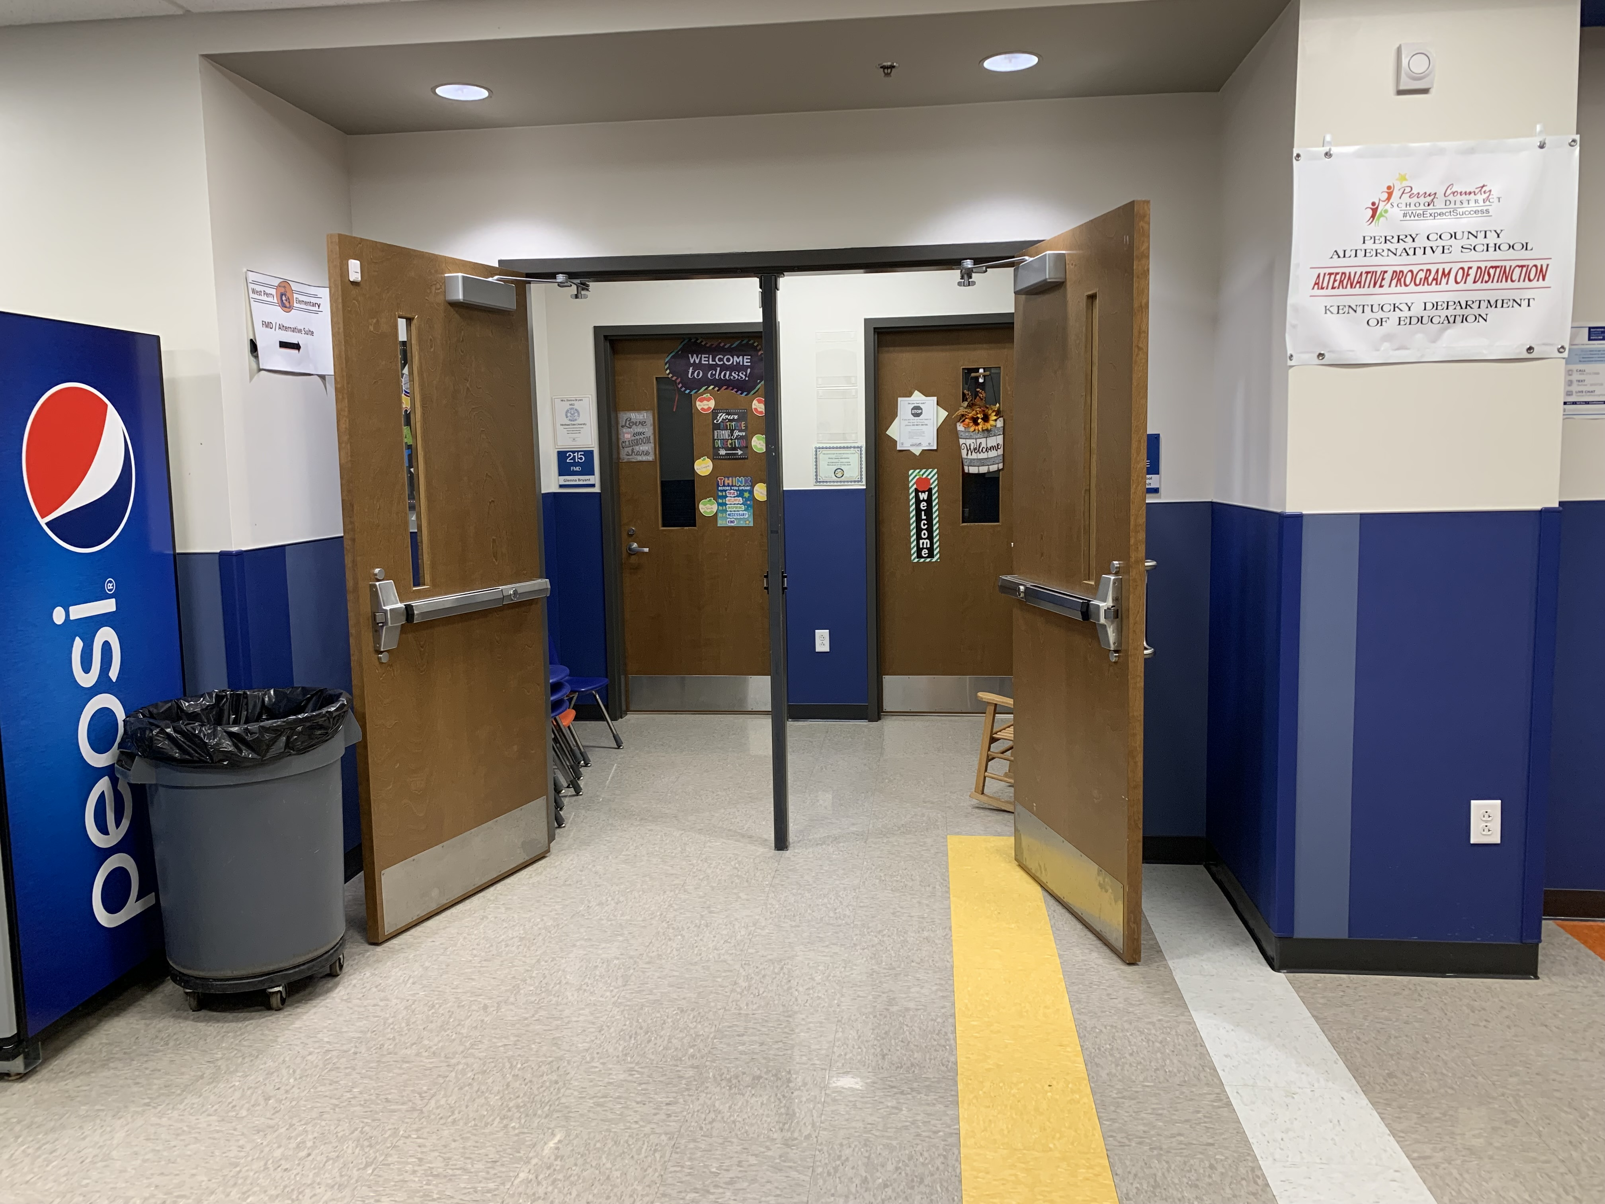

Slide 11
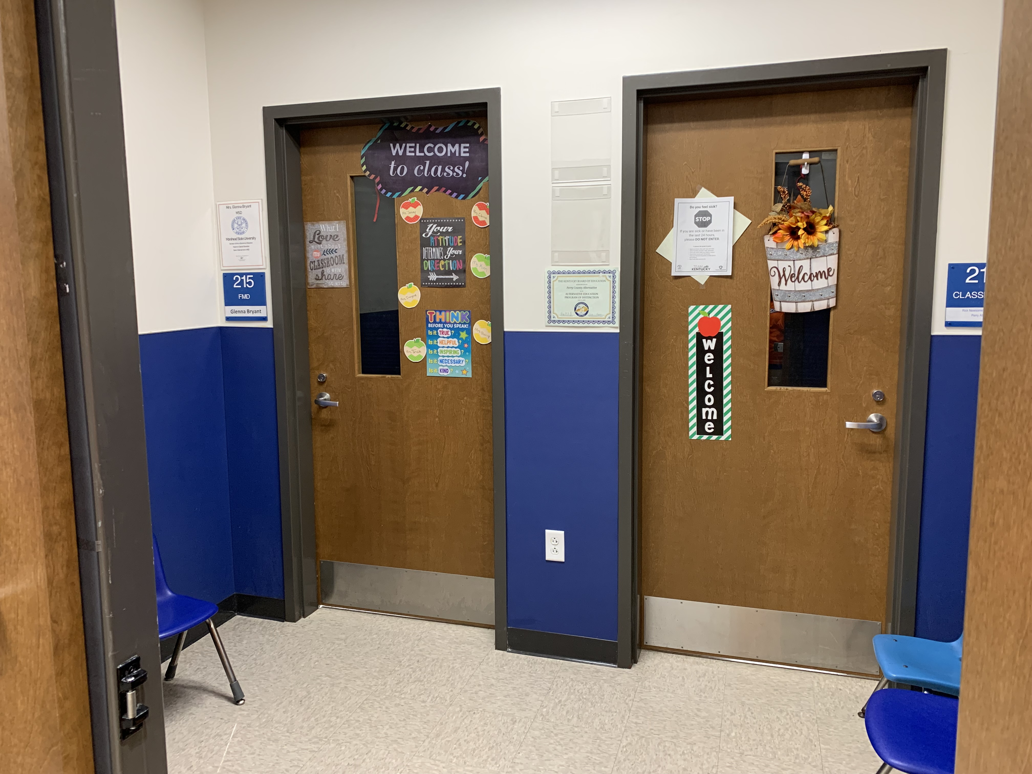

Slide 12
Roadblock! Supply Chain Crisis

Slide 13
Speedbump!
Due to supply chain issues, several items in my original grant were unavailable or on backorder.
While awaiting on materials, we decided to change the location. The new area is currently occupied, unfortunately we cannot create the sensory area until this summer.
I plan to share updated progress and show our final creation when school starts in August.

Slide 14
Change of Plans for Sensory Area
Original Plan
New Location

Slide 15
New Idea
This will be so much more than a sensory wall; it will be an entire sensory area where students can find respite and take a sensory break.
The area will also be used by speech, occupational and physical therapists.

Slide 16
What question will guide our study of this innovation?
Will a sensory break between learning activities and/or during transitions allow students to regulate behavior?

Slide 17
What outcomes will prove that your innovation has succeeded?
There will be a decrease in the amount of time dealing with inappropriate behavior.

Slide 18
How will you measure those outcomes?
We will observe and analyze behavior logs already used in the classroom setting.

Slide 19
We will observe our students
analyze behavior logs
attain student feedback
watch for preferred sensory activities.

Slide 20
Budget
Optic Curtain Light $119
Wall Mount Bubble Aquarium $275
Chameleon Skin Sensory Tape $27
Silly Shapes Sensory Circles $55
Touch & Change Boards $120
Sensory Gel Maze $46
Squishy Handprints (3) $156
Sensory Play Discs $27
Teacher Geek Gears $100
Giant Fiber Noodles $29
Hardware & Attachments $46

Slide 21
What I actually received:
Wall Mount Bubble Tube $110
LED Lights $60
Hexagon Lights $60
Sensory Floor Mats $170
Hexagon Mirrors $12
Sensory Mini Mats $63
Light Panel $70

Slide 22
Thank you KVEC for the opportunity to create a sensory area for our students.
Liza Clevenger Hylton, MS, CCC/SLP

