Slide 1
Professional Action Network
Justin Combs, Special Education

Slide 2
Post Secondary Transition
Name: Justin Combs
Title: Special Education Teacher
School: Breathitt High
District: Breathitt

Slide 3
Problem of Practice
The problem of practice for post-secondary transition has two prongs:
High school special education teachers do not get the opportunity to meet with students to discuss post-secondary transition as much as they would like.
Students with special needs require more intense instruction and guidance on planning for after graduation, starting at the middle school level while completing the Individual Learning Plans.

Slide 4
Description of you project
I found many teacher specific resources for post-secondary transition; but not
student specific. This encouraged me to create a student checklist for preparing
students with special needs to be ready for the real world after graduation
beginning at the sixth grade continuing to the twelfth grade.
To provide students three extra years to work and determine what career path they want to follow to receive the necessary education or training.
The checklist will be interactive, with hyperlinks incorporated within the checklist to lead students to valuable resources. The purpose of the checklist is increase positive post-secondary transition outcomes.

Slide 5
What are the findings from your research?
According to the Kentucky Post School Outcomes Center, the 2020 Annual Report for the Youth One Year Out surveys showed:
58% of students with special needs in the state of Kentucky responded to the survey.
Indicator 14 A (enrolled in higher education) is at 17.8%,
Indicator 14 B (Competitive Employment) is at 52.3%
Indicator 14 C (Enrolled in other post-secondary education or training) is at 68.2%.
Note: This is based on 2,667 responses out of 4,604.
(www.kypso.org Annual Report 2020 Kentucky Post School Outcomes p. 7)

Slide 6
Trending Data for Indicators 14A, 14B, and 14C
 | 2010 | 2015 | 2020
14A | 23.9% | 18.43% | 17.8%
14B | 51.7% | 58.17% | 52.3%
14C | 60.9% | 67.82% | 68.2%
Indicator 14A (enrolled in higher education) decreased from 23.9% to 17.80%.
Indicator 14B (competitive employment) increased from 51.7% to 52.3%. However, it decreased from 58.17% in 2015 to 52.3% in 2020.
Indicator 14C (enrolled in other post-secondary education or training) increased from 60.9% to 68.2%.
(www.kypso.org p. 7)

Slide 7
Analysis of Youth One Year Out Survey
The data indicates the need to assist teachers by developing a process for the students to envision their future.
Process starts in the sixth grade.
Time for student exploration of career paths.
With the assistance of the teachers, students can receive the guidance and instruction needed to follow their career path.
Places more responsibility upon the student, which is a quality
required to become successful.

Slide 8
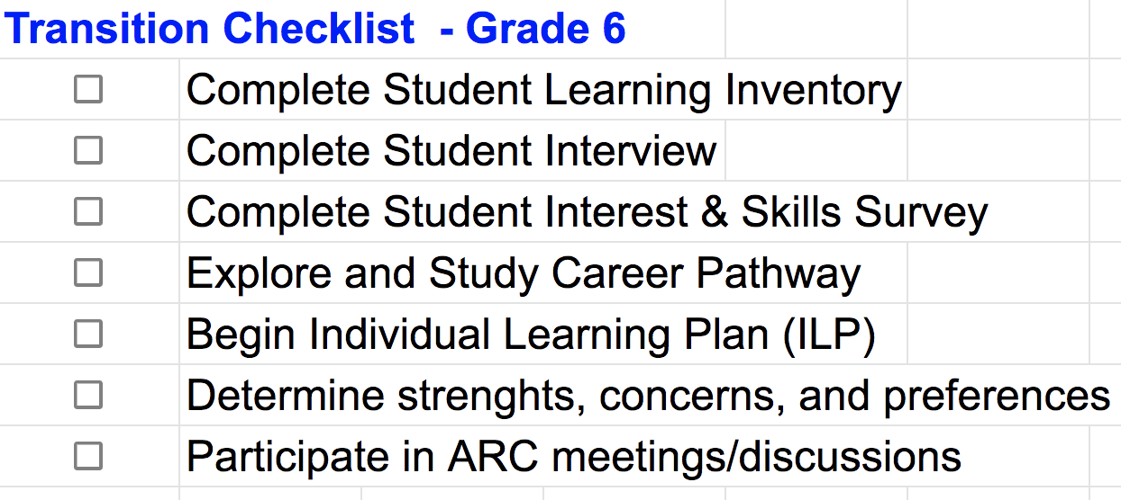
Solutions
Transition Checklist 6-12 Grades

Slide 9
How will your project improve practice for teachers?
The interactive checklist will assist teachers in promoting responsibility and independence to students.
Within the checklist, hyperlinks are provided to assist students with resources.
The teachers can review the hyperlinks with the students to have a question and answer session.
This will lead the students to want to begin the exploration stage.

