Slide 1
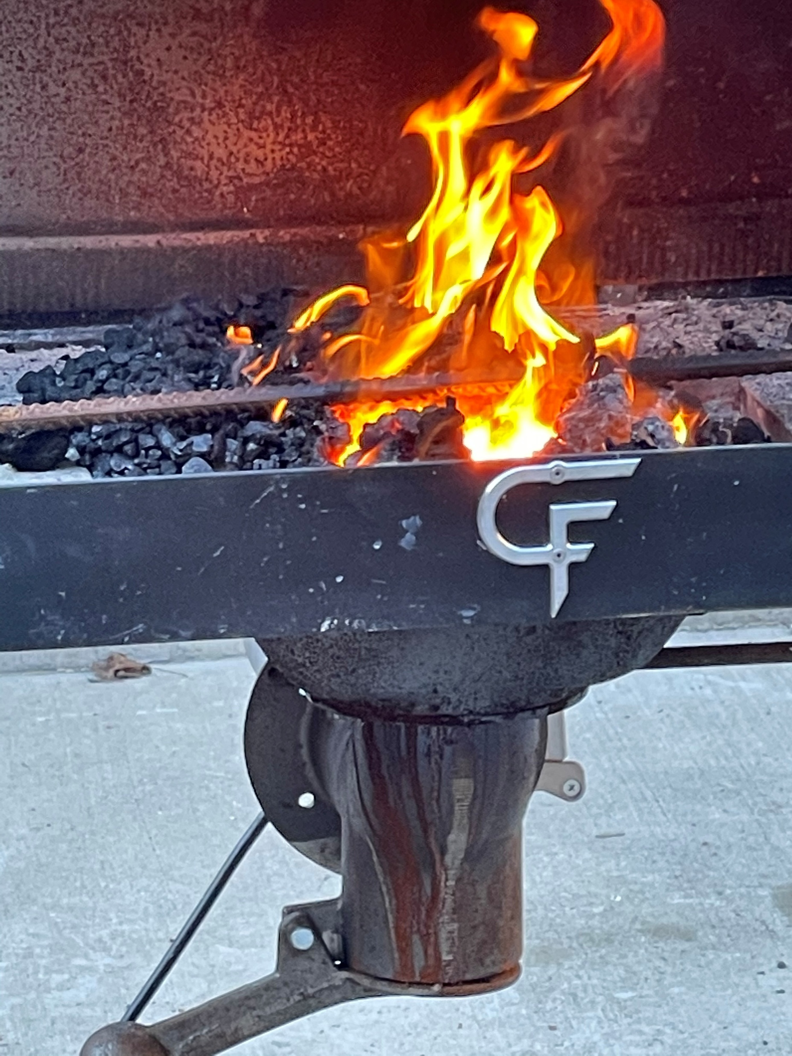
The Bulldog Metal Refinery and Pottery Works
Hazard High School Art Students
Joanna Thompson Art Teacher

Slide 2
Plan for the metalworks program to expand
Plan was to get the students more actively participating and learning the process of blacksmithing with finally using welding to building the metal work.
*Examples of metal work would include hooks, flower/plant holders.
Sales downtown at the Farmers Market and Thursday on the Triangle.

Slide 3
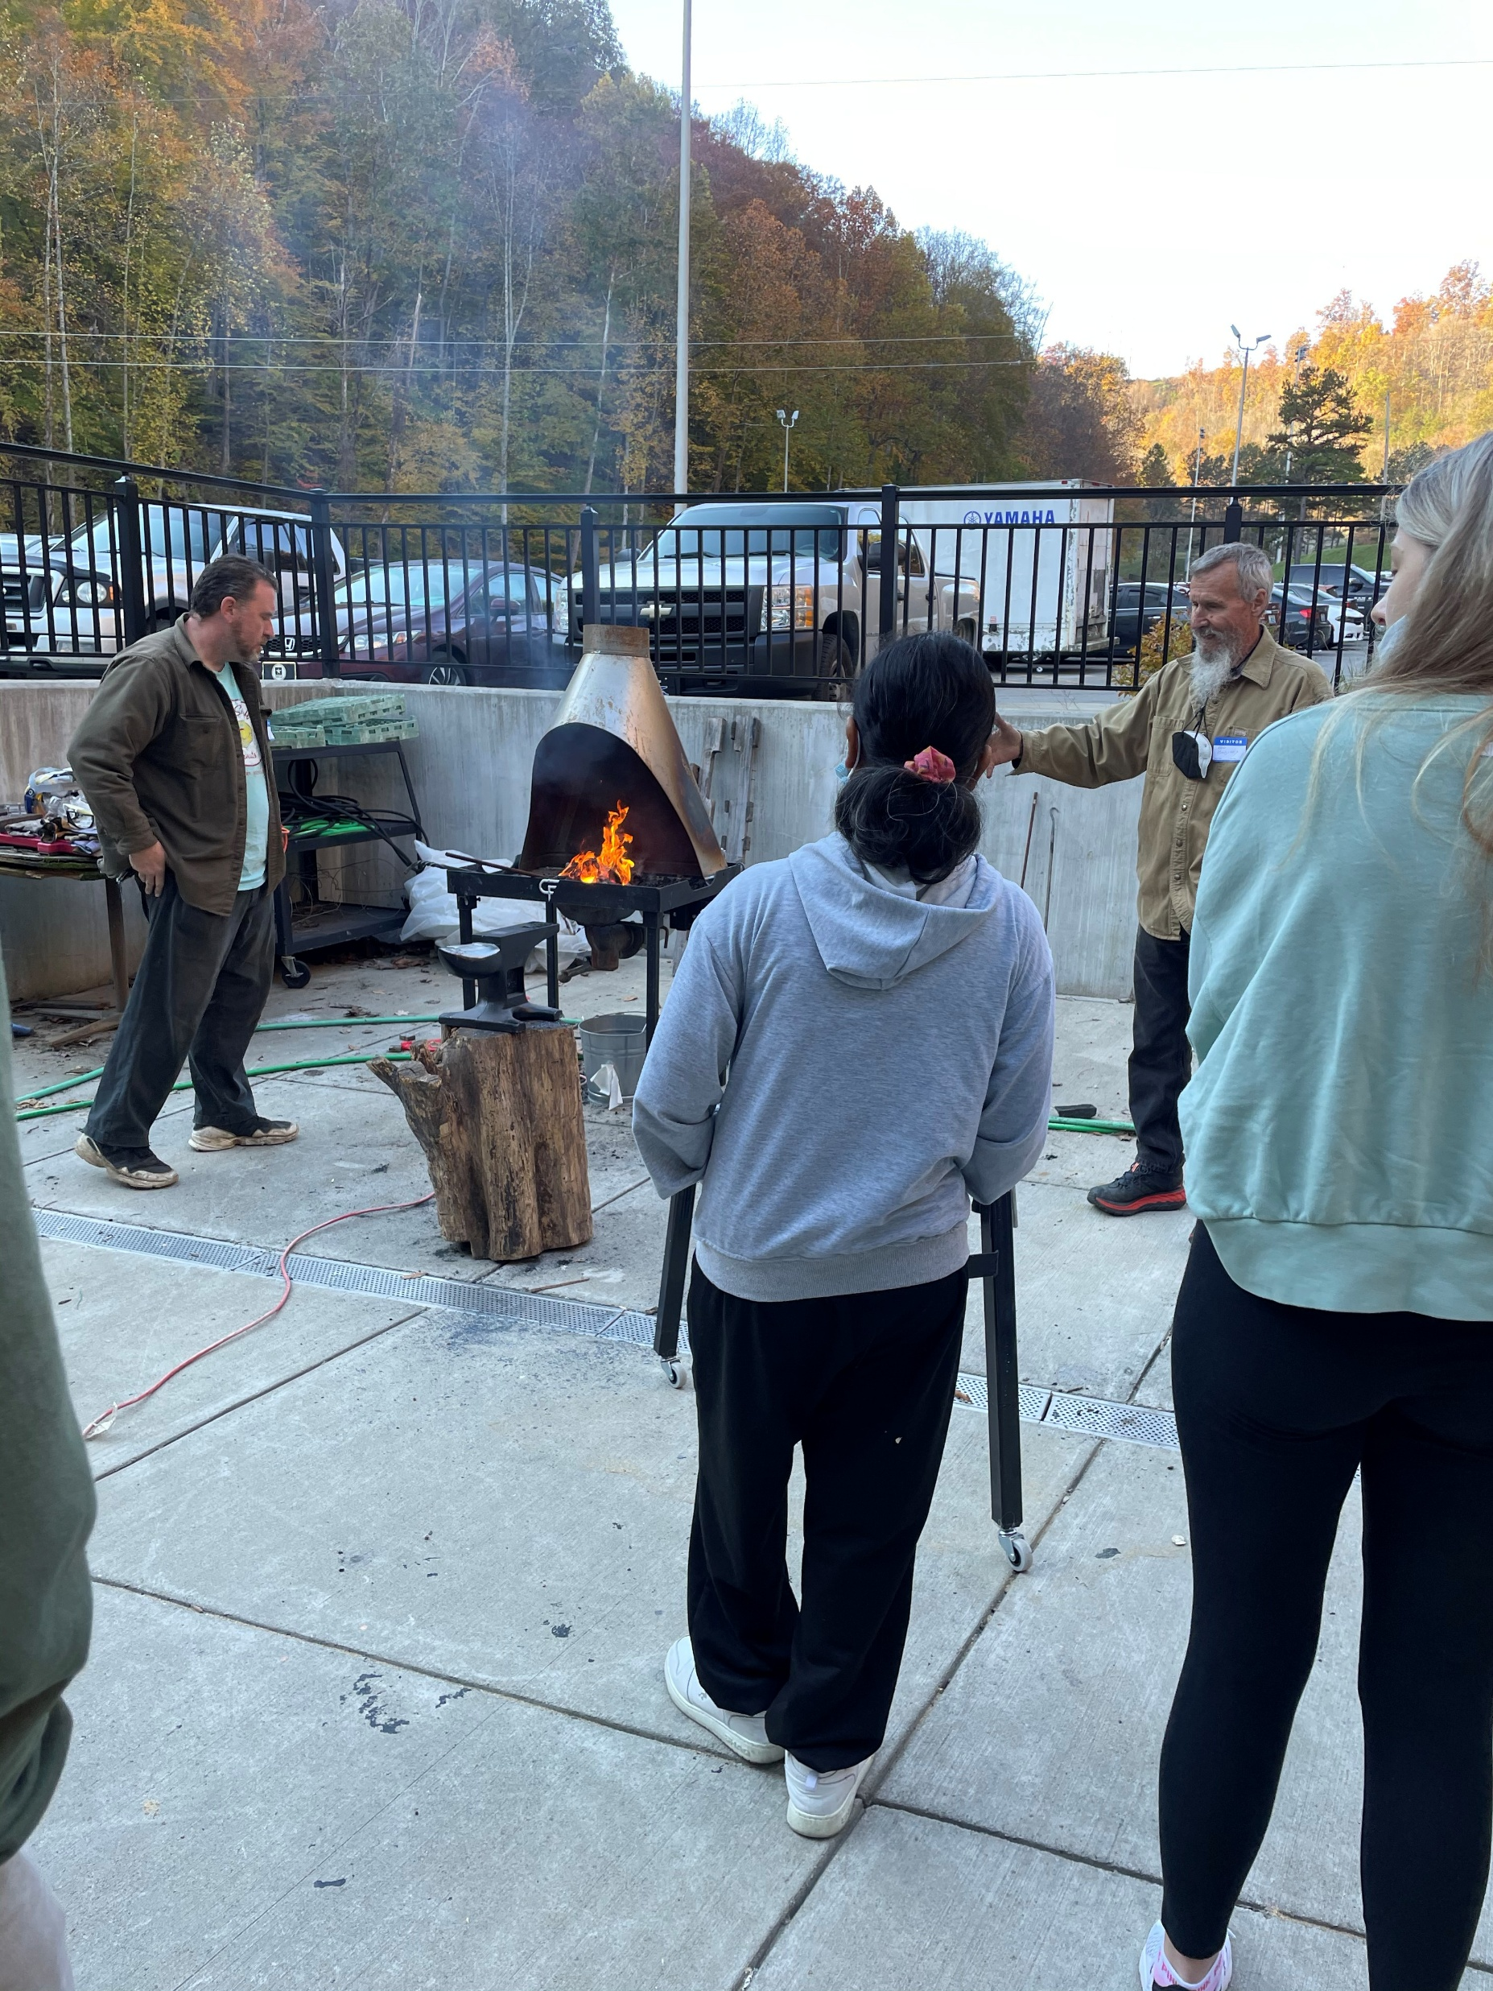
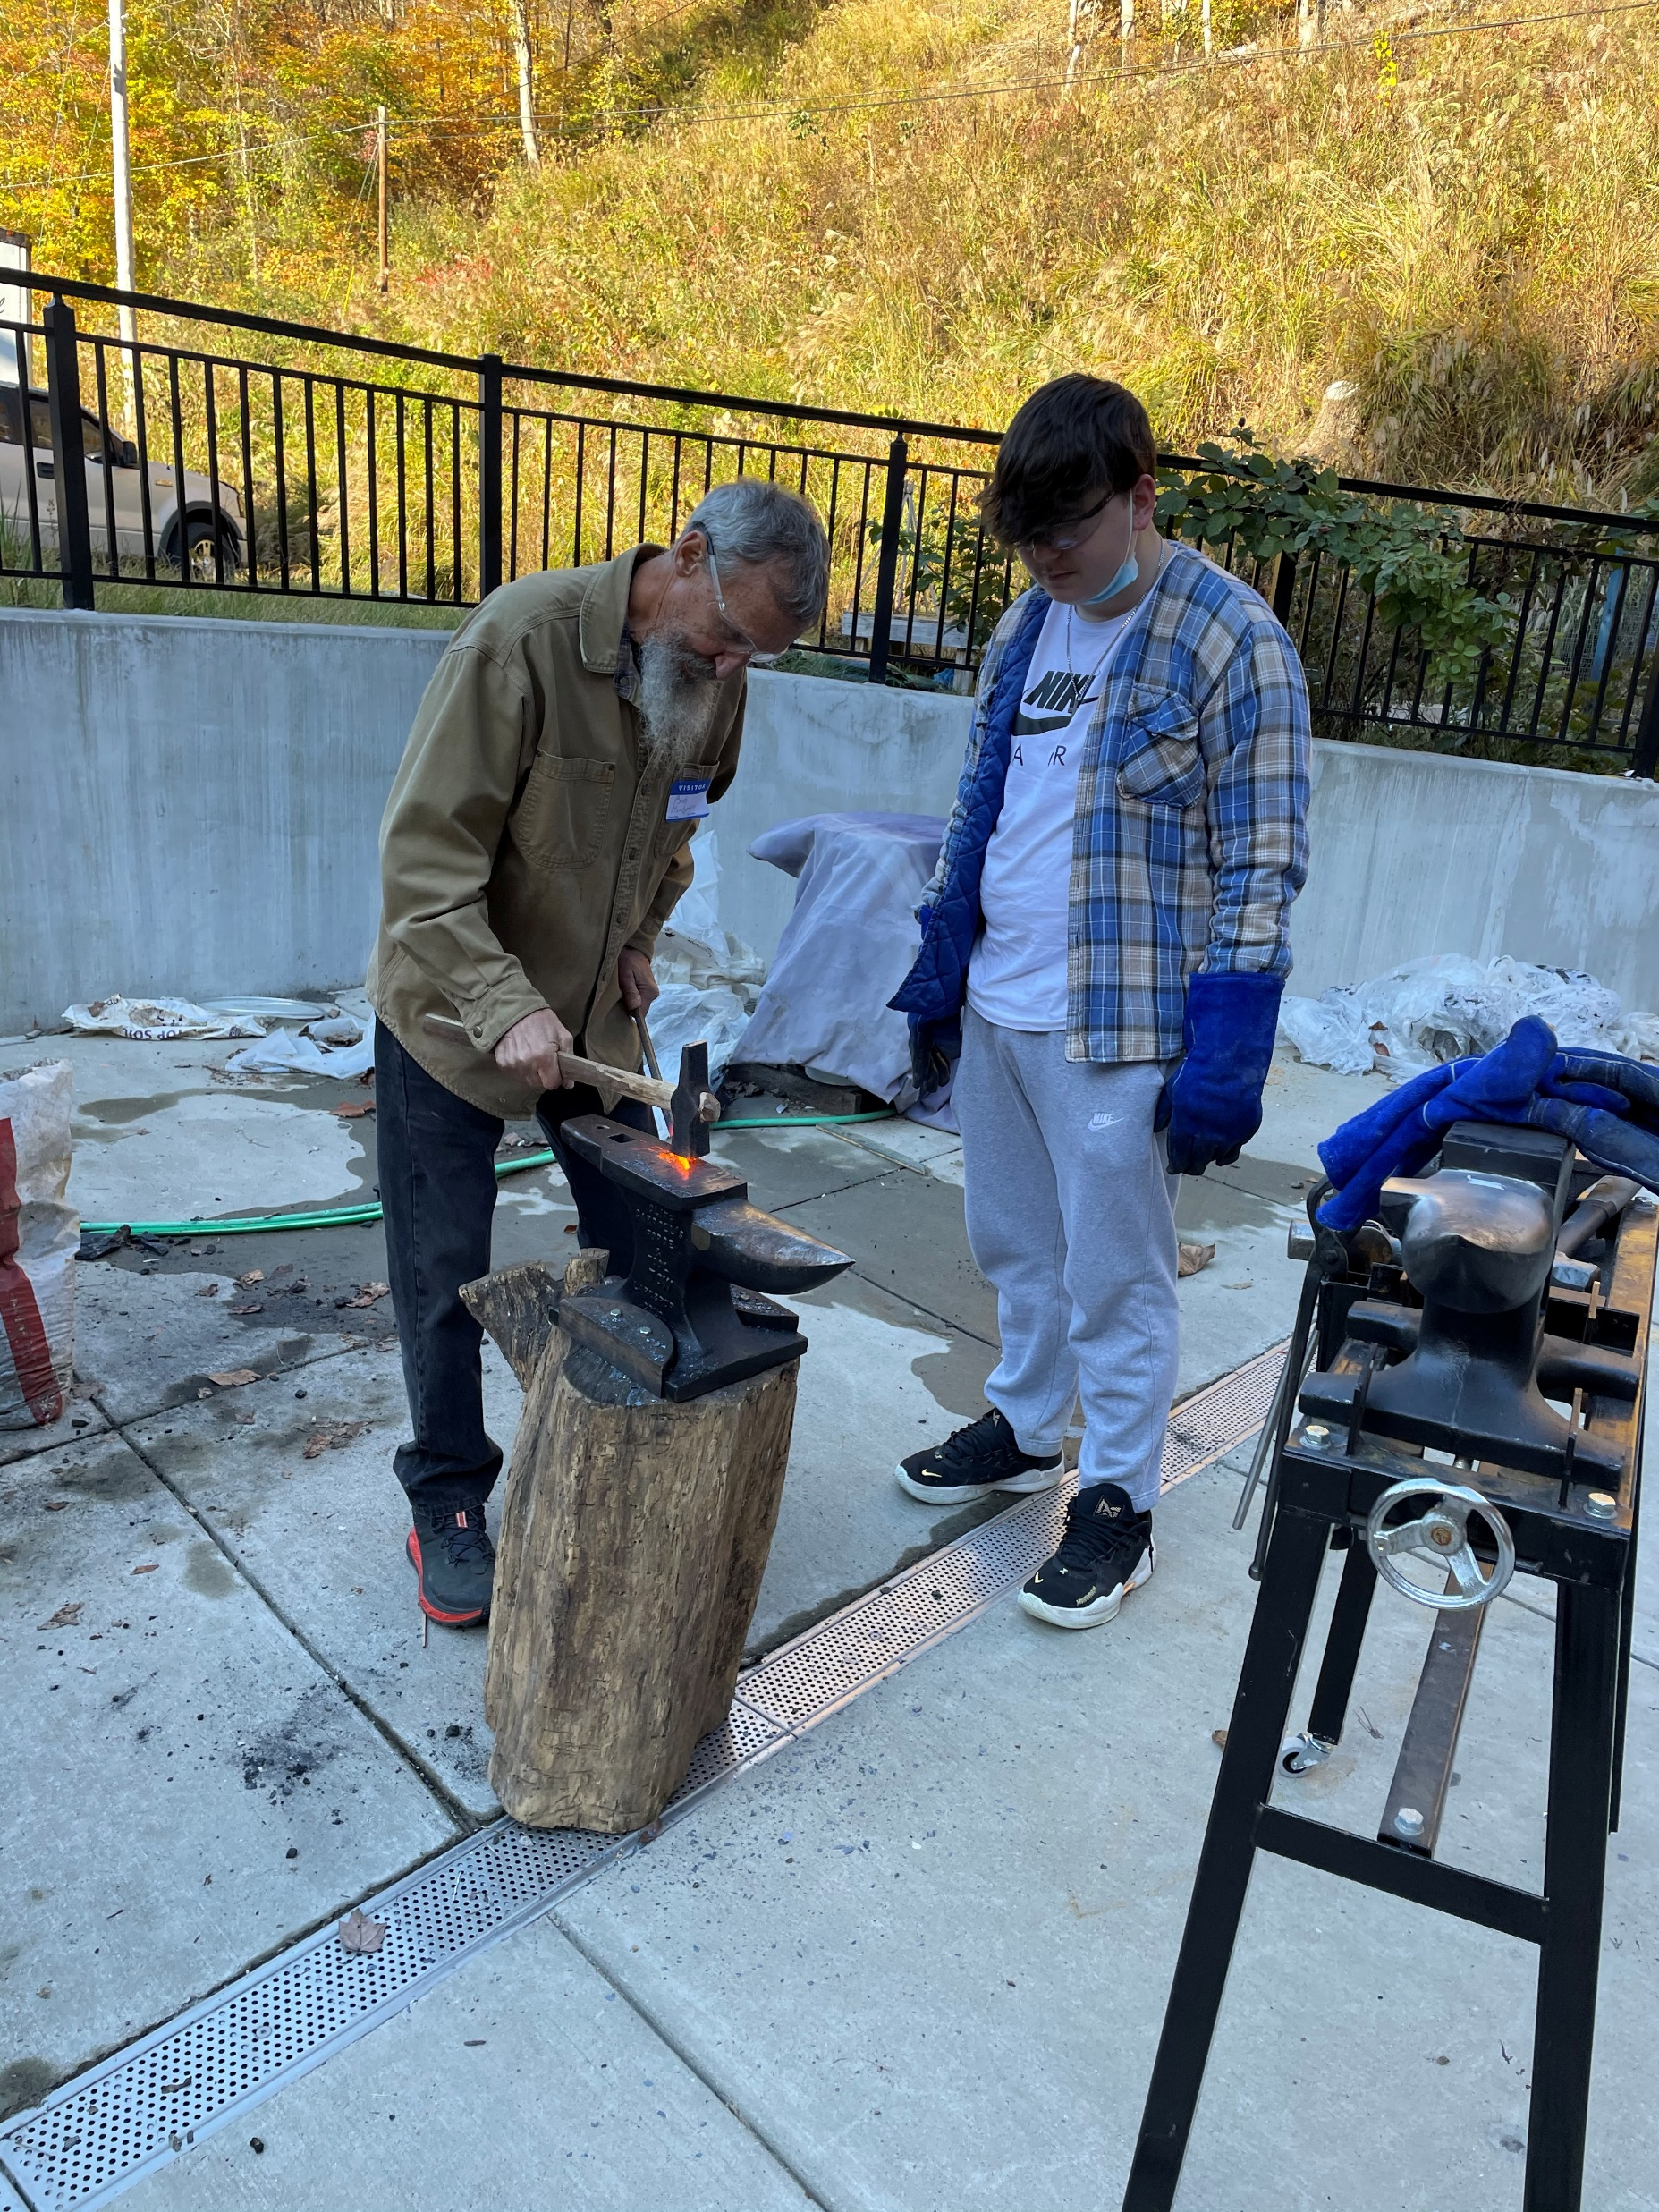
Examples of Students Working with Visiting Blacksmiths

Slide 4
Examples of Creating Hooks
Metal Smithing is one craft that I have learned by teaching and takes time, perseverance, and not giving up. The student’s year long dedication to learning blacksmithing has been awesome and their willingness to learn on their own and learning from guest artist who are blacksmith.
Picture to the left is a video that can be played.

Slide 5
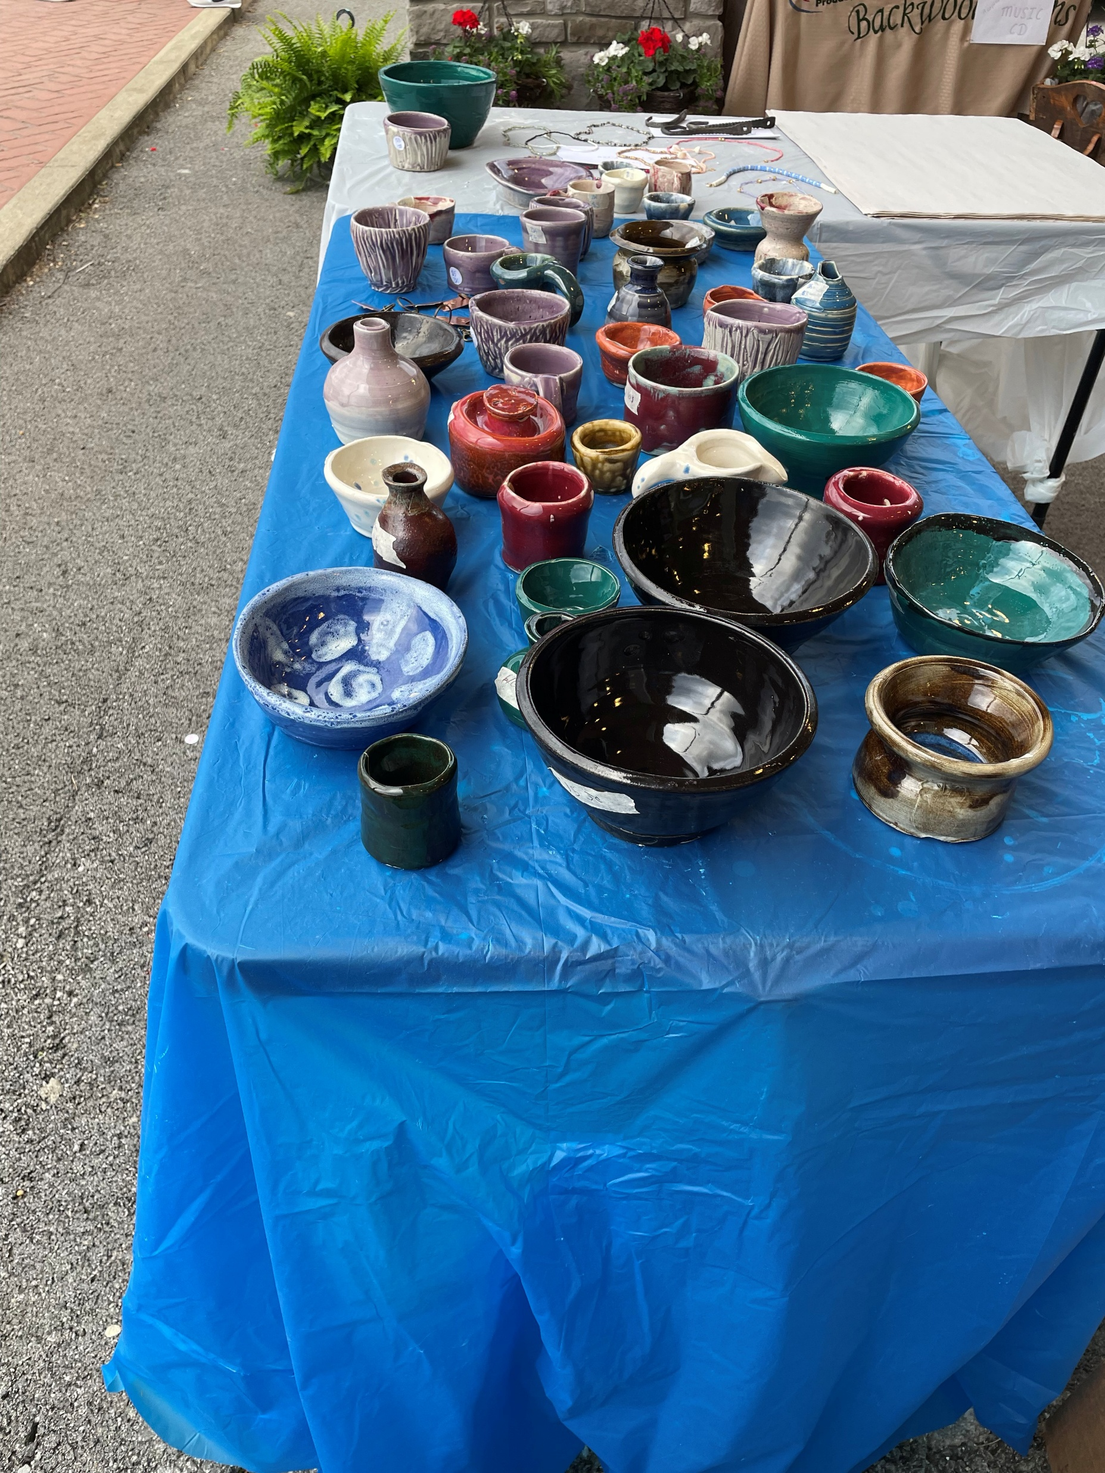
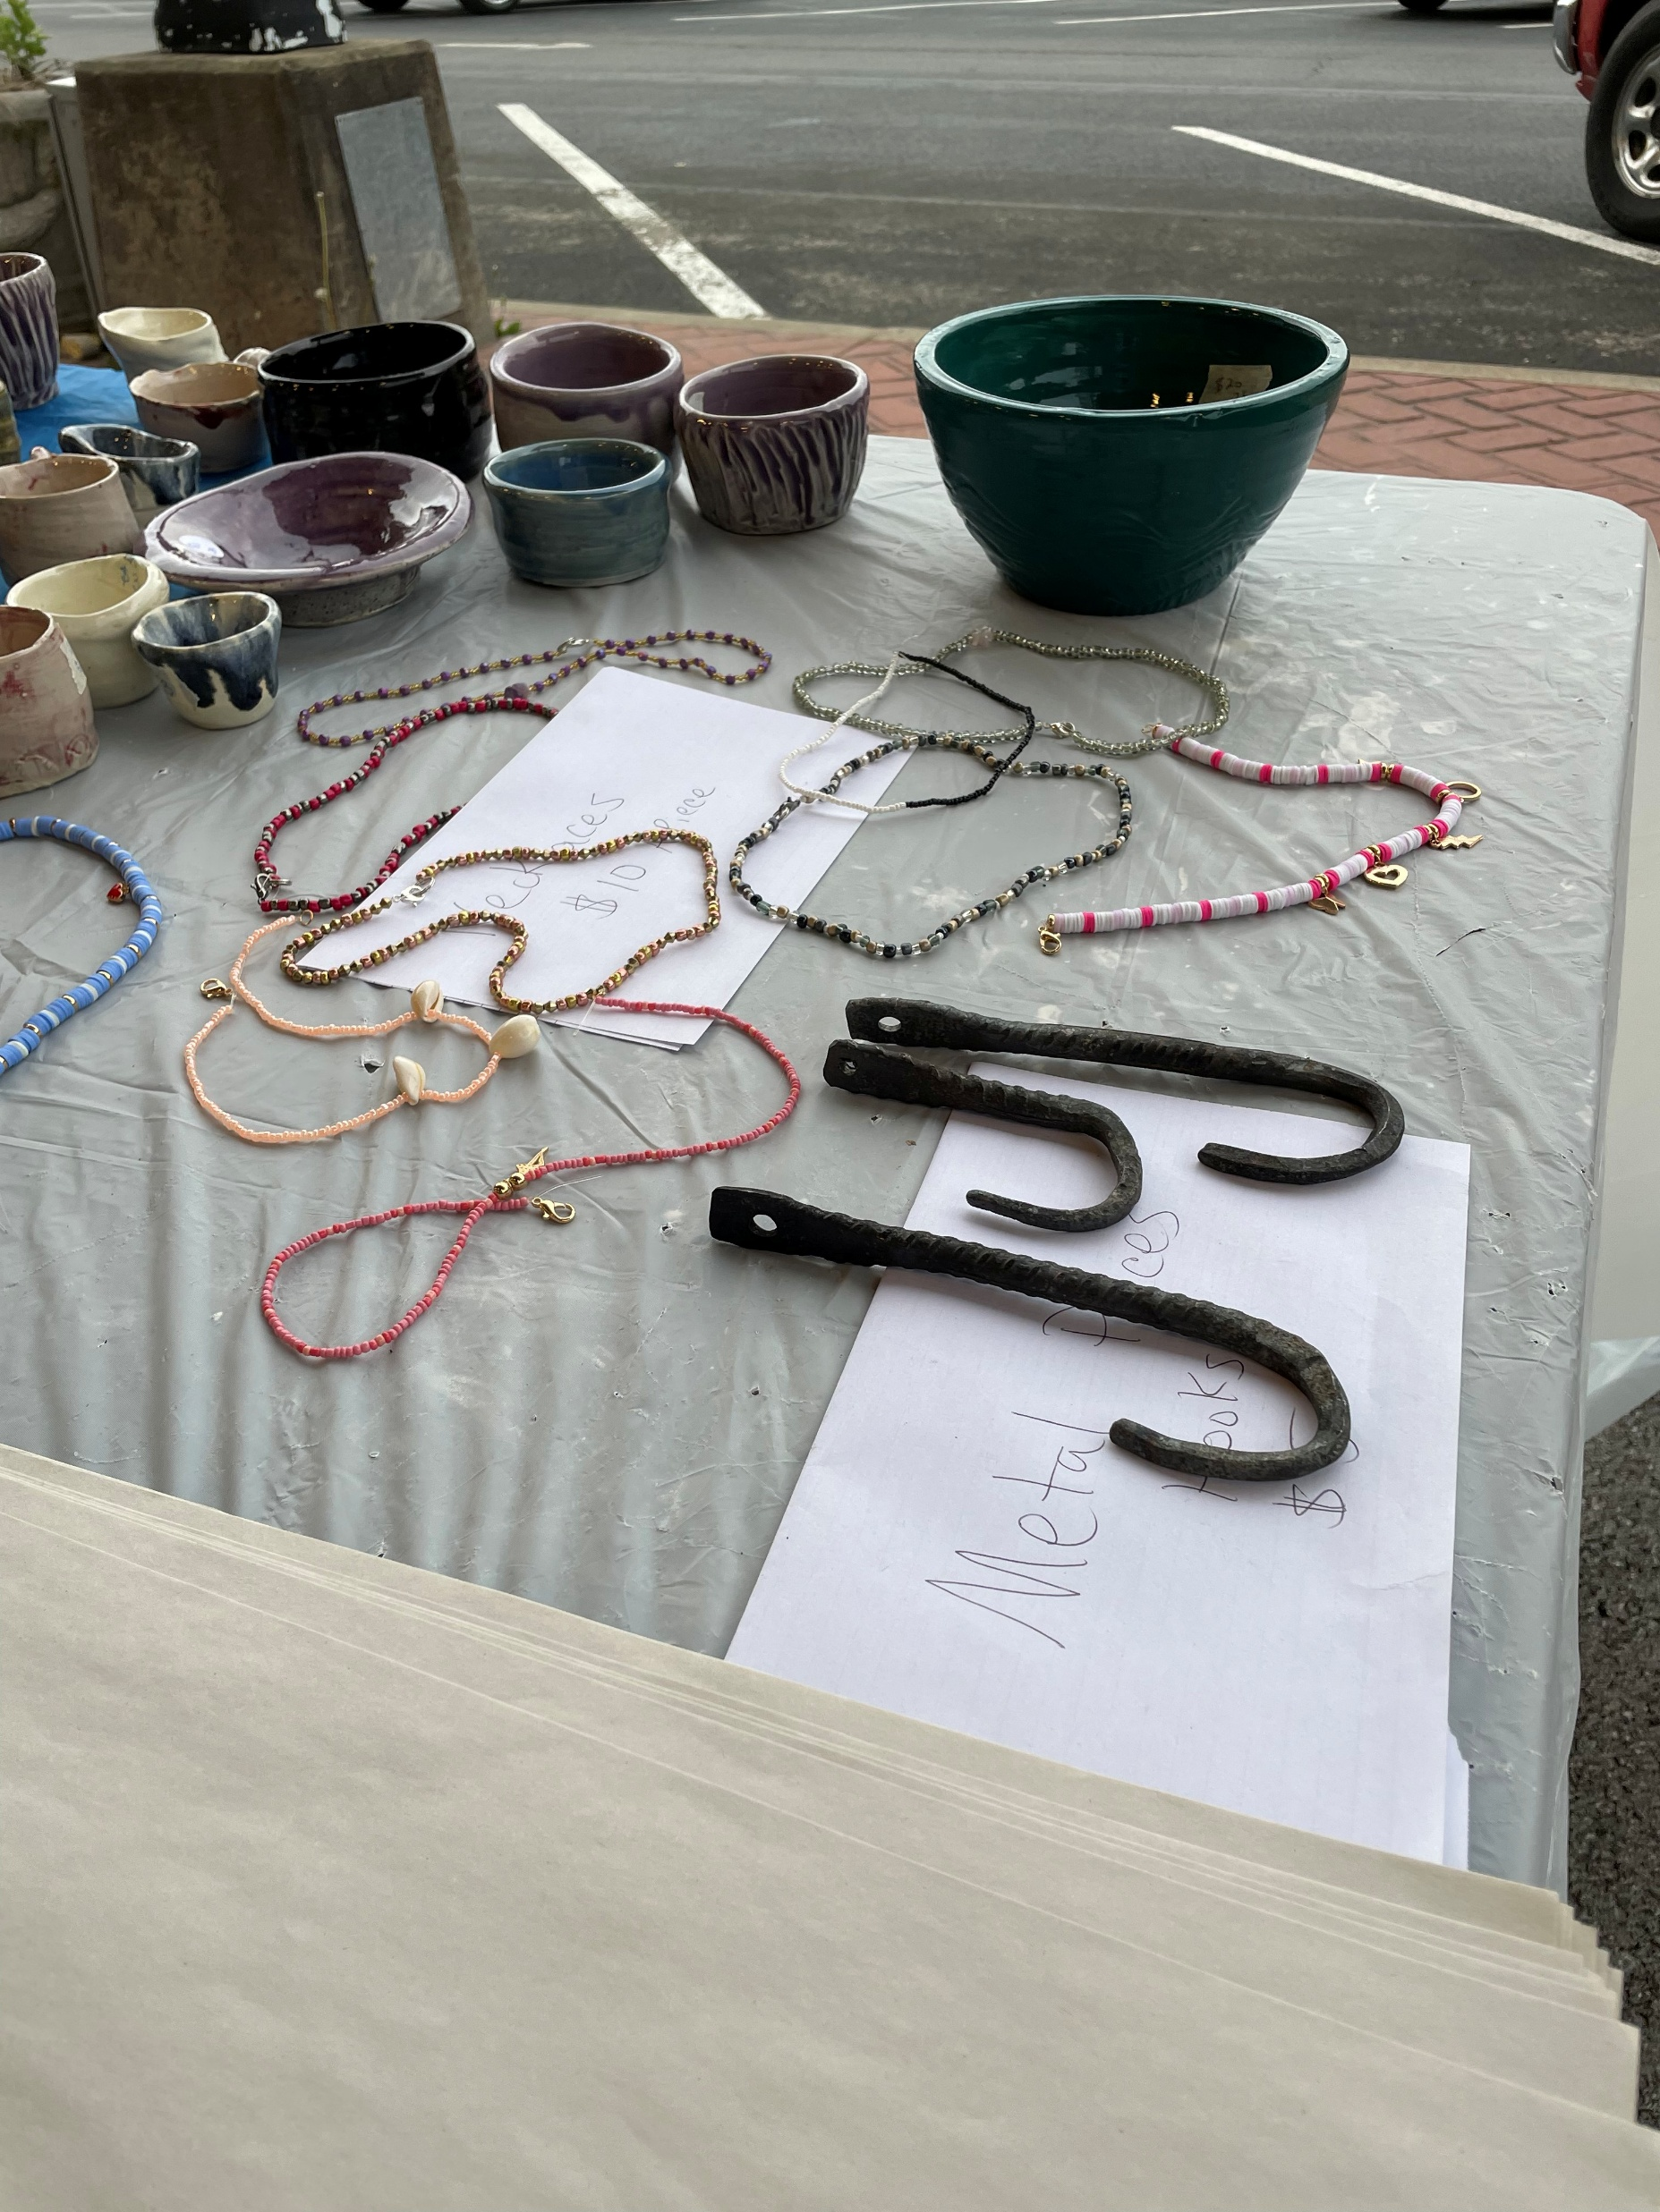
Goal of Selling Downtown Hazard. Farmers Market example:

Slide 6
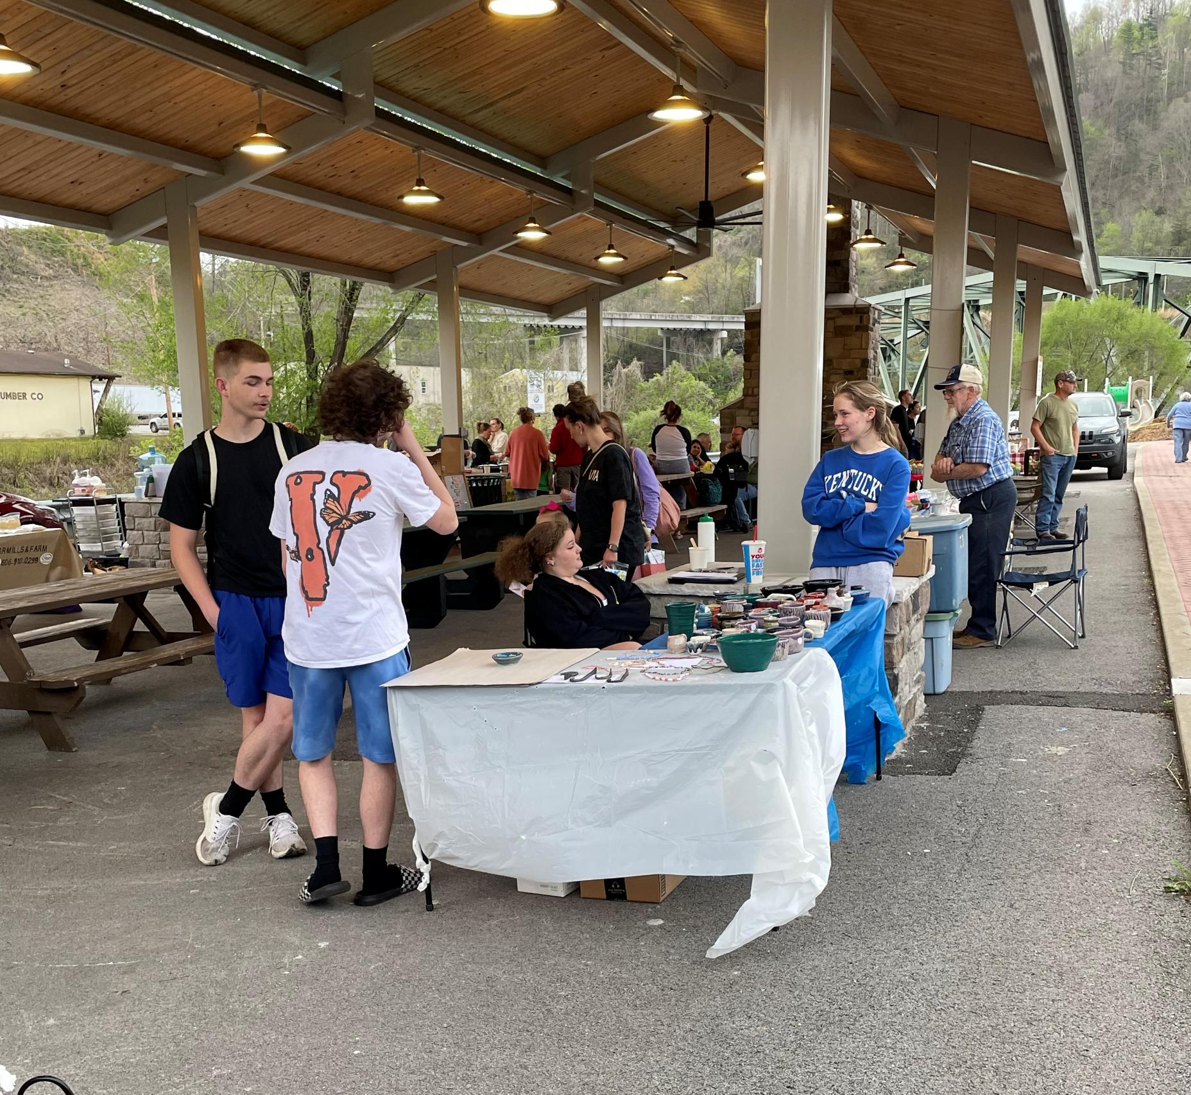
Hazard High School Students selling art at the Farmers Market

Slide 7
Future for the Program

