Slide 1
Implementing a Modern Classroom
By: Jennifer Smith
Johnson County Middle School
7th grade Language Arts

Slide 2
About Me
My name is Jennifer Smith and I am currently in my 7th year teaching Language Arts. I have taught at Johnson County Middle School for the past 4 years and at Louisa Middle School the 3 previous years. My biggest struggle in teaching has been differentiating instruction, especially during the pandemic. I found myself, and my students, getting frustrated because they couldn’t keep the pace, and were falling behind. By incorporating the Modern Classroom Approach, my students now have the opportunity to work at their own pace as they work towards mastery. It also frees me up to provide small group instruction to the students who need it.

Slide 3
What is the Modern Classroom Approach?
And how can I use it in my classroom?

Slide 4
3 Aspects to a Modern Classroom Approach
Blended Instruction
Self-Paced
Mastery Based

Slide 5
Blended Instruction
Blended learning combines traditional face-to-face instruction with a digital environment. There are several benefits of blended instruction. The biggest benefit being that students can learn independently at their own pace via the digital technology but also giving them access to one-on-one or small group instruction, when needed, with their teacher. It’s the best of both worlds.

Slide 6
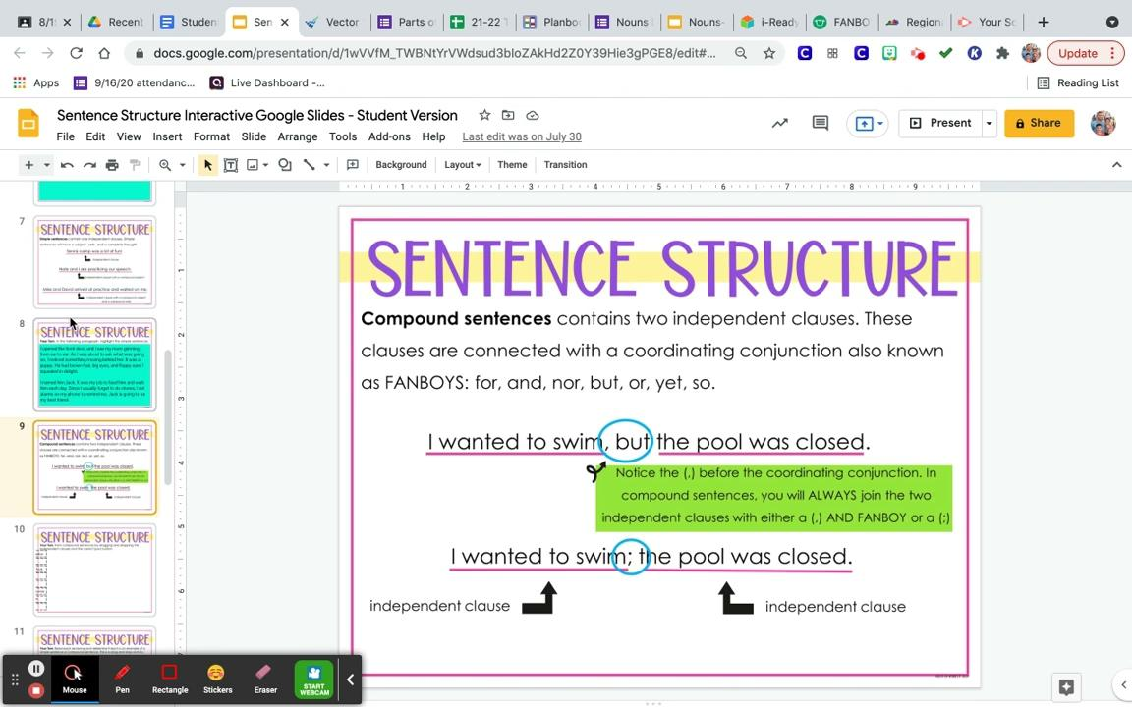
Blended Instruction in Action
I use Screencastify to record my videos. I then upload the videos to EdPuzzle to add questions throughout the video to ensure that the students are actively engaged. Students can pause and rewind the video if they miss anything and can go back and rewatch it anytime during the unit.
Attached is a link to my EdPuzzle video with questions.
https://edpuzzle.com/media/612186a583d628416321be49

Slide 7
Self-Paced Units
Students learn at their own pace. Students track their progress using an interactive Pacing Guide. This allows students to know where they are in the unit. Students that are on the same pace can work together collaboratively when needed. Students complete a series of Must Do, Should Do, and Aspire To.

Slide 8
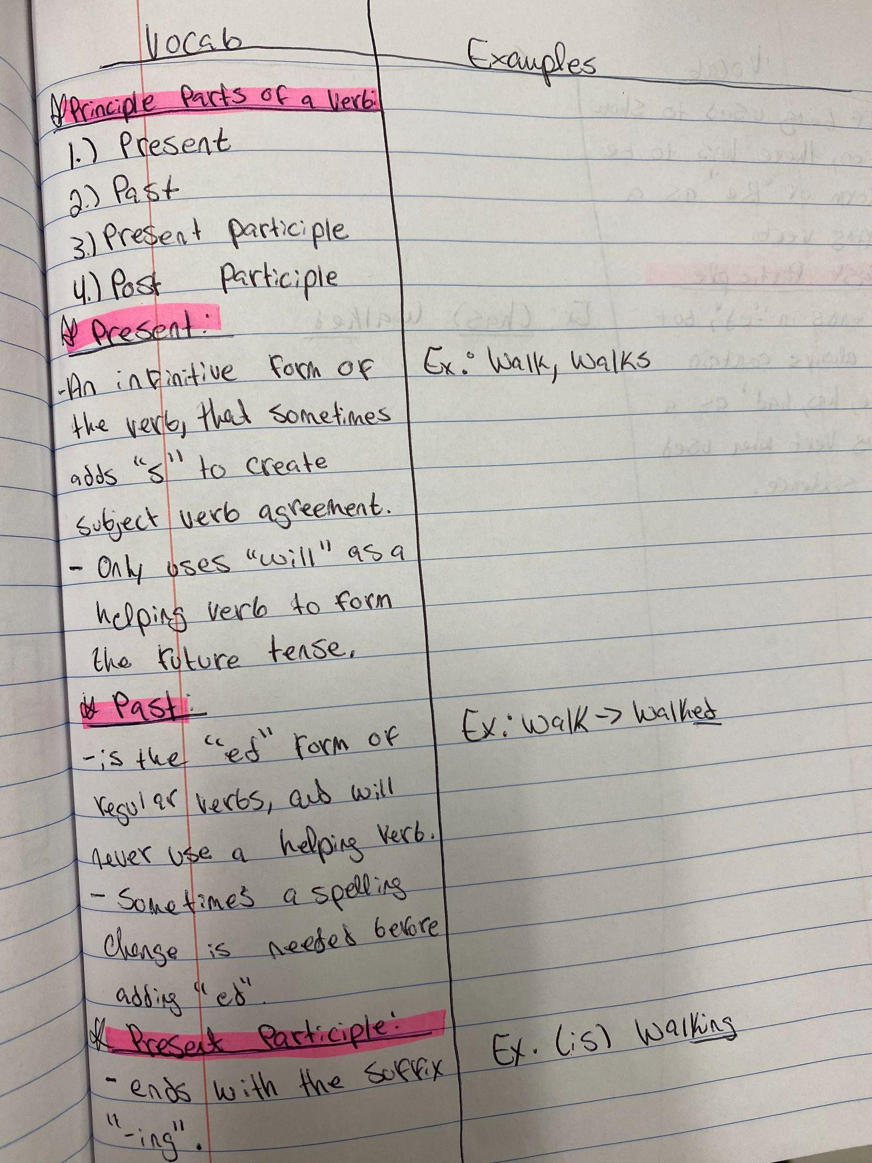
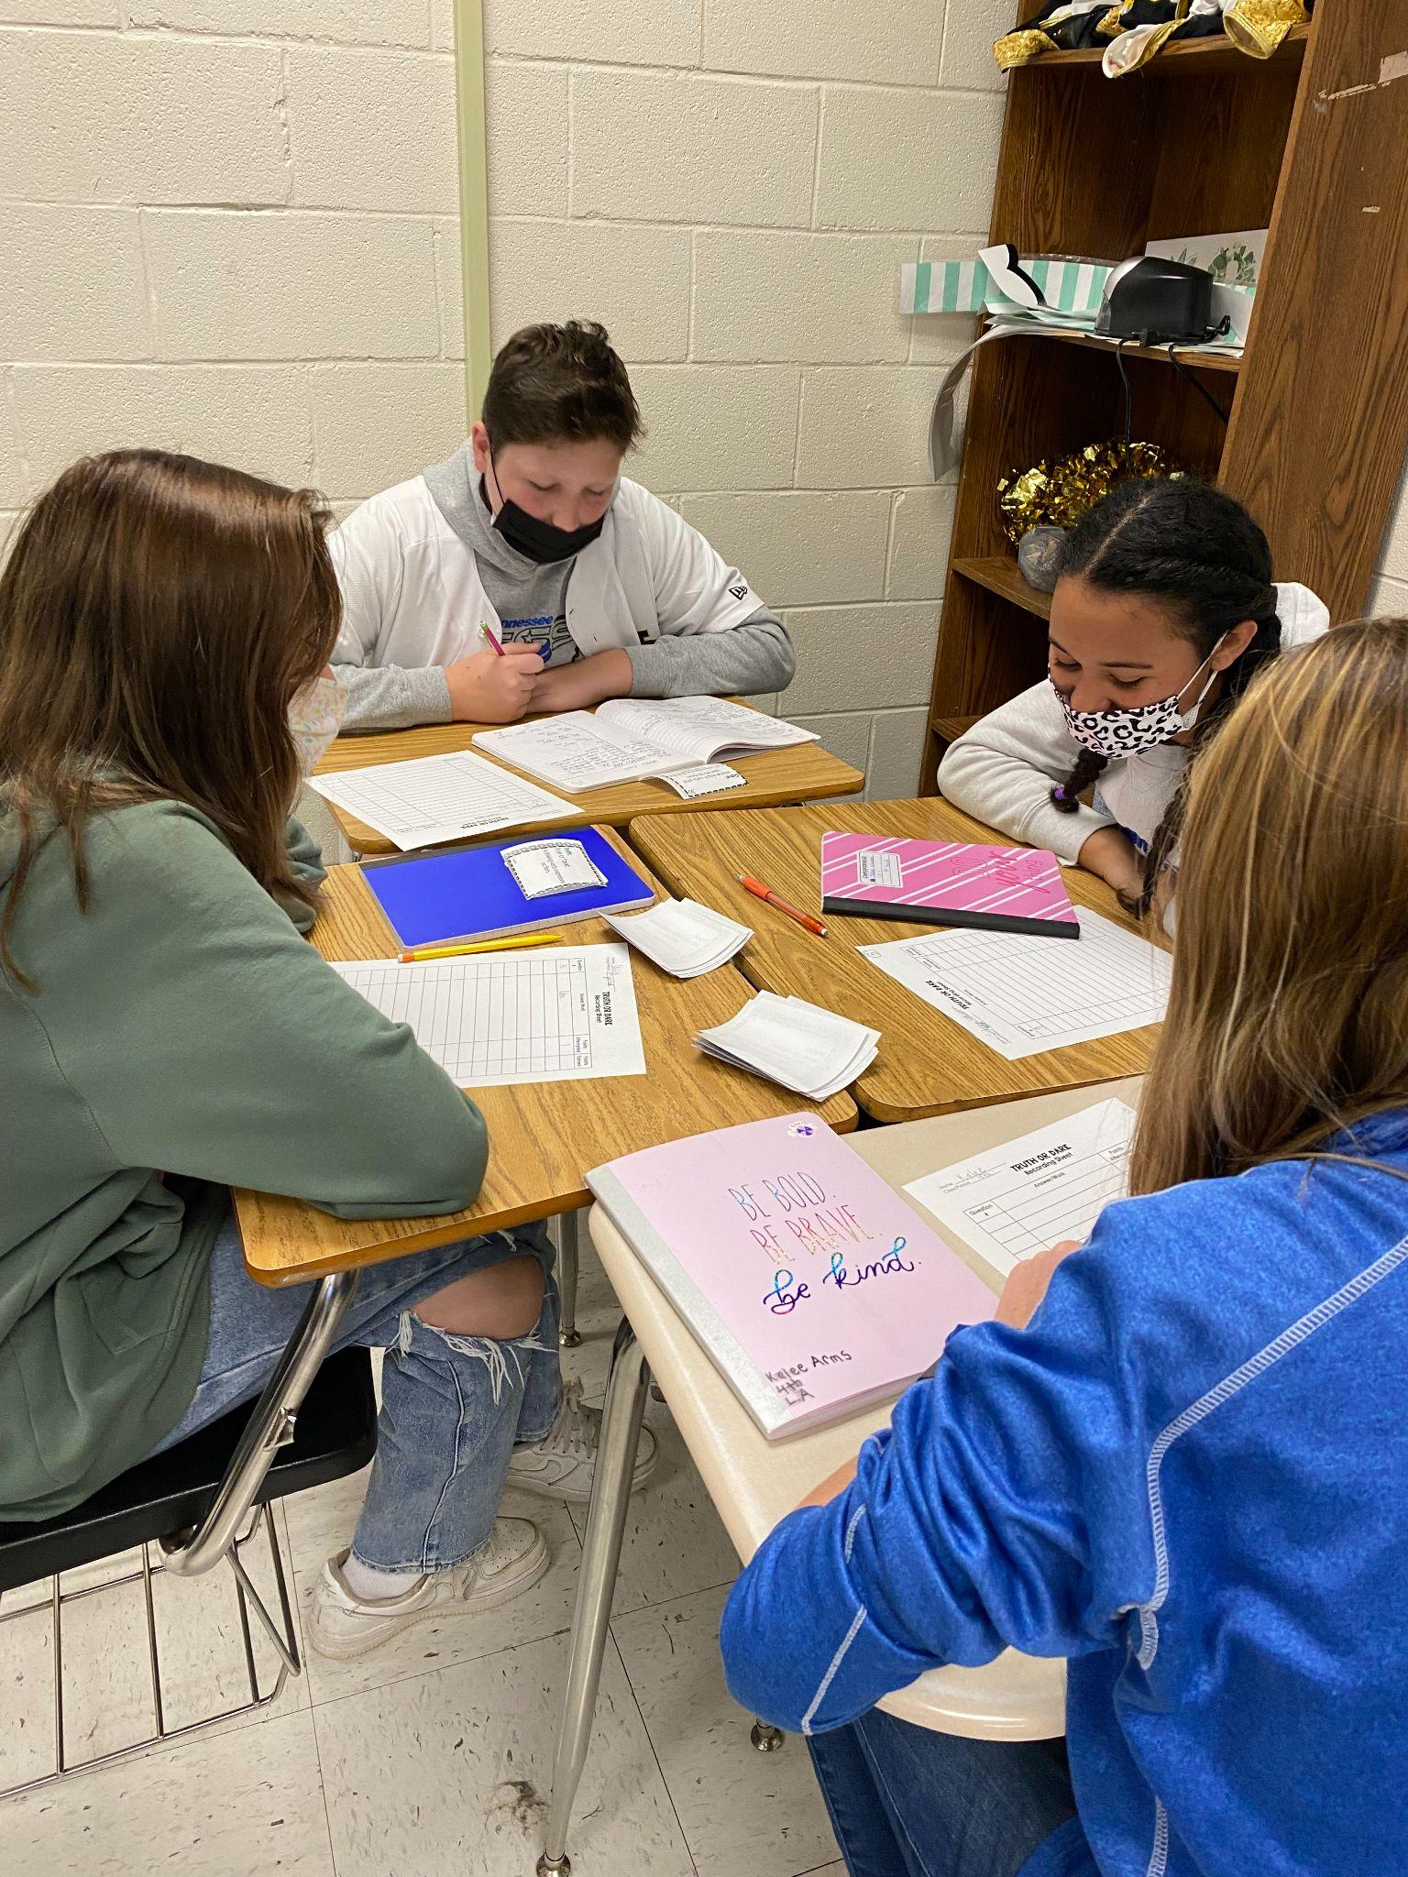
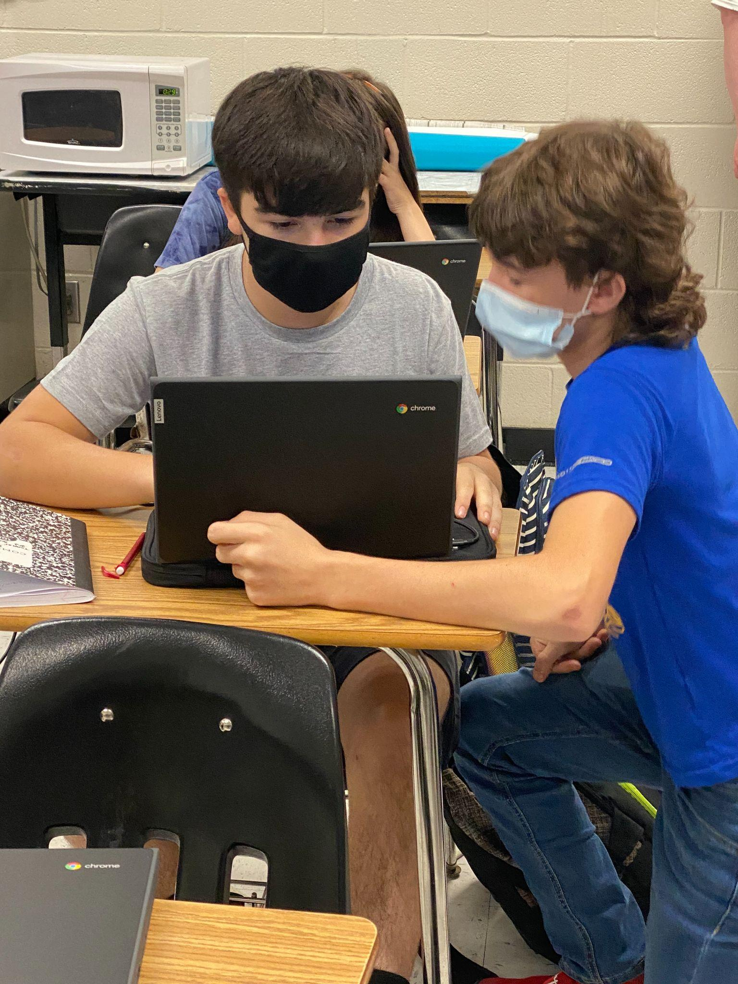
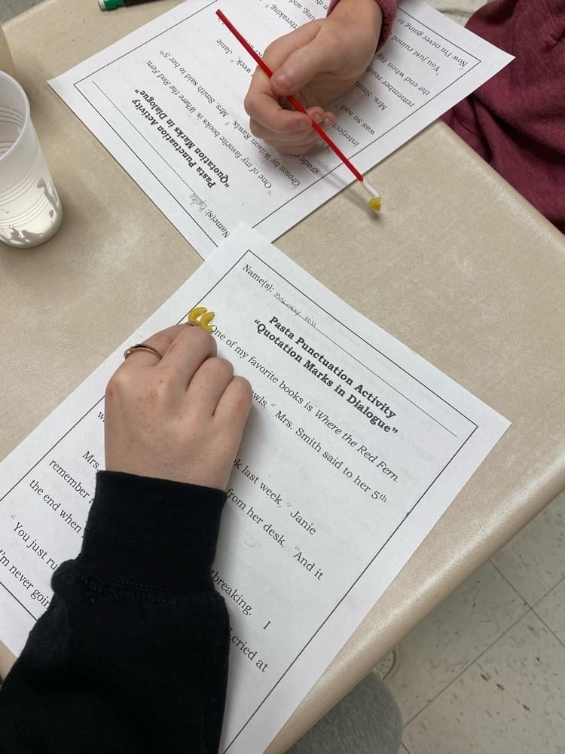
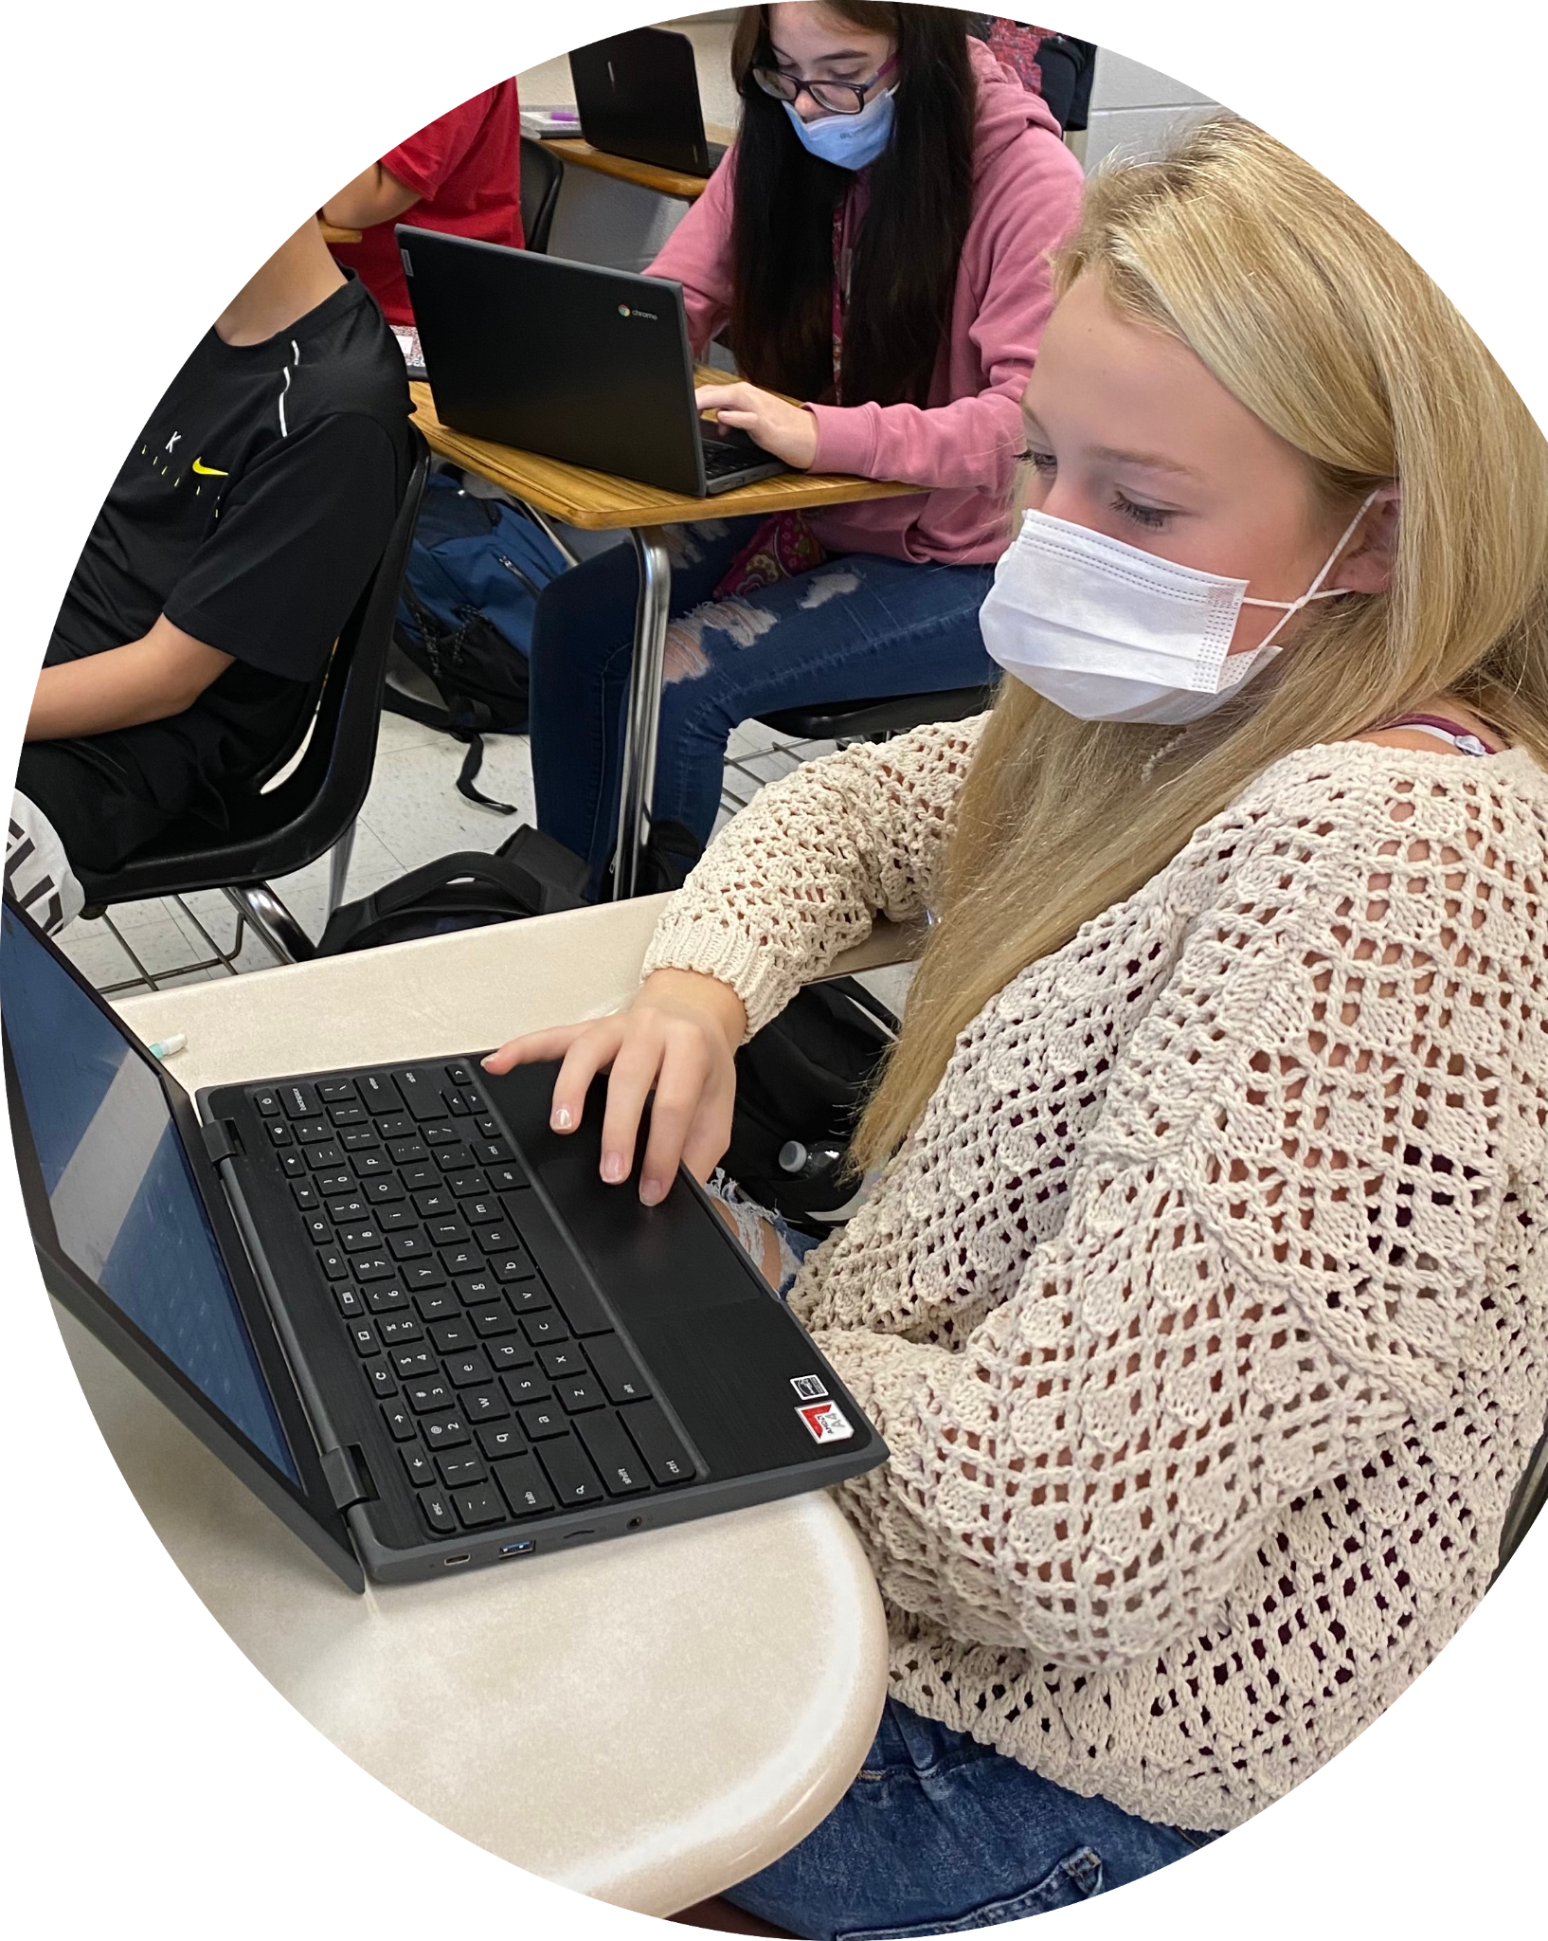
Self-Paced in Action
Students work through the unit at their own pace. Each lesson will begin with a short video that the students will use to take lecture style notes. Questions are embedded in the video to ensure students are participating
Students keep a notebook to record all of the notes form their videos that they can use for reference throughout the unit. If a student is absent, they can easily catch up when they return by simply starting at the first lesson they missed and moving through at their own pace until they get caught up.
Once students have finished their tasks, they can become peer tutors
Students that are on the same pace can work collaboratively to complete tasks
Students also have the option to complete a fun enrichment activity once they complete all of their tasks.

Slide 9
Mastery-Based Grading
Students complete Mastery Checks throughout the unit. These help students know if they are ready to move on to the next task or if they need additional support/reteaching. Students have multiple attempts to show mastery. Before retaking a Mastery attempt students have to complete a re-teaching activity.

Slide 10
Lesson Tracker and Pacing Guide
This photo is an example of the Pacing Guide that I use in my classroom. Each activity is color coded to show the students which activities are Must Do (green), Should Do (pink), Aspire to (Purple). Each activity is linked to the specific task/activity. Dates listed are just a goal for when to be on that lesson but students aren’t required to complete the lesson on that day. Click the link below to access the Pacing Guide.
https://docs.google.com/document/d/1BE1Ba7KSEPUNtNs0ltbiUUeM9BhPjD0o1QX17dy9RZE/edit?usp=sharing

Slide 11
It is very beneficial to the students to set a goal for each task for them to reach that will indicate Mastery. I like to use 80%. Students will know that if they reach 80% they are ready to move on to the next task and if they are below 80% they will need to complete a re-teaching session during small-group instruction
See example below
https://docs.google.com/document/d/1O-RCsIVGUrgvfeUvSx7Aj5ip1ugasg9Y4wx9S887fUo/edit?usp=sharing

Slide 12
Should I use MC?
Is Modern Classroom right for you? It takes a lot of time to prepare the videos and materials. These have the be completed ahead of time before starting the unit. However, the students really enjoy working at their own pace and working with their classmates. My advice: Pick one unit and try it out for yourself!

Slide 13
Thank you!!
Any questions?
Email me: jennifer.smith@johnson.kyschools.us
Modern Classroom Project - Podcast
www.modernclassrooms.org - Free Online Course

