Slide 1
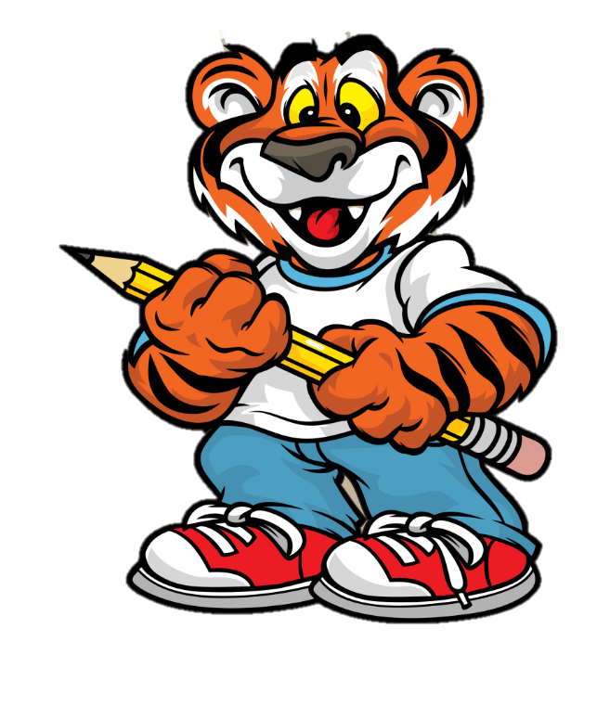
Get to Know Us
Inside Out
Frankie Puckett
Paintsville Elementary
Paintsville Independent Schools
2021-2022

Slide 2
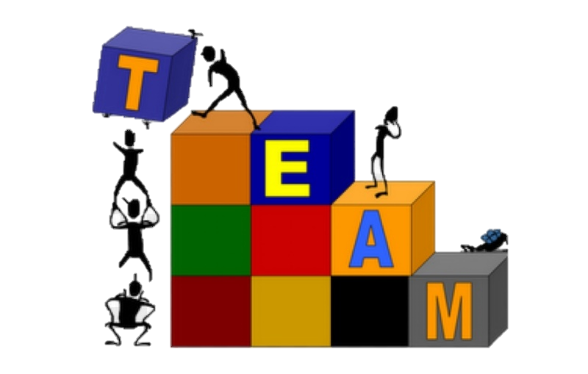
Area of Focus
The future of workers in Kentucky will need to rely a great deal on collaboration, teamwork, cooperation and communication skills. As we get our students ready to be successful in school and beyond, we must cultivate these behaviors and characteristics. It is imperative e that positive social emotional learning and communication are embedded in their overall emotional stability.

Slide 3
Why did I choose this topic?
Collaboration, teamwork, cooperation and communication skills are important and essential skills that, when practiced on a regular basis will carry over and be used at home, on the playground, and someday in the workplace. It is imperative that we build positive attitudes & behaviors, social skills, emotional awareness, along with open communication

Slide 4
Action Plan
The action plan is to integrate cooperative board games into the classroom that will provide every student who plays the opportunity to practice working together as a team for a common goal.
The hope is that these games also provide students that might not often feel doing well, empowered or built-in at school, an opportunity to fit in. A movement, that when supported, will continue throughout their academic and professional career.

Slide 5
Participants in the Project
Participating in my study were students ranging from grades Pre- Kindergarten - 6th grade with & without various levels of abilities.

Slide 6
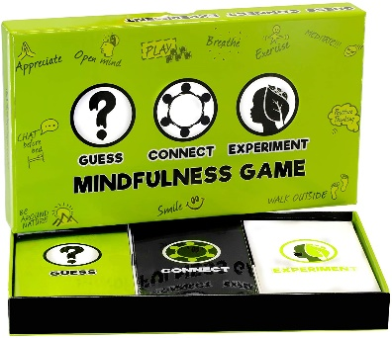
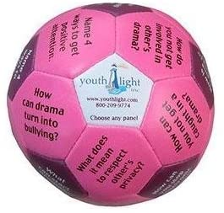
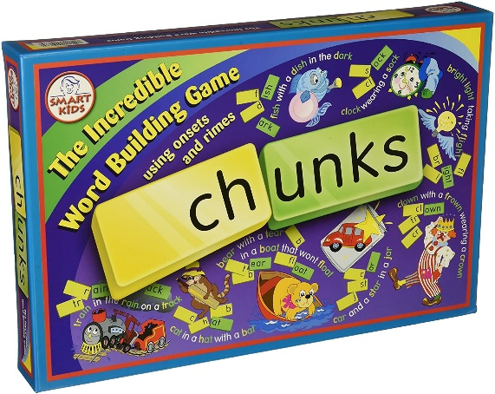
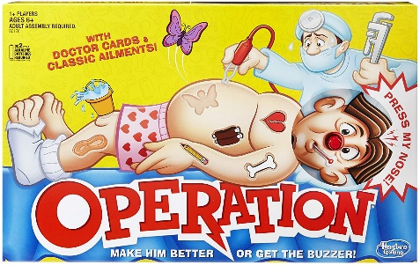
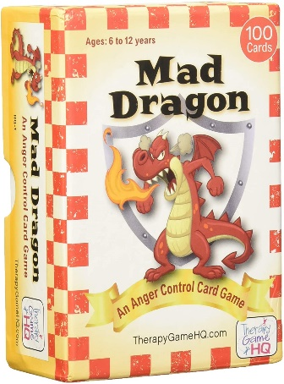
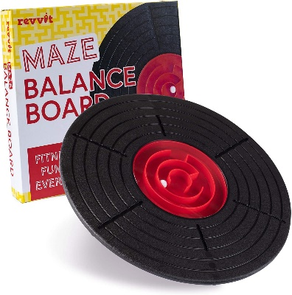
REQUESTED RESources:

Slide 7
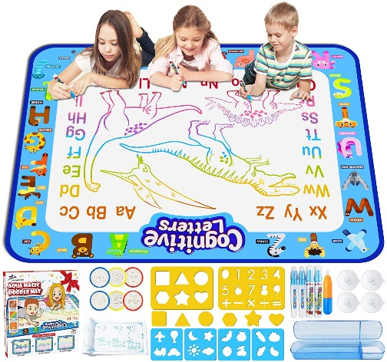
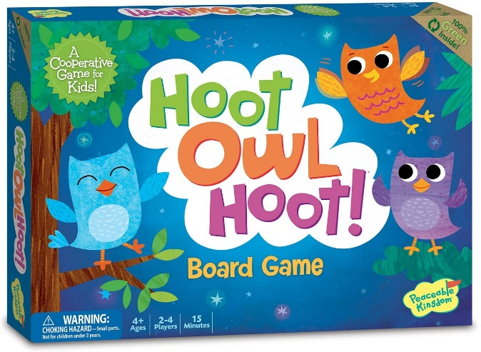
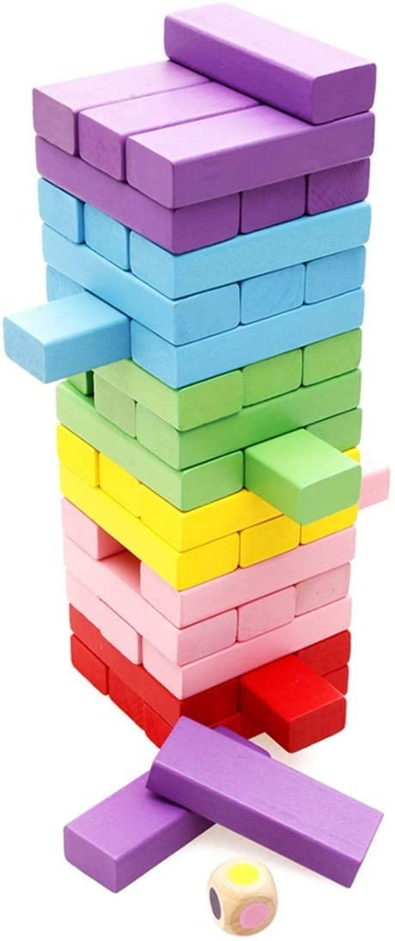
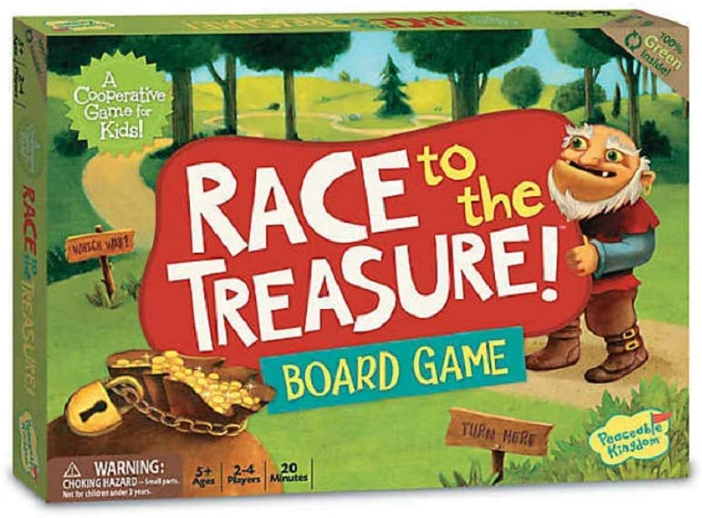
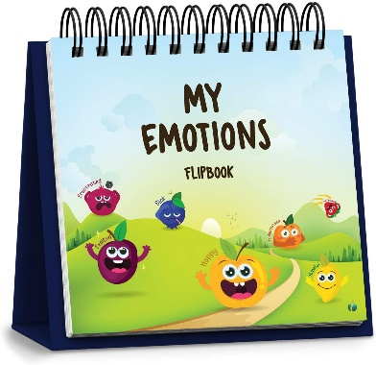
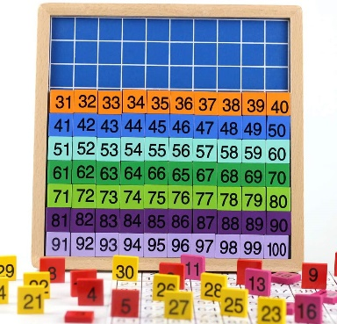
REQUESTED RESources:

Slide 8
Please email or call:
Frankie.puckett@Paintsville.kyschools.us
606-789-2654 Ext 2229

