Slide 1
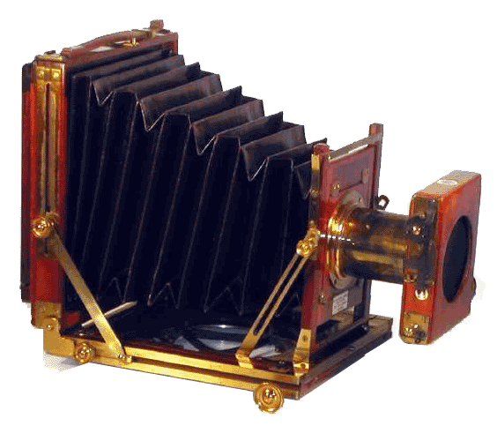
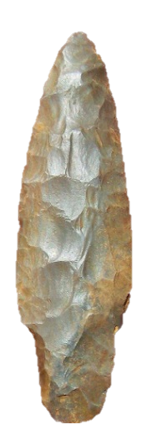
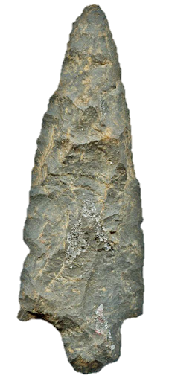
History Alive!
50 Awesome
Johnson County FACTS
2021-22
Frankie M. Puckett
Paintsville Elementary School

Slide 2
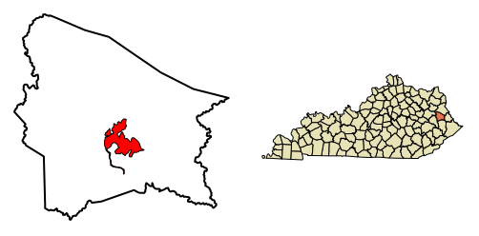
Project Objectives:
Students will develop a sense of pride in the county they live and interact with daily.
Students will implement the rigorous use of technology and provide a digital legacy by learning about primary and secondary sources.
Students with my help will create a digital scrapbook of information gather about Johnson County so their story come alive.

Slide 3
Participants in the study:
Participants in this project were be K-8 graders who will work in small groups to complete the project.
The plan continues to be to have resource and general education students working side by side to gather and research information.

Slide 4
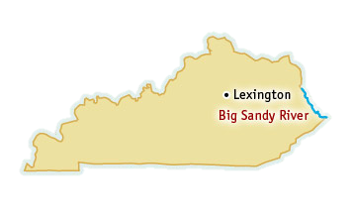
Action Plan:
History Alive! Is a project that will get students involved in learning about primary and secondary resources concerning their county and community. They will use the information gather to make a digital scrapbook of the enormous amount of wealth of information that Johnson County has to offer but has long been forgotten or has never been shared down through generations. It is important for students to understand the culture, heritage and significant past events. These needs to be seeked out and captured and preserved.

Slide 5
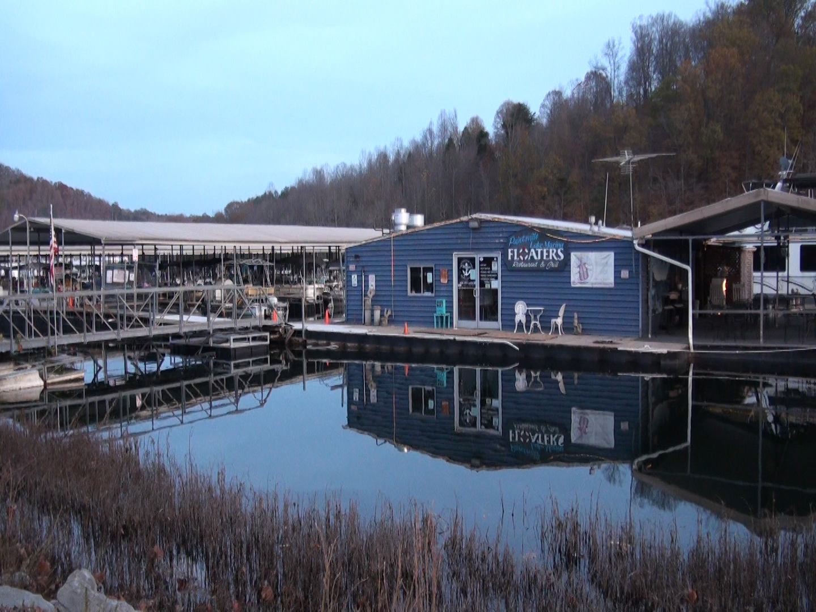
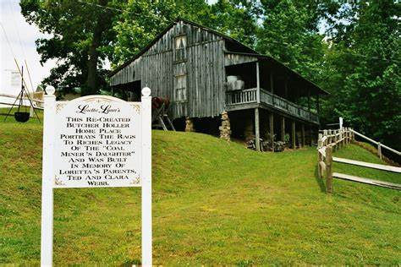
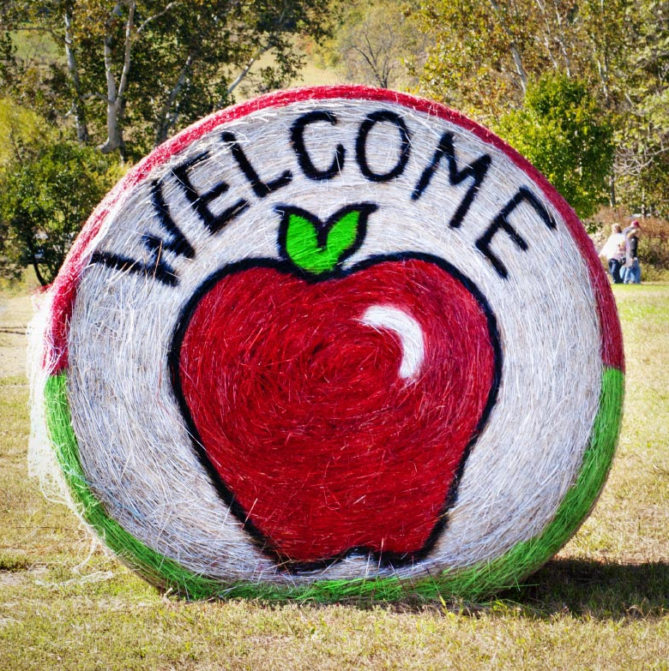
Why I chose this topic:
I chose this topic to help students learn about rich culture and heritage of their hometown community outside of the school setting.
It will allow our students a chance to interact with others within the community. Research will be collected from in person and online interviews, collecting old news paper clipping and researching information at the local library.

Slide 6
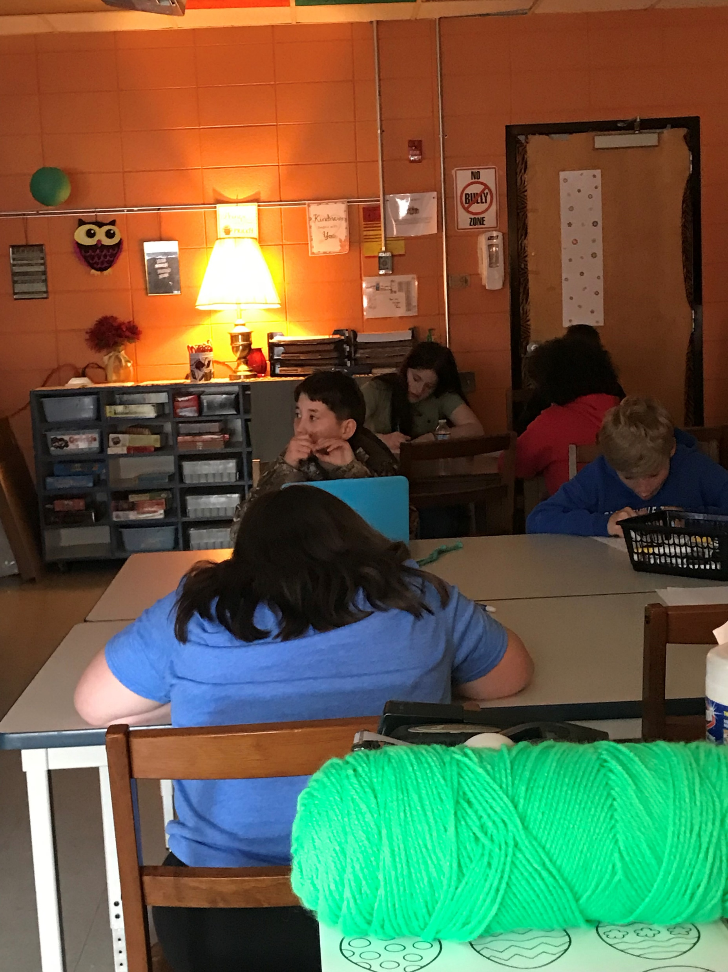
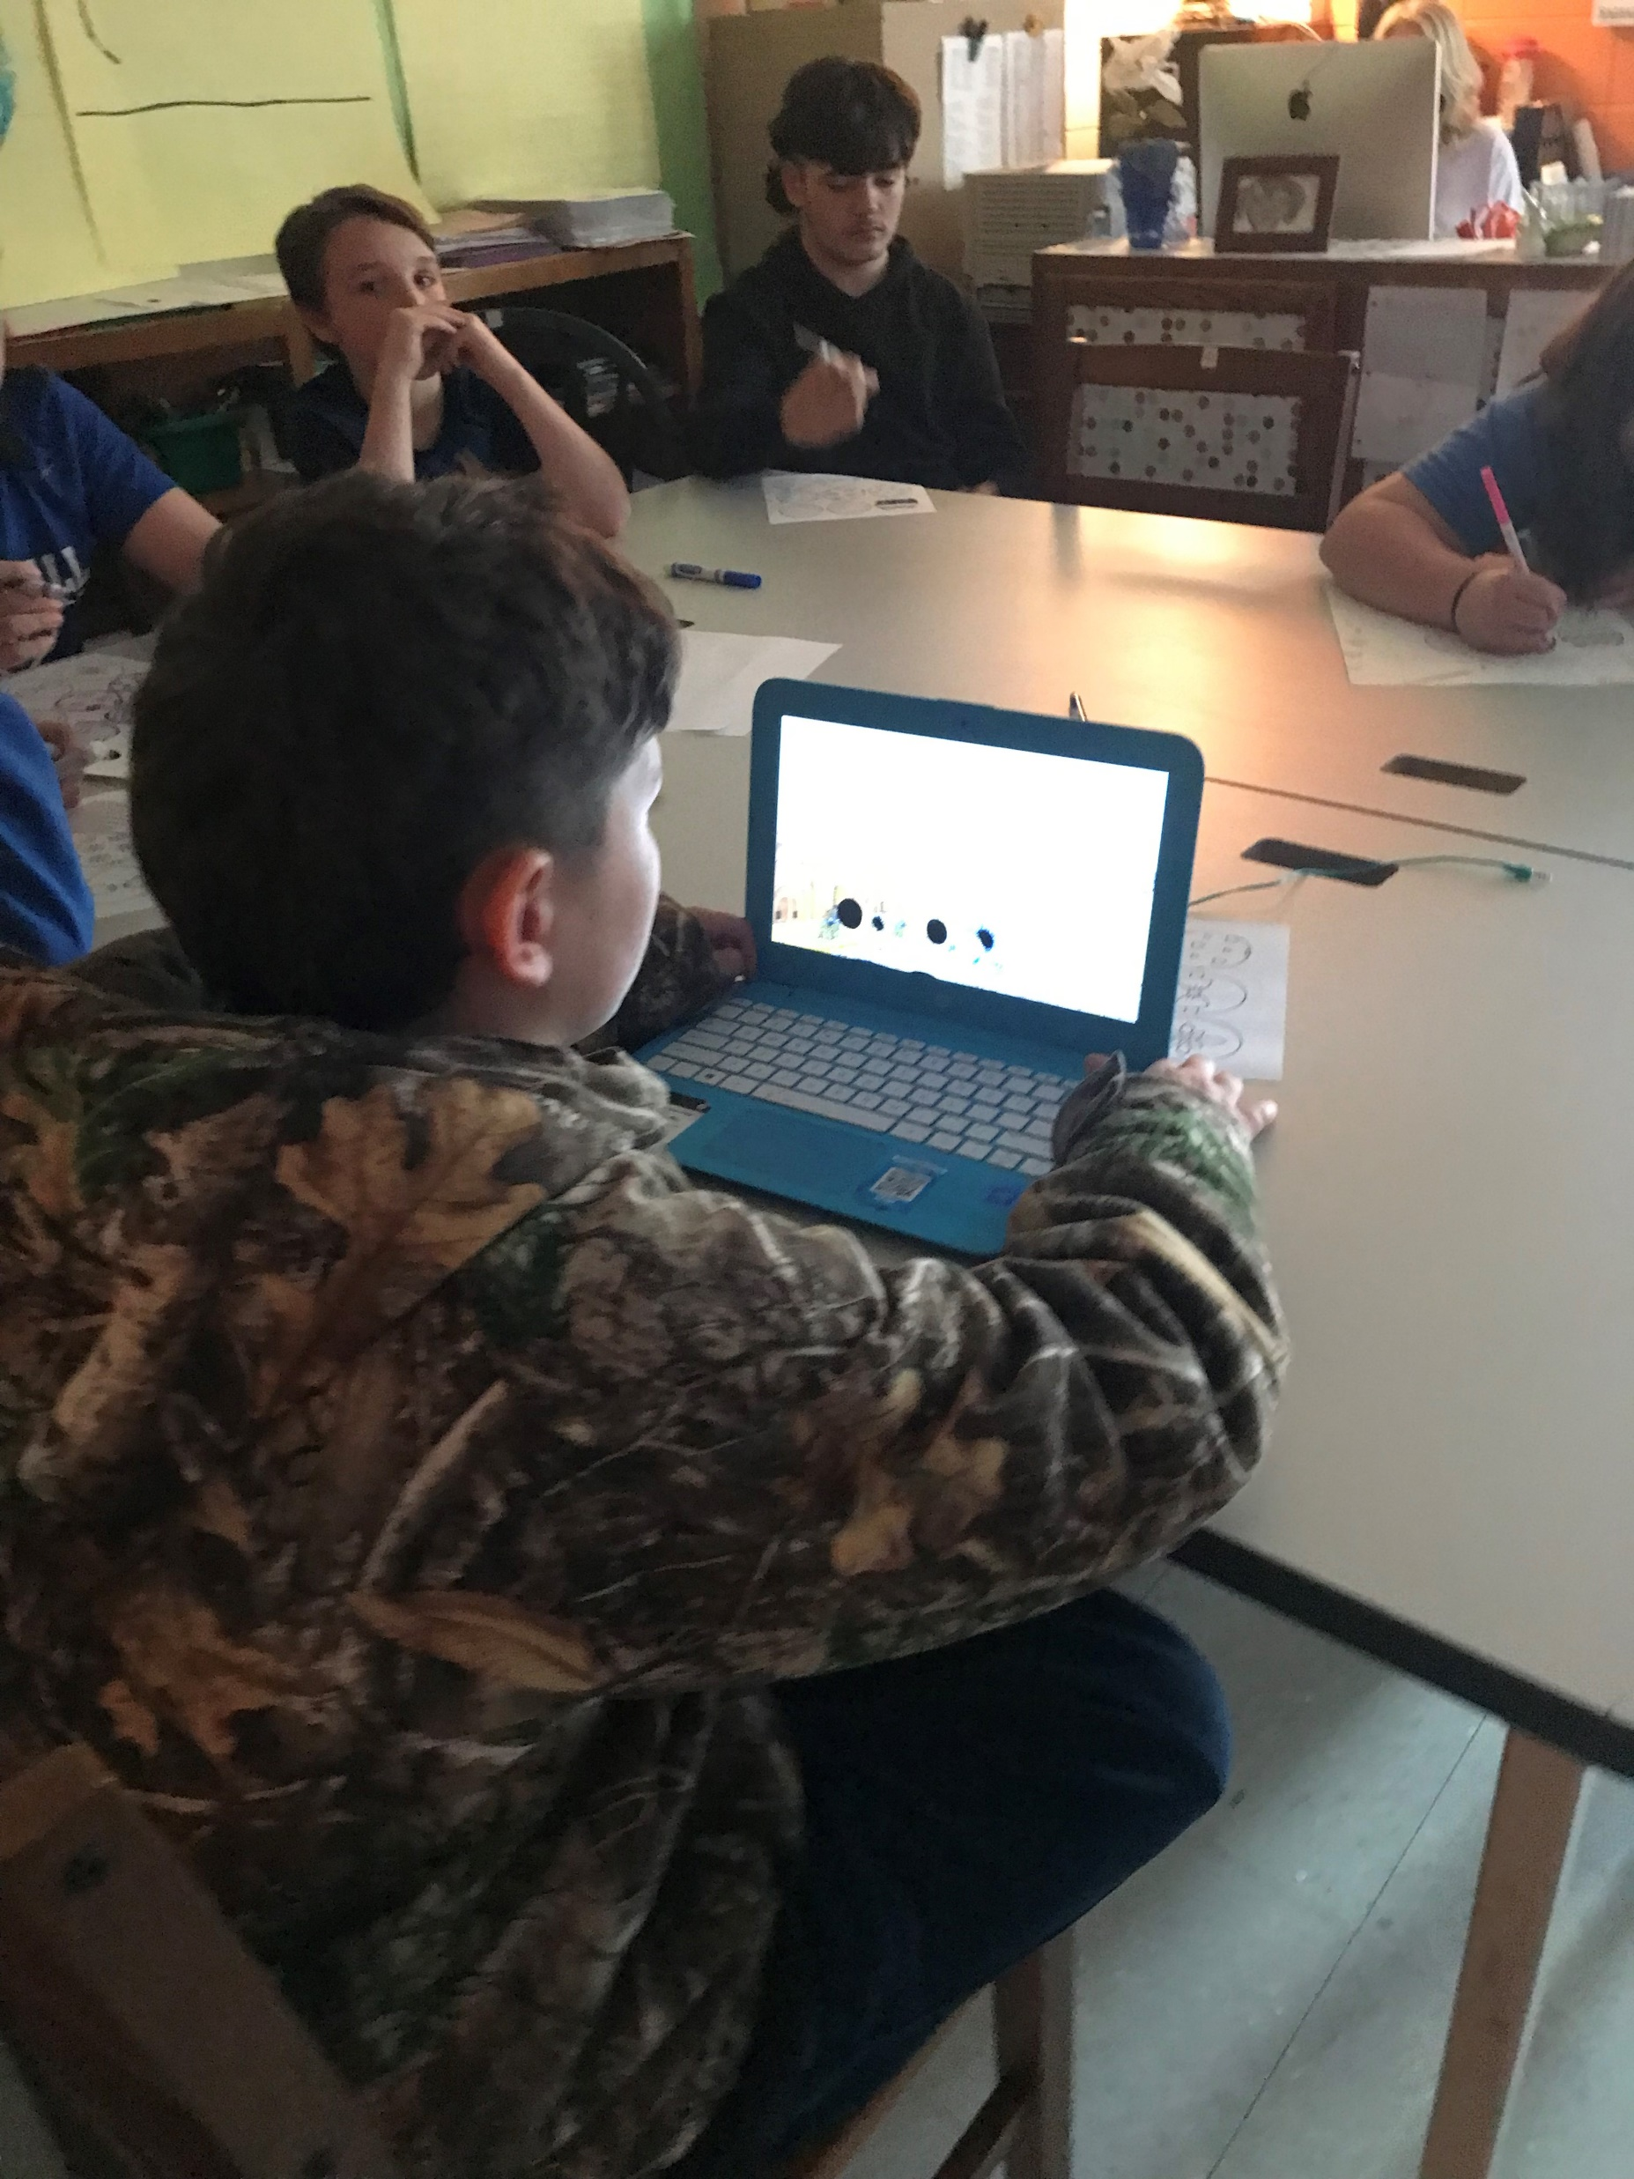
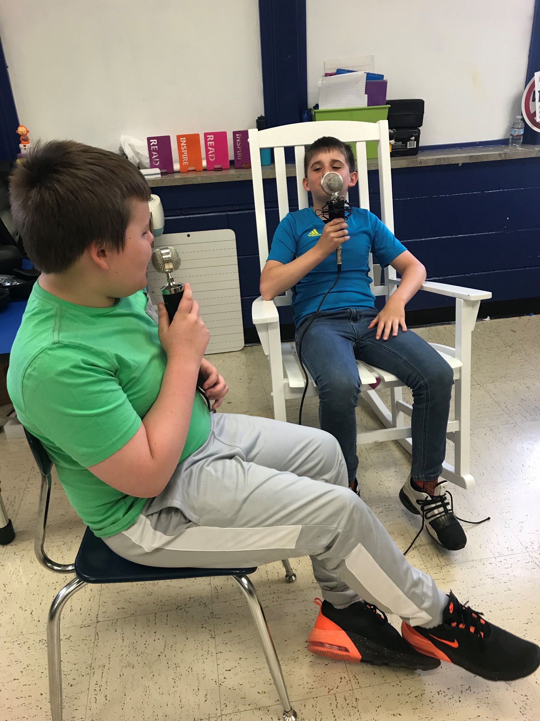
Photographs

Slide 7
FACTS and Tidbits Uncovered
6-7-1750 – Dr. Thomas Walker crossed Big Sandy at mouth of Paint Creek.
C and O Railroad used to be named Cautori.
1903- Small Pox epidemic broke out with more than 103 cases.
Sipp Theater was not the first theater.
6-10-1880 – Paintsville population was 319.
1861 -- Flat Gap school is the earliest school of record in Johnson County.
1946 – Anna Louisa Preston became first woman member of local American Legion.
1998 – Paintsville native Maxwell C. Bailey prompted to Lt. General in the US Airforce; Johnson County’s highest ranking military officer.

Slide 8
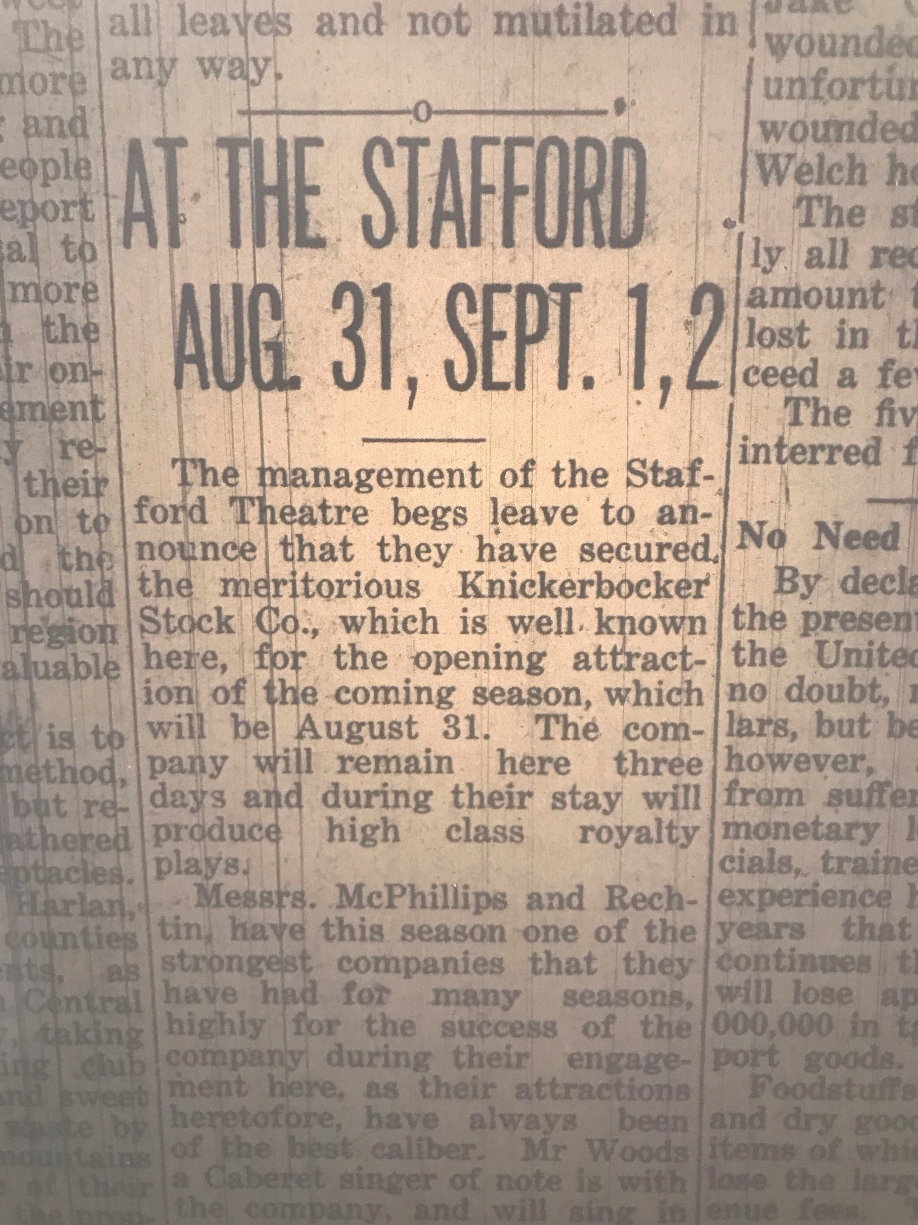
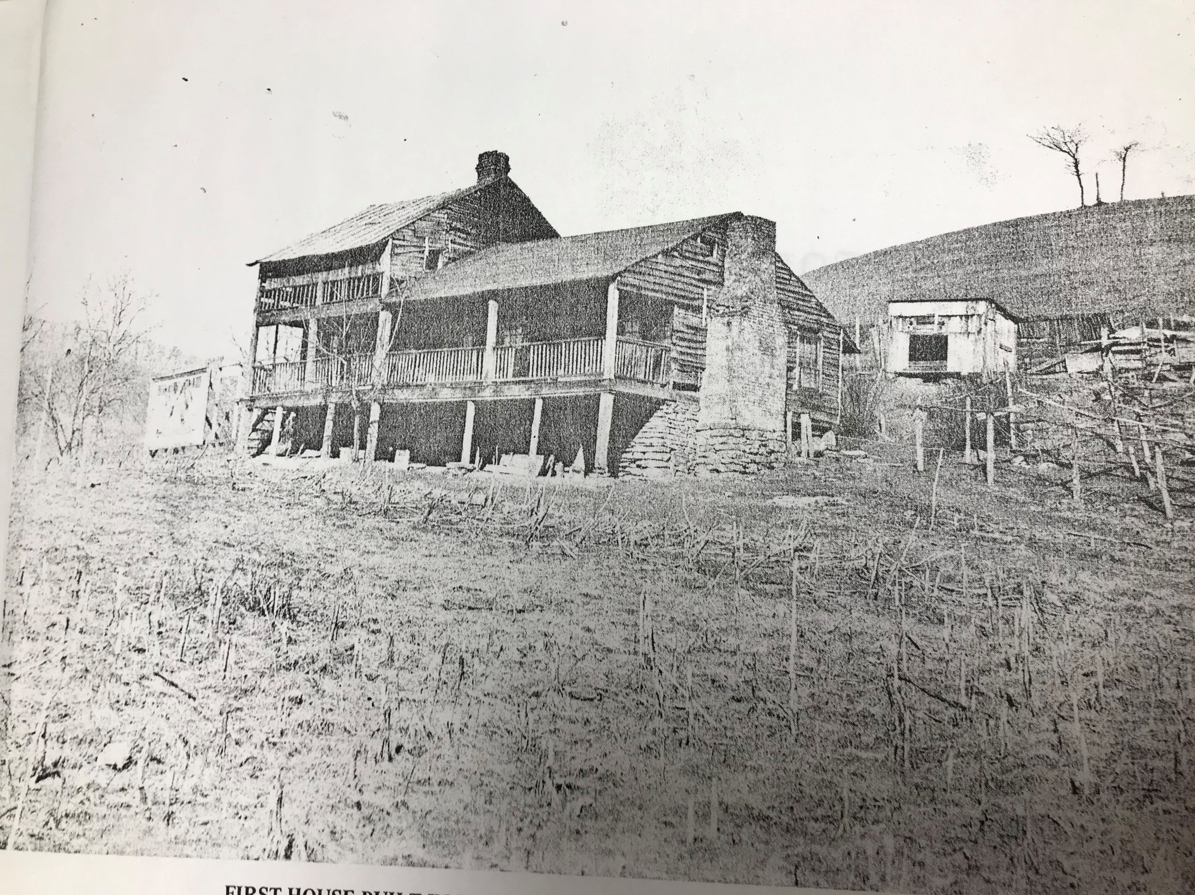
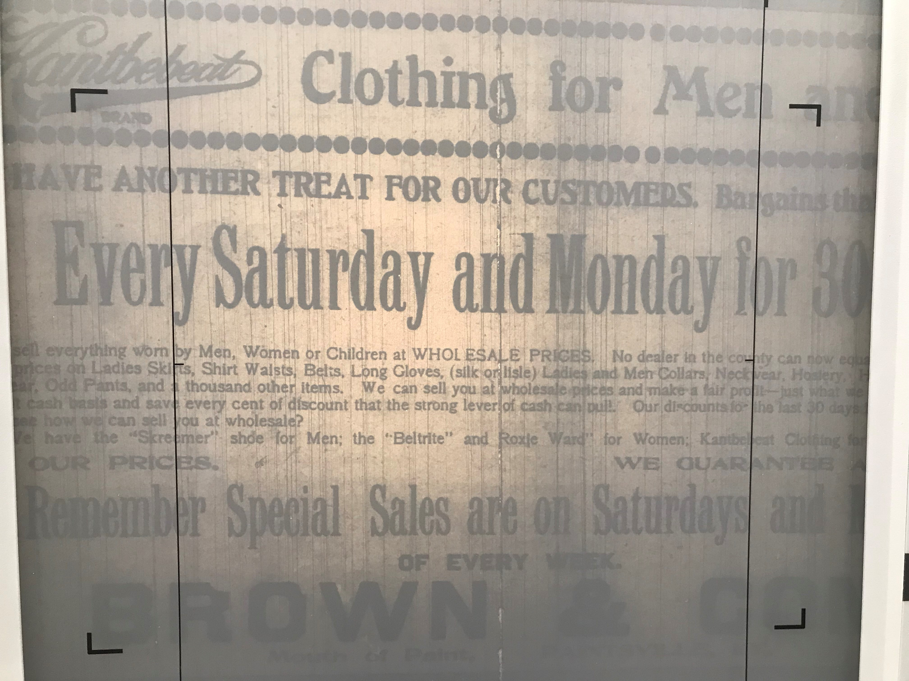
Facts and Tidbits Uncovered
The very first house built in Johnson County.
Sipp Theater was not the first theater.
In 1910, they was a store called Kantbebeat.

Slide 9
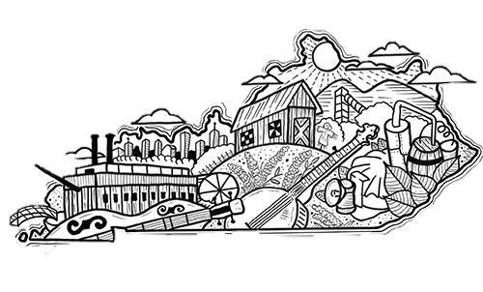
FUTURE Project Outcomes:
Our Goal: Students will feel pride in their community. They will recognize that they can utilize innovation technology personally and that they can use technology to overcome stereotypes and showcase their beautiful Johnson County and the history that exists there. Ultimately, a long run proof of success will be to narrow and close achievement gaps in income levels of students.

Slide 10
Measure of Outcome:
Primary and Secondary Assessment:
Pre-test: 40%
Post-test: 70%
The digital scrapbook is still being compiled and will be completed in June. Our school and local county library has been wonderful wealth of information to help the students understand the resources and what and where to locate information.

Slide 11
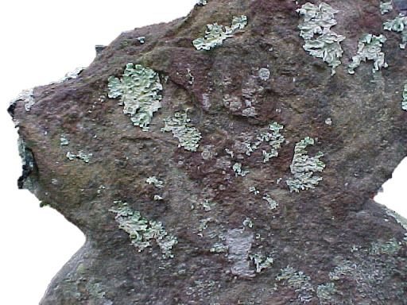
Please contact me at the following email or phone number.
Frankie.puckett@paintsville.kyschools.us
606-789-2654 EXT 2229

