Slide 1
Our “Virtual Game” Is Strong
By: Erin Bowling
Porter Elementary
Johnson County School District

Slide 2
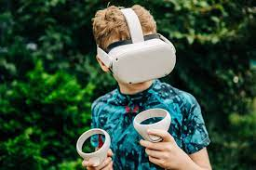
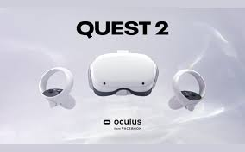
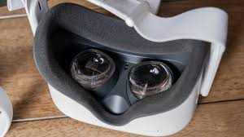
Awarded:
3 - Oculus Quest 2 Virtual Reality Headsets

Slide 3
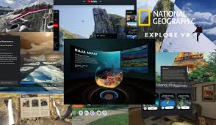
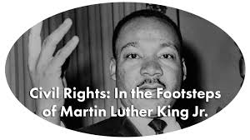
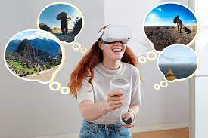
OUTSIDE THE WALLS OF THE CLASSROOM!!!

Slide 4
Excitement and engagement surrounding science and social studies!
Pictures in books and videos are excellent resources, but what is better is actually feeling like you have been there.
What was once thought as an exciting and expensive Christmas gift has now been adapted for education enjoyment.
Students are not limited to word descriptions or book illustrations.
Student can learning by doing rather than just reading or hearing.

Slide 5
So what does it do???
It creates an entire digital environment.
360 degree immersive user experience that feels real.
Provides students with immersive learning experiences that brings your lessons to life.

Slide 6
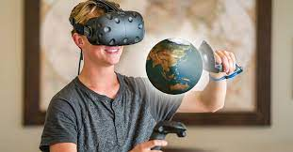
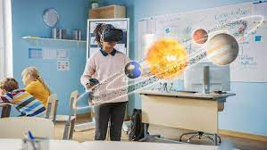
A FEW EXAMPLES:
Tours of beehives
Walk with MLK
Identify stars, constellations, planets and even satellites
Geography possibilities are endless: seven wonders of the world, field trips where ever you want to go
Variation of traits
National Parks
Earth’s place in the Universe

Slide 7
The why!!
Pandemic and outside of school learning experiences
Provide experiences that they may never have.
Make knowledge available to my rural students that they may otherwise not receive.
Combat behavioral issues who experience difficulty concentrating and staying focused.
Meets all 7 learning styles.

Slide 8
Projected BUDGET:
3 – Oculus Quest 2 All-in-One VR Headset – $299.00 per unit
Total – $897.00

Slide 9
pROS AND CONS…..
- One of the coolest technological experiences. It does what it says and so much more. Adults, children, teens there is something for everyone.
- The educational experiences with it are endless. You can use it to enhance teaching in almost any area.
Con: You really have to spend time learning, downloading, assessing, purchasing, etc. It’s definitely not something you just put on and go.
Very difficult with first graders, I kept learning about it though and found a way to make it easier.

Slide 10
The kids love them!!!

Slide 11
evaluation OF effectiveness
I modified the way in which I did my evaluation just slightly. I initially was going to teach one Social Studies unit and one Science unit. I ended up teaching two Science units and then reteaching using the Virtual Reality googles. The first grade Social Studies standards did not lend themselves to the googles in the way that they Science did.
Standards Assessed and Evaluated
Structure, Function, and Information Processing
1). 1LS-2 – Read text and use media to determine patterns in behavior.
1-LS3-1 – Make observation to construct and evidence based account that young plants and animals are alike but not exactly like their parents.
Space Systems
1ESSI.1 – Use observation of the sun. moon, and stars to describe patterns.
1ESSI.2 – Make observation at different times of the year to relate the amount of daylight to the time of year

Slide 12
What are they seeing?!?!

Slide 13
Evaluation and effectiveness
To evaluate the effectiveness of the Oculus VR Headset I plan to choose two units from each subject area (Science and Social Studies).
I will teach those two units prior to the arrival of the VR sets.
I will assess both units, recording the scores of those assessments.
I will then re-teach the lesson incorporating the Oculus Quest, reassess, and compare scores.
As well, I will do a pre and post survey evaluating overall engagement, noting student behavior and student feelings towards the VR experience.

Slide 14
assessment analysis
SCIENCE UNIT | PRE-ASSESSMENT | POST-ASSESSMENT
Unit 1 – Structure, Function, and Information Processing | Score – 80% | Score – 89%
Unit 2 – Space Systems | Score – 85% | Score – 95%

Slide 15
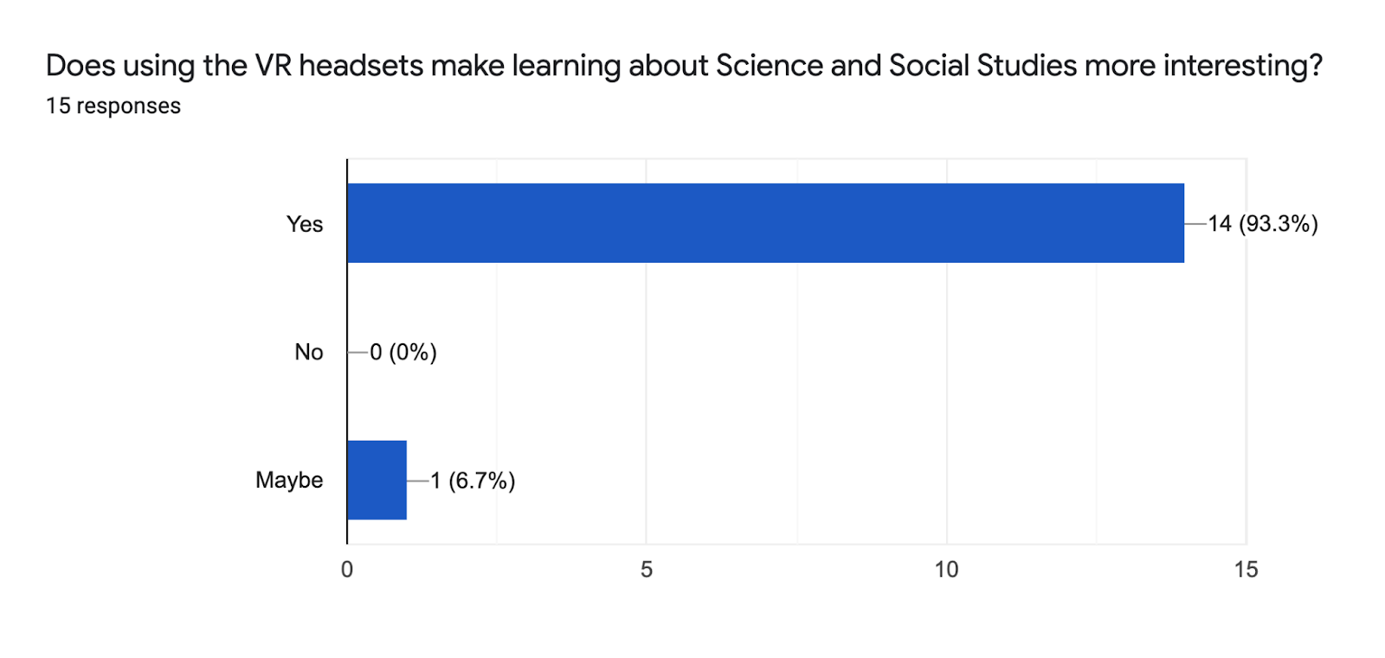
Post Survey

Slide 18
THANK YOU!!!!
Erin Bowling
1st grade teacher
Porter Elementary
Erin.bowling@johnson.kyschools.us

