Slide 1
Functional Vision Assessment KIT
Name: Danielle Aldrich
School: District Wide- Itinerant TVI
District: Floyd County, Kentucky

Slide 2
What are the current problems of practice that caused you to choose this topic?
There are multiple areas that we evaluate and assess as Teachers of the Blind and Visually Impaired (TVIs), that it can be overwhelming to make sure that we cover everything and know how to accurately assess each vision skill for different visual impairments. Currently there isn’t a concrete testing KIT that you can just buy for evaluating every area our student’s functional vision.

Slide 3
Explain your project…..
When a student is referred for a suspected visual impairment, part of the evaluation includes a Functional Vision Assessment (FVA). This evaluation is conducted over numerous days using various materials and methods to test each area of their functional vision. I have created a FVA Kit with video models and resource links that TVIs can use to see the materials and methods needed to complete each section.

Slide 4
Resources and Images…
Pictures and materials referenced in this presentation include embedded links to the websites where they can be purchased from by clicking on the image.
For a compiled list of all links click here.

Slide 5
FVA KIT
Acuity
Color Vision
Oculomotor Behaviors
Visual Fields
Depth Perception
Contrast Sensitivity
Online Resources

Slide 6
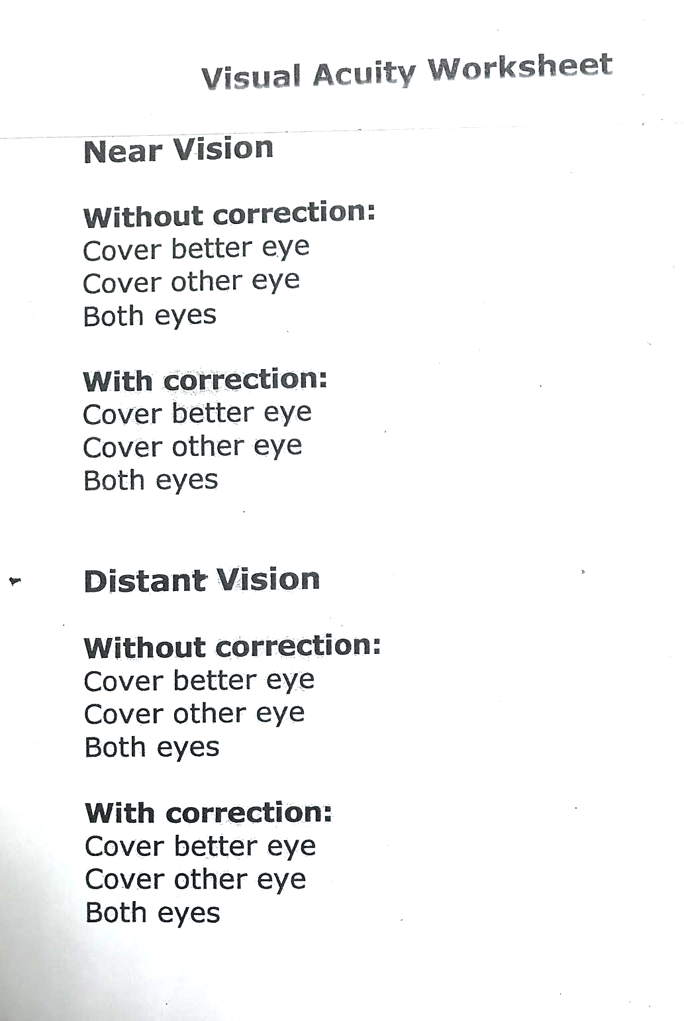
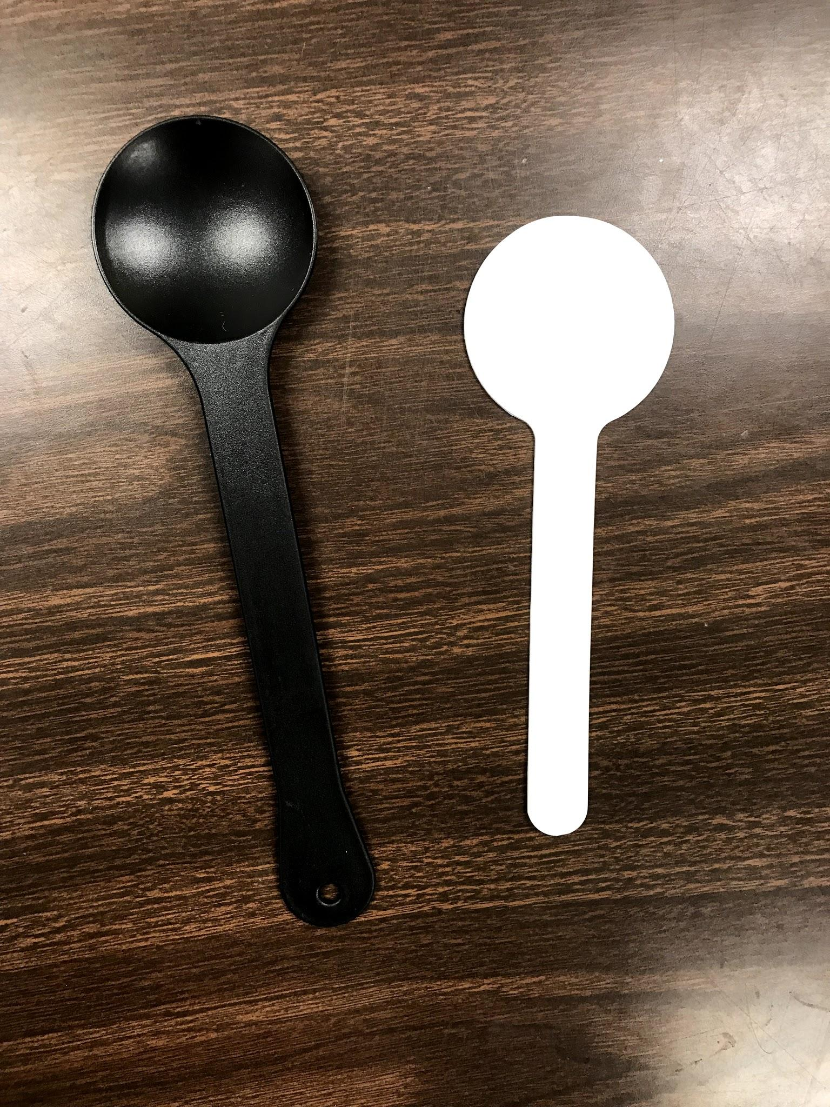
ACUITY
This is a handmade worksheet used to record the student’s acuity.
The student will use occluders when testing individual eyes.

Slide 7
ACUITY
Optotype: Distance
Used to measure the ability to distinguish details (recognition) at 20 feet. Determine if the student needs pictures, letters, or numbers to choose the right chart to use.
Snellen Chart- Shows letters with acuity notations and basic red green color lines.
Kindergarten Test Chart: Shows pictures of a moon, heart, mug, star, plus, circle, hand, flag, and sailboat.
Low Vision Test Chart for Distance from Feinbloom: Shows PVNumbers in a logarithmic progression from 20/1000 to 20/20.

Slide 8
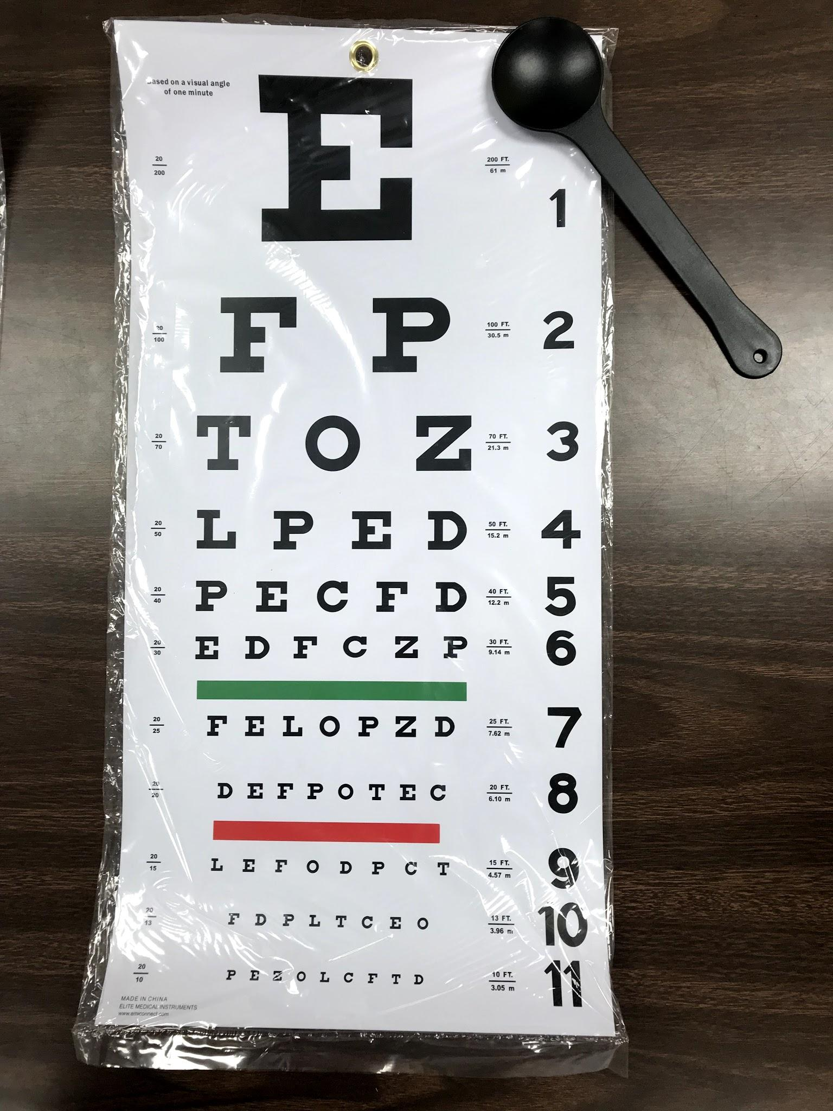
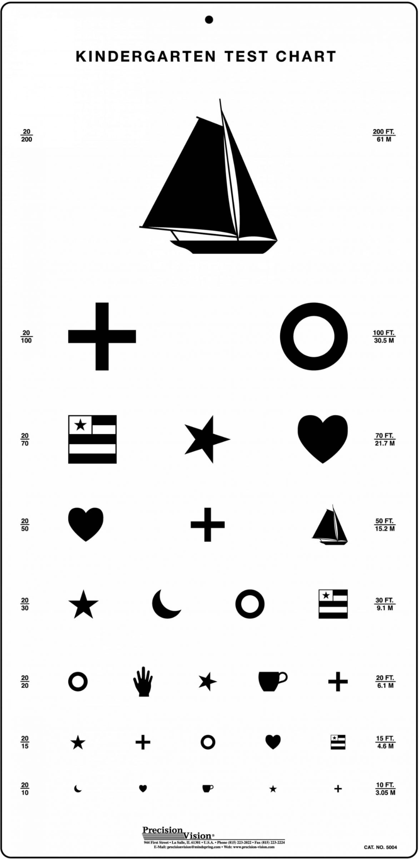
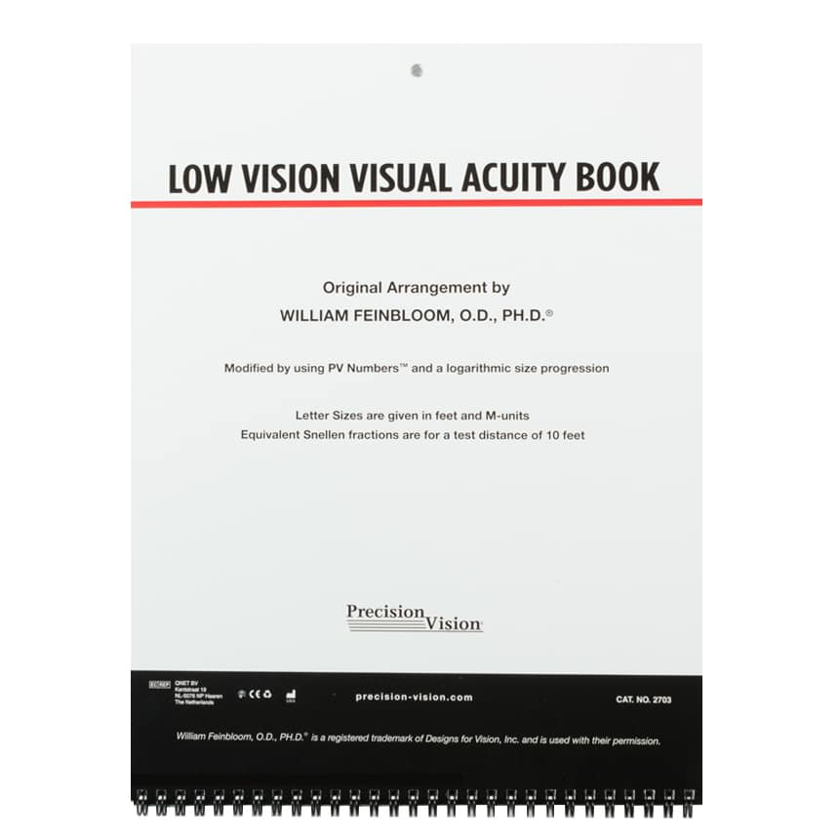
ACUITY
Optotype: Distance Charts

Slide 9
ACUITY
Optotype: Near
LEA Symbols Chart
String with bead should be held with one bead near the temple which will allow for testing distance of 16 inches.
If student has communication deficits, they can point to the symbols they see using the matching 4 image cards.

Slide 10
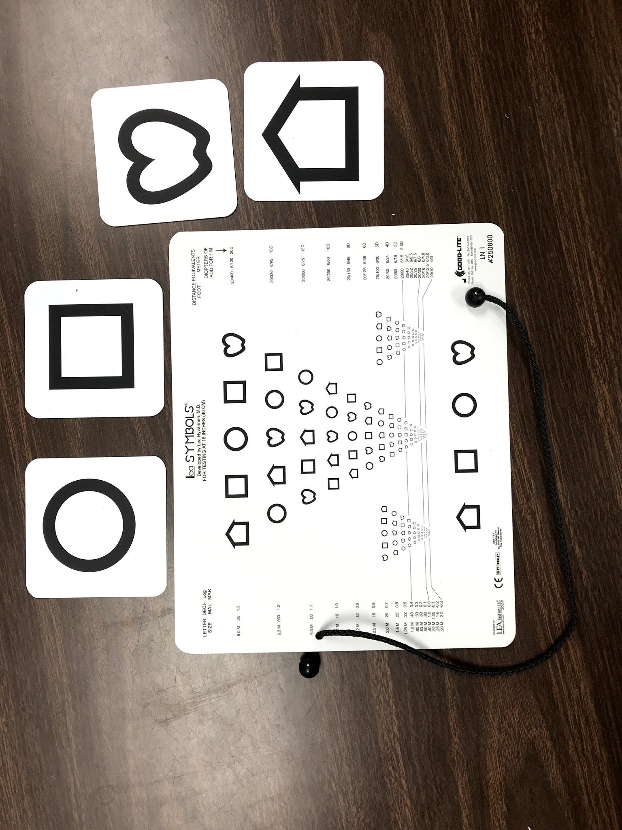
ACUITY
Optotype: Near LEA Symbols Chart

Slide 11
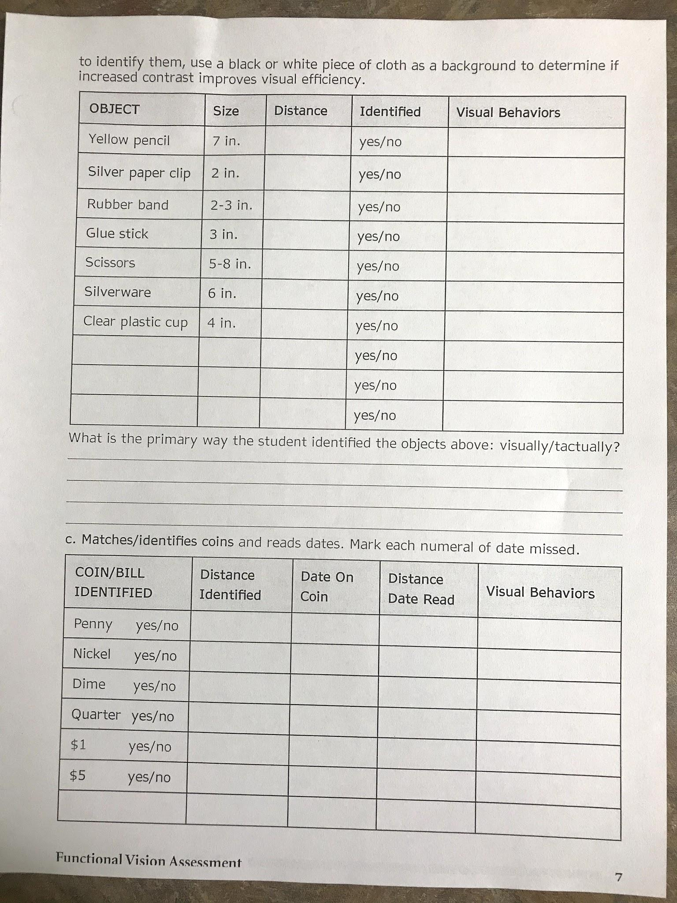
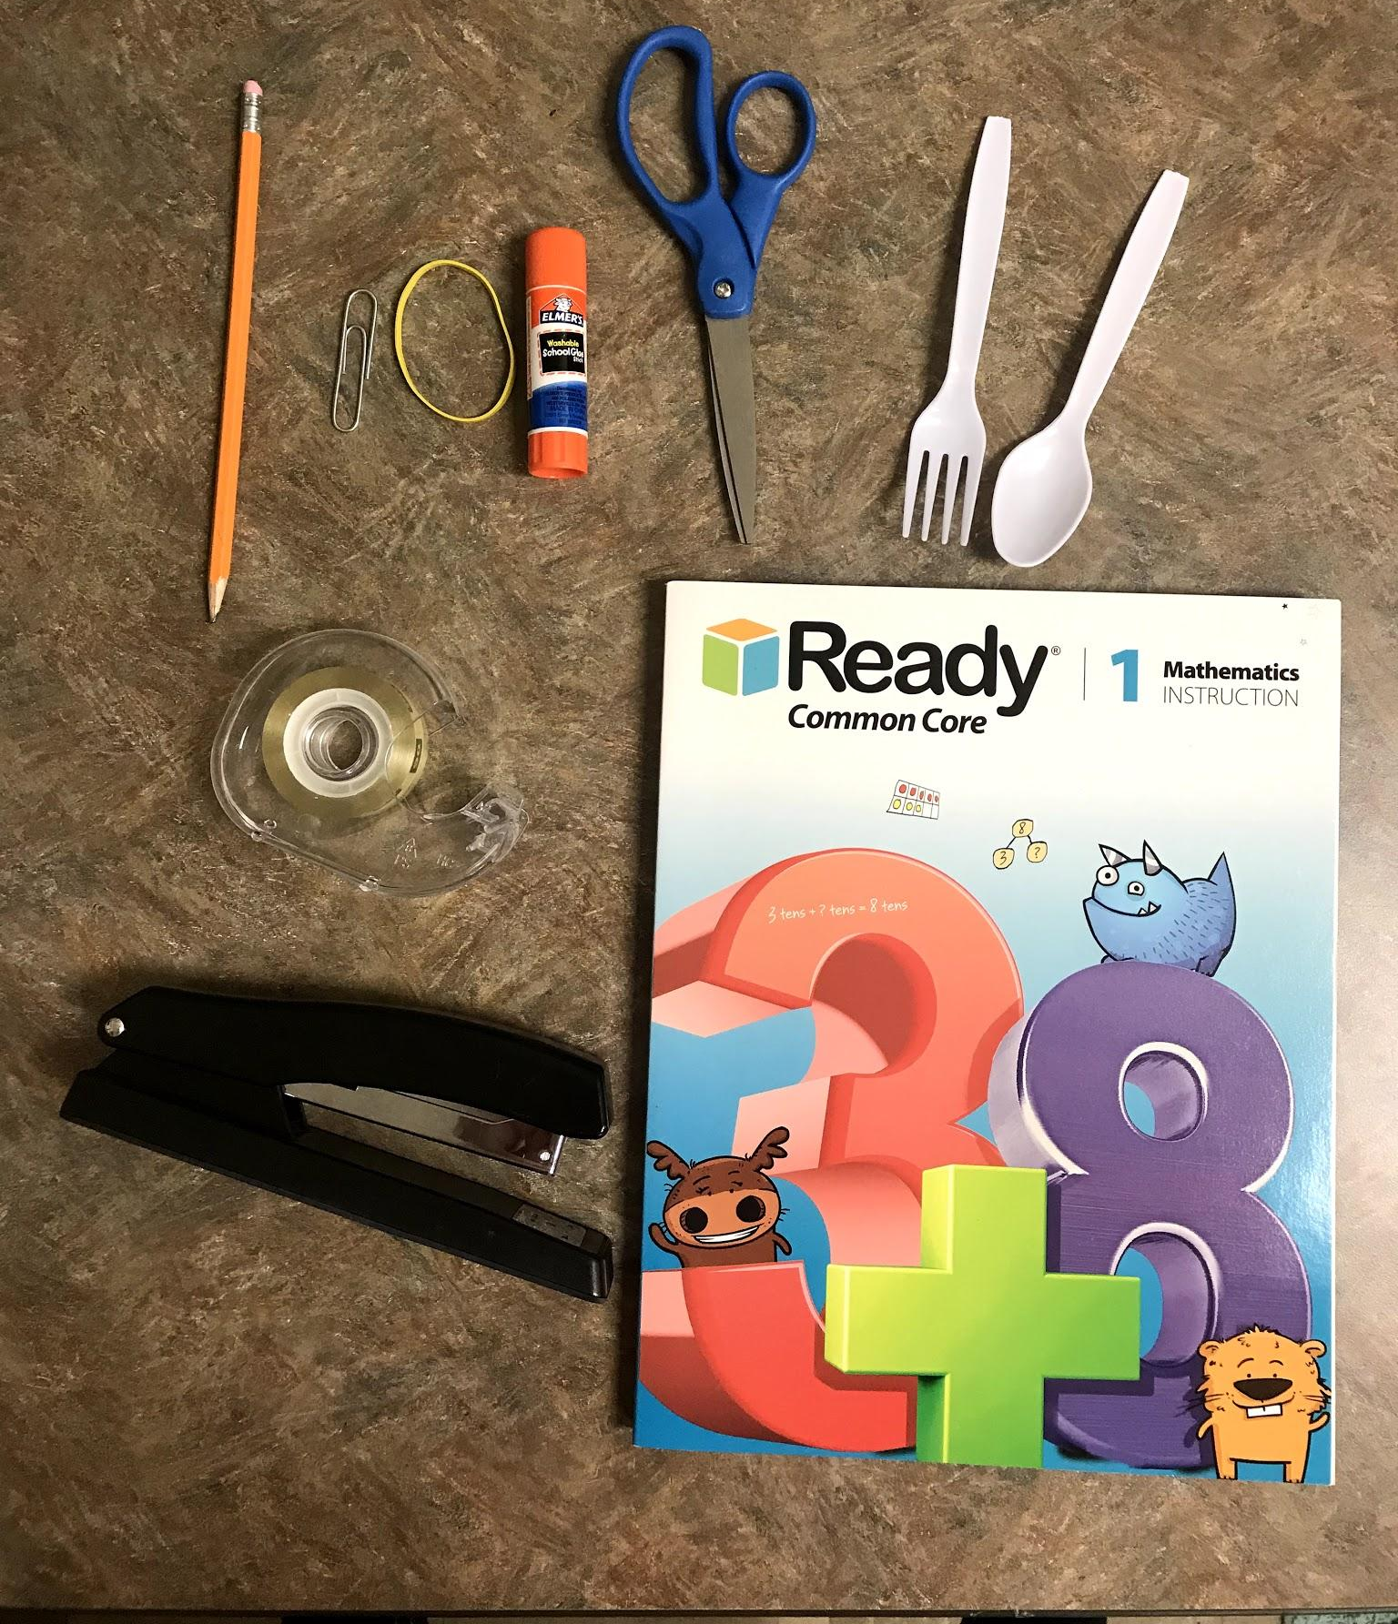
ACUITY
Near and distance Informal Acuity Testing sheets from APH’s FVLMA Practitioner’s Guidebook used with familiar sized objects and money at designated distances.

Slide 12
ACUITY
Near Informal Acuity Testing with 1 inch, 2 inch, and 3 inch photos in both color and black & white from APH’s NewT Kit. You can order just the NewT cards or order the whole Kit from APH.
Record how many pictures of each size and at what distance the student could see for both black and white and colored photos. Note if the student had difficulties with more visually cluttered images.

Slide 13
ACUITY
Optotype: iPad Apps
eyeSnellen
The most accurate visual acuity test for the ipad.
Test distance of 6 feet. Can use with iPhone remote (have to purchase).
Choose from letters, numbers, picture, & logMAR.
User friendly with adjusting settings & navigating.

Slide 14
ACUITY
Optotype: iPad Apps
Eye Chart Pro
Tests acuity using the following chart options: Snellen, Tumbling E, Landolt C, Sloan, & Near Vision.
Can use iPhone as the remote to isolate individual lines during testing.
Advanced features can be purchased to put colored backgrounds, change to landscape formatting, additional charts, and mirroring of charts.

Slide 15
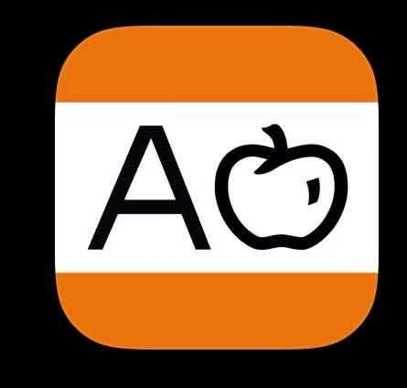
ACUITY
Optotype: iPad Apps
Kay iSight Test Professional
Use to measure near and distance acuity from 33cm to 6 meters for each individual eye and both eyes.
Choice of letters or Kay pictures with choice of different crowding options.
Very user friendly with changing sizes and charts.
Only free for a trial period then have to purchase.

Slide 16
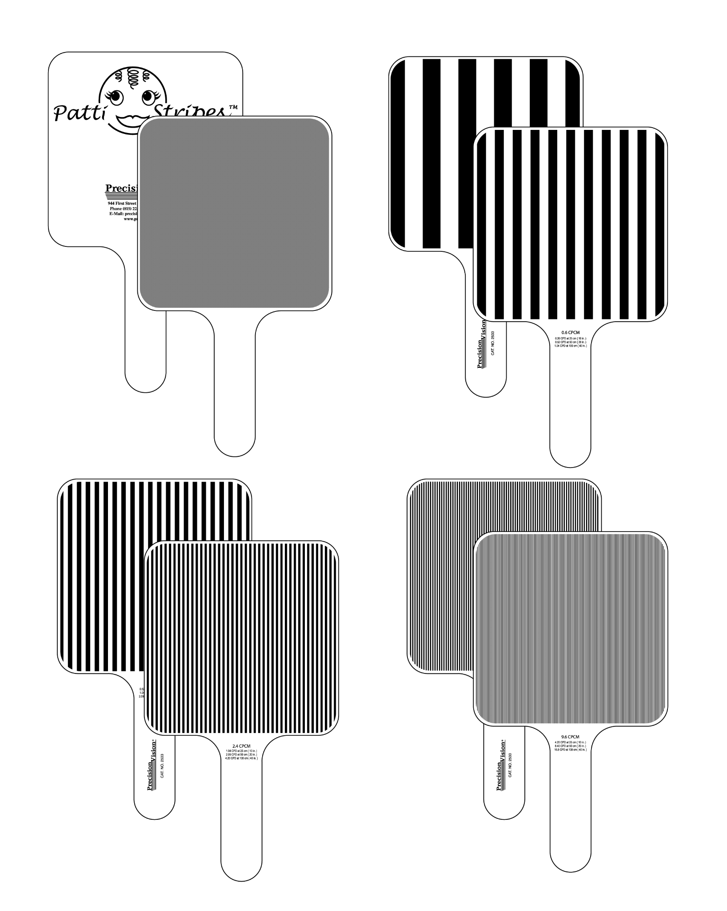
ACUITY
Grating- Patti Stripes Square Wave 4 Grating Paddles
Used to test infants, children, and those with cognitive disabilities by measuring the grating acuity using paddles with different grating levels.

Slide 17
ACUITY
Grating- Patti Stripes Square Wave 4 Grating Paddles
When the student sees the grating paddle they will visually respond by looking and following the paddle. Always start with the larger stripe sizes and move down.
When the student stops selecting the striped paddle over the gray paddle, this acuity is noted with the distance.
Demonstration Video of Patti Stripe Paddles

Slide 18
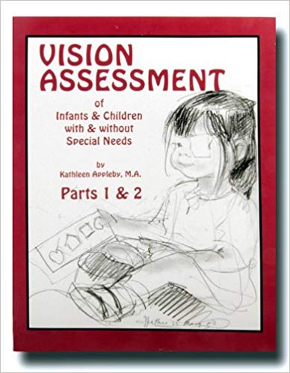
ACUITY
Vision Assessment of Infants & Children with & without Special Needs by Kathleen Appleby is a great resource for testing & reporting grating acuity on pages 53-58.

Slide 19
ACUITY
Functional (detection) acuity- measures the ability to look towards a functional object (ex: toy).
Obtain functional acuity by determining the smallest object at the greatest distance the child maintains visual contact with object.
Functional Acuity for objects chart from TSBVI

Slide 20
ACUITY
Functional (detection) Acuity Chart-
Objects of different beads and foam pieces match this template.
Created by Dr. Donna Lee at University of Kentucky to reference object sizes.

Slide 21
ACUITY
Functional (detection) Acuity Chart-
Sheridan’s ball test: Can use when student has complex needs and struggles to communicate what they are seeing. Examiner will observe the student’s shift of gaze, tracking, or change in visual behavior. A series of different sized styrofoam balls are rolled in front of a black background at a distance of 10 feet. Examiner will note the smallest size of ball the child visually responds to.

Slide 22
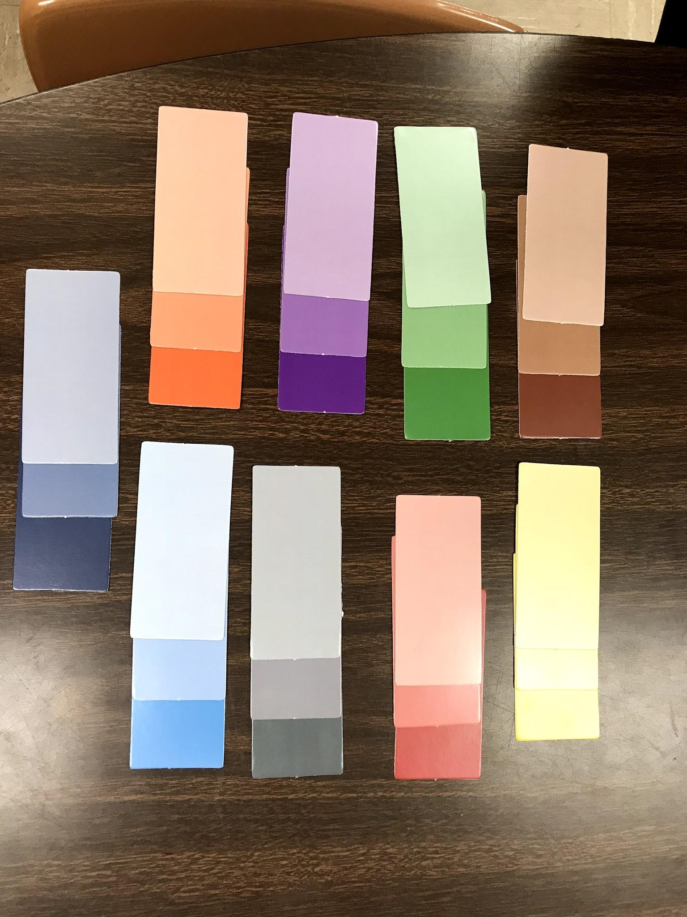
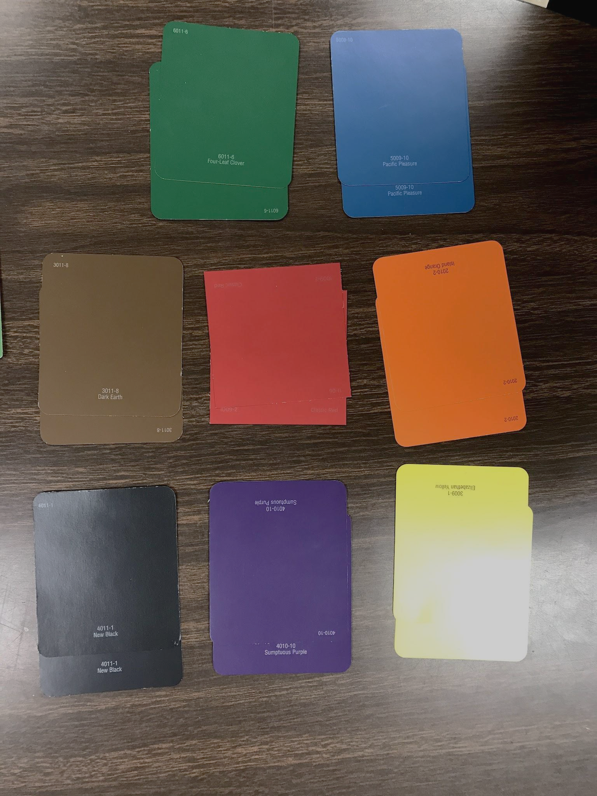
COLOR VISION
Student will match 2 paint chips of each color (from hardware store)
Student will match 3 paint chips of different hues (light, medium, and dark shade) of each color. (included in the Newt Kit from APH)

Slide 23
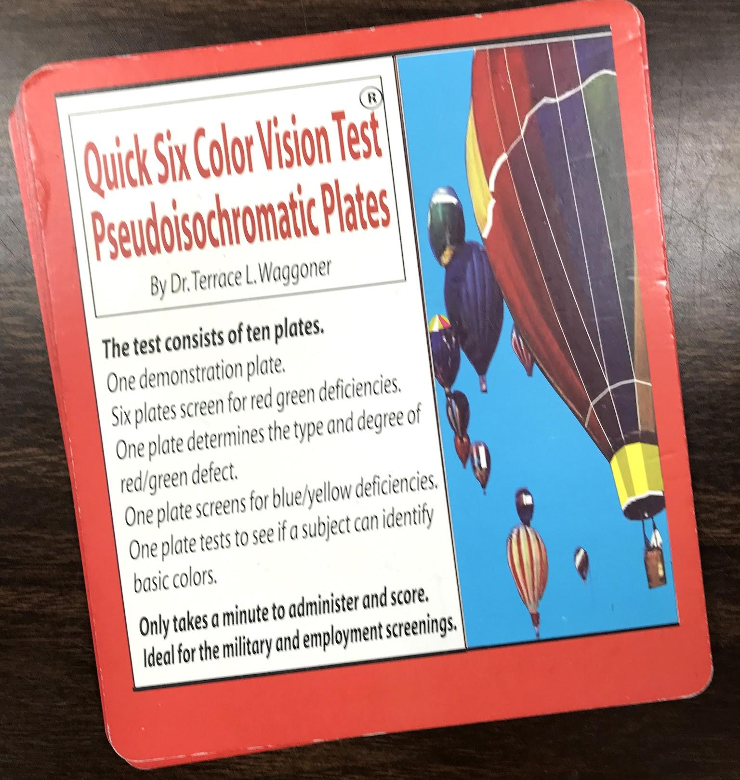
COLOR VISION
Color Vision Tests:
Quick Six Color Vision Test Pseudo-Isochromatic Plates
User friendly and includes score sheet
Student must know their numbers or be able to trace them with their finger

Slide 24
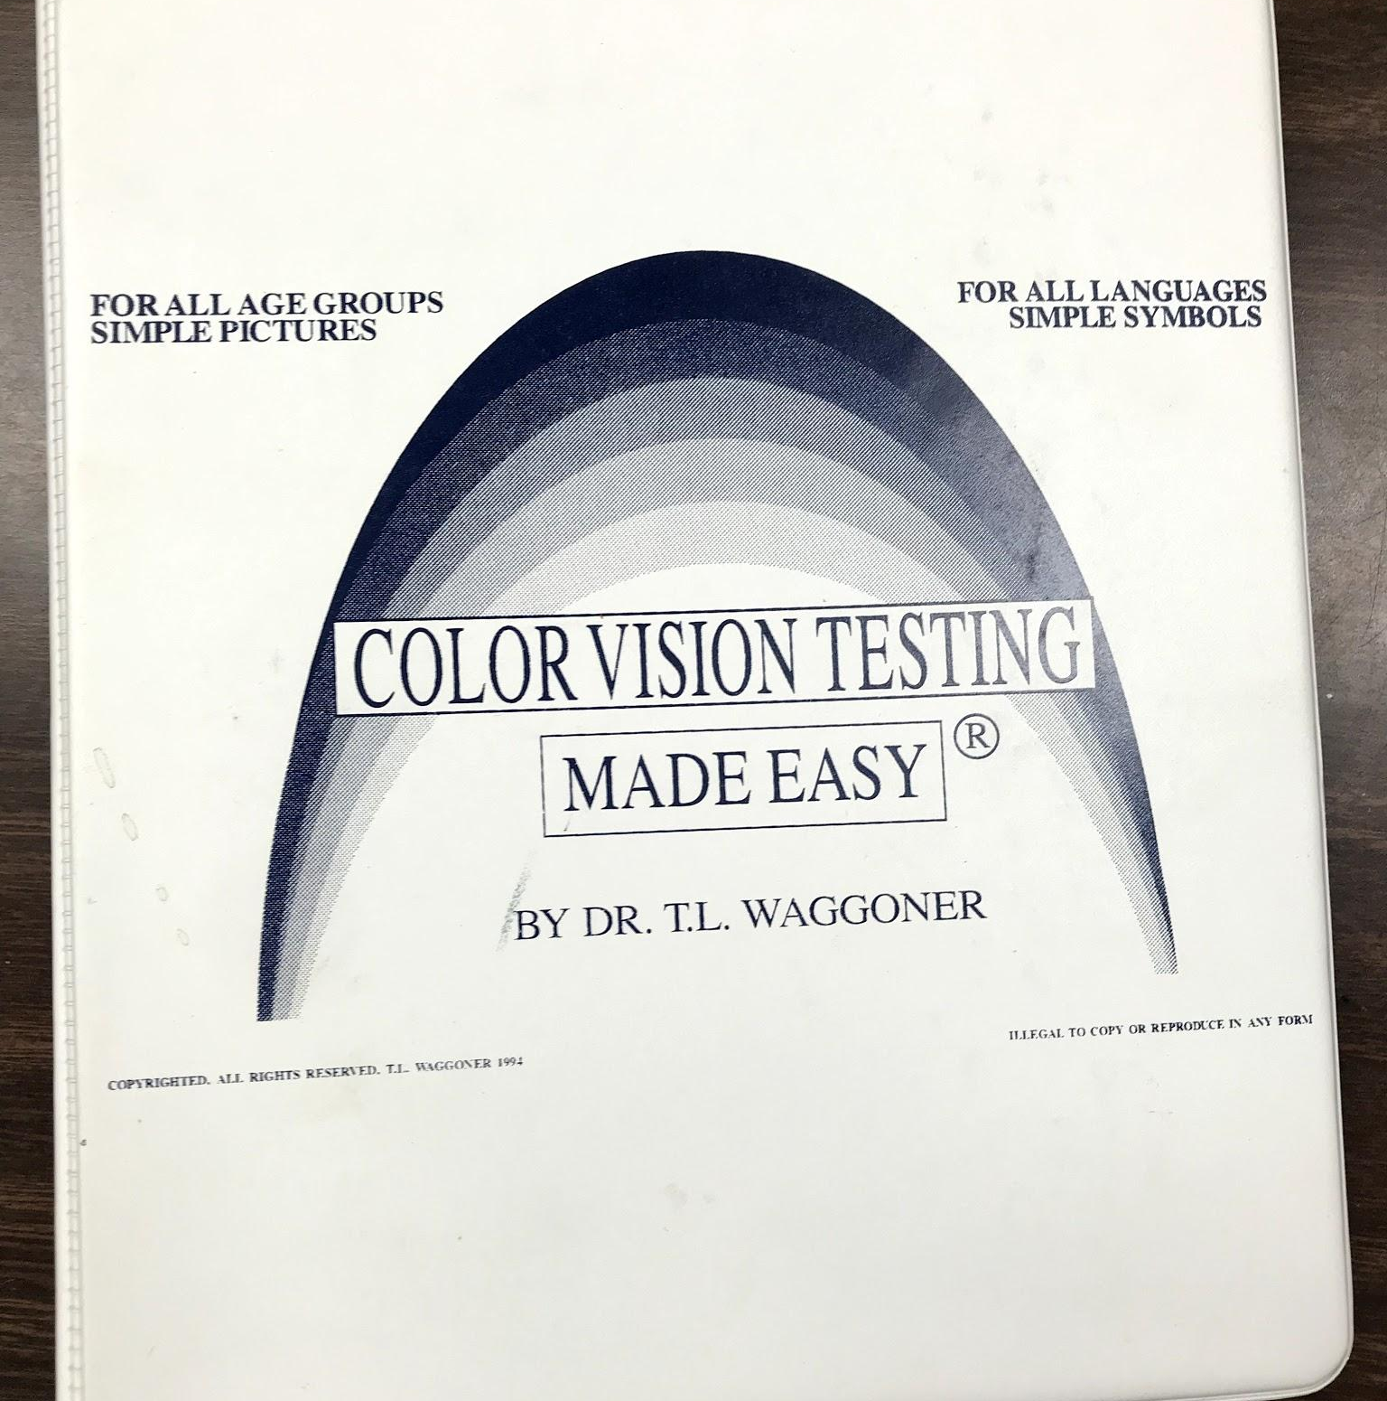
COLOR VISION
Color Vision Testing Made Easy by Dr. Waggoner
Instead of numbers it uses simple shapes and pictures. Includes score sheet.

Slide 25
COLOR VISION
Color Vision Apps:
PseudoChromatic Color Test
Series of circles with numbers to trace over with your finger (Ishihara).
Color Vision Test Lite
Tests 3 types of deficiencies
(general, protanomaly, & protanopia)

Slide 26
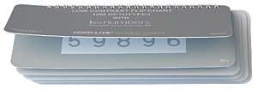
VISUAL SKILL: CONTRAST SENSITIVITY
LEA Numbers Low Contrast Flip Chart
Hiding Heidi Low Contrast Face Test

Slide 27
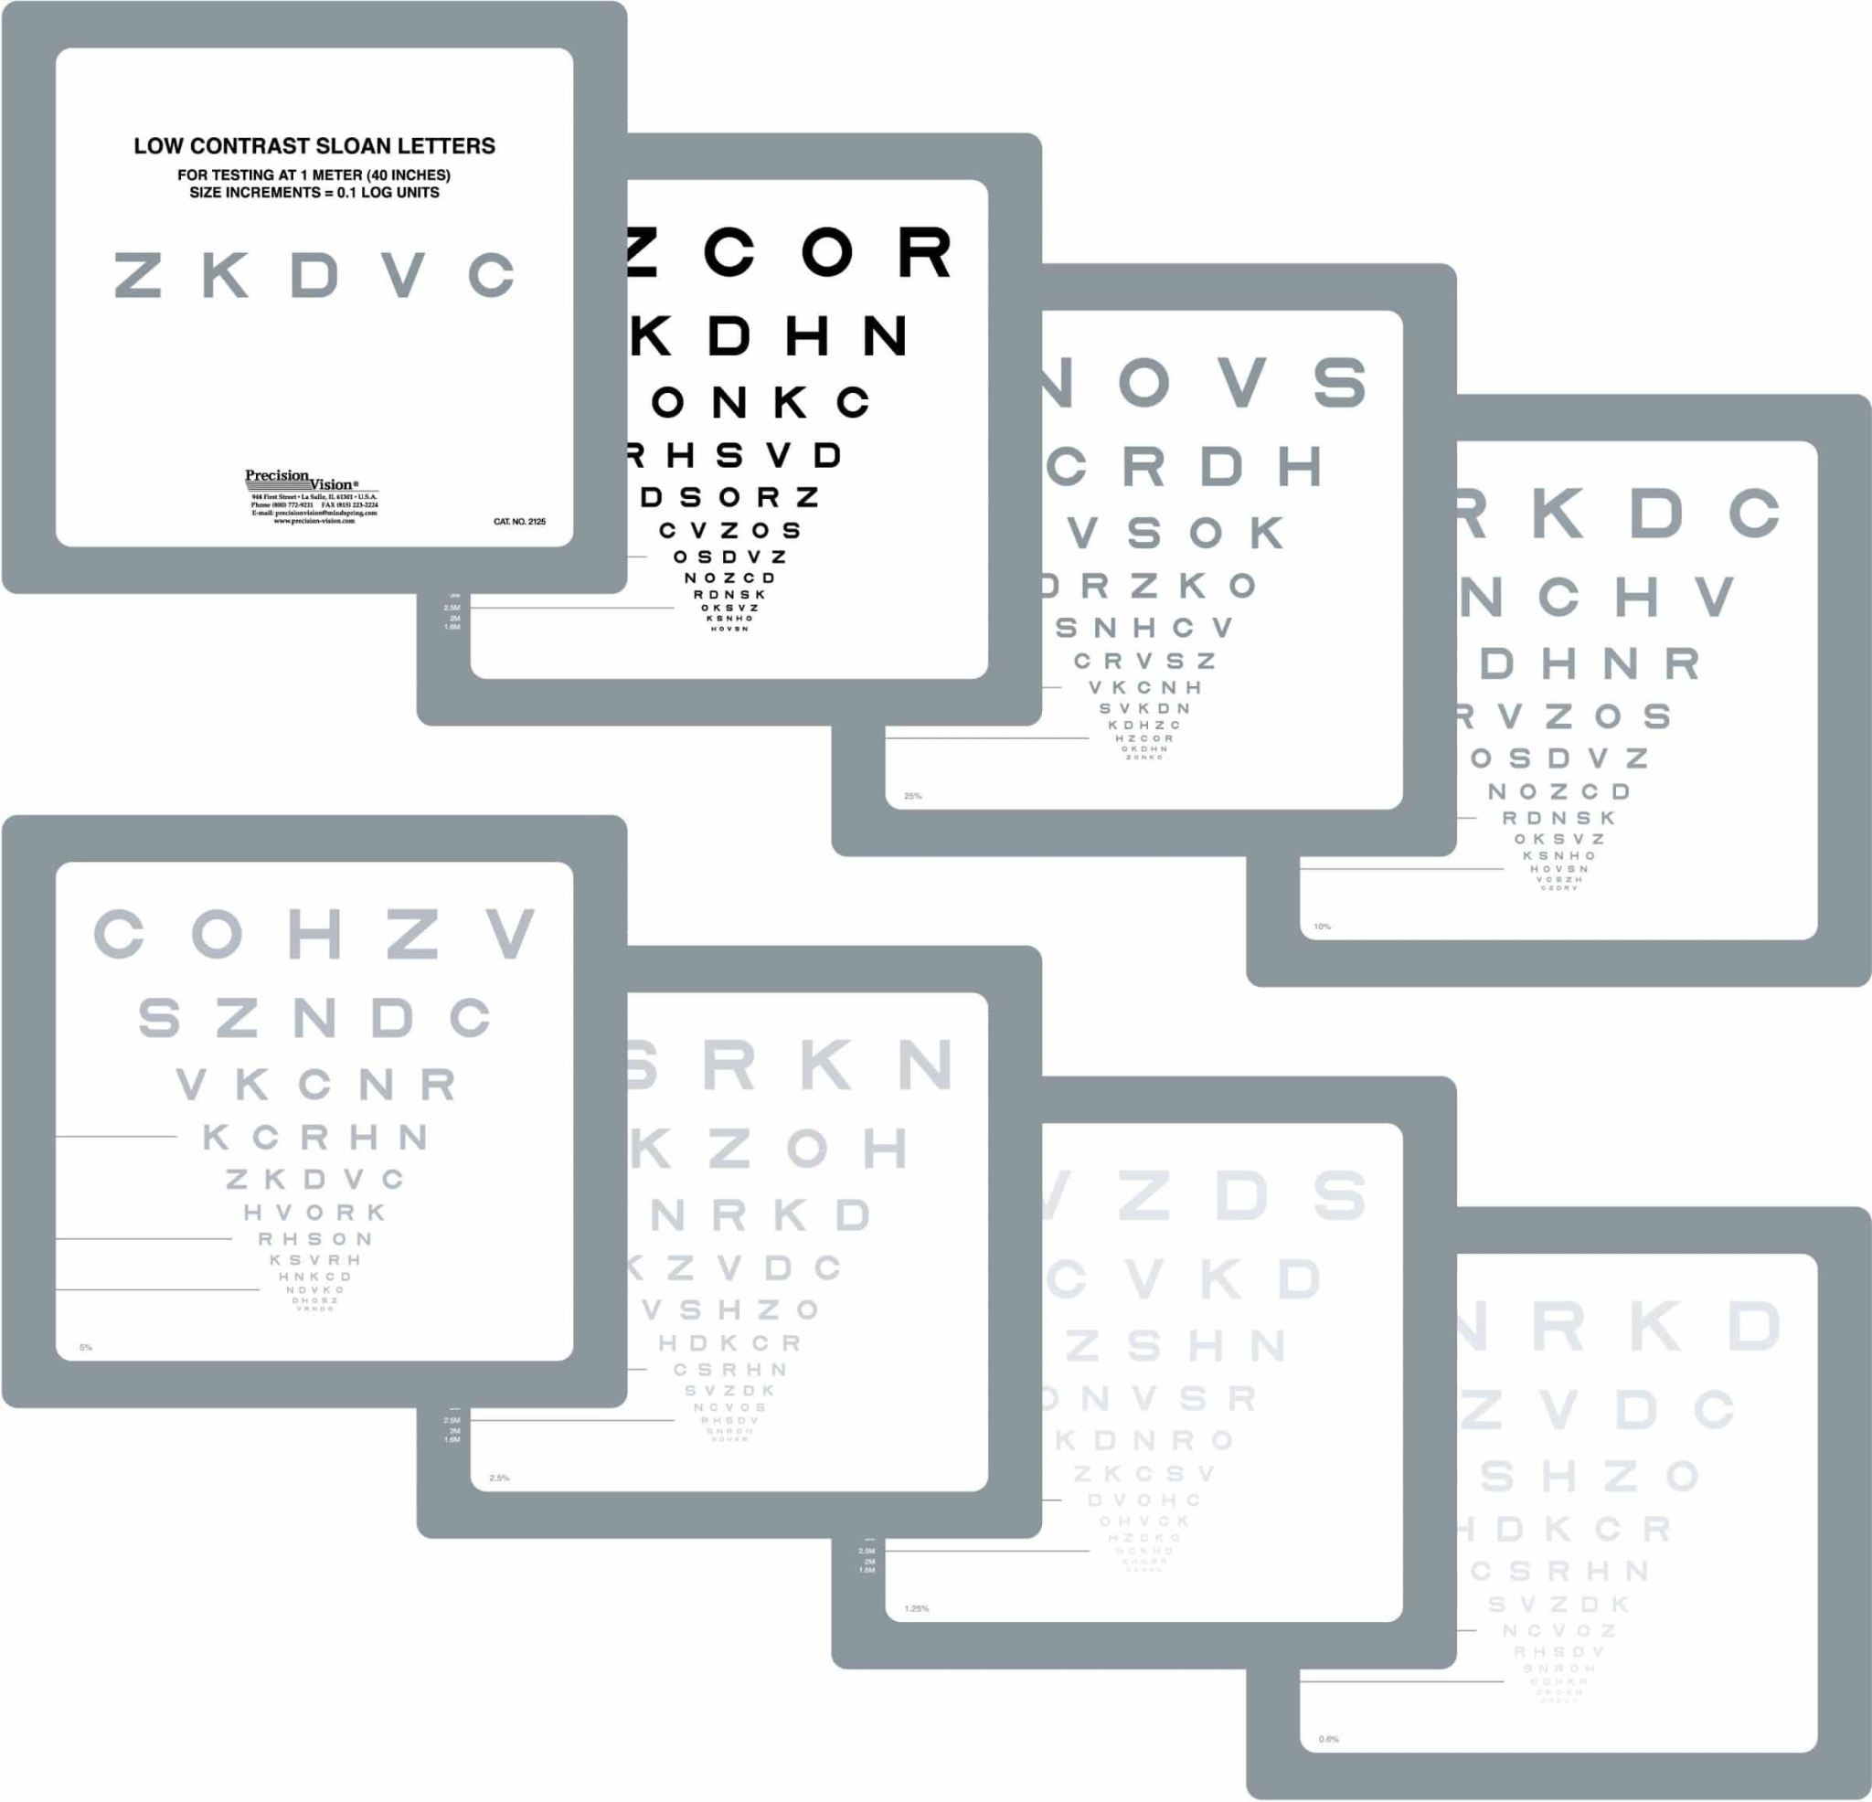
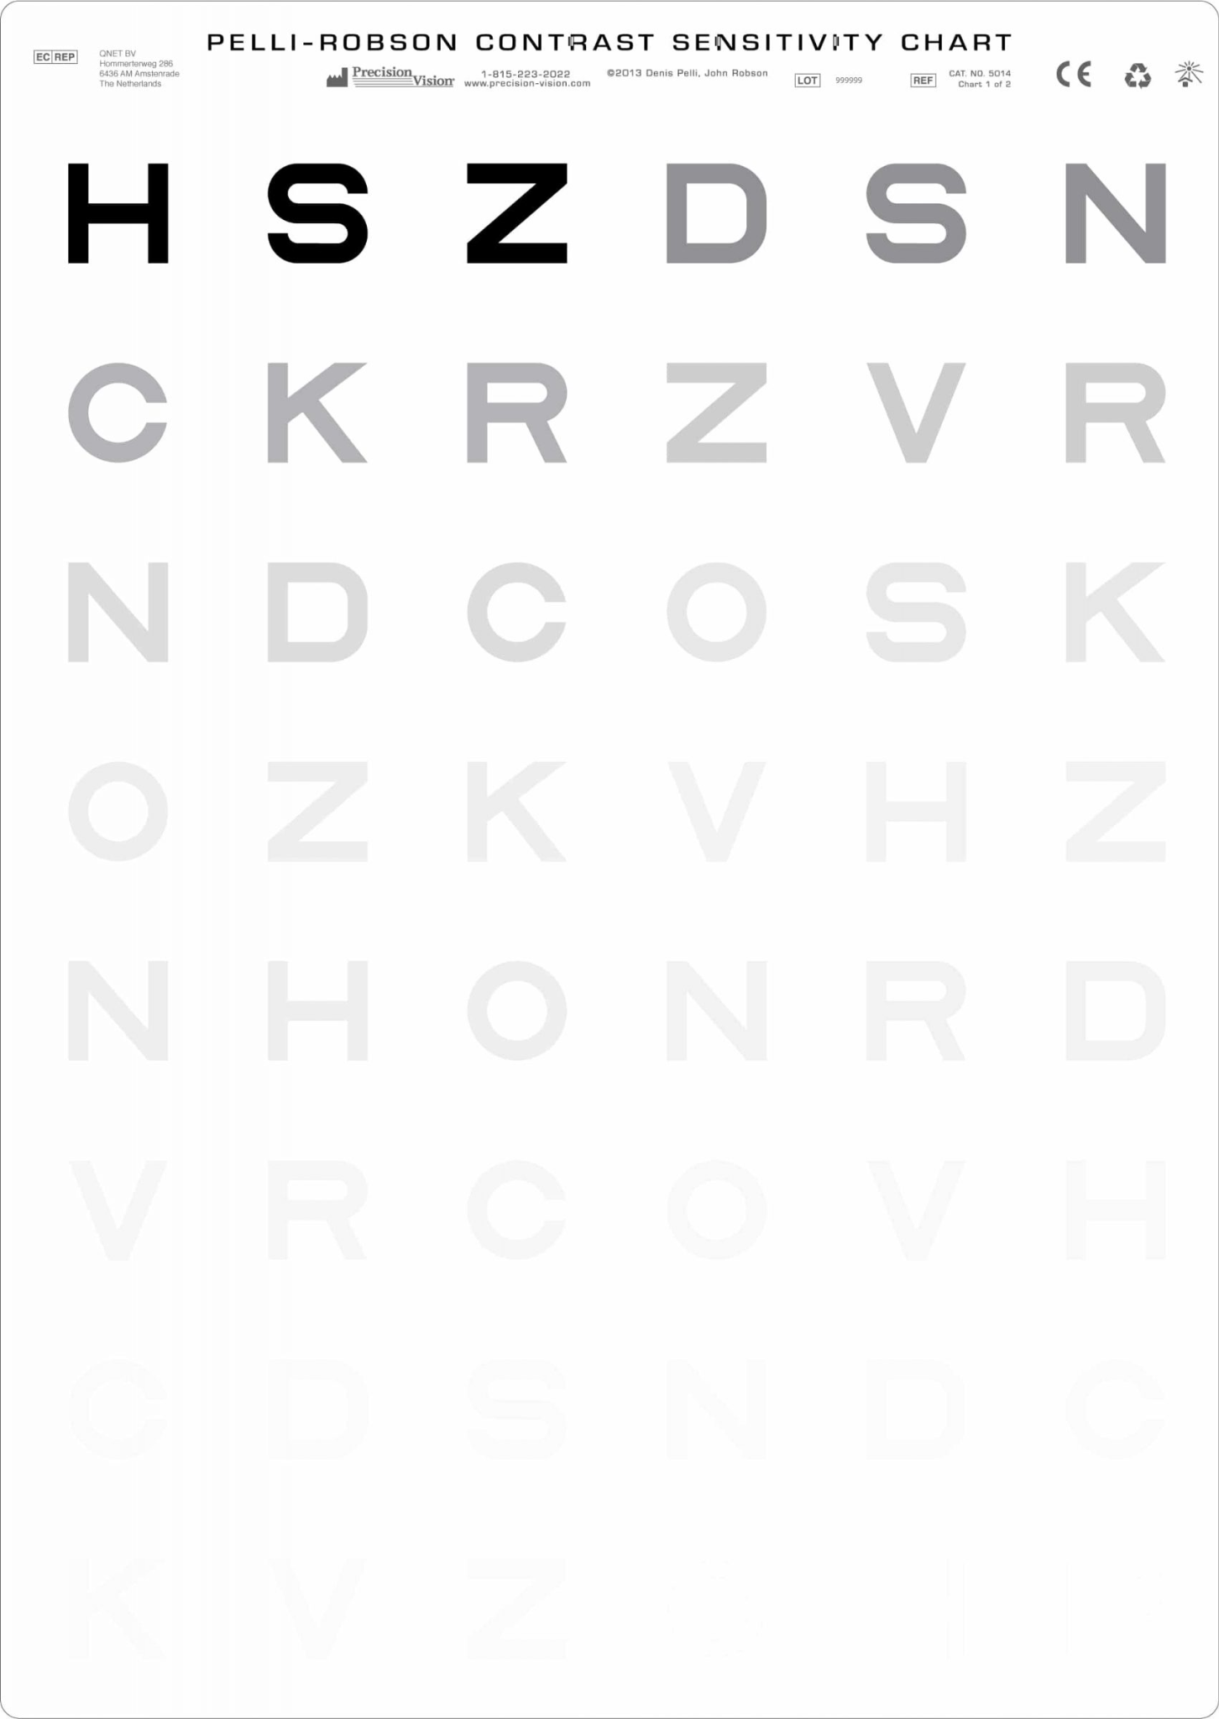
VISUAL SKILL: CONTRAST SENSITIVITY
SLOAN Letter Set Low Contrast Book
Seven contrast levels from 25% to .6% by page
Includes easy to read reporting forms
Contrast Sensitivity Pelli-Robson Chart
The letter sequences are grouped into three and the contrast decreases from each group to the next.
Includes easy to read reporting forms

Slide 28
VISUAL SKILL: BLINK REFLEX
Test blink reflex by quickly moving hand in the direction of the student’s face to check the blink to threat response.
To test blink to touch response touch either the student’s forehead just between the eyebrows or on their nose.

Slide 29
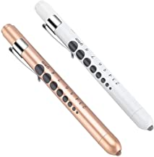
VISUAL SKILL: PUPILLARY RESPONSE
Darken room for 30-60 seconds (pupil will dilate), turn light on or illuminate the face from below towards center of forehead using light pen and note student’s pupil response (should constrict).

Slide 30
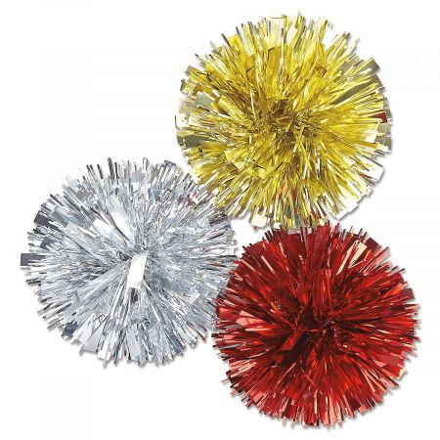
VISUAL SKILL: AWARENESS & LOCALIZATION
I would use the bright pencil topper, a pom pom on a stick, a slinky, or a flashing toy to determine if the student had awareness (appear aware of a object) and localization (being able to pinpoint the location of the object).
Present the objects against a black background. Note if required lighted toy or movement to obtain either skill. Make sure they are silent toys so student isn’t attending to the sound of toy.

Slide 31
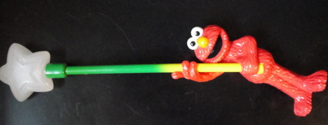
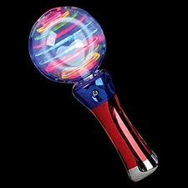
VISUAL SKILL: FIXATION
Observe the student and look for indication that the student is actually fixating on the desired object, such as maintaining gaze or reaching for it. Suggest using a high interest toy (lighted or bright toy) presented against a plain black background.

Slide 32
VISUAL SKILL: SHIFT GAZE
Test by moving fixation between two objects. Note if the student can look smoothly from one object to another.
Note if the student can copy from the board (fixate at the board then shift gaze and fixate on the paper.
Shifting Gaze from Near to Far Video

Slide 33
VISUAL SKILL: SCANNING
Test the ability to shift gaze from one stationary object to another using both head and eye movements and being able to identify the object.
Activity: Put index cards of pictures, letters, numbers, or words on a wall. Have student scan wall naming what they see in a row.
Use this site to print high contrast bubble words: https://roman-word-bubbling.appspot.com/

Slide 34
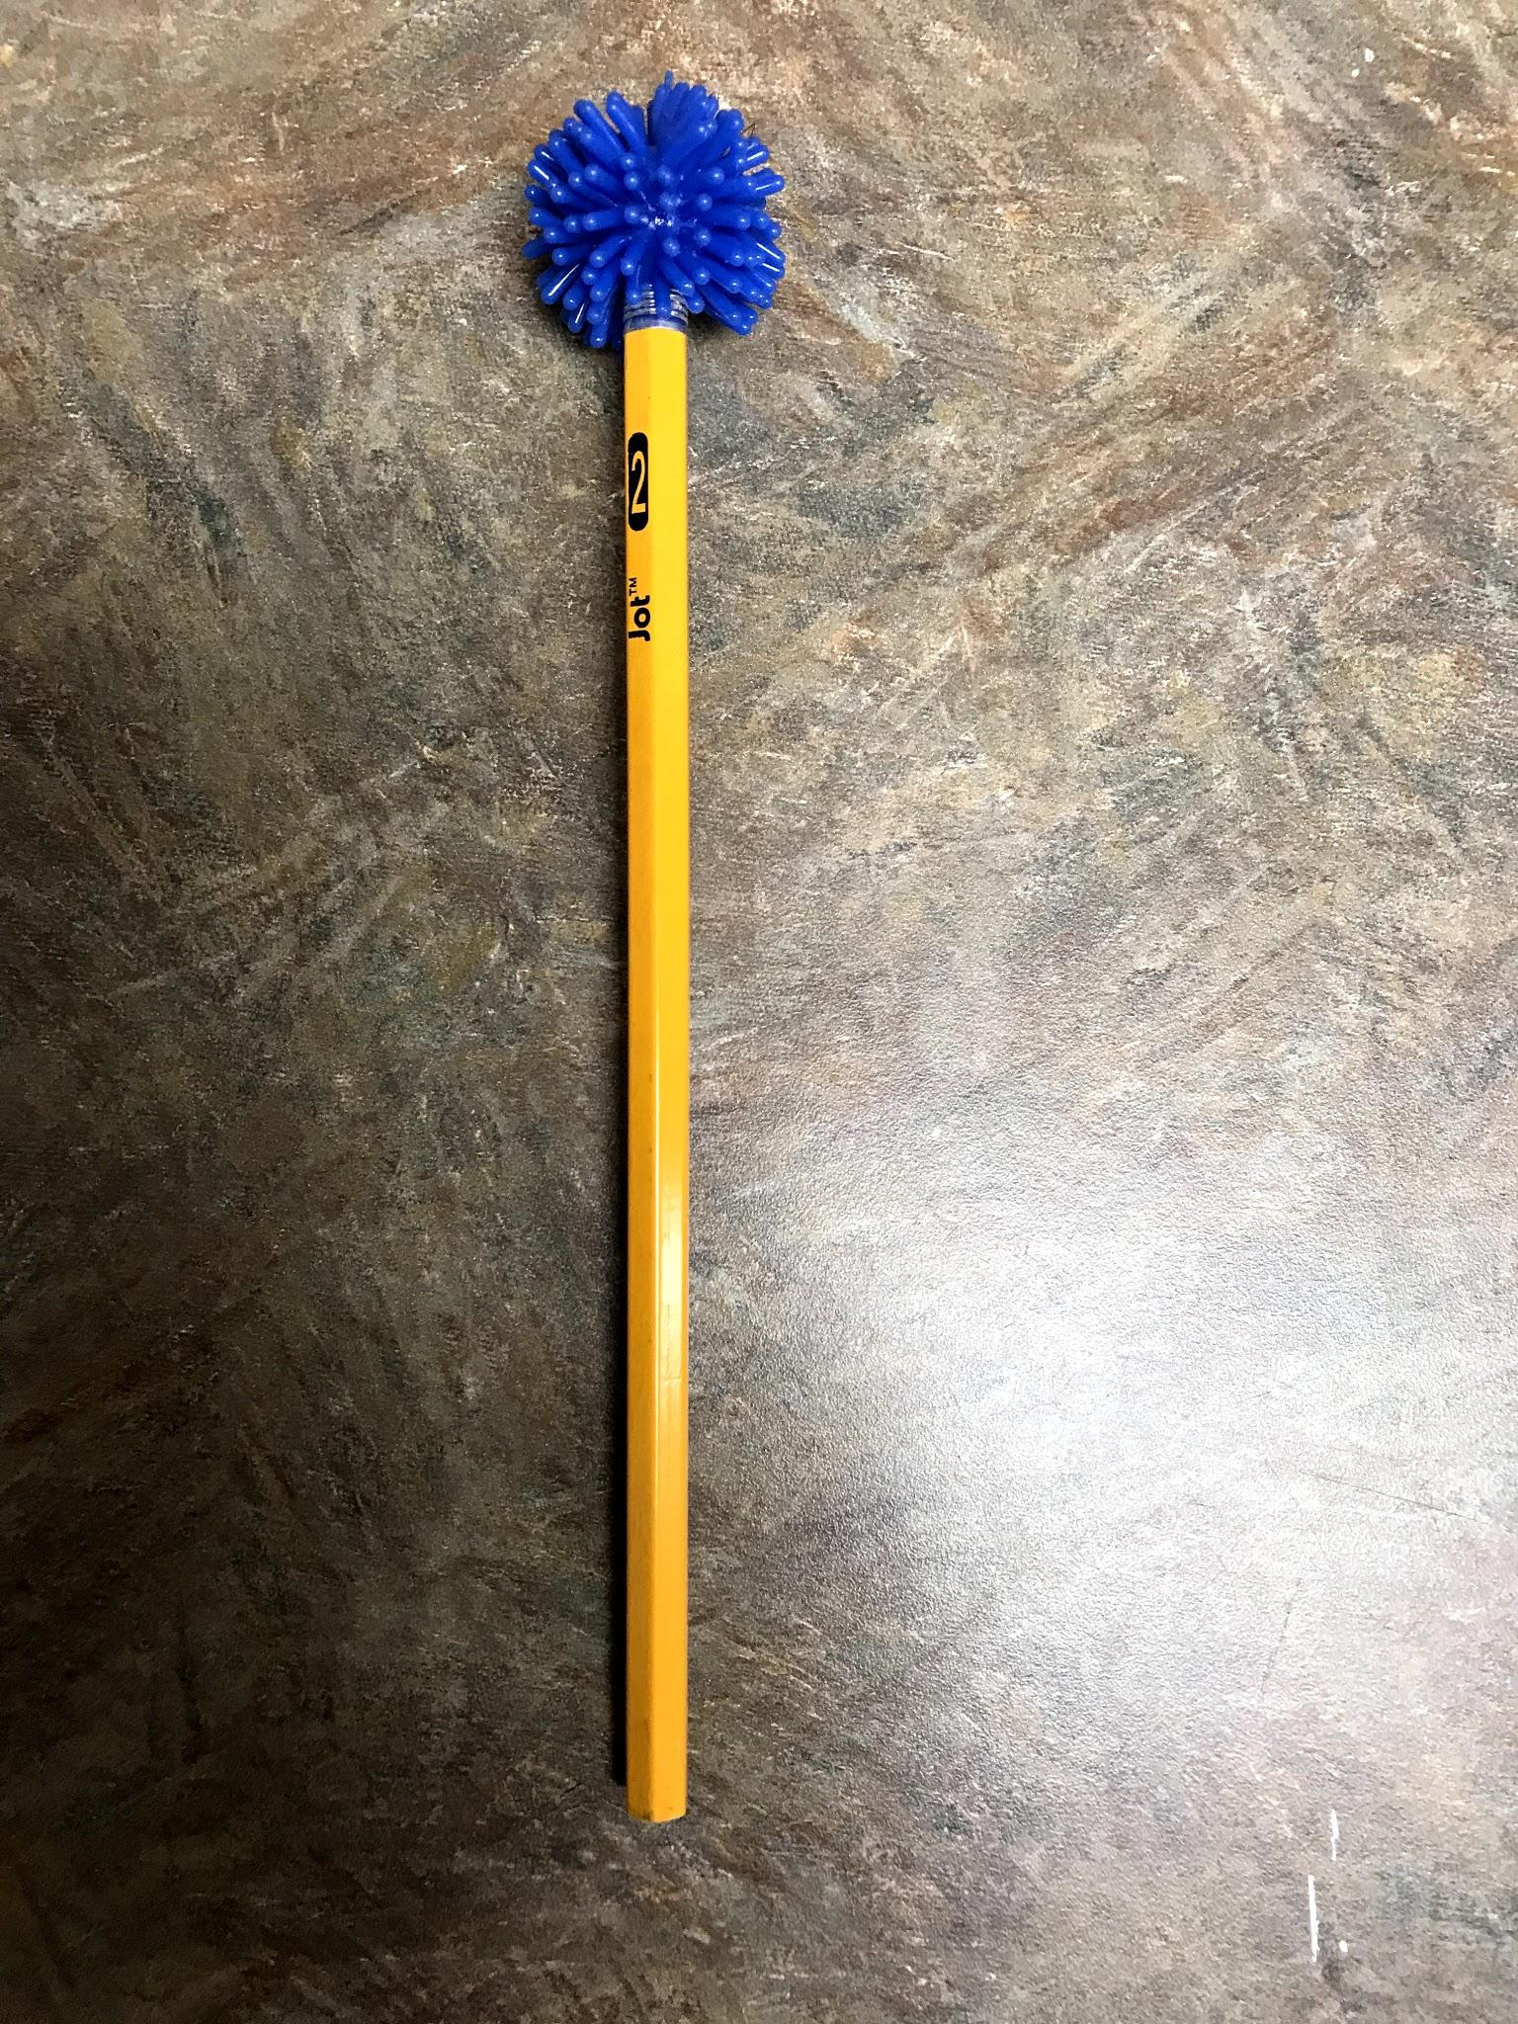
VISUAL SKILL: TRACKING
Stand within 2 feet facing the student. With your hand or bright object like pencil topper below, trace capital letters H, O, and / noting eye movements in all directions of horizontal, vertical, circular, and diagonal.
Can use wind up toys to track horizontal movements.

Slide 35
VISUAL SKILL: TRACKING
NYSOA K-D Test: Method of evaluating saccadic performance.

Slide 36
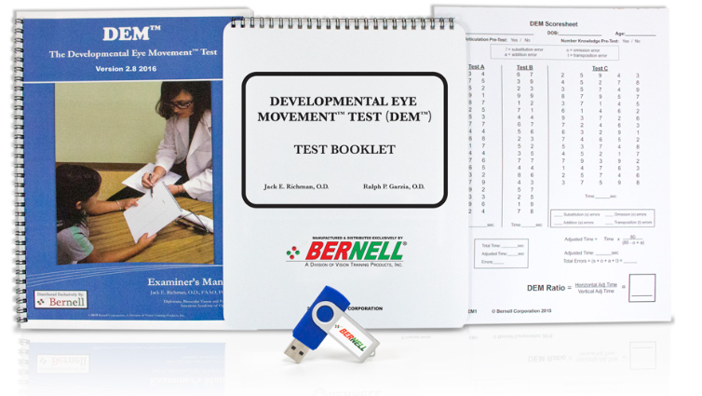
VISUAL SKILL: TRACKING
Developmental Eye Movement Test
Assesses fixational and saccadic activity during reading and non reading tasks.
Easy to read reporting forms.

Slide 37
VISUAL SKILL: MUSCLE BALANCE
Hirschberg Test- hold penlight 3 feet away from student’s eyes pointed at bridge of nose. Reflection should be symmetrical in both eyes.
Cover-Uncover Test- Have student fixate on visual target in central position. Cover one eye and note if there is movement in uncovered eye.

Slide 38
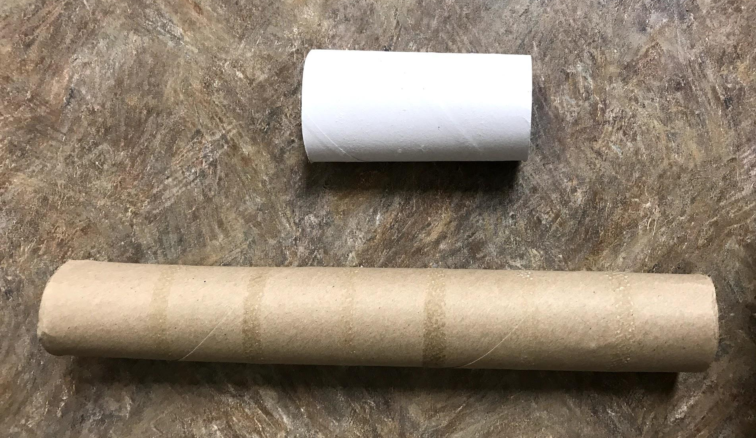
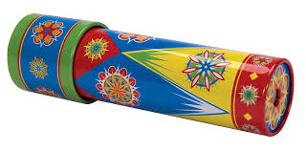
VISUAL SKILL: EYE PREFERENCE
Present student with a paper towel or toilet paper roll and ask them to look through it at an object across the room. The student will naturally hold the roll up to their dominant eye as a reflex. Can also present student with a kaleidoscope.

Slide 39
VISUAL SKILL: CONVERGENCE
Test the ability to maintain binocular vision as objects approach or retreat from the bridge of the nose.
Hold a bright visual target, like pencil topper below, 10 inches from student’s nose. Have student fixate and slowly move towards bridge of nose. Note if eyes move symmetrically inward as it approaches and back as it retreats.
Convergence Video

Slide 40
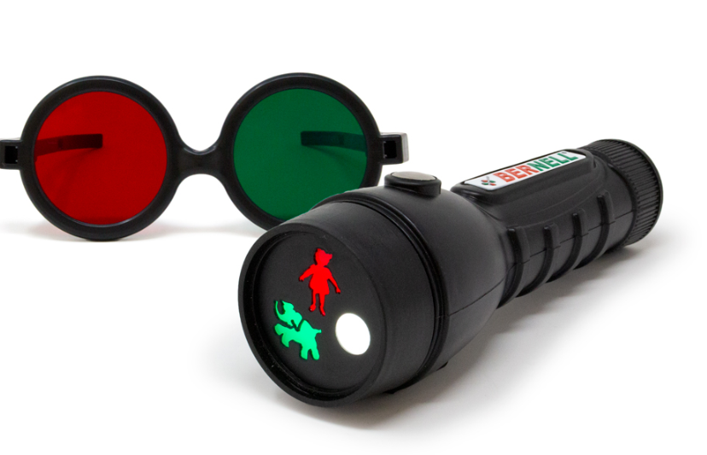
VISUAL SKILL: CONVERGENCE
3-Figure Test Flashlight with Reversible Glasses
Quick Test for Diplopia, Suppression, or Fusion in children.
More evidence for double vision, convergence insufficiency, or students with strabismus issues.

Slide 41
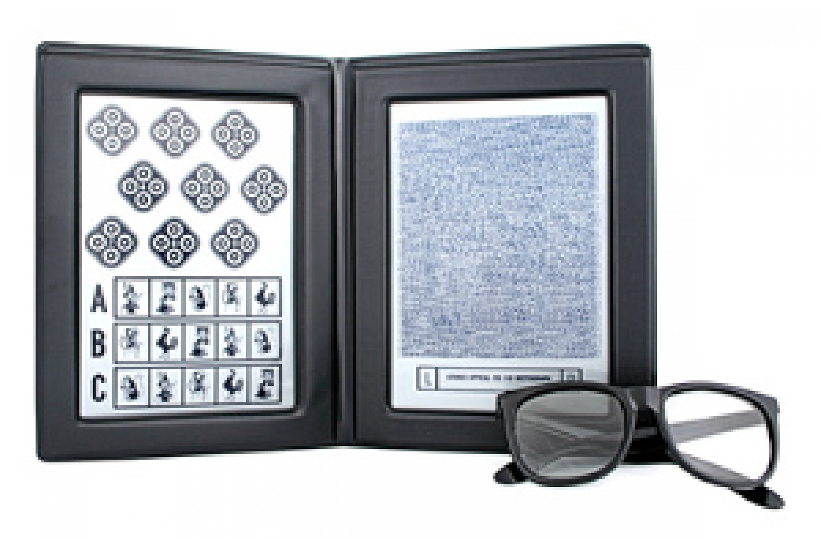
VISUAL SKILL: DEPTH PERCEPTION
The Random Dot Stereo Butterfly test includes glasses, instructions, and score sheet to test for depth perception.
Informal observations- note student’s ability to reach for objects, response to changes in ground surfaces, and response to drop offs or stairs.

Slide 42
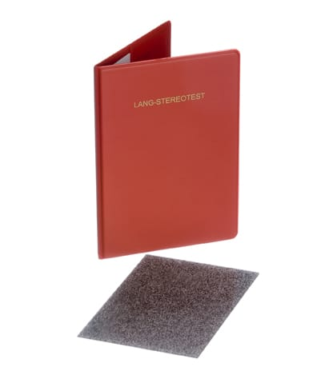
VISUAL SKILL: DEPTH PERCEPTION
The Lang-Stereo test can be administered quick and without glasses.
Includes simple instructions and easy scoring with either negative or positive results for depth perception concerns.

Slide 43
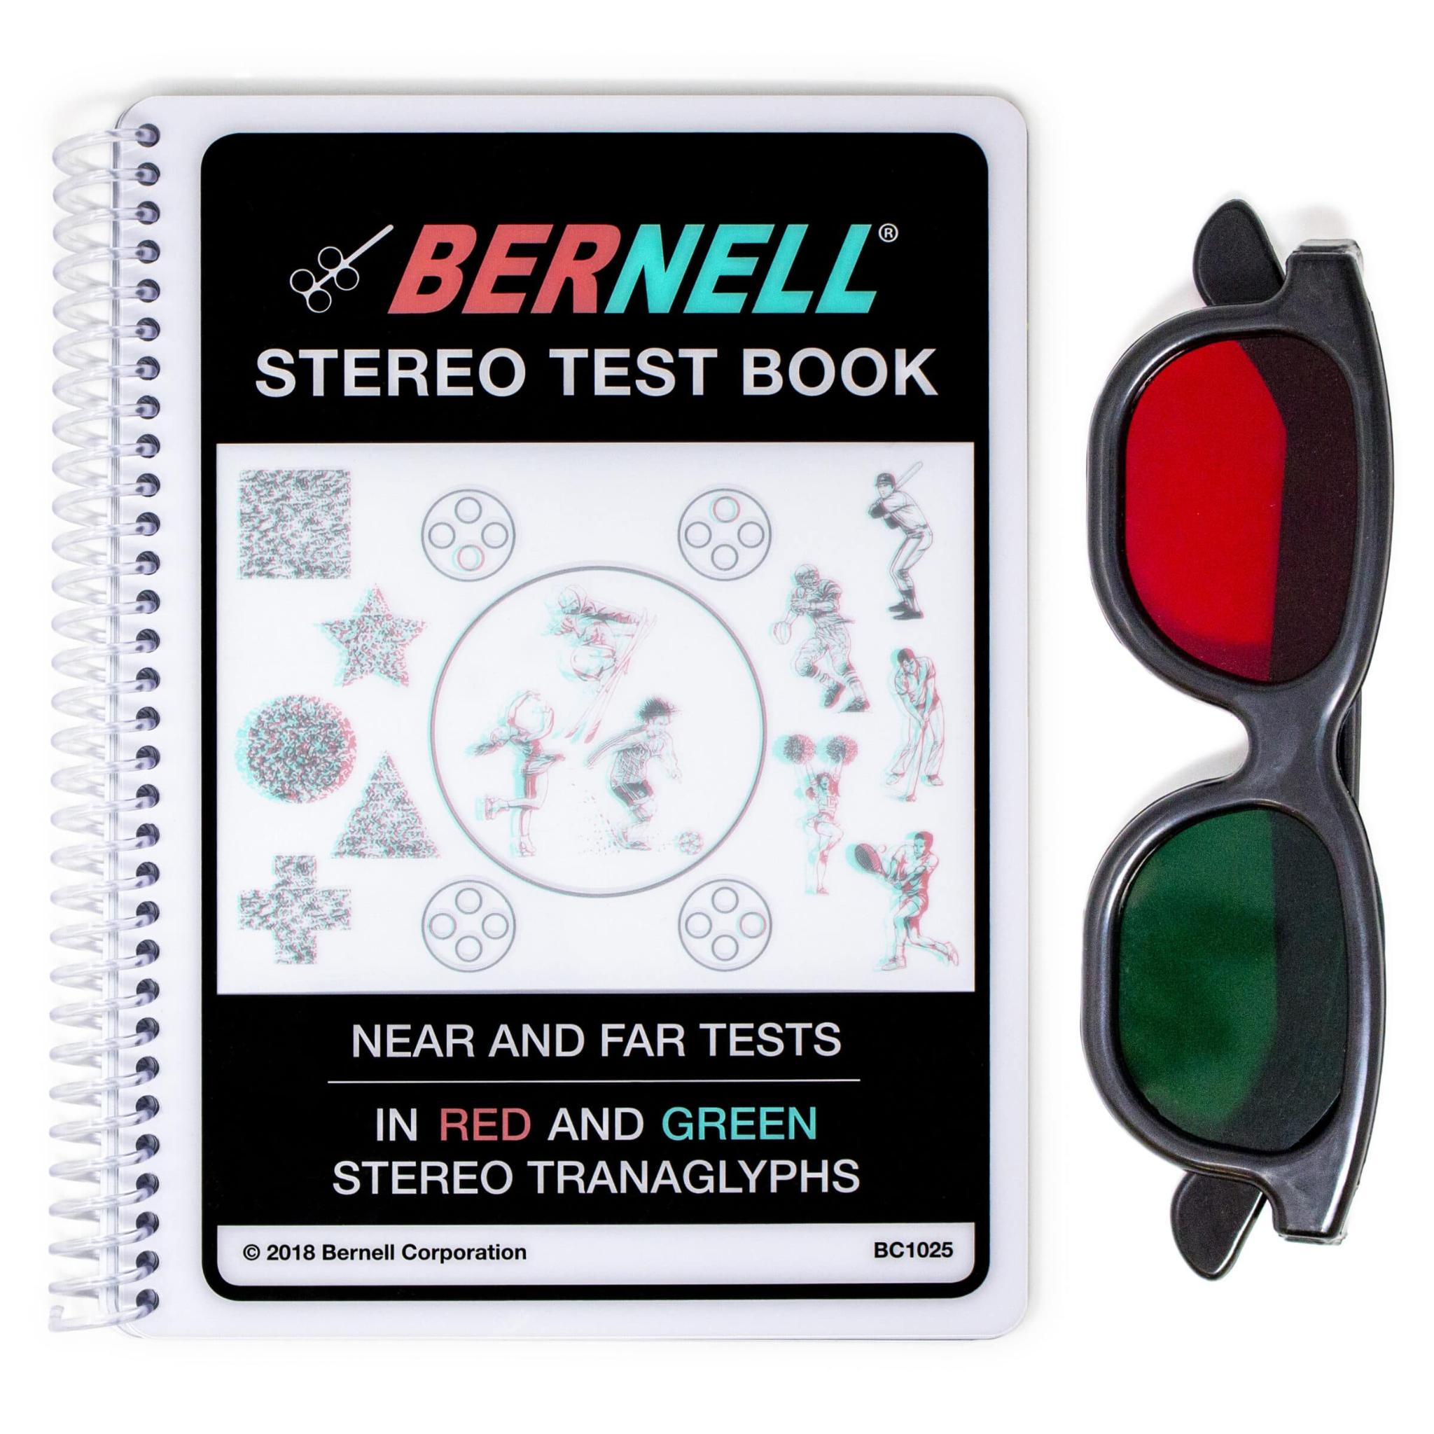
VISUAL SKILL: DEPTH PERCEPTION
The Bernell Stereo Test Book is for near and far test for screening stereoscopic vision deficits in all ages.
Helps to detect binocular vision issues such as poor stereopsis, amblyopia, suppression, and strabismus.
Easy to administer and includes reporting answer key.

Slide 44
VISUAL SKILL: VISUAL FIELDS
Confrontation field test- Performance notes reduction of field in an area, not in terms of degrees.
Sit facing student with same eye closed. With equal distance in between you, present the visual target (stick below with a black dot on one end, to make sure the student is seeing the dot can hide easily by turning around stick for confirmation) and note if the student detects the target in the field. Can also hold 1 or 2 fingers in the field instead of object.
Visual Field Video

Slide 45
VISUAL SKILL: VISUAL FIELDS
Confrontation field test (with 2 people)- Sit facing the student. Have them look at your visual target (suggest using a clown nose). A second person will stand behind the student and slowly present a target into each area of the visual field. Suggest using a long stick like a selfie stick or extending squirt gun stick.

Slide 46
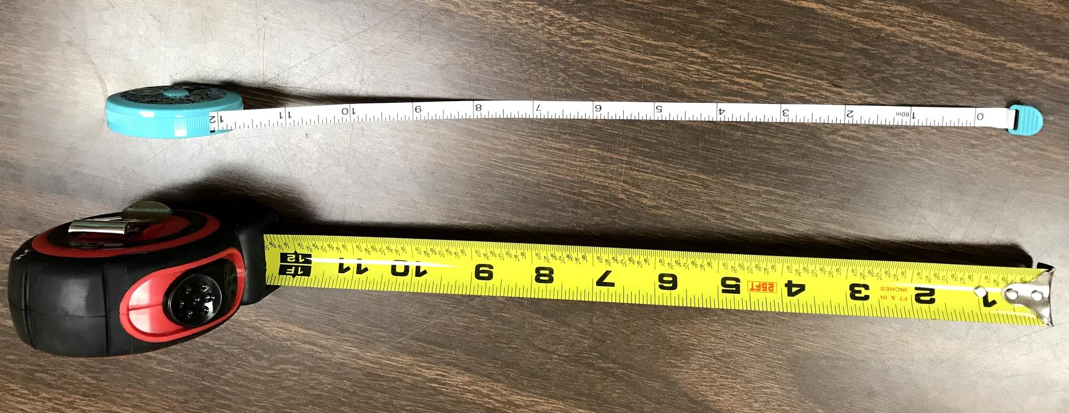
MISCELLANEOUS MATERIALS
Tape Measures- both hard and flexible types

Slide 47
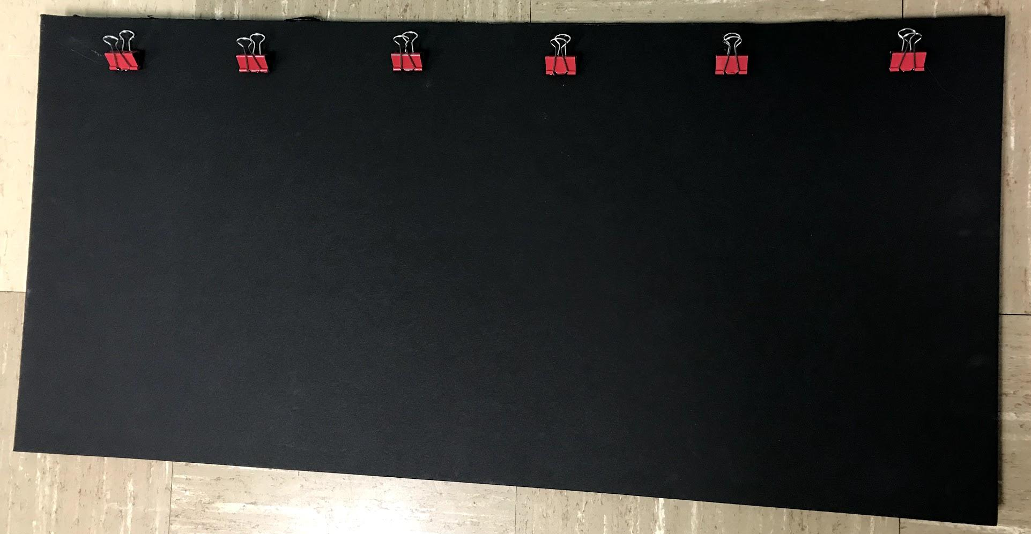
MISCELLANEOUS MATERIALS
Flashlight with different colored filters
Black background (foam board) with clips to present materials

Slide 48
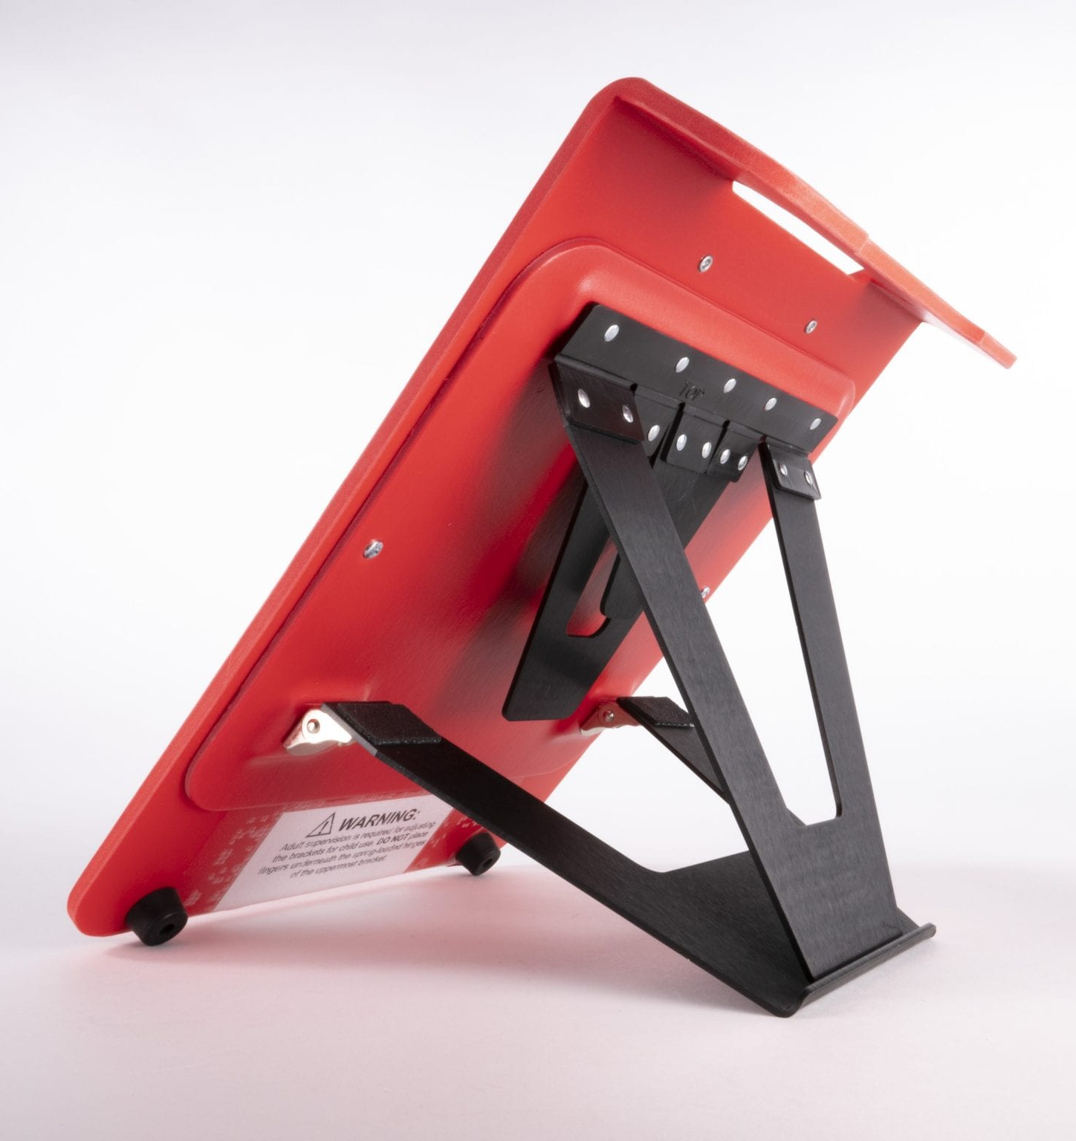
MISCELLANEOUS MATERIALS
ReadWrite stand from APH
All in One Board from APH

Slide 49
WEB RESOURCES
This is a FVA template I love: https://www.perkinselearning.org/technology/blog/foolproof-functional-vision-assessment-template
This website breaks down each section of the FVA and has links to free printables: https://www.teachingvisuallyimpaired.com/fve-lma.html

Slide 50
WEB RESOURCES
This is a good website to use to explain the purpose of an FVA to parents: https://www.familyconnect.org/info/education/assessments/functional-vision-assessment-fva/135
FVA checklist: https://www.tsbvi.edu/technology/534-hatton-functional-vision/5594-session-4-handout-c-checklist-for-functional-vision-assessment-birth-to-3

