Slide 1
Professional Action Network
MENTAL HEALTH and WELLNESS

Slide 2
Introduction
Title: Mental Health and Wellness
Name: Chasity Prater
School: Campton Elementary
District: Wolfe County

Slide 3
What is the problem of practice that caused you to choose this topic?
My problem of practice for choosing this topic is to identify the following:
Academic performance
Social relationships
Physical Health

Slide 4
Description of you project
My project description is as follows:
Survey grades 4 - 6
Tips for protecting physical/mental health
Create Teen Mentor program
Co-teach with school counselor

Slide 5
What are the findings from your research?
Areas of Improvement from Self-Care Assessment
Getting enough sleep
Resting when sick
Get away from distractions
Express feelings in a healthy way
Talk about problems with someone I trust

Slide 6
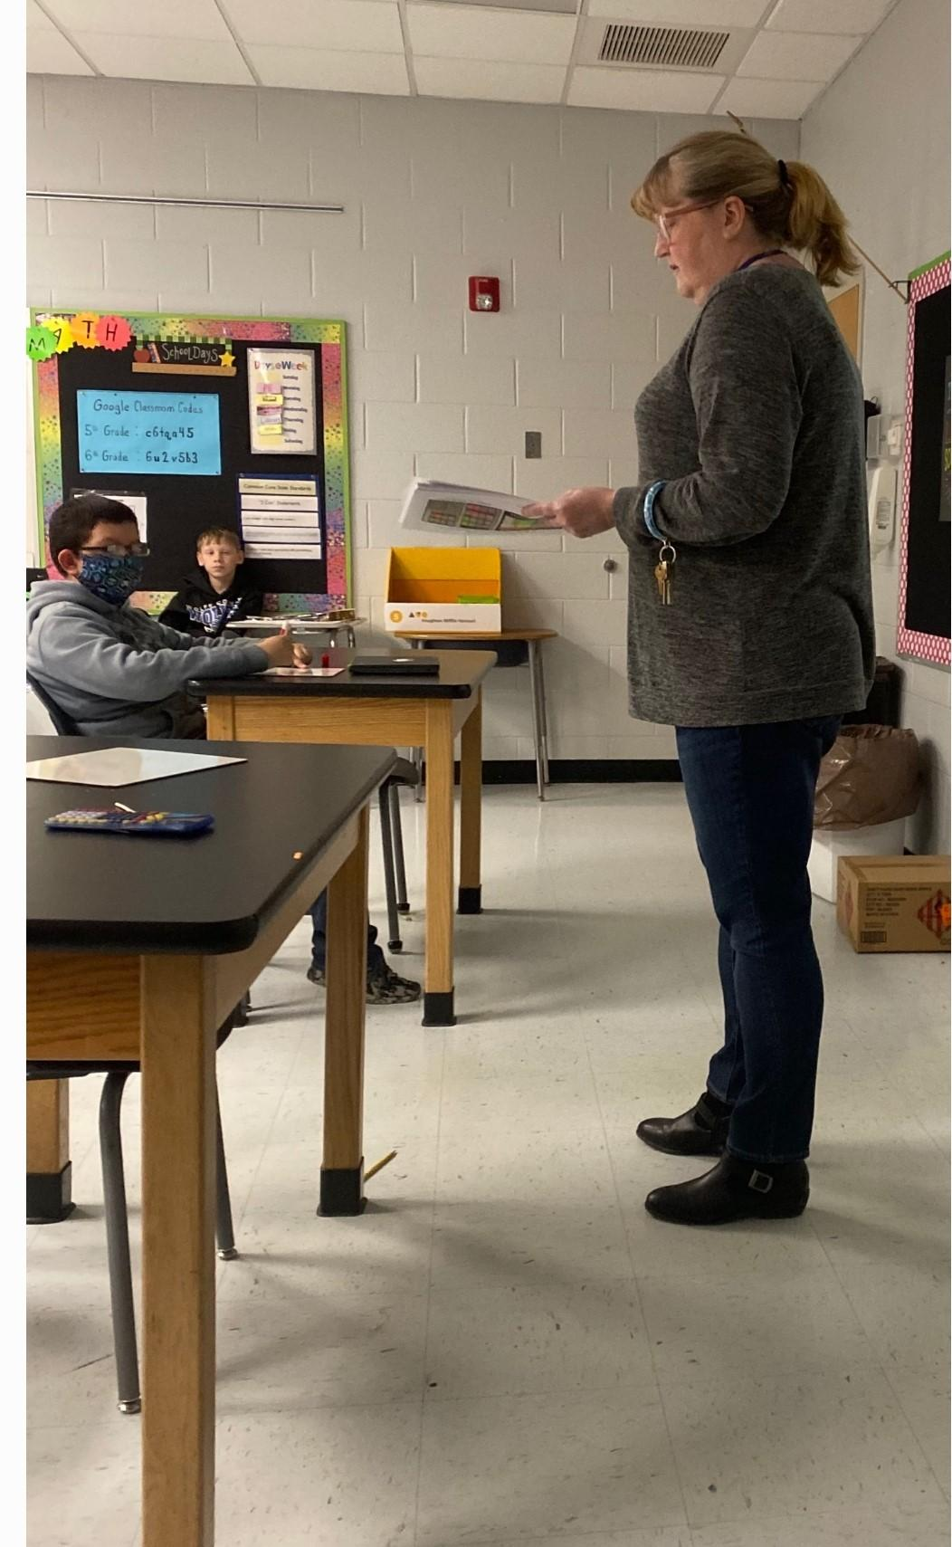
Results of Survey
Discussing results from the
Self-Care Assessment

Slide 7
Project Findings
Teen Mentor group needs daily devotion to the program.
Take the time to reach the different grades
Management of student interests (clubs, games, etc.)

Slide 8
Relaxation Techniques

Slide 9
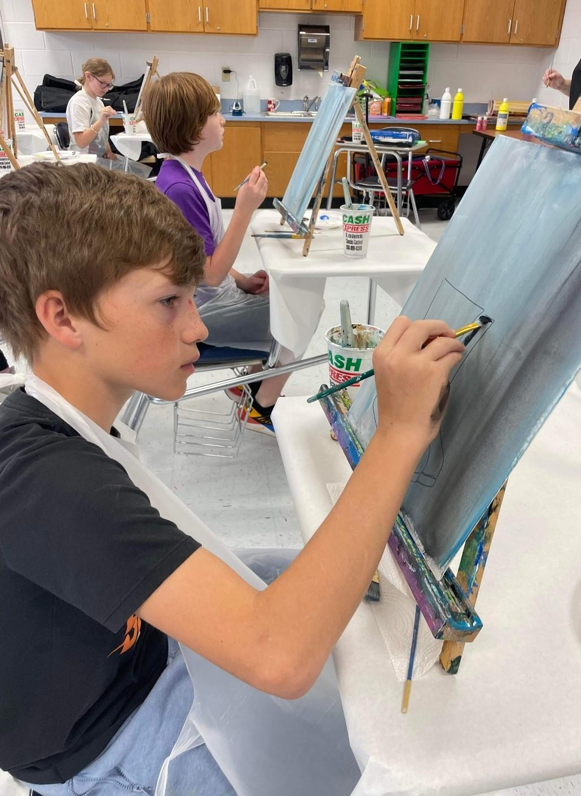
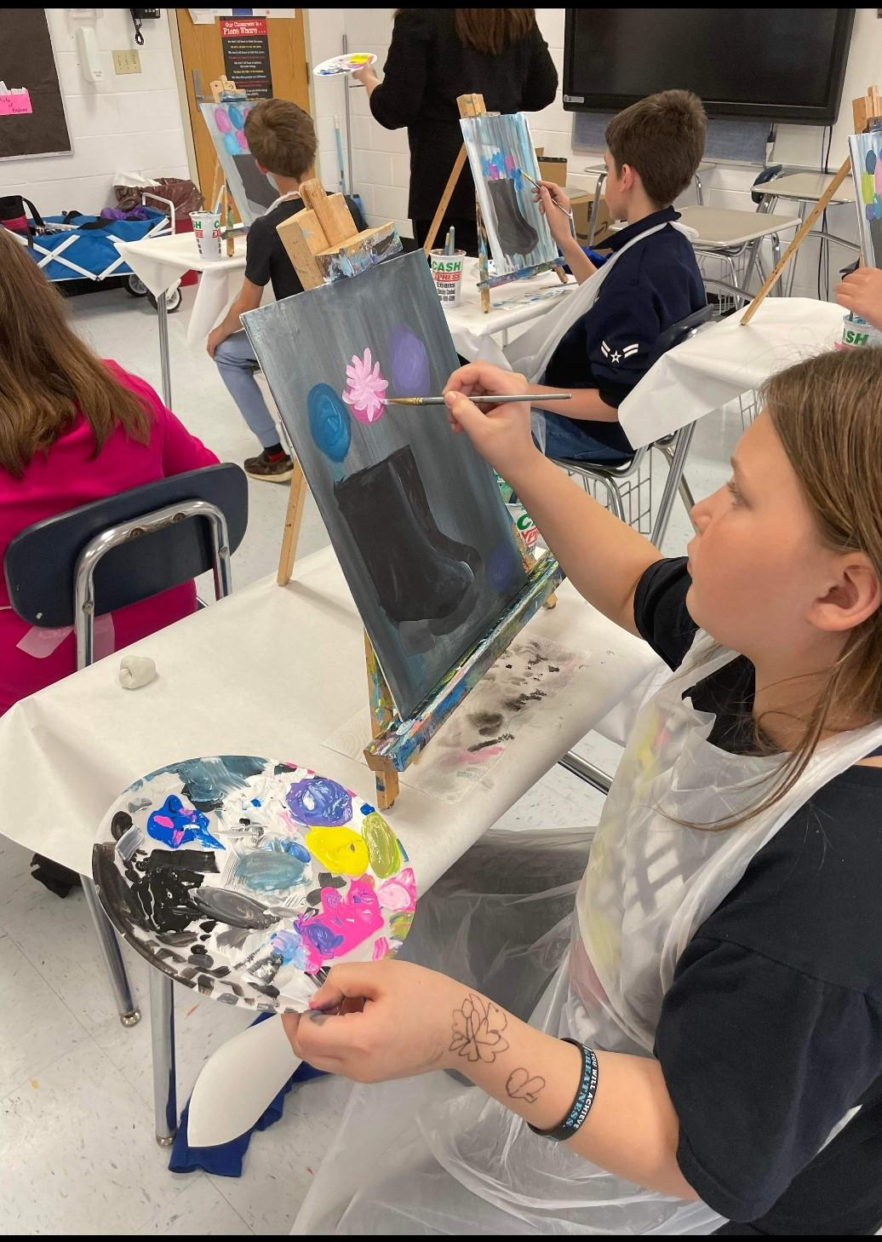

Slide 10
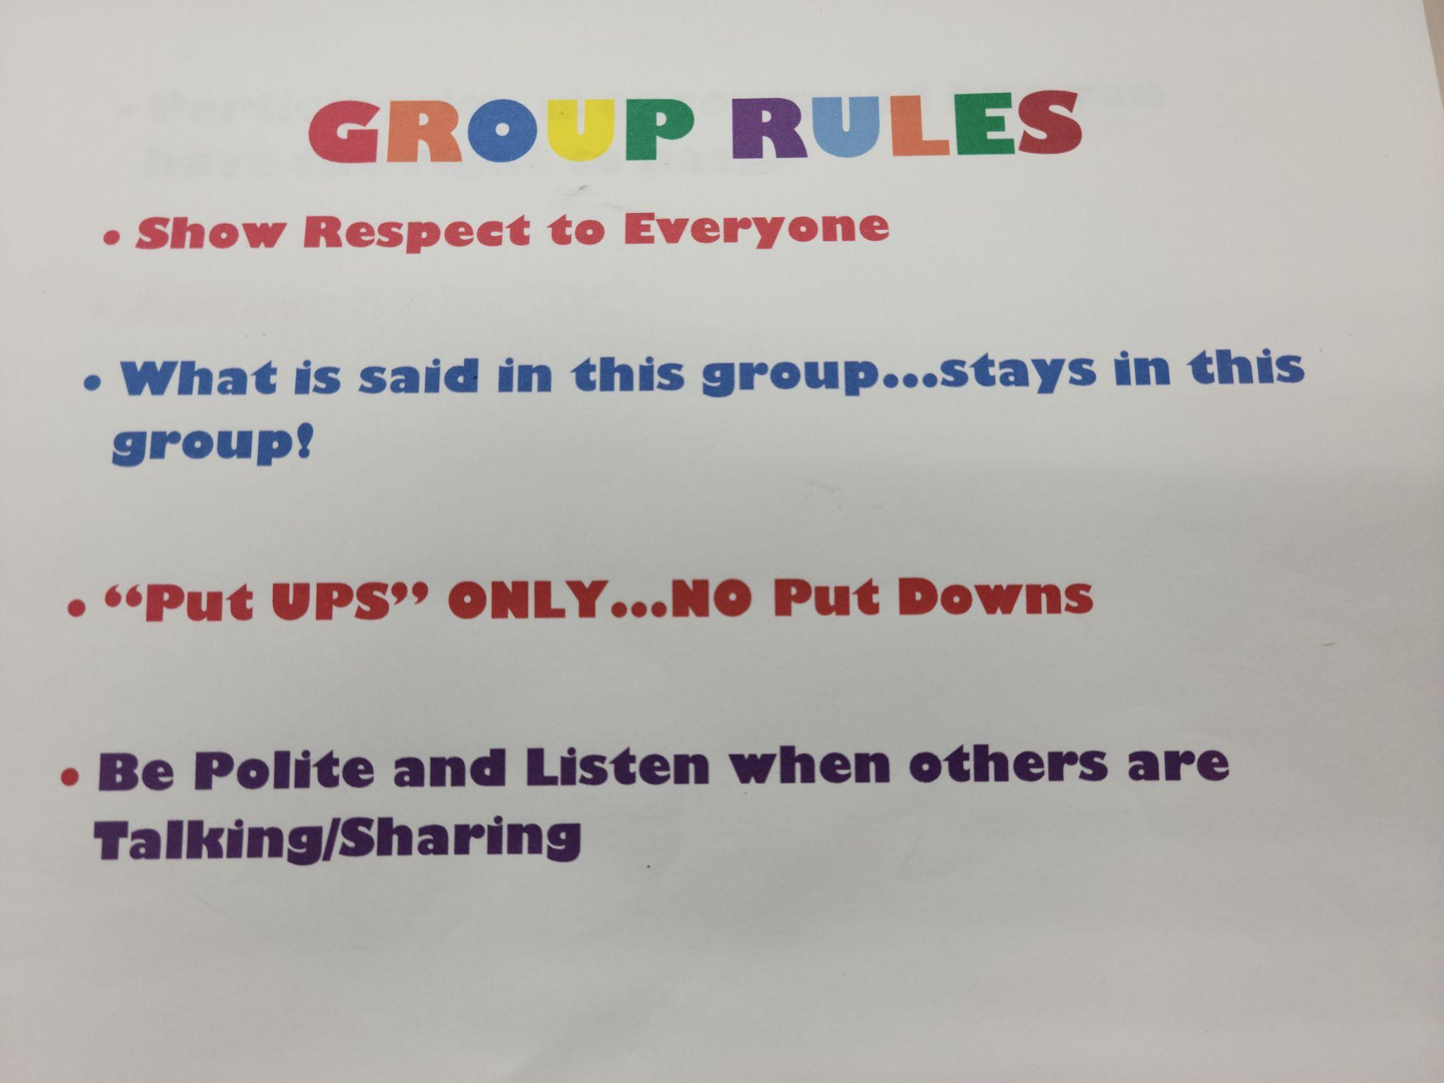
Rules that students helped to make

Slide 11
How will your project improve practice for teachers?
Give teachers a “starting point” in which to begin a Peer Support Group
Share Rewards and Failures
Establish Rules/Procedures
Involve others from the school

