Slide 1
3-d Printing (with pens)
An evolution of the Arts
Charles Brennan Hackney
East Ridge High School
Pike District

Slide 2
The Proposal
My problem of practice is showing students the connection between art and technology. There seems to be a disconnect in students minds of what art is and how it can be used in a broader sense. When I talk to students for the first time, they always consider art to just be old pictures and paintings, it never dawns on them that all technology we use is somehow connected to art. Whether that be from the design or the aesthetic of the devices they use every single day.
With my last grant I was able to show my students that connection, and it was a big highlight for my class. Everyone was curious about it, and it blew some minds that there was a 3-D printer in the art room. It helped gain a lot of attention for my class, which was welcome. It also helped achieve my goal of showing the students that there are viable and exciting careers with art and jobs that are also connected with technology.
For this years grant I was wanting to go a step further with an even newer technology. This new technology also has a direct connection with the 3-D printer because it is 3-D pens. Instead of using a machine with a pre-designed layout, the students will be able to make free-form 3-D objects and builds. We can then take these builds and transfer them over to our software and make 3-D prints out of them. This allows for a strong connection to STEAM course work that students may not get in a lot of Art classes.

Slide 3
Items Purchased
3-D Doodler Pens
Pen filament
Paint for finished products

Slide 4
The Process
Much like 3-D printers, 3-D pens have most of the same parts and processes.
The pen has an internal heater and extruder that is fed from the top the plastic filament that is the same type used in most school 3-D printers.
Works very much like a hot glue gun as you continuously fed filament from the top.
Difference is it has fast and slow buttons so you can have better control then with traditional hot glue guns.
The only con me and my students faced from the pens where they must be always plugged in, which is a very minimal distraction.

Slide 5
Some Data I gave 30 students a survey asking them to make connections between art and technology. Then gave a similar survey after teaching the Unit and doing the projects.

Slide 6
The Journey
Spent a week on a 3-D printing Unit and had the students watch various tutorials on YouTube and various sites.
Practiced creating simple objects using the 3-D pens (pictured on next slide).
Found and printed out templates for students to use and start creating actual 3-D objects.
Had students work further to create more advanced projects (total working time about 2 weeks).

Slide 7
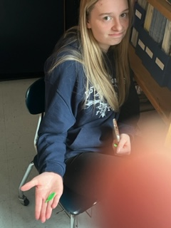
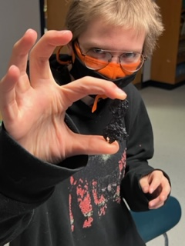
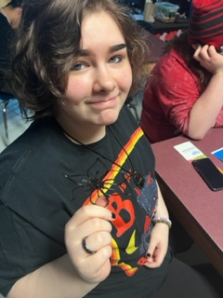
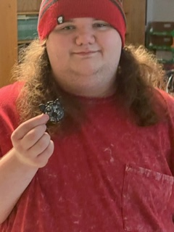
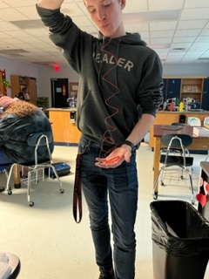
The First step in the Design Process
Students working with the pens the first day.
Surprised me the level they could achieve with them as most had no experience with them before.
Some had experience and had their own but said they were not as advanced as the ones we were using.

Slide 8
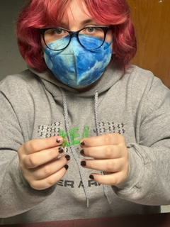
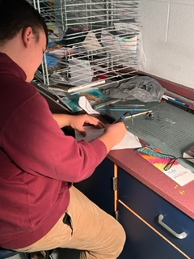
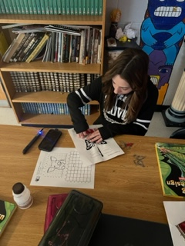
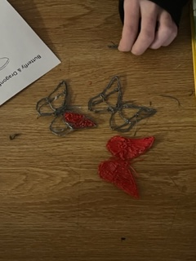
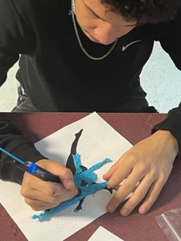
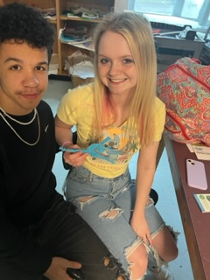
Step 2
Students using a template to trace out more complex objects and they also free handed a lot during this step.

Slide 9
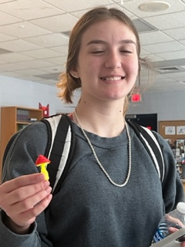
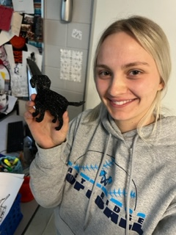
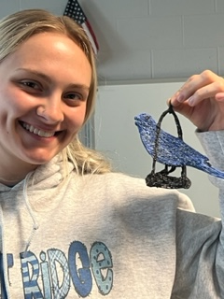
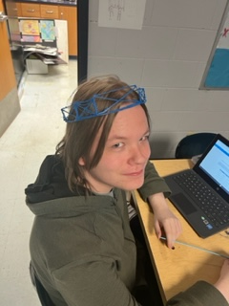
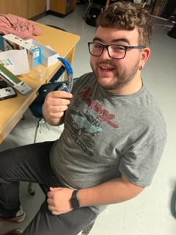
Step 3
Here students worked on building up their objects into an actual 3-D space.
Most students handled this more complex operation easily after the other days of practice.

Slide 11
To be Continued…
It was my goal at the beginning of this grant to get the students comfortable with the pens and then be able to take that work over to the actual 3-D printer which KVEC had helped me with previously. We have not gotten to this step however, but I plan on doing so before the end of school.
It is my ultimate goal to start with he 3-D pen process then move into doing 3-D scanning using a HP Sprout PC. Then take those scans render them out more completely and print using my 3-D printer.

Slide 12
Conclusions
The students had more fun with this unit and project then almost any I had done this year. I know it is cliché but seeing their smiling faces made it worth all the missteps and mistakes to get them caught up on the process.
I think more then anything it got more students to open their eyes about how technology and art can be interrelated and even solidified in some that if they have a passion for art, they can turn it into viable careers which is my wish for any project I give them.
I state this every time I receive one of these grants but thank you so much to KVEC and the learning innovation grant without you none of this is possible. I mean this from the bottom of my heart thank for all that you help accomplish in this region.

