Slide 1
Autumn Newsome
West Whitesburg Elementary
Letcher County Schools/Knott County Schools
Professional Action Network
2021/2022
DHH 101
Do’s & Don’ts for Teachers with Hearing Impaired Students

Slide 2
"Do the best you can until you know better. Then when you know better, do better."- Maya Angelou

Slide 4
You may have a student with a hearing loss in your classroom.

Slide 5
The following questionnaire is designed to help you informally determine whether or not you have a student with a hearing loss…

Slide 6
Do any of your students…
Appear isolated from peers?
Become easily fatigued when listening?
Have a low tolerance for frustration?
Give inappropriate answers to simple questions?
Frequently request repetition?
Have poor reading skills?
Have poor spoken and/or written language?
Have poor attention skills?
Johnson, C.D. & Sexton, J.B. (1997). Educational audiology handbook. Clifton Park, NY; Cengage Learning, Inc.

Slide 7
IF YOU ANSWERED “YES” TO ANY OF THOSE QUESTIONS, YOU MAY HAVE A STUDENT WITH A HEARING LOSS.

Slide 8
Here are a few examples of what a struggling DHH student may do:
Look around frequently
(to localize sound and to know what to do next)
Appear off-task
(looking up at the speaker is essential for understanding)
Become defiant or defensive
(some students may feel embarrassed to ask for help or for repeated directions.)

Slide 9
THINGS TO KEEP IN MIND…
*Students with hearing loss can often “blend in” with other students. They are at risk for “blending in” or fading into the background. This is a troubling issue as students may continue to fall behind and fall through the cracks.
*They don’t always know how to advocate (speak up) for themselves.
*Many of these students pass routine hearing screenings. This doesn’t mean they hear normally. They have simply learned how to ADAPT in a hearing environment.

Slide 10
What to do if you find yourself in this position...

Slide 11
seat your Deaf or Hard of Hearing student beside of something noisy such as an air conditioning unit or air purifier. This will impact his or her ability to hear you.
turn your back to your students. A classroom is a lot like the ocean; you don’t turn your back on it lol! Turning your back makes it nearly impossible for your students to hear you.

Slide 12
seat the child in an area where the speaker’s face won’t be visible. For instance, if the speaker is standing in front of sunlight or a bright light, the speakers face may not be visible.
cover your lips when you talk. With mask mandates in many schools across the commonwealth, this can be very difficult. However, if possible, stand six feet away from your student, pull your mask down, and speak slowly and clearly. Visual cues are absolutely essential for children with hearing loss. Clear masks are an even better option (link can be found on slide 20)!

Slide 13
DO - Remind them to use an inside voice as some students with hearing impairments speak loudly.
DO - give extended wait (processing) time
DO- be patient

Slide 14
DO - use Closed Captions
DO - provide breaks as they get fatigued
DO - repeat directions

Slide 15
DO - Keep background noise minimal. Humming sounds from air conditioning units, pencil sharpeners, videos, music, student’s discussions, phone ringing, etc.
DO - use visual supports and examples such as signs, visuals, black and white texts, paper copies, etc.

Slide 16
DO - provide redirection, as many kids lose focus when trying to localize sound.

Slide 17
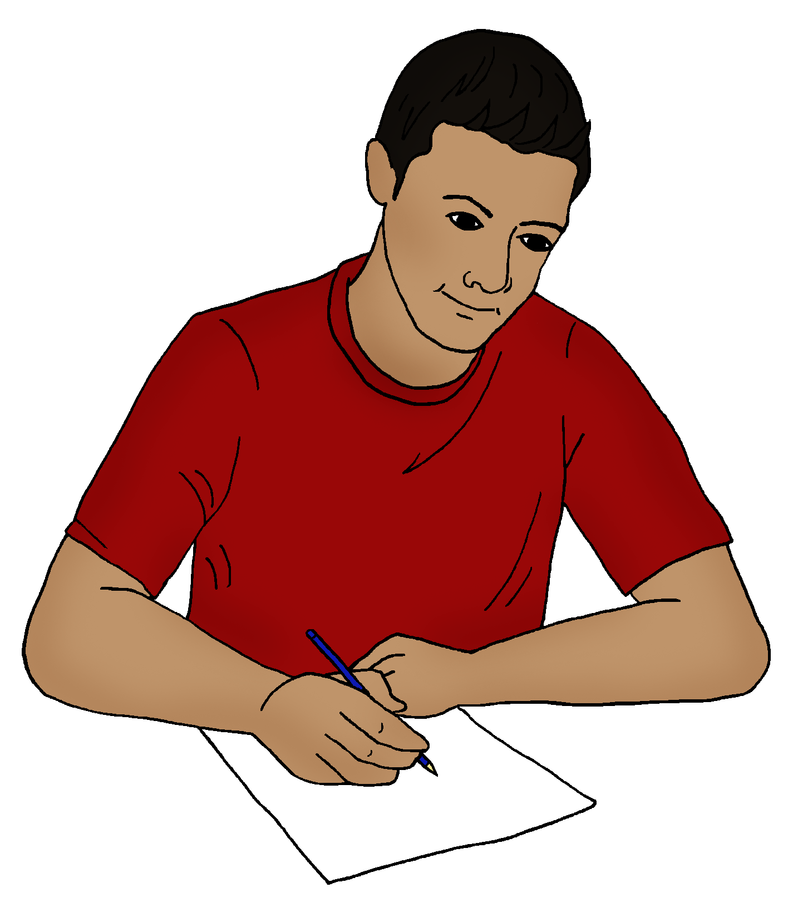
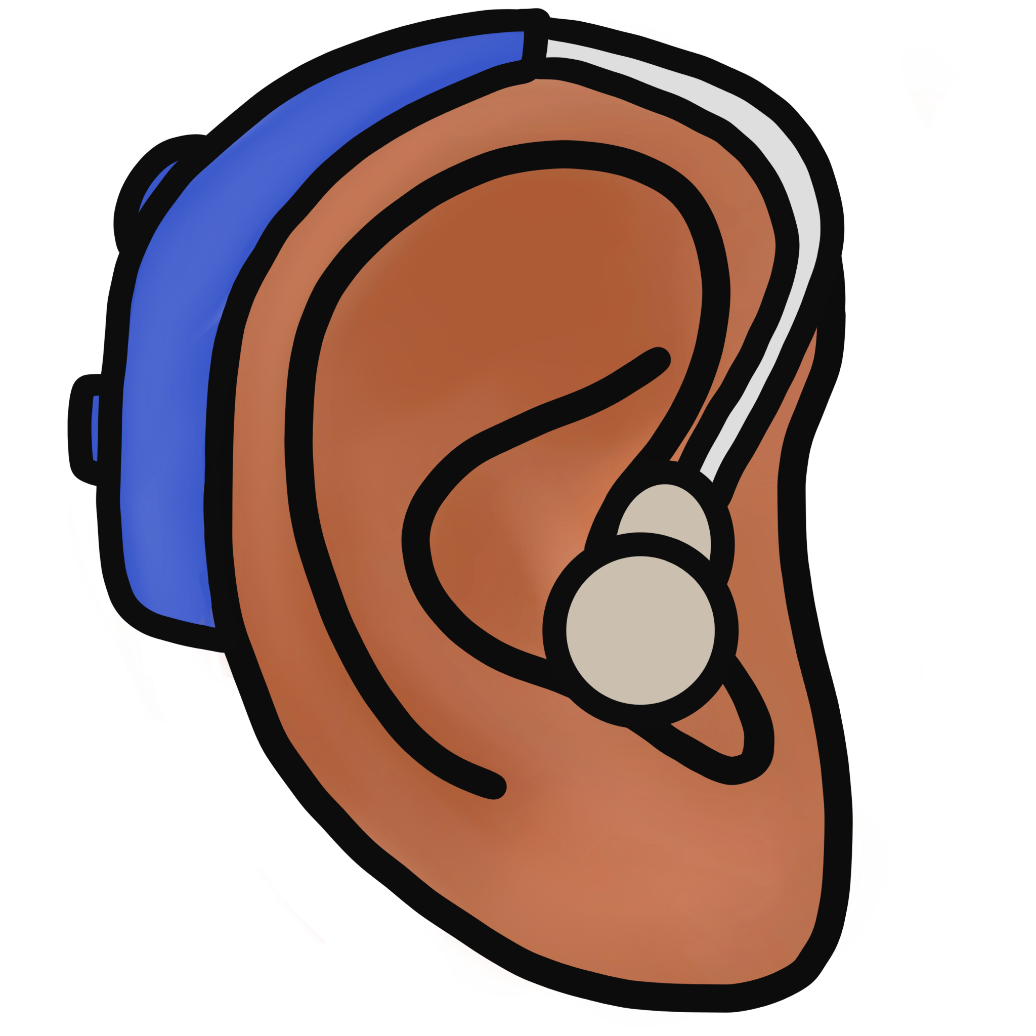
Some students with hearing impairments wear two hearing aids. Some students wear only one.

Slide 18
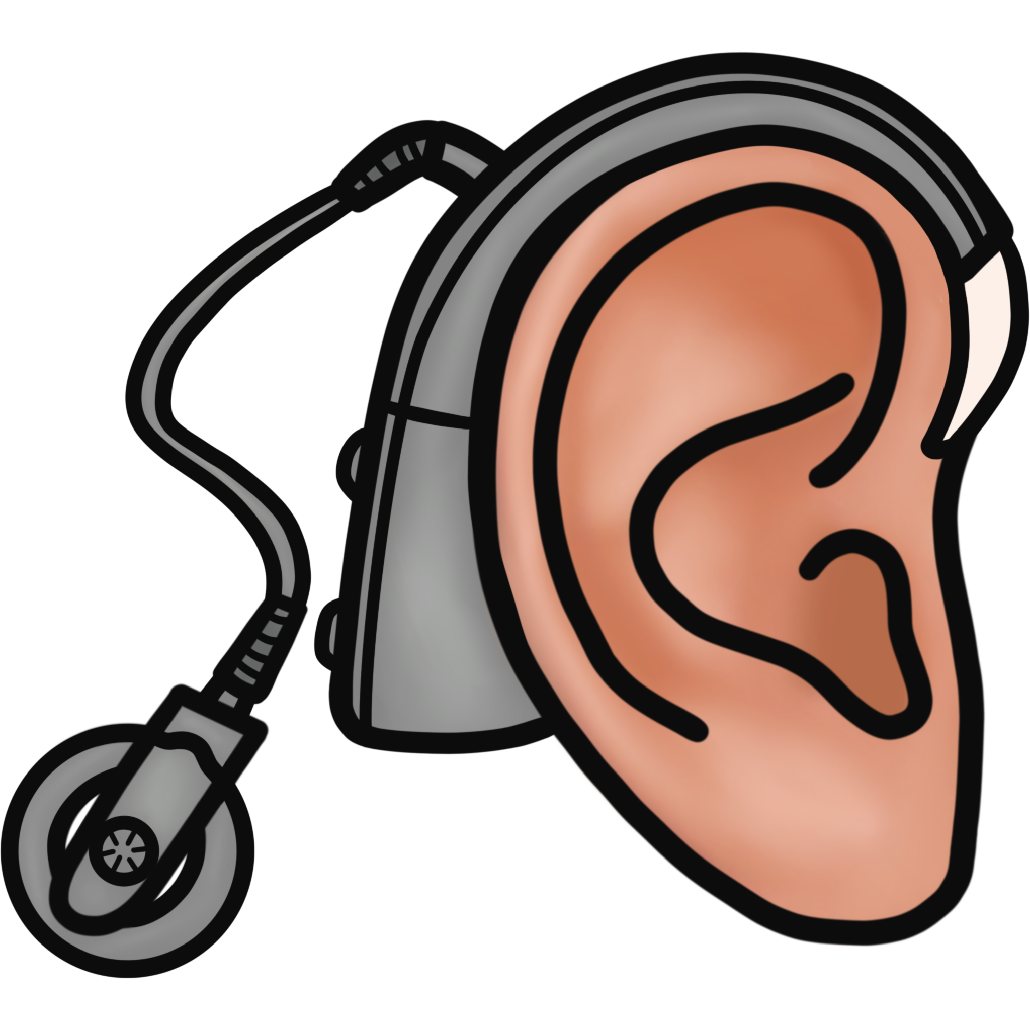
Other students may wear cochlear implants. These are less common than hearing aids.

Slide 19
Other students may not wear any devices at all, which makes them even more at risk in the classroom setting. These students are hard to identify. However, we can help them be successful by making sure their needs are met and that they have ACCESS.

Slide 20
Clear masks can be purchased on Amazon.
Click the link to purchase below
https://www.amazon.com/UPGRADE-Transparent-Reusable-Anti-Fog-Sanitary/dp/B08NWJZTZ8/ref=sr_1_6?crid=3TOB0LSFY5WHR&keywords=clear+face+mask+shield&qid=1646335602&sprefix=clear+face+mask+shield%2Caps%2C175&sr=8-6

Slide 21
There are also MANY more resources for teachers here:
https://www.umaryland.edu/media/umb/oaa/campus-life/disability-services-/documents/Tips-for-Teaching-Students-Who-Are-Deaf-or-Hard-of-Hearing.pdf
https://www.crisoregon.org/Page/91
https://education.ky.gov/specialed/blindef/Pages/Resources-for-Students-with-Hearing-Impairment.aspx

