Slide 1
Water Versus Dirt: Which One Will Win
Grethel Jones
Jackson Independent School

Slide 2
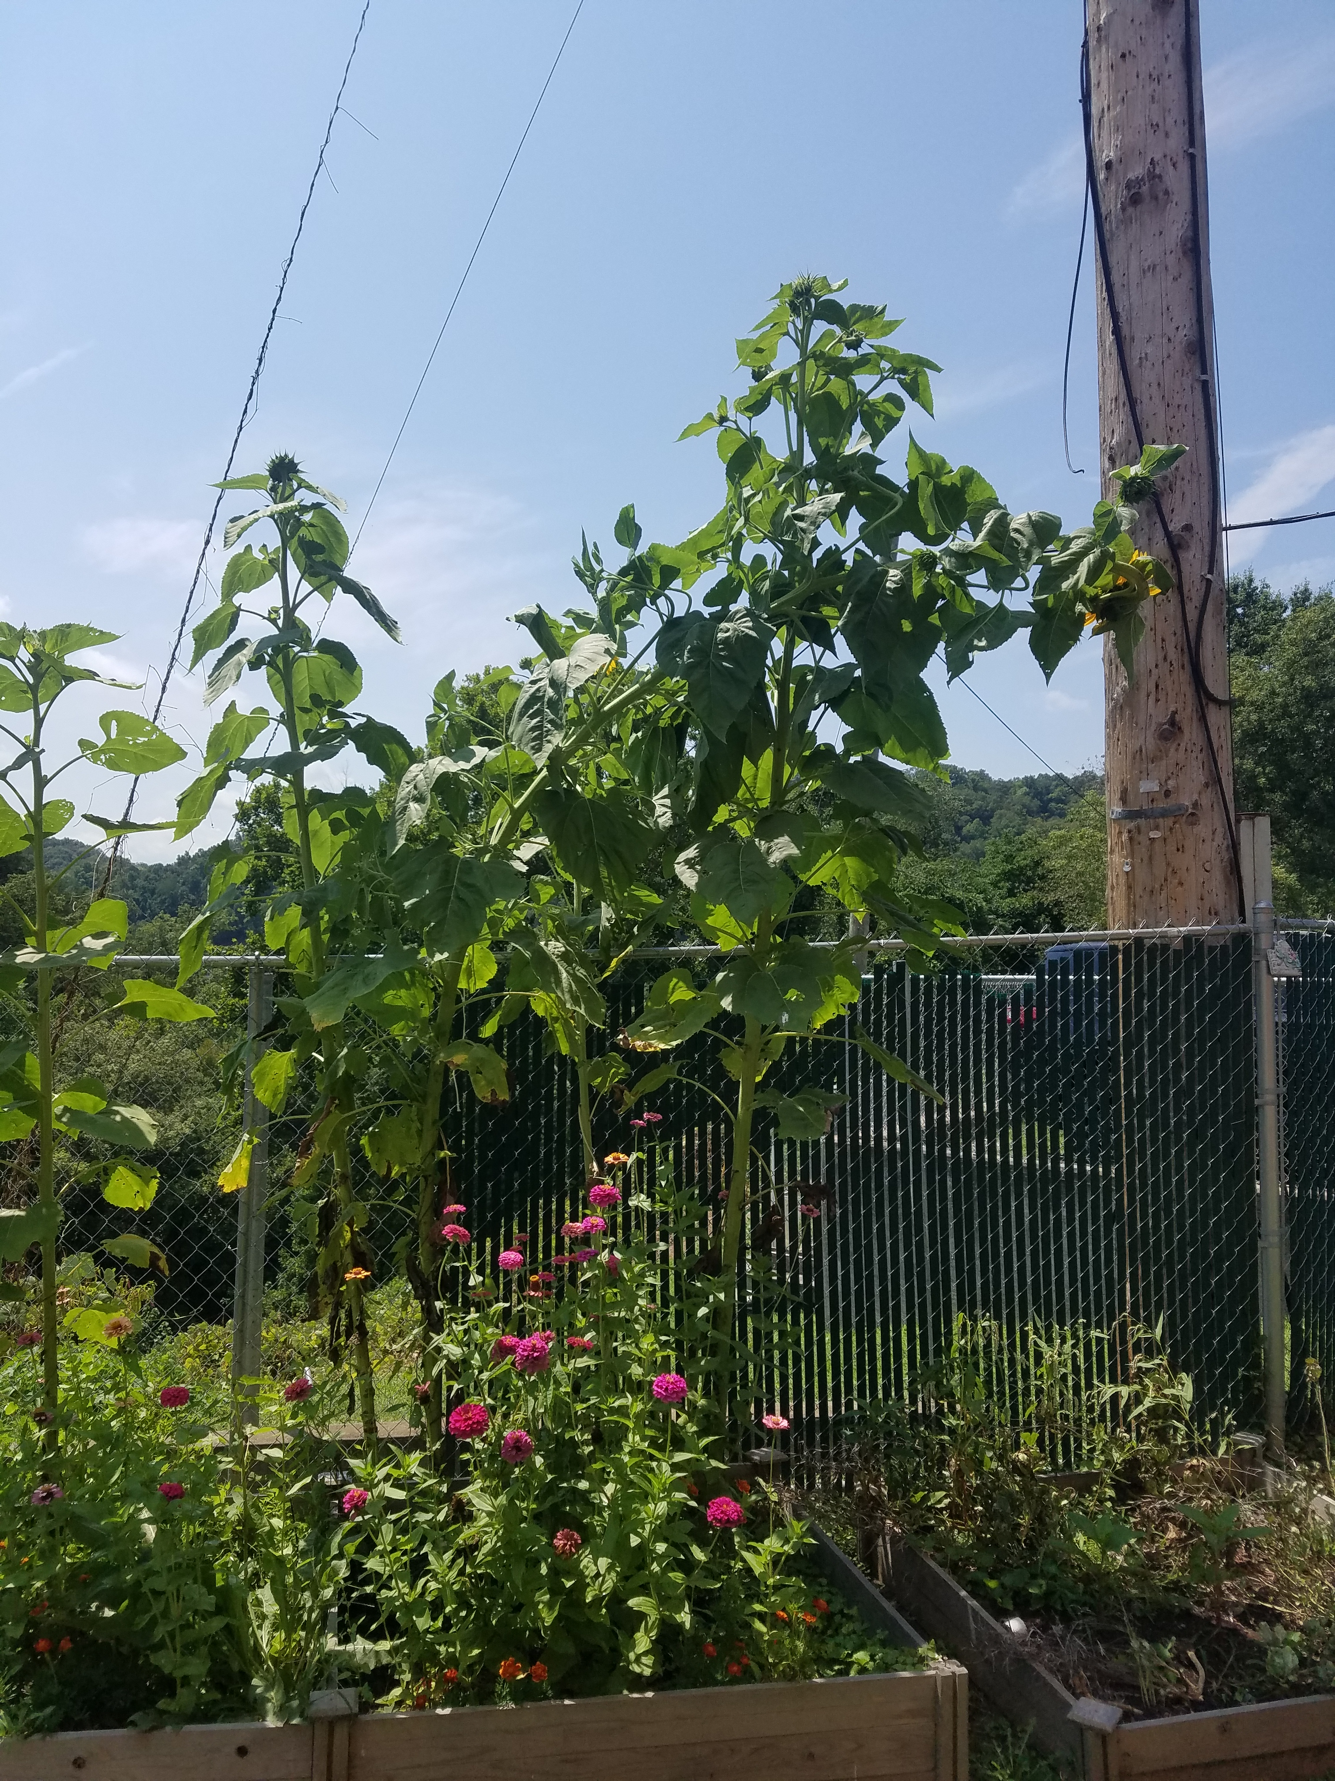
Is aquaponics an effective way to grow food versus traditional gardening?

Slide 3
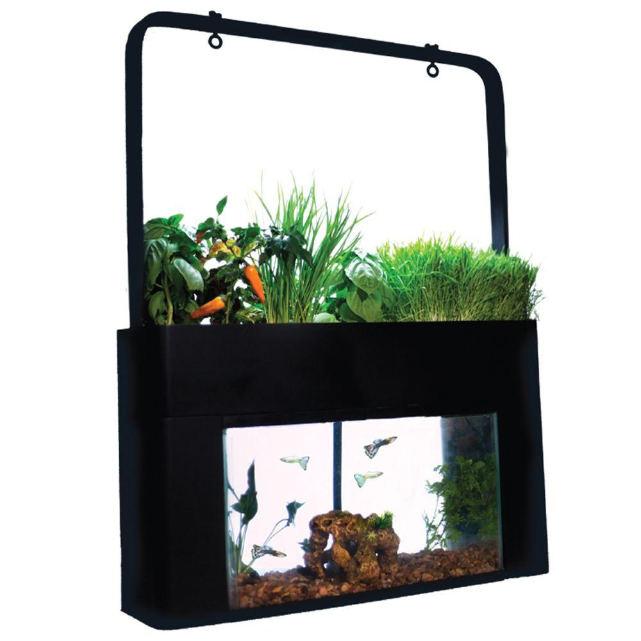
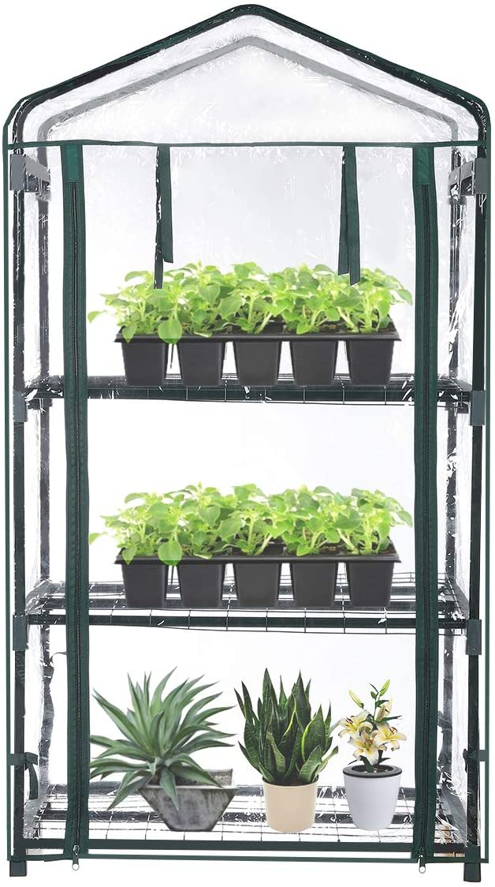
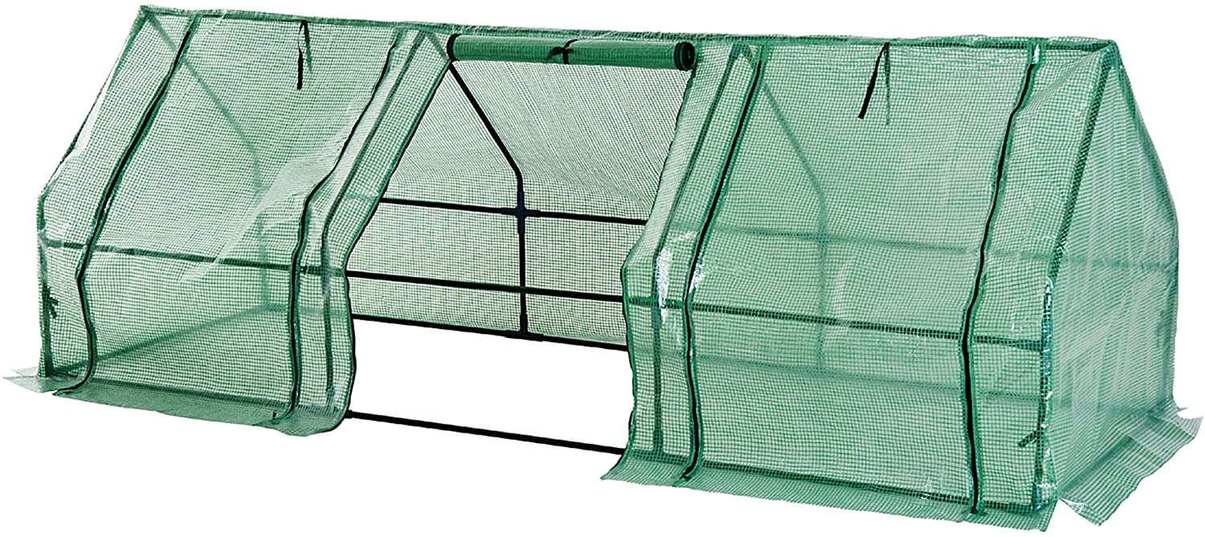
Action Plan:
Set up an aquaponics system within the classroom.
Set up a small greenhouse inside so that the class can compare the growth rate of plants using water versus dirt.
There will also be a small greenhouse outside for growing new plants in the spring for our outdoor garden.

Slide 4
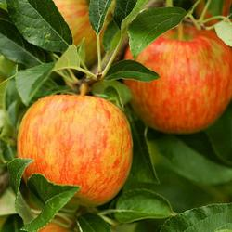
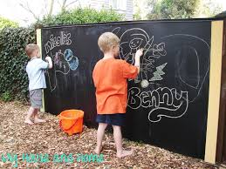
Plant some winter crops outside in the garden area.
Plant a tree in the outside classroom area.
Add an outdoor sorting table, chalkboards, and items for the students to use for observing and documenting the growth and life cycle of plants.

Slide 5
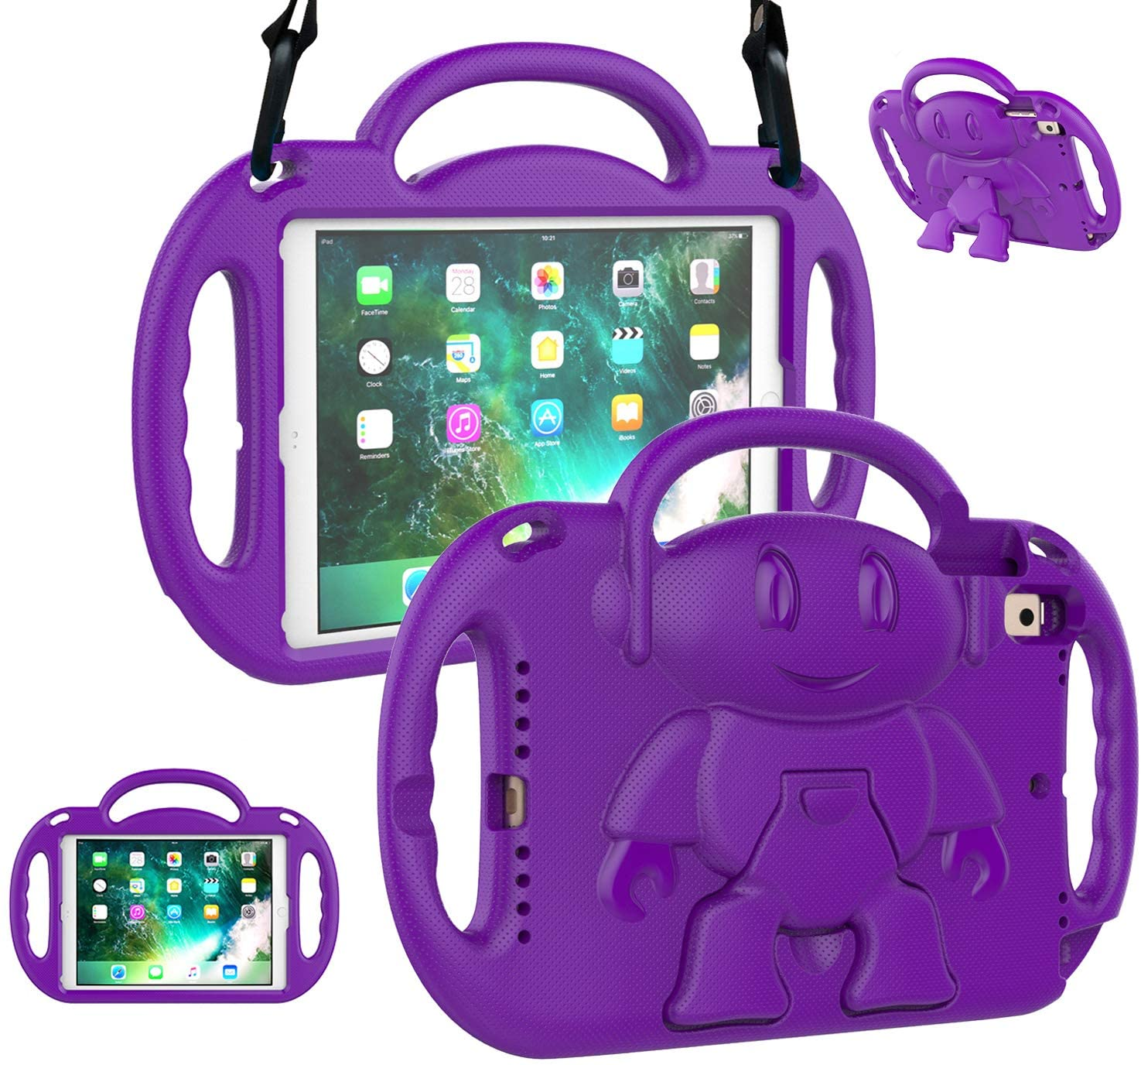
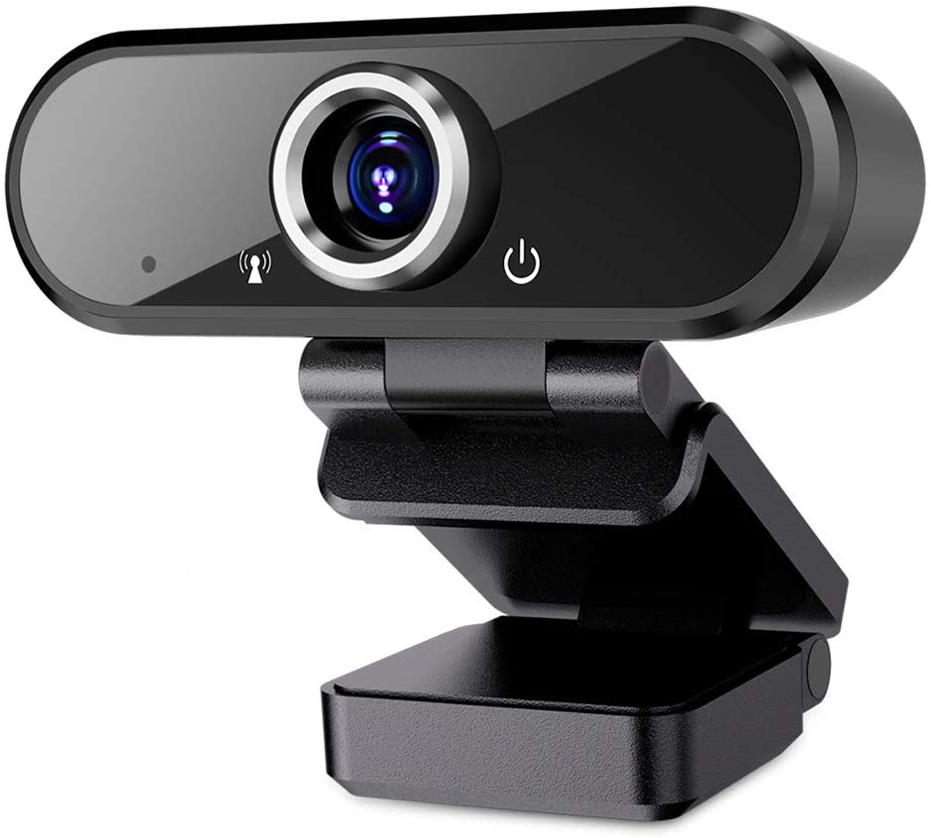
The students will use an I-pad for documenting their activities, researching and discovering new information, and engaging in apps that support their knowledge of life cycles and correlations in nature.
A webcam will be used to document the growth of plants and fish.

Slide 6
Objectives:
Children will begin to understand living and nonliving things and be able to group things accordingly.
Children will use sorting and reasoning skills as they record changes in plant growth.
Children will use their senses to make observations and document these observations.
Children will have hands-on knowledge of plants and aquatic animals through observing the correlation between plants and fish within the aquaponics system.
Children will understand where our food comes from and how they can provide their own food source through gardening both in water and dirt.

