Slide 1
What are Kinder Kits?
Same manipulatives that we would use for center time in class.
It address reading, writing, math, social studies and science.
Manipulatives include:
Draw and Write Journals
Ten Frames
Print Numbers Practice Book
Story Telling Lapboard
Real Bugs Discovery Kit
Good for me Rewards Kit

Slide 2
What are these materials?
Draw and Write Journal: designed for beginning readers and writers, room at the top for drawing (good for motor skills), primary writing lines for letter, word and sentence practice.
Ten Frame: helps develop skills and counting, composing and decomposing numbers, addition (to 20) and subtraction (to 20).
Print Number Practice Book: write and wipe book, different numbers on each page, dotted numbers to trace, and blank lines to practice with.
Story Telling Lap Board: brings stories to life, help with language and vocabulary, order of events.

Slide 3
Materials Continued…
Real Bugs Discovery Kit: 12 amazing bugs to work with, bugs are permanently encased in indestructible acrylic, fact book, handy magnifier, and storage container with compartments for each bug.
Good for me Reward Kit: motivates students to reach goals, tracks students progress, and students can earn reward certificates.

Slide 4
Action Plan
Implement Kinder Kits ASAP to students who are participating in person or through NTI
What is needed: Kits and materials discussed in previous slides will be needed for each student People involved: myself, kindergarten aid, students and parents
Students will actively use kits for school daily.
Timeline: 6 months (Oct.– April)

Slide 5
Success!
To determine the success of my kits, students will be given an assessment.
First assessment given mid September (already given)
Graded using rubric
Second assessment given March

Slide 6
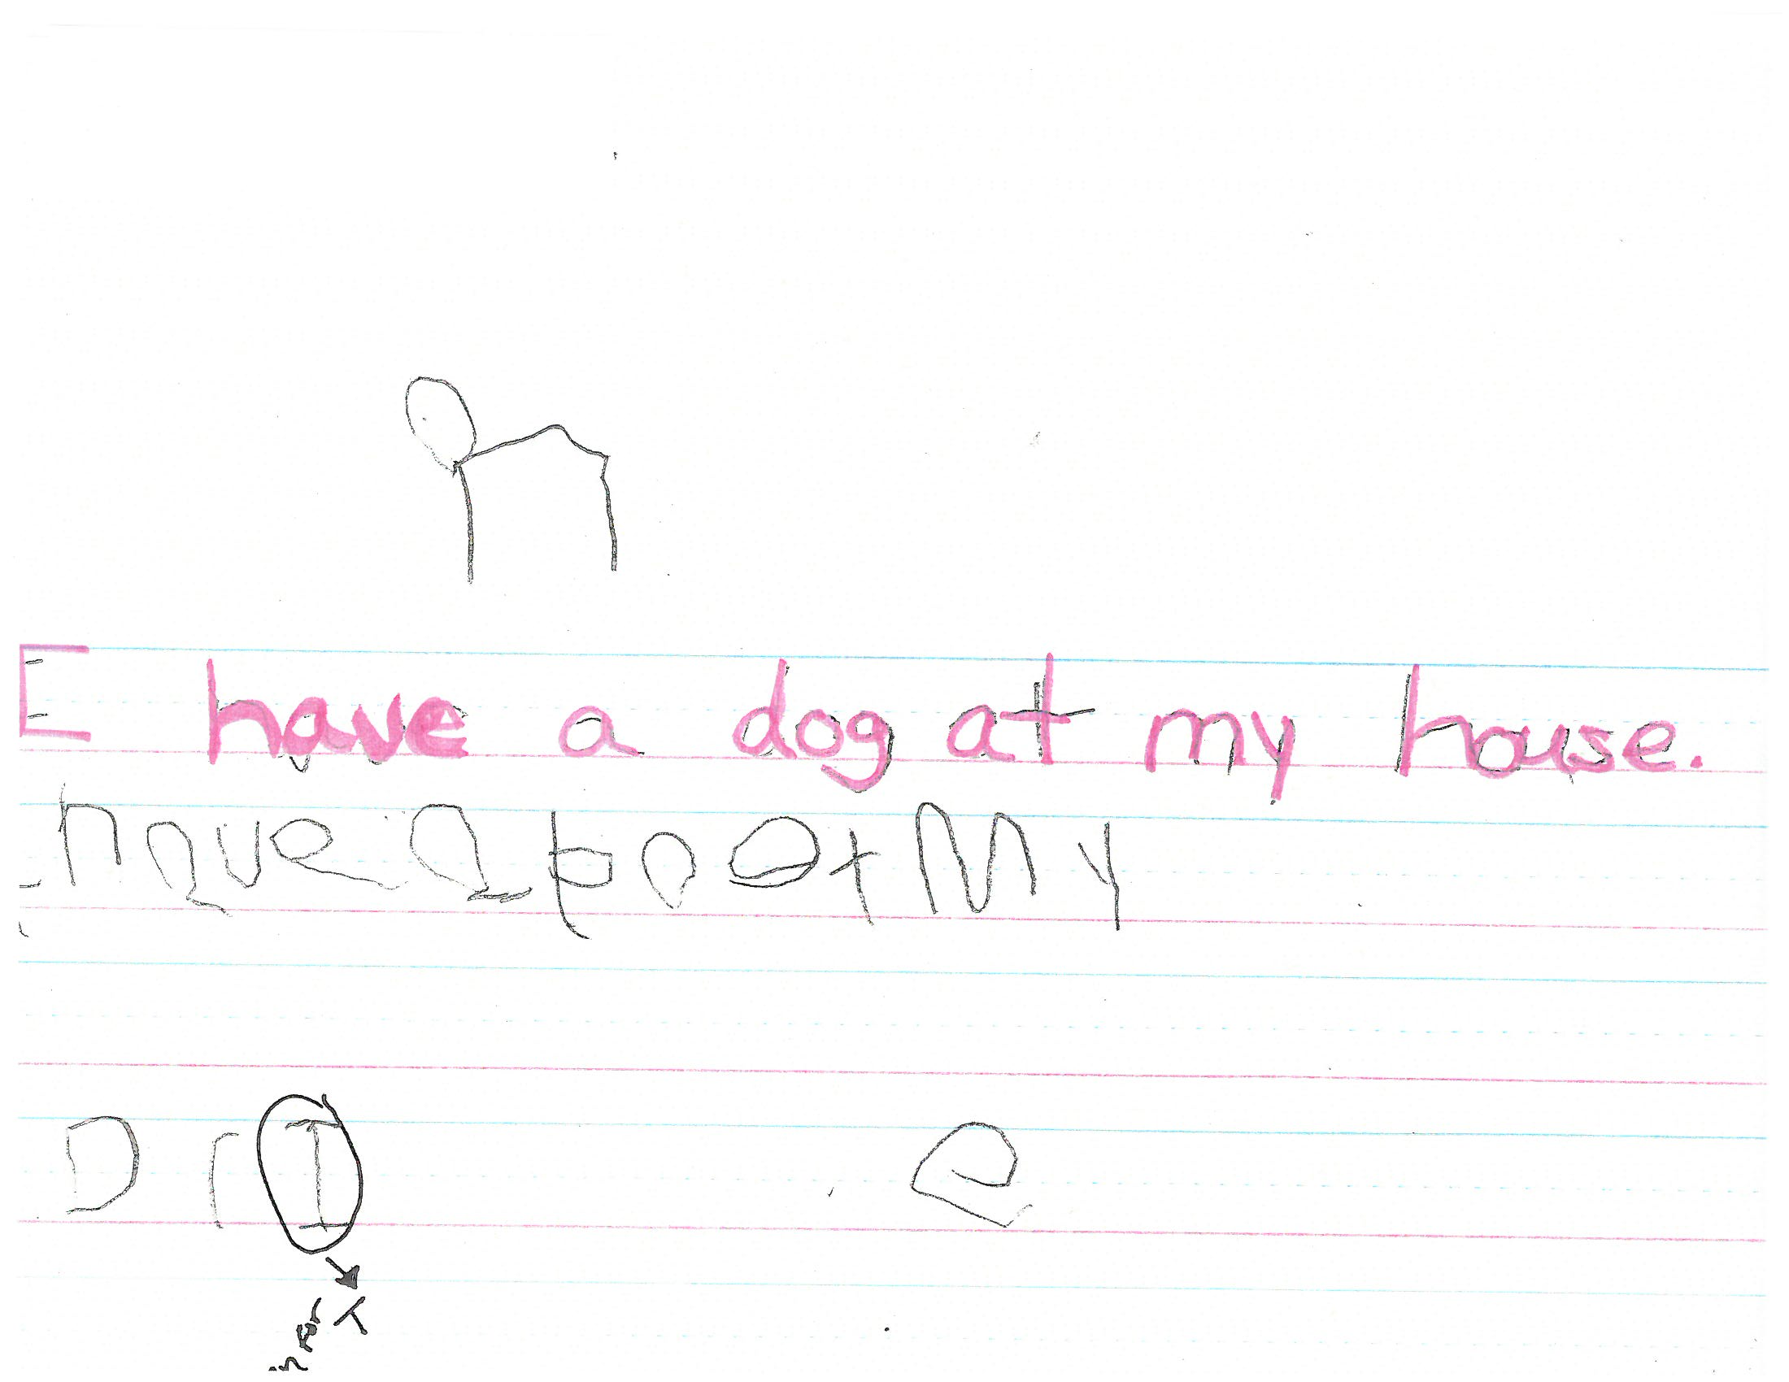
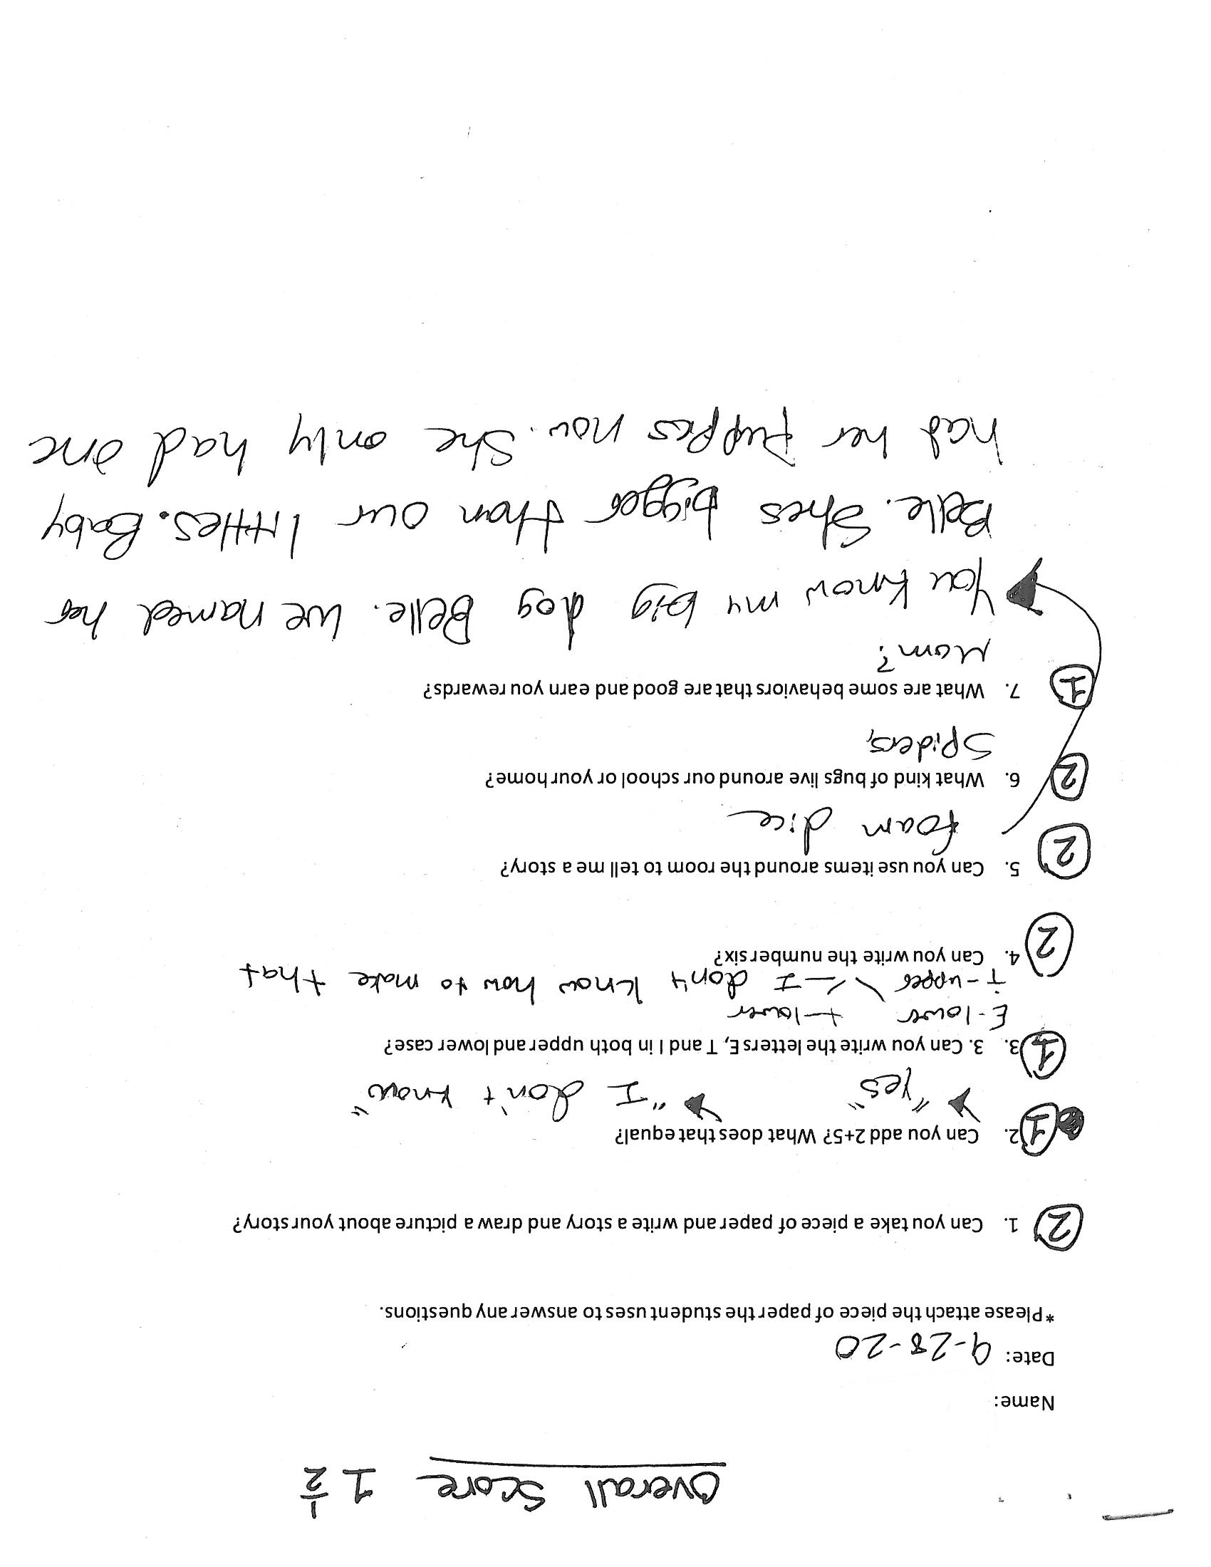
Student Sample 1

Slide 7
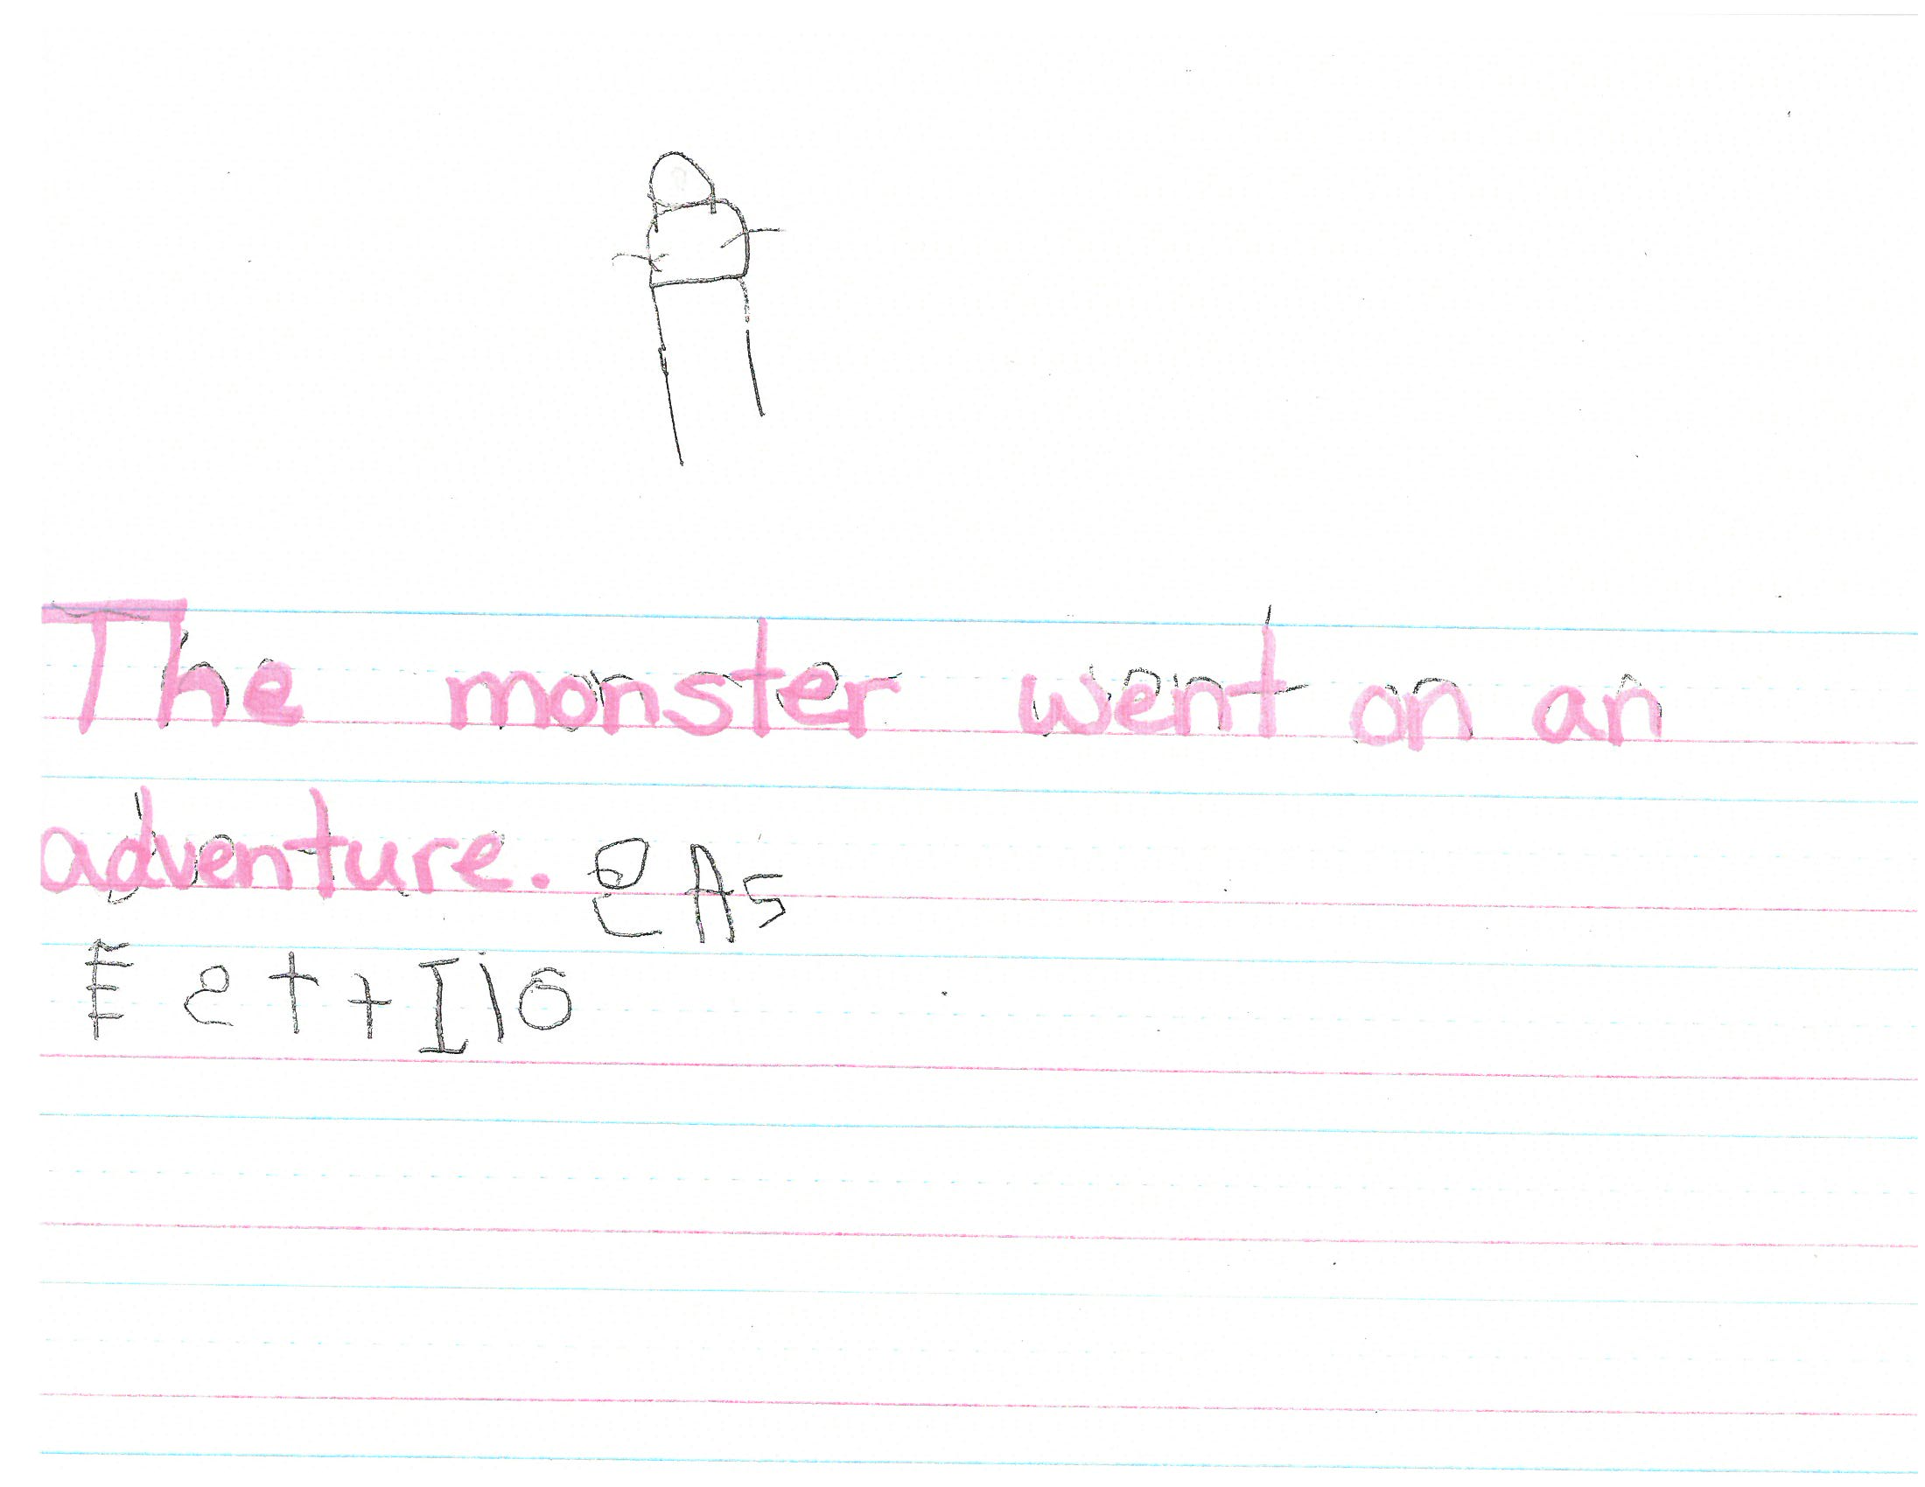
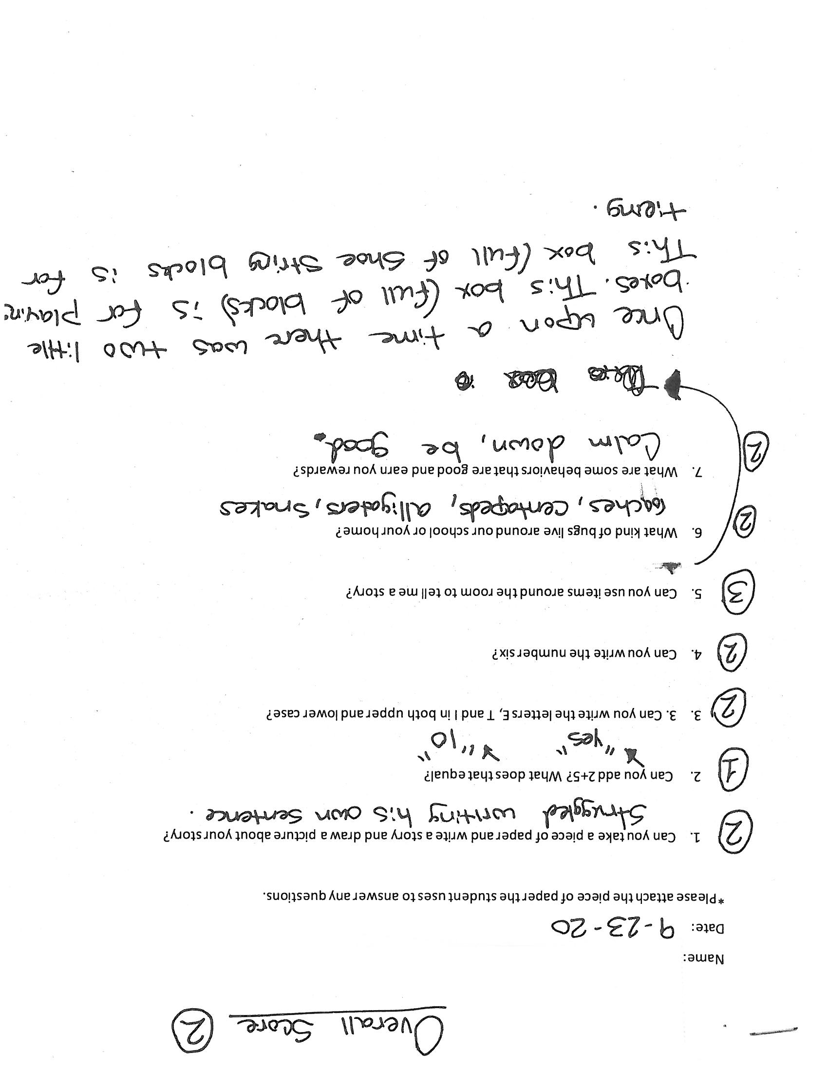
Student Sample 2

Slide 8
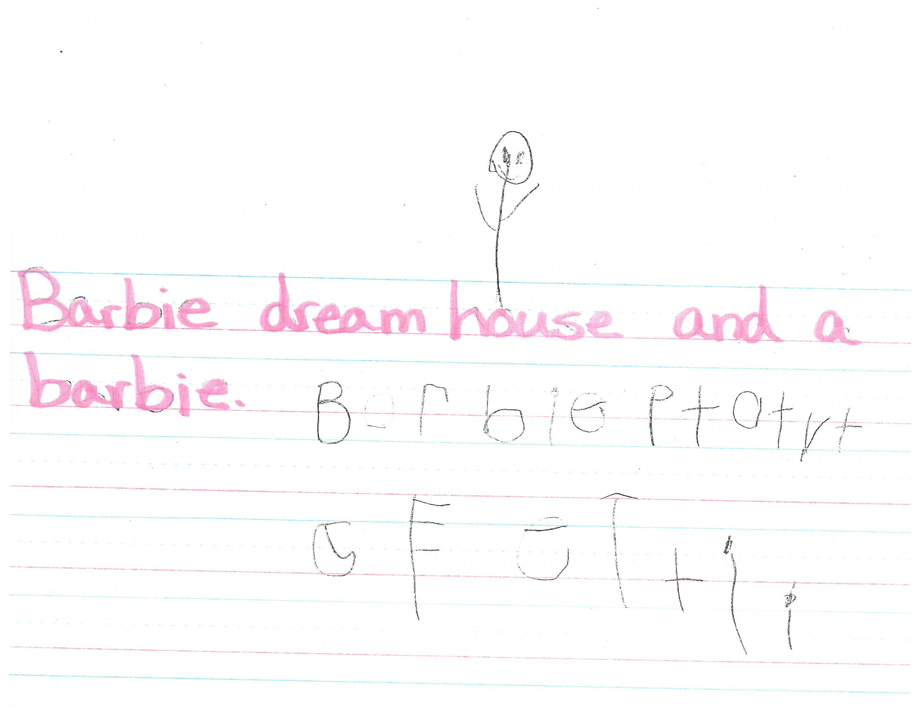
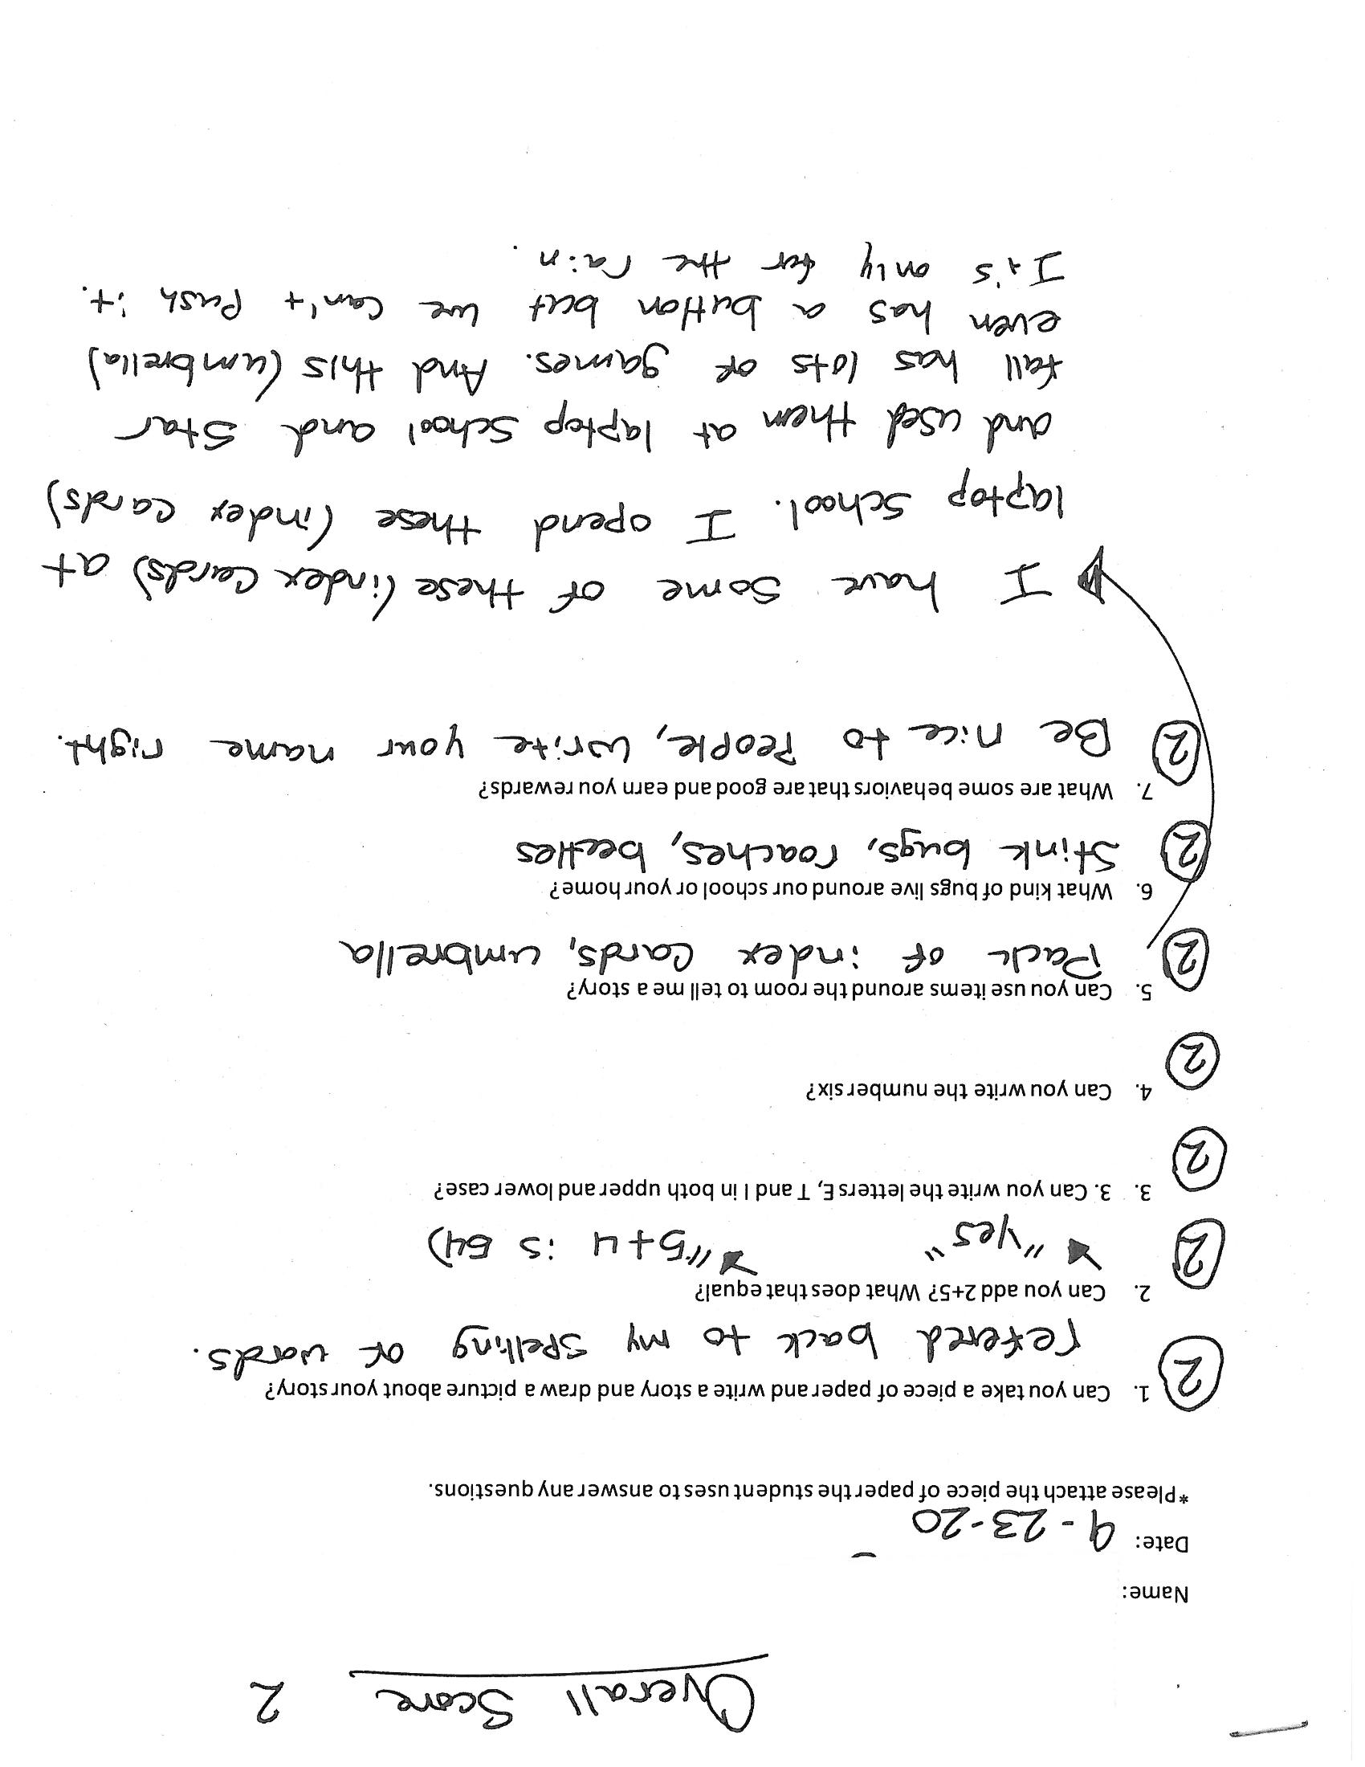
Student Sample 3

Slide 9
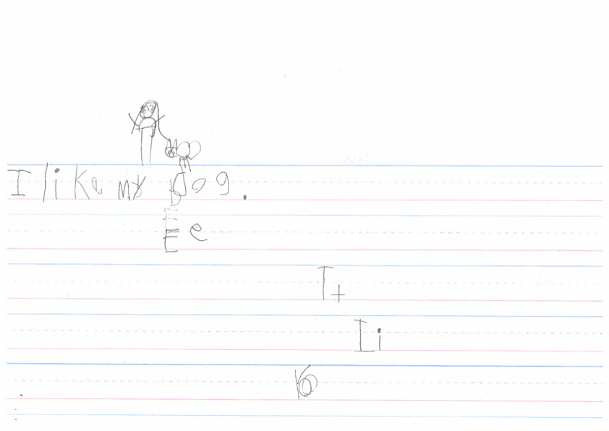
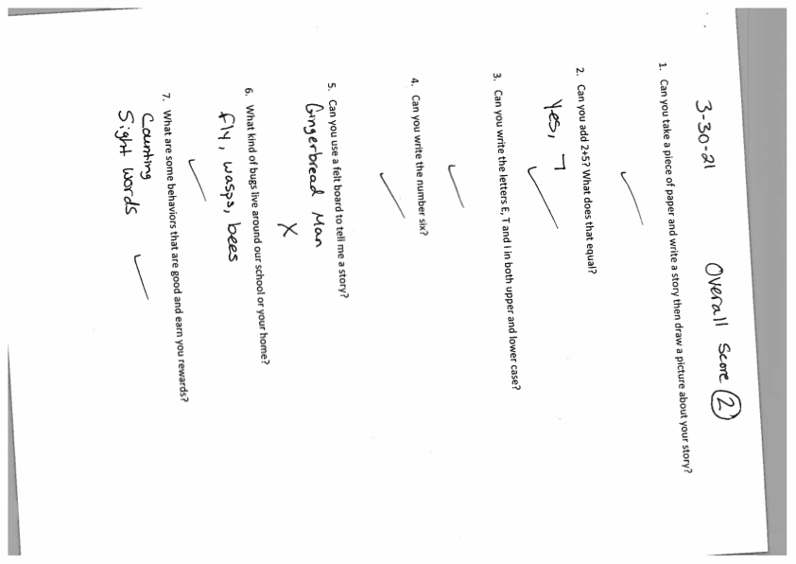
Student Sample 4

Slide 10
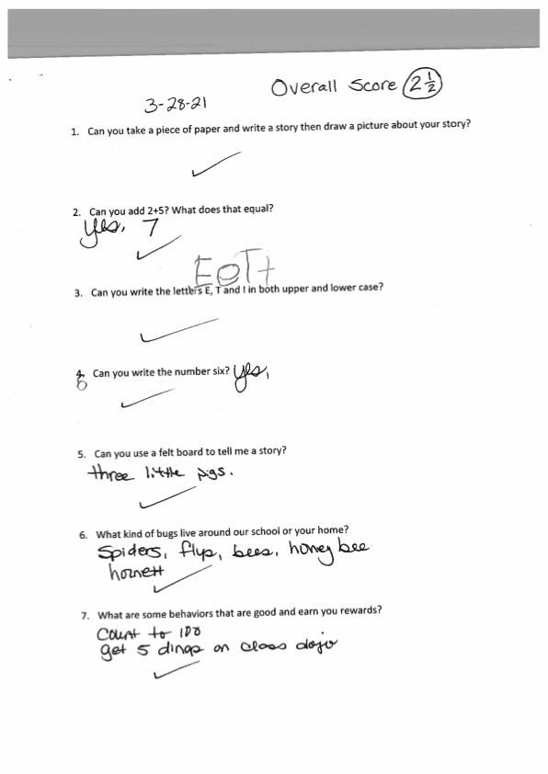
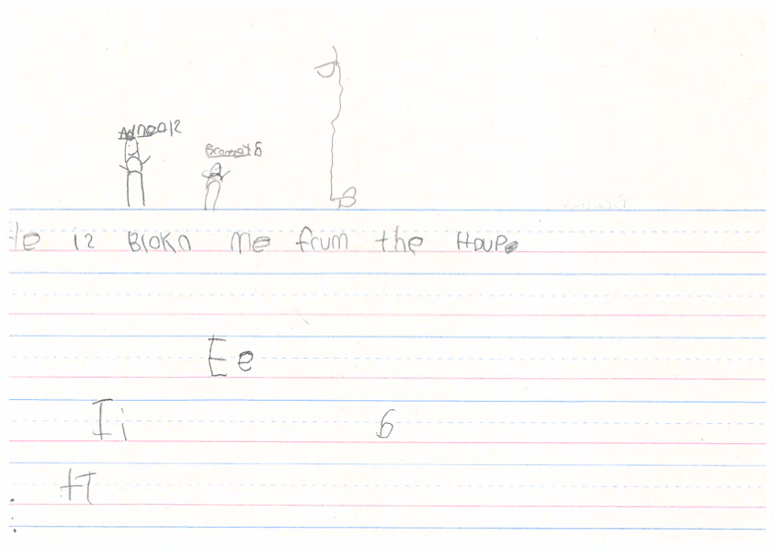
Student Sample 5

Slide 11
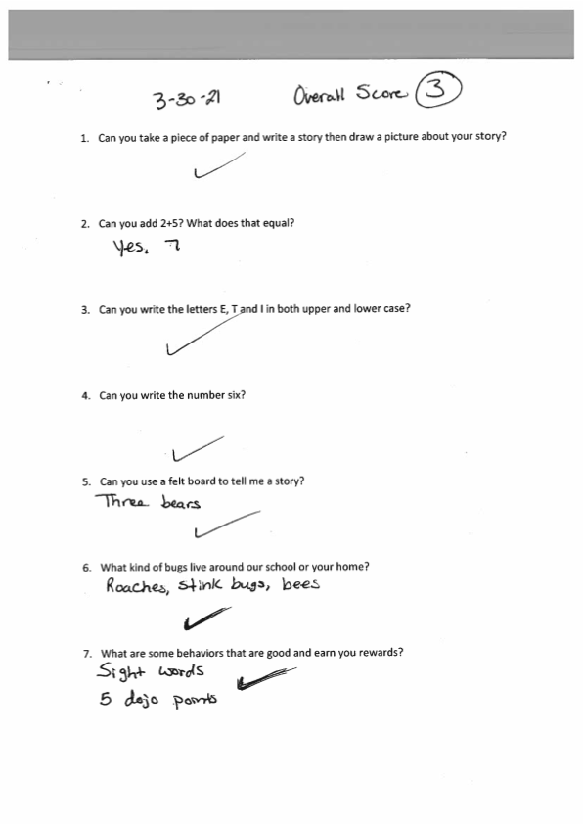
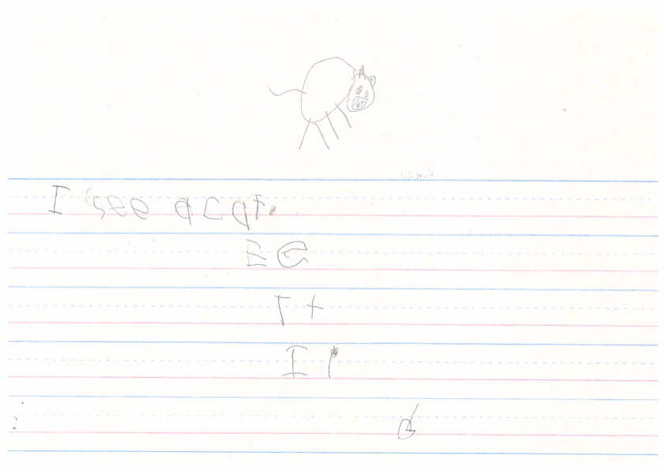
Student Sample 6

Slide 12
Assessment Data
Overall my data told me that the use of Kinder Kits did help my students. We seen a huge improvement from our first round data!
First Assessment:
0/8 students scored a 3
4/8 students scored a 2 or above
4/8 students scored a 1 or above
Second Assessment:
1/8 students scored a 3
6/8 students scored a 2 or 2 above
1/8 students scored a 1 or above

Slide 13
Kinder Kits Assessment
*Please attach the piece of paper the student uses to answer any questions.
1. Can you take a piece of paper and write a story and draw a picture about your story?
2. Can you add 2+5? What does that equal?
3. Can you write the letters E, T and I in both upper and lower case?
4. Can you write the number six?
5. Can you use items around the room to tell me a story?
6. What kind of bugs live around our school or your home?
7. What are some behaviors that are good and earn you rewards?

Slide 14
Assessment Rubric
 | 1 | 2 | 3
A. Ability to Answer | Student is unable to explain reasoning for answers. | Student is able to briefly explain reasoning for answers. | Student is able to fully explain reasoning for answers.
B. Work Shown | No detail | Little detail | Complete detail
C. Answer Accuracy | Student gives incorrect answer to all parts of question. | Student give partial correctness to one or more parts of the question. | Student gives correct answer to all parts of question.
D. Completion of Question | Student does not complete question. | Student partially completes question. | Student completes all parts of the question.

Slide 15
Communicating Results
Based off the data collected during this cycle, I would determine that my Kinderkits were a success. Students were able to use and learn with all our materials. Based on our second round of data (January), my students had showed a slight improvement. However, this could be due to the simple fact that we had not been in school since October. Luckily, our third round data (March) showed better results.

Slide 16
Action Research Cycle
Based on my conclusions I would determine that my kits were overall a success.
The biggest strength of my kits overall was that my students had access to in school materials at home. This truly help improve NTI and success for my students overall learning.
This is also the biggest limitation to my project. Once most of my students returned to school mid March, some of them did not have their materials anymore. They had been lost or left at home most school days. This had a big impact on the students’ ability to learn and use the materials. Luckily, I had planned for this and wrote my grant with a few extra’s of each item.

Slide 17
Overall!!
Overall, I am very happy with how my students performed and use their items throughout this experience. I believe that without the use of my kits, students would not have been as successful in their learning. These kits were an amazing resource to have throughout our hybrid learning experience.

