Slide 1
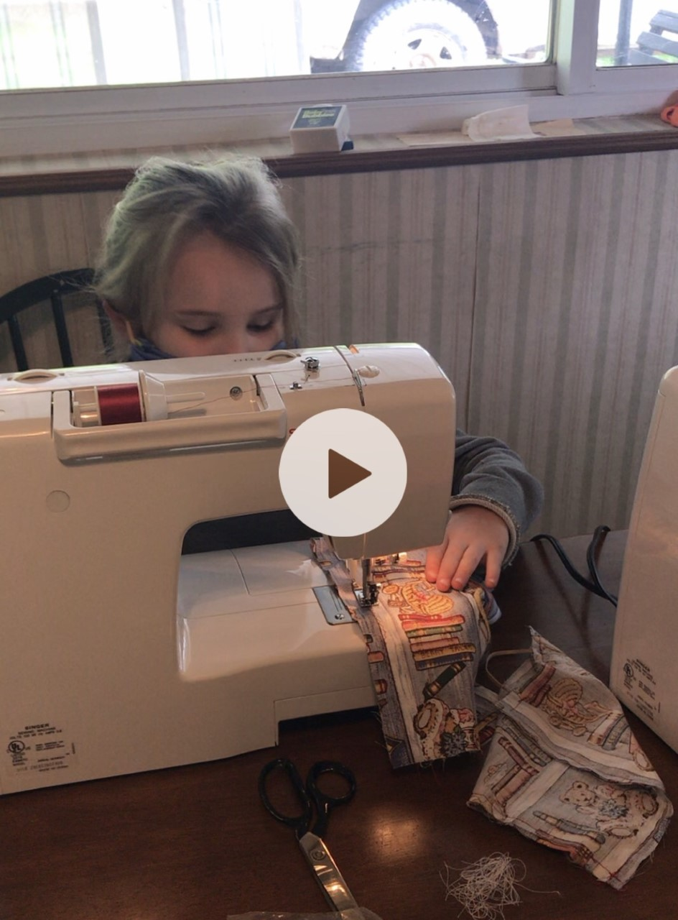
Debbie Napier Rosspoint Middle School Harlan County, KY
Sewing: A Bridge to Appalachian History, Economic Success, and Cultural Awareness
KVEC Learning Innovation Grant
2020-2021

Slide 2
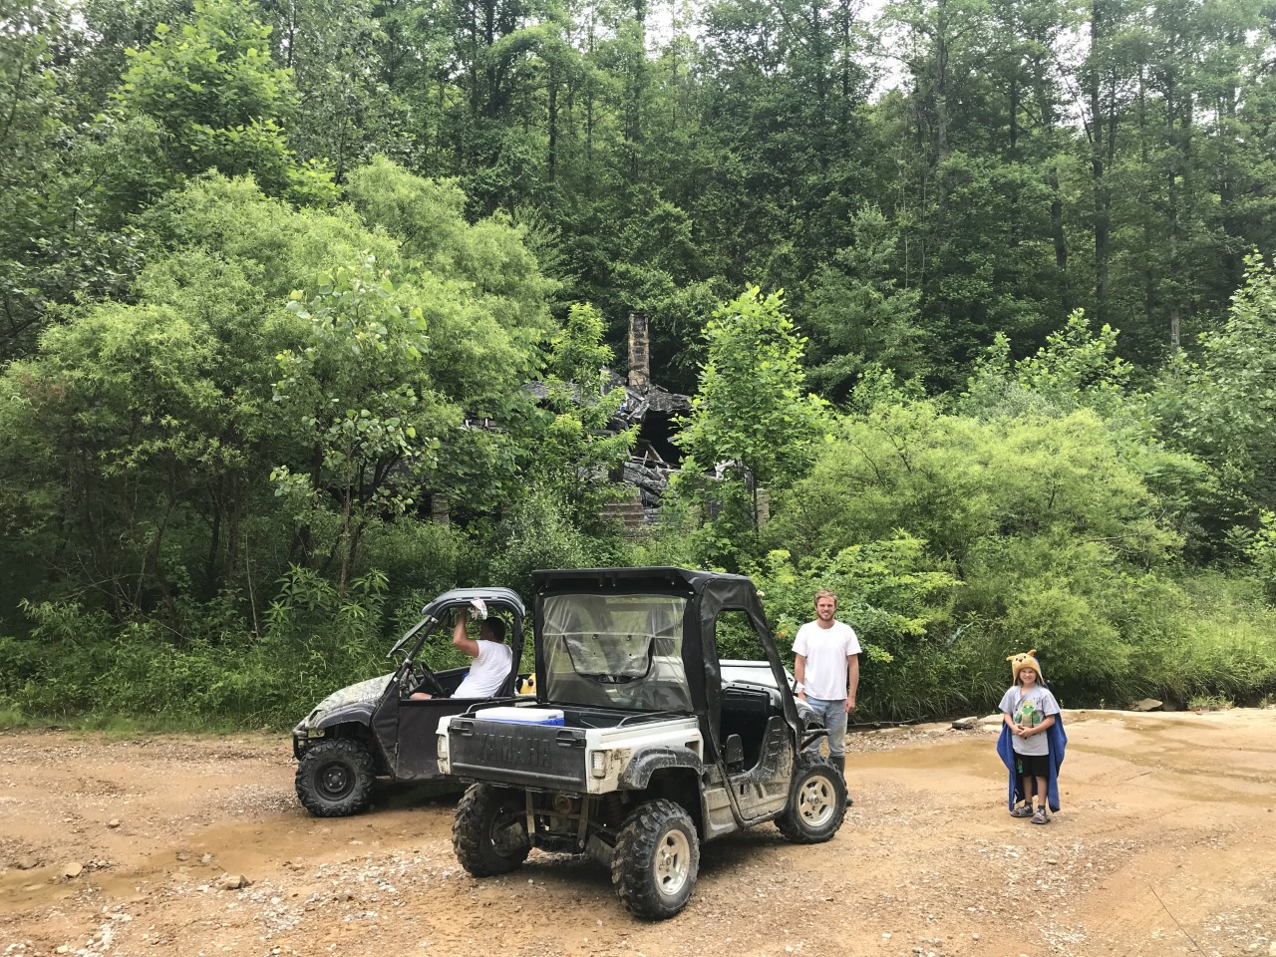
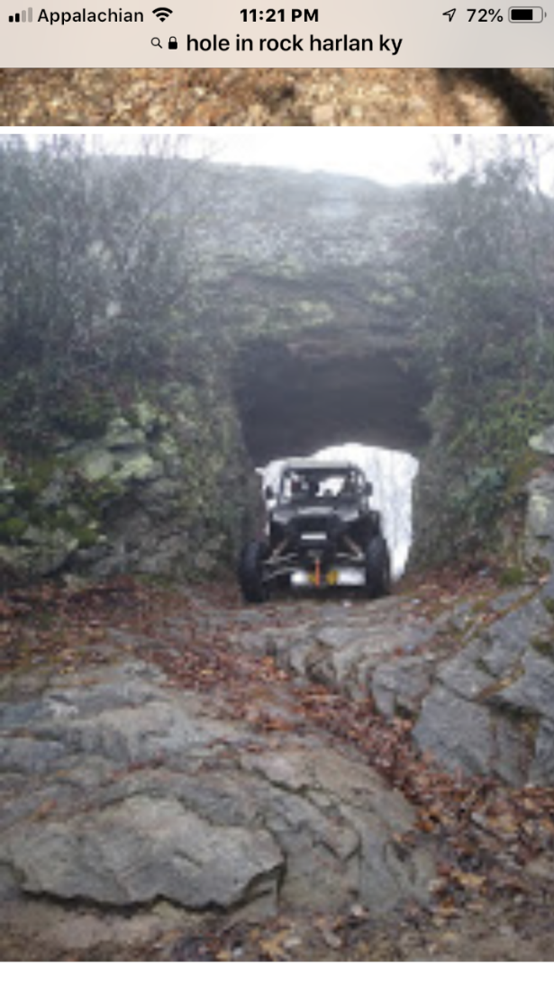
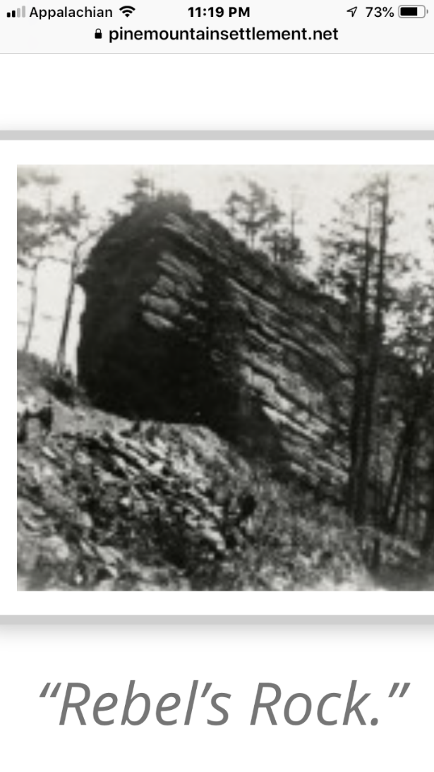
Harlan County
I’m proud to live in Harlan County, the prettiest place on earth.
Harlan County is rich in cultural tradition, natural beauty, and American history.
Family and tradition matter in our Bible Belt communities.
With the weakening of the coal industry and diminishing job opportunities and population, many young people leave the area for college and economic opportunities. This brain drain phenomena, along with the growing unemployment and poverty rate, help contribute to self-esteem issues, motivation, and a feeling of the loss of pride.

Slide 3
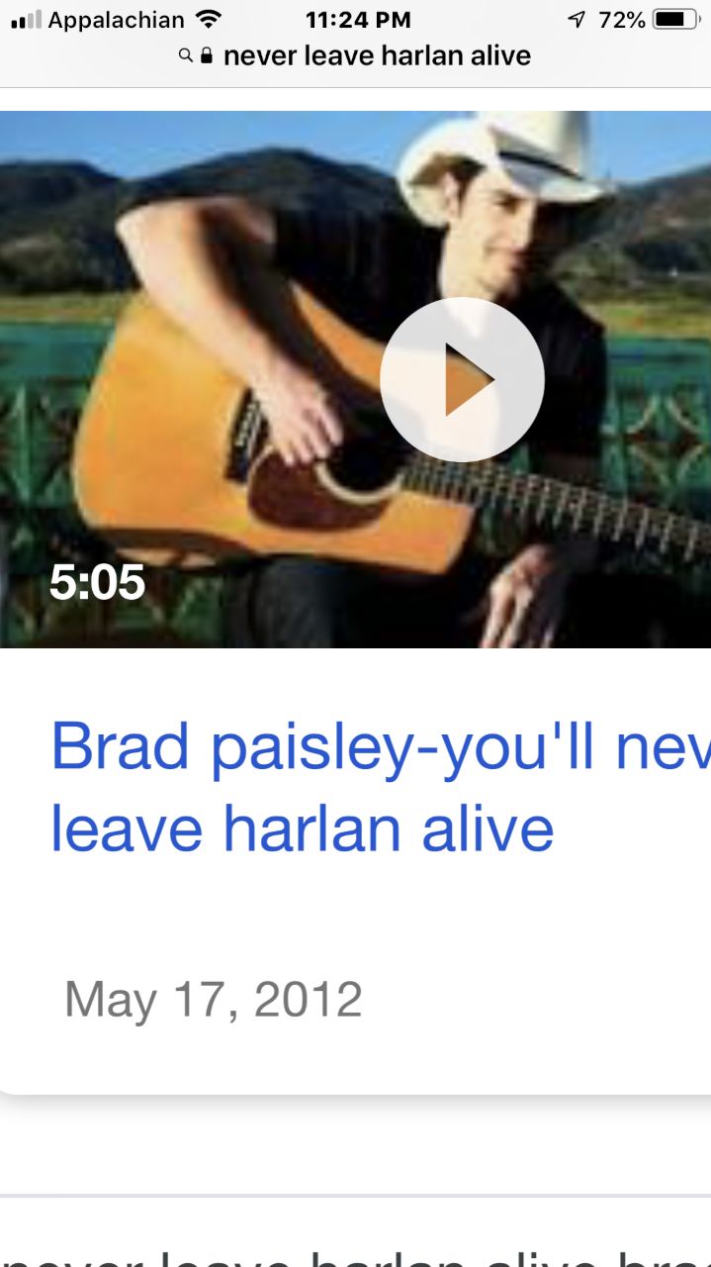
Research question:
What ways can innovative technology contribute to Harlan County school children overcoming the stigma of living in a poverty area, build personal self-esteem and pride in community, learn to sew and create clothing, and allow inquiry and research to develop “living history” roles?

Slide 4
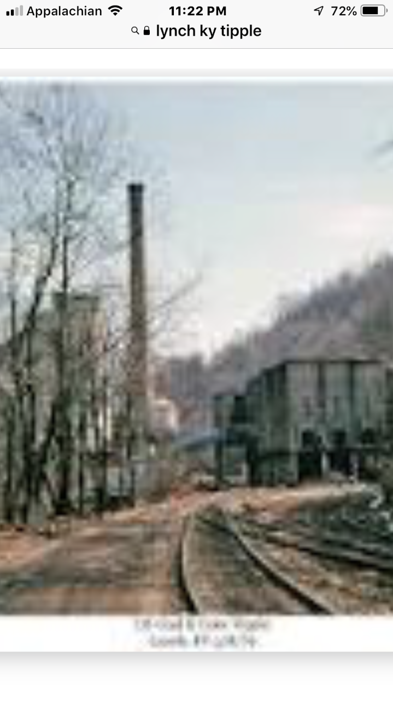
Action Research that Worked
For the past two years, my 6th graders have implemented the strategy of place-based learning to explore Harlan County Coal history and develop virtual field trips to showcase areas in our county. This was possible thanks to the assistance of KVEC Learning Innovative Grants. Results:
Students developed great pride in their history
Innovative technology (the virtual field trip) impressed the community
Showcasing their work brought encouraging community support
Students generated more inquiries even when the project was culminating
Students interest prompted them to desire to explore more local history (Thus this grant to build on their interests!)

Slide 5
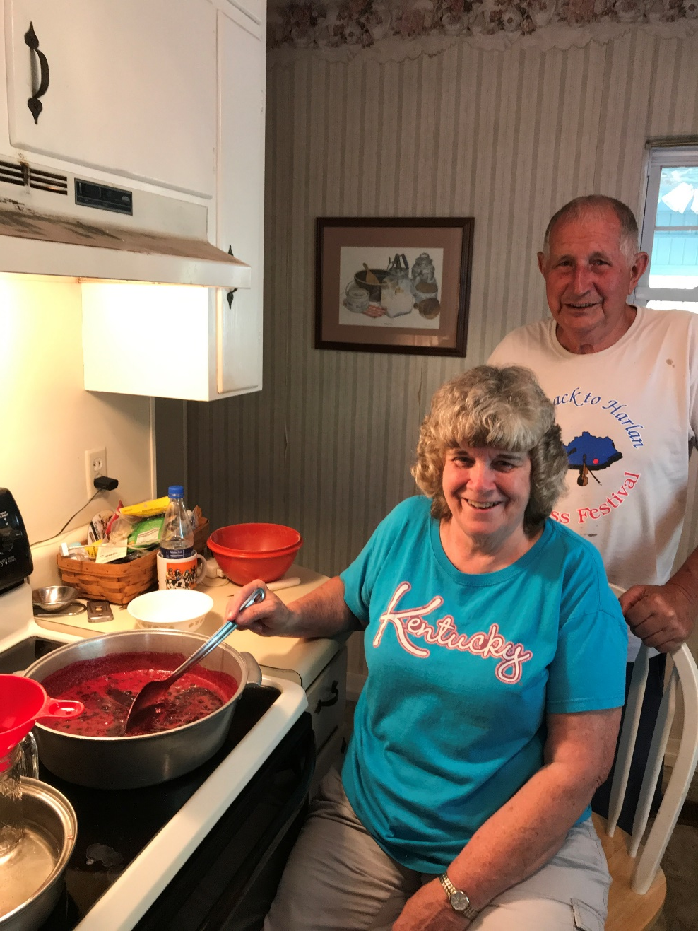
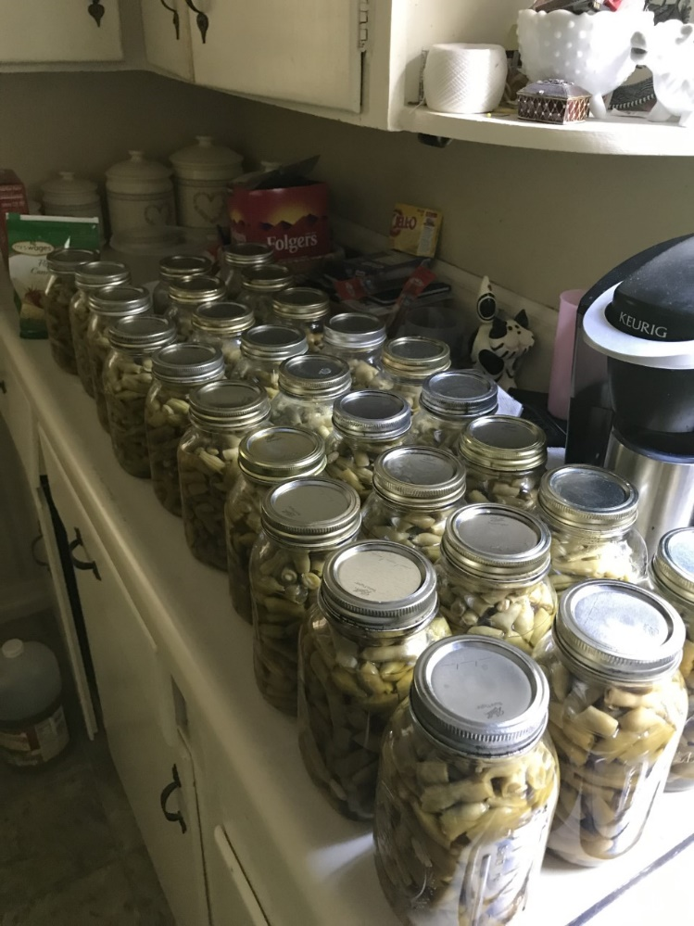
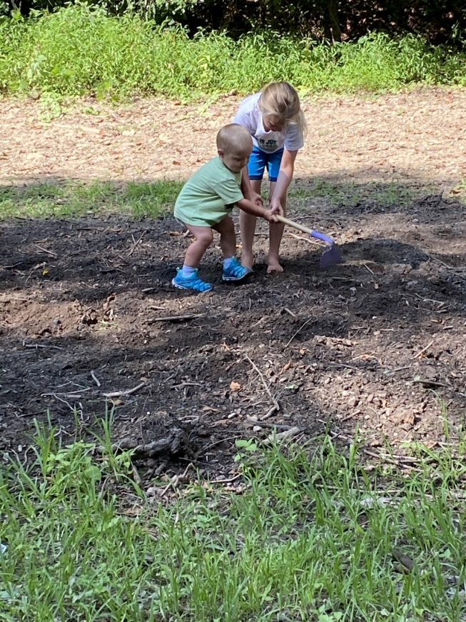
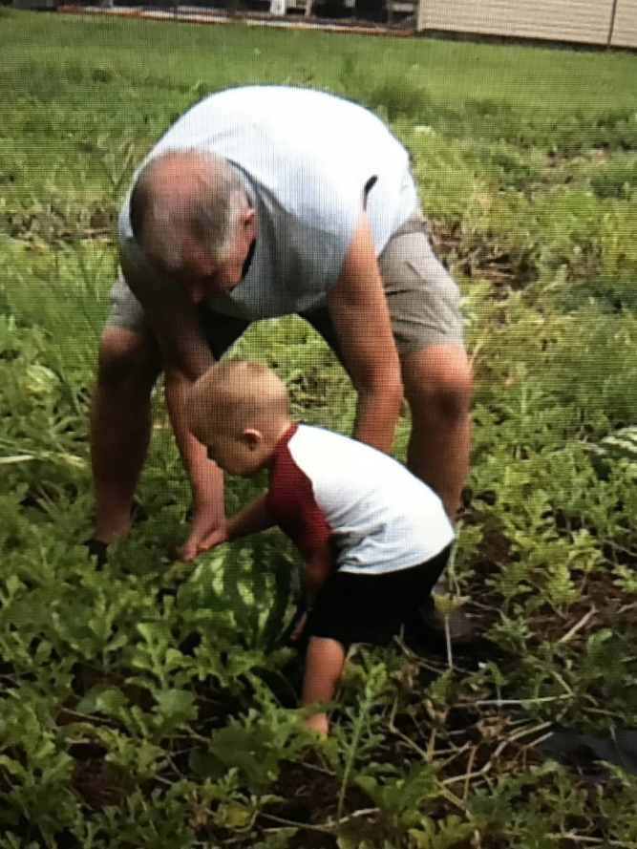
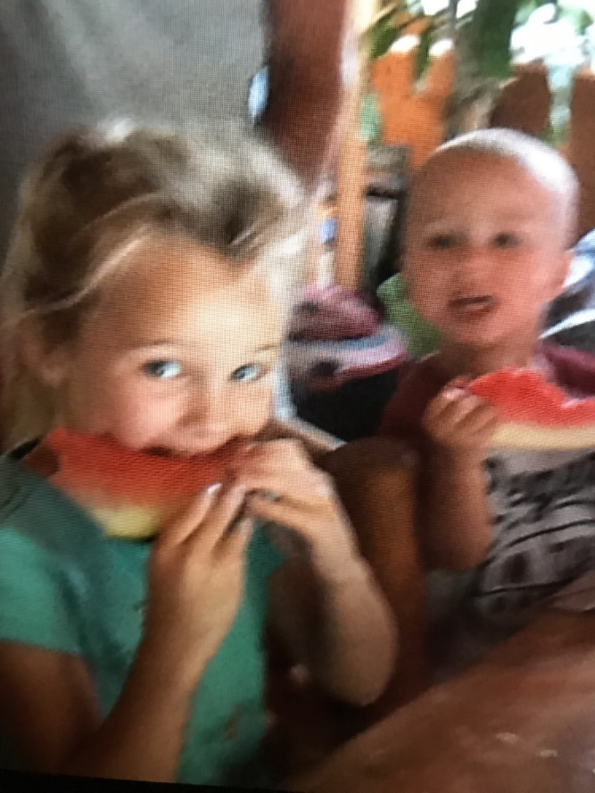
COVID came along!!!
Many students began to garden with grandparents.
Families were “putting away” or canning garden vegetables and fruits.
Students were wearing homemade masks.
Activities became local and families united.
Would we be in school?
Why not strengthen another Harlan cultural heritage? Sewing or quilting

Slide 6
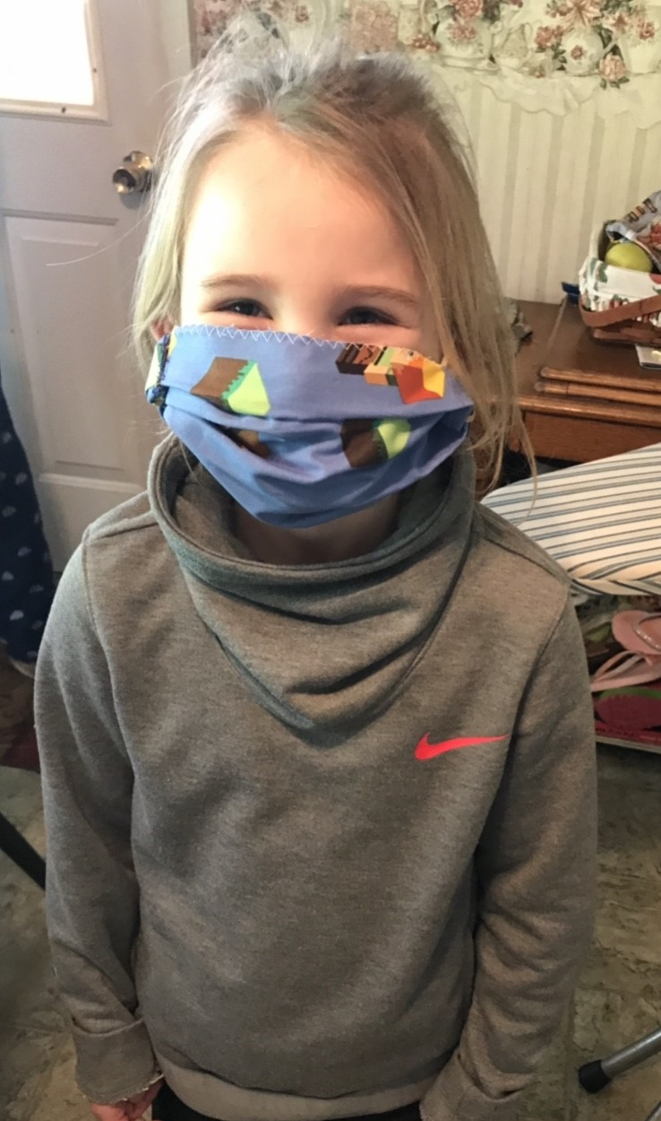
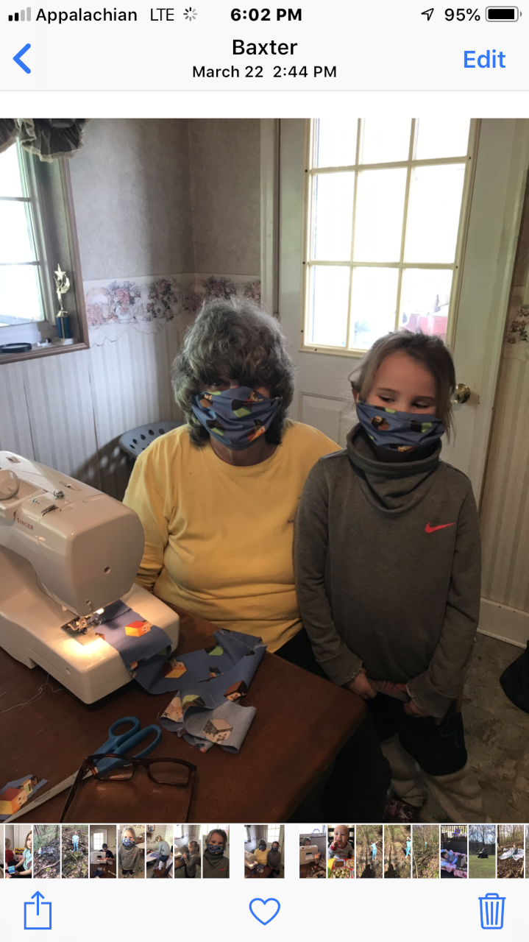
Sewing and Quilting
Sewing could showcase an important part of our community heritage. The ability to sew can also be used by individuals to create economic independence. What a super asset for anyone! Students can provide a community service to others; create clothes, accessories and do alterations for themselves; and learn a skill they can use as a job base for the future.
Face masks: for themselves and to donate to others
Lap quilts for veterans
Period clothing for a living history performance

Slide 7
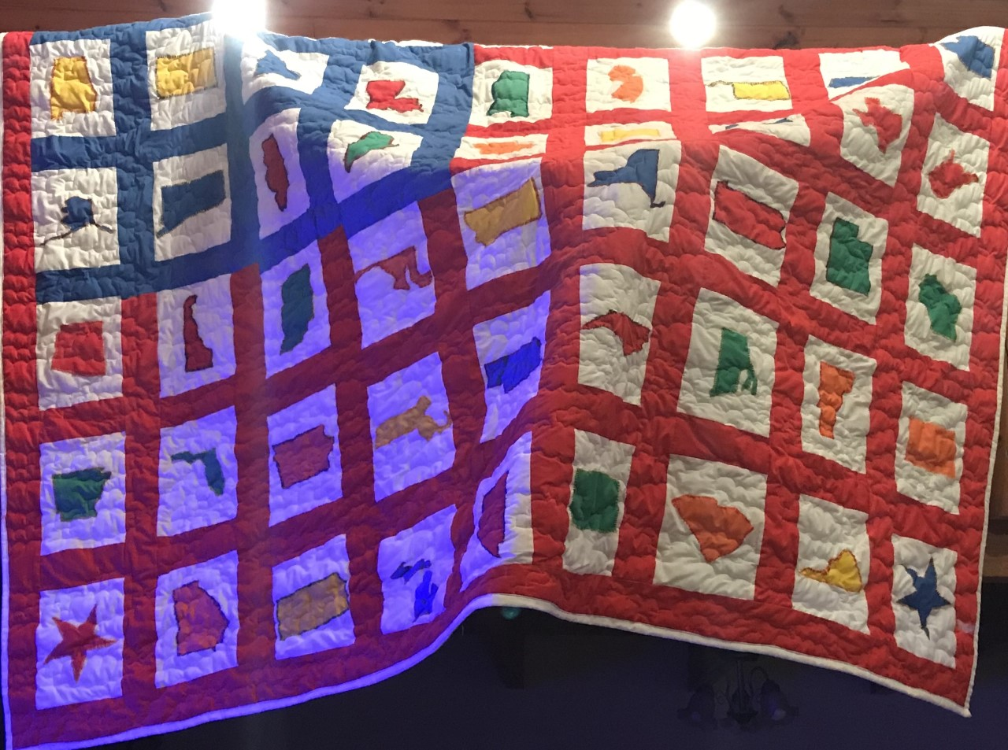
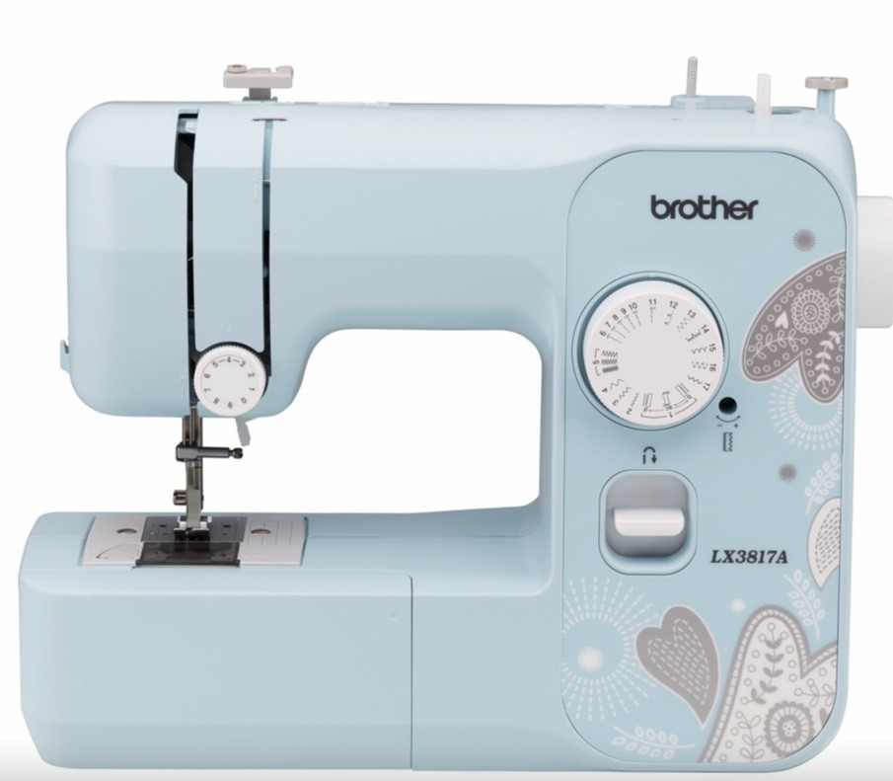
Planning and Resources
I talked with the Harlan County Extension Office who will provide help with students.
Community volunteers will help too.
Since we have such a need for a virtual learning platform this year, students and I will use ZOOM in small groups.
Portable machines will allow students to work from home or school.
Grant funds will help us purchase 6 sewing machines, 6 portable cases, material, and accessories.

Slide 8
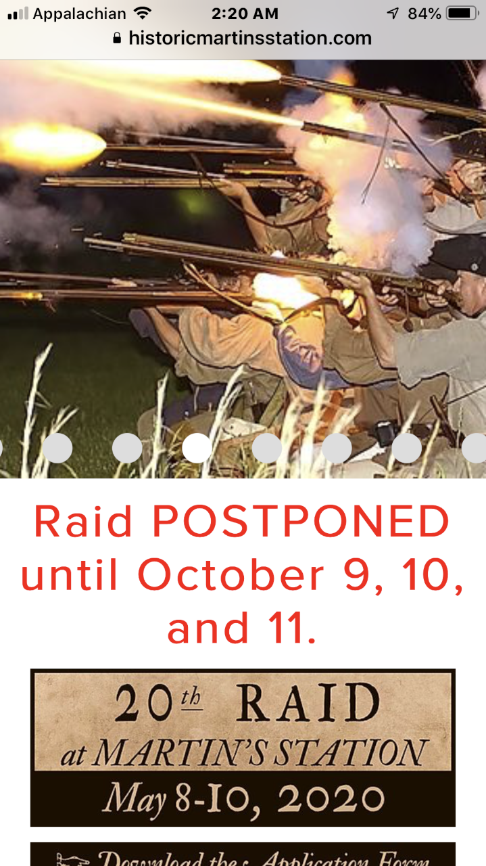
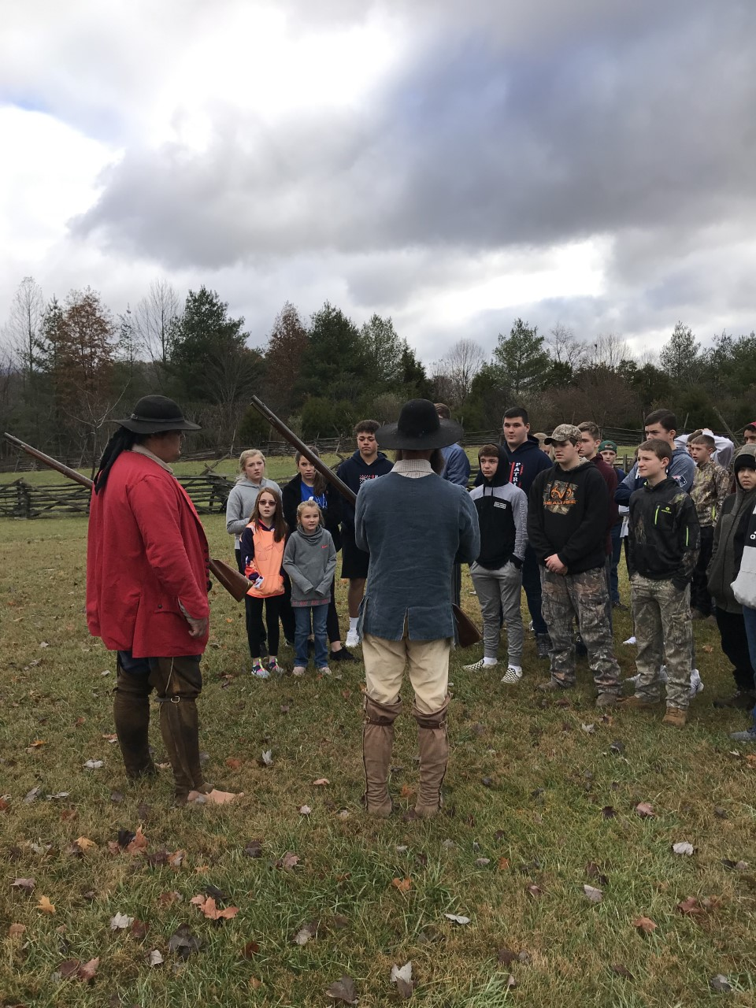
The Finale: Making Clothes, the Historical Inquiry Process, a Culminating Performance
Our final project will be to sew period clothing from history for living history presentations. Each student will explore a historical figure who they will research during the schoolyear. This detailed inquiry will help them to create a character scenario. For example, Silas Harlan is a Revolutionary War hero for whom Harlan County is named. One student will assume his role, sew period clothing for him, and play his role in an outdoor “Living History Day” at our school. Video clips will be digitally uploaded on our school website.
Students will use primary sources, artifacts, classroom research activities, documents, and other inquiry opportunities to create a background portfolio of their historical character and use it to design their character into a living history persona. This spring, all students will outfit themselves in their period clothing, assume the role of their historical character, and perform live on a “Living History Day” at our school.

Slide 9
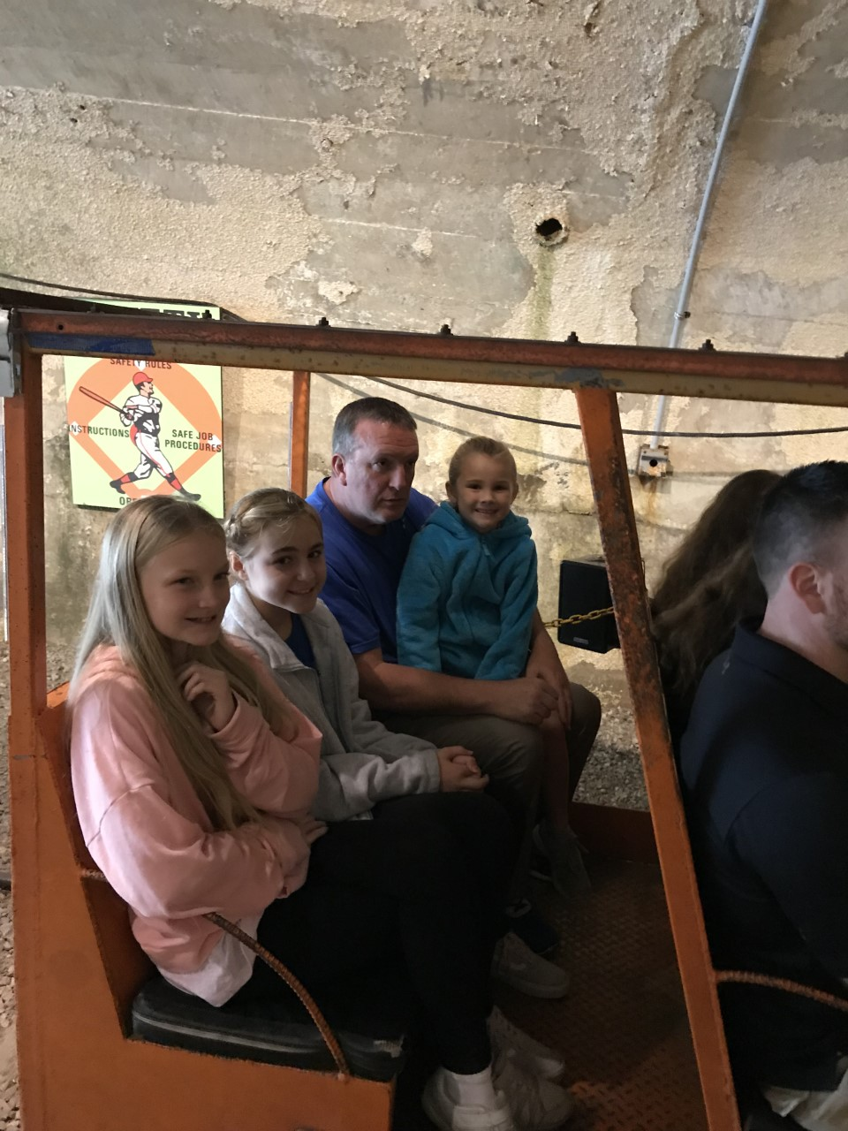
It’s About the KIDS
Students “get into” a study that is fun and engaging in which they create products and a live performances. Engagement promotes rigorous investigation which in turn prepares students for sustained research and investigation in high school, college, and careers.
And we learned to sew!!!!!

