Slide 1
Strategic Support
for
Differentiated Learners from a
Distance

Slide 2

Ms. Tackett
-South Floyd Elementary
- Nine Years of Classroom Experience
-Teaches Reading and Science
-Loves to Incorporate STEAM opportunities to engage diverse learners

Slide 3
Background
During this unprecedented school year, educators everywhere have been concerned about how to meet the diverse needs of their students.
In a world of digital, distance learning it is often difficult to provide support to students who learn in a variety of ways.
The intent of this ARI grant was to find benefits in the way we utilize resources to help support students at South Floyd Elementary. One way has been to equip our students with resources that would increase their engagement while learning in a virtual setting.

Slide 4
Action Research Question
Do students who have varied learning styles succeed and engage more when given resources that compliment their preferred learning style?

Slide 5
Research

Slide 6
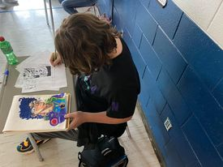
-Note taking by hand is correlated with higher rates of achievement.
-Active Engagement though writing stimulates the brain to increase engagement.
-Princeton University study shows increased comprehension when diverse learners can engage through active engagement when writing by hand.

Slide 7
Proposal
Funding from this ARI grant has been used to supply
8th grade students at South Floyd Elementary School with reusable Rocketbook Notebooks to support learning virtual and hybrid learning during this school year.

Slide 8


Rocketbooks
Rocketbooks are cloud-connected smartnotebooks that you can reuse. Once written on, students can send their work to their own Google Drive and to their teachers with a press of a button.
Students can use notebooks in a virtual or hybrid setting and use them to organize by sending it to their Google Drive while also still utilizing pen and paper.

Slide 9
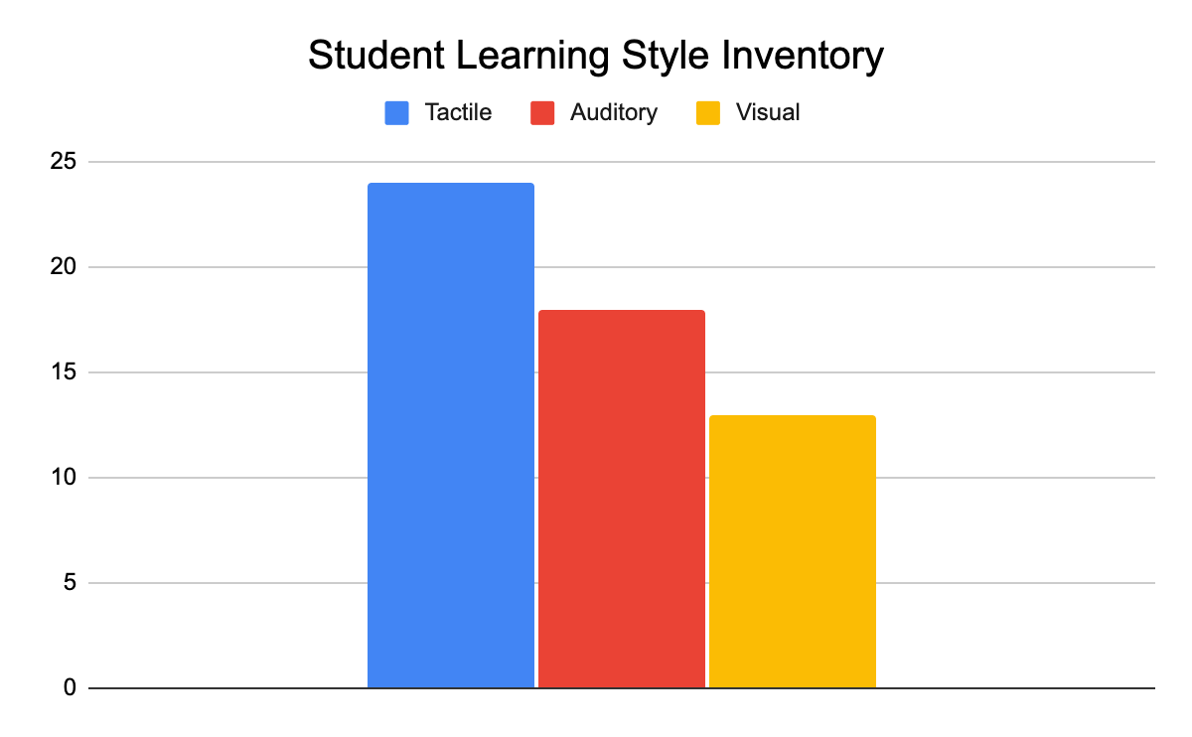
Differentiated Learners
The first priority was to determine the specific learning styles of our students to see if there would be a correlation of types of learners and increased engagement.
-Utilized 10 question quiz on educationplanner.org

Slide 10
Distributing Rocketbooks
Once students took learning style assessment they could pick-up Rocketbooks and experience a short orientation and set up session.
We have 32/55 8th grade students who are currently utilizing Rocketbooks.

Slide 11
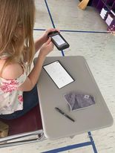
Outcomes
Inconsistencies this year created barriers for obtaining authentic quantitative data about how Rocketbooks supported student learning.
However, we did find that students utilized Rocketbooks with ease when prompted and for their own individual use.
This created opportunities to communicate with teachers, show work and maintain organization despite what type of learning experience our students were enrolled in.

Slide 12
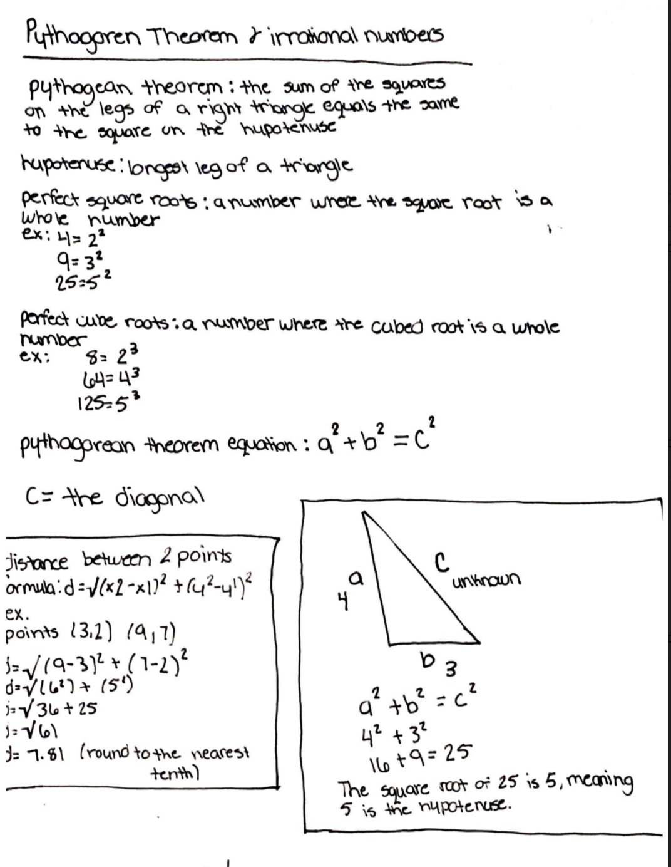
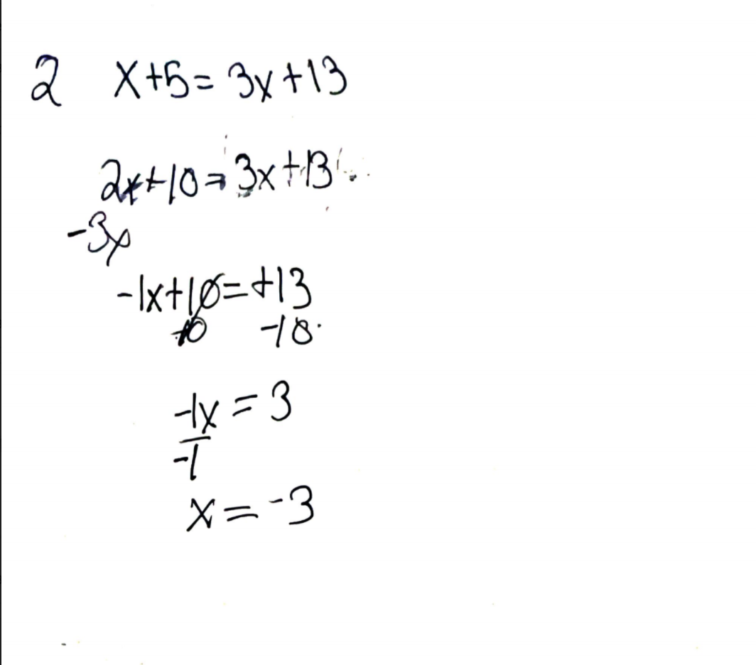
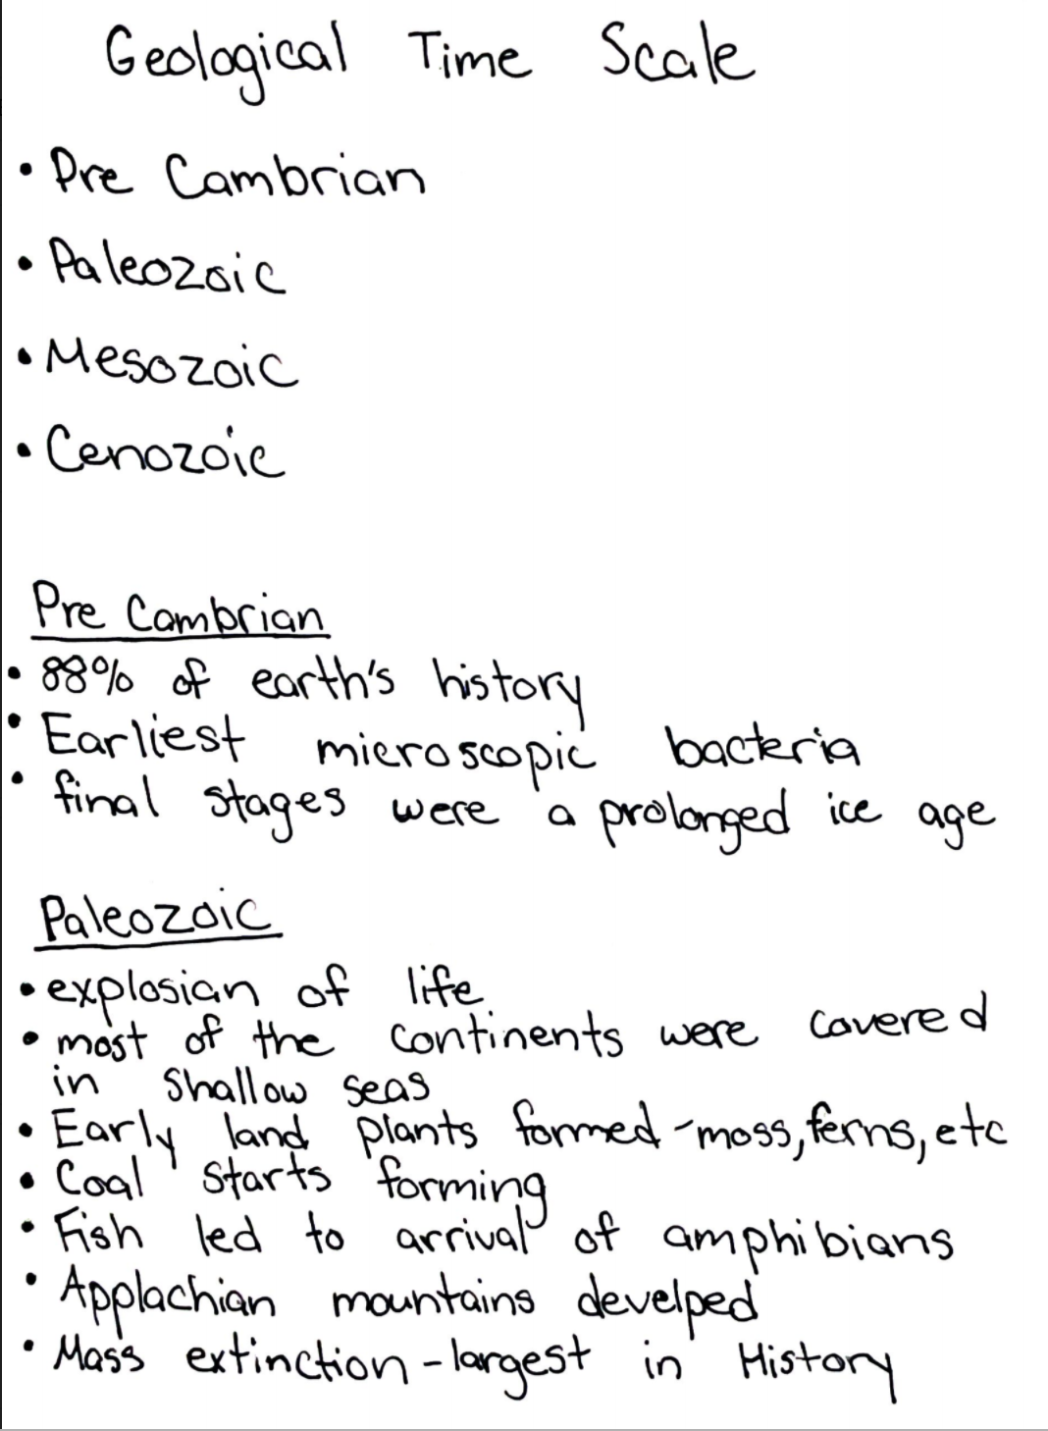

Slide 13
A Word From Our Students

Slide 14
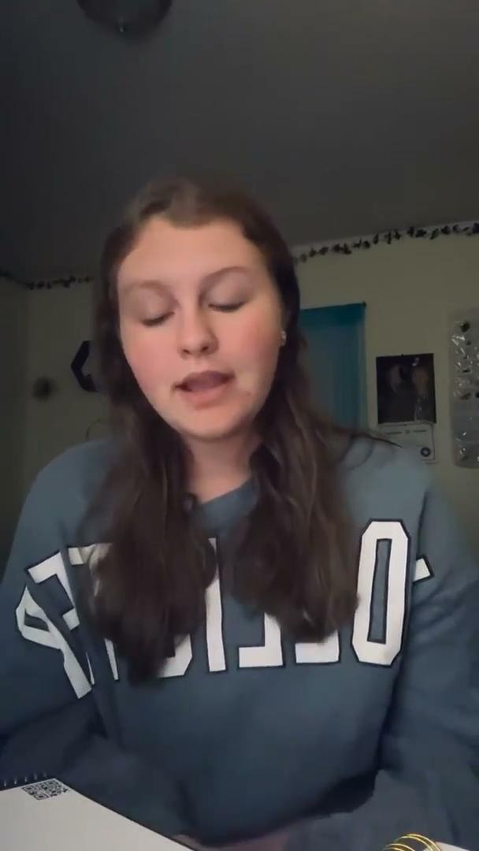

Slide 15

Thank you!
Kelsey.Tackett@Floyd.kyschools.us
@kelsey_tackett

