Slide 1





Dell Student Tech Crew
Partnership with
Floyd County Public School District
and
Kentucky Valley Education Cooperative

Slide 2



Dell Student Tech Crew
Dell Student Tech Crew is a certification program dedicated to building future problem solvers to assist in the advancement and maintenance of technology.

Slide 3
Dell Student Tech Crew
Certification Process like Dell employees
Mentorship with Dell Employees
Practice and Perfect Customer Service
Develop Knowledge
Spark Innovation

Slide 4



One District,
Two Opportunities

Slide 5

Floyd County School of Innovation

Slide 6


Floyd County Schools and KVEC
Virtual Option

Slide 7
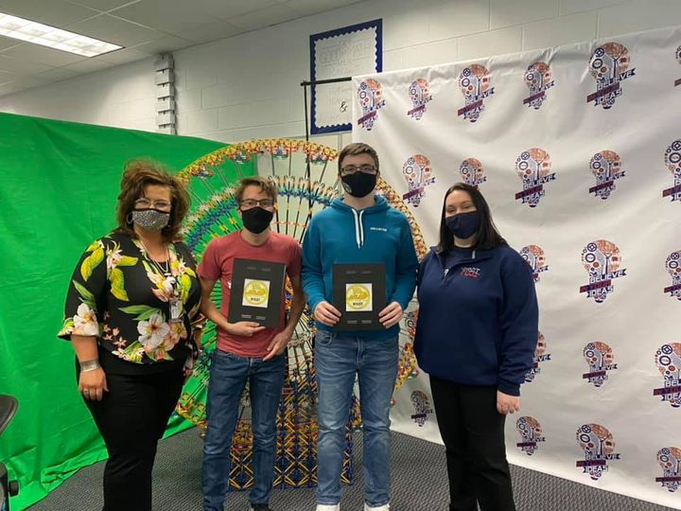
Nine Floyd County Students are Dell Tech Certified
Branson Johnson
John Lewis
Michael Akers
Conner Lockhart
Brylie Pennington
Nate Ball
Ryan Hicks
Kanyan Blankenship
Jacob Robinson
Branson Johnson and John Lewis
were Floyd County’s first
Dell Certified students through the Floyd County School of Innovation.

