Slide 1
STEM Virtual Worlds
Jesse Lucas
Pikeville High School
Physics/Engineering

Slide 2
Problem of Practice
Can we use technology to help spark interest in STEM fields even in a Pandemic?
Hybrid schedule (for now)
STEM classes need hands-on class.
Sparks interest
Step in scientists shoes

Slide 3
Plan
RobotC Virtual Worlds
Principles of Engineering
Vernier Video Analysis
Intro to Physics
iPad - explain everything app
Physics/Engineering

Slide 4
RobotC Virtual Worlds
Simulator for VEX robotics
Students may or may not get to build
Depends on schedule
Can use whether in or out of class
If out, they still get entire unit
If in, saved tremendous amounts of time
Perpetual license

Slide 5
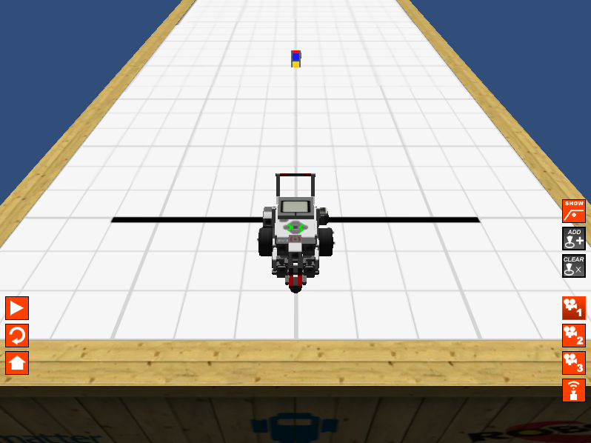
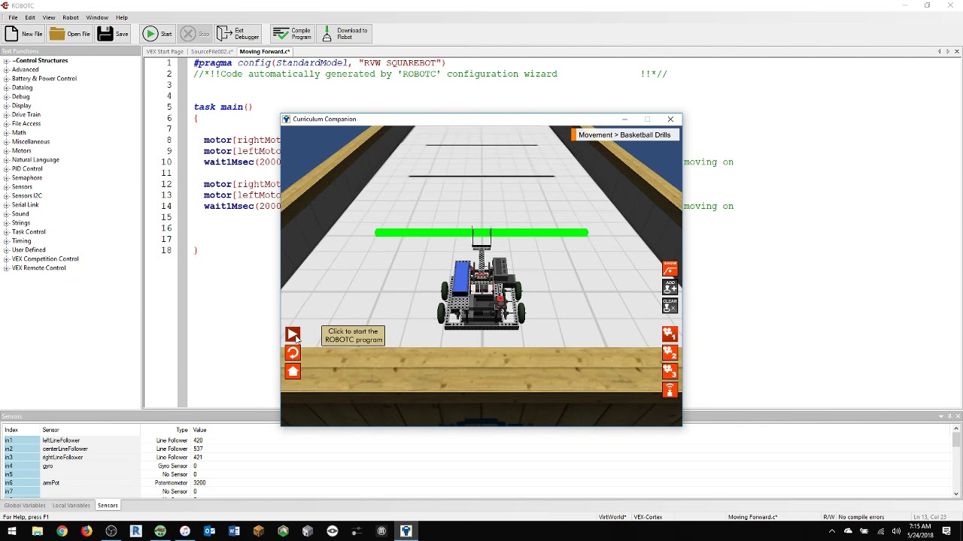
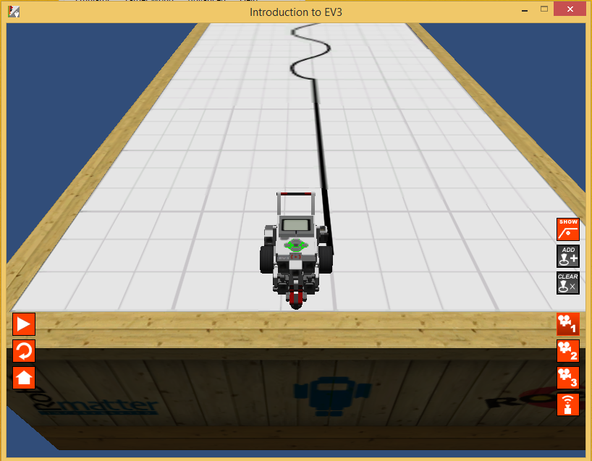
RobotC Virtual Worlds

Slide 6
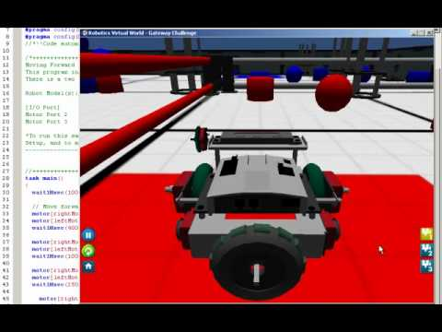
RobotC Video

Slide 7
Vernier Video Analysis
Video Analysis app for computers
Streamlined and simple
Select video and then you’re off
Position graphs
Motion graphs
Multiple directions
Perpetual license

Slide 8
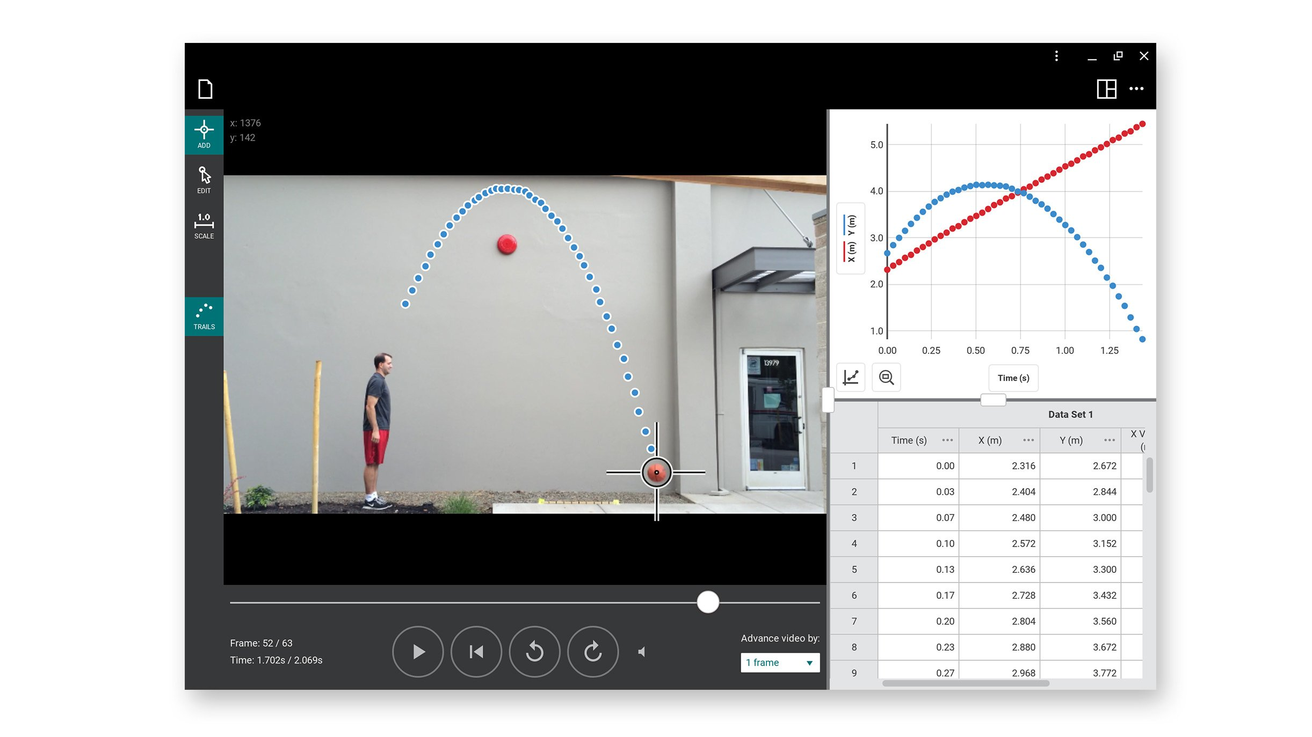
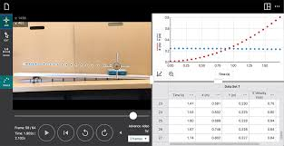

Slide 9
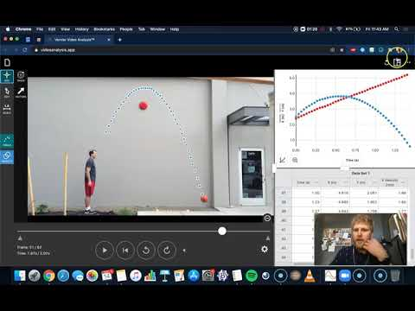
Video 4:00 - 5:05

Slide 10
iPad + Explain Everything App
Virtual Whiteboard
Animation features
Video editing
Packaged with resources
Remote whiteboarding
Has on cloud storage
Small purchase each year
Plan on repurchasing it with classroom budget yearly.

Slide 11
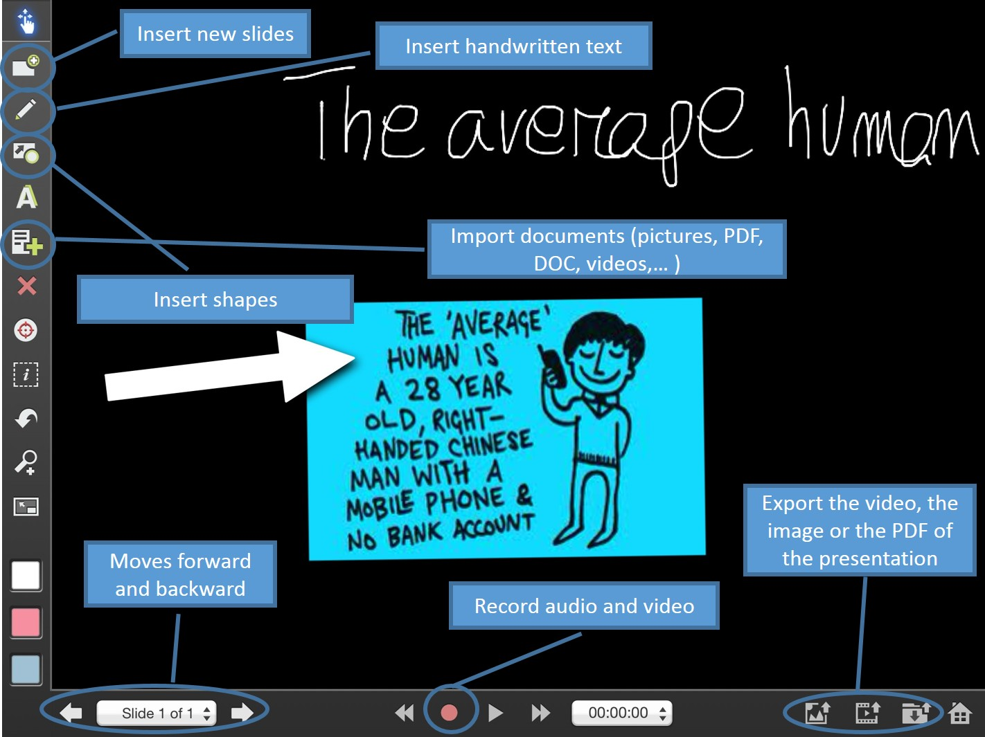
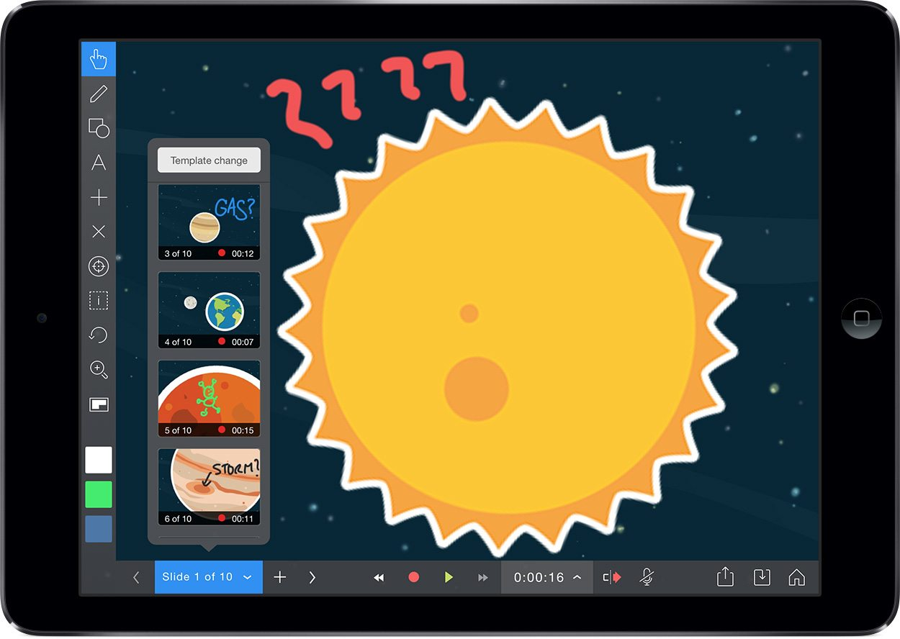
iPad + Explain Everything App

Slide 12
Video 0:00 - 1:13

Slide 13
Proving and Measuring Outcomes
Can give a pre and post assessment before each use to gauge if students enjoy experience and make them more interested in STEM career.
RobotC Virtual Worlds -
Assign objectives
Vernier Video Analysis -
Use driving questions: pre assessment
Pointed questions on summative assessment
Explain Everything App -
Compare math retention before/after
Survey to see if videos helped

