Slide 1
Play Based Learning
And Exploring
ARI Grant
Frankie M. Puckett
2020-2021

Slide 2
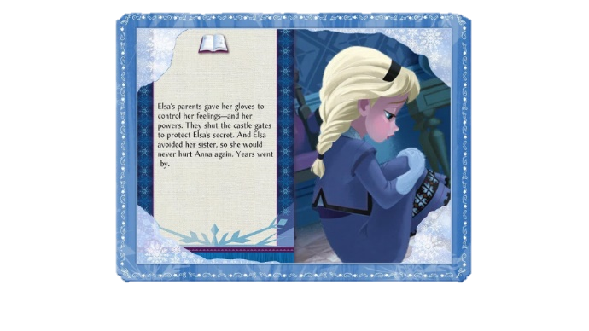
Project Question and Objective
How can I better serve all my students and meet their diverse learning needs?
The objective was to find out if using multi sensory hands-on projects/activities would increase student engagement and learning.

Slide 3
Number Balance Scale Monkey
Educational games and supplies students used to help with learning.
LCD Writing Tablet
Alphabet Linking Letter and Word Building Cubes
VTech Write & Learn
TPT
Dry boards and erasers
Even Steven Odd and Even
File Folder Game
Jumbo Foam Dominoes

Slide 4
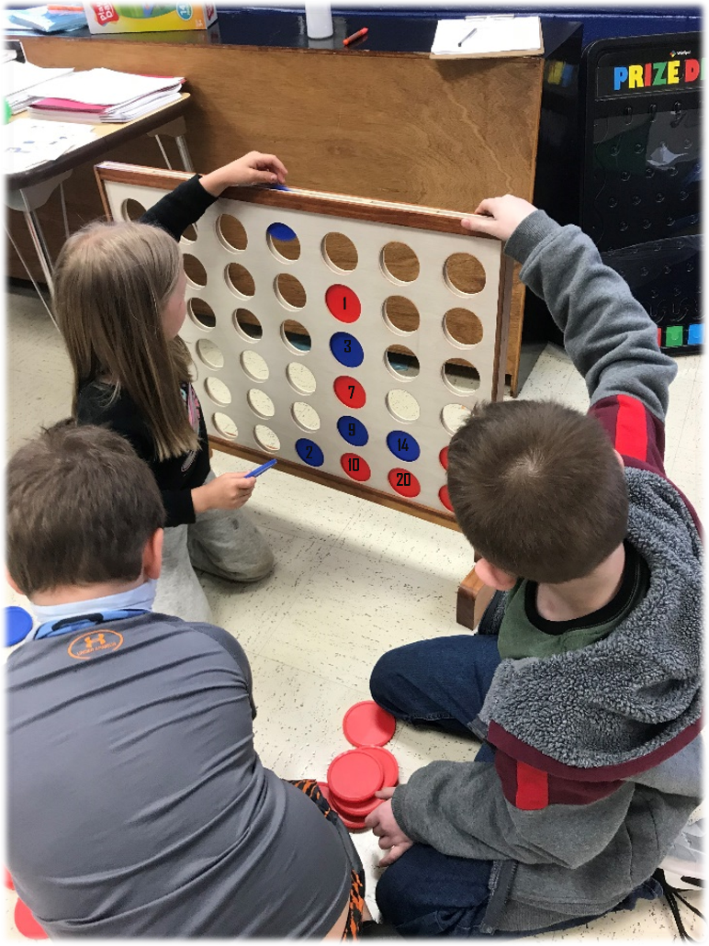
We used the connect 4 game to practice math and literacy skills at various levels.
Various numbers were written on the chips. The student was given a problem and had to find the answer. If correct, they dropped the chip. If not, it was reviewed and used for them next time.
Also used for sight words, rhyming words and contractions.

Slide 5
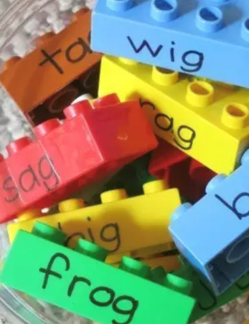
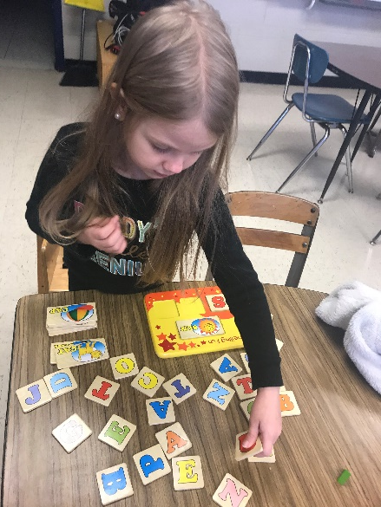
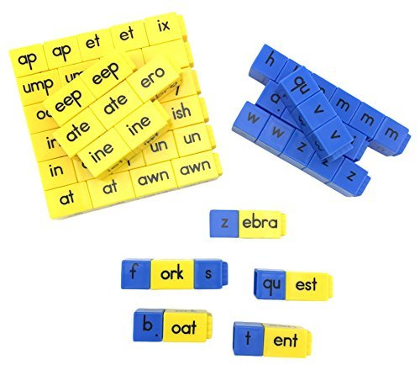
Students practiced the alphabet, spelling and word skills with various literacy tools.
Also learned words with color-coded cubes for easy identification: blue cubes are initial consonants; yellow cubes are short and long vowel word family chunks.

Slide 6
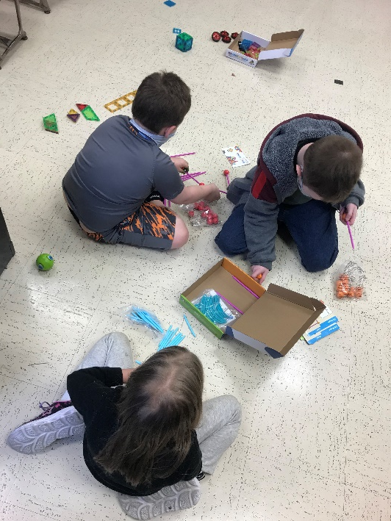
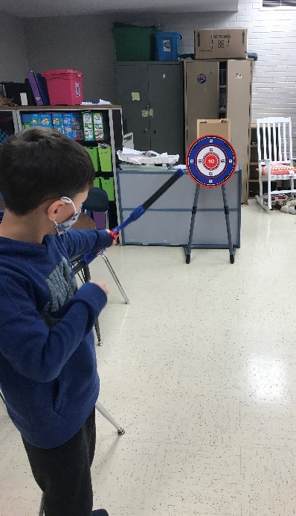
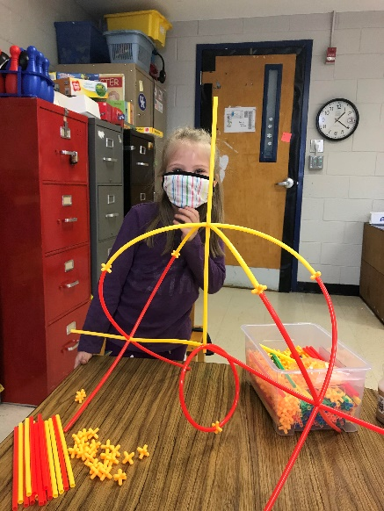
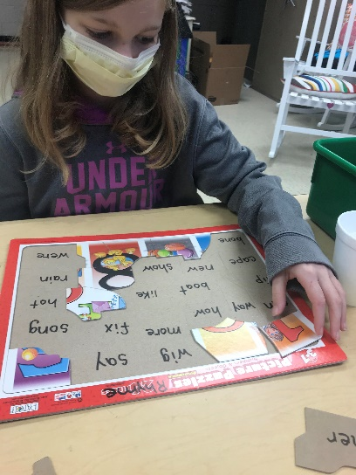
Learning in Motion:

Slide 7
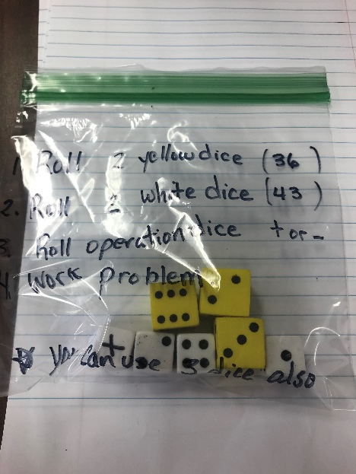
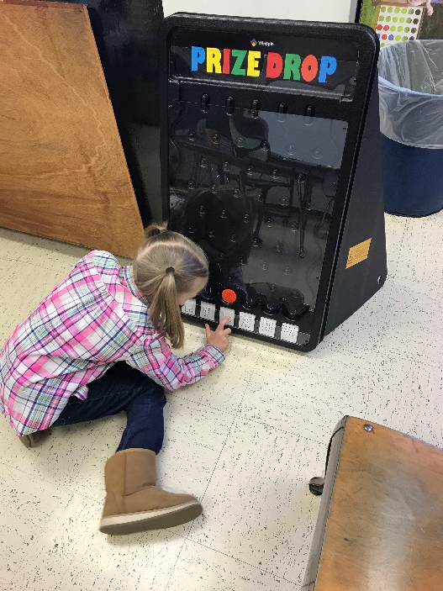
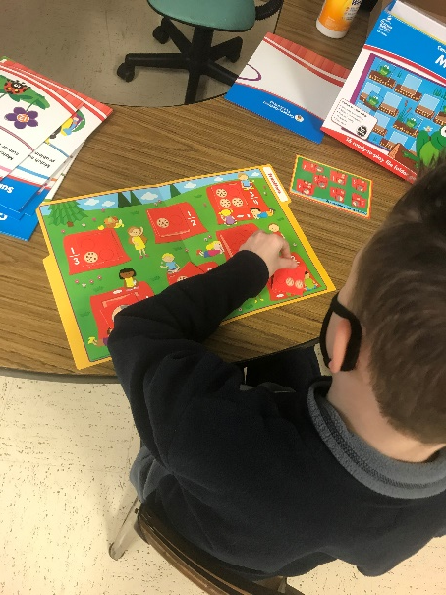
Learning in Motion:

Slide 8
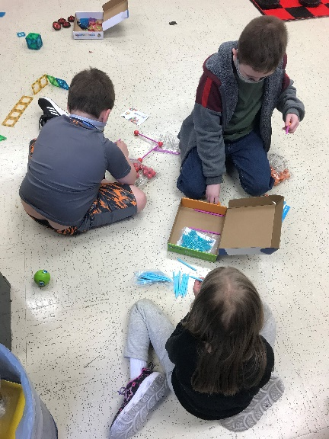
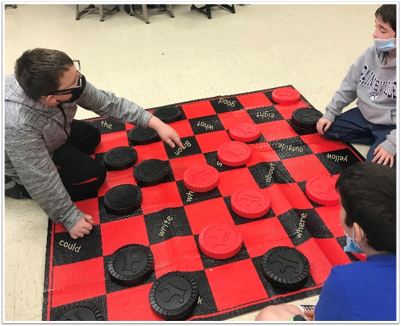
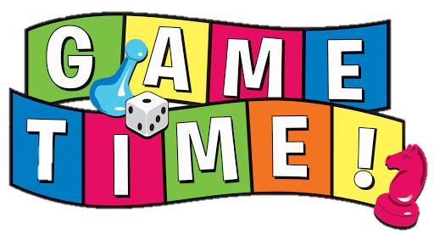
This engaged students by making review sessions and quizzes fun and interactive in math, spelling and reading!

Slide 9
2nd Grader: High Frequency Sight Words: 80/220
3rd Grader: Multiplication Facts: 5/25
Kindergartener: Upper and Lowercase Alphabet Identification: 5/52
2nd Grader: High Frequency Sight Words: 80/220
3rd Grader: Multiplication Facts: 5/25Kindergartener:
Upper and Lowercase Alphabet Identification: 18/52

Slide 10
I feel the project was successful because my students increased letter/number/word fluency along with basic math facts (multiplication).
It increased time spent hands-on multi-sensory activities/tasks/games will increase students scores on curriculum-based probes.

Slide 11
As we end the school year, my goal is to help my students progress academically and socially utilizing multi-sensory tasks/games.
My students became enthusiastically engaged; actively reading and learning math facts and understanding concepts being taught.
Thank you!

Slide 12
Questions
Frankie.puckett@paintsville.kyschools.us
Clipart and background images:
Dreamstime.com
Free clipart.com
Clipartpanda.com
Walloftext.com

