Slide 1
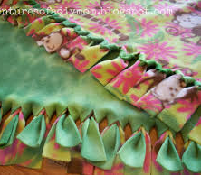
Lap Quilts for Hospice
Donna Combs
Breathitt High School

Slide 2
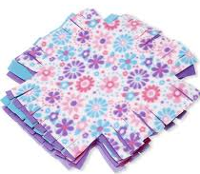
Problem of Practice
How to use in-person and virtual learning to create 20-25 Lap Quilts for Hospice while improving the student’s Math skills.

Slide 3
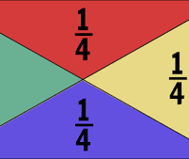
Strategies Used
The students will increase their knowledge in the area of measurements by using repetitive practices, and hands-on activities.

Slide 4
Resources Necessary
Some of the resources that we will need are: Fleece material, acrylic ruler, internet, Ziploc baggies, and scissors. We will also need the support of the administrators.

Slide 5
Improving our Math Skills
The students will continue to improve their Math skills, especially in the area of fractions, while giving comfort to Hospice patients, who are suffering through fears of the unknown. The students know that even a small quilt will bring comfort. It will allow them to know that someone cares enough to take their time and knowledge to create something so special.

Slide 6
Research Question
The research question that guides this project is: How can we, as young adults, use math in real-life situations to benefits those around us?

Slide 7
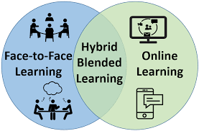
Successful Innovation
We will know that our project was successful when we complete the Fleece lap quilts from kits that was made, so that we can participate even when we are using a Hybrid Model Instruction

Slide 8
Outcome Measured
We will measure the outcome of this project by connecting our Math skills to real-life situation and understand how Math is essential to our world. We will also know that it is a success by knowing that others appreciate something that we have made and can find comfort in it.

Slide 9
A positive outcome will be achieved when we deliver the quilts to our local Hospice organization and know that they will bring comfort to those who are experiencing pain and fears of the unknown.

Slide 10
Donna.combs@breathitt.kyschools.us
If you have any questions, please contact:

