Slide 1
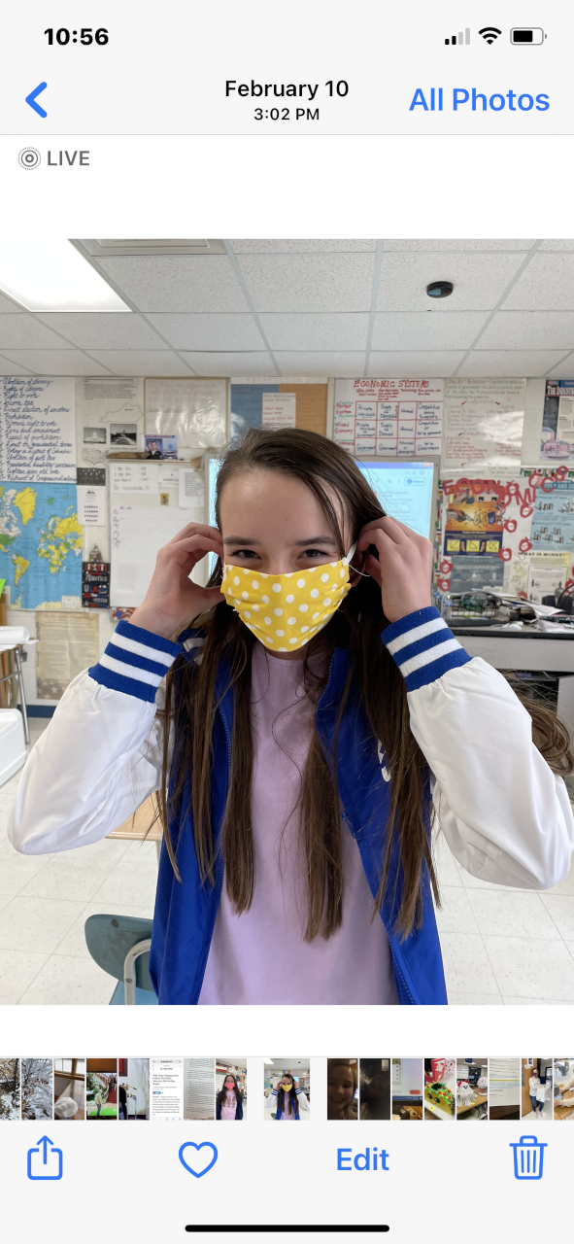
Sewing: A Bridge to Appalachian History, Economic Success, and Cultural Awareness KVEC Learning Innovation Grant 2020-2021
Debbie Napier
Rosspoint Elem. School
Harlan County, KY

Slide 2
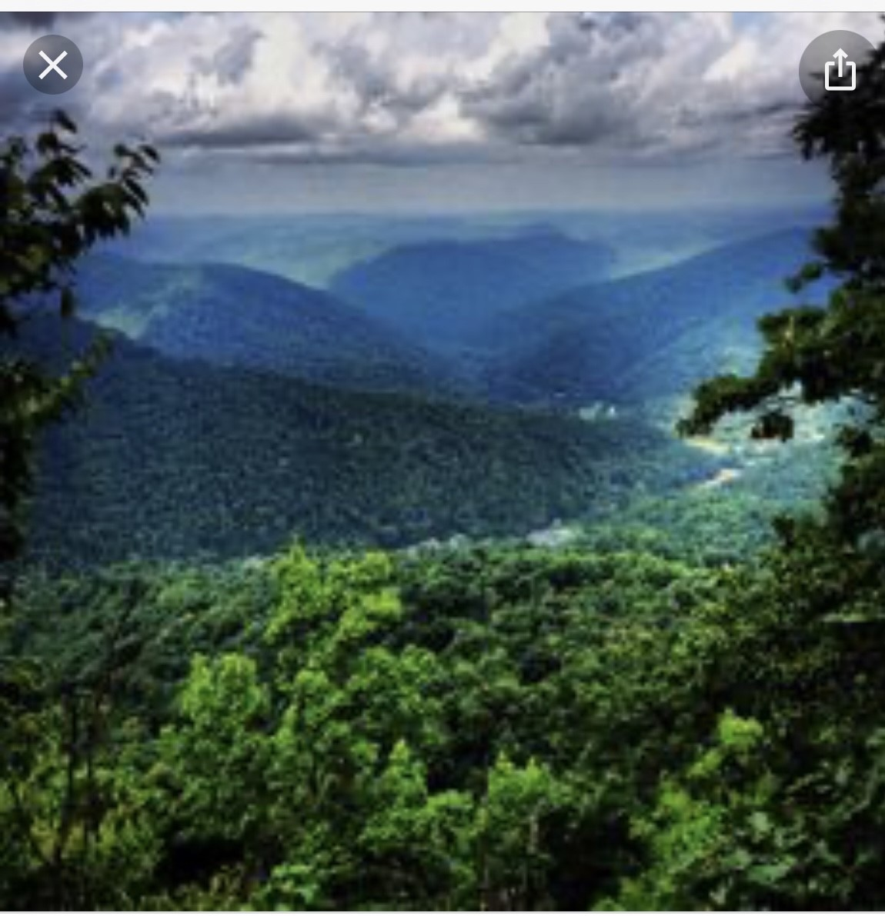
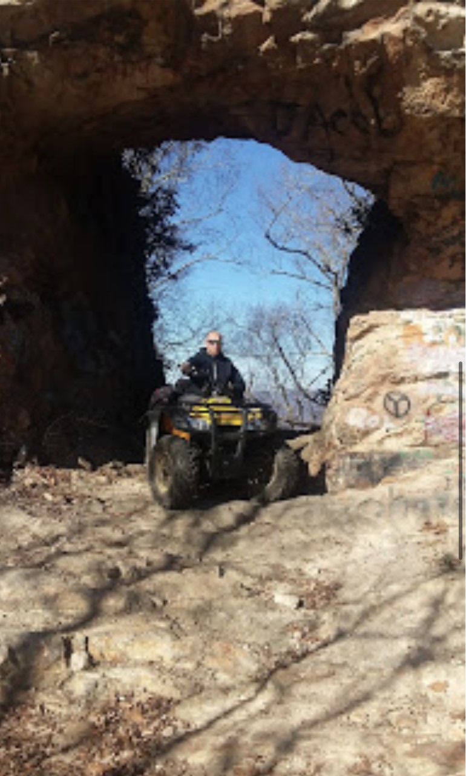
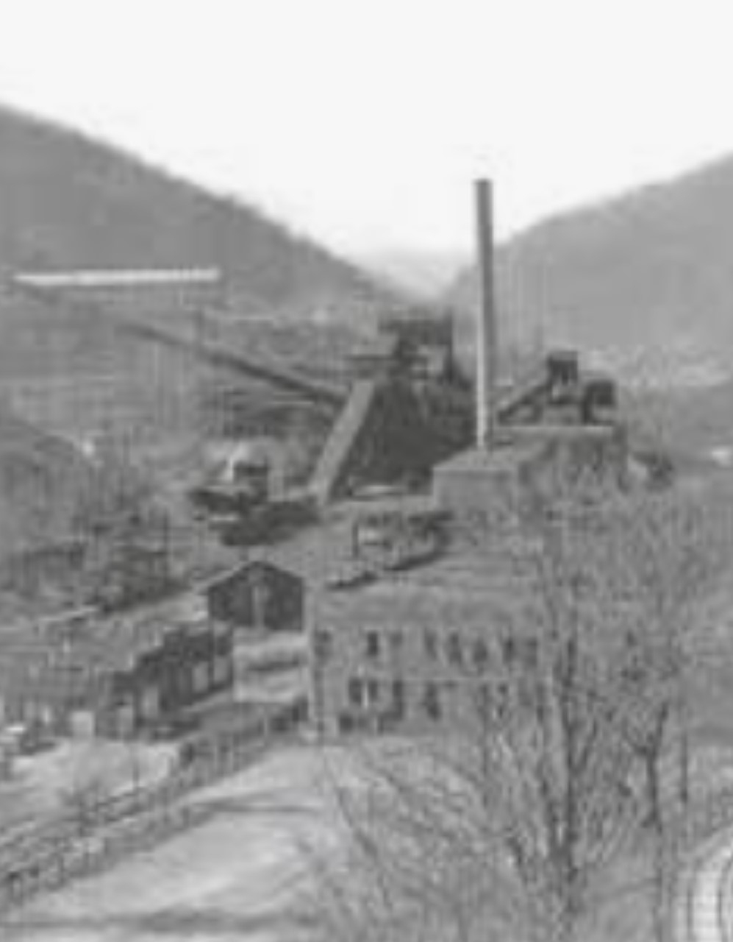
Harlan County
· Natural beauty
· Rich culture
· History making!
Population and job loss from the diminishing coal industry forces young people to leave for college and economic opportunities. We are proud of our traditions want our area to shine out as a cultural light!

Slide 3
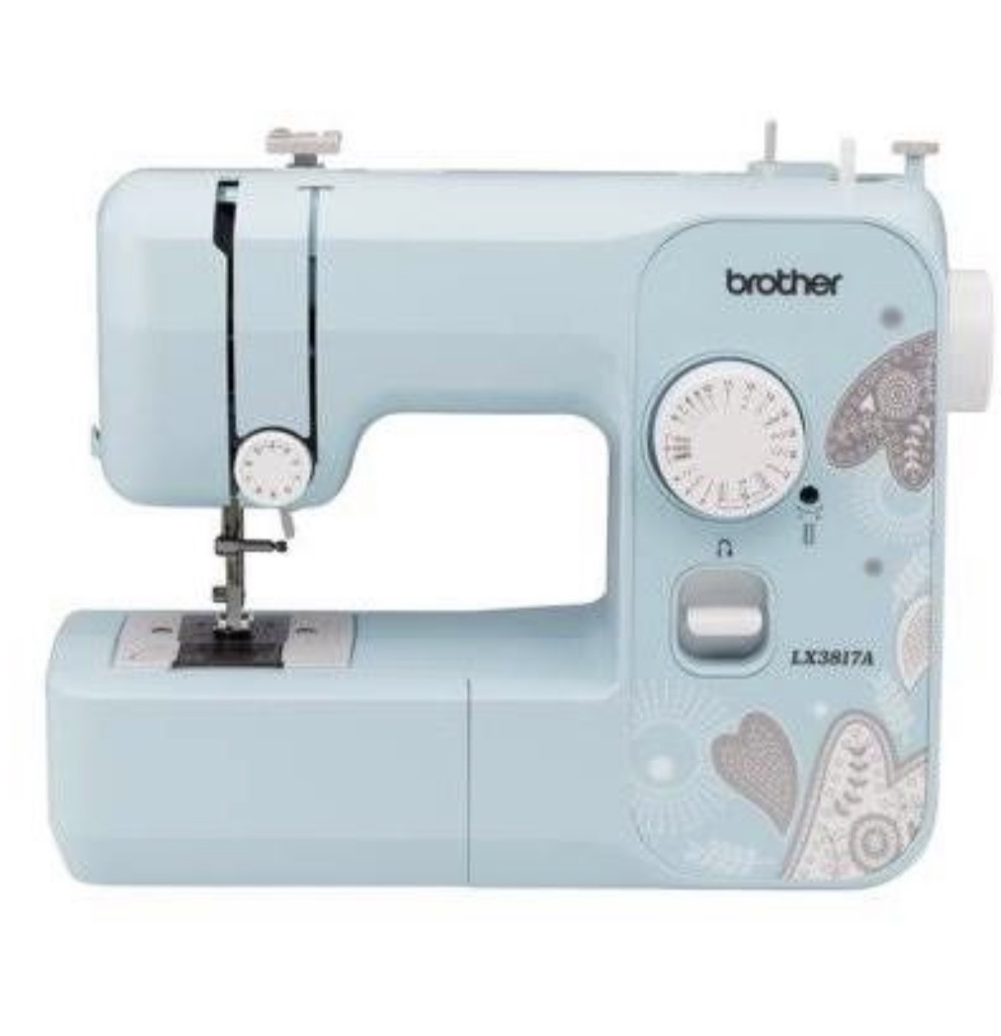
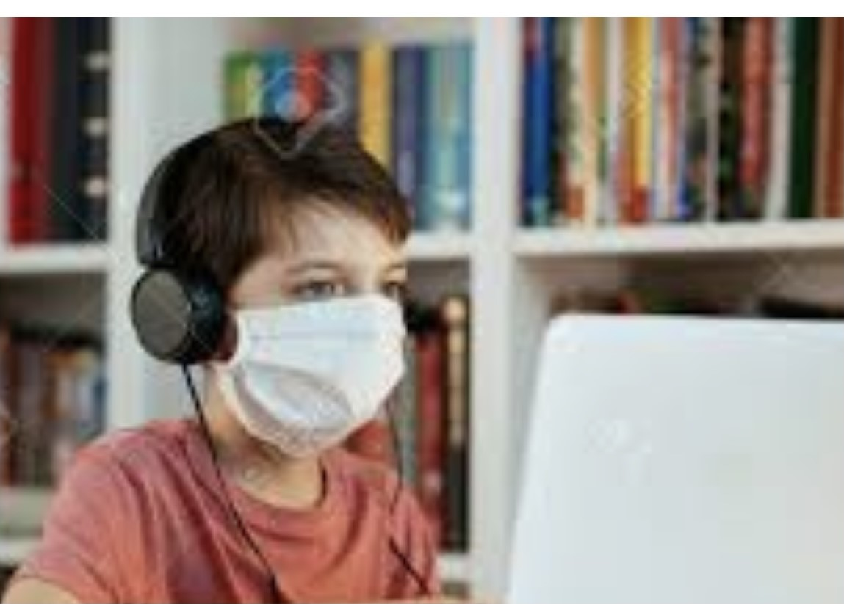
Research question:
In a Covid challenging world…. What ways can innovative technology contribute to Harlan County school children overcoming the stigma of living in a poverty area, build personal self-esteem and pride in community, help them learn to sew and quilt, and encourage them to explore with inquiry and research to develop living history roles?

Slide 4
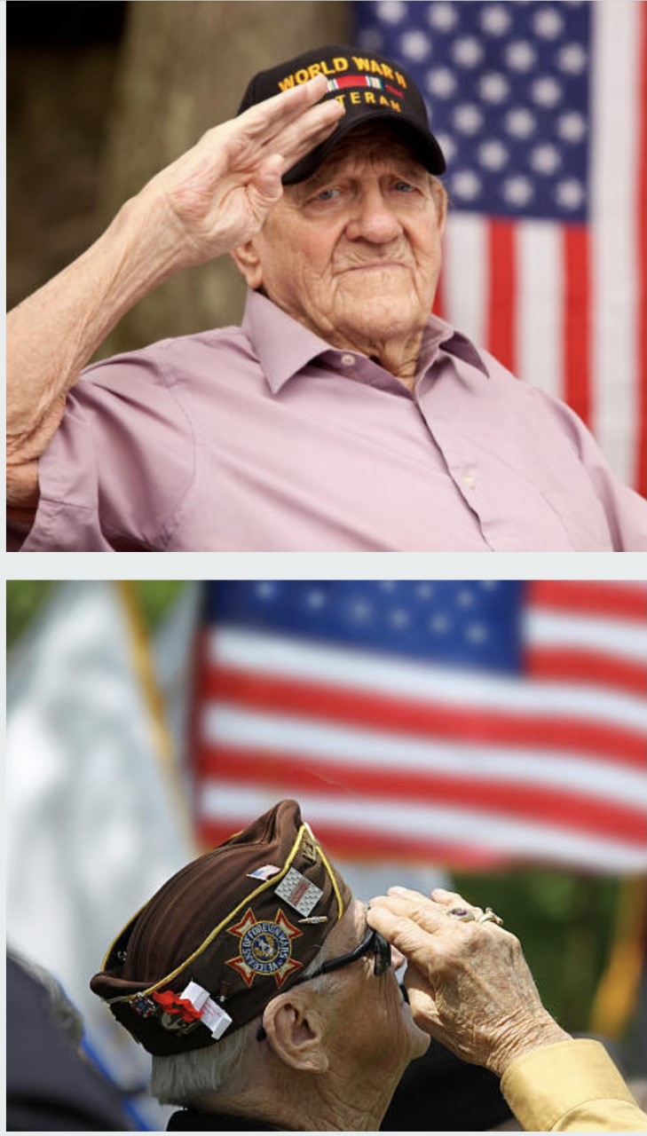
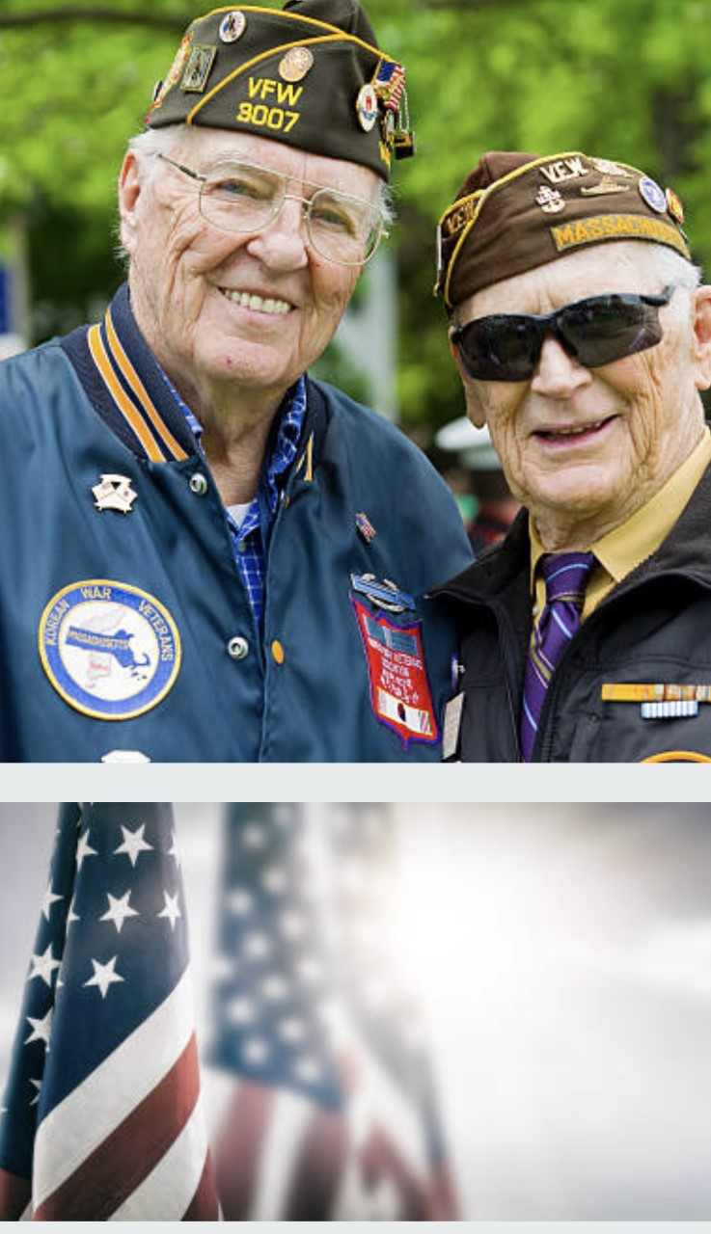
Action Research through Place Based Learning (for us, a connective process)
Harlan County Coal History Virtual Field Trips for two years
· Pride in community recognition
· Generated more inquiry, desire to explore local culture
· Covid introduced gardening, canning, and sewing masks
· Students were motivated to donate needed masks
· Students discovered family members who sewed
· Quilting could bring cultural pride
· Decided to donate quilts to veterans as a service
· Develop an economic talent!

Slide 5
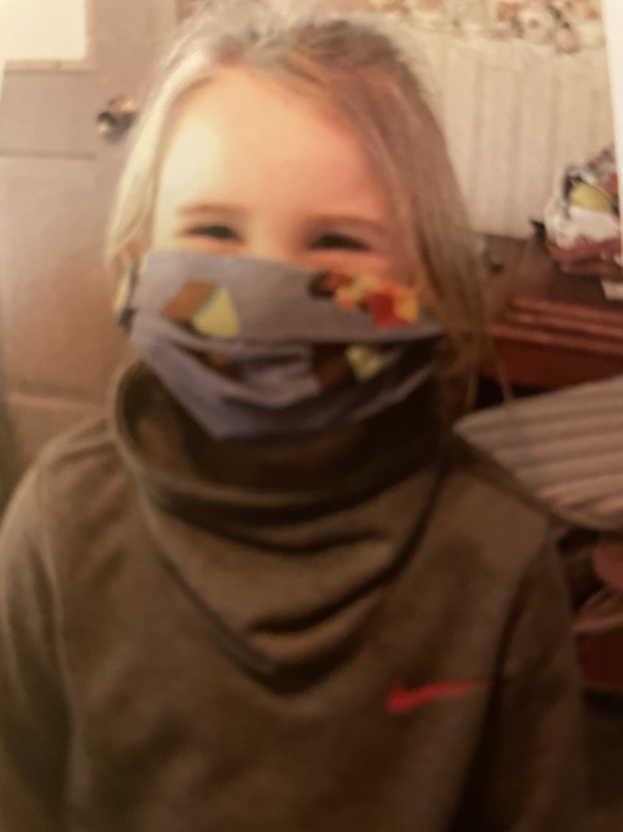
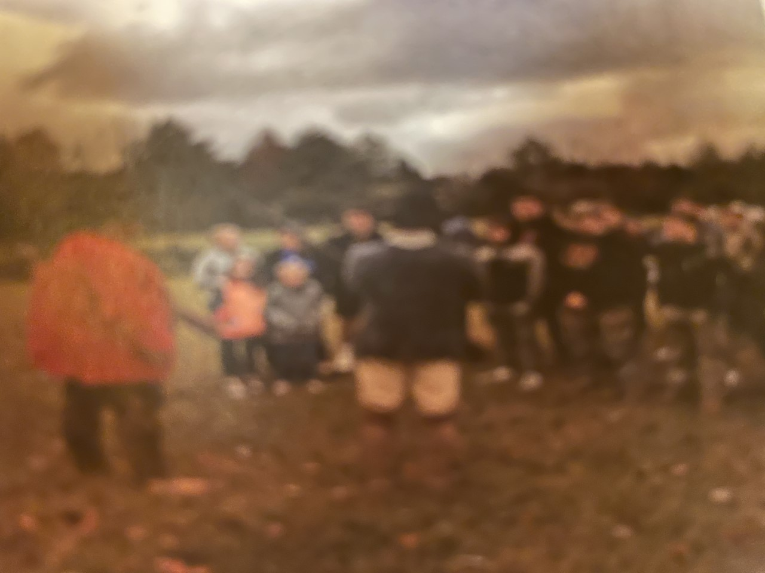
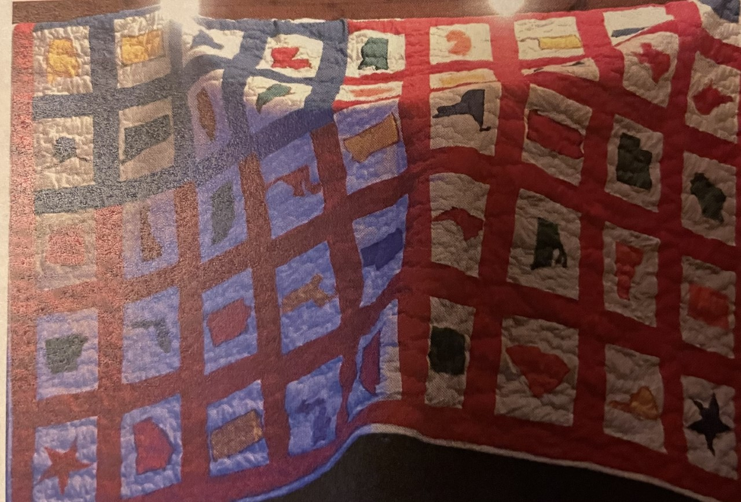
Sewing and Quilting (as Place Based Learning)
Sewing could showcase an important part of our community heritage. The ability to sew can also be used by individuals to create economic independence as a future job source in an area that needs job growth. What a super asset! Students are providing a community service for others, learning to make clothes, will have the ability to do alterations, and learn a skill they can use as a job base for their future.
Original (Interesting word!) Plan
Learn to sew, then make……
Face masks for themselves and to donate
Lap quilts for veterans
Period clothing for living history

Slide 6
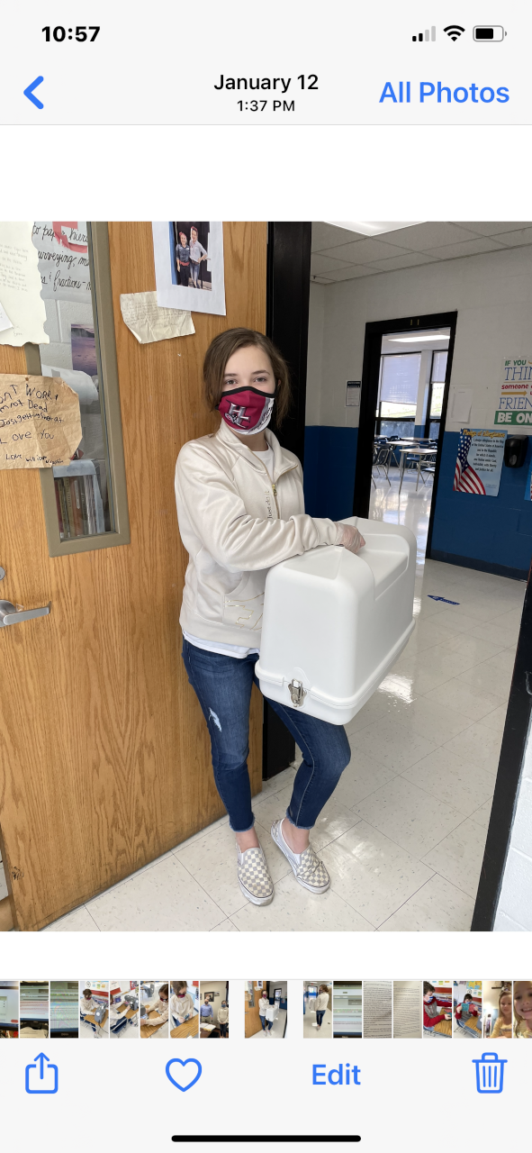
Planning and Resources
Innovative Grant for 6 sewing machines and 6 portable cases that allow students to work from home or school.
Virtual learning platforms will guide students.
Harlan County Extension Office to provide help with students as well as community volunteer participation.
Grant funds purchased material and other accessories.
Our finale will be period clothing for living history.
We will be revisiting this slide!

Slide 7
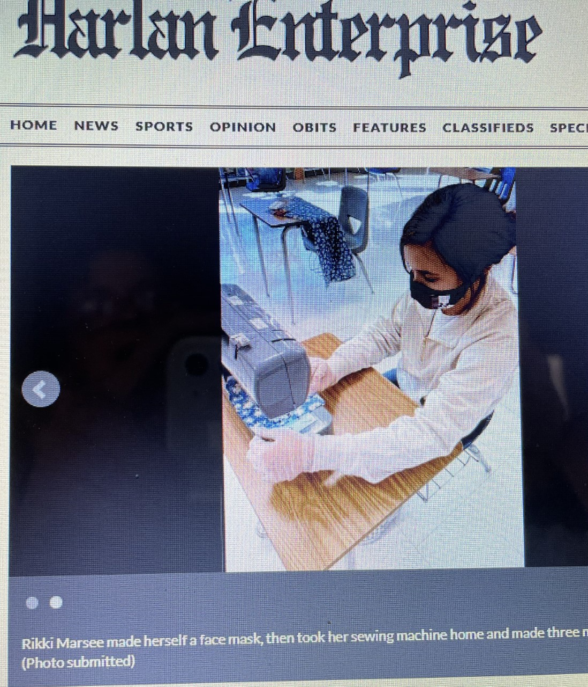
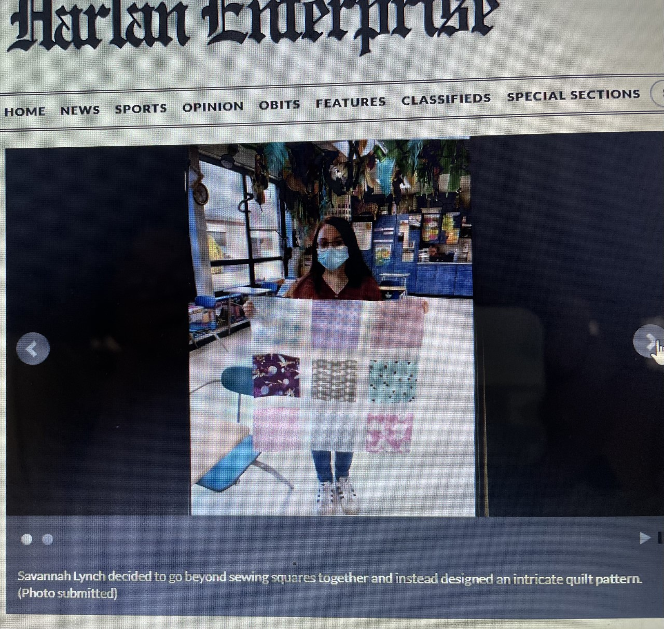
Are our outcomes proving our innovation is succeeding?
Yes, yes, yes, yes, yes!
Several students have completed multiple masks, but the quilting has emerged as the dominate and more easily learned activity.
You can’t pack those sewing machines home in secret, and the community has gotten behind us and loved the project. One grandmother made an extra quilt herself to donate and asked that all the students sign it and include it with theirs as an EXTRA donation to veterans. The project was picked up by a local newspaper which showcased what students were doing. Then our class was contacted by WYMT Television who wanted to come and interview students about their accomplishments - then students were the featured news story that night!

Slide 8
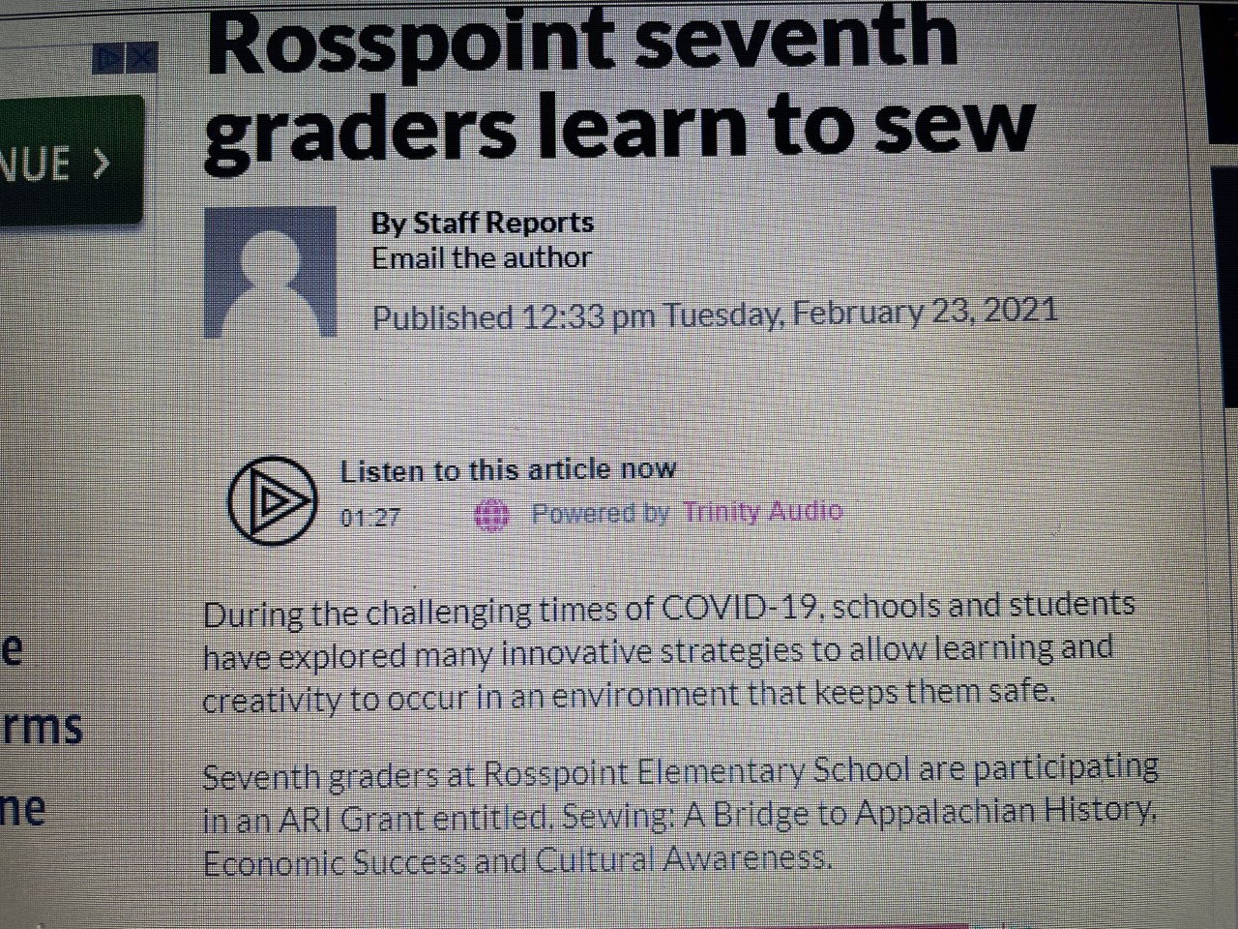
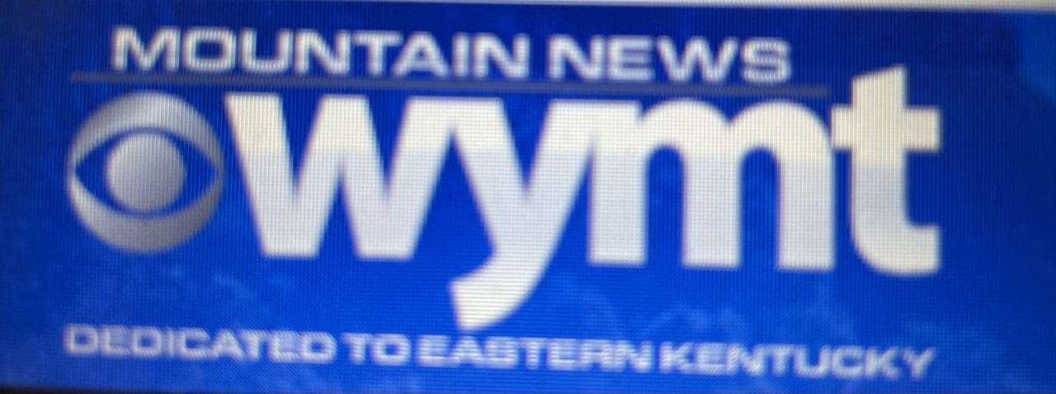
A Rally of Community Support
The newspaper article and WYMT feature story aroused local pride. Students shared how community members contacted their families and were so proud of them. Our community needed such a positive experience during this challenging year. I even received a couple of phone calls at school from individuals who wanted to drop off material for students to use. I must share one special story. A sweet voice over the phone shared that she had recently lost a sister who loved to quilt. The lady said that her sister would have loved hearing that young students were developing the ability to sew and quilt. Then she asked to drop off her sister’s material that was already cut in quilting squares as a legacy in her memory. My students were very moved by this, and the pieces have been handled in a special way including being sewed together very neatly!

Slide 9
Emerging Leaders and Teachers
Students have been awesome in overcoming several challenging Covid restrictions. Community volunteers aren’t currently allowed in classes, and the Extension Office isn’t allowing employees to come into schools. We can’t be within six feet of each other for more than a few minutes. As a teacher, I have faced a challenge trying to have four machines going in class at once. But several of the students are becoming sewing experts. They can help and/or coach classmates to unclog a machine, fill a bobbin, rip out seams, line up quilt sections, etc… as well as I can and are eager to help. A student can say, “Help, Mrs. Napier,” and a classmate jumps in and replies, “I will.” That has been one of greatest feeling of pride – that such a number of students are confident and adept at being teachers.

Slide 10
On going work…
Our work is ongoing. I estimate that we have nearly 15 quilt tops ready to be quilted, though not one has reached final completion. When we return from spring break, that is the next stage of our work. Here is a video of students with many of the quilt tops that are ready for backing to be attached.

Slide 11
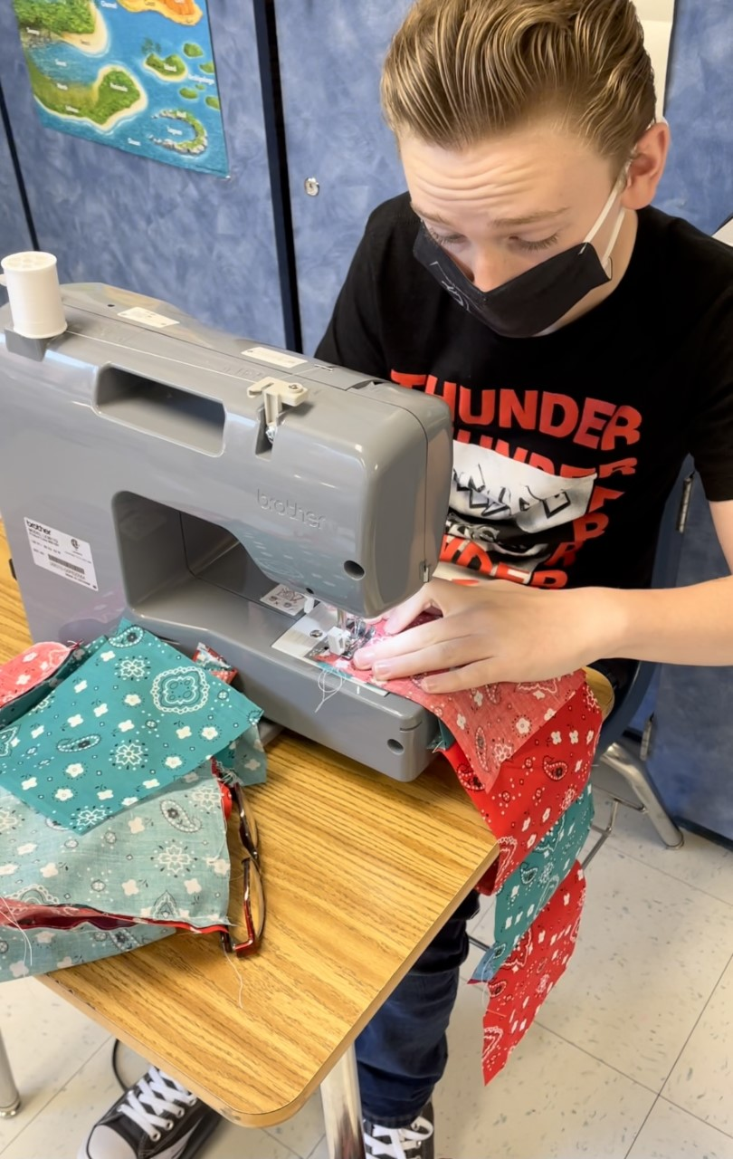
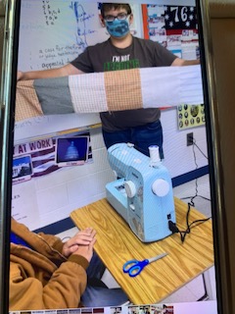
Measuring Our Outcomes
Observations of student esteem
Community input
Completion of sewing projects
Using technology platforms to figure out problems
Awesome engagement

Slide 12
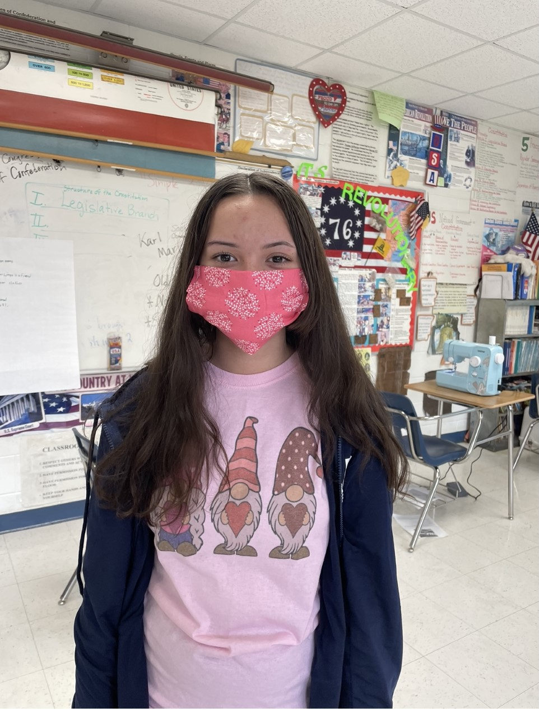
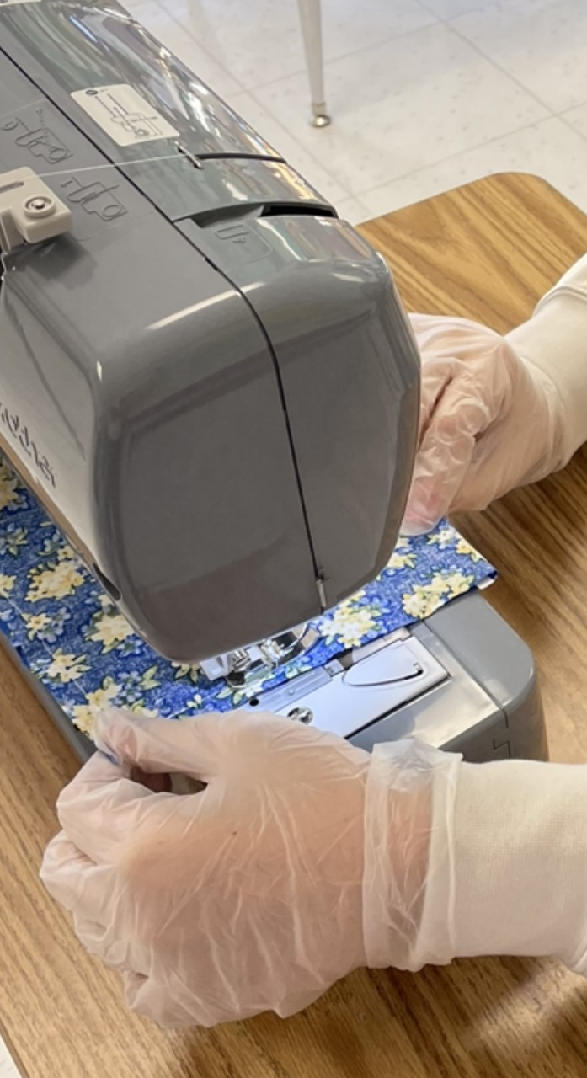
Revisiting Planning and Resources (Original with modifications…)
Learning Innovative Grant for 6 sewing machines/cases to allow work from home or school. I thought students would fight for the machines every night, but when the newness wore off, and I had to throw in bonus points.
Virtual learning platforms guide students. Students were much more comfortable coming in for targeted instruction with me the first time and used our links as a secondary source. Links and videos were great as support and backup.
Extension Office and volunteers to provide coaching. Volunteer restriction due to Covid at multiple levels (School district and Extension Office), BUT students stepped up as great tutors and teachers. Some are faster than me at lots of stages like filling a bobbin.
Grant funds purchase material and accessories. Covid shortages in stores.
Finale period clothing for living history. Ambition can be humbled. Who knew in person instruction would not resume until February then be limited to three days a week. Mastering basic sewing takes longer to learn in a classroom setting than one on one. I should have planned this as a two year project with the living history as the second year!

Slide 13
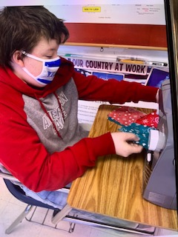
Extending the Finale: Sewing period clothing, inquiry process, and culminating performance
We said our project is ongoing, that mastering sewing has taken a little more time than planned, and that we are still a ways from finally finishing our quilts though they are scheduled to be completed during April. The extra time to master sewing, and some delays associated with Covid, has pushed our finale down the line. Ultimately, it will occur during students’ eighth grade year. Each student will use primary sources, artifacts, classroom research activities, documents, and other inquiry opportunities to create a background portfolio of a historical character, sew period clothing for their character, and create a living history persona for a schoolwide living history day.

Slide 14
It’s About the Kids
Students get into a project that is fun and engaging in which they get to be creative. Engagement promotes rigorous application and performance which in turn prepares students for sustained research and investigation in high school, college, and careers.
In sixth grade, these students explored Harlan County Coal History, in seventh, they have learned about Appalachian sewing and quilting culture, and in eighth they will sew period clothing and create living history characters.
In an extremely tough school year setting, students watched a community rally behind them. That support has led students to feel great pride in what they have accomplished. I think it has been a challenging and rewarding experience that students will always carry with them.

