Slide 1
Case Studies that Captivate
Cortney Flannery Kidd
Floyd County School of Innovation

Slide 2
Planning
Inspiration for Project
Purpose for Investigation
Where Is the Money the Money Go?
Plan of Action
Evaluation of Learning

Slide 3
Inspiration for Project
As remote learning has become an obvious necessity to education, class norms must be reevaluated and learning has to be refocused. I want to reinvent and use these virtual opportunities to create a new version of higher level learning.

Slide 4
Purpose for Investigation
With the implementation of the Next Generation Science Standards (NGSS), there is great emphasis on student students being able to properly prepare a claim and then support their reasoning.
In order to check for full understanding of data interpretation, I have decided that case studies and interactive materials are the ultimate opportunity for students to use a true problem-solving process to explain logic and science.

Slide 5
Where the Money Went…
Case Study Set from ScienceOutside.org
NSTA Discovering Engineering in Biology: Case Studies
Engineering in Life Science
NSTA Ebook Interactive Class Subscriptions (7 Class Titles)

Slide 6
Plan of Action
The plan was designed to promote PBL strategies that allow students to work through “experience learning”. They were presented with open ended problems on relevant topics and were able to analyze and create solutions for themselves.
Because many of my classes are also Career and Technical Education courses, I intended to use both the case studies and the interactive texts to keep them immersed in full learning virtually or face to face.

Slide 7
Evaluation and Evidence
Students have been formatively assessed on a regular basis using multiple methods.
Rubrics, technical writing, and engagement in scientific arguments allowed for monitoring of effective communication.
Student work has been displayed, videoed, recorded, and presented in social settings (when allowed).

Slide 8
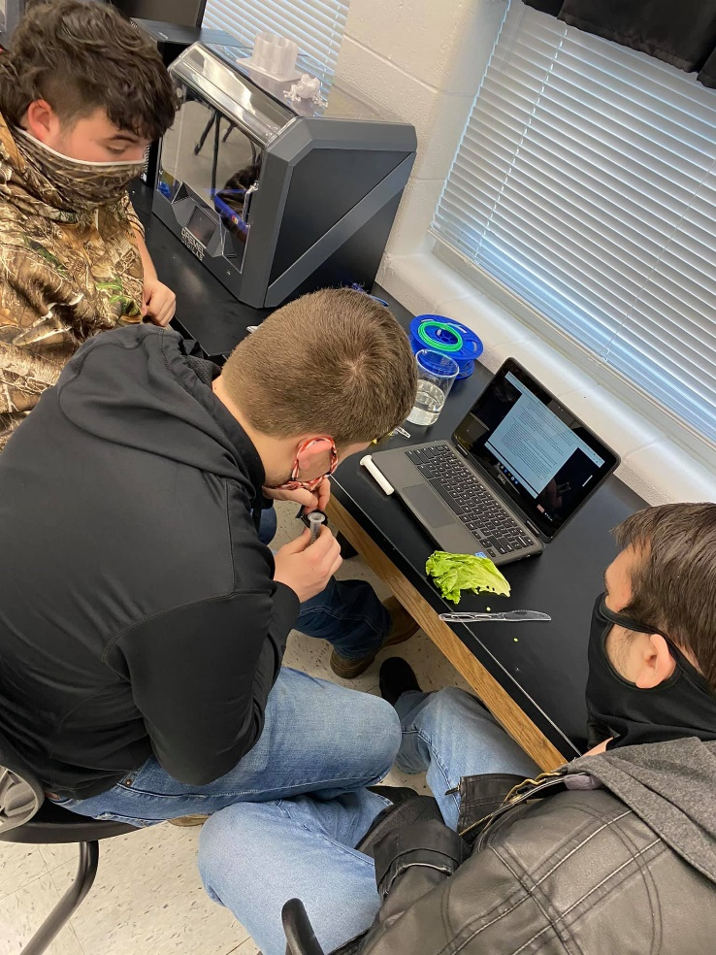
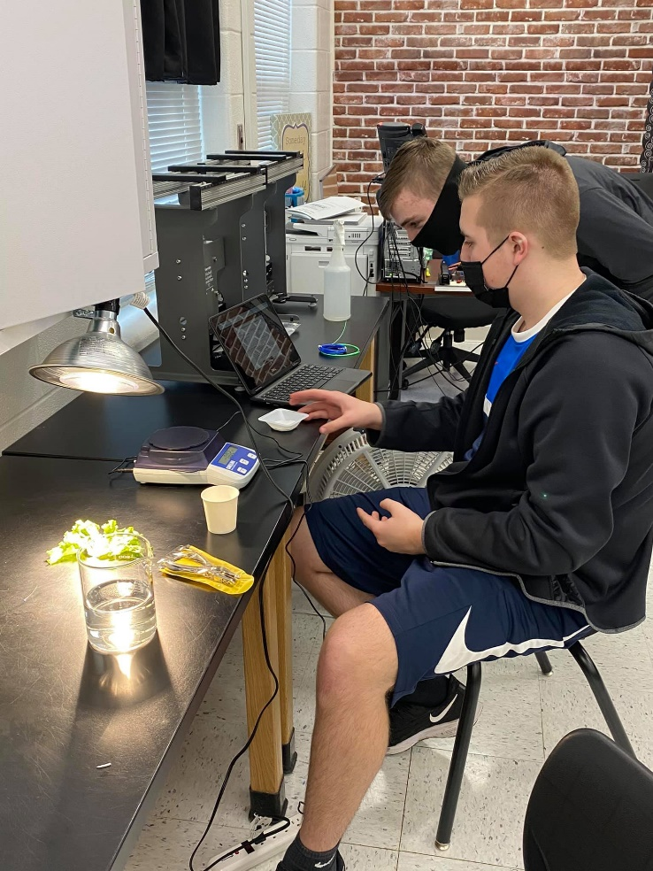
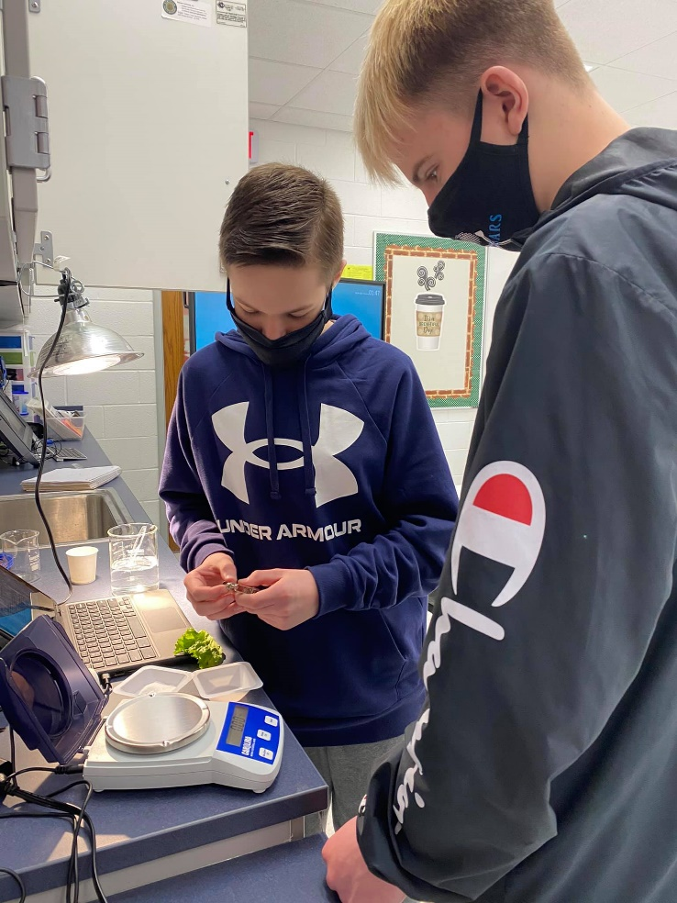
Figuring it Out

Slide 9
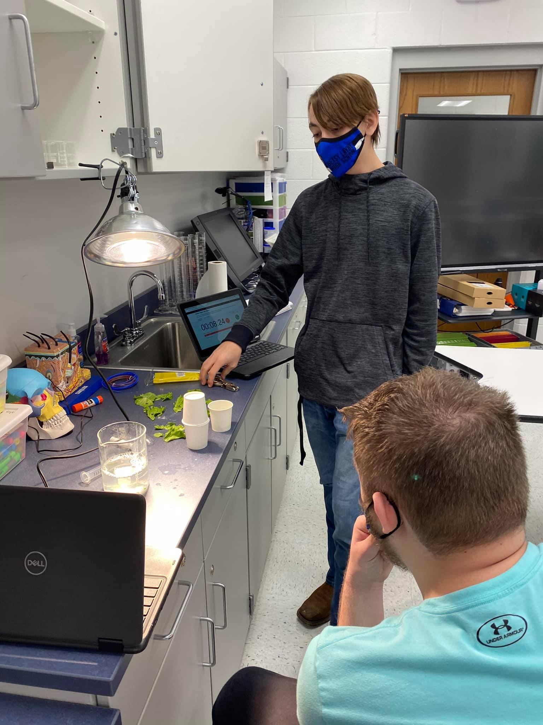
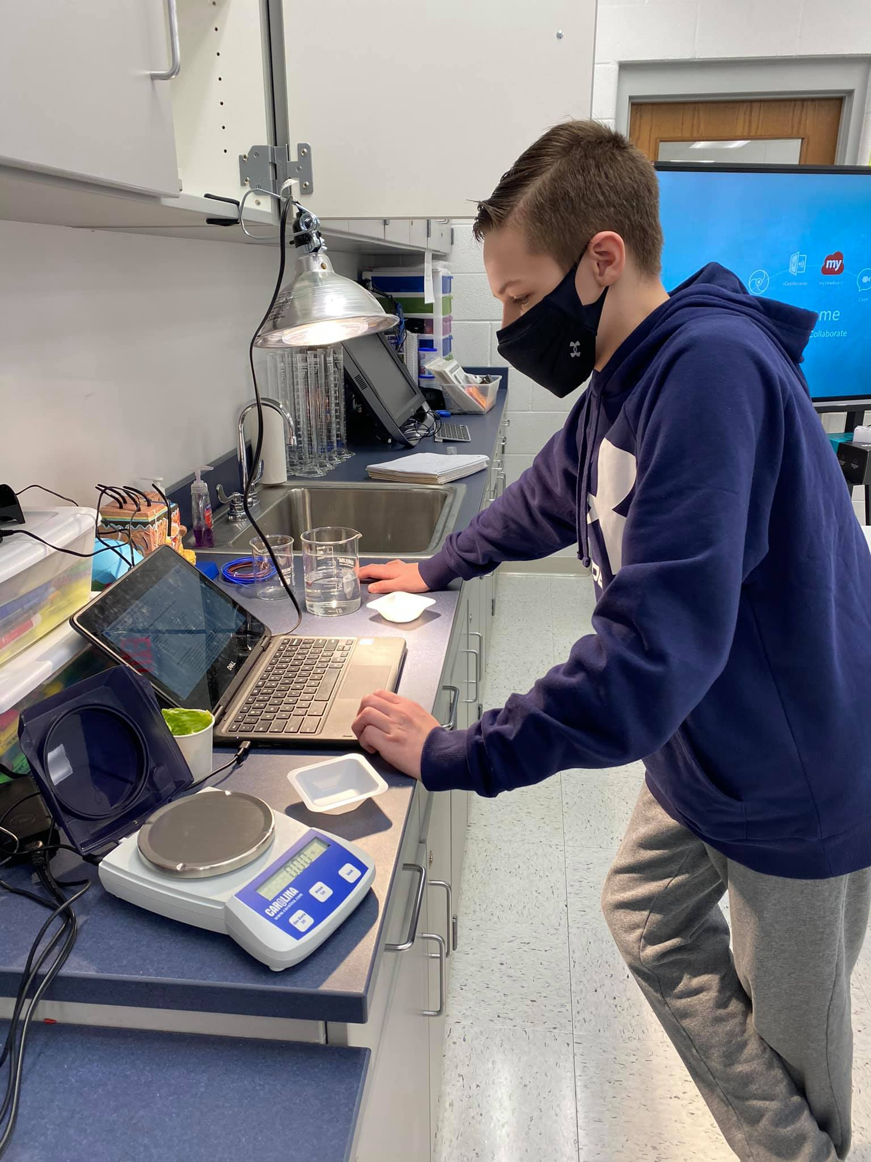
Figuring it Out

Slide 10
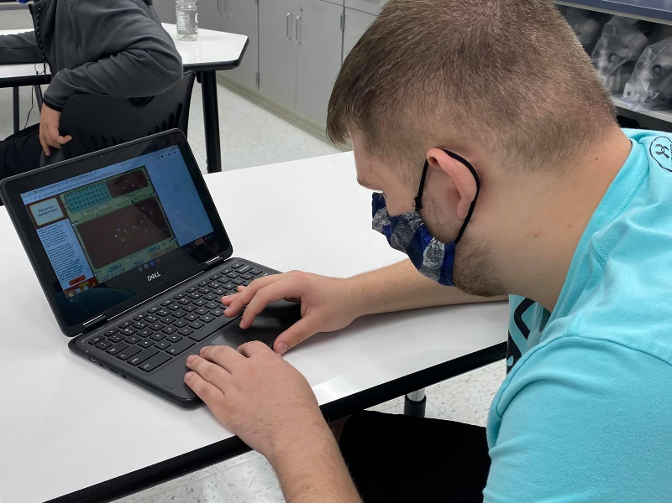
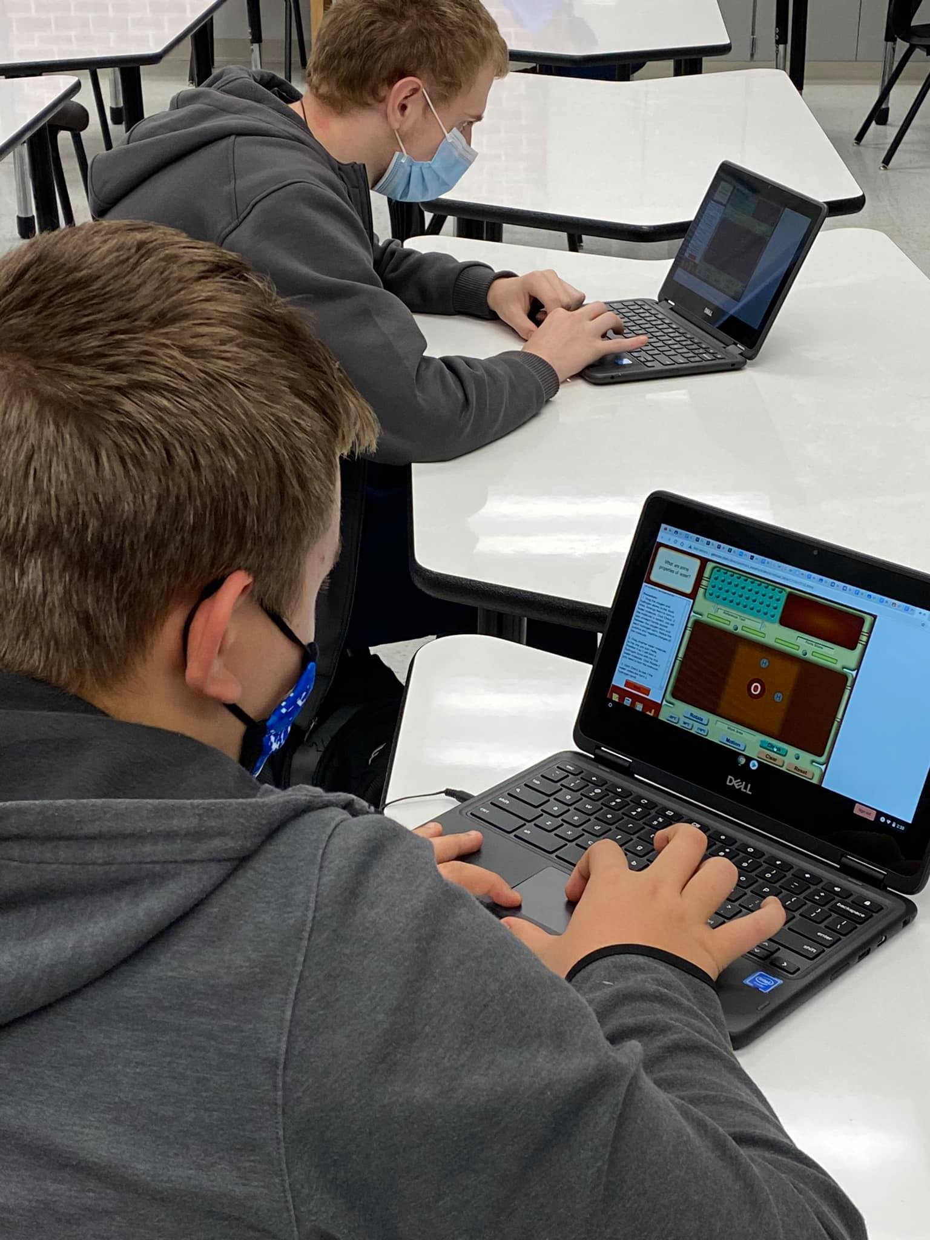
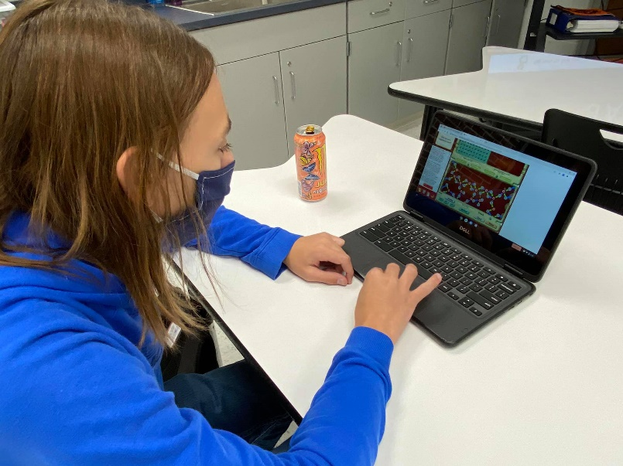
Figuring it Out

Slide 11
Figuring it Out

