Slide 1
Building Bridges to the Future
Cortney Flannery Kidd
Floyd County School of Innovation

Slide 2
Planning
Inspiration for Project
Purpose for Investigation
Where IS the Money Going?
Plan of Action
Assessment of Learning
Sustainability

Slide 3
Inspiration for Project
Innovative education is the “bridge to the future” for our students at our school, FCSI. This project was designed with the idea of merging real life problems with creative activities that allow true skill development.

Slide 4
Purpose for Investigation
The intention in this design challenge was for students to experience a unique blended learning style that are intentionally designed so students could use both hands on and digital platforms to solve engineering problems.
Students were presented design parameters, expectations, and a problem to solve/challenge goal to meet.
This learning plan allowed for collaboration among peers- even those virtually participating.

Slide 5
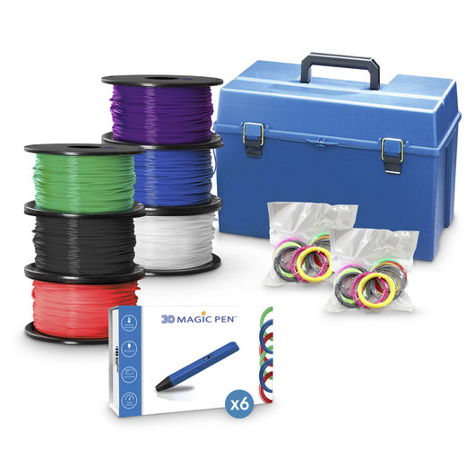
Where the money went…
Hamilton 3D Magic Pens
Model Bridge Classroom STEM Packs- Balsa Wood
NOVA Superbridge DVD

Slide 6
Plan of Action
Students participated in a competitive design activity (towers for our particular need at the time) that ended in three part assessment-- communication/blueprint, scale modeling, and finally destructive testing.

Slide 7
Assessment of Learning
To assess student learning and use of the engineering targets, students will participate in “elevator pitches” where they will present their design strengths and challenges.
Students developed scale and prototype models.

Slide 8
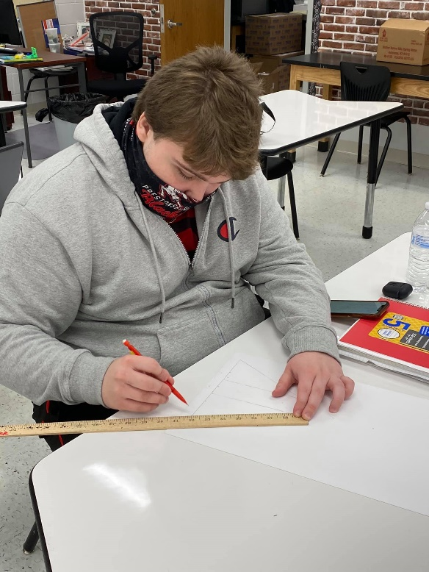
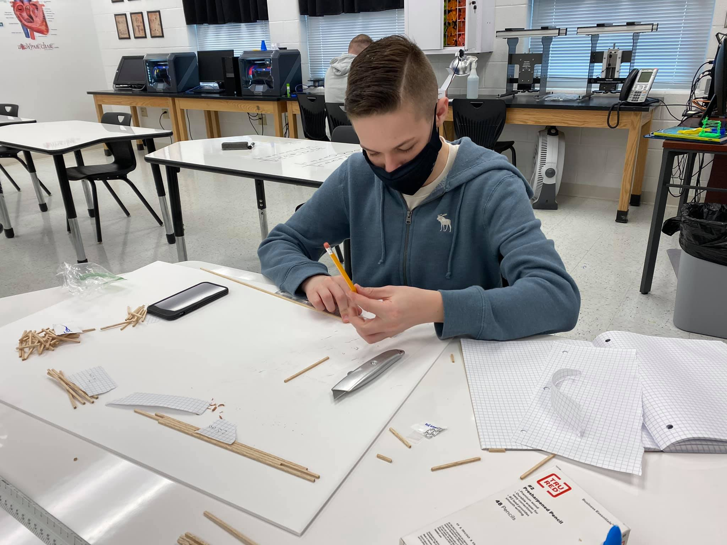
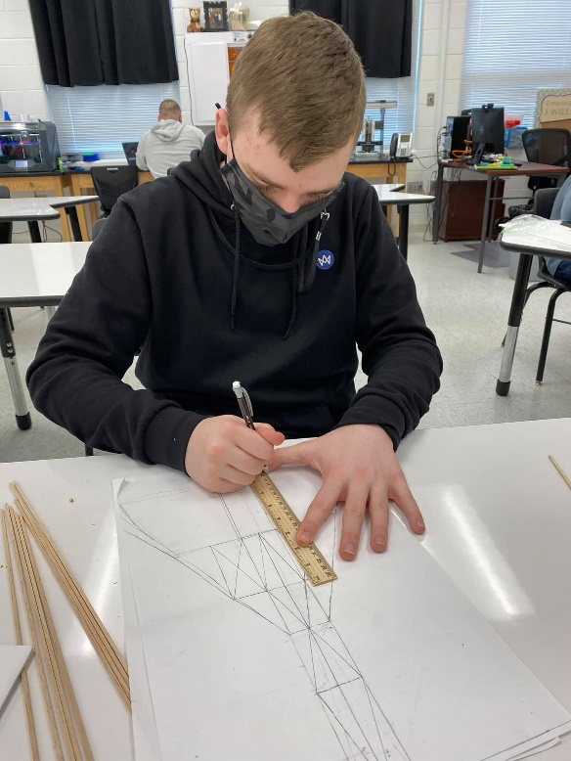
From paper plans to wooden wows!

Slide 9
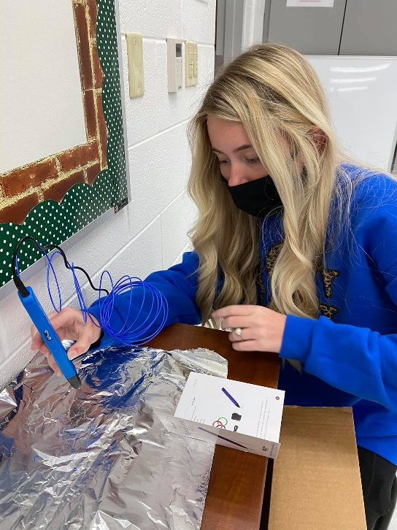
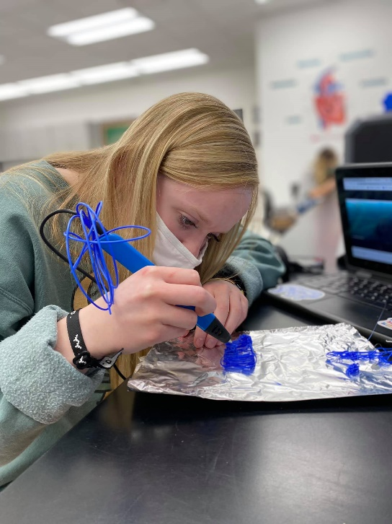
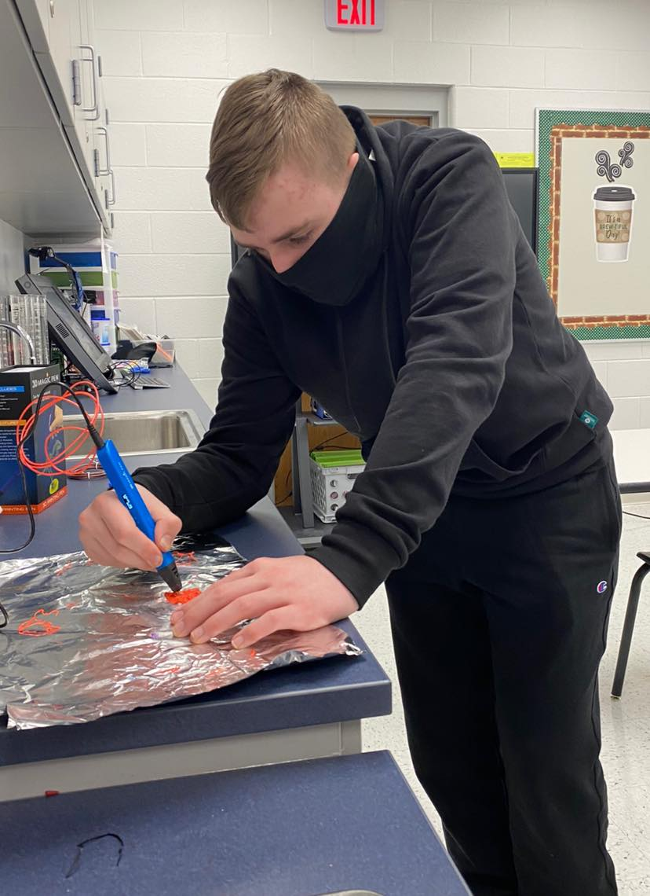
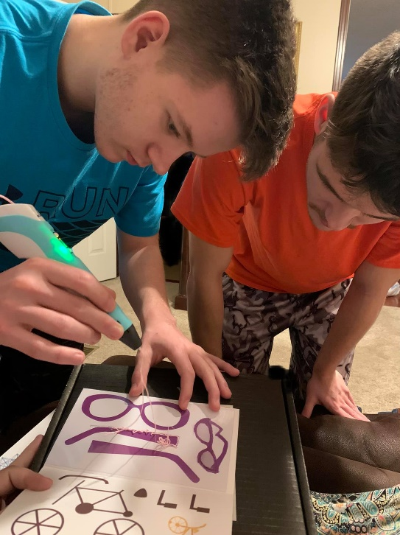
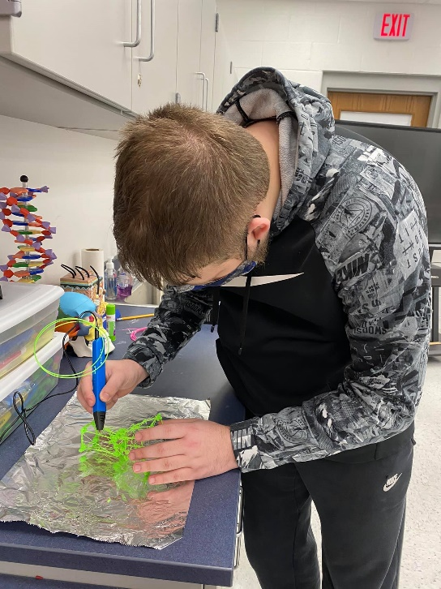
From paper plans to wooden wows!

Slide 10
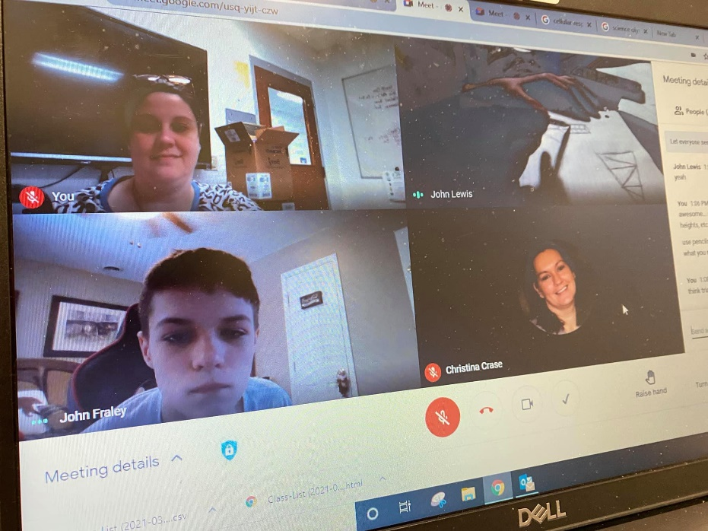
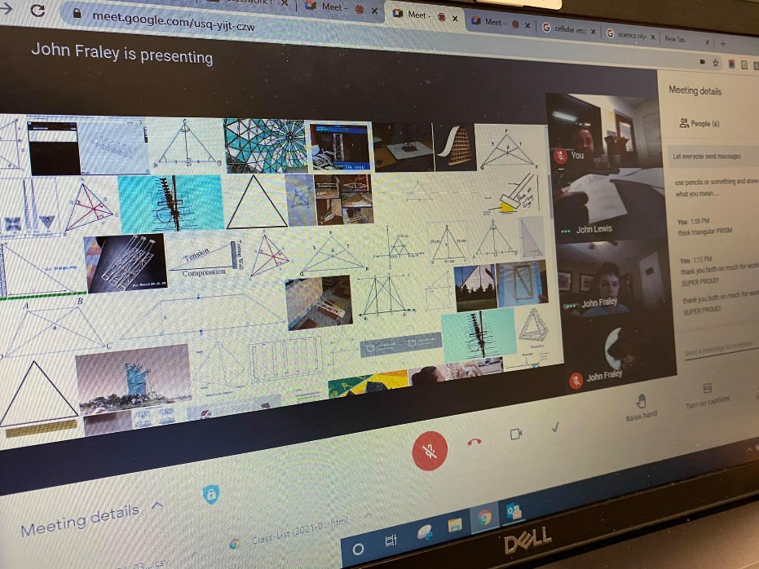
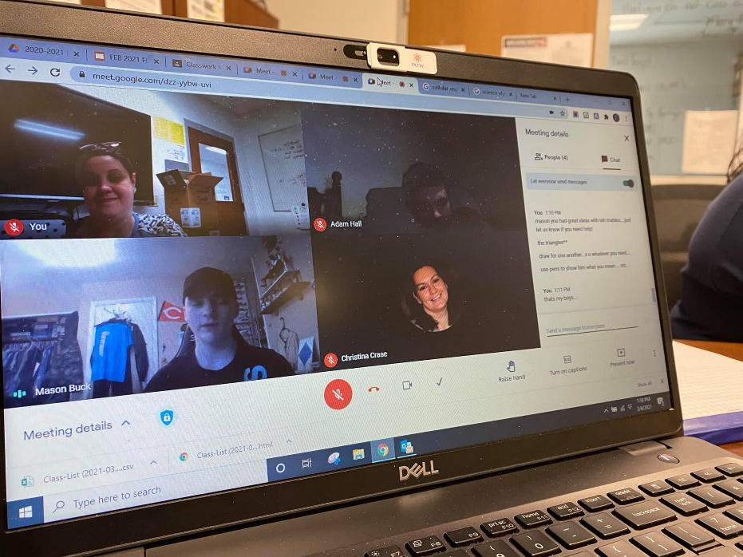
From paper plans to wooden wows!

Slide 11
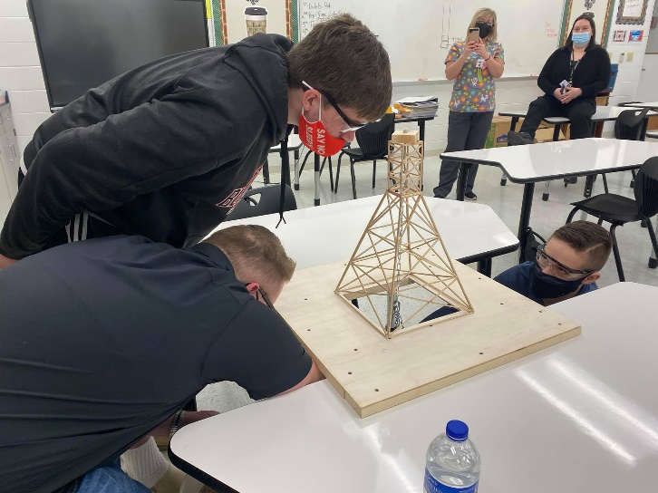
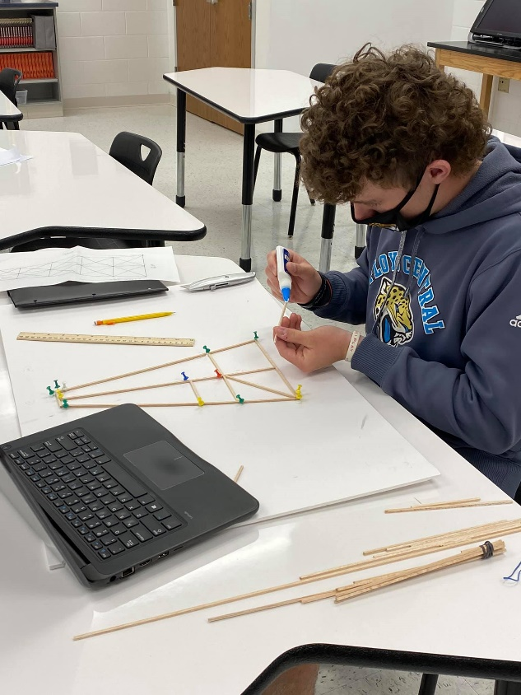
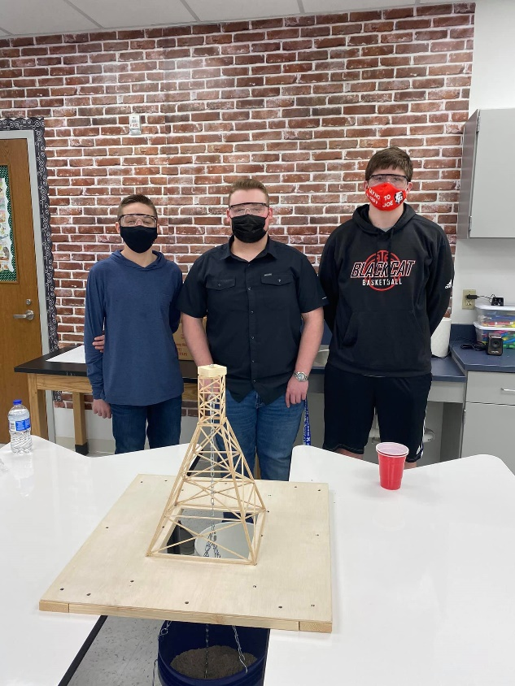
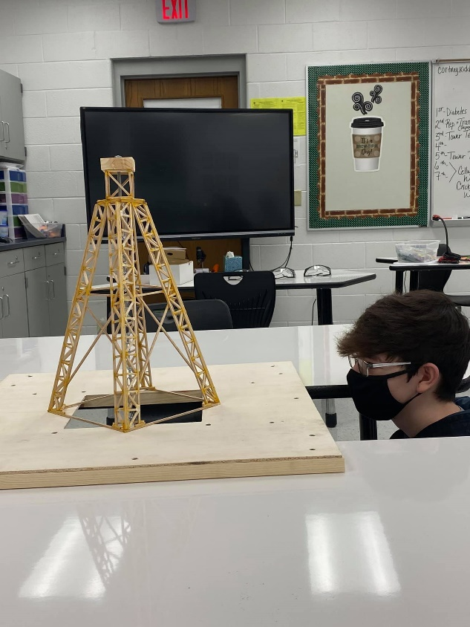
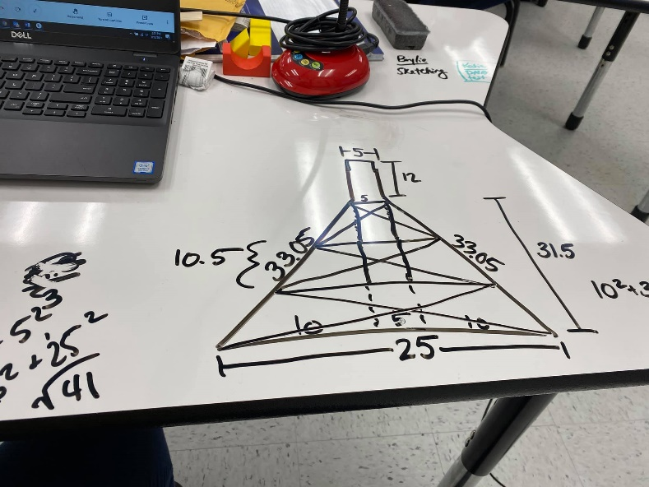
From paper plans to wooden wows!

Slide 12
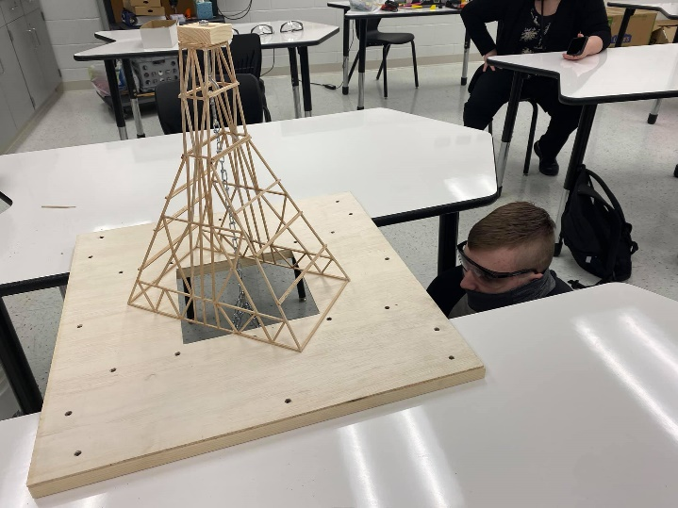
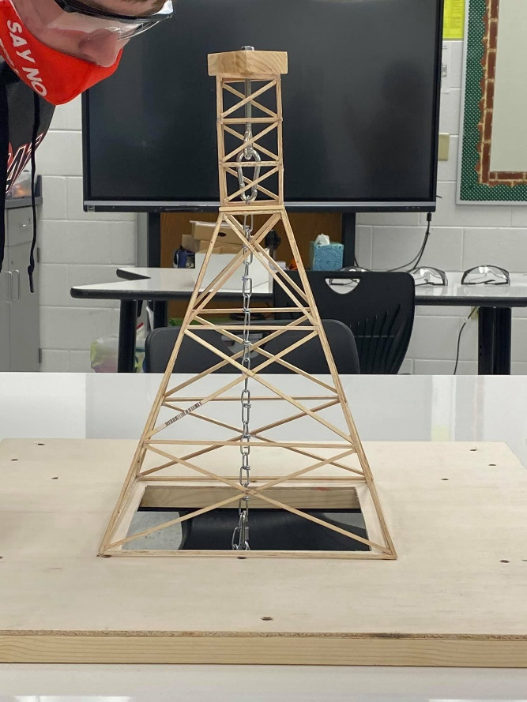
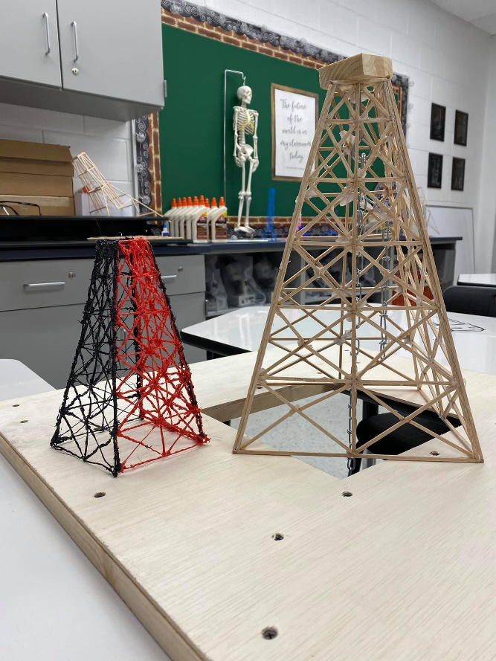
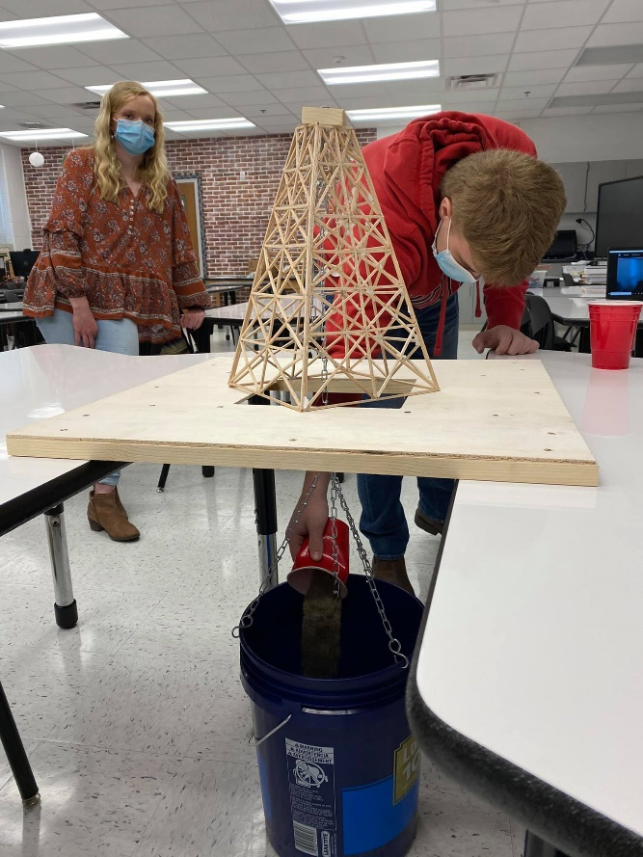
From paper plans to wooden wows!

Slide 13
Sustainability
This project is 100% something that can be continued with replenishment of consumables. Students will be able to alternate between different model builds (towers, bridges, extension arms, etc.) This step by step approach is wonderful for covering the engineering process and promoting learning with intentional planning and revision.

