Slide 1
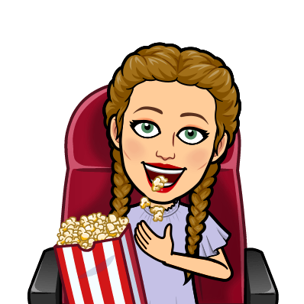
Tom Cat Theater
Anna Burton
W.R. Castle Elementary

Slide 2
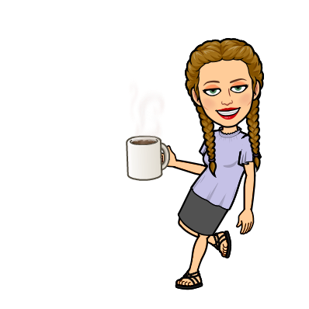
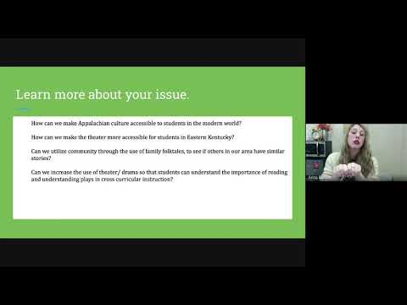
Video

Slide 3
What is your problem of practice?
Students struggling to understand Appalachian culture and to investigate the aspects of drama in the learning and teaching of Appalachian culture and media. Students will be able to access a student created online program that shows how to use theater equipment, and a collection of folktales and family stories that helps modernize the Appalachian culture and makes it available to all Eastern Kentucky students.

Slide 4
Learn more about your issue.
How can we make Appalachian culture accessible to students in the modern world?
How can we make the theater more accessible for students in Eastern Kentucky?
Can we utilize community through the use of family folktales, to see if others in our area have similar stories?
Can we increase the use of theater/ drama so that students can understand the importance of reading and understanding plays in cross curricular instruction?

Slide 5
Plan of Action.
I intended to utilize both in person and virtual access to the theater program. Students from various grade levels will be able to “walk” other students through the process of a stage production with the end result being a performance ( story telling, or reading a local folk story/ Appalachian folktales).
If we end up in a virtual only situation the Kentucky Healthy guidelines allow for small groups ( 10 or less) to come and perform on the stage located at W R Castle. Students would have scheduled times to come in and work on the stage, from a specific time during the work day. All local and state policies will be followed to the letter.
If we are in school students will be placed in groups with no more than 6, that will create a virtual show. Students will work on lighting, utilizing an IPad to record, Imovie to edit, and performing a story on stage.

Slide 6
Implementation of the Plan.
Evaluation:
Do students have a better connection with Appalachian Culture.
03
Data Collection
Using youtube
Google forms 3rd-6th grade
01
02
Virtual Accessibility.
Can students from all grade levels access this in Johnson County.

