Slide 1
Paperless Math!! By Cindy Collins North Magoffin Elementary 20/21
Encouraging Students to Stay Involved

Slide 2
How do we engage students?
So many students face the challenge of having difficulties in math. They may struggle due to a disability, lack of teaching, or maybe they just hate it for the challenge it can be. No matter what it may be, there is such a desperate need to pull these students back from the brink of falling so far behind they are not able to catch up. I hope to engage these students with the use of digital notebooks... Take paper out of the equation and allow them to use the technology that is part of their life in such a huge way and is the way for teaching during this hard time.

Slide 3
Causes of disengagement in math
Students see math as irrelevant to them creating emotions of boredom and lack of effort.
Students feel isolated in regards to math. They feel they are alone in working and learning concepts. As if they are the only ones struggling.
Some students can feel depersonalization toward math, with the teacher not addressing their needs.
They can feel as if math is tedious. The work it takes to get to the answer along with the challenge of understanding the concepts..

Slide 4
Action Plan to Create Engagement
It is my hope to increase student engage during this difficult time of teaching through technology with hybrid learning through the use of Digital Notebooks. Seems as though students in today's world have difficulty in being motivated. This could be due to the times of everything is a game, the fact that many are being raised by grandparents, disabilities, and many more.
Middle school students are at a cusp of wanting to please the teacher or just give up. They seek attention and encouragement with new ways to learn. With the digital notebook, it is my hope the use of technology entirely, they find the want to engage.
Math and technology has faced difficulties because of the math symbols and the use of so many numbers, but with a digital notebook, this problem is eliminated! They will have the ability to show their work in the notebook and with one picture with their device, it is changed into the digital form needed for distant learning. They paper is GONE!

Slide 5
Meet the Digital Notebook
What is a digital notebook?
The digital notebook bridges the gap of traditional handwriting surfaces with the power of the cloud. It will allow students to do their show their work but without the use of several pieces of paper. Students will complete their work without having to worry about keystrokes for mathematical symbols, then easily upload their imagine through a simply app to have forever and to be attached to a Google Classroom assignment without problem.
How to use?
The notebook consists of two gel pens and a spiralbond notebook containing special paper which the pens will write on smoothly. Once the student has completed their work, they take a picture through an app which uploads it in a couple clips into their Google Drive or device cloud. These notebooks can erased by the simple heat from a blow dryer.

Slide 6
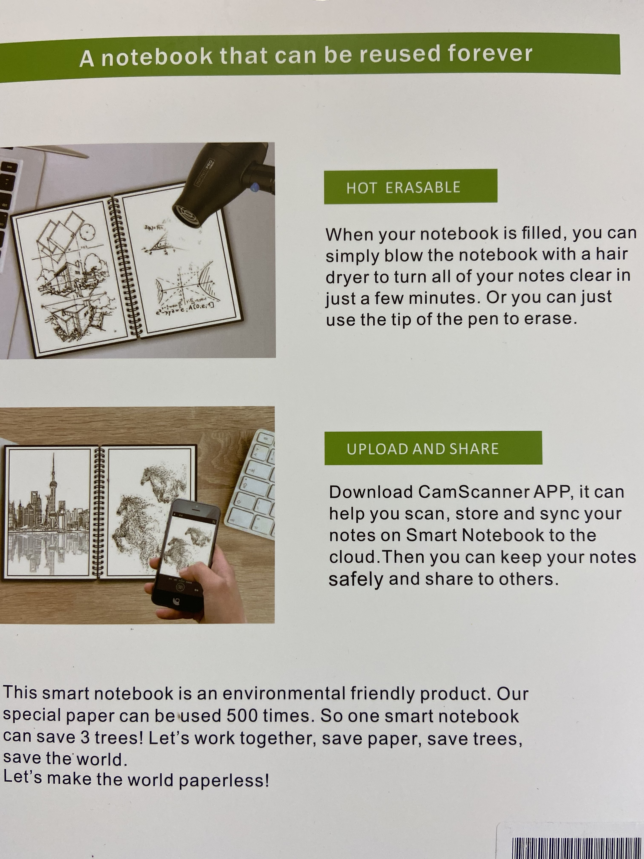
Digital Notebook
Package of Notebook

Slide 7
Digital Notebook Inside the Book

Slide 8
In the hands of students.....
It is my hope that the digital notebook becomes a device that creates engagement for completion of work. So many kids hate working out their problems for math and when it comes to doing this virtually, the challenge for teachers to ensure completion of work with the evidence of them understanding it through their work seems impossible.
This notebook takes the standard way of showing understanding to a new, innovative, and technology way. It is my hope that students will want to complete their work in class and at home, helping to increase their knowledge and understanding of concepts.

Slide 9
Data Collection
2020/2021 School Year
This school year my students will be given the notebook and I will be comparing the data from last year and comparing it with this years. I will be taking one of my challenging students who struggled in staying engaged and comparing with a similar student this year that has the reputation of not working in math. It is my hope that the data shows a significant growth in participation. I will also be doing the same with one of my higher students to see if their effort increases as well.
I will be talking with students to get the pros and cons of the notebook along with their opinions of working without traditional paper.
2019/2020 School Year
I began the journey to become paperless last year in math. The challenges to this was great, yet through determination and my students showing such a difference in participation, I knew to become paperless this year was a necessity. The challenge which I faced was a large one...I had to find a way for students to show their work and prove to me that they were learning the concepts without the use of calculators.

