Slide 1
Leveling the Playing Field
Spring Fire Summit Presentation
By: Andrea Rowland

Slide 2
Contents of This Presentation
Here’s what you’ll find in this Presentation:
Problem of Practice Review
Original Grant Proposal and Plan
Goal
Initial Data
Resources
Concluding Data
Video
Conclusions
Next Steps

Slide 3
Problem of Practice
How do we level the field for students in a virtual setting?

Slide 4
Ways that we Level the Field
Emotionally
Educationally
Socially
Environmentally
Ensuring that all students have the their emotional needs met so that they can actively engage in learning.
Making sure that all students have the same opportunities to learn within the classroom no matter their learning style or where they start at.
Making sure that students have the resources that they need in their learning environment to be successful.
Ensuring that all students have the same opportunities to engage in social interactions with peers.

Slide 6
Starting Positions What the Virtual Field Looks Like!

Slide 7
Growth is still essential for all students no matter where they start from educationally or environmentally.
The problem of practice addressed with this grant is how to level the playing field at home for virtual reading instruction for students.

Slide 8
The Plan
I propose to implement guided reading virtually at home.
Guided reading allows teachers to focus in on the five components of reading daily with small numbers of students at a time.
Students work within their level and learn reading skills and strategies that are specific to their reading needs.
During this time that teachers get to monitor reading habits of students, model good reading techniques, teach new strategies, assess students, provide phonics instruction, and even check comprehension

Slide 9
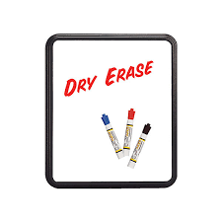
The New Look!
Guided Reading will be completed virtually!

Slide 10
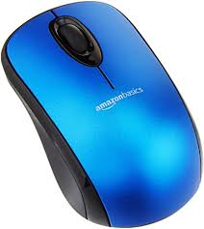
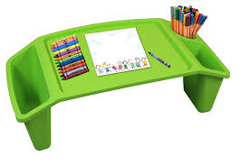
The Plan
How to level the playing field at home for virtual reading instruction for students.
Environmentally
I propose to provide all students with the resources they need to be successful with virtual guided reading.

Slide 11
The STEPS
Step 1 Collect Data
Survey parents about learning environment needs
Step 2 Implement
Provide resources to students based on need
Step 3 Compare
Conduct parent survey of resource effectiveness
Survey parents about quality of learning environment
Conduct virtual guided reading groups
Reassess student reading levels
Analyze results
Assess students reading levels
Compare data to beginning of the year and previous year data

Slide 12
Goal
Provide the resources for all students to make growth in reading.

Slide 13
Initial Data- Educationally
- At the beginning of the year, I had student reading levels ranging from level B to Level R (based upon Fountas and Pinnell reading levels)
In August, data from running records indicated that 14 out of 32 students were reading below grade level expectations for the beginning of second grade.

Slide 14
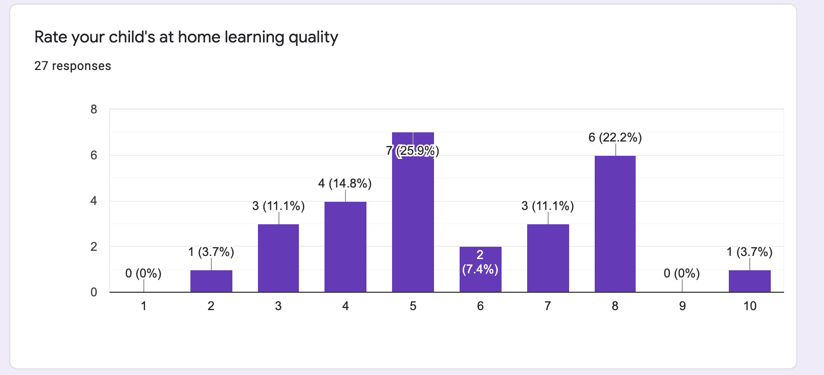
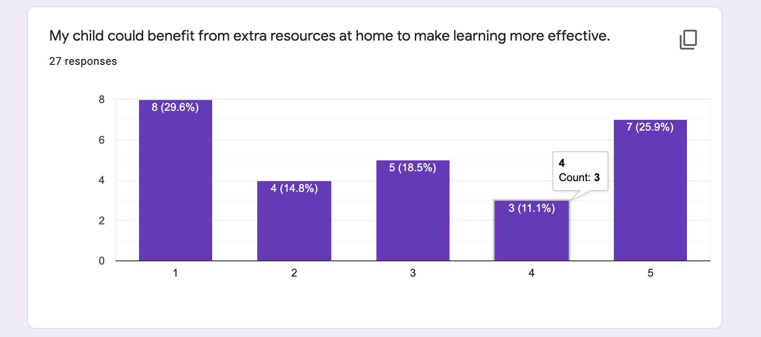
Initial Data- Environmentally

Slide 15
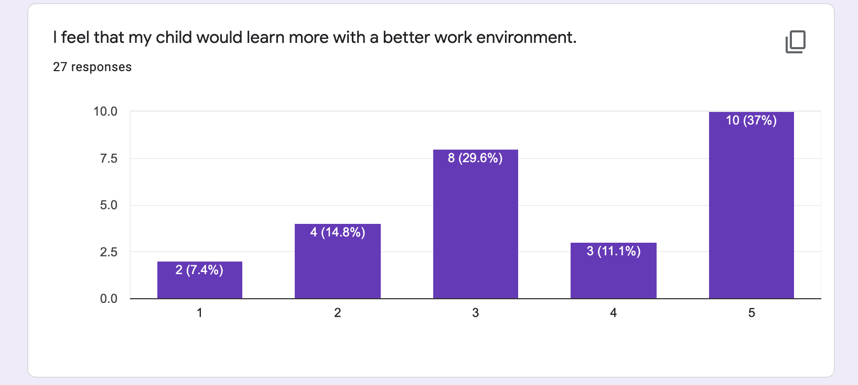
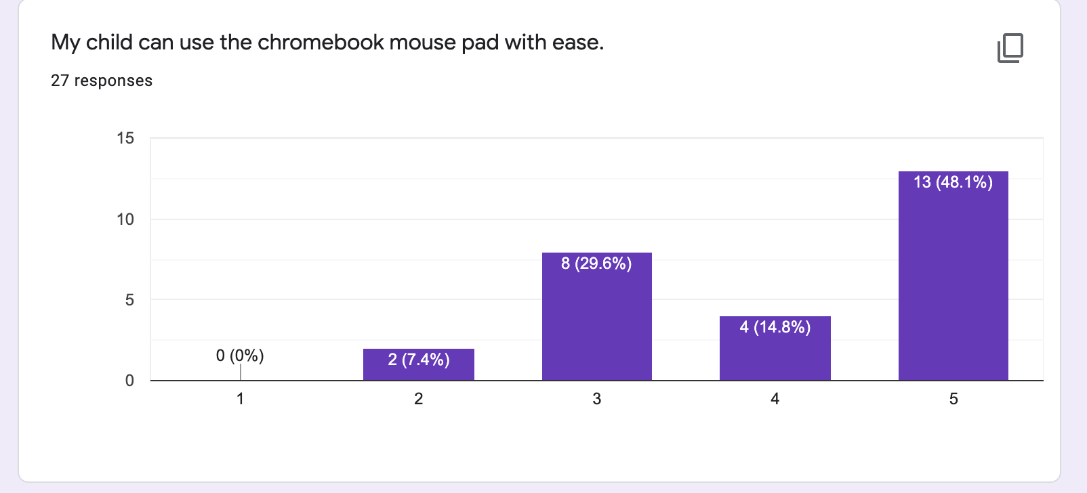
Initial Data- Environmentally

Slide 16
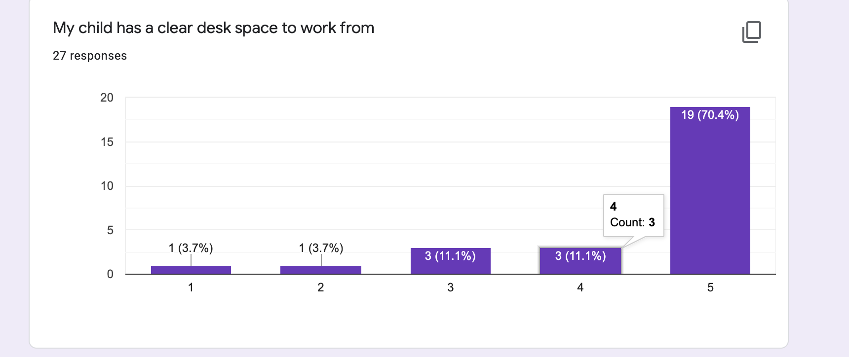
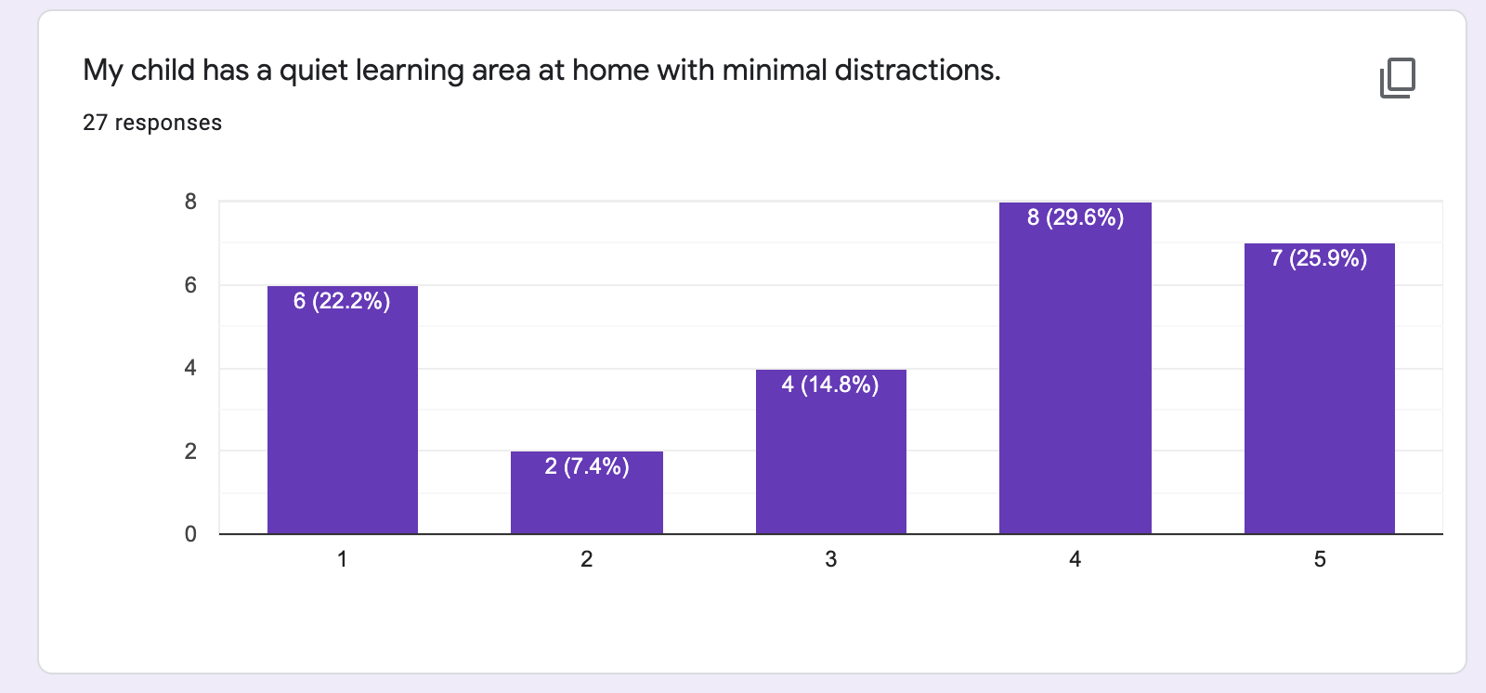
Initial Data- Environmentally

Slide 17
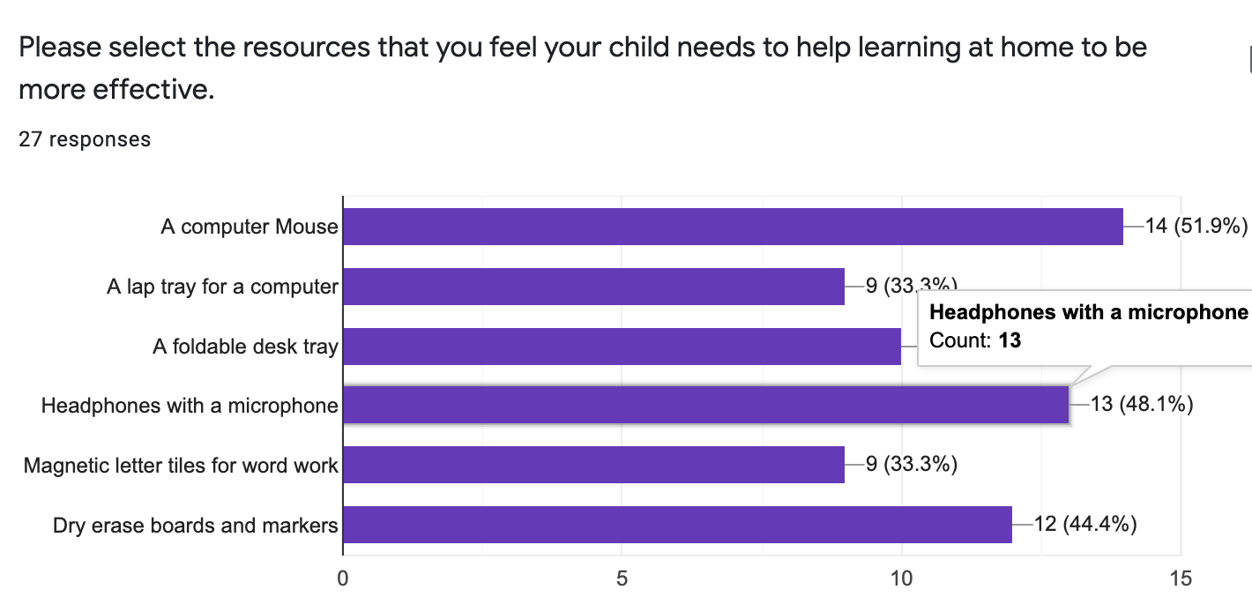
Initial Data- Environmentally

Slide 18
Resources Bought
Environmentally
I propose to provide all students with the resources they need to be successful with virtual guided reading.

Slide 19
Concluding Data
Was it a success?

Slide 20
YES!
Educationally
Environmentally
Spring data shows that only 6/32 students are below the expected level for this part of the year. All of the students have grown at least a level.
Concluding statements and parent survey shows that resources assisted students in making growth in reading via guided reading groups.

Slide 21
Of parents surveyed indicated that these resources benefited their child and enabled them to complete virtual reading more effectively.
100%

Slide 22
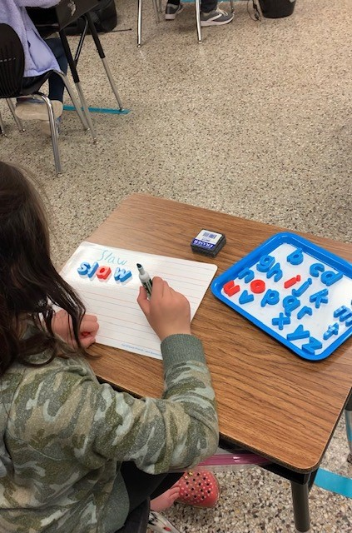

Slide 23
Next Steps
Continue Guided Reading Hybrid
Collect End of Year Data to determine final levels
Conduct Final Parent Survey
Celebrate our Success
Examine Areas for Improvement
Collect and Reuse resources next year

Slide 24
With a level playing field- learning is possible just about anywhere!

Slide 25
Thank You

