Slide 1
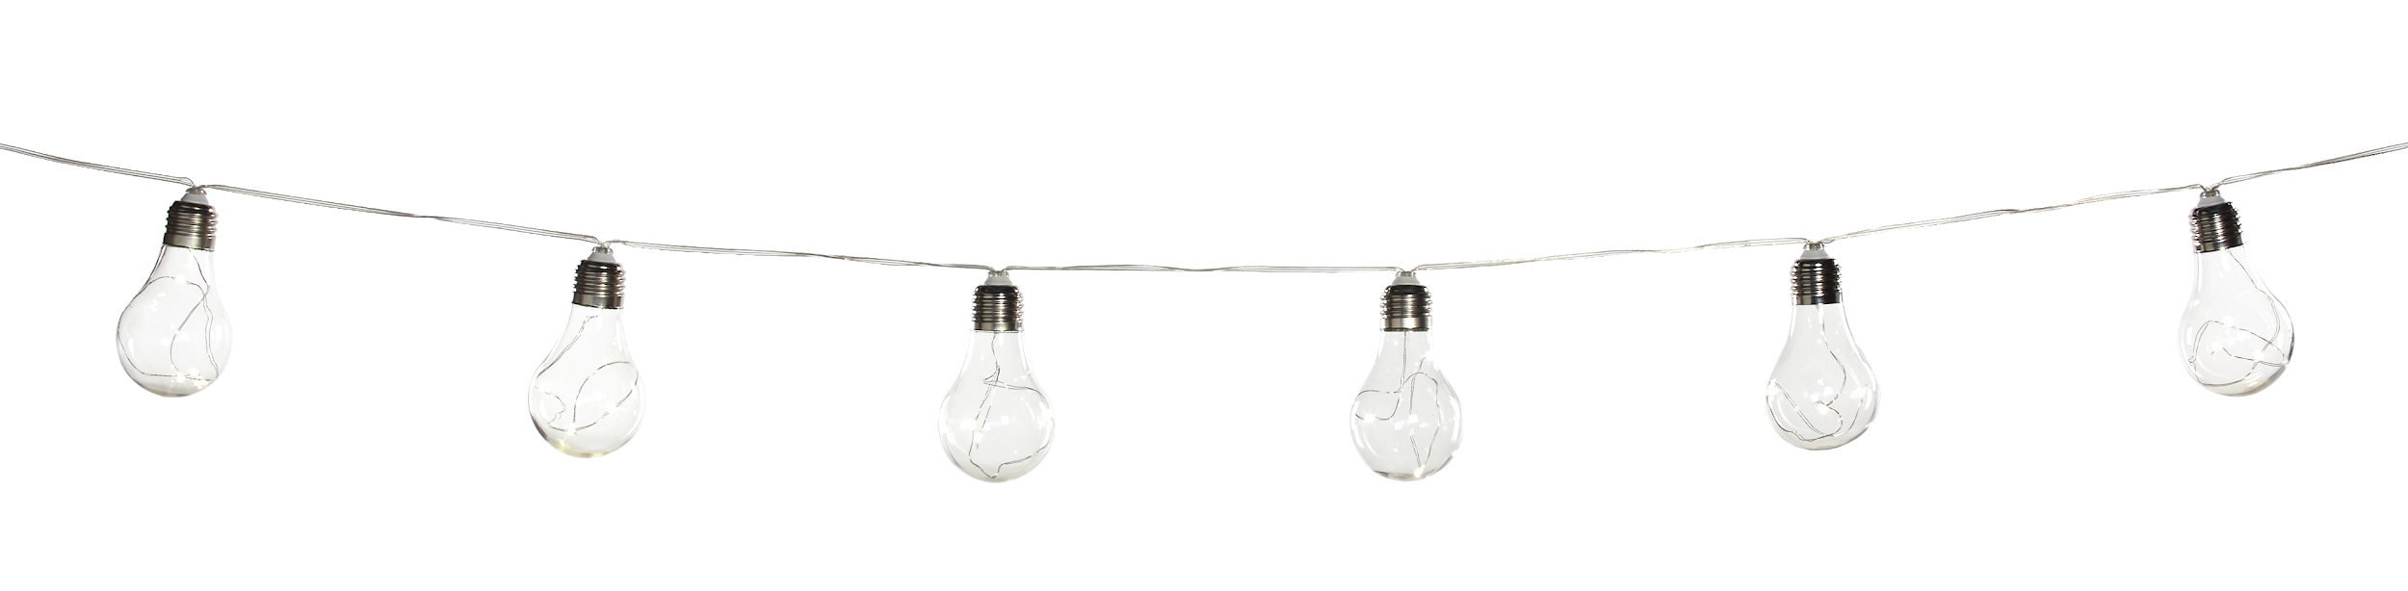











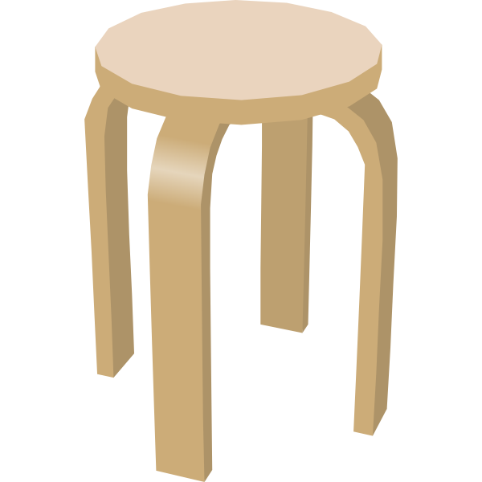
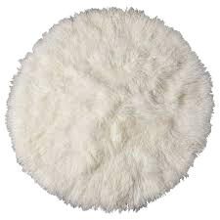
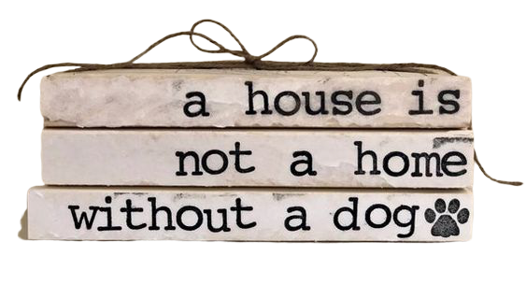
Adapted Digital Resources for Distance Learning in the Complex Needs/Life Skills Classroom - Boom Cards
Traci Campbell
Highland Elementary
Johnson County

Slide 2


Area of Focus:
We as teachers are suddenly tasked with teaching special education students through e-learning.
Providing materials and digital resources to students and parents who are now receiving school at home.
Trying to prevent regression during the long school break

Slide 3

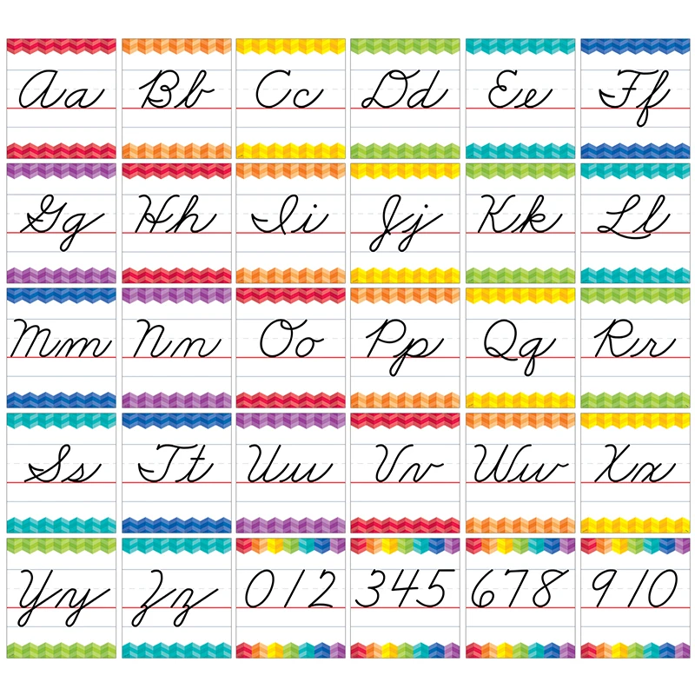
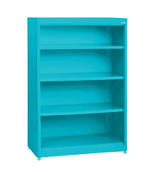




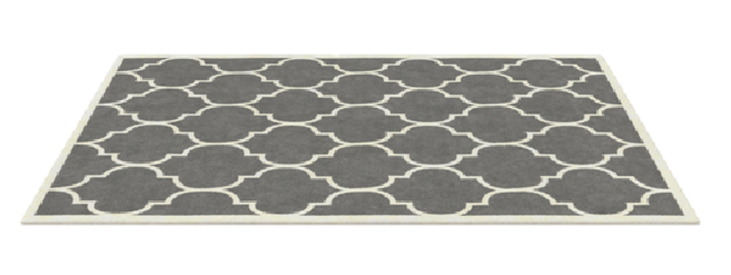
Boom Learning is an online platform with digital activities students can do at home to practice important skills.

Slide 4


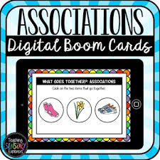


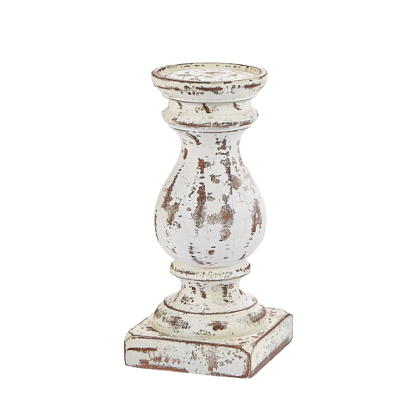
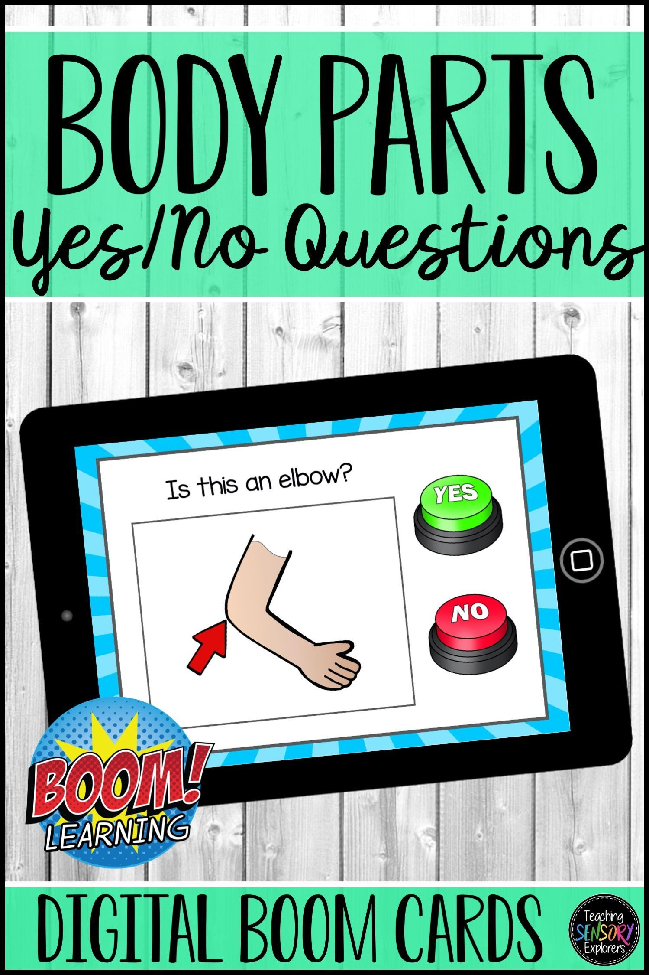



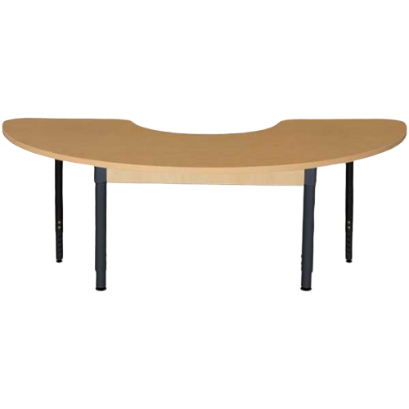

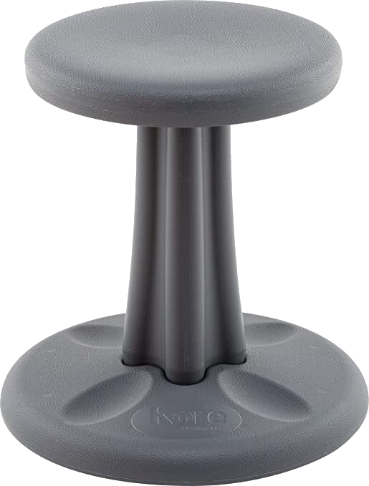
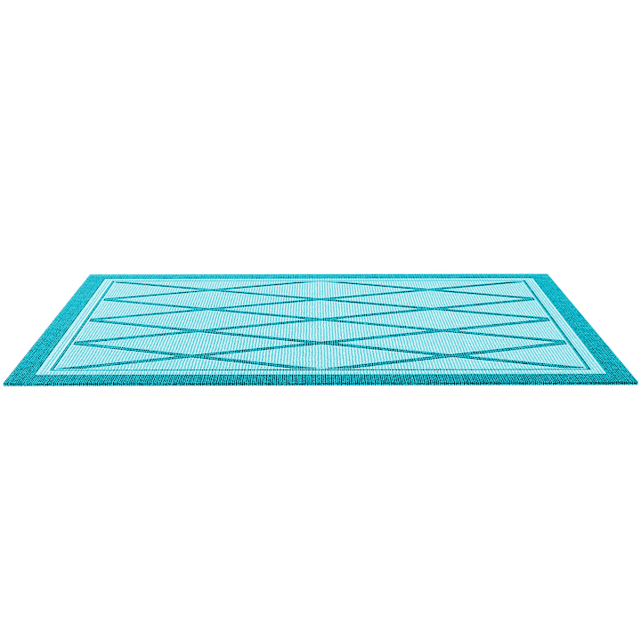
Will Utilizing Boom Learning increase student
Engagement and Learning?

Slide 5
ACTION PLAN:
Virtual/In-Person
Chromebook
Google Classroom
Boom Learning
Interactive/Engaging
Research Based: Errorless Learning/Error Correction
Independence

Slide 6





Project Outcome/Data Collection
Differentiate Student Learning
Practice Specific Skills, Monitor Progress, Automatic Data Collection
IEP Data
Progress/Mastery

Slide 7



BUDGET:
Boom Learning Membership
Boom Learning Points
TPT Points for Boom Cards

Slide 8





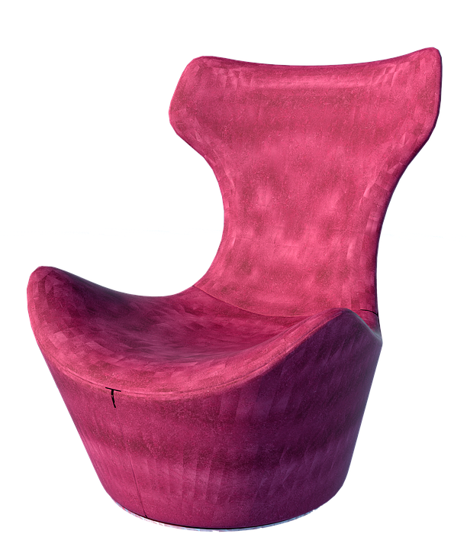
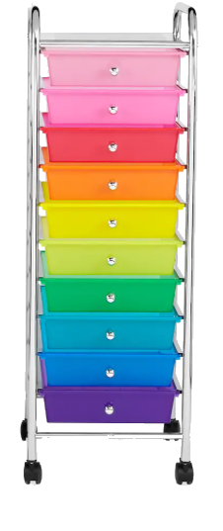

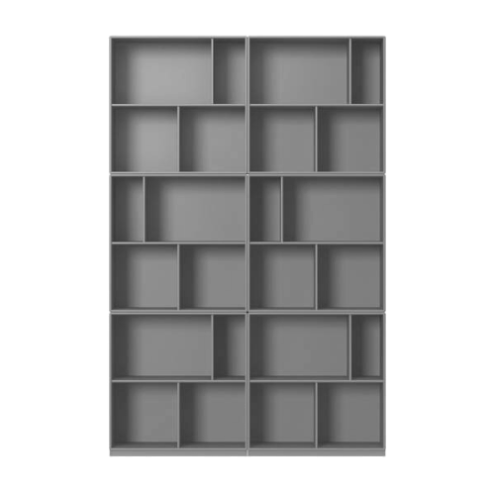
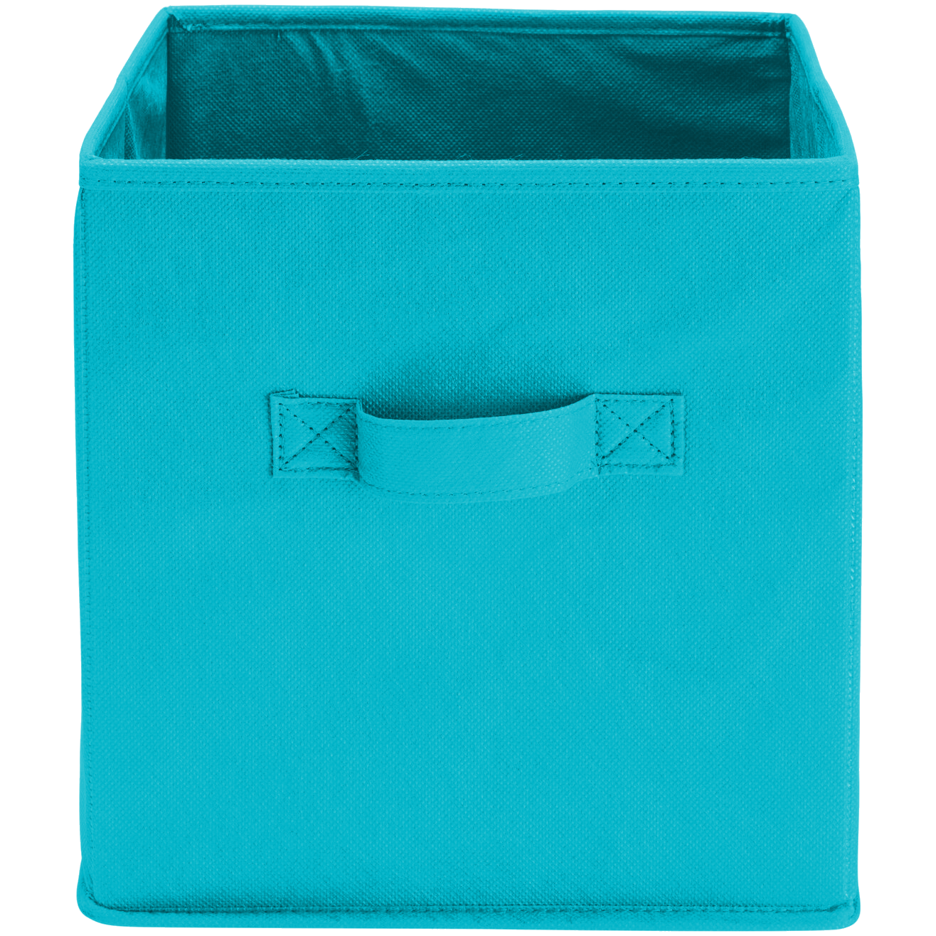
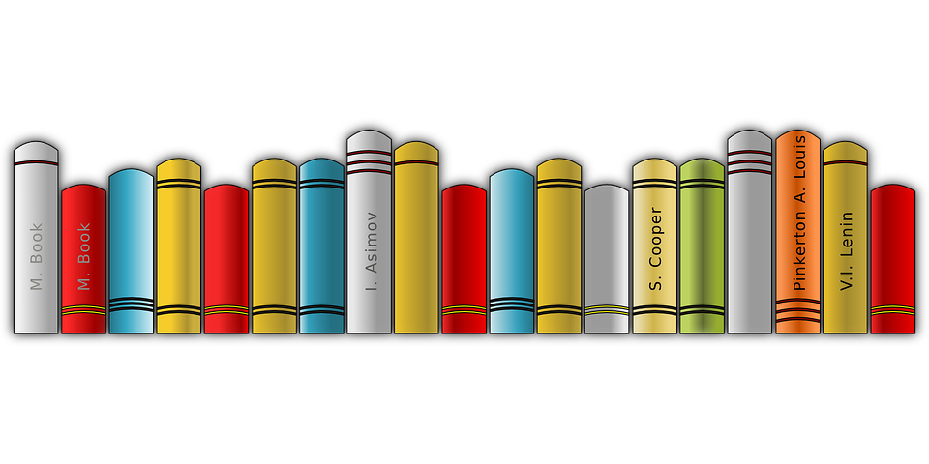
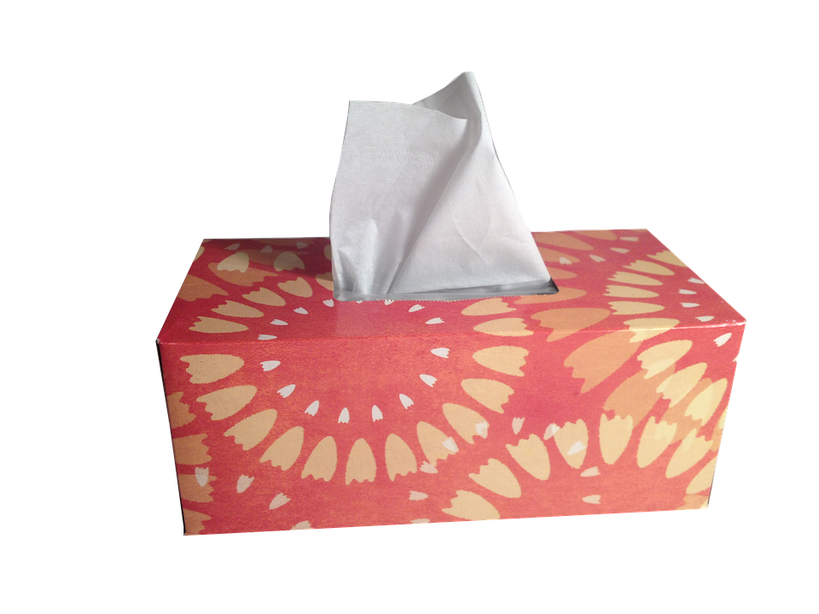




Student Engagement
Data Collection
Goals/Objectives
In Person and Virtual Learning

Slide 9
*As a special educator for students with autism and other developmental disabilities, it can be challenging to address each student’s individual needs especially during remote/distance learning. My classroom is committed to providing a stimulating and creative environment and enhancing student learning as well as engagement. All students within the classroom have severe delays with his/her expressive language and behavioral deficits. Many of my students benefit greatly from utilizing technology and are more engaged during learning.
*The students I serve within the complex needs classroom range from PreK to 5th grade. Each student has their own individual needs and ability levels. Utilizing digital resources allows me to accommodate their needs whether it’s at home or in the classroom.
*The goal is to collect data in both academic and social skills. Data will be collected on each student and their specific IEP goals and objectives to determine progress/mastery on each.

