Slide 1
Interdisciplinary Literacy Practices: Recognize that Text is Anything that Communicates a Message for Students with Special Needs
Stephanie Nichols, LCPS
Carole Mullins, KVEC
Chasity Craft, KVEC

Slide 2
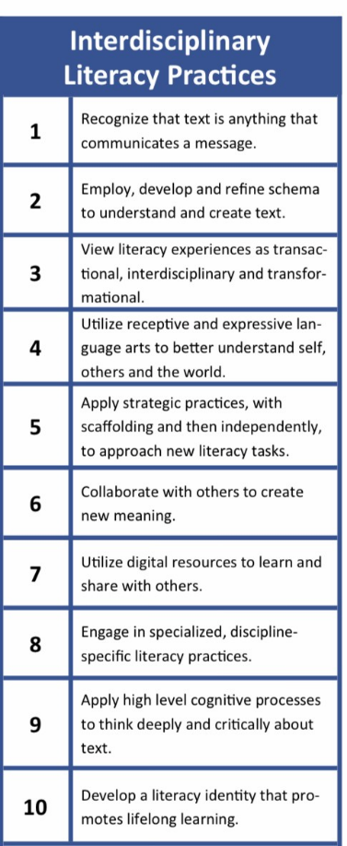
The Kentucky Academic Standards
in Reading and Writing have
ten (10) Interdisciplinary Literacy Practices.
What are Interdisciplinary
Literacy Practices? Literacy is to learn and practice reading and writing skills and to extend those skills to incorporate literacy into all other subjects. (Forsstrom, 2020). These practices are fundamental to fostering an environment that goes beyond teaching and learning isolated skills. Literacy focuses on the larger vision and objective of empowering independent, lifelong learners who think deeply and critically about text. (Kentucky Academic Standards in Reading and Writing, 2019).

Slide 3
Specially Designed Instruction
Explicit Instruction
Structured Overview
Tiered Instruction
Concrete Representation
Multiple Means for Practice
Scaffolded Instruction
Strategy Instruction
Direct Instruction
“SDI is adapting as appropriate the content, methodology, or delivery of instruction to address the unique needs of the child with a disability and to ensure access of the child to the general curriculum.” KCAS, 704 KAR 3:303. 707 KAR 1:002 (58).
(IEP and Lesson Plan Development Handbook, pg. 4).

Slide 4
Earner Requirements
Part 1 earner requirements are:
Type an overview and answer questions in 300 – 500 words.
To receive a Passing score: The earner would completely answer four prompts with a clear explanation, in a typed narrative format. Prompt will include in what context you are providing interdisciplinary instruction, type of classroom (Regular or Resource classroom), number and grades/age of students, the two (2) specially designed instructional strategies used, and the predicted outcomes of the lesson.
Part 2 earner requirements are:
One-page typed lesson plan
The earner is required to submit a link, to a video, that shows 5-10 minutes of them engaging students in understanding that text is anything that communicates a message (Interdisciplinary Practice #1
Two (2) SDI strategies used in the video.
The earner then submits (3-5 pieces of student work), that is viewed in the video.
There is a rubric that accompanies this part to ensure that all sections are completed.
Part 3 the earner is required to Type a reflection of this Micr-Credential process in 300 – 500 words.
To receive a Passing score: The earner would completely answer four prompts with a clear explanation, in a typed narrative format. Prompt will include in what context you are providing interdisciplinary instruction, type of classroom (Regular or Resource classroom), number and grades/age of students, the two (2) specially designed instructional strategies used, and the predicted outcomes of the lesson.

