Slide 1

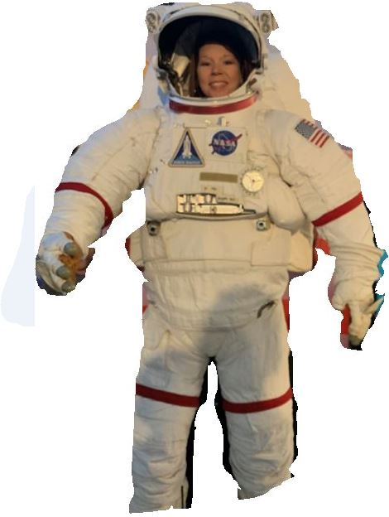
Readers are Leaders
Presented by Melissa Davis on behalf of First Grade Teachers at
Louisa West Elementary School
Lawrence County, KY

Slide 2
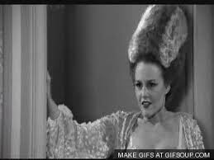
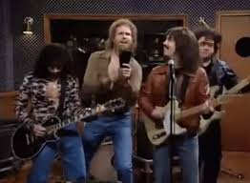




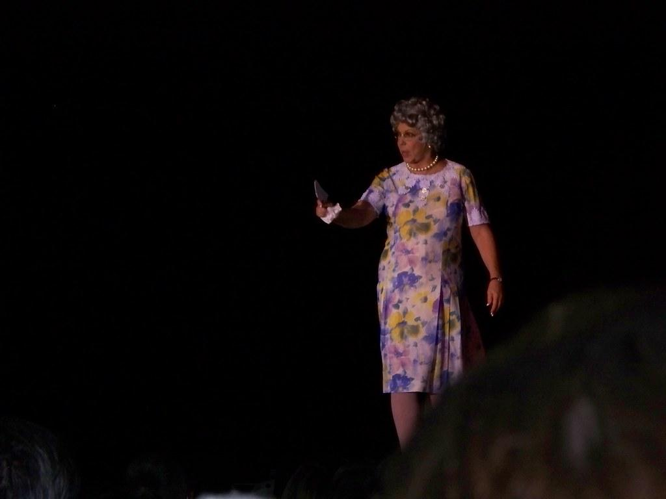
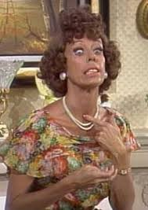
The Team
Janie Daniels
Tammy Kelly
Melissa Davis
Marilyn Mullins
Amanda Adams
Maleesa Clark

Slide 3
Problem of Practice
Accelerated Reader (AR) tests are too difficult for emergent readers, which prevents some students from participating in the AR program.
Many books that are used in class and as homework are not part of the Renaissance program.
Students are unable to test on the books they practice.

Slide 4


Strategy
So…
We created our own AR tests!
Notes:
Need to add bullet points

Slide 5
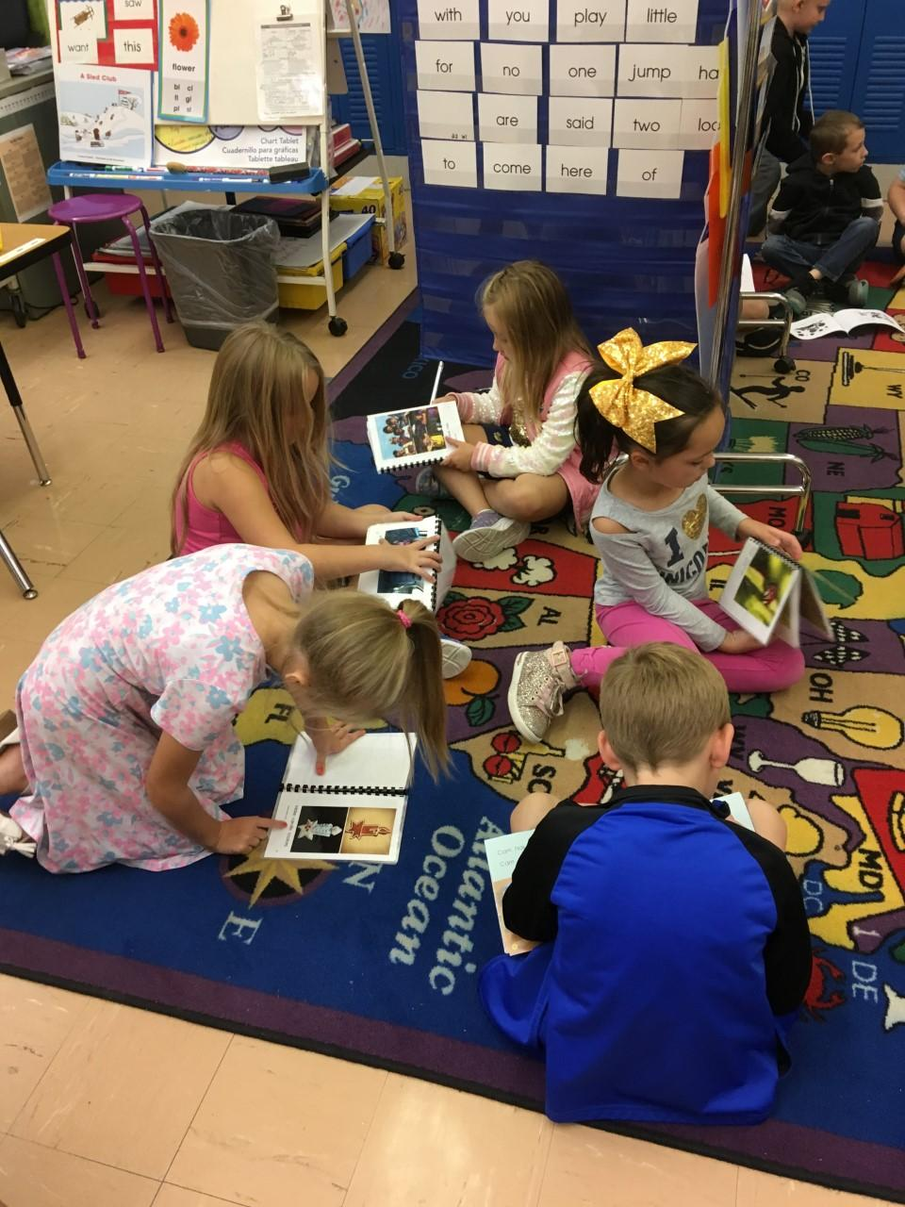

Slide 6
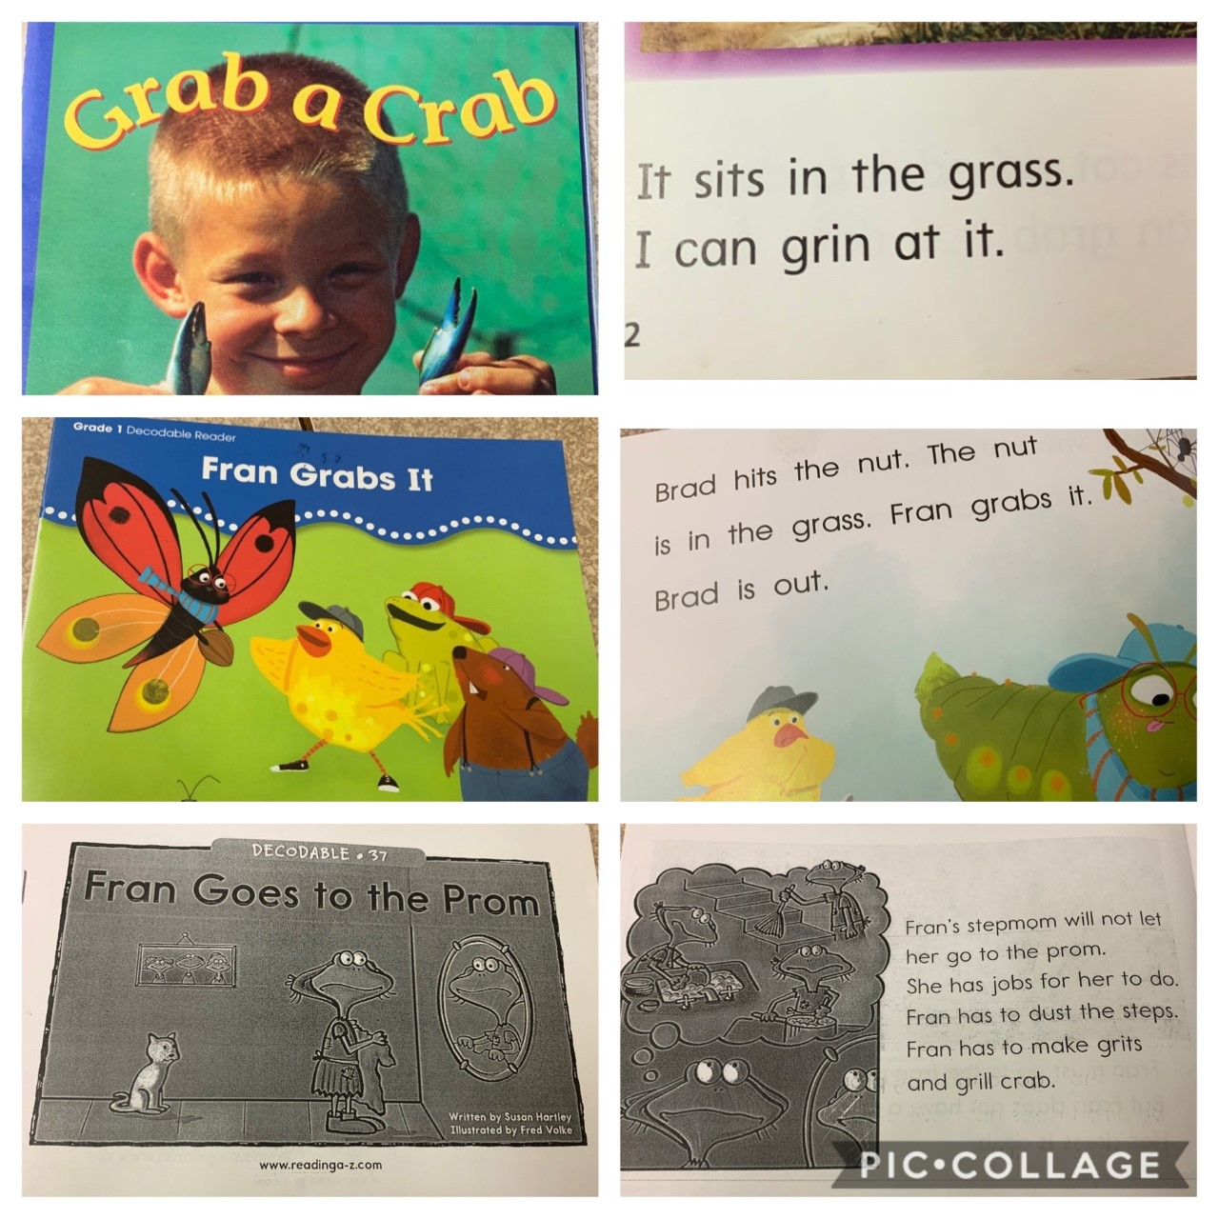
Phonics
Skill:
R-blends

Slide 7
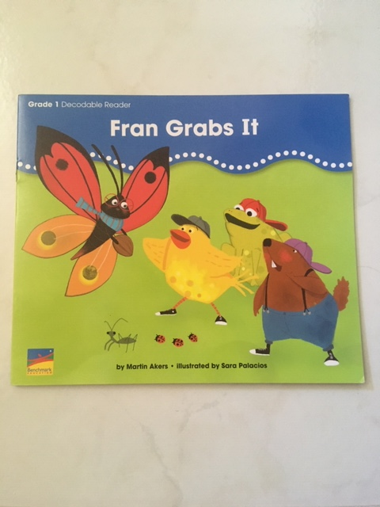
R-Blends Book

Slide 8
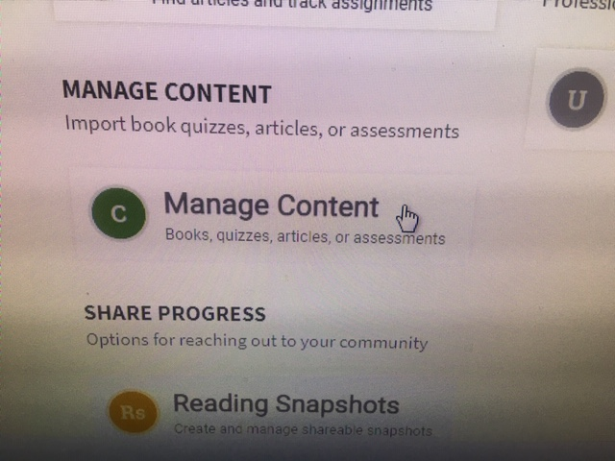
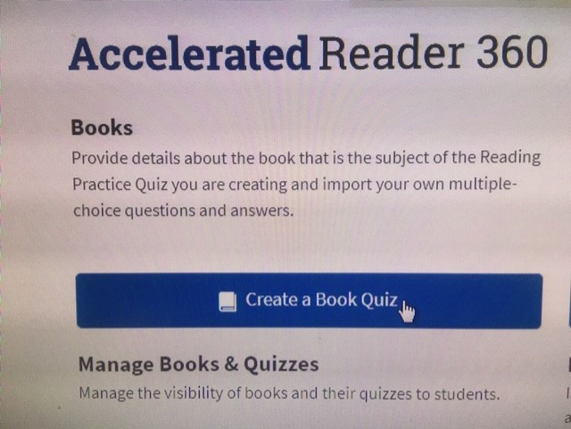
Creating Quizzes
Step 1
Step 2

Slide 9
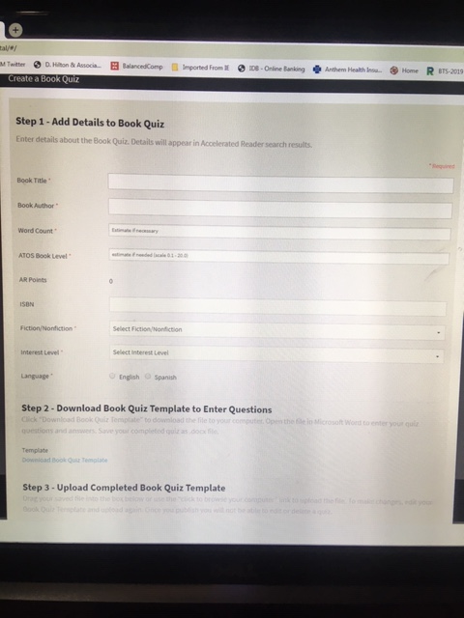
Step 3
Notes:
Talk about details about this form.

Slide 10
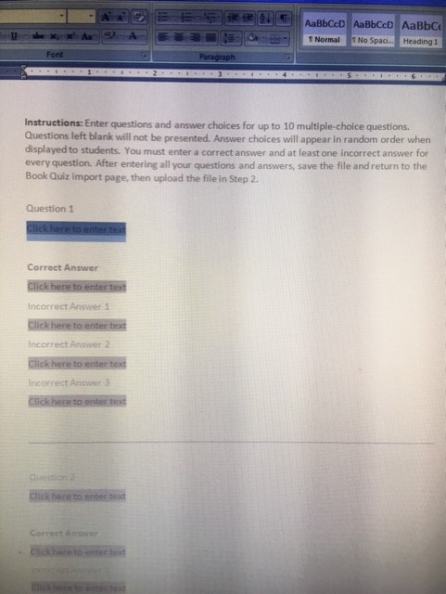
Step 4
Notes:
Talk about the questions, answers, and, finally, saving it as a word document that will be uploaded to the online quiz creating form.

Slide 11
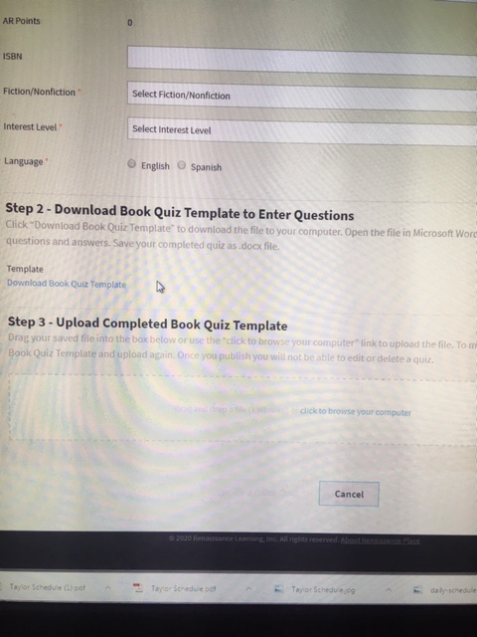
Step 5
Insert file of the completed book quiz
Notes:
Talk about details about this form.
After you upload, talk about clicking save and that it will take a few minutes for the quiz to become available on Renaissance.

Slide 12
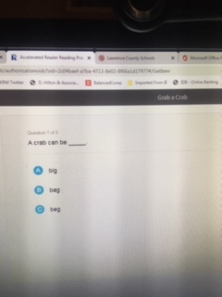
Test Preview
“Grab a Crab”
Teacher Made Quiz
#400415
Notes:
I could not find Fran Grabs It on Renaissance.
I hyperlinked the quiz number but Renaissance has to open to that when running the PowerPoint.
It would only matter if we were presenting in person. This picture should suffice.

Slide 13
Resources
RAZ website
Benchmark series
Treasures series
Renaissance
Binding Machine
Copy paper and ink for copying books
Laminating sheets
Additional books not in the Renaissance program

Slide 14
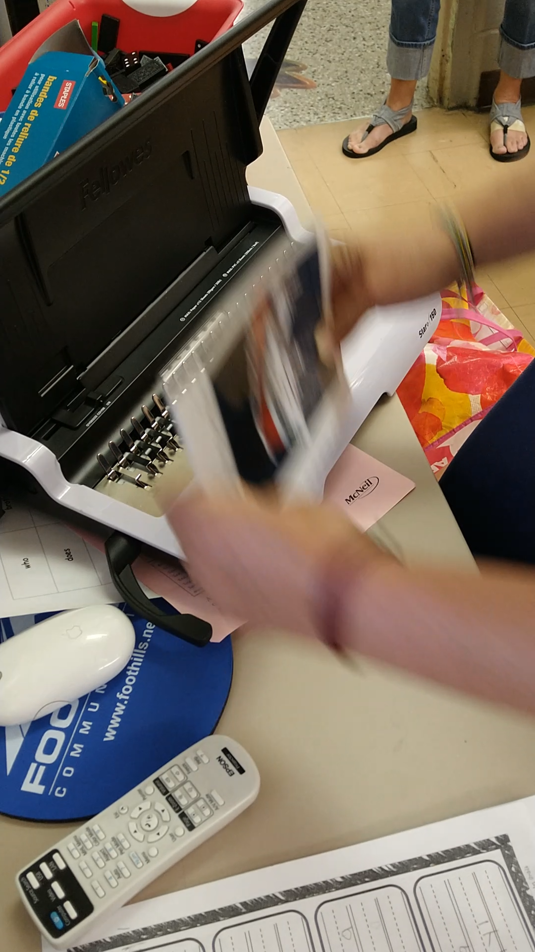
Creating Books
Notes:
When you open this in Slide Show, the video of Tammy will begin playing.
It looks like just a black screen, but the video is there.

Slide 15

So…

Slide 16
Guiding Research Question
How does providing these
teacher- created AR tests improve and motivate all readers to become more successful?

Slide 17
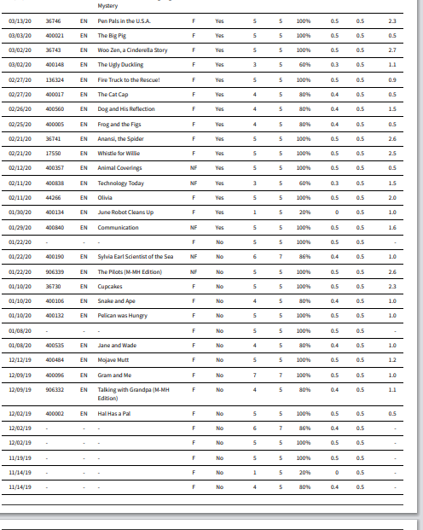
Monitoring AR Tests
Screenshot of Renaissance Records Report
Quizzes beginning with 400 are teacher created quizzes,
This student took 16/25 teacher-created quizzes, which is 64% of the total.
Notes:
This is where we need to put a picture of a student report with the #400 numbered tests.

Slide 18

Monitoring AR Tests
28 out of 123 students have taken more Renaissance AR tests that are a part of the Renaissance Library. (23% of students)
That means 95 out of 123 students took more teacher created quizzes. (77% of students)

Slide 19
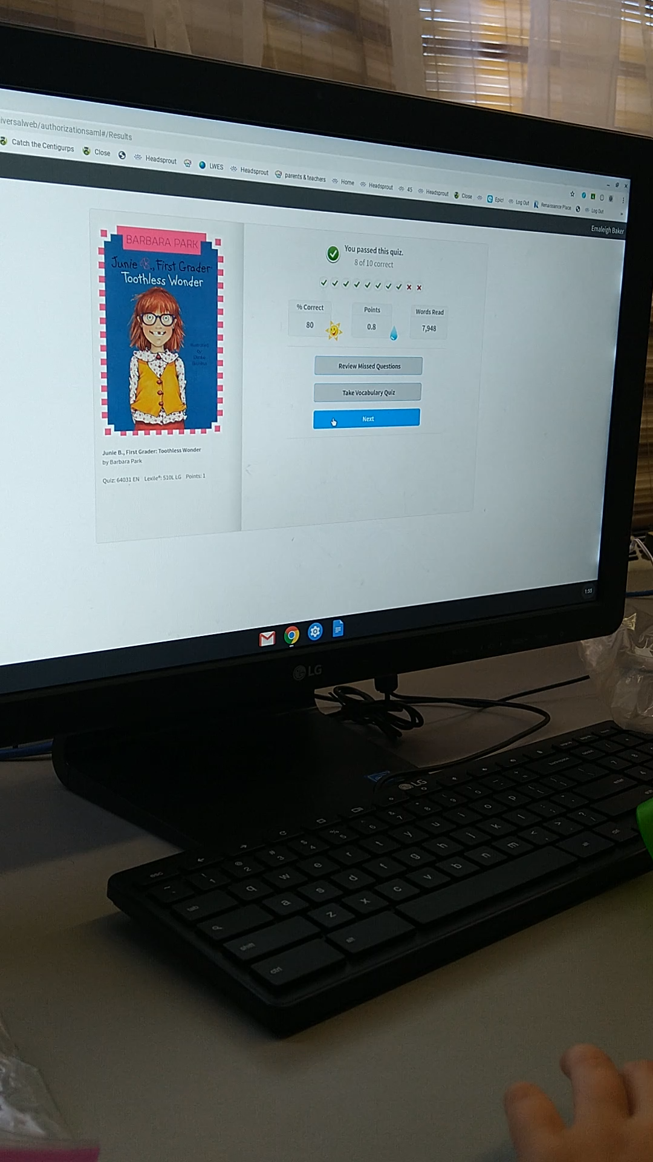
Student Monitoring
Video of Student’s Flower
Notes:
Video will begin when you click the mouse.
I have tried everything to get the video to turn right side up, searched tutorials online, but nothing works. Does Kelly know how to do this?

Slide 20
Data
In January, 42% of students in first grade had met their AR goal for the year.
In March, 67% of students in first grade had met their AR goal for the year.

Slide 21
Projected Data
The projected goal is based upon the students close to the first grade AR goal. This data would be officially recorded at the end of the school year.
Projected goal due to school closing from COVID-19
In May, 85% of students in first grade were projected to meet their AR goal for the year.

Slide 22
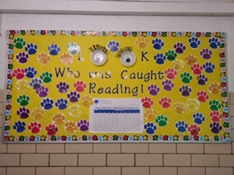
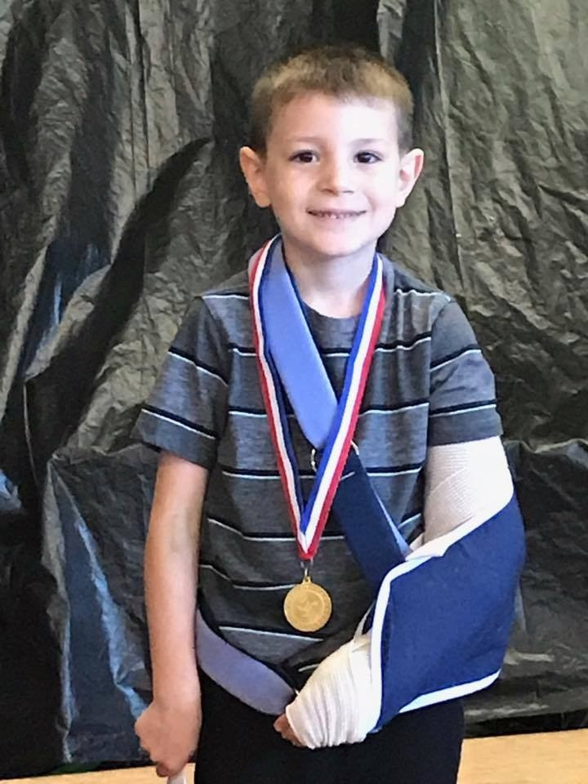
Our Goal to Success

Slide 23
Monitoring AR Test Accuracy
Data from the Summary Diagnostic Report – Report ran in April
AR quizzes taken | AR quizzes Passed | Accuracy
951 | 839 | 88%
1,763 | 1,591 | 90%
1,551 | 1,469 | 95%
1,425 | 1,117 | 78%
1,118 | 855 | 76%
780 | 663 | 85%
Total- 7,588 AR Tests Taken for First Grade | Total- 6,543 AR Tests Passed for First Grade | Percentage for students passing AR tests 86%

Slide 24
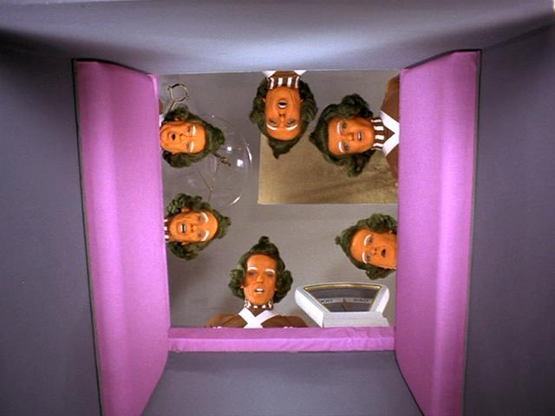
The End?
…or is it just the beginning!

