Slide 1
21st CCLC
Eagle Enrichment
Johnson Co Schools
Misty Delong
Site Coordinator
The Power of Expressive Painting:
Extended Day, The Arts and At Risk Youth

Slide 2
Project Overview
We paired credit recovery with weekly painting projects to encourage at risk students to become invested in their education due to the positive relationships developed during extended day schooling.
Students improved their academic performance due to the weekly checks from Extended Day teachers and because of their positive experience painting each week.
We learned that relationships and building on positive academic achievement changed the course of these students lives in school. They went from not having success to passing their classes and looking forward to their weekly art class.
They took pride in their contribution to our school.

Slide 3
Program Overview
Eagle Enrichment services students in grades 7-12
7:00 – 8:20 am, 3:30 – 5:30, Monday - Thursday
Programming begins in the Library with our Food Services Snack and Breaks out into various Enrichment Sessions
WIN Time, Driven always by student needs
94 Average Daily Attendees
161 Regular Attendees (30 Days or More)
4H Extension Agency, Primary Community Partner

Slide 4
Program Overview
Various Community Partners
Johnson Co Public Library
Camp Shawnee
Christian Appalachian Project
Mountain Comprehensive Care Mental Health Services
Johnson County Health Dept
Partners provide Enrichment Programming Daily with the assistance of the Four Full Time Teachers
Provide Volunteer Tutors
Assist in Program Design

Slide 5
What did we do?
We targeted a small population of students with various at risk indicators to participate in weekly painting lessons during our extended day programming.
These students would participate in Credit Recovery to keep them on track to graduate with their peers, and they would create pieces of art each week

Slide 6
The Power of Expressive Painting
32 Students attended Summer School. We developed a positive rapport with these students, and recognized they needed something to encourage them to be successful in their classes.
They lacked a strong connection to the school. They were not participating in sports or extra curricular activities. These students make up the small population of students not attached to any adult beyond their 50 minute classes each day.
Those students were targeted for this project.
Each of these students had various at-risk indictors.
Many fell below the Federal Poverty Line
They had all failed at least on subject during the traditional school year
Many come from broken homes that are impacted by poverty, drug misuse and abuse, incarceration, and were cared for by people other than their parents.

Slide 7
Why Did You Do it?
We realized after summer school that these students were looking for positive relationships at school.
They were not successful repeatedly in the traditional school setting. They had fallen into a pattern of behavior that, in many cases, they had inherited from their parents.

Slide 8
Why Did You Do it?
These students were given a clean slate in Eagle Enrichment.
We paired creative, fun activities with their credit recovery.
These students found that they enjoyed painting and creating art.
It also served as a therapeutic time for the students to calm their mind, to talk with their peers, and with adults.
These relationships carried over into the traditional school year.

Slide 9
How Did It Work?
The targeted students needed Credit Recovery to graduate with their class.
The students were given a computer program to make up the content they needed to graduate, but along with the academic work. They would participate once a week in a painting class.

Slide 10
How Did it Work?
The students must complete two hours a week in Extended day Academic Programming as well as one hour per week of therapeutic painting.
Some times, we had guest instructors from Mountain Comprehensive Care. Other times, we used videos from YouTube.
This was a time each week that we talked about what was going on in their classes, as well as their personal lives.

Slide 11
What does it look like?
These kids were great!

Slide 12
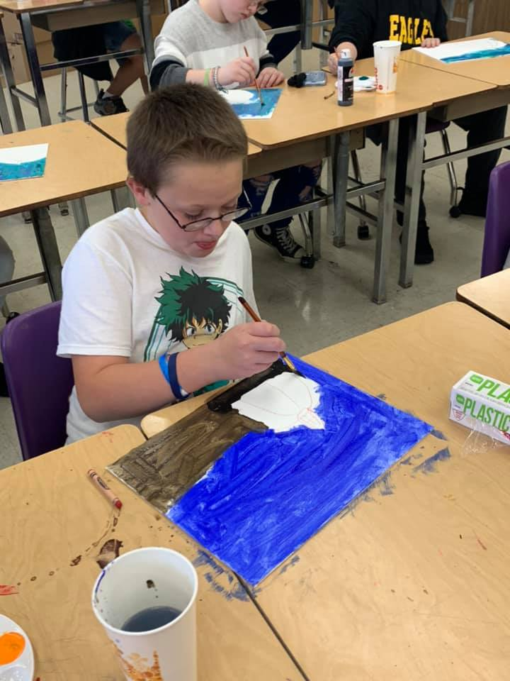
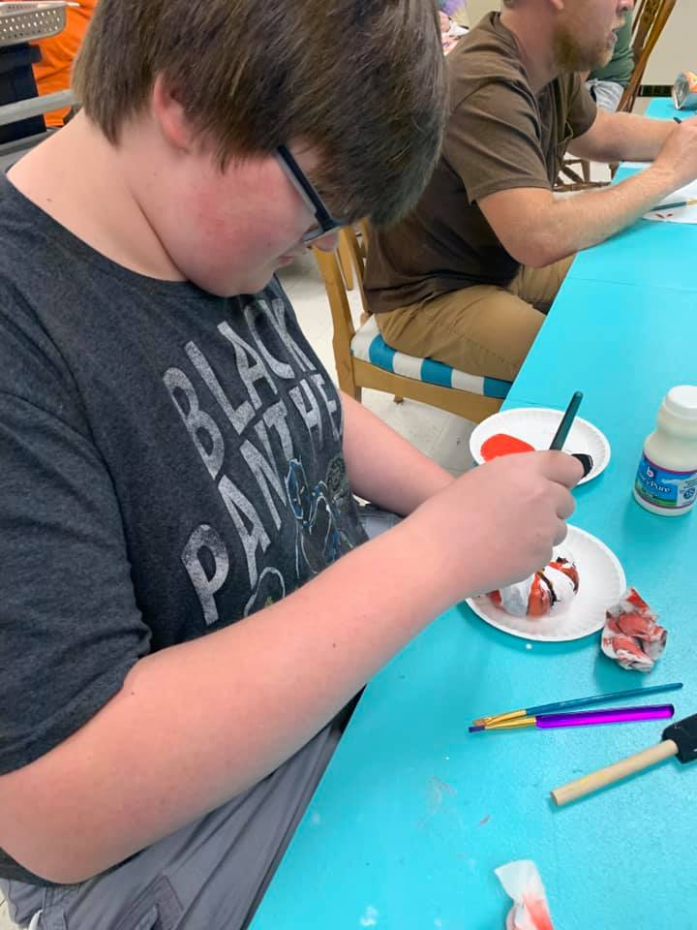
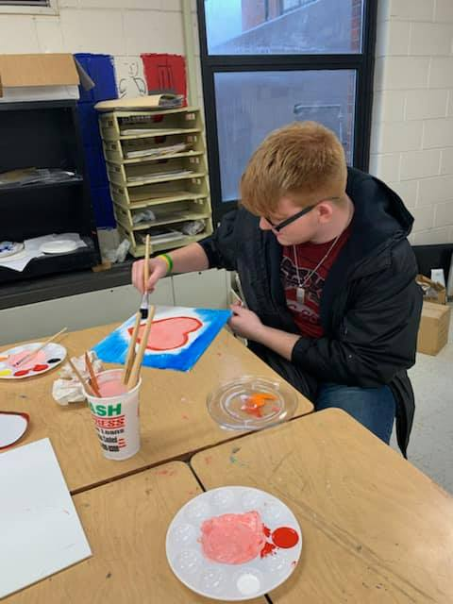
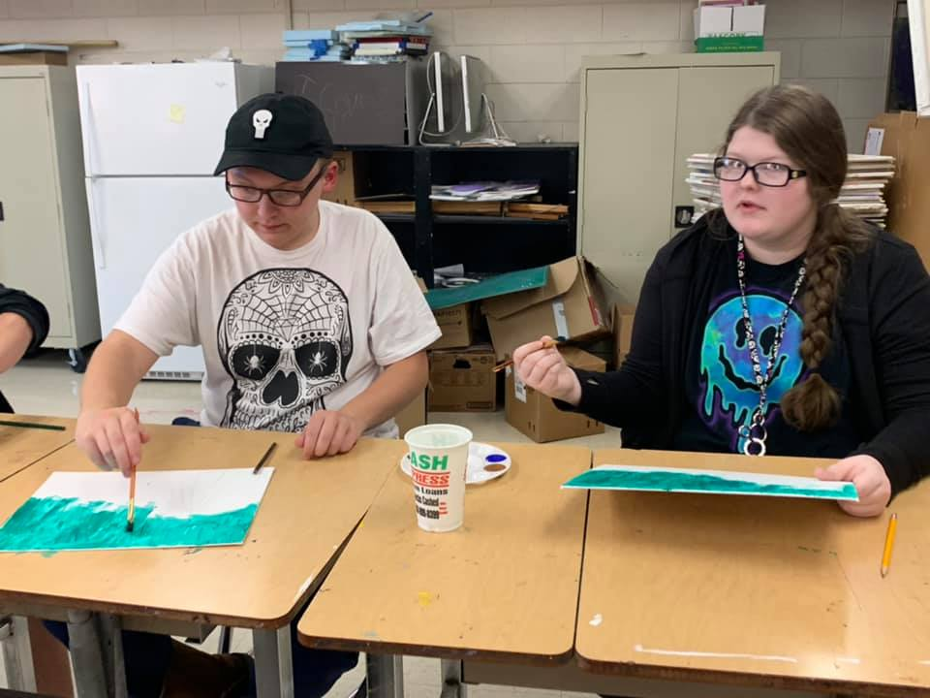
What Does it Look Like?

Slide 13
Painting with Mt Comp

Slide 14
Weekly Painting

Slide 15
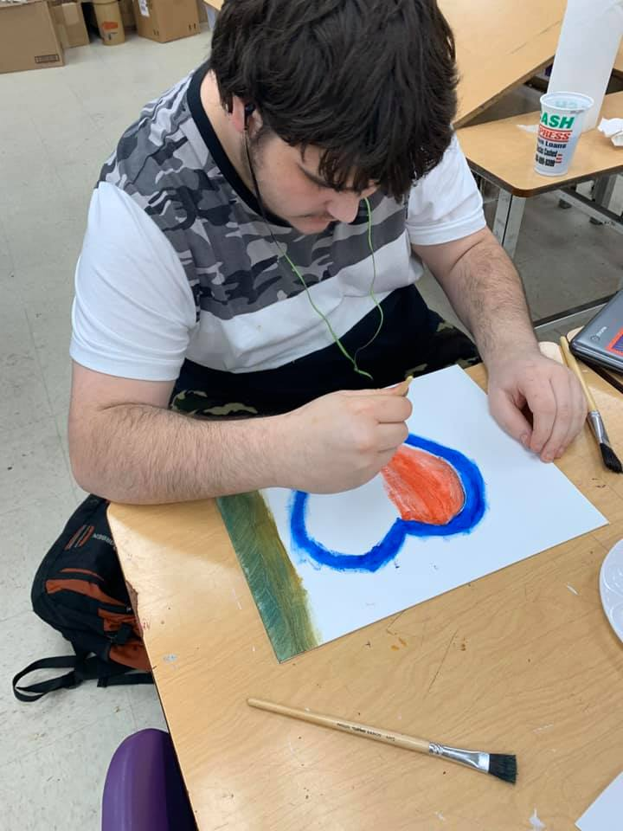
How Did It Impact Learning
Students who participated passed all their classes this school year.
They also completed their credit recovery.
They continued to come to Extended Day learning after they met the basic requirements.

Slide 16
They painting for birthdays, Valentine’s Day, and Presents for their Families.

Slide 17
We had FUN!

Slide 18
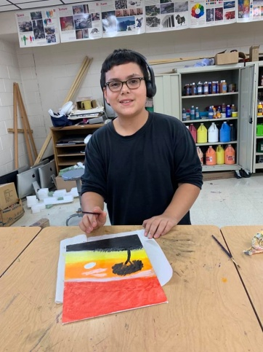
What Did I learn?
Relationships make all the difference.
These students had adverse experiences with school.
But, once their relationship changes with school and with extended day, they were able to be successful.

Slide 19
JOHNSON COUNTY SCHOOLS
Eagle Enrichment
Relationships
Matter!

