Slide 1
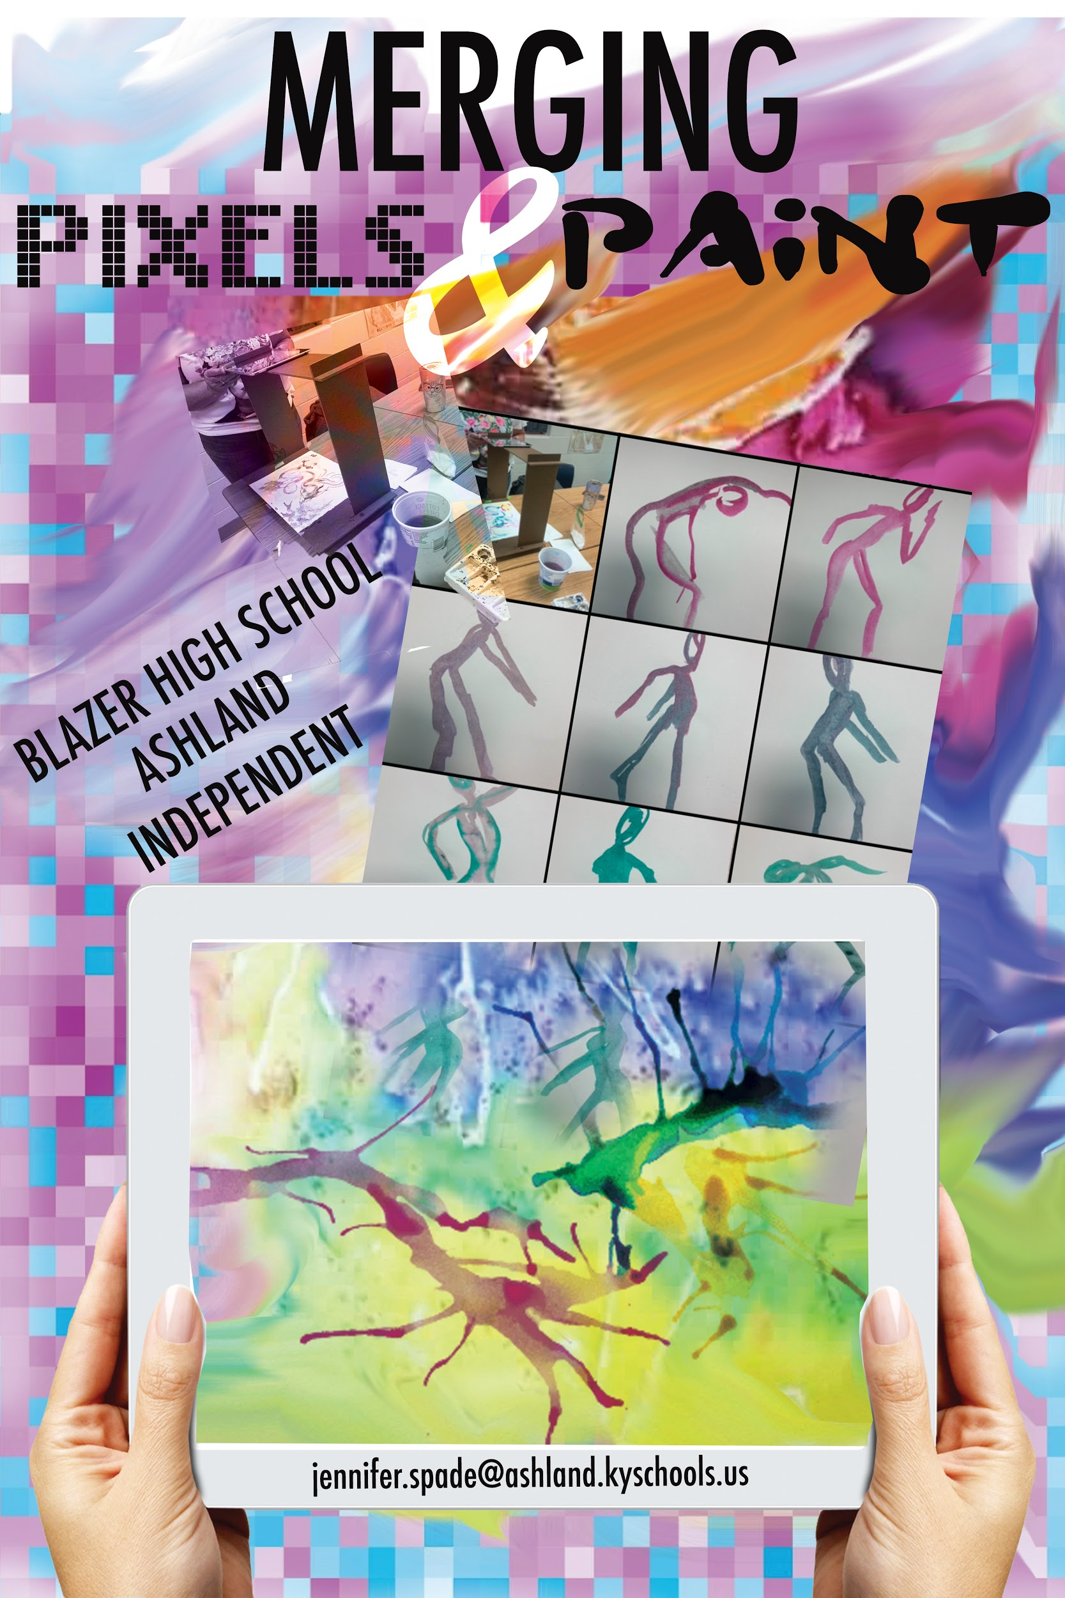
Merging Pixels
&
Paint
Jennifer Spade • Blazer HS • Ashland,KY
Notes:
My grant was created for the use of technology in the art room with iPads.

Slide 2
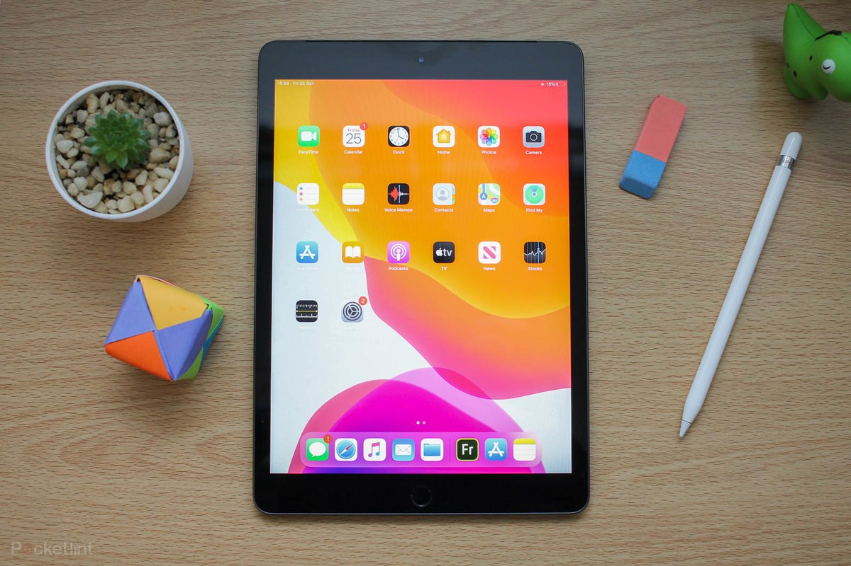
What is your problem of practice?
Not all students have access to technology in the art room.
How do you know this is a problem?
Students are without devices to make photographs and digitally manipulate images..
What strategy will you implement this year to address the problem?
I plan to purchase ipads for my classroom to alleviate lack of technology.
What resources and personnel do you need to implement your strategy?
I need funding for ipads, I will implement the lessons designed to engage students and take them to the next level of understanding how to create digital artworks.

Slide 3
5. What research question will guide your study of this innovation?
How does technology improve understanding of art?
6. What outcomes will prove that your innovation has succeeded?
The outcomes that will prove the success of this project are the products created by the students. (ie photographs/artworks)
7. How will you measure those outcomes?
I will measure the outcomes based on the criteria for each assignment and how the students met the objectives of each project evidenced by production of work
8. How can you be sure that any positive outcomes on these measures are actually due to your innovation and
not something else?
I can be sure that the outcomes are measured by the technology because students who did not previously have access to technology will now be able to use an ipad to create photographs and digitally manipulate photos to create works of art.

Slide 4
Project #1
Mood Boards
EDUCATION IN FOCUS

Slide 5
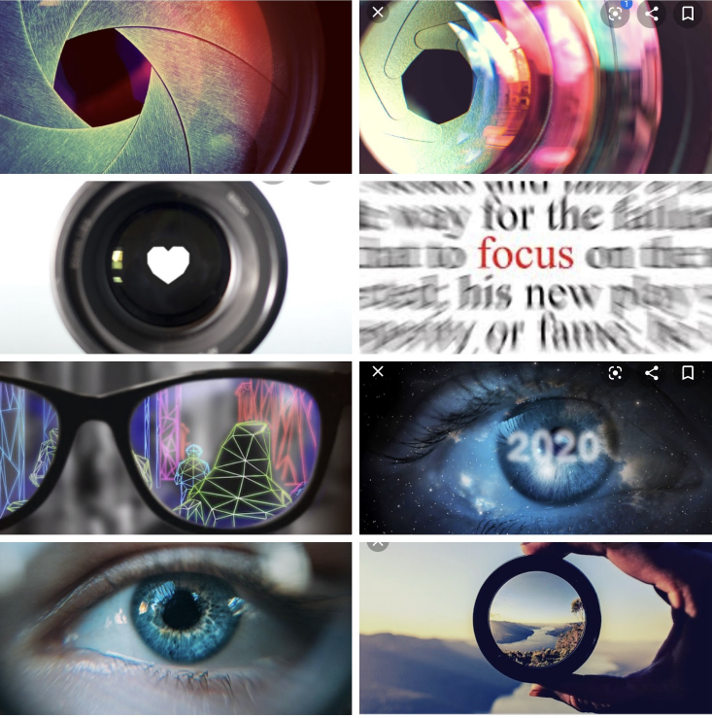
Mood Boards
Objective:
To organize thoughts in a digital realm to convey an idea.
Students selected, images, fonts, colors, and other visuals to use for inspiration of design thinking.

Slide 6
Students utilized Adobe Spark and Canva to create their mood board for the KSBA Banner Design

Slide 7
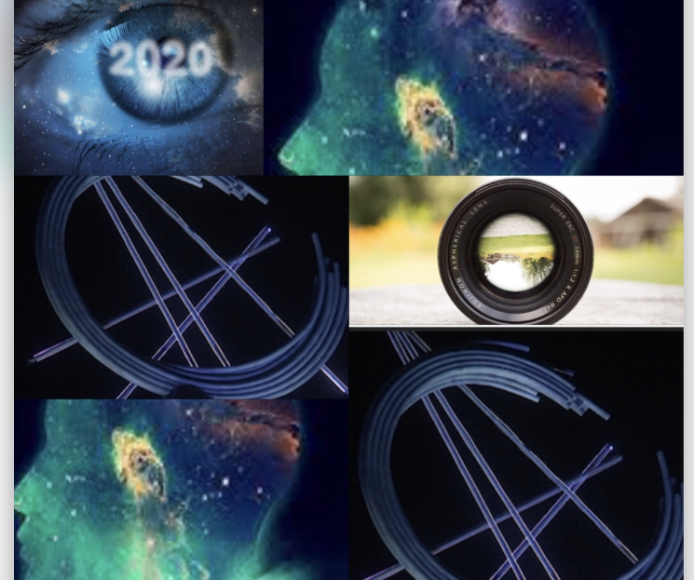
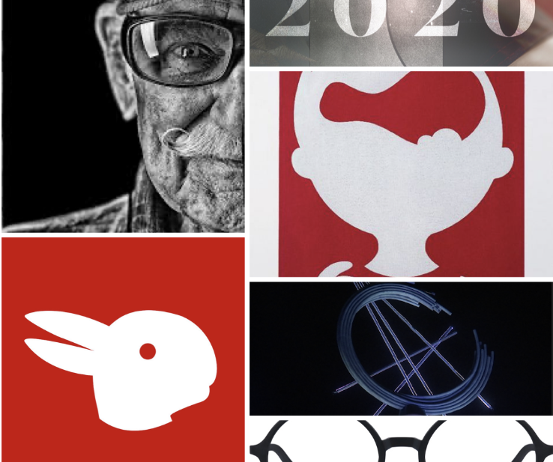

Slide 8
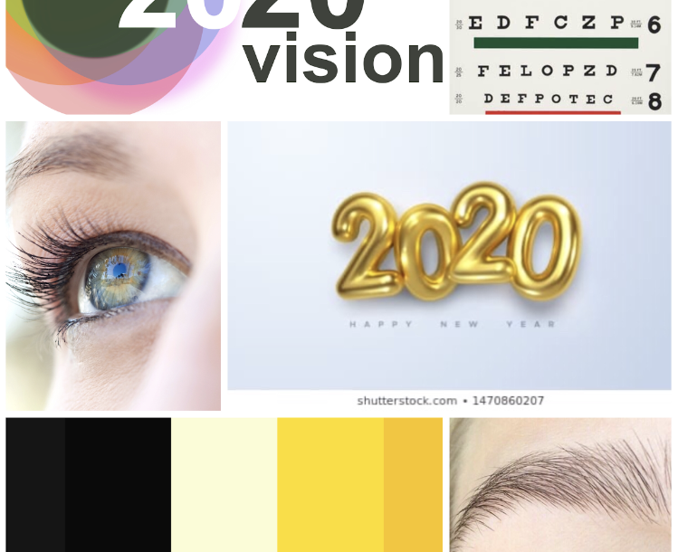
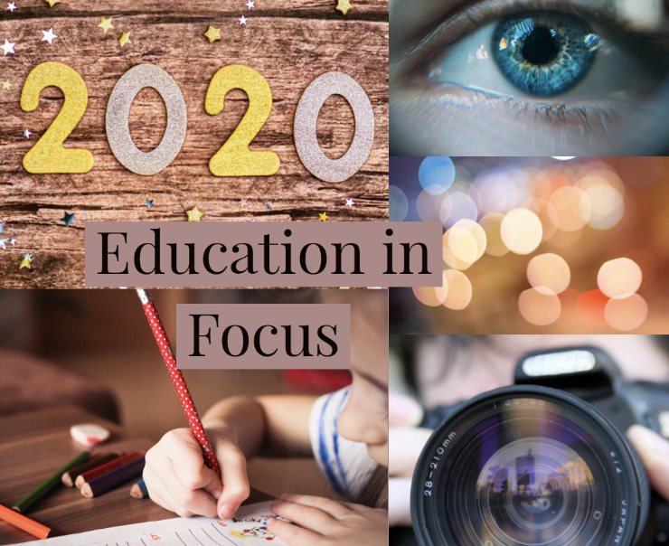
WE HELD A GROUP CRITIQUE TO FURTHER REFINE OUR IDEA

Slide 9
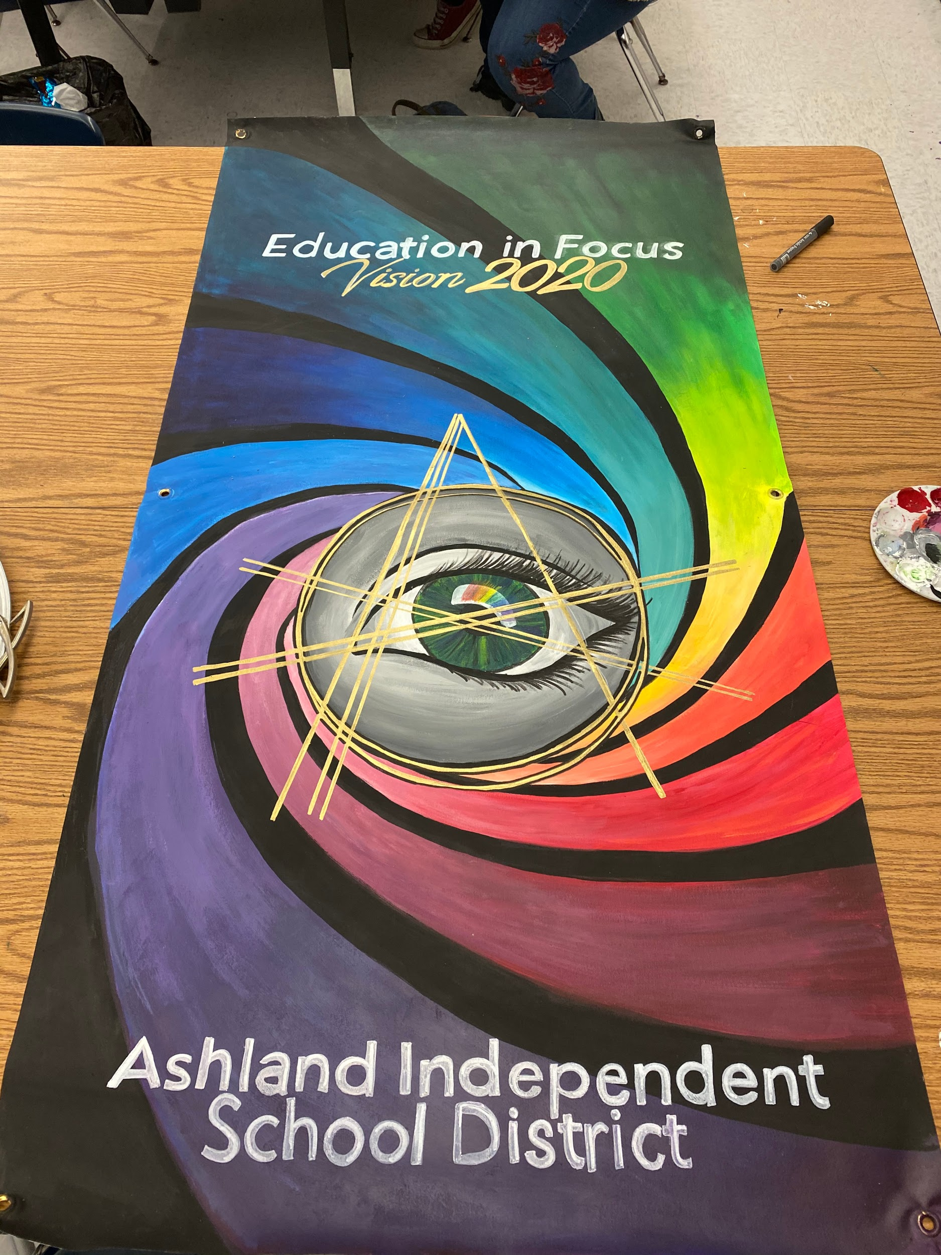

Slide 10
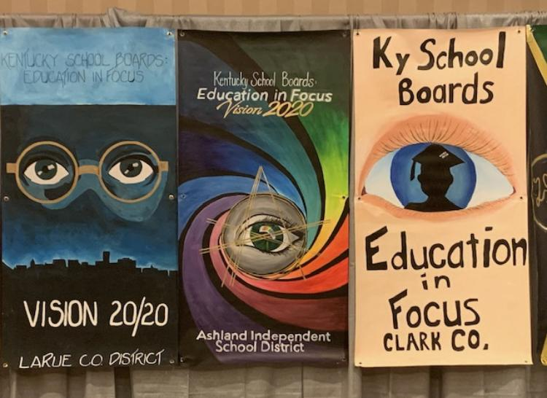

Slide 11
Project #2
LOGO DESIGN
ASHLAND AREA MORTGAGE

Slide 12
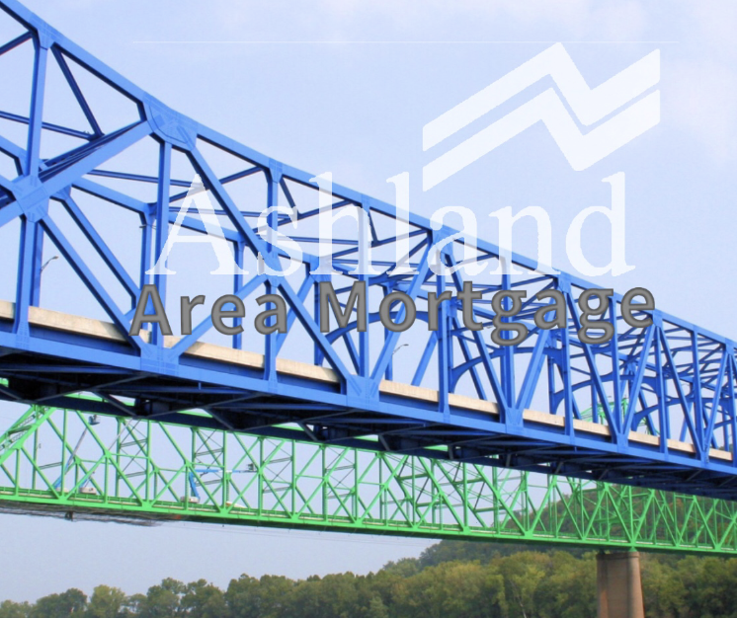
STUDENTS WERE ASKED TO CREATE A NEW LOGO FOR A LOCAL MORTGAGE COMPANY.

Slide 14
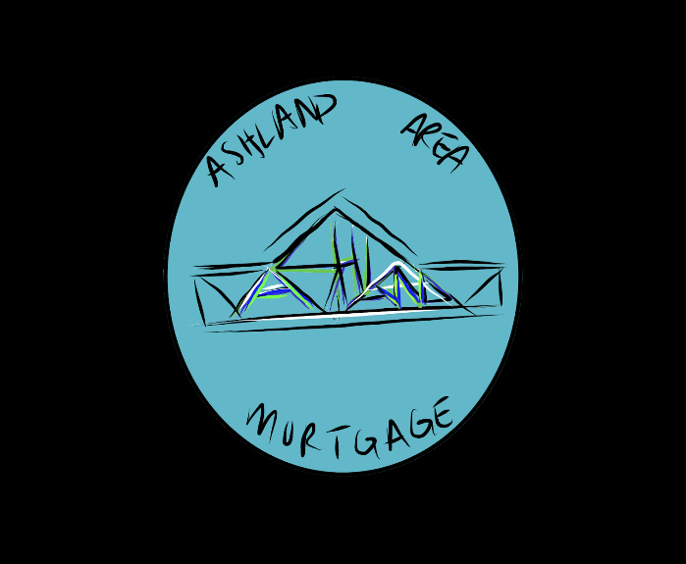
STUDENTS WORKED IN PROCREATE TO CREATE THEIR LOGOS

Slide 15
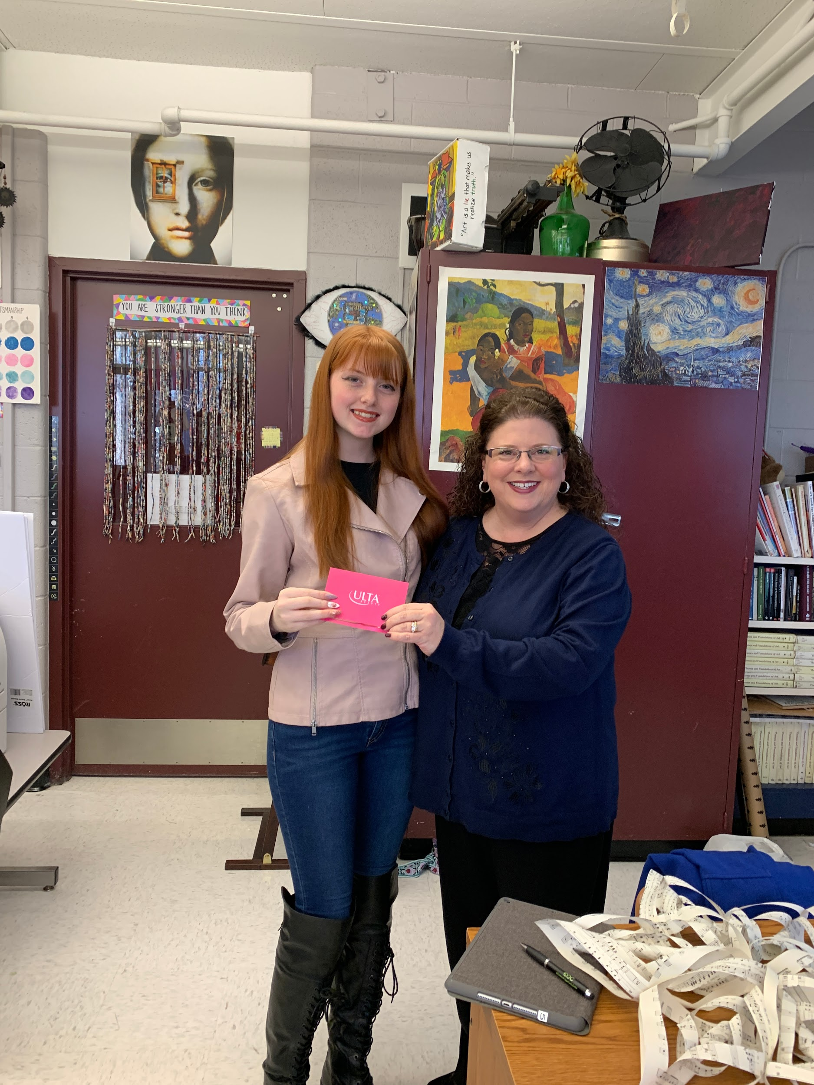
THE BUSINESS CHOSE THIS DESIGN AS THE WINNER. THE CLASS WAS REWARDED FOR ALL THEIR HARD WORK AND THE STUDENT WAS GIVEN A GIFT CARD FOR HER DESIGN.

Slide 17
Project #3
ALEXA MEADE INSPIRED ARTWORKS

Slide 18
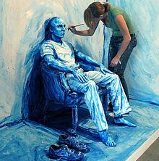
ALEXA MEADE
Objective:
To create an image in the style of this Artist who paints directly on her subjects and then photographs them.

Slide 19
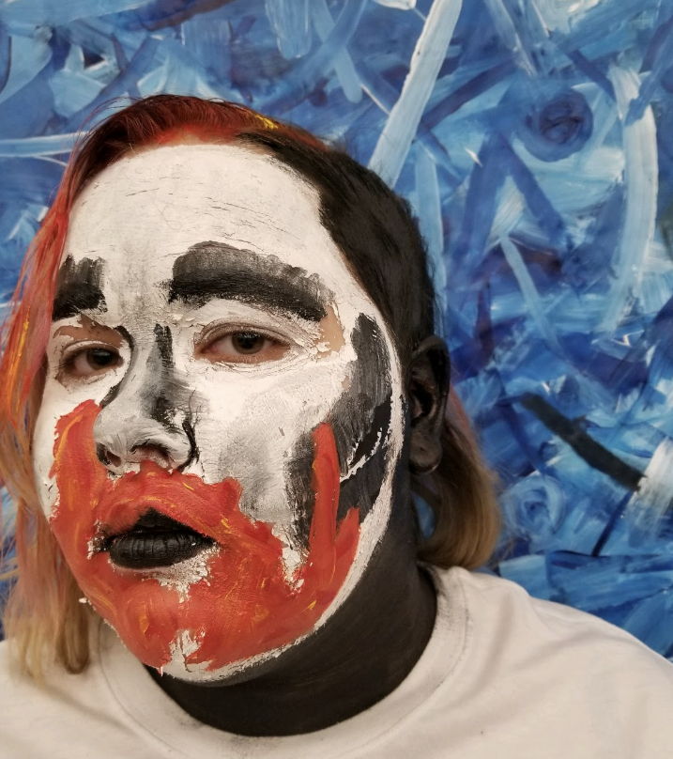
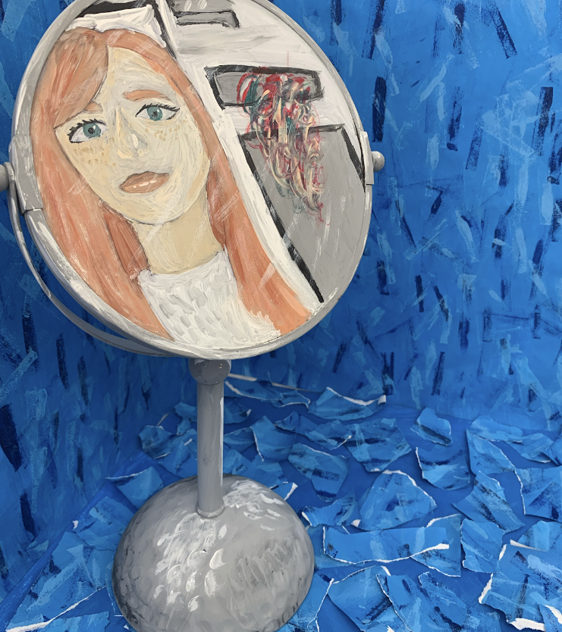

Slide 20
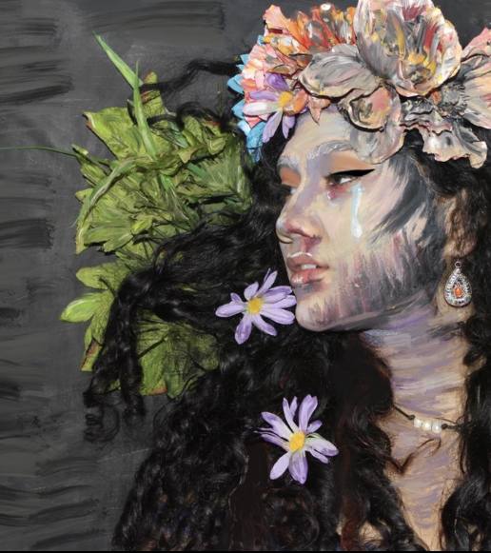
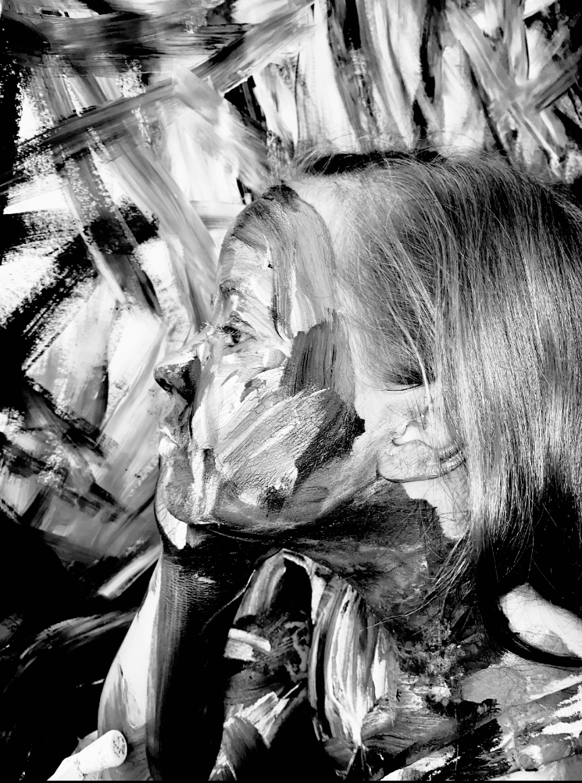

Slide 21
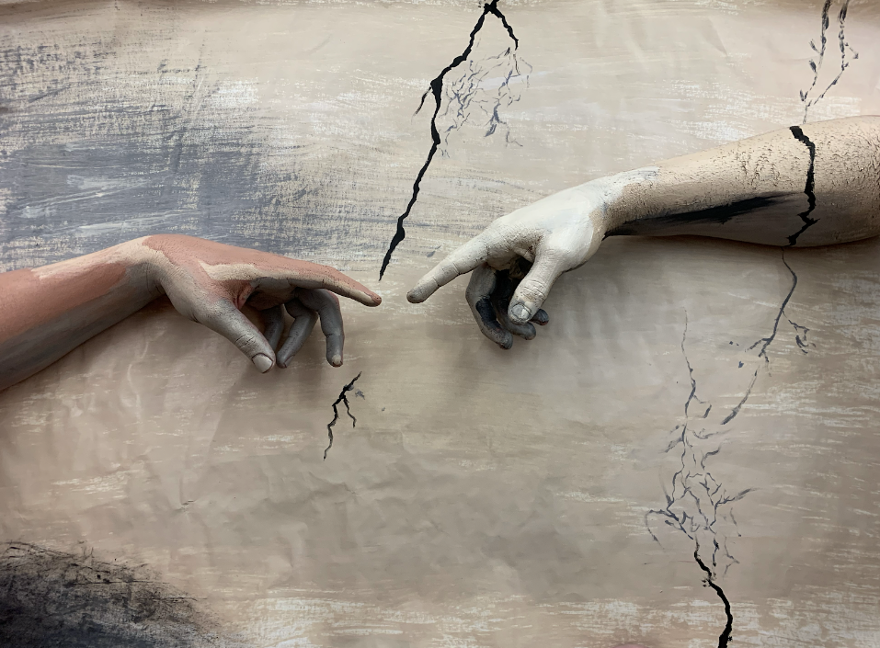

Slide 22
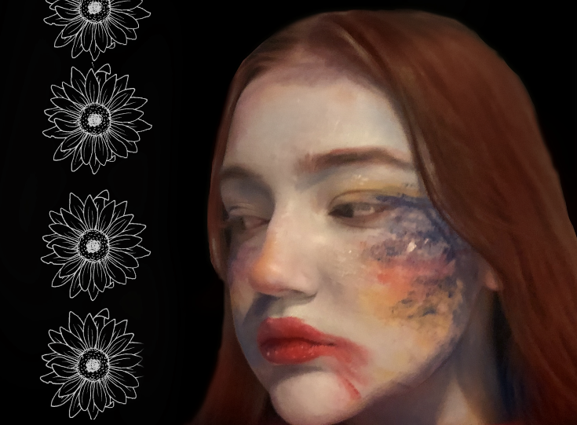

Slide 23
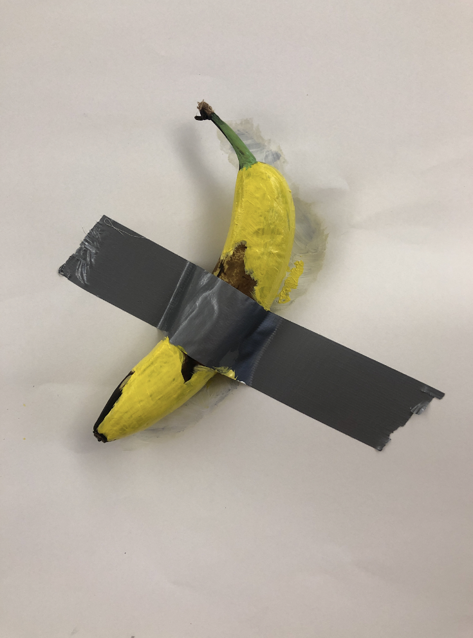
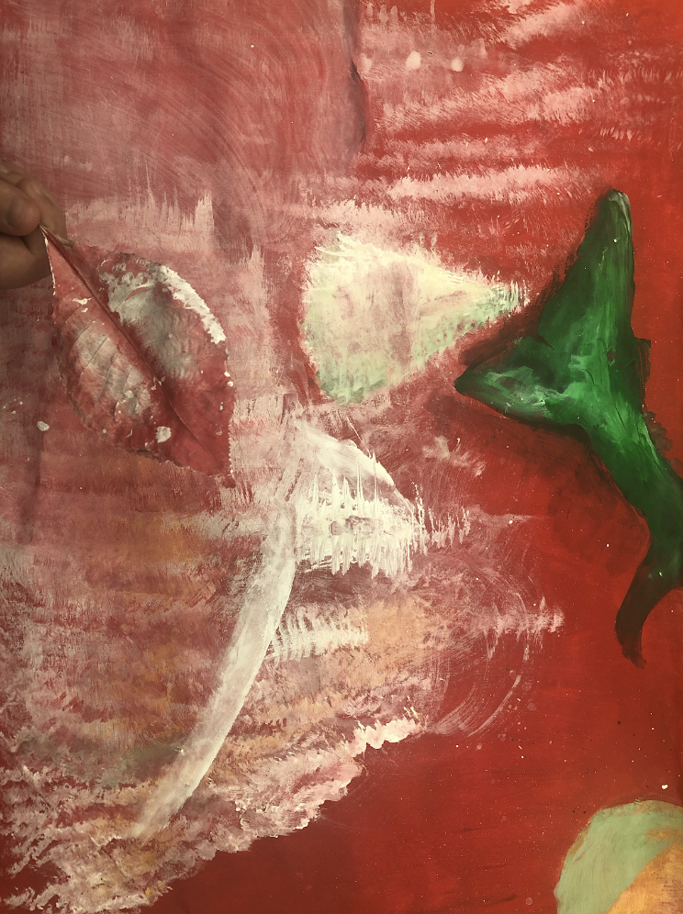
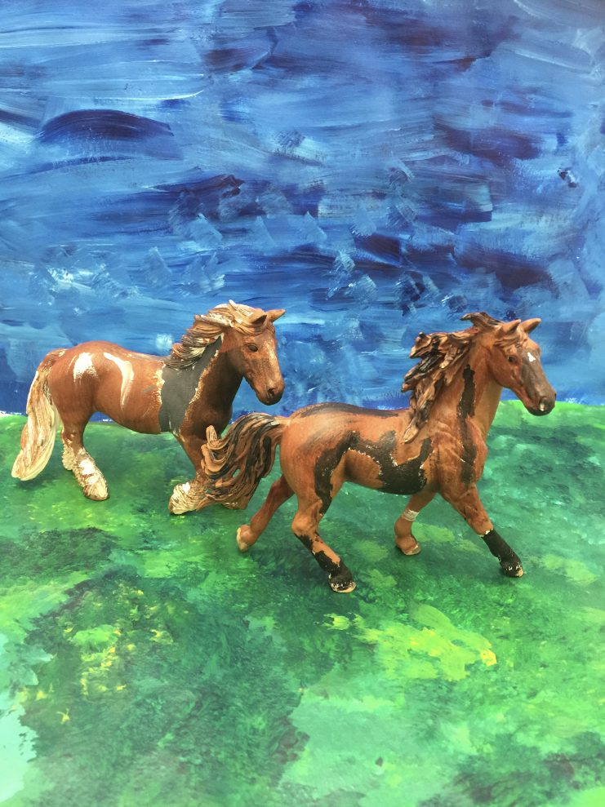

Slide 24
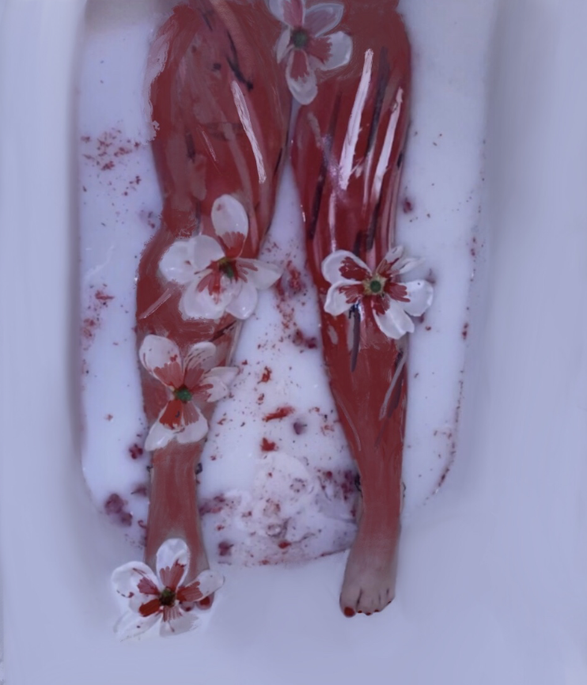

Slide 25
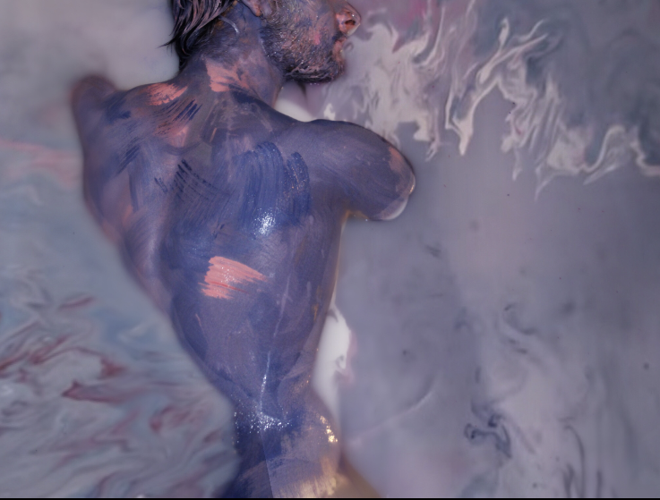
STUDENTS WERE ABLE TO DIGITALLY MANIPULATE THEIR PHOTOS FURTHER USING VARIOUS APPS ON THE IPADS INCLUDING MEDIBANG AND PROCREATE.

Slide 26
Project #4
SCHOOL BASKETBALL T SHIRT DESIGNS

Slide 27
T SHIRT DESIGNS
Objective:
To create a T shirt design for our school’s basketball team, to be sold to raise money for the art department.

Slide 29
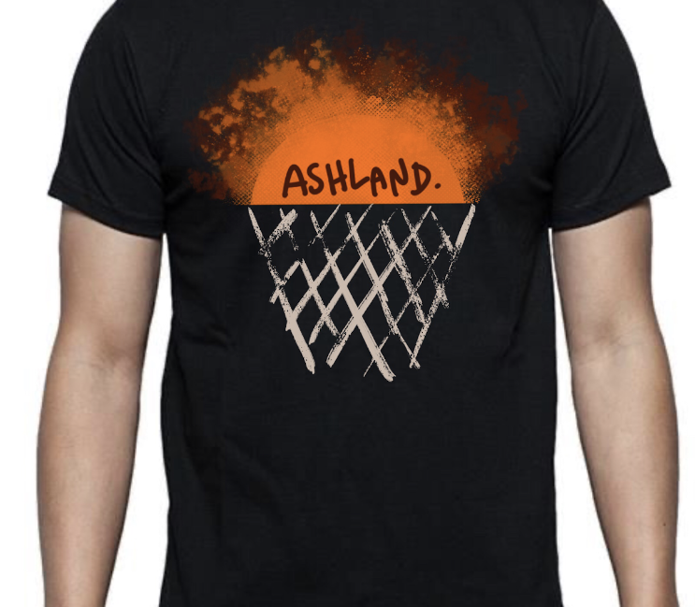
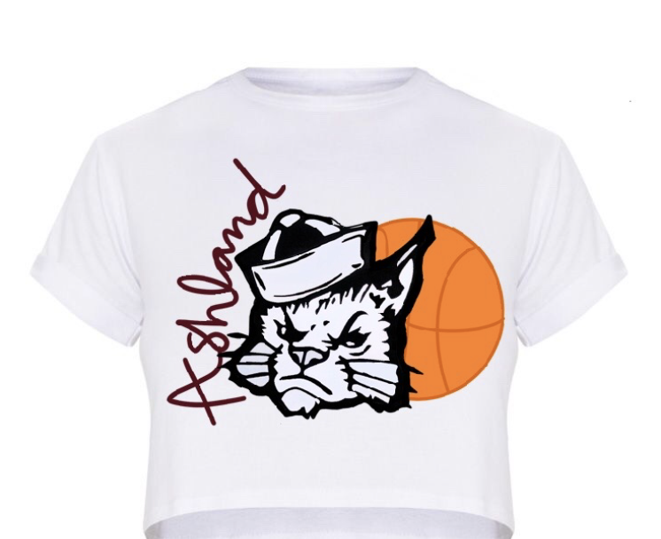
STUDENTS WORKED IN PROCREATE TO DRAW IMAGES AND INSERT TEXT

Slide 31
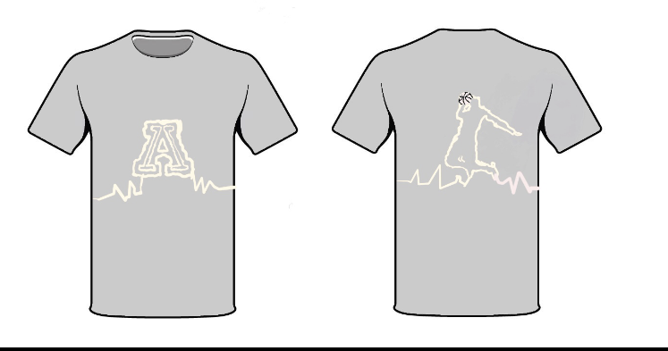
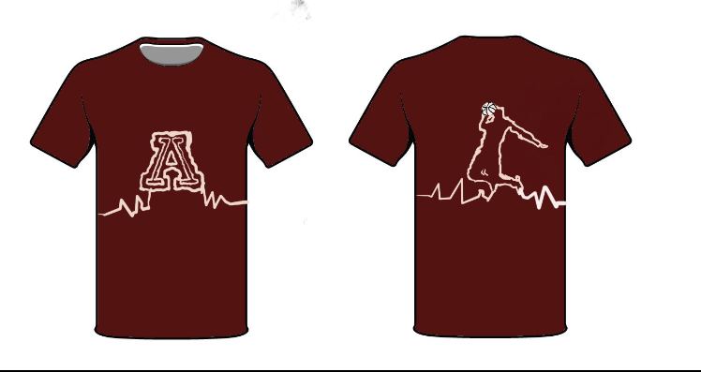

Slide 32
Project #5
OAKVIEW ELEMENTARY CAFETERIA MURAL

Slide 33
CAFETERIA MURAL
Objective:
Students used iPads to create both mood boards and drawings for a mural for one of our district elementary schools. The mural was scheduled to be completed in March but will have to be rescheduled.

Slide 36
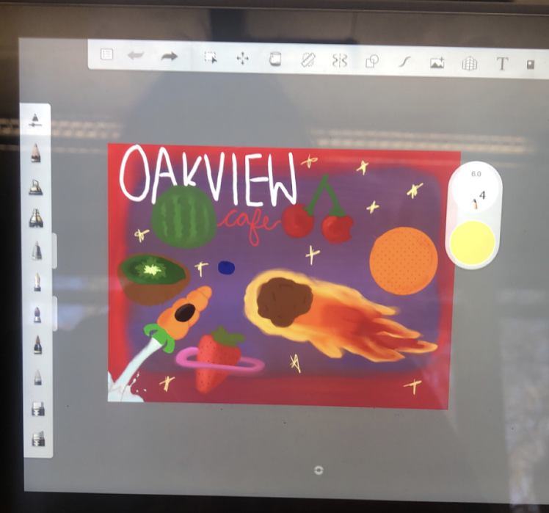

Slide 38
THIS WAS THE DESIGN SELECTED BY THE CAFETERIA WORKERS.
THE SCHOOL’S MASCOT IS THE COMETS SO THE KIDS ENVISIONED DIFFERENT TYPES OF FOODS AS PLANETS WITH A MILKY WAY.
THIS STUDENT DREW EACH ITEM AND GAVE THEM LOTS OF PERSONALITY.

Slide 39
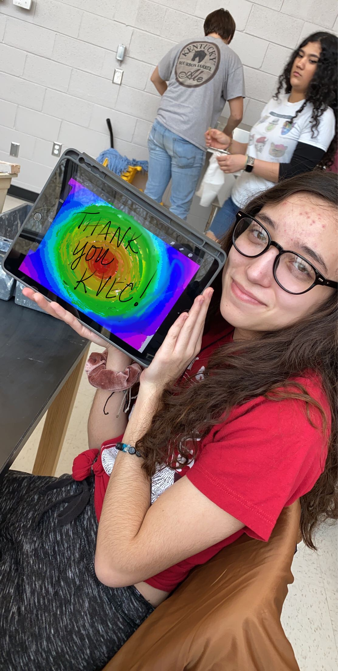
THANK
KVEC
YOU

