Slide 1
Virtual Reality:
Learning Beyond the Classroom
Amber Tackett, Paul Blazer HS
Ashland Independent

Slide 2
My Presentation

Slide 3
Problem
Typically, AP Art History Students learn about architecture through still images
Going to a site in person > experience than a photograph
International travel is EXPENSIVE and not viable for all students

Slide 4
Solution
Bring those places to life within the classroom via virtual reality
Virtual Reality allows students the opportunity to feel as if they are physically in the location, and have full control over what they look at through moving their head naturally
For students without smartphones you can use smaller tablets (less than 7” is best for most VR sets)

Slide 5
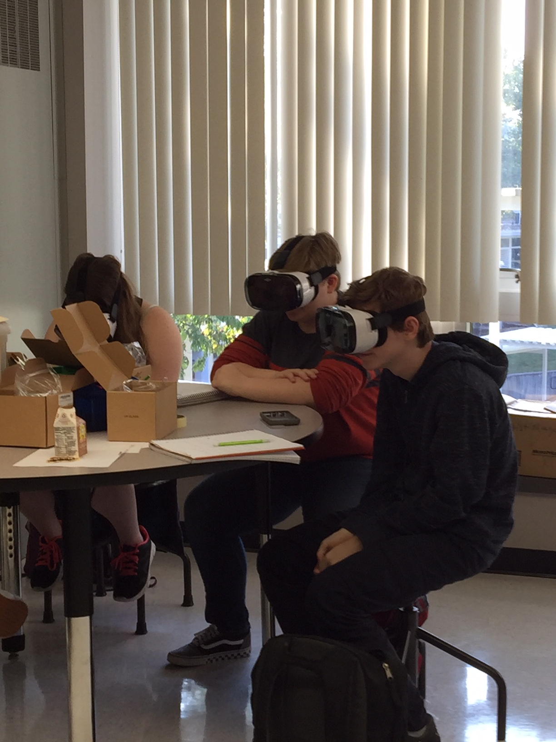
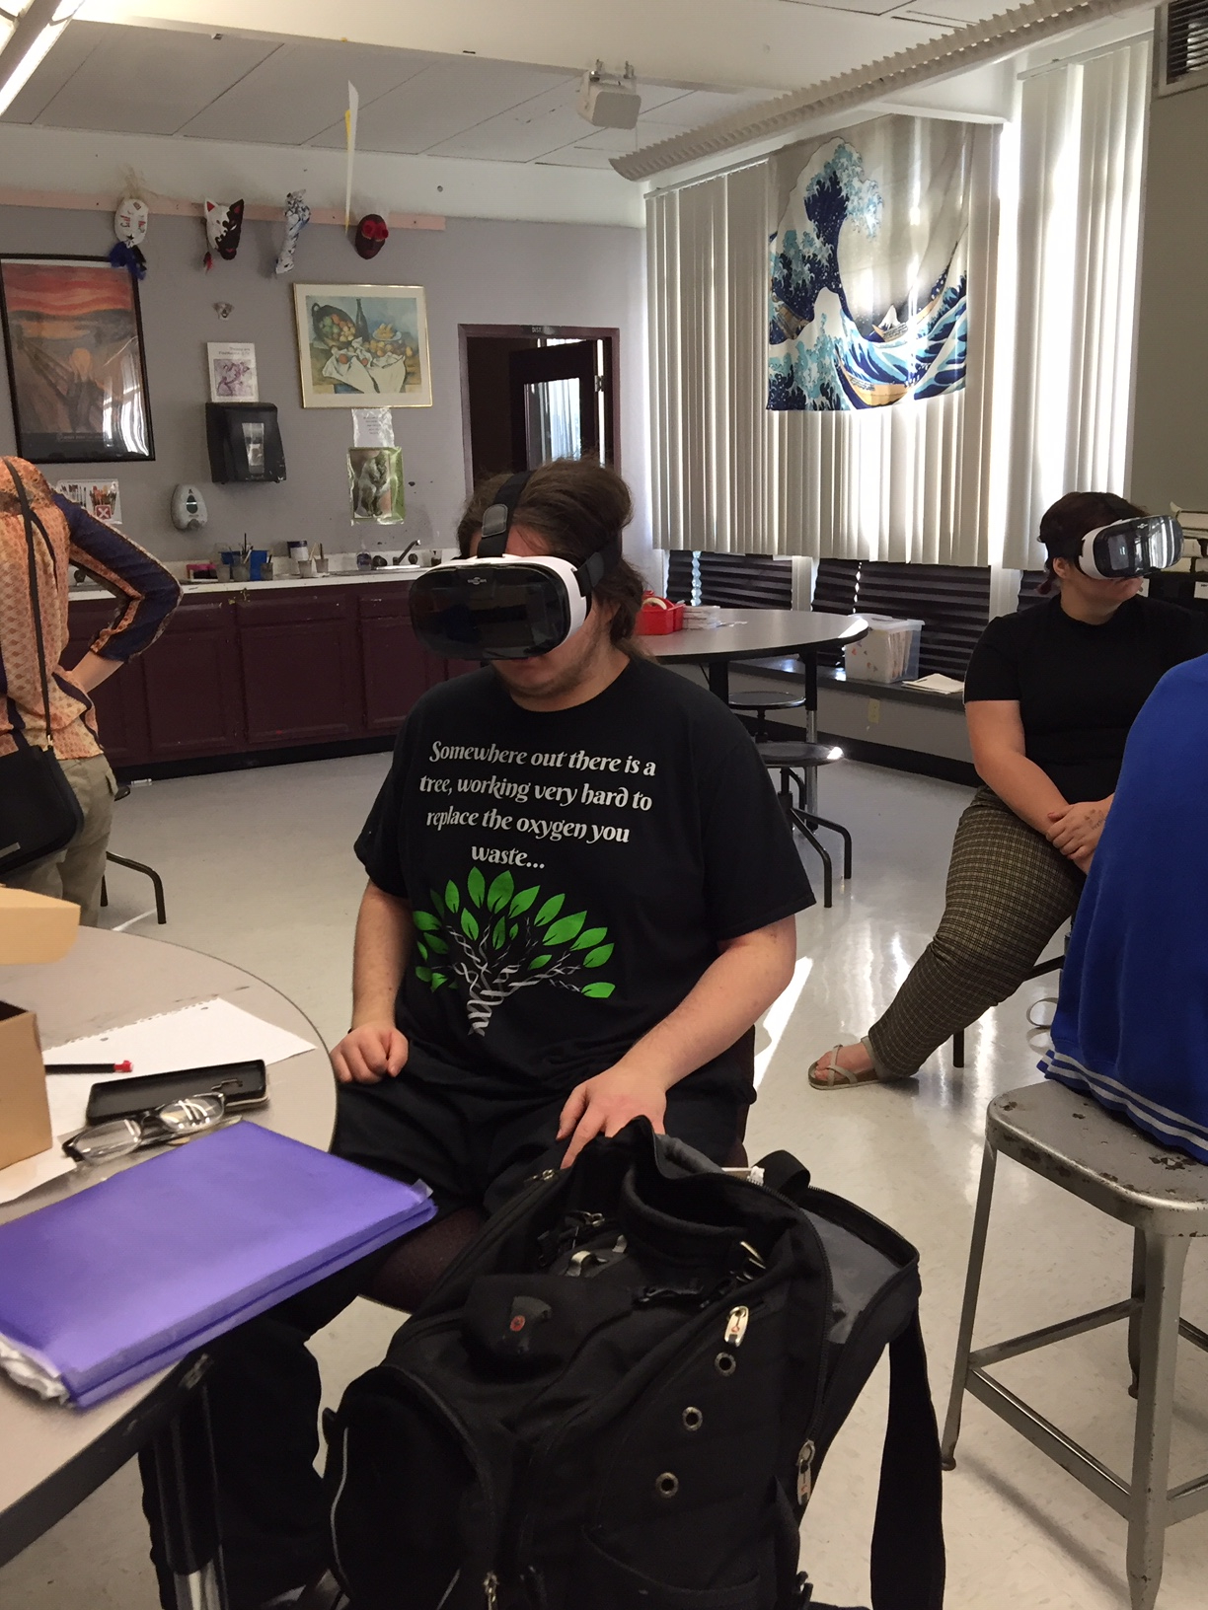
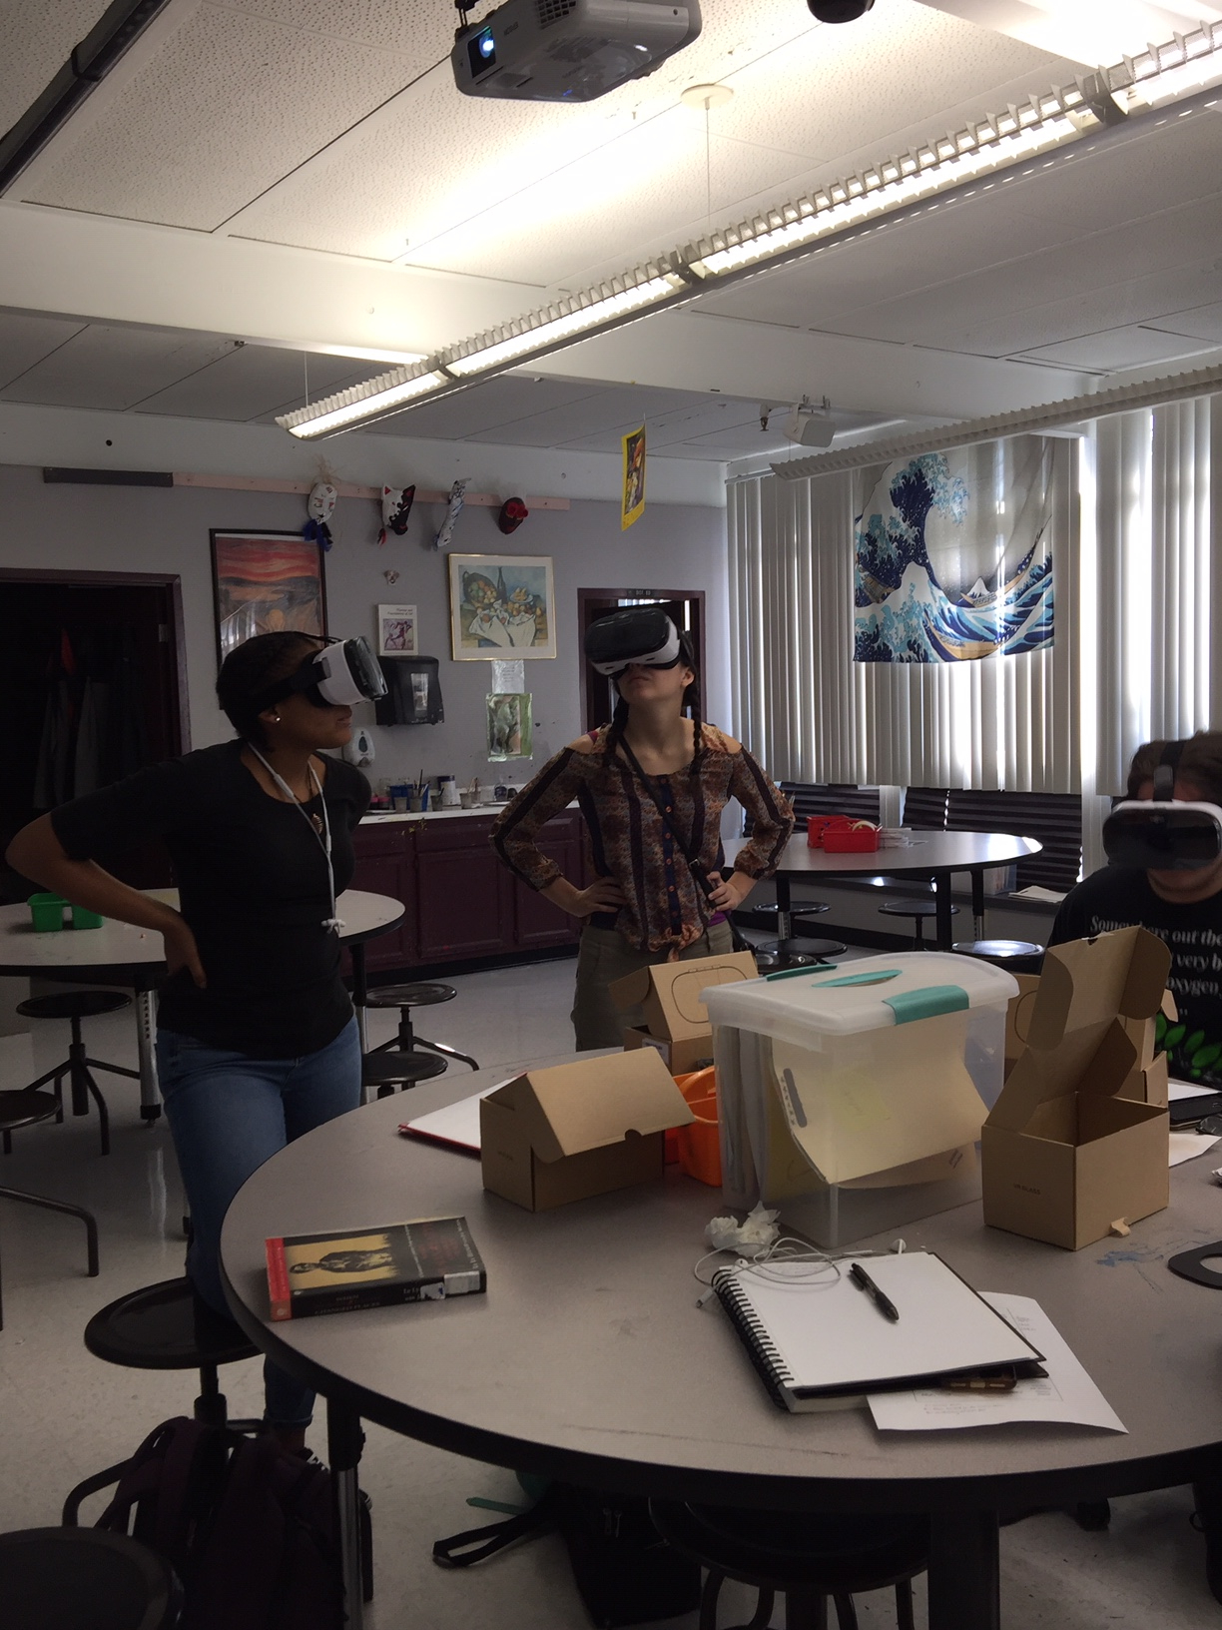
First interaction with VR

Slide 6
Student Reaction
TONS OF QUESTIONS! They were engaged and wanted to learn more!
They were and are excited for the experience when I get the VR goggles out.
“It’s a cool way for us to get to see it in a 3d way, which makes it more personal.”
- Jordan

Slide 7
The Results
Does Virtual Reality better help students grasp architecture?
In comparing scores from exams of previous years to this year there were not many differences. There are several reasons for this: 1) different groups of students are hard to compare accurately to one another 2) this years’ group as a whole performs worse on exams than previous years 3) not every architecture piece we talk about has a VR video.
However, on questions that I used VR students were better at questions that described the buildings. For instance, there was a 9% increase in students who answered a question about the Acropolis correctly than in previous years.

Slide 8
Results Continued
The student average on architecture did increase from the first unit (where we did not use the technology) where the average was 47% to most units after being in the range from 50% to 77% correct on architecture questions.
The greatest result was the engagement of students and the awe they experienced visiting these places virtually.
I also believe with VR technology increasing that this experience has a great potential of increasing student achievement in the future.
VR technology holds a lot of promise for providing students experiences they are otherwise not afforded in life - that makes it worth it to me as a teacher!

Slide 9
Other classes VR could be used
Science: Visit Biomes, tour cells or human anatomy, etc.
Social Studies: visit the location of important events, geography, etc
Language Arts: visit locations they read about, etc
Math: geometry, various math game apps, etc.
The resources are growing for VR and augmented reality in the classroom to increase the ability for students to more actively experience what they are learning.

