Slide 1
Unlocking the Wonders
Jessica Davis, 6th Grade Mathematics Teacher
Paintsville Elementary, Paintsville Independent Schools

Slide 2
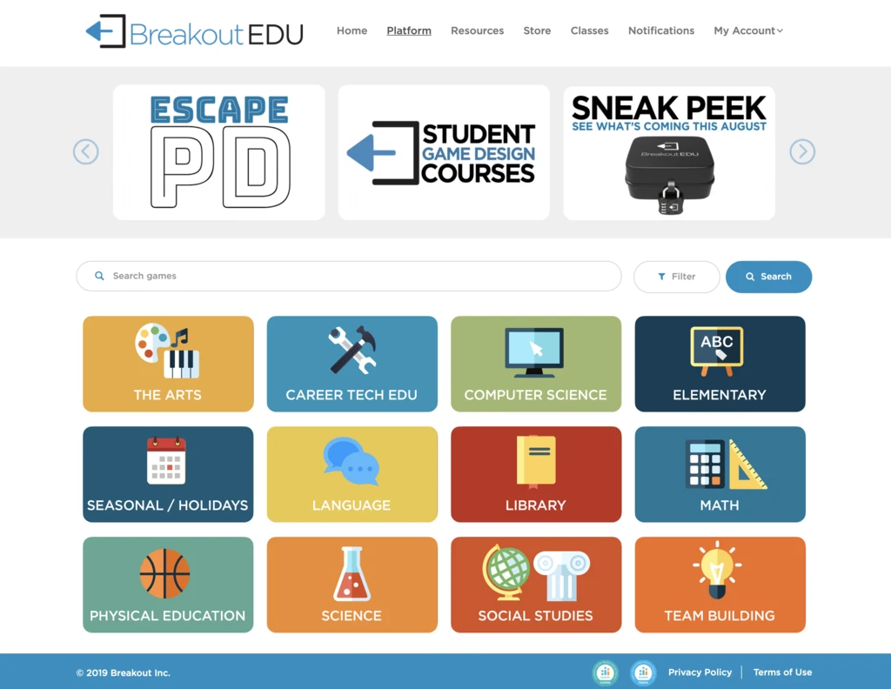
Problem of Practice/Research Question
Can breakout boxes create a critical thinker?

Slide 3
Why Problem?
When awarded this grant originally, I was teaching 6th grade Social Studies and curriculum would be changing quite a bit. Standards were changed from current world geography to ancient civilizations. How can make students involved in “unlocking the wonders” of ancient civilizations?
After being awarded the grant, I was moved to 6th grade math. Now my problem has changed to making my math students become critical thinkers and apply all types of math to “real world” breakout rooms to escape in time.

Slide 4
Strategy to be Implemented
Purchase 6 Breakout Kits that includes locks, boxes, invisible ink, and most importantly access to teacher created Breakout Rooms that have proven to be successful.

Slide 5
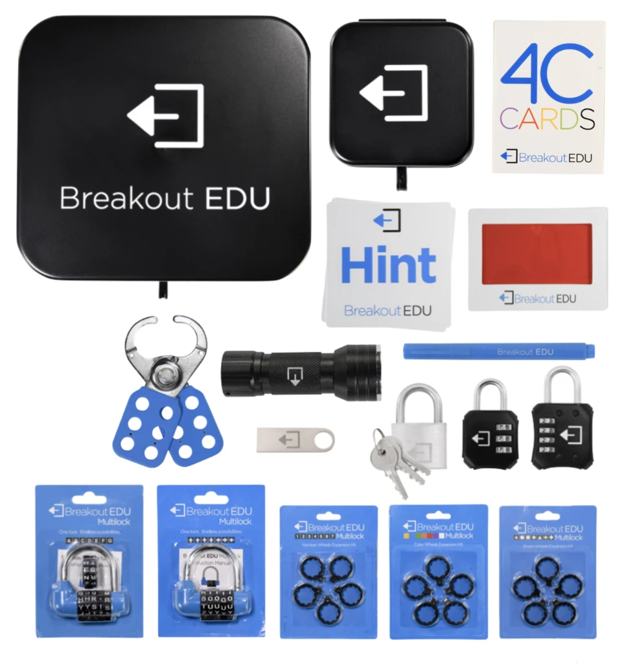
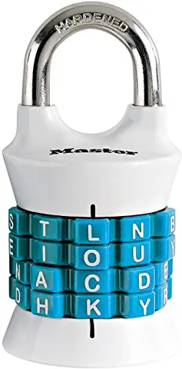
Resources Needed
Variety of resetable locks from amazon.
6 Breakout Edu Kits and access codes
www.breakoutedu.com

Slide 6
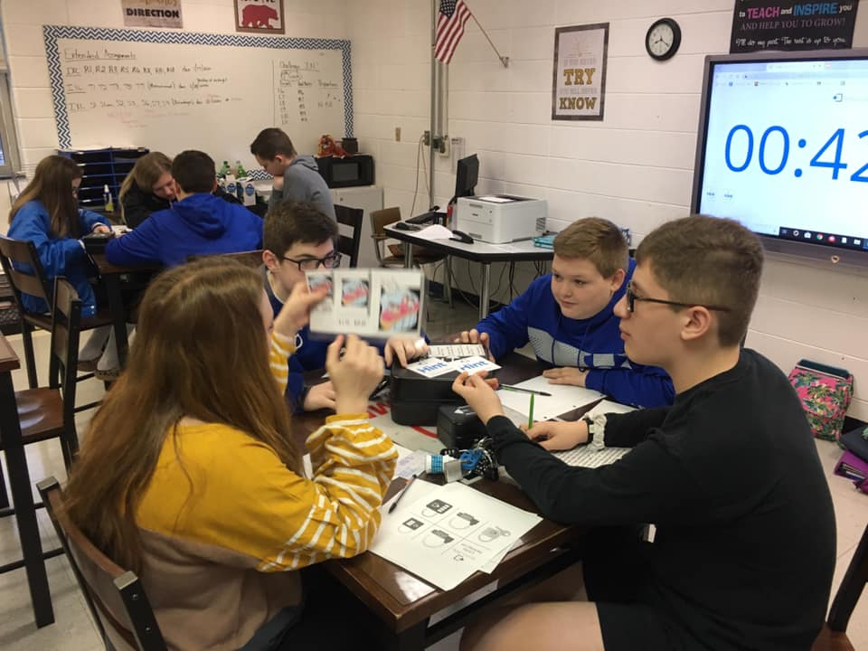
Successful or Not?
Student achievement will increase.
Student engagement will increase.
Students will learn more interactively.
Student collaboration will increase.
A critical thinker will be created.

Slide 7
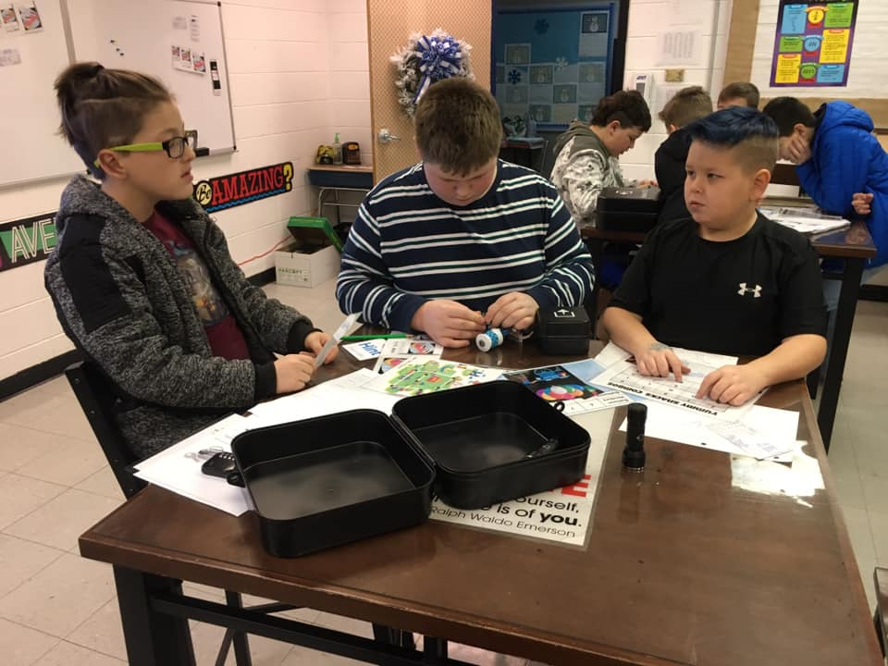
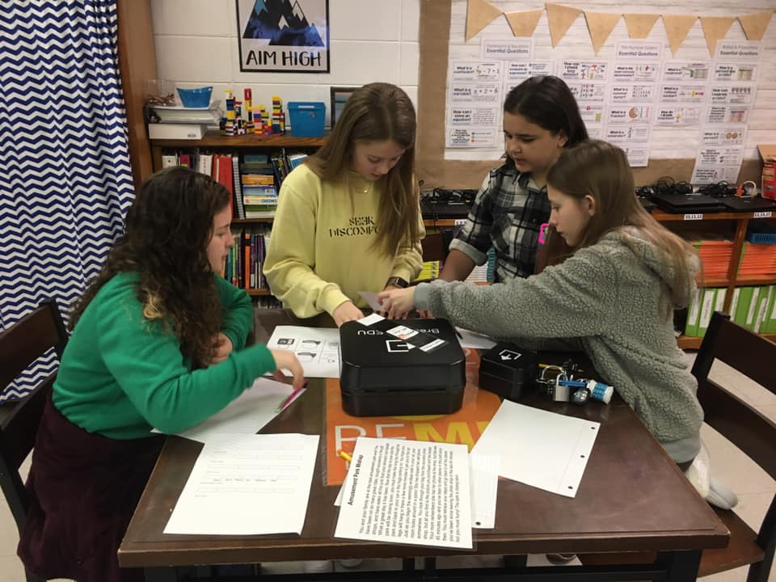
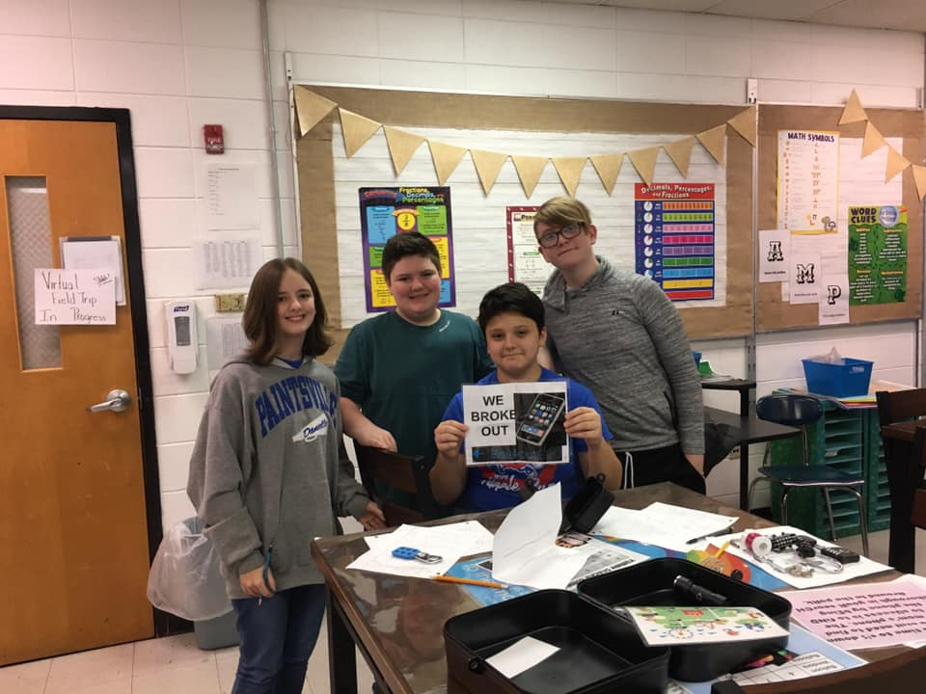
Breakout Boxes Implementation

Slide 8
Breakout Boxes Implementation
We got to use the physical breakout boxes throughout the school year. Not only did we get to use the physical boxes, but there were also access to digital breakout boxes. Students worked mainly as individuals on the digital breakout rooms and they enjoyed working at their own pace. I was also able to share the digital breakout rooms with the gifted and talented teacher. She was able to use the more complex digital breakout rooms with her kids. They completed some individually, small groups and some whole group. Overall, the students were engaged and excited to complete the breakout rooms! They learned a lot about perseverance and critical thinking in the process.

Slide 9
Student Thoughts
“When do we get to do another Breakout Box?”
“I feel like I am getting better at the breakout rooms, can we try doing another one.”
“I really like the digital breakout rooms where I can work at my own pace.”

