Slide 1
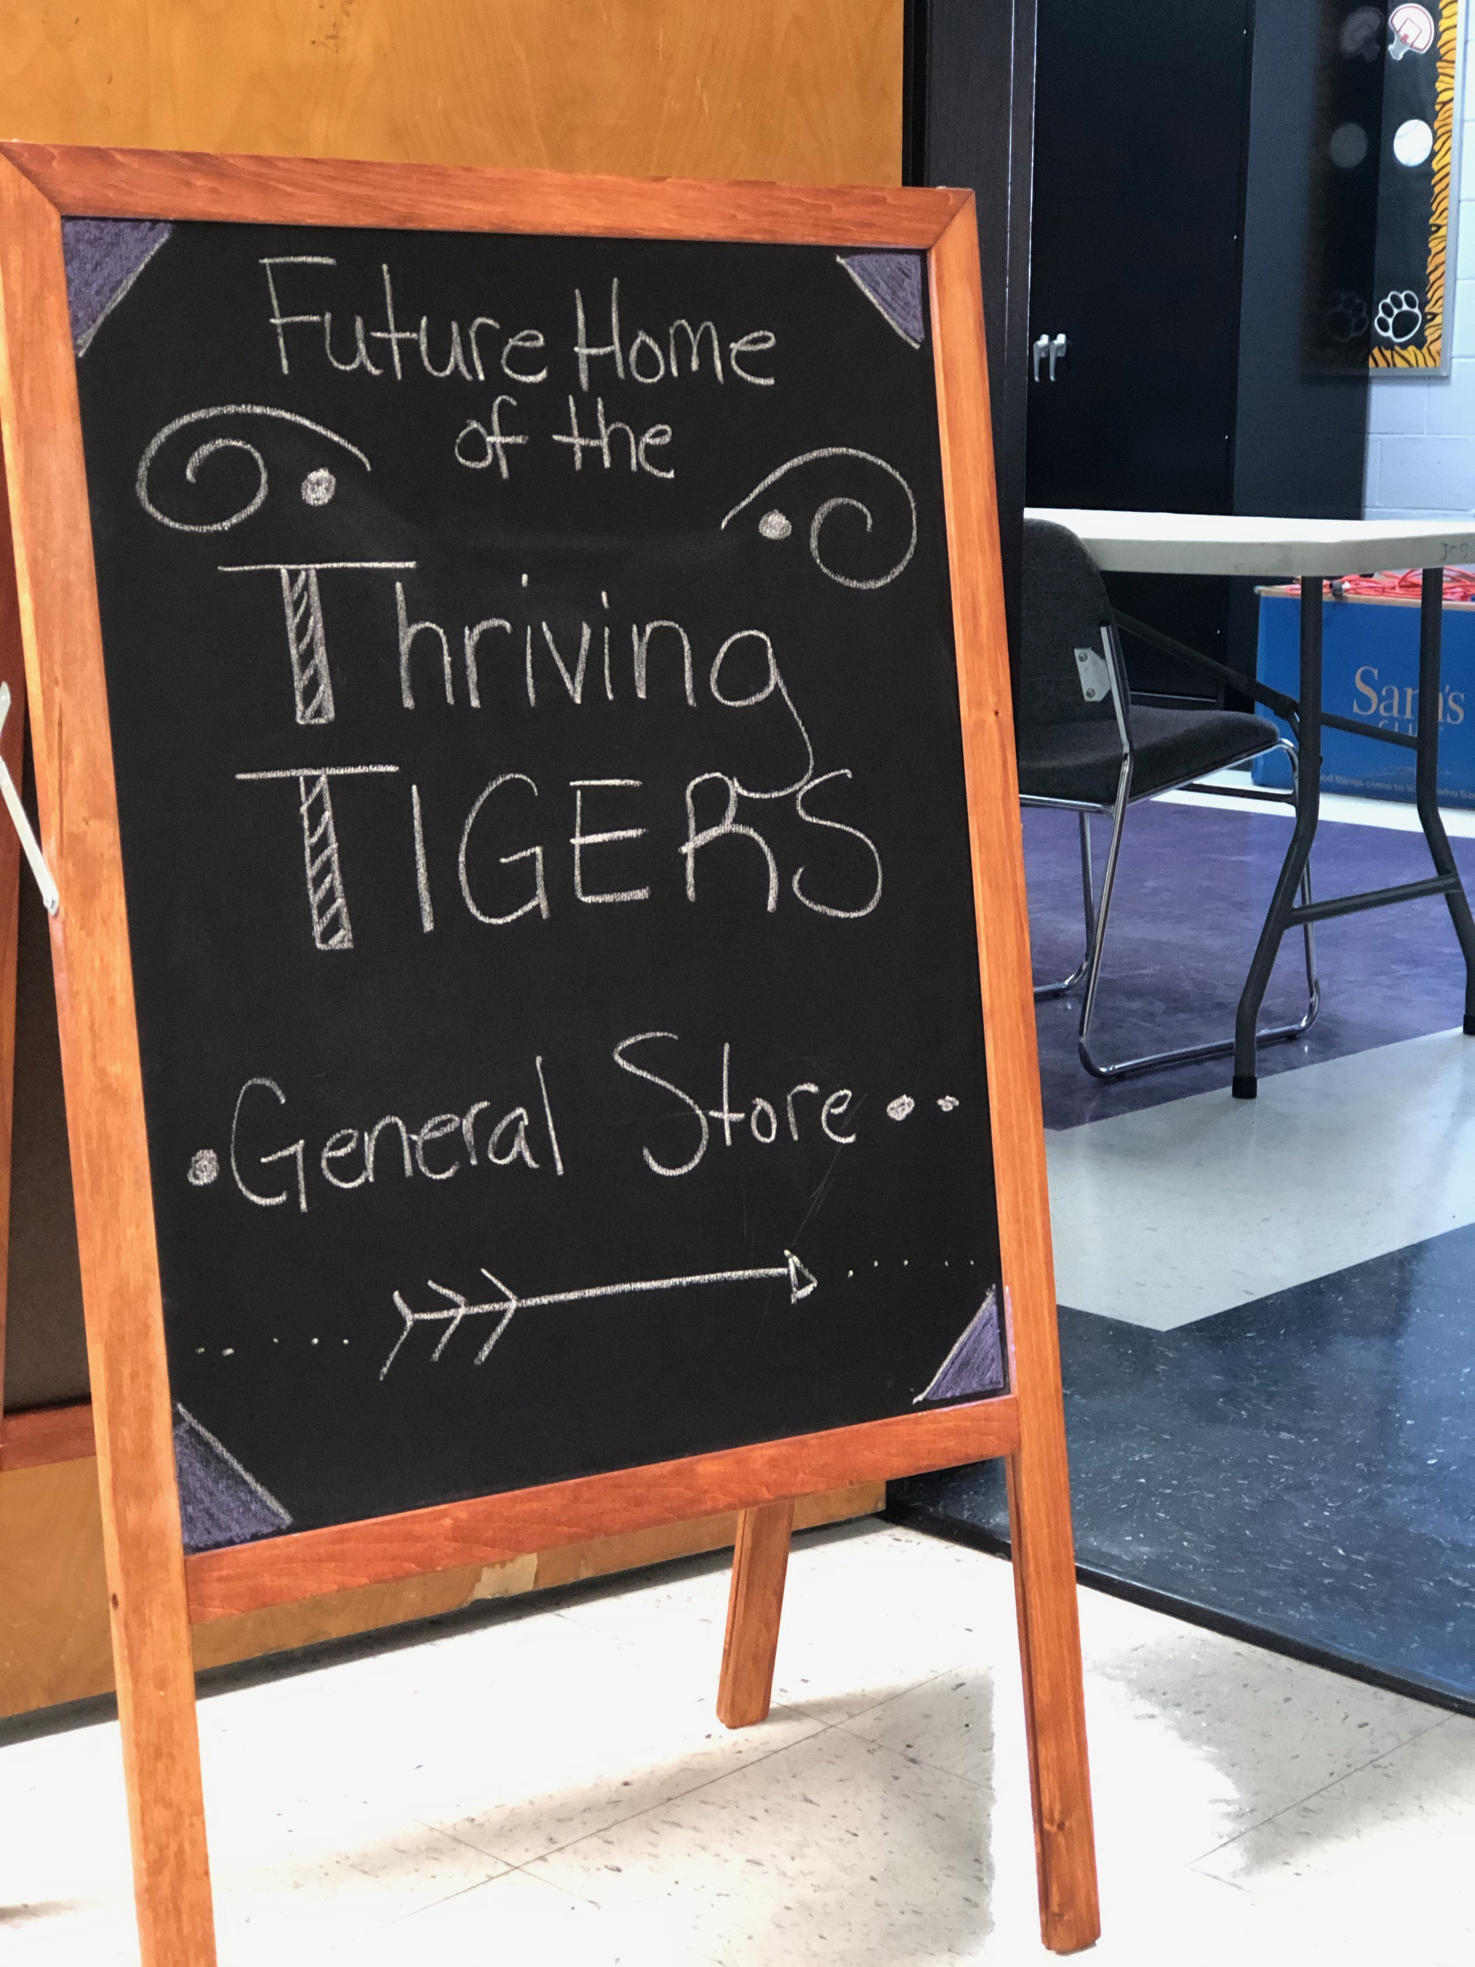
Thriving Tigers General Store: Claws for a Cause
Dixie Combs
Jackson City School
Jackson Independent School District
Dixie.combs@jacksonind.kyschools.us

Slide 2
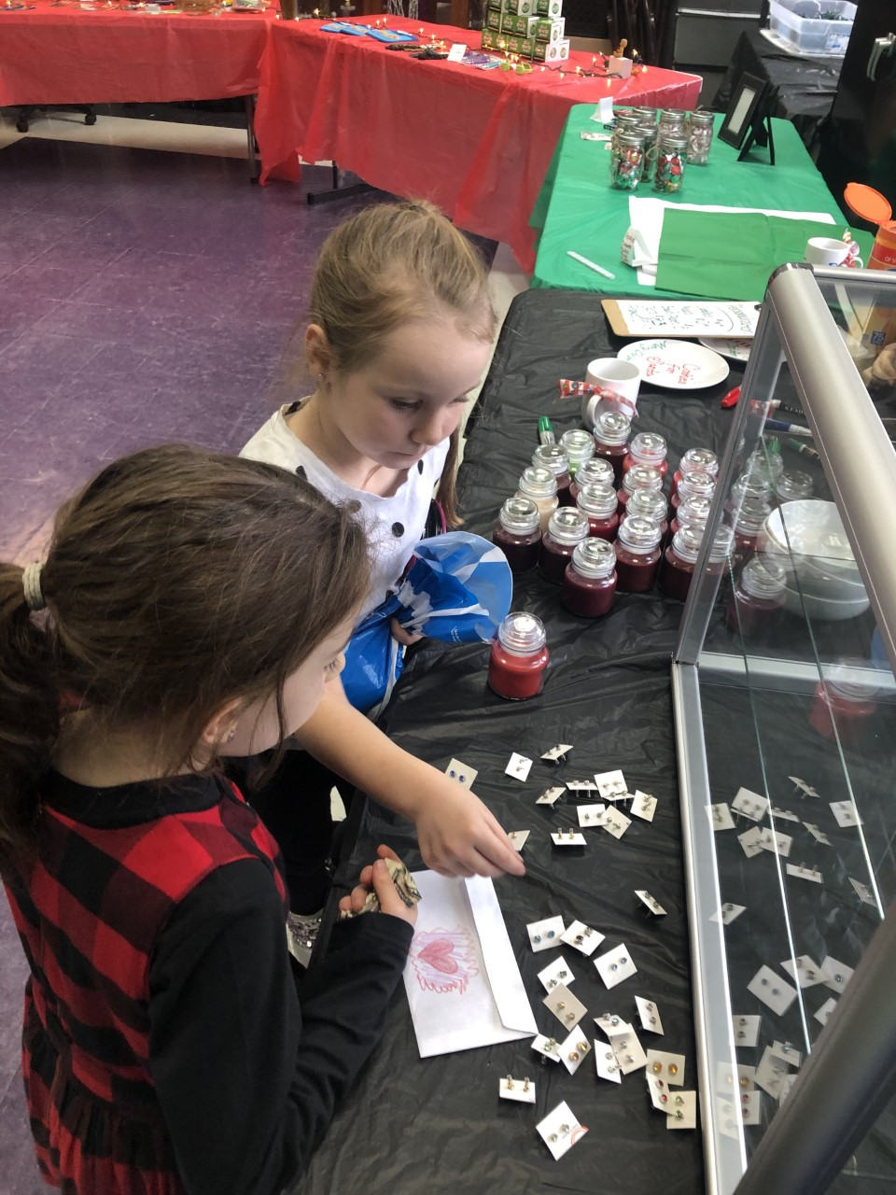
What We Did
Created the Thriving Tigers General store, managed by students supervised by their teacher/sponsors. – FRYSC, School groups
Engaged students and teams in school-wide Financial Literacy efforts.
– 6-8th Grade Math
Students and teams “rented” the store to sell their merchandize.
– FRYSC/Athletic Organizations
Students designed business models based on identified need and financial goals, while practicing good business ethics.
- 5th Grade STEAM Class
Notes:
Refer back to your grant -

Slide 3
Why Thriving Tigers General Store?
Students need opportunities to learn and practice financial literacy strategies.
Notes:
Refer back to your grant – What was the need?

Slide 4
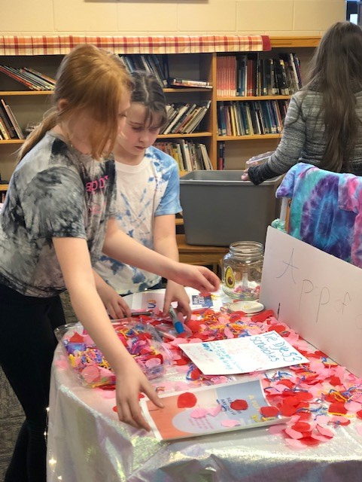
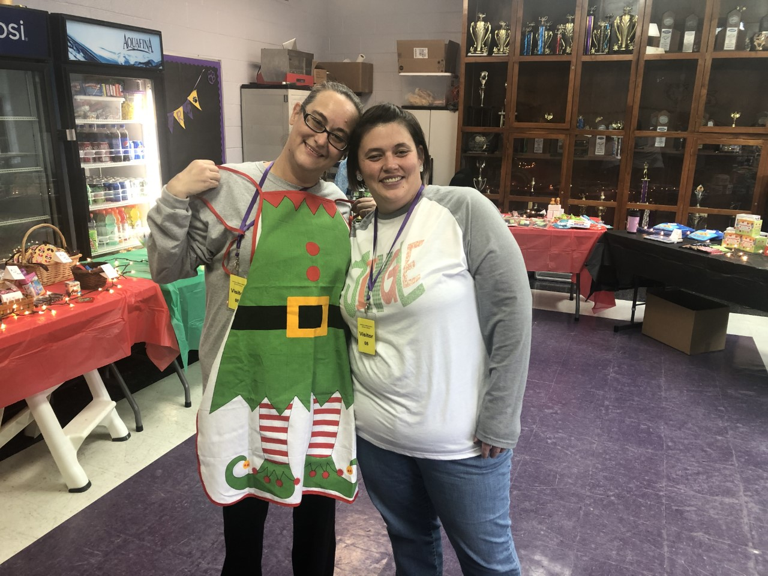
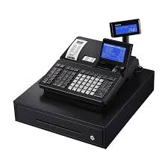
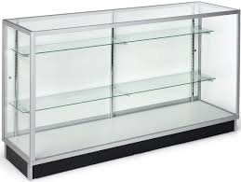
How it Worked
General Store operation during FRYSC Christmas Shoppe and classroom and Sporting Events
Classroom support for Financial Literacy in the form of workbooks and peer mentoring.
Student and Parent Engagement in Financial Planning and Goal Setting
Funding Supported:
Cash register and accessories
Table-top Display Cases
Storefront Signage
Goal-setting Charts
”Money Matters Teen Workbooks”
“Meet Ms. Money” Literature
Notes:
Provide examples, add photos, maybe student statements, data tables, etc…

Slide 5
IMPACT
What we know:
Participating students increased daily attendance by 12% February 2020. – Infinite Campus Report
Participating students demonstrated increase in knowledge of commerce and business ethics by 30% in Spring 2020. - FRYSC Survey
Anticipated Project Outcomes – Pre-COVID Crisis
Participating students will improve in Math by 15% by Spring 2020.
Participating students will demonstrate an increase in Financial Awareness, as indicated on the FRYSC survey, by 25% by Spring 2020
Participating students will graduate Financially Literate in Spring 2020.
Notes:
Talk about the impact it had on your students, if you didn’t get to finish your grant then tell what will be the benefits for students. How does this help students in the long run.

Slide 6
“I’m saving this for my sister, so she can shop too.” - Appalachia Howard , 3rd Grade
Notes:
Talk about the impact it had on your students, if you didn’t get to finish your grant then tell what will be the benefits for students. How does this help students in the long run.

Slide 7
We learned a thing or two or three…..
Collaborate!
Be flexible!
Be Intentional!
Notes:
Add (Evidence may include: data, photographs, student work, tools, video, etc.). Talk about good and bad.

Slide 8
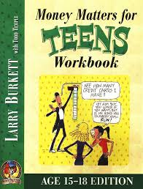
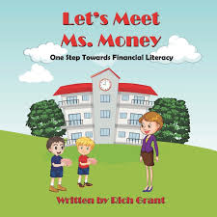
This CAN be used with other classes!
There are still aspects of this project that were cut short due to school being closed:
Middle School Financial Lit. -
“Money Matters” Teen Workbook
Kindergarten – 3rd Grade –
“Meet Ms. Money”
4th Grade 4H Dollars and Sense Program
8th Grade 4H Reality Day
General Store Equipment
Notes:
Talk about how this will benefit

Slide 9
THANK YOU! Stay Safe. Stay Healthy.
Notes:
Don’t forget to Thank them for the experience

