Slide 1
Should I Stay or Should I Go?

Slide 2
Carole Bentley 7th Grade Science Duff-Allen Central Elementary

Slide 3
Problem of Practice Coal jobs are gone! Jobs are scarce! How is a living going to be made here? What can we do to keep our young people living here?

Slide 4
What are our children going to do?
What is going to be offered for them to remain in eastern Kentucky?
What is going to be available for our children to be able to make a living and sustain a family in this area?
The ones who packed up, left the area, and only returned to the area to visit families they had left behind?
What is it going to be for our children of the 21st century?
Or…
Will our children be like those in the 1950’s & 1960’s?

Slide 5
In the Dwight yoakam song, Readin’, Writin’, route 23, he sings about his family leaving eastern Kentucky to go north to find jobs….roads that led to the city factories…Dayton, fairborn, Plymouth, Detroit…general motors, ford, general electric, Armco and so many other locations and factories where jobs were available.

Slide 6
Readin', Rightin', Rt. 23
Dwight Yoakam
They learned readin', writin', Route 23 To the jobs that lay waiting in those cities' factories They learned readin', writin', roads to the north To the luxury and comfort a coal miner can't afford They thought readin', writin', Route 23 Would take them to the good life that they had never seen They didn't know that old highway Could lead them to a world of misery
Have you ever been down Kentucky-way Say south of Prestonburg Have you ever been up in a holler Have you ever heard A mountain man cough his life away From diggin' that black coal In those dark mines, those dark mines If you had you might just understand The reason that they left it all behind
They learned readin', writin', Route 23 To the jobs that lay waitin' in those cities' factories

Slide 7
I don’t know about you, BUT… *I am tired of seeing our young people leave Eastern Kentucky. *I am scared about no young people staying here to pay taxes that would support what Eastern Kentucky needs. *I am sad about the youth having to leave to find jobs and leave their family roots, culture, and life among these hills. So… What can I do? What can we do to keep them here? What can we do to give them opportunities that will allow them to stay here?

Slide 8
My view is that we, as teachers and employers must be looking towards technology to provide jobs for our youth.
After researching, a very minimal amount of time, I found that there were serval jobs available in Eastern Kentucky that were specific to coding. Job openings from Hazard to Pikeville were listed for coders.
So, at that was the time that I decided to get on the technology train. Don’t get me wrong…I love the computer and Internet, but coding, games, and the inside computer is nothing that I am interested in and did not care to learn about. It is just NOT MY THING!
However, I know/knew and realize that my responsibility as a teacher is to give my kids the best opportunities available so that they may be their absolute best and become successful in their adult life.
So! I bit the “bullet” and spent time talking with my colleague (the Tech Guru) about what would be important and pertinent for my kids. In the end, I ended up writing a grant to purchase 6 Spheros for my classroom. OOOOOHHHHHHH WHAT A FABULOUS DECISION THAT WAS!!! Using coding, tablets, and Spheros. One of the best decisions EVER! By using the Spheros, my kids were EXCITED, INTERESTED, TRUE COLLABORATORS, CRITERIA-FOCUSING, BUDGET MANAGING, PROBLEM SOLVERS & SOLUTION MAKERS & REDESIGNERS—FOR REAL. I ended up having the best and most productive classes EVER! I was truly a facilitator who led from the side lines while my kids took the reigns and were learning in a real world manner! Let me tell you about what my kids did.

Slide 10
Day | Expectation
1 | Write and Practice using equipment and block coding to retrieve ice
2-3 | Use team’s code to retrieve ice & make any necessary adjustments to the coded path
4 | Get the ice back to the base camp
5-6 | Inspection of parts which will be used to construct a structure to haul ice from the polar ice caps. Checking out the prices of parts. Discussing and creating a design—a model must be drawn of the proposed structure
7 | Completion of the design & Purchase of the materials for construction of the structure
8 | Itemized list of all parts which will purchased for the construction of the structure. Purchase from Materials Agent--Payment
9-11 | Construction of the structure
12-13 | Testing, Redesign/Improvements
14 | Retrieval of Ice Race—Who Has the Best Machine?
15

Slide 12
Mars Polar Ice Cap Retrieval Program & Data Analysis
The department realizes that there were many constraints of this project.
Name 3 constraints, in order of most to least, that most hindered your work.
Describe 3 of your Rover design elements that you would change and explain why you would make those changes.
The department has recently received a contract from the government to build a smaller rover that will be able to bring water to a second Base Camp, Base Camp “C”. This is where 5 scientists will be studying and researching ways to grow food on Mars so that humans can provide a way to sustain their life on Mars without the transport of any food from Earth. This project shall focus on the available light and the gases needed for photosynthesis to produce sugars for plants that would then grow to provide a source of available food. Below are recommendations from 3 major companies. You must analyze the data and provide a rational for which company would be the best for this project. You must support your answer with reasoning as to which company should be chosen for this job.
Which Company would you choose to hire to construct a rover for this next project?
List 3 constraints and give specific and detailed reasons for the company you chose. This information will be submitted for review by the department leader.
80% of the time breaks down during sudden changes in atmospheric temperature changes. | Temperature changes do not appear to have an impact on the functioning of the rover. However, sudden changes in atmospheric temperature causes the rover to become 30% slower and causes the rover to completely shut down 60% of the time. | Sensitive materials are used in the production of the rover to keep the rover running even during sudden atmospheric temperature changes. The rover is equipped with heat and cooling shields to keep it running, even when drastic changes in temperatures occur.
Constraints | Company A | Company B | Company C

Slide 13
Company
Materials
Cost
Time
Energy
Speed
Company A | Company B | Company C
80% of the time breaks down during sudden changes in atmospheric temperature changes. | Temperature changes do not appear to have an impact on the functioning of the rover. However, sudden changes in atmospheric temperature causes the rover to become 30% slower and causes the rover to completely shut down 60% of the time. | Sensitive materials are used in the production of the rover to keep the rover running even during sudden atmospheric temperature changes. The rover is equipped with heat and cooling shields to keep it running, even when drastic changes in temperatures occur.
$7,000.00 | $14,000.00 | $30,500.00
6 months | 4 months | 1 year
Rover must be refueled every 3 hours, which takes 2.5 hours. The rover has no capability to store any extra available energy. | Rover must be refueled every 2 hours, which takes 1 hour. This rover has the capability to store energy from the sunlight but only 60% of the light, which is captured in the solar panels. | Rover must be refueled every 12 hours when no sunlight is available. If sunlight is available, solar panels will collect and use the energy from the sun. Any extra available energy will be stored for the rover to use at a later time.
Rover must be refueled every 3 hours, which takes 2.5 hours. The rover has no capability to store any extra available energy. | Rover must be refueled every 2 hours, which takes 1 hour. This rover has the capability to store energy from the sunlight but only 60% of the light, which is captured in the solar panels. | Rover must be refueled every 12 hours when no sunlight is available. If sunlight is available, solar panels will collect and use the energy from the sun. Any extra available energy will be stored for the rover to use at a later time.
6 mph | 10 mph | 8 mph

Slide 14
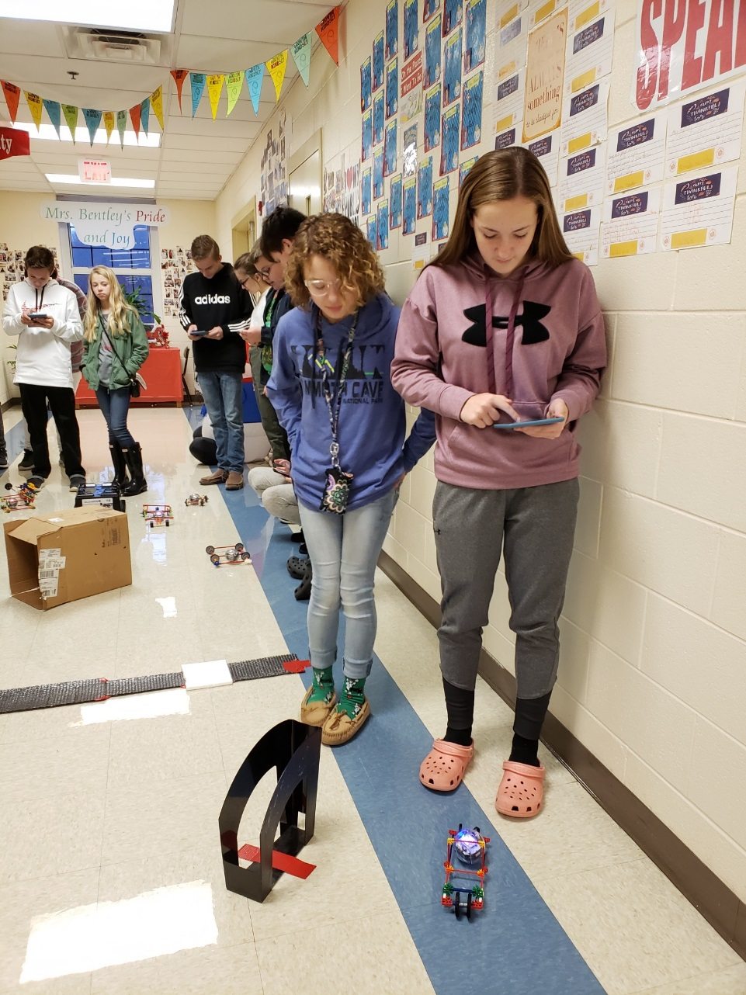
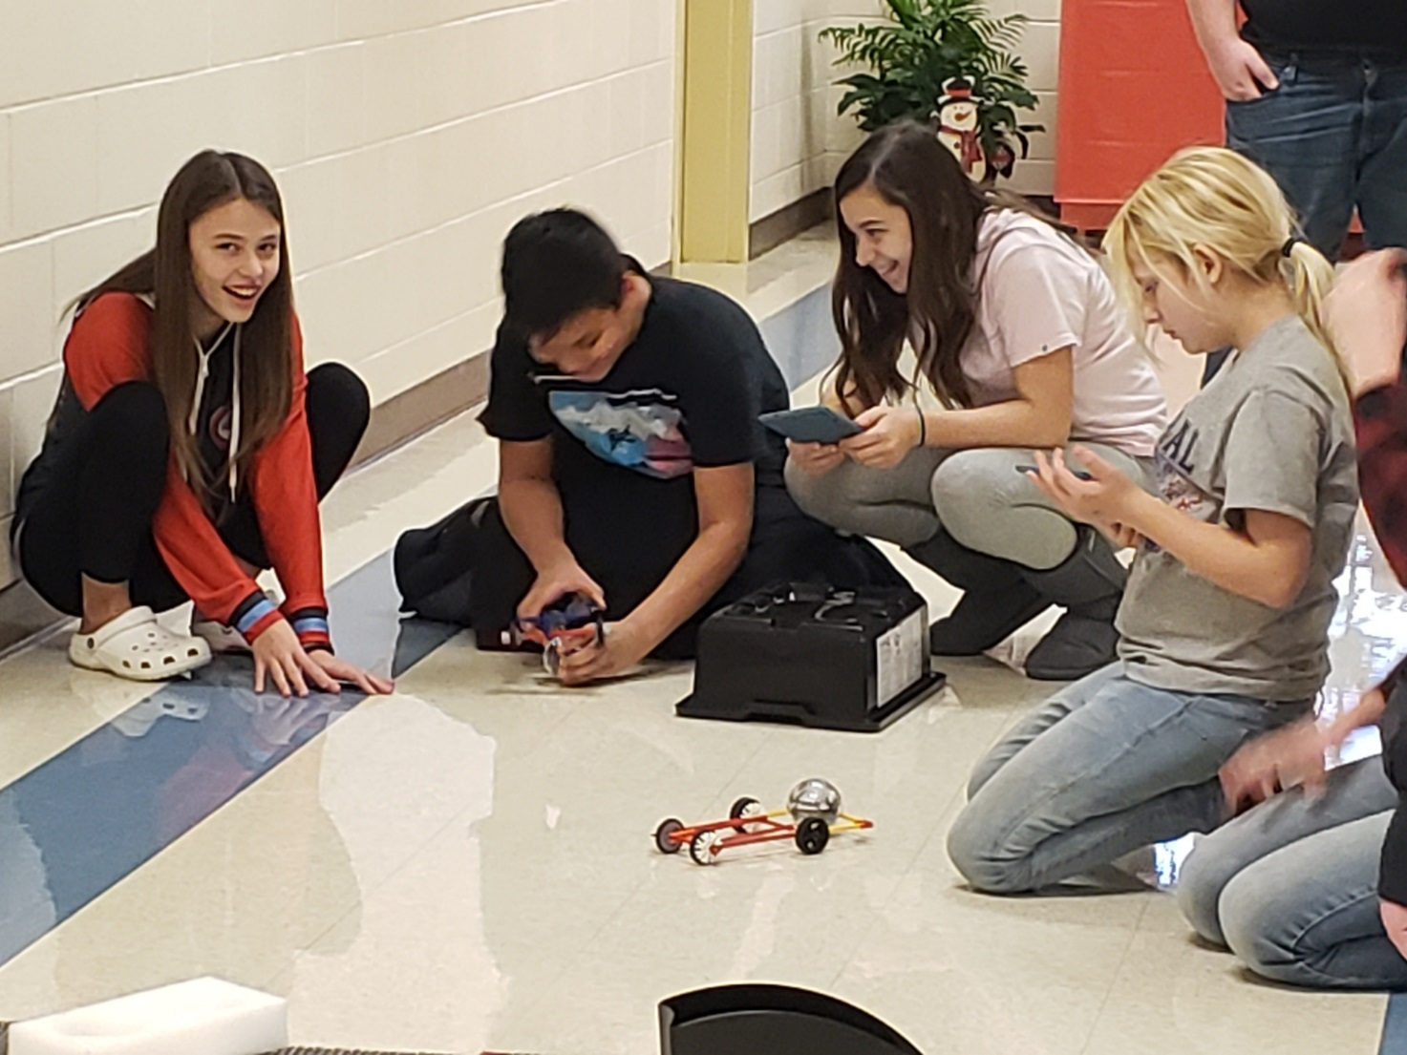

Slide 15
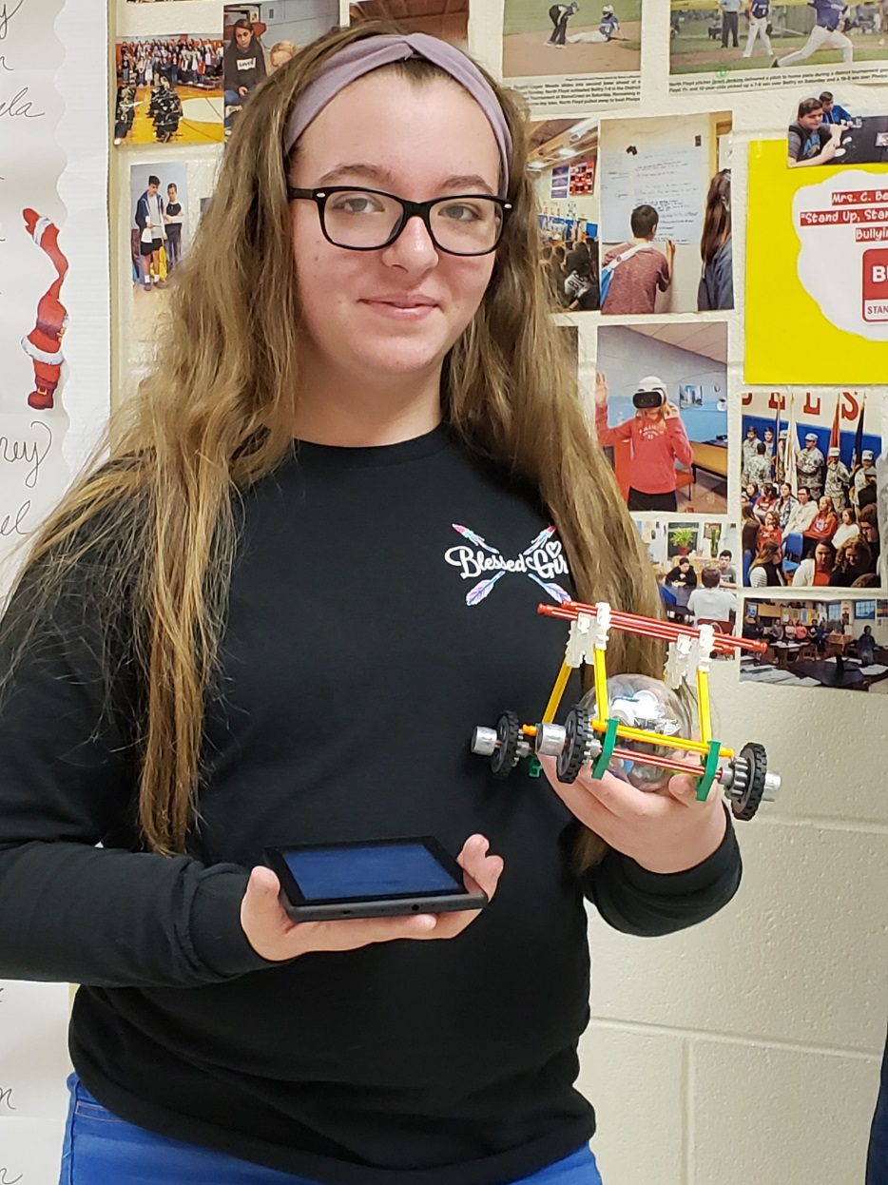
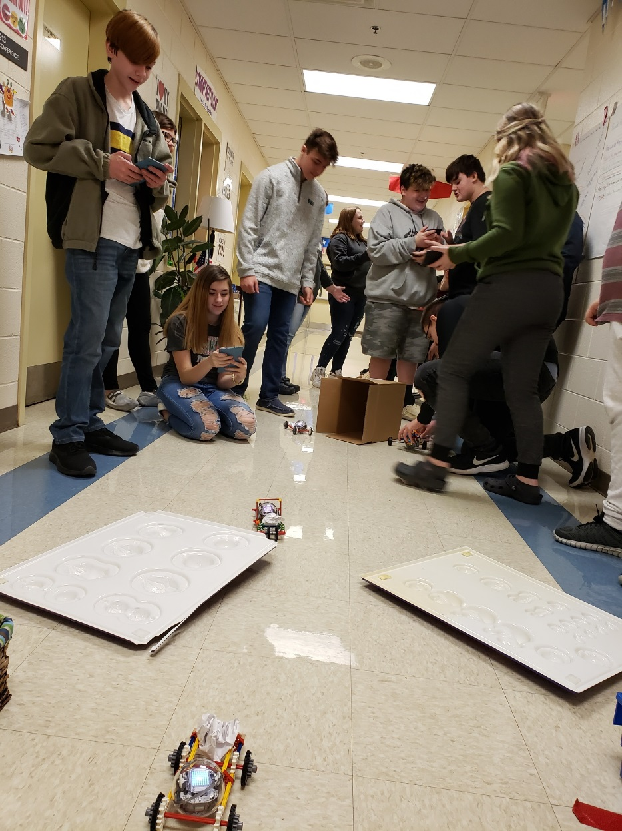
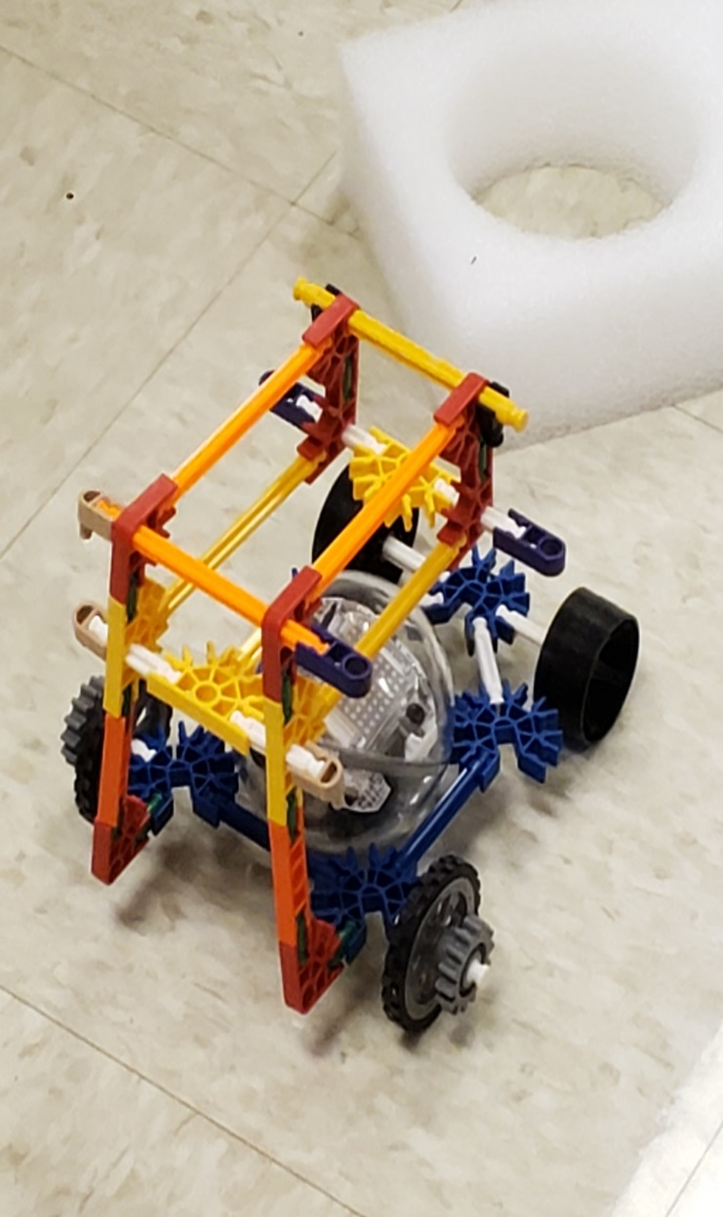

Slide 16
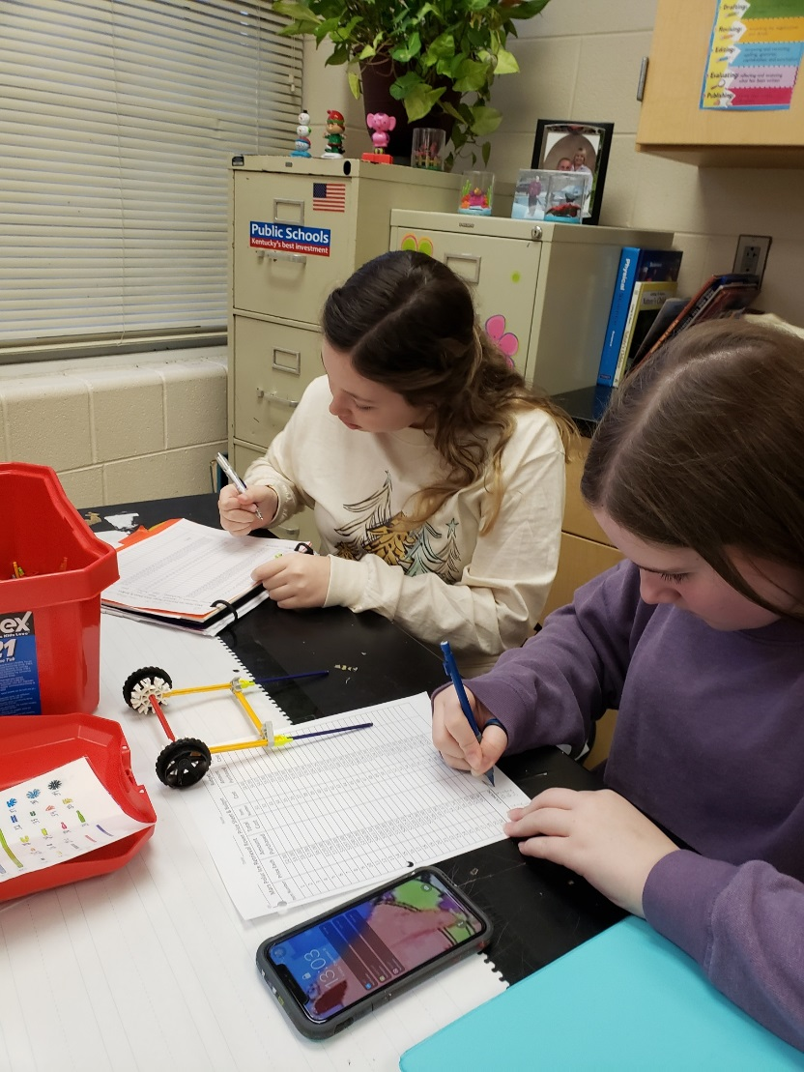
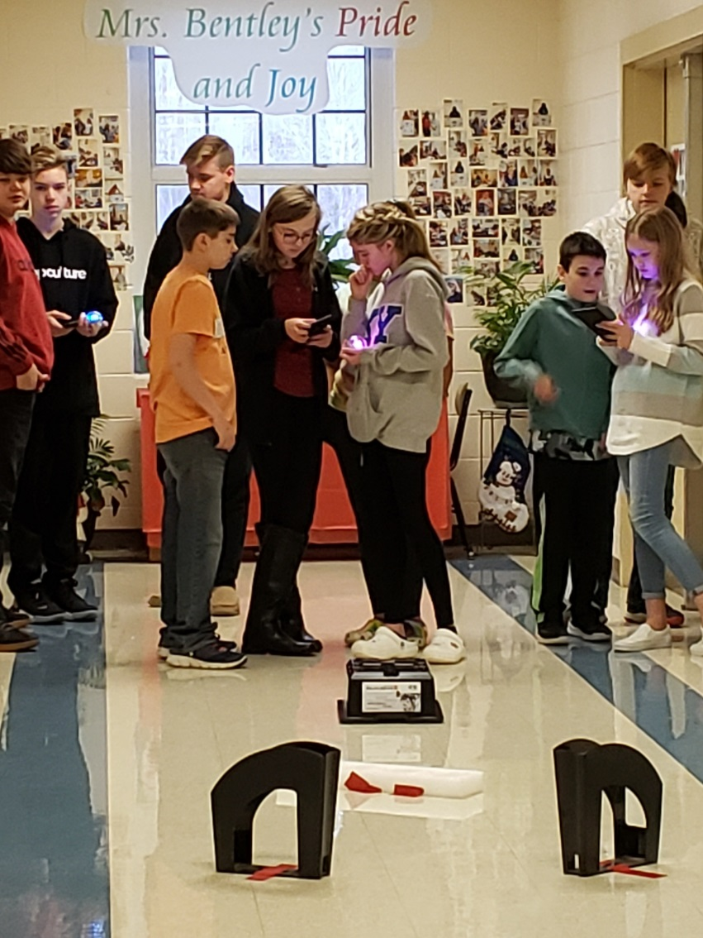
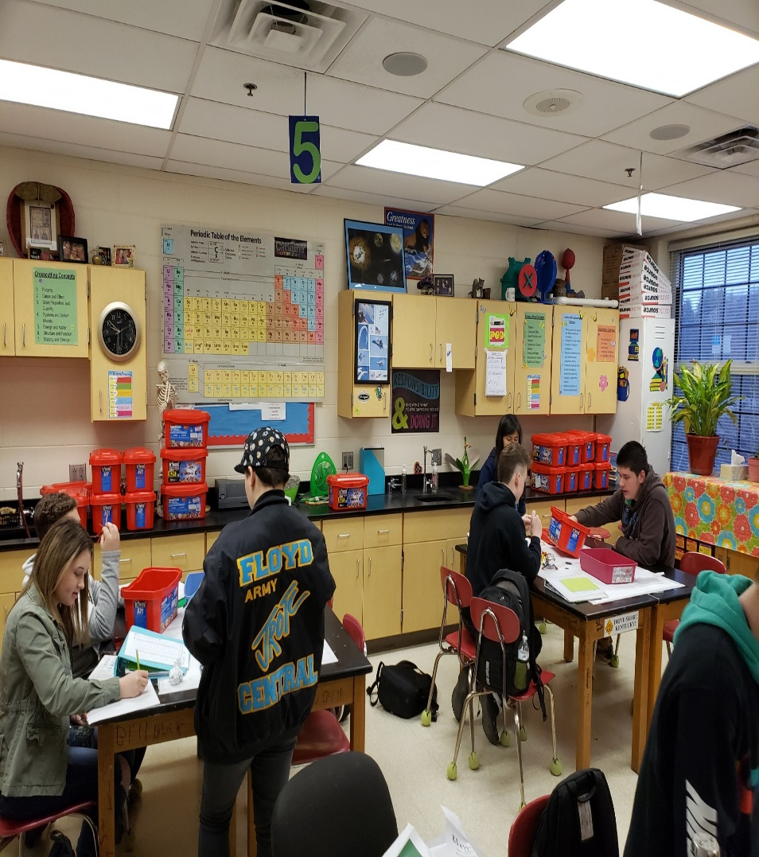

Slide 17
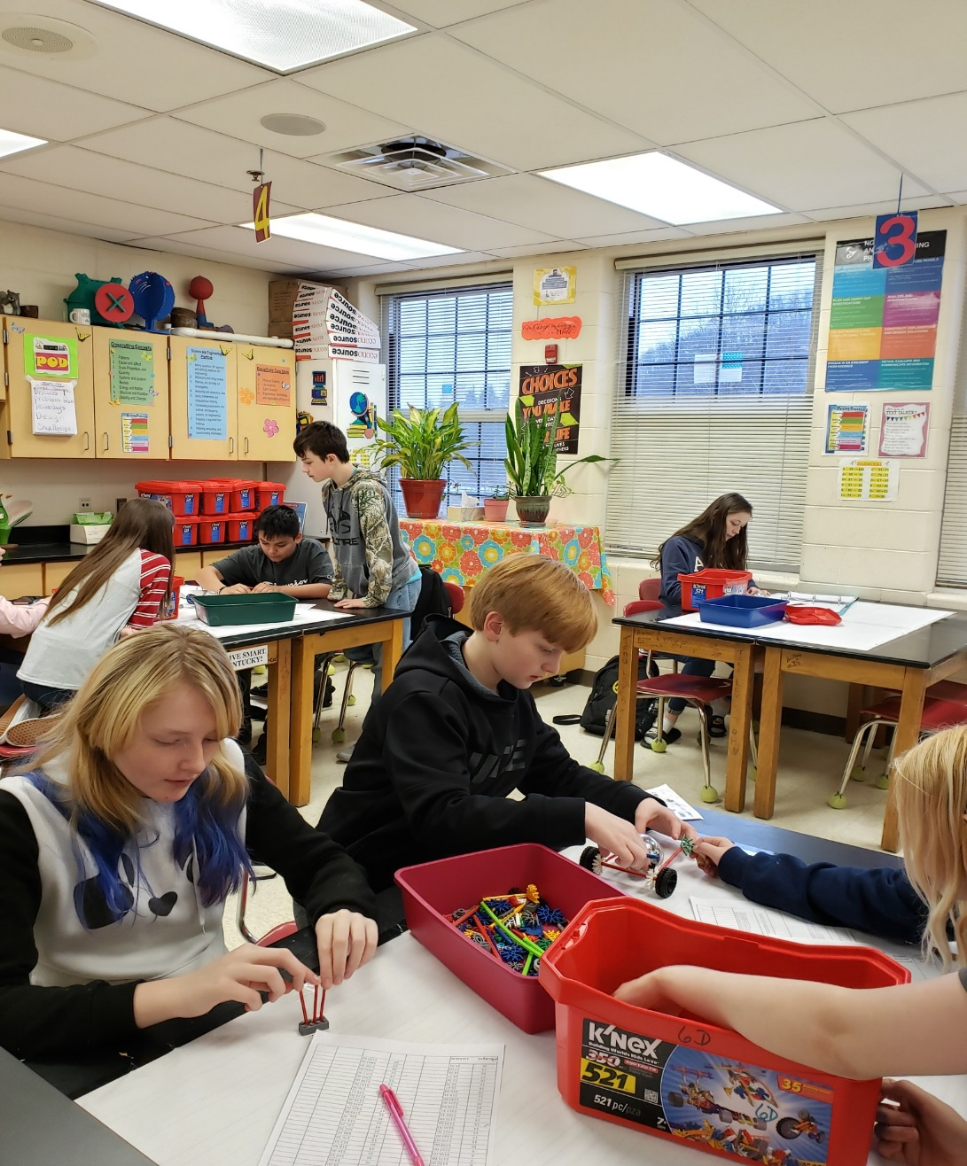
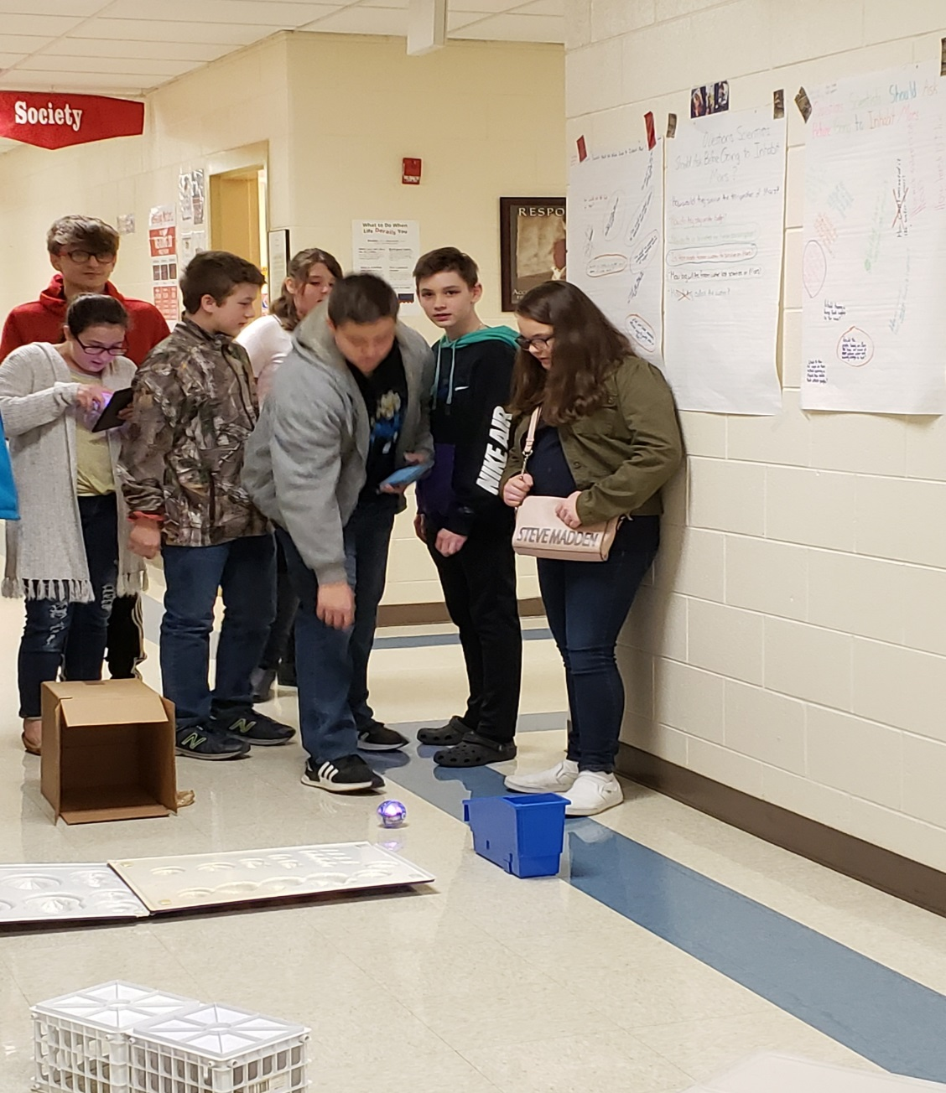

Slide 18
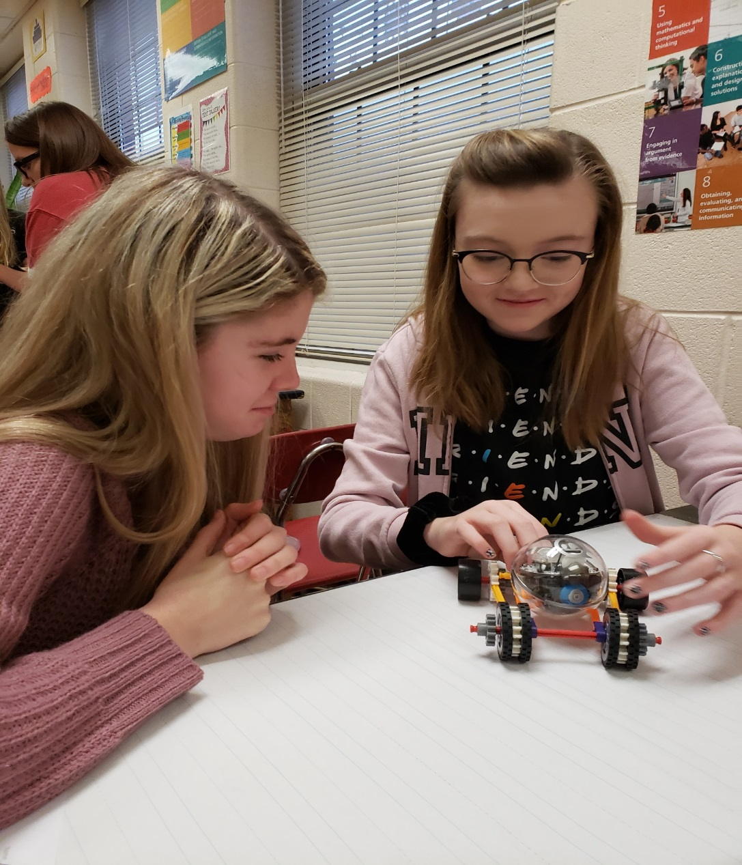
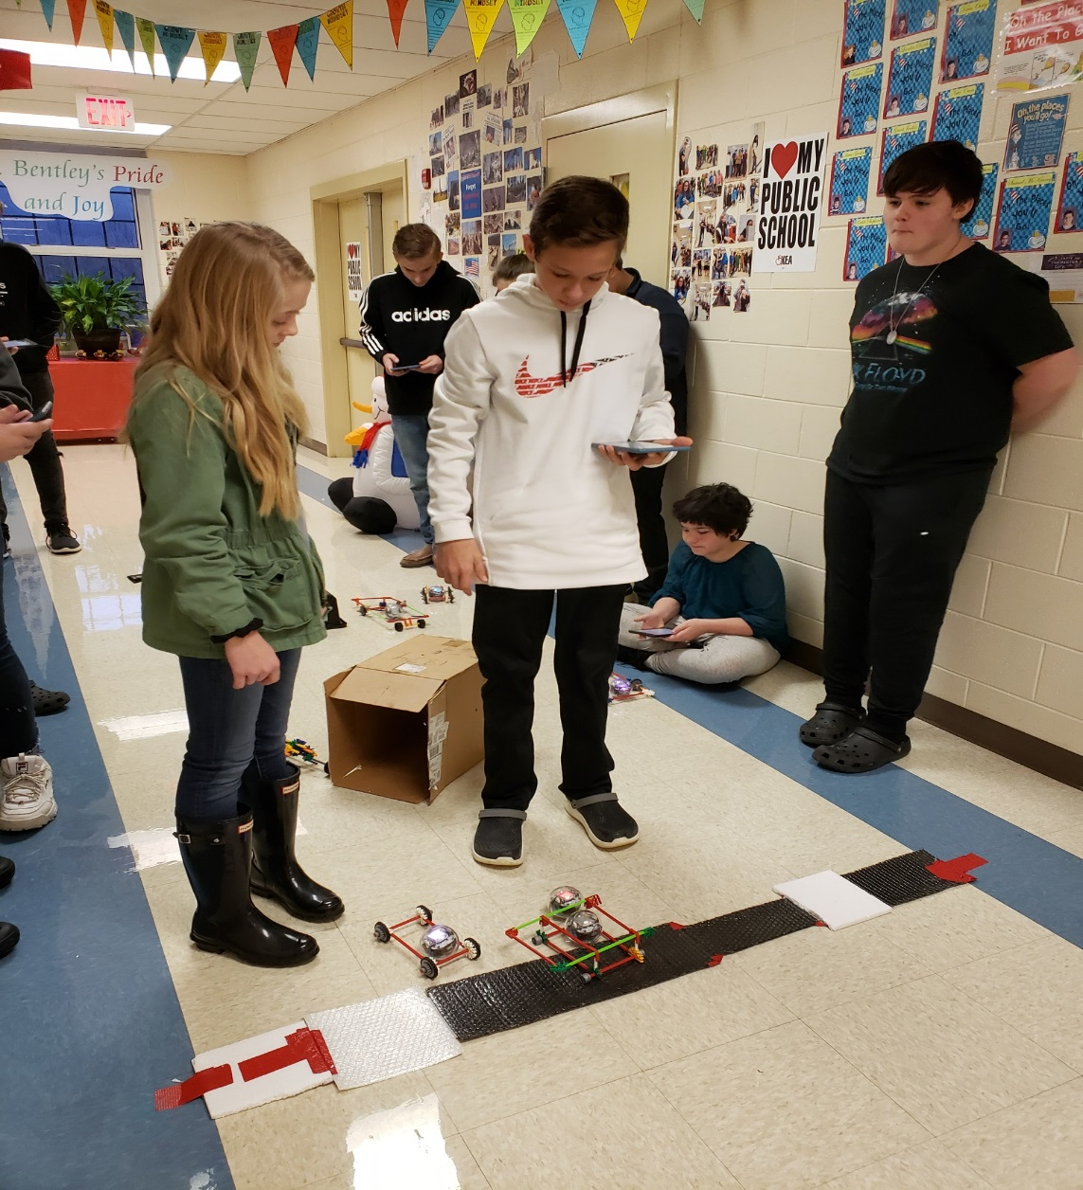

Slide 19
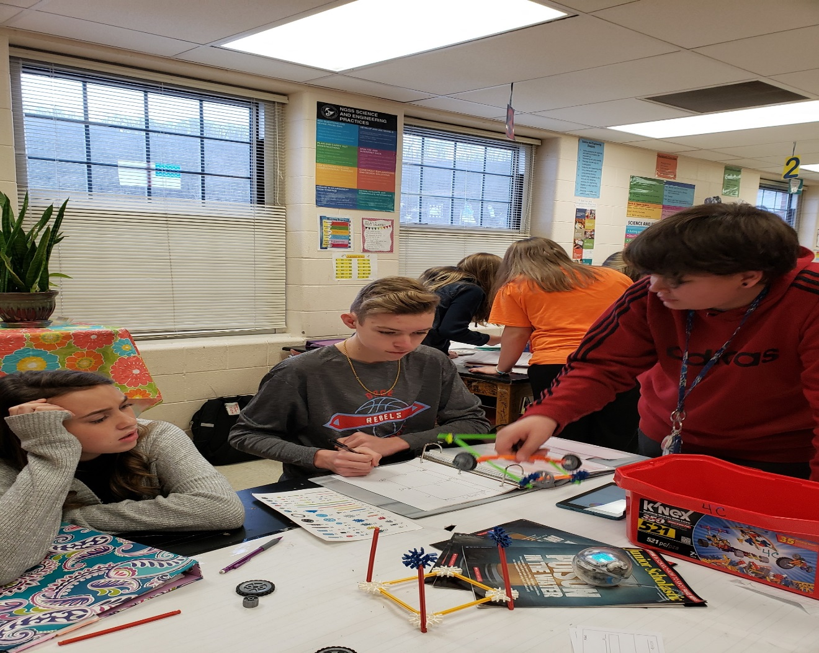
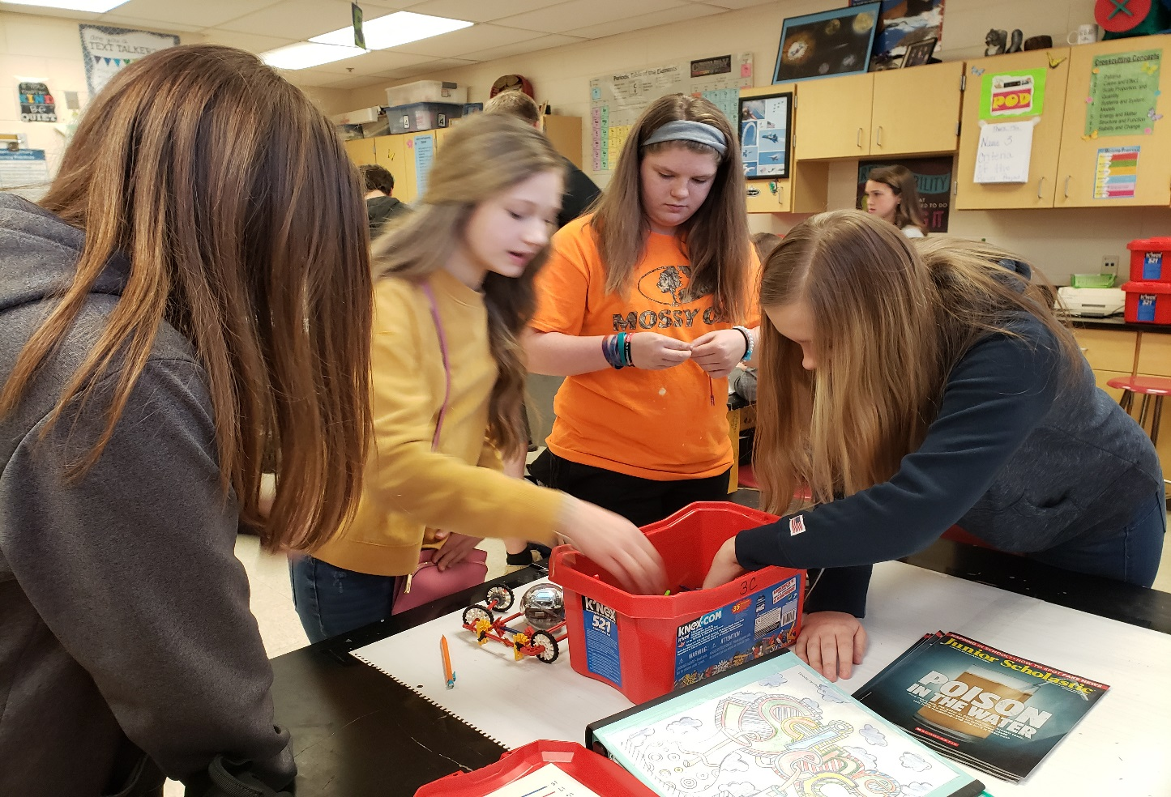

Slide 20
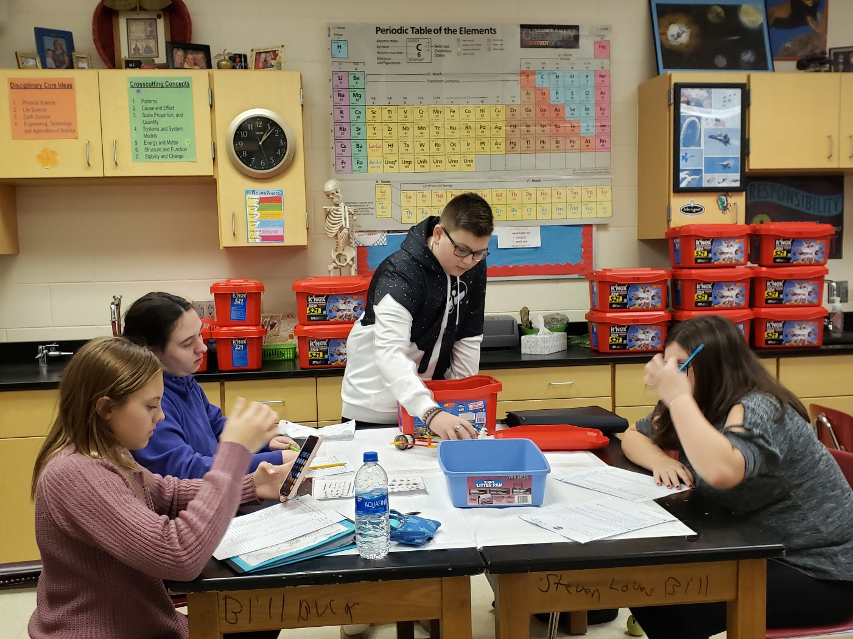
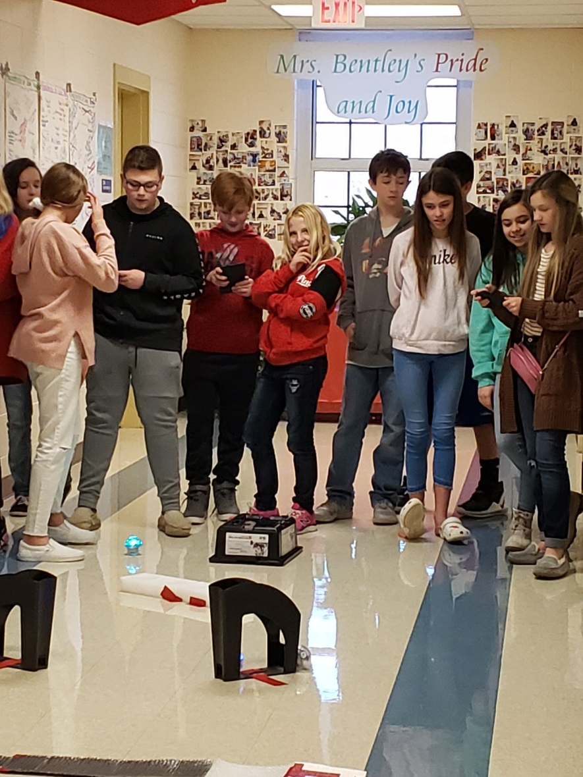

Slide 21
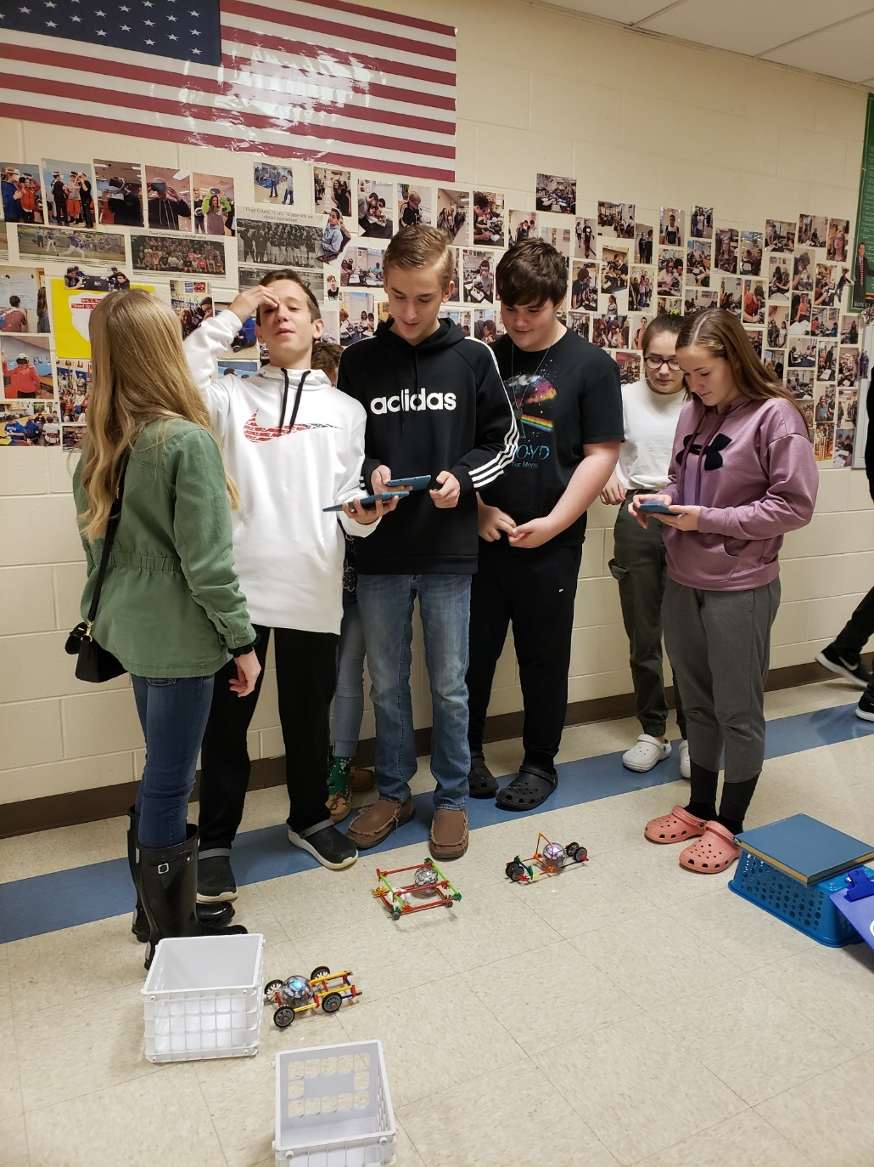
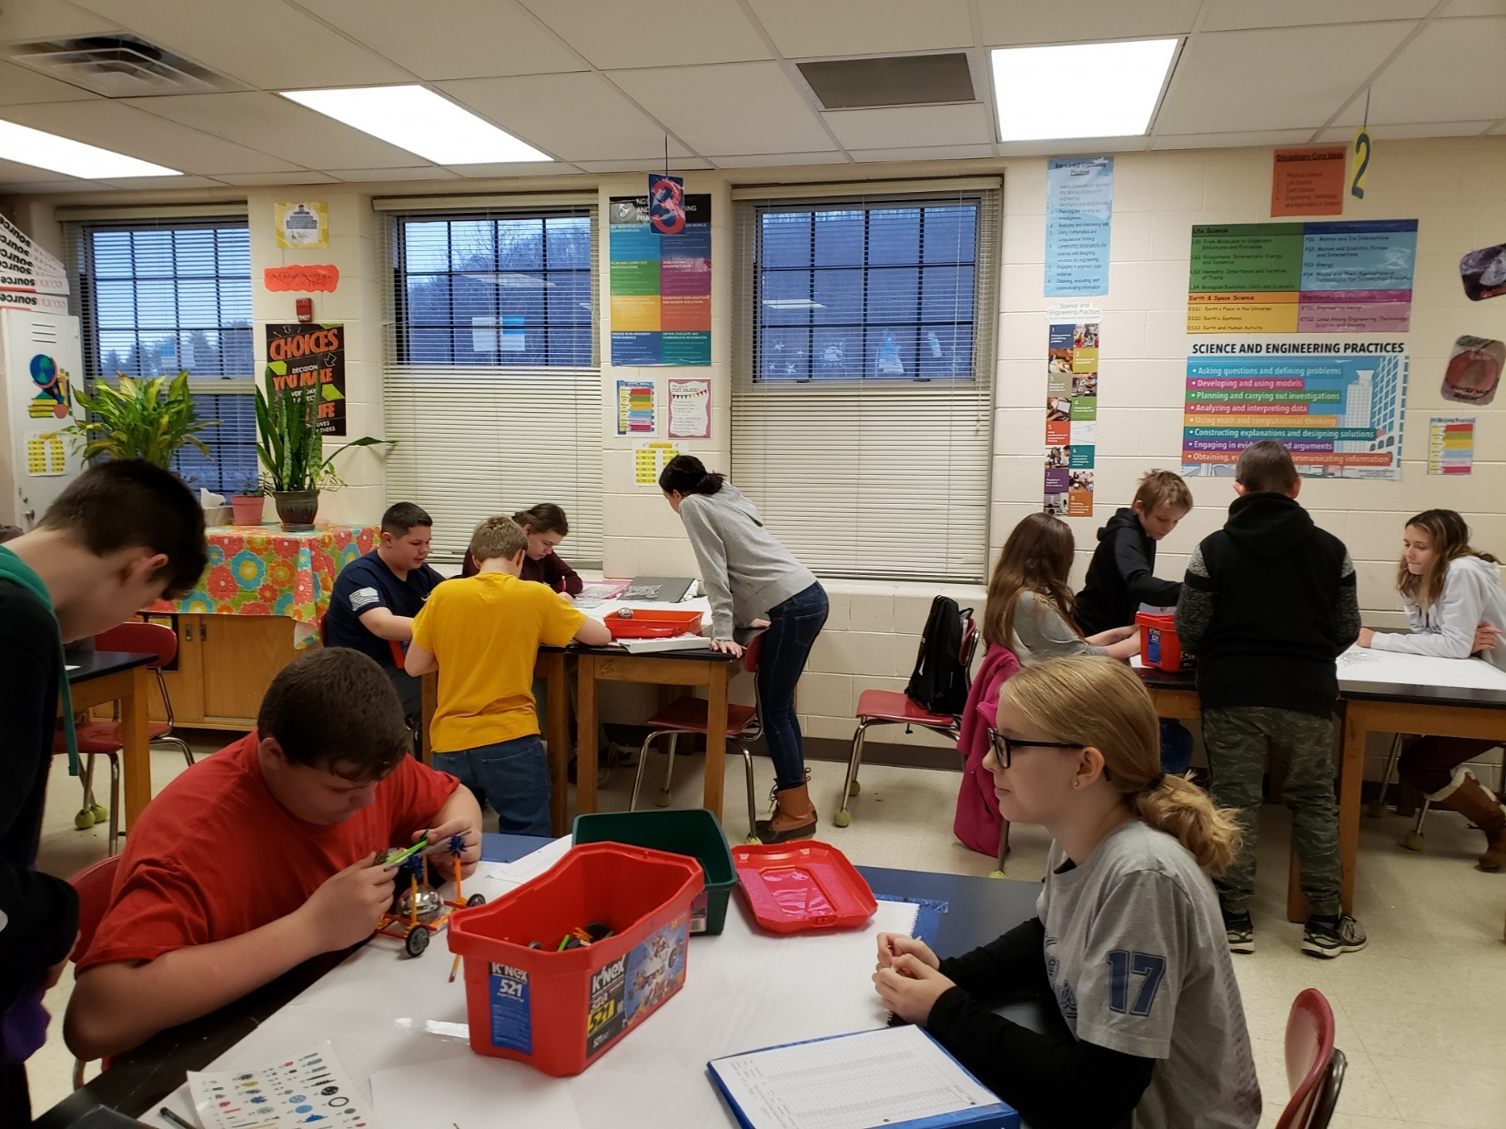

Slide 22
So, stepping out of my comfort zone led to the BEST of each of my students. They were able to take over. They coded their Rovers to complete a specific task. They were absolutely amazing…just like the workers they will someday become. We, as a united Eastern Kentucky group of people must look toward new and innovative ways to educate our children so that they will have the opportunities to remain here. To be citizens who contribute to our communities by purchasing homes, spending their hard earned money at businesses, paying taxes to continue to keep up our BEST Eastern Kentucky. We have to look ahead! We have to have a new vision! We must provided opportunities to our children that give them a way to remain here.

Slide 23
