Slide 1
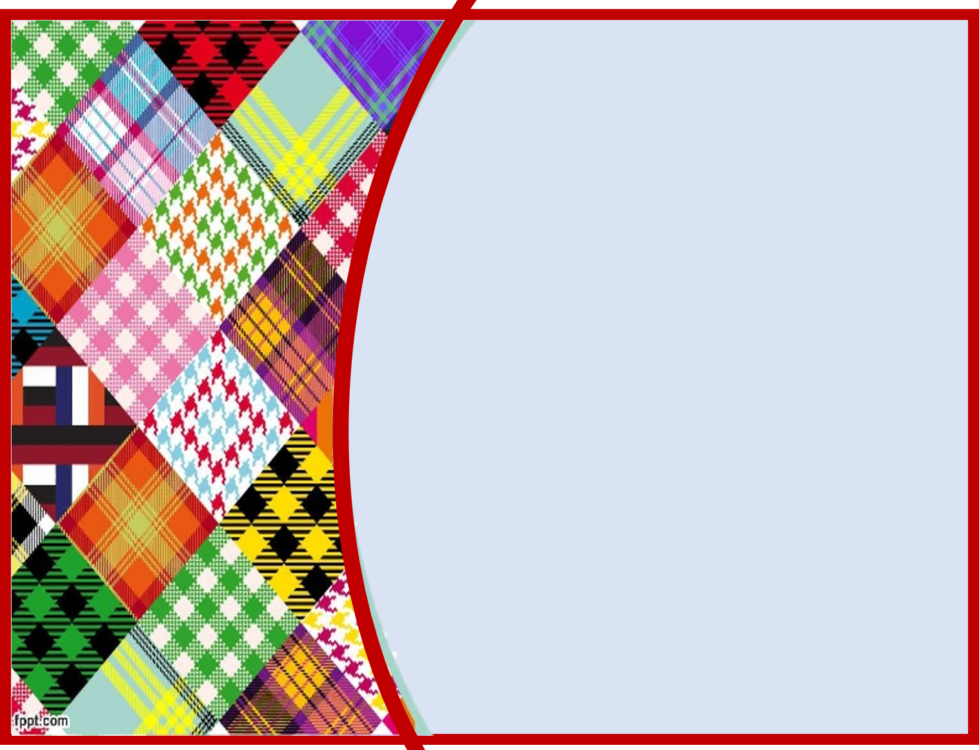
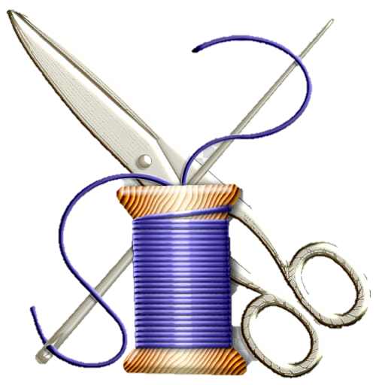
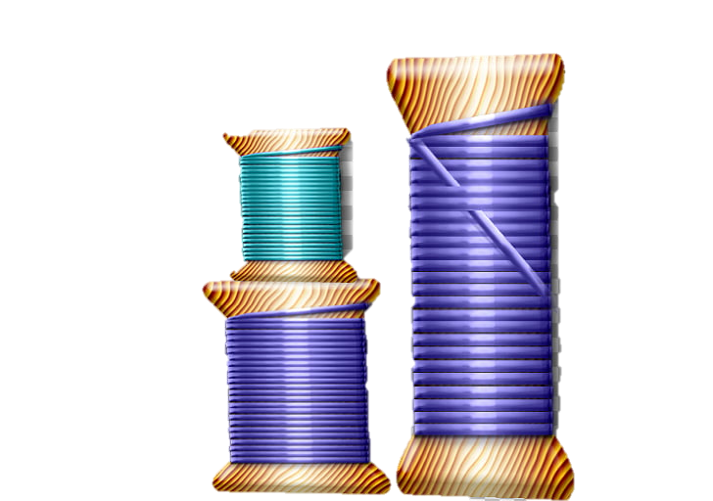
Sew To Speak
Paintsville Independent School
Melinda Music
Jordan Miller
Frankie Puckett

Slide 2
Area of Focus
The goal of Sew to Speak is to promote
student communication skills with each other and myself. They will learn how to answer reflective questions to assess their skill and to perfect it as well. My goal for them is to continue to improve communication skills (speech, language, fluency, and voice) throughout the project while learning a new life skill that they may find as a new hobby, talent, and/or means of entrepreneurship.

Slide 3
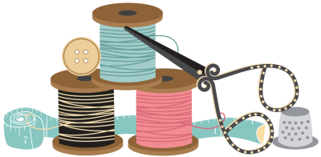
Why did I choose to research this topic?
Many kids and adults sit around on their cell phones and iPads today to pass time. It is very difficult to simply find a seamstress to make alterations in our hometown, mostly because learning to sew and operate a sewing machine is a thing of the past.
I want my students to know it is never too late to learn and I want them to see this belief in practice.

Slide 4
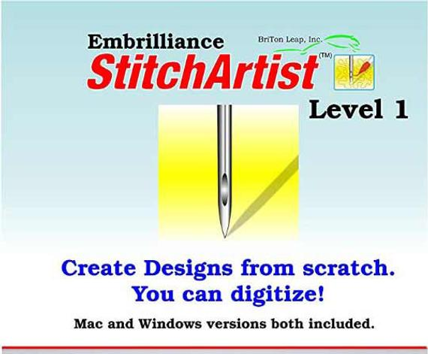
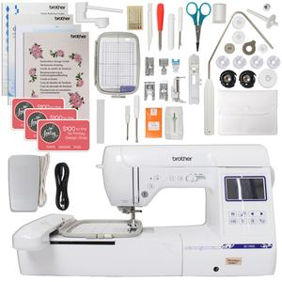
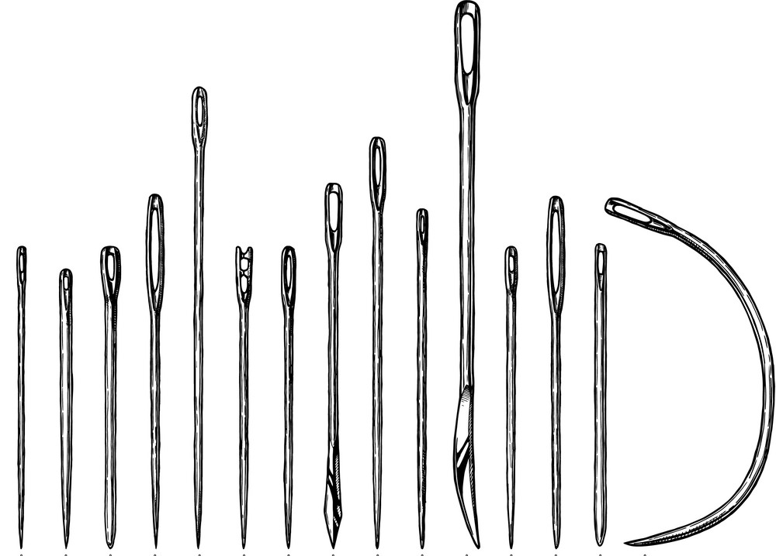
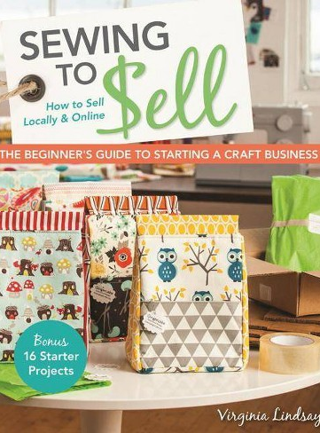
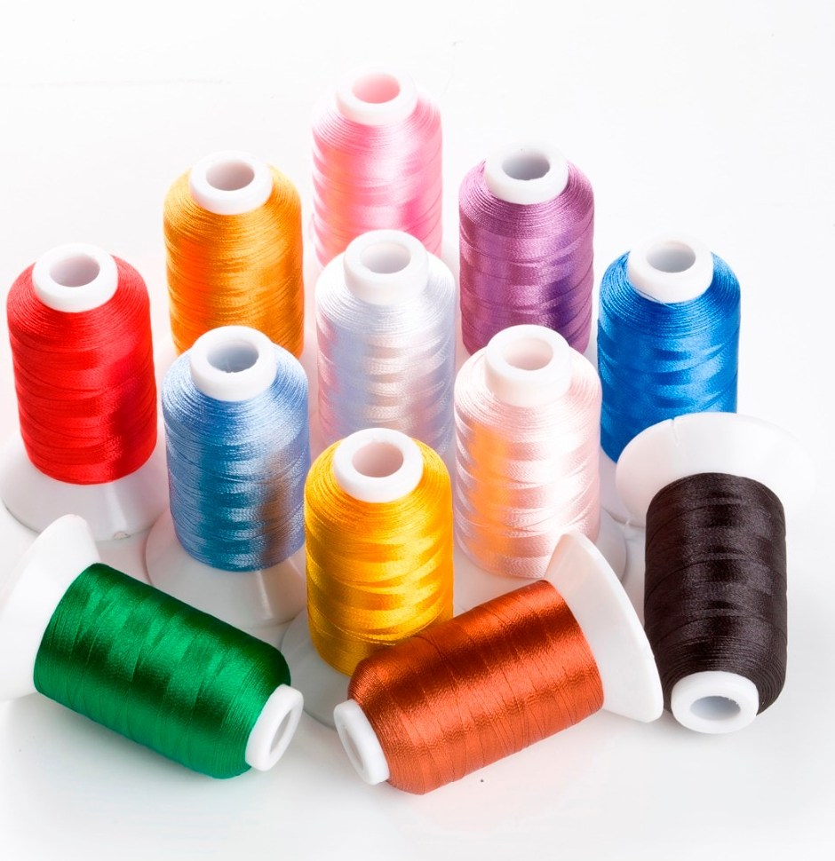
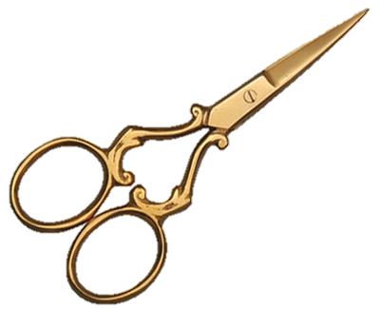
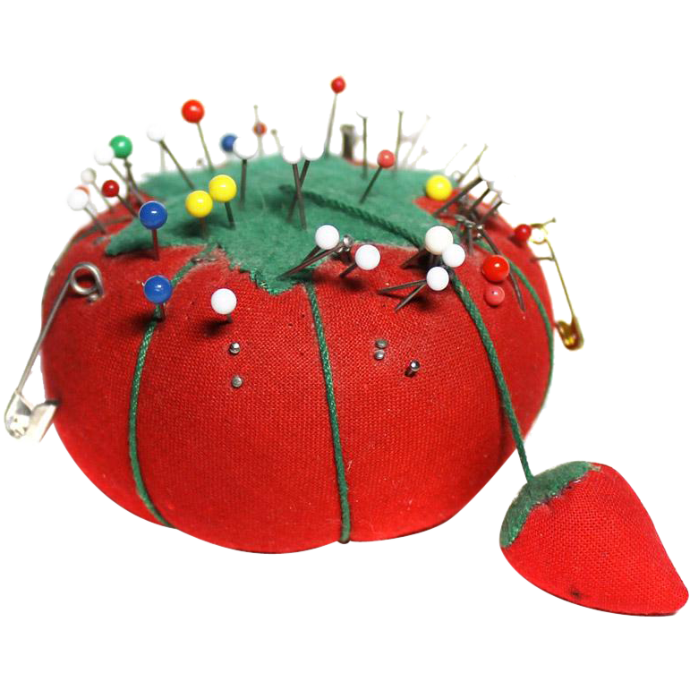
Supplies/equipment

Slide 5
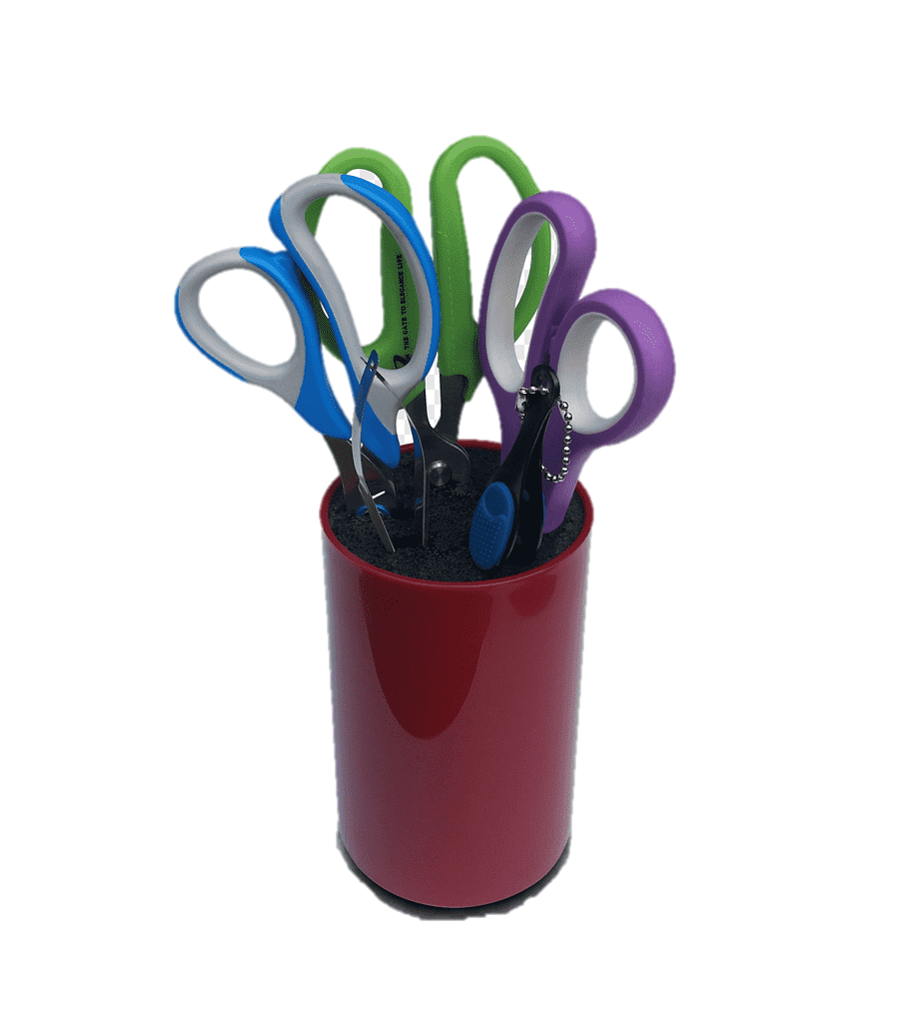
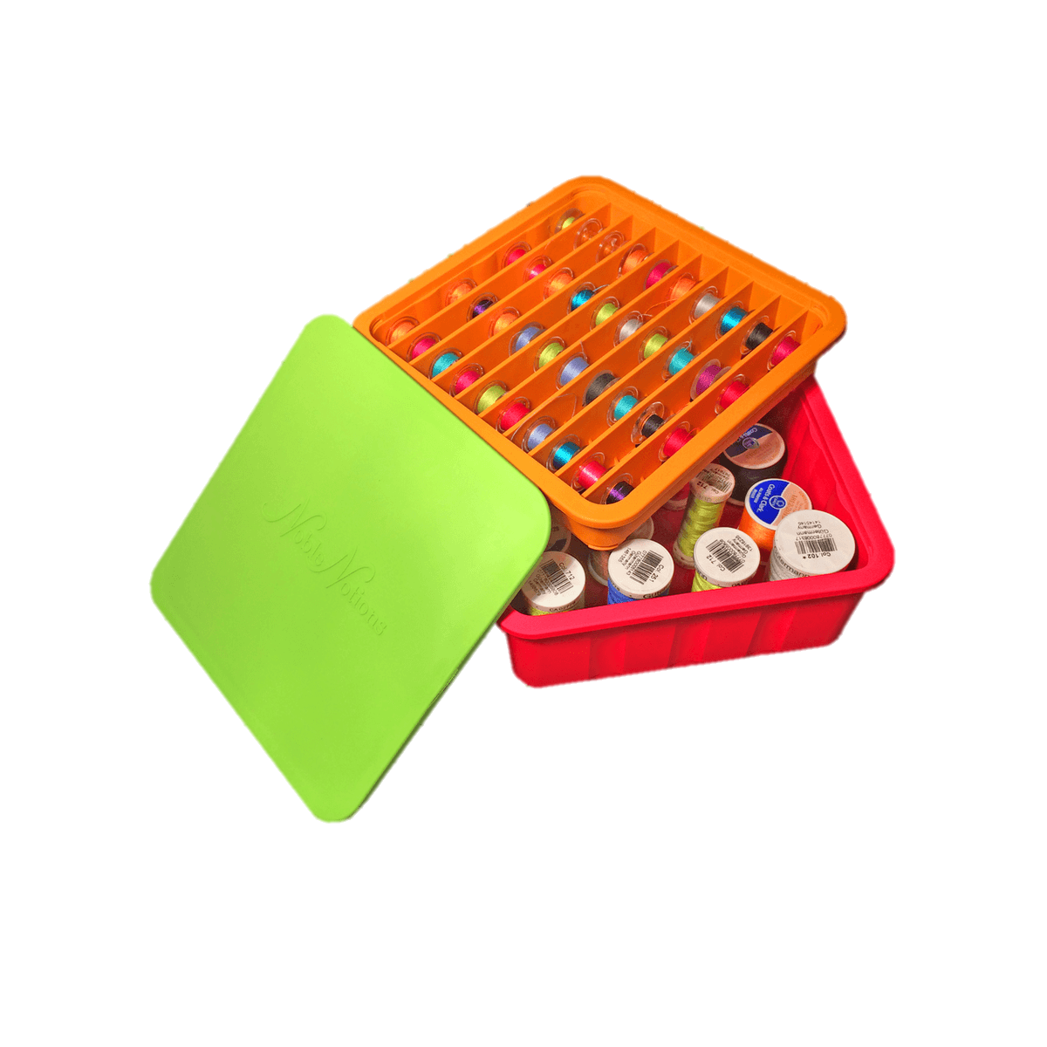
Innovation
A traditional practice like sewing becomes new and engaging for this generation of students that is rarely exposed to the step-by-step process of manufacturing clothing. Students will take skills and concepts learned in mathematics and communication to a real-world application that requires constant measurement and conceptualization of the finished piece.

Slide 6
Teaching kids to sew and embroider is fun and easy, and you'll be helping them learn skills and embroidery basics that will last a lifetime!

Slide 7
Participants in the Study
The participants this year ranged in grade levels from 6th through 8th graders.
The plan for next year is to incorporate 9th through 12th grade as well.

Slide 8
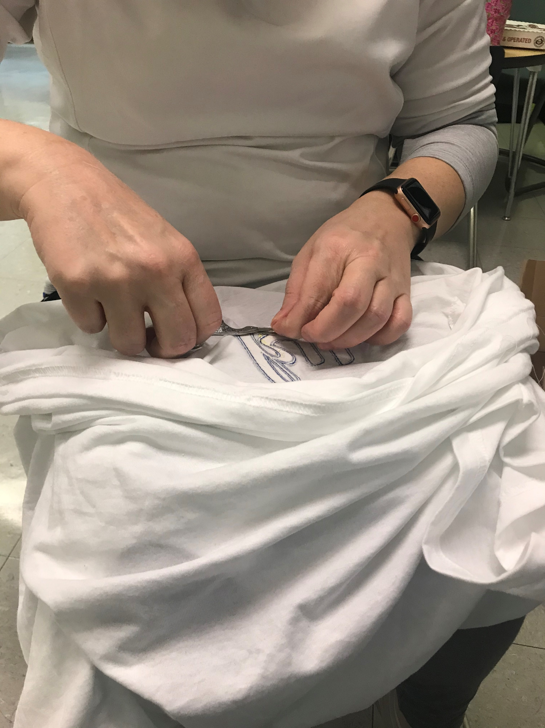
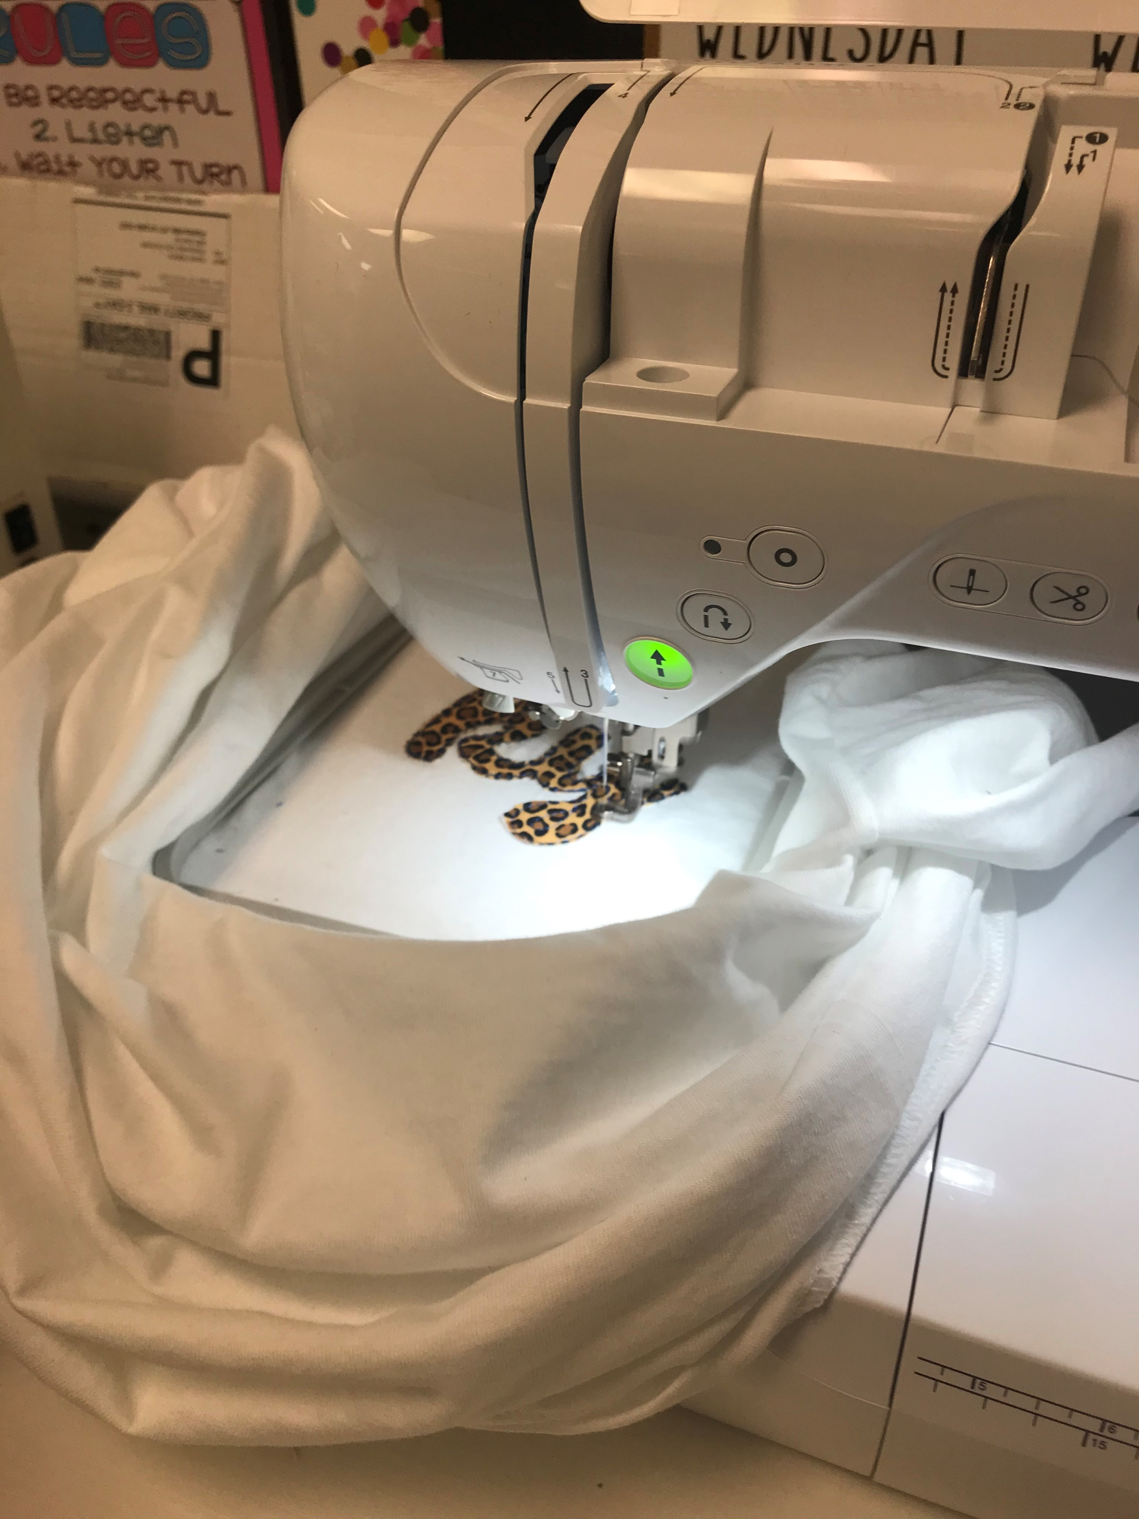
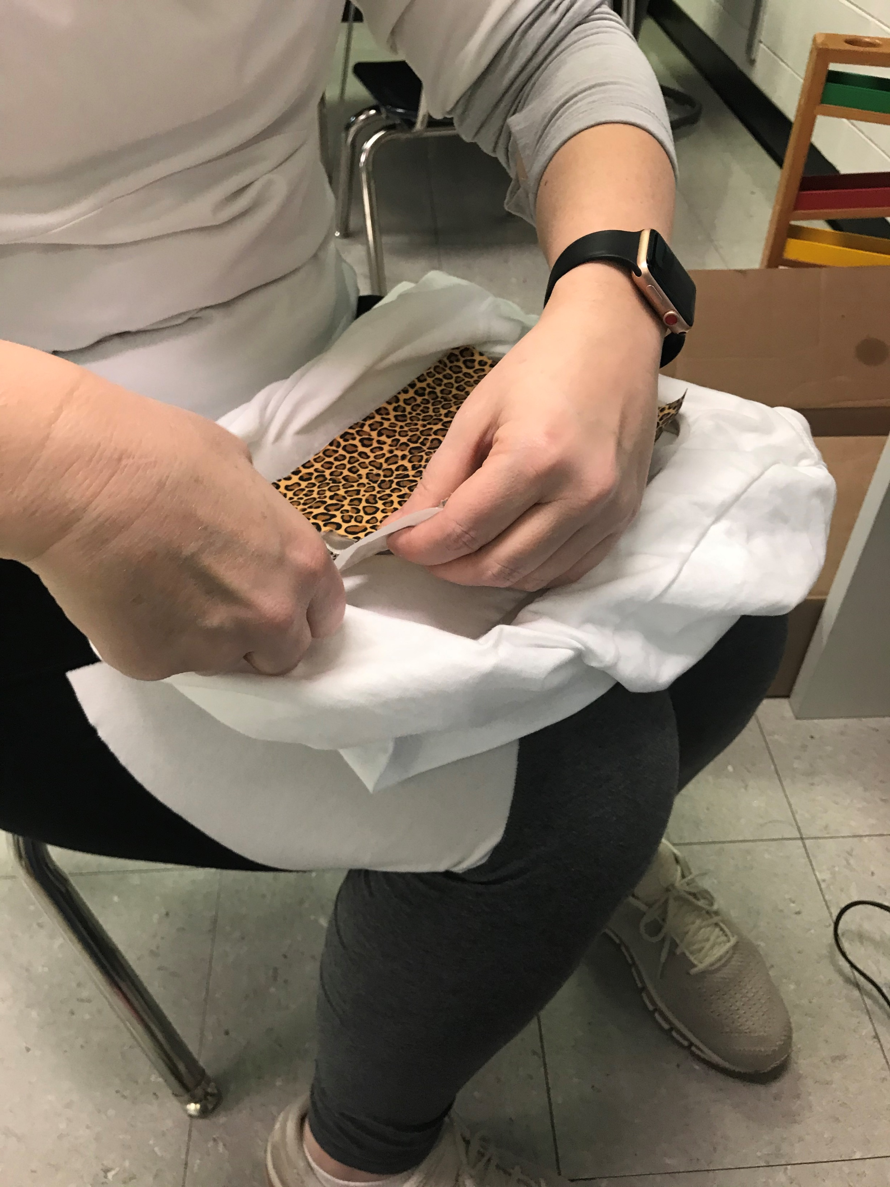
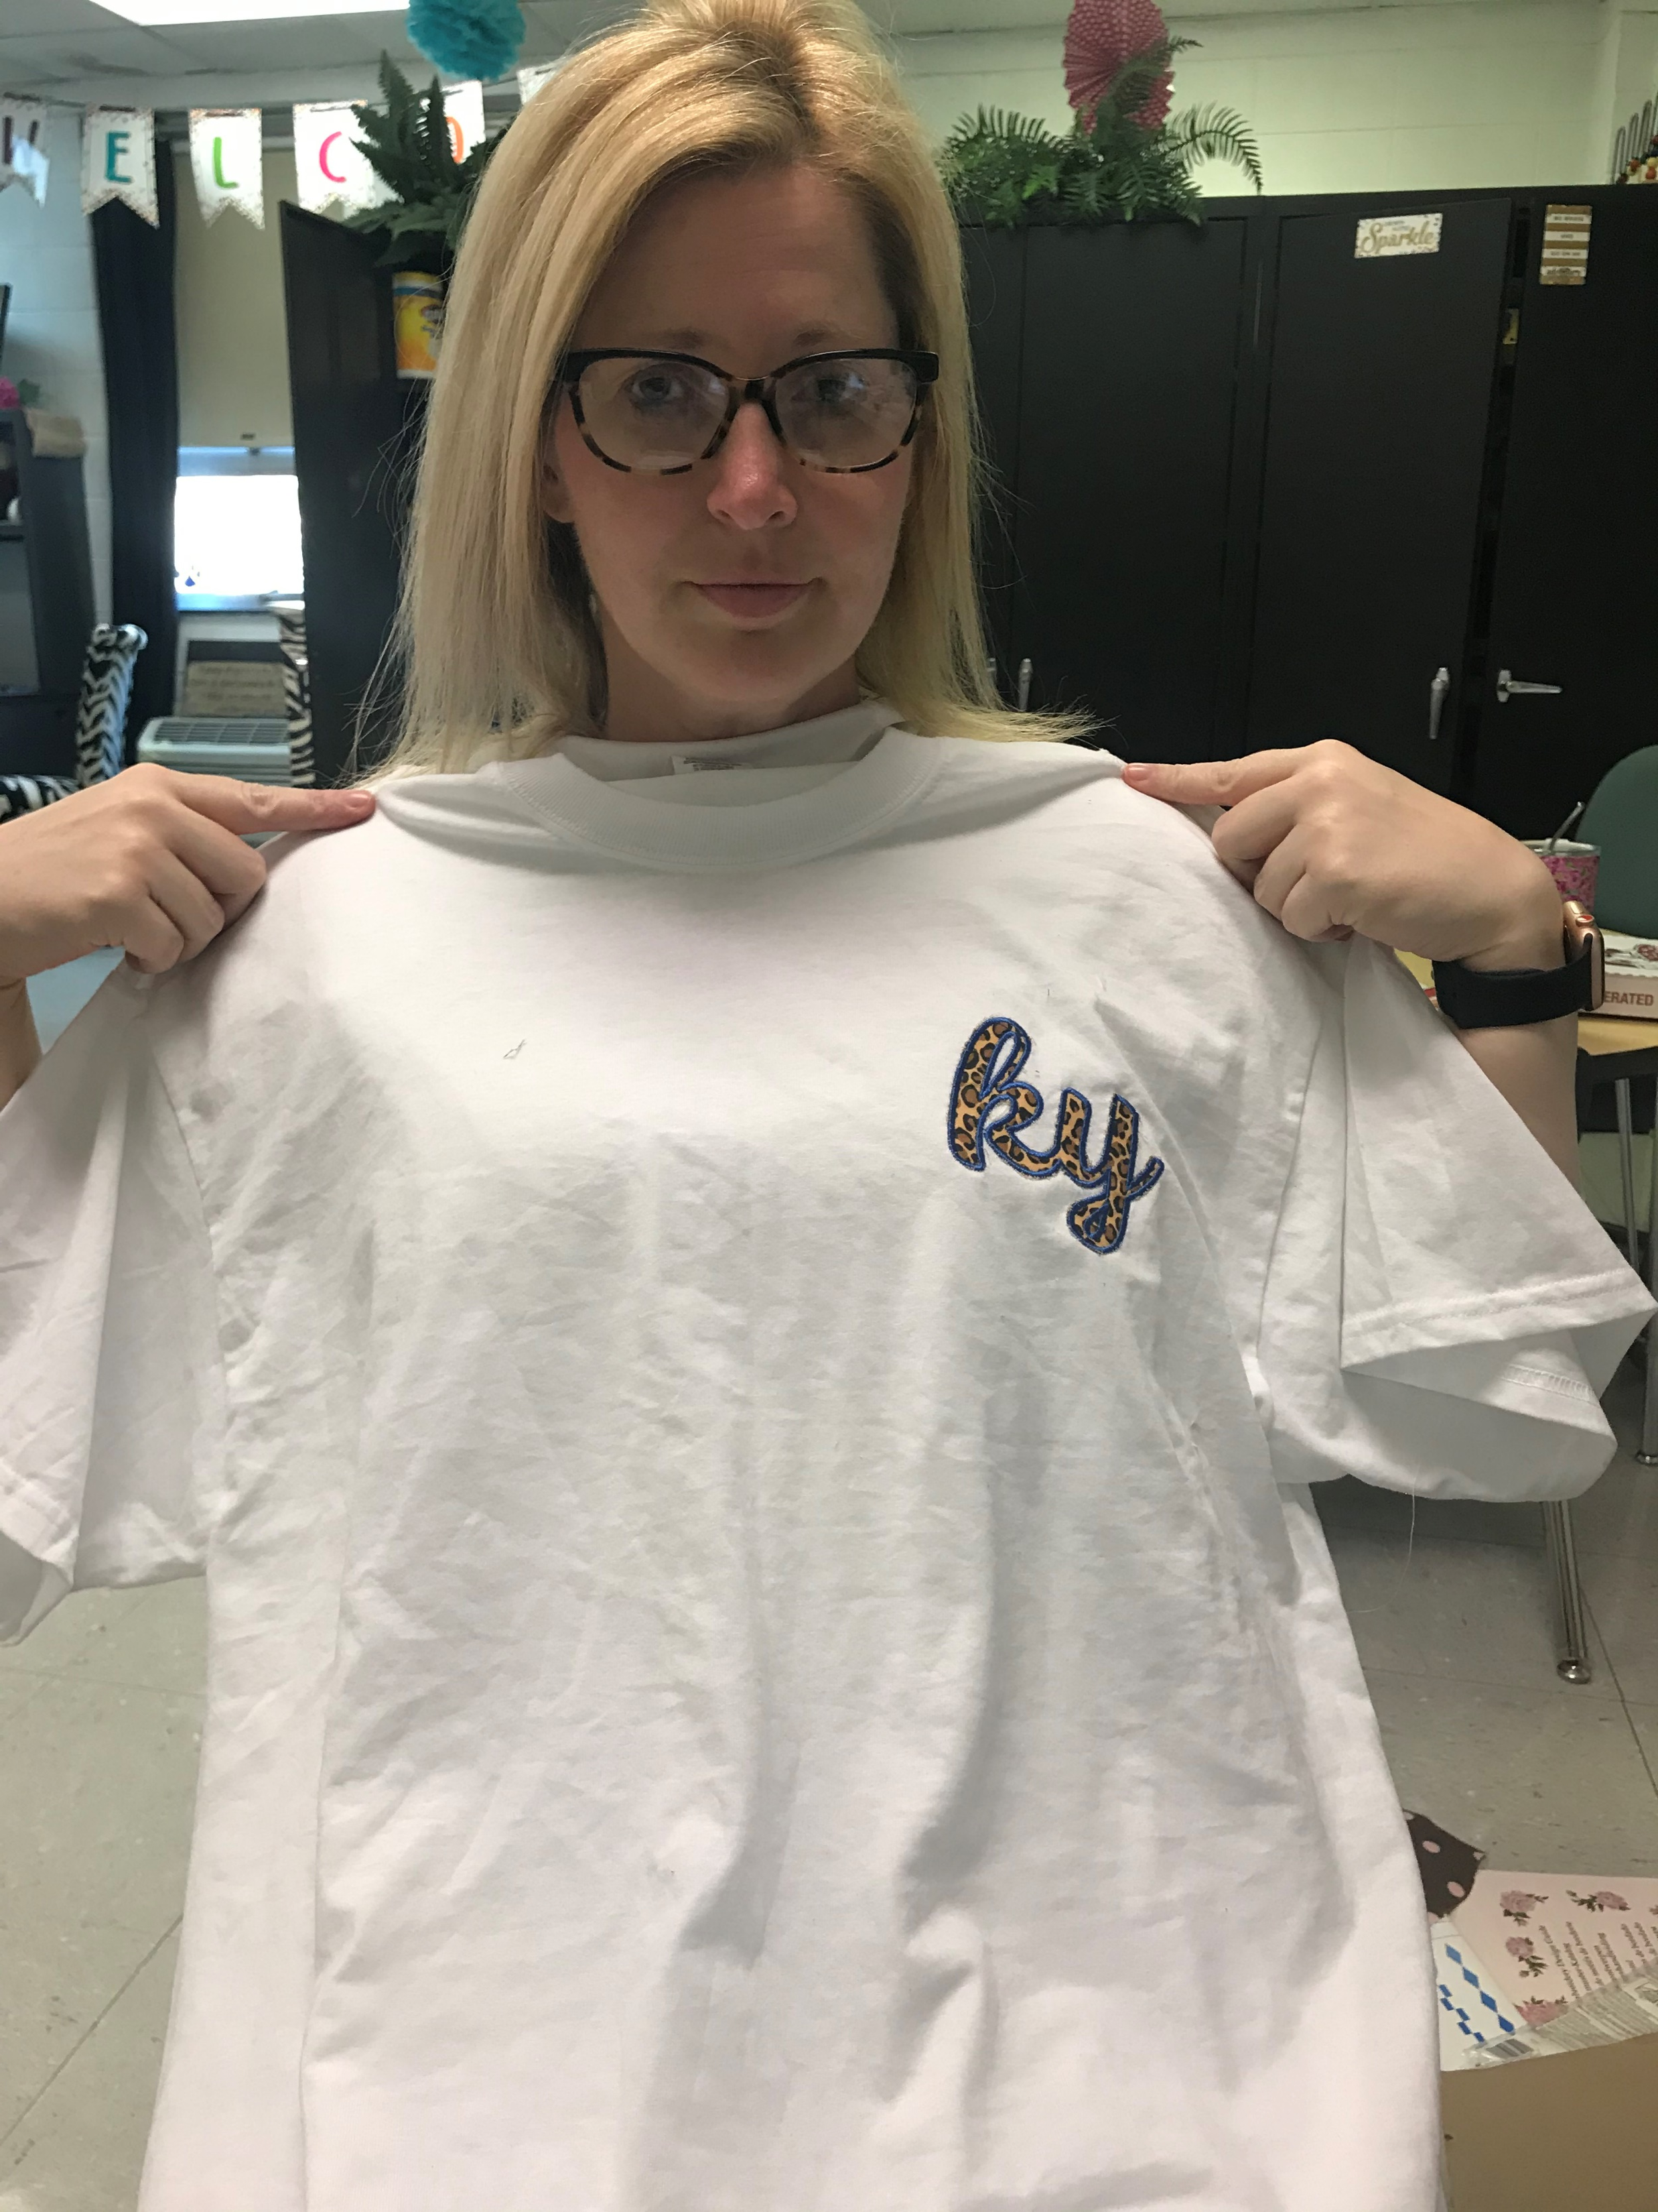
Student Teacher Zone

Slide 9
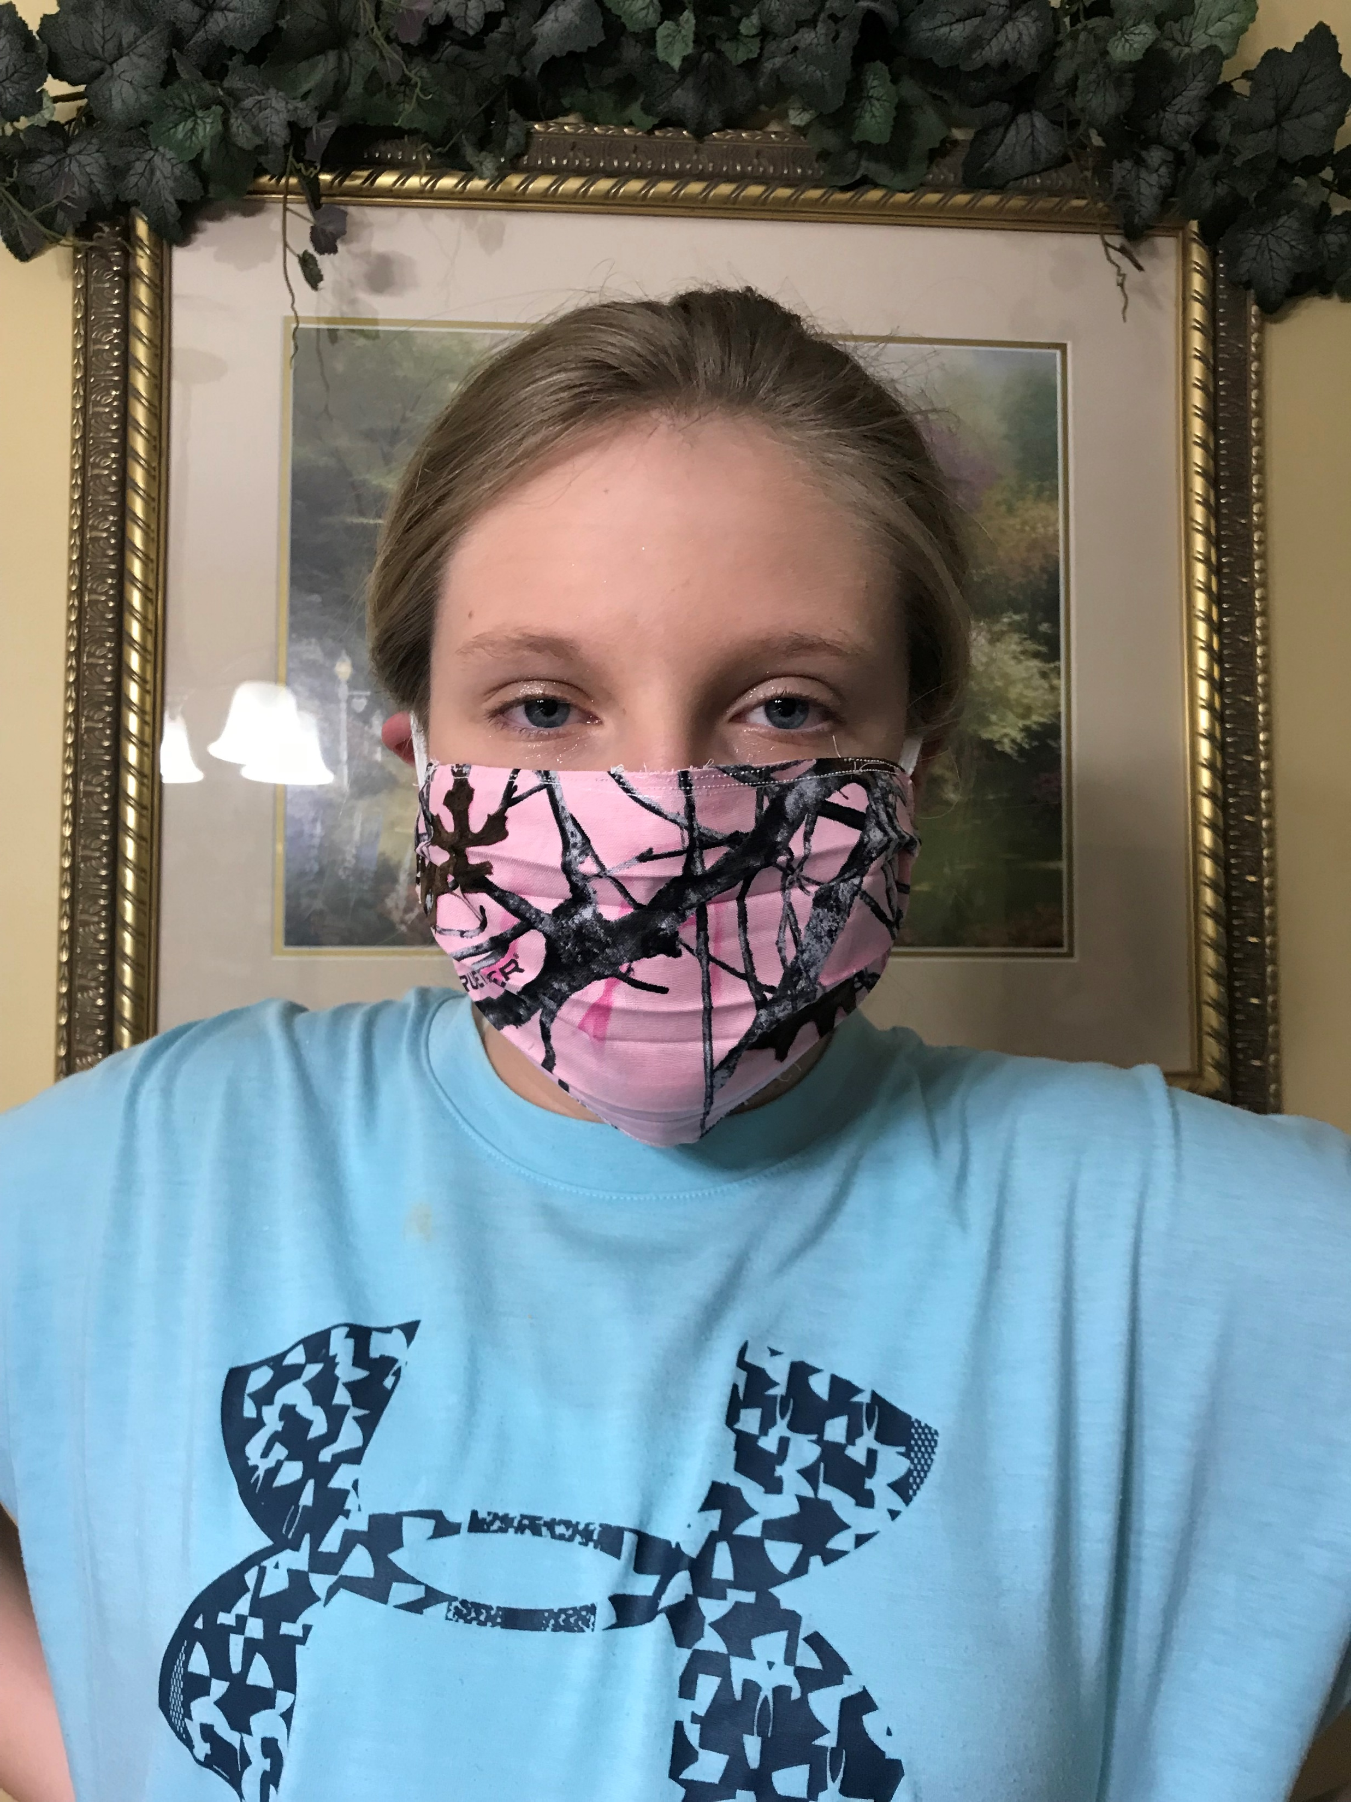
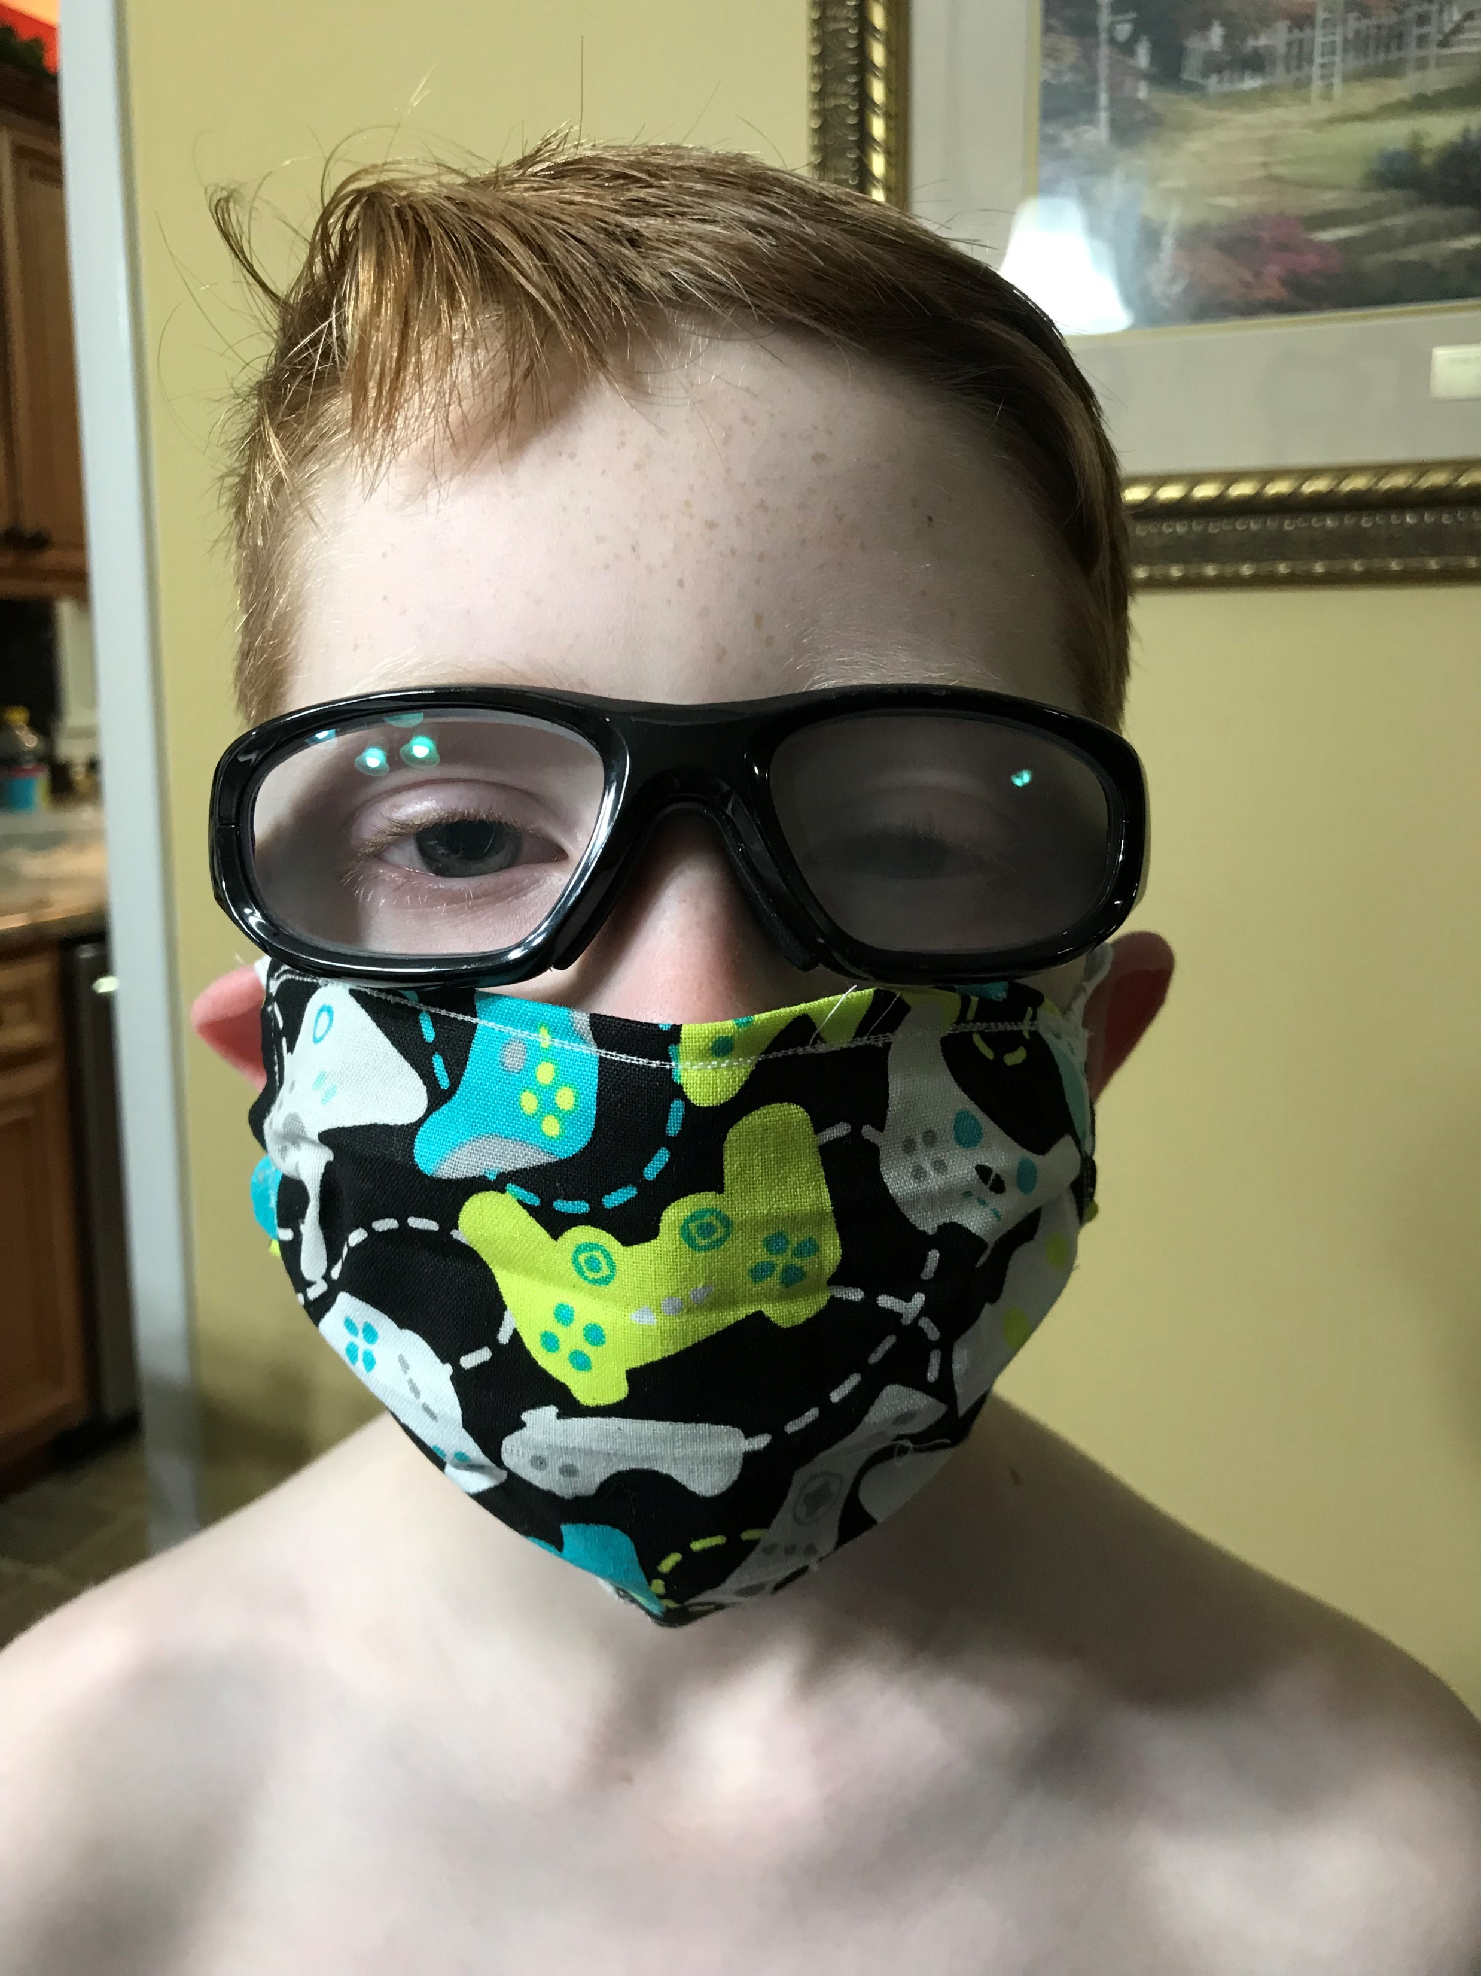
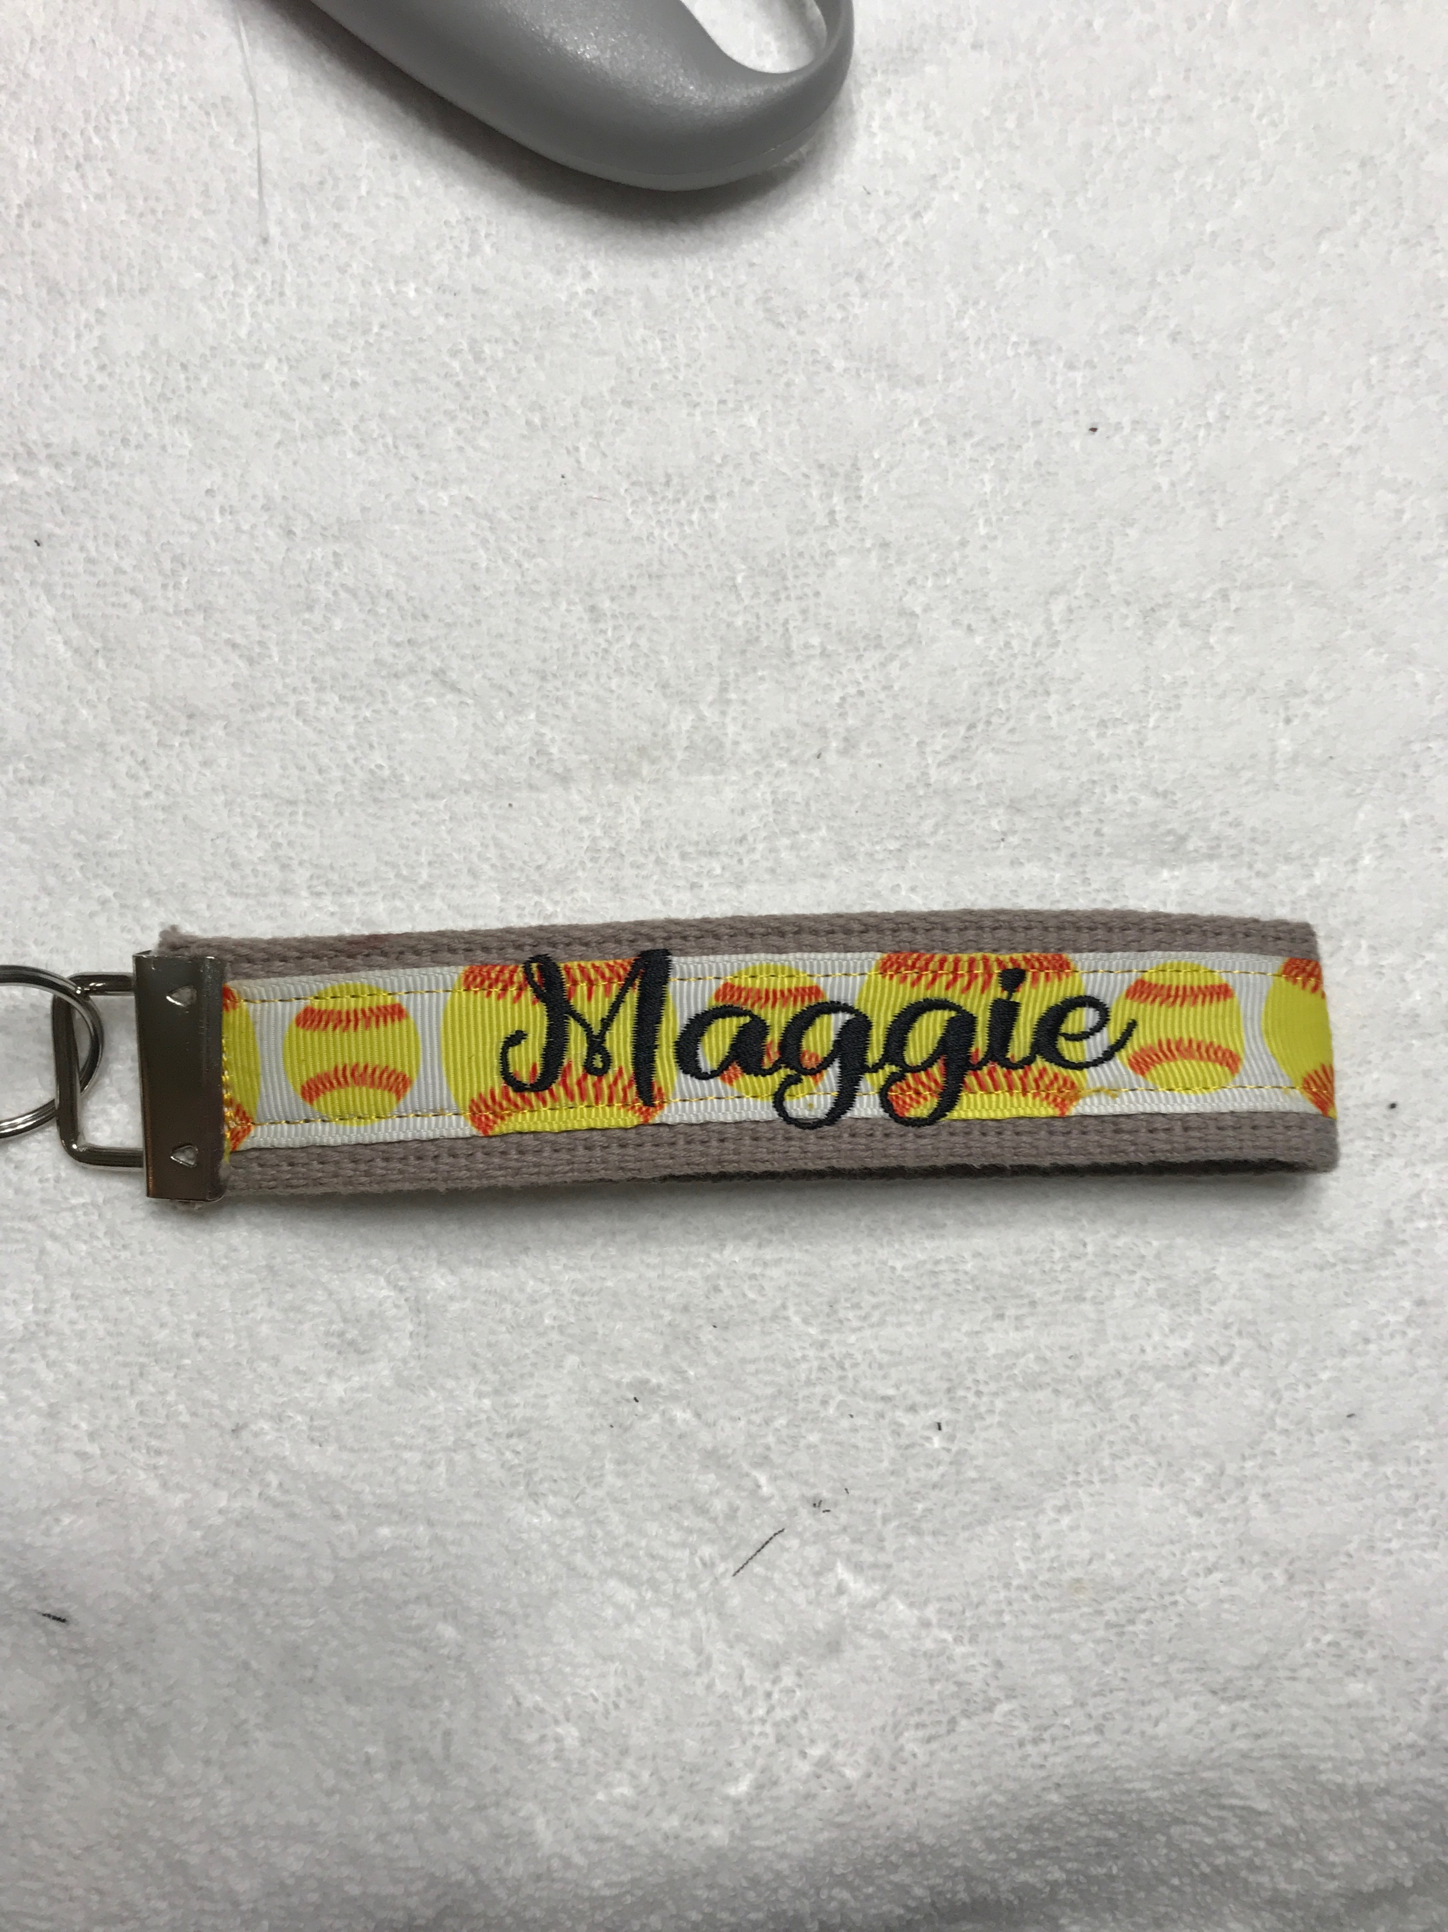
Student Zone

Slide 10
Student
Zone

Slide 11
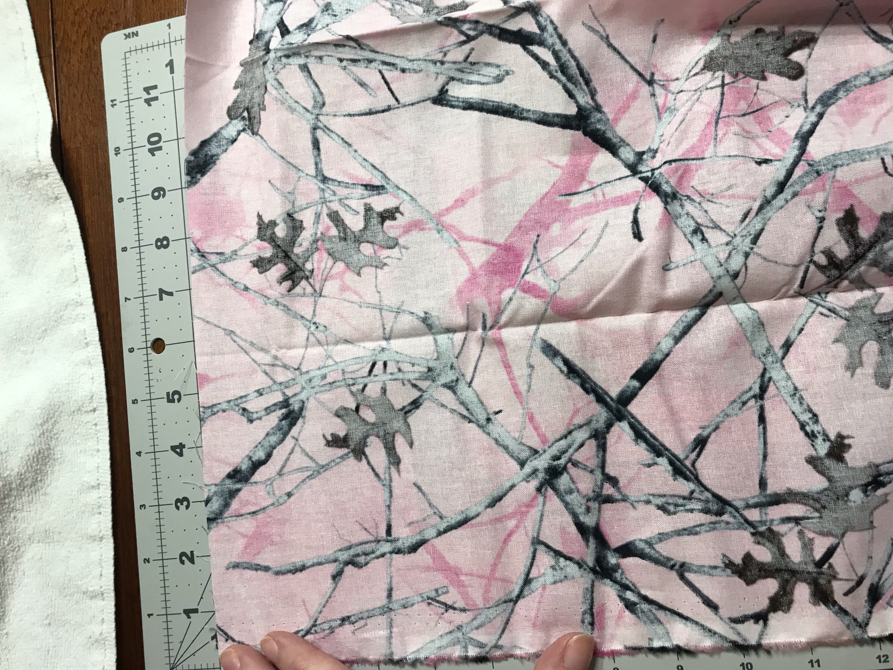
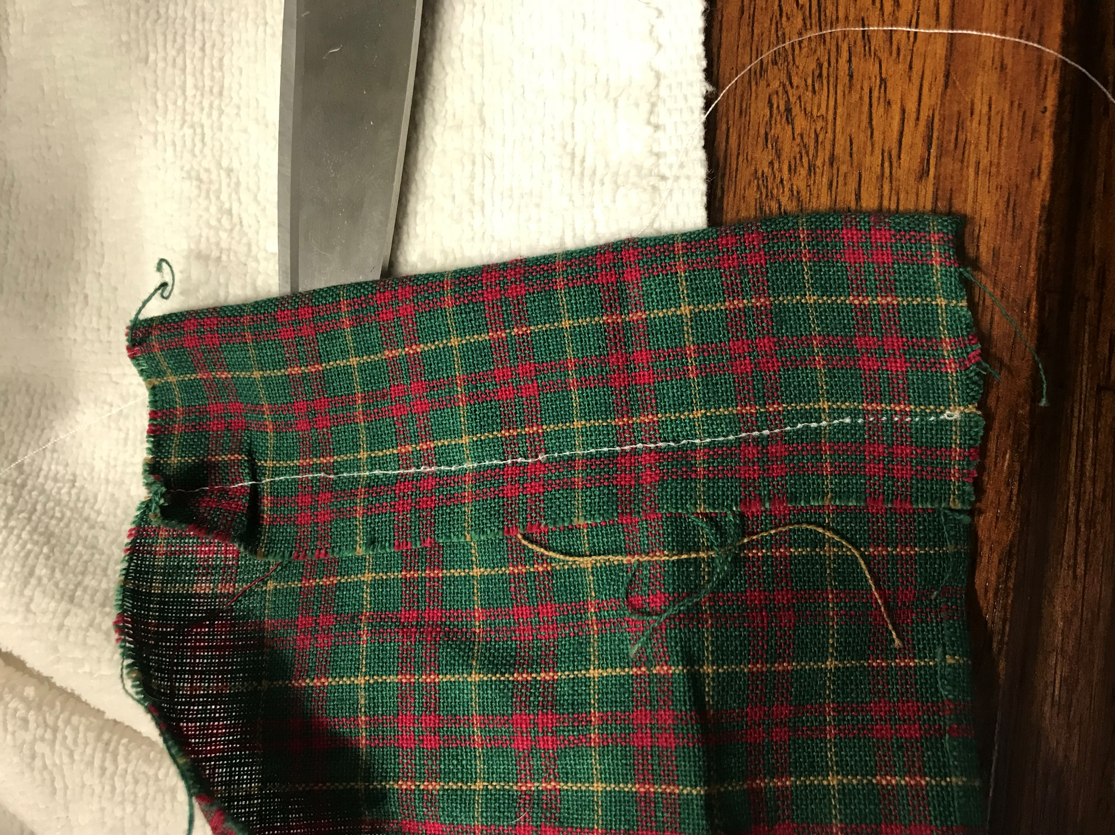
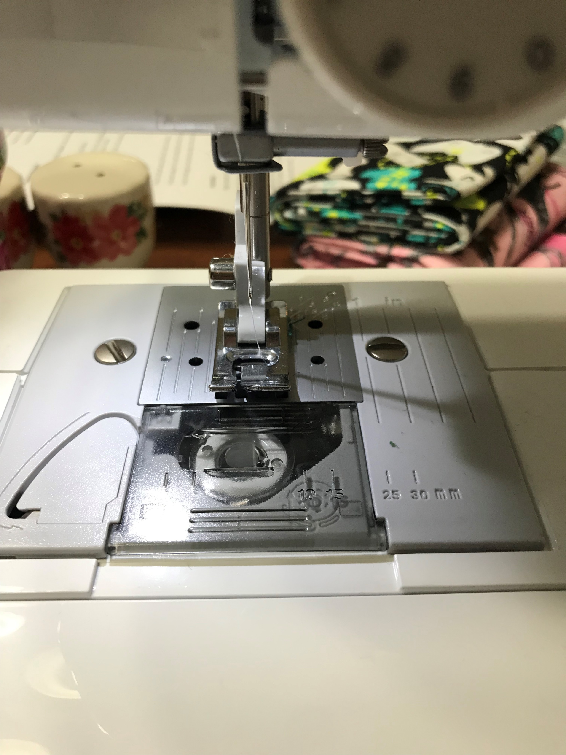
Running stitch, back stitch, stem stitch, lazy daisy stitch, and cross stitch are some of the most basic of all stitches and are used in a wide variety of needlework and sewing projects.

Slide 12
Reflection
Remember that the process is more important than the final product. Learning communication skills and utilizing learned mathematical practices has been positive. Even though it has been a slow but steady pace. Keeping that in mind will alter your own experience, which is more likely to make it a fun experience for the child.

Slide 13
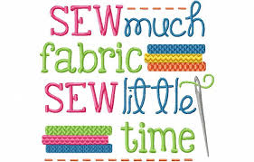
Any questions:
Please contact us at
Melinda.Music@Paintsville.kyschools.us
Jordan.miller@Paintsville.kyschools.us
Frankie.puckett@Paintsville.kyschools.us

