Slide 1
Sensory Walk: Learning Through Fun
Courtney Hall
Ashley Bowling
Robinson Elementary
Perry County Schools

Slide 2
About
With our 2019-2020 Innovation Grant from KVEC, we bought a Cricut and vinyl to make a sensory walk with sight words in our primary K-2 hallway. Sight words include the entire dolch preprimer and primer levels that are required for K-1 students to be fluent in before moving on to the next grade.

Slide 3
Sensory Learning
According to research, students learn better when a variety of instructional strategies are implemented. Kinetic, visual, tactile are all ways to help students of all ages become more successful when it comes to learning. Our sensory walk aims to help students who prefer various learning styles to become familiar and eventually fluent in the sight words that are required according to their grade level.

Slide 4
Why a sensory walk?
Where is this implemented?
How was this implemented?
Sight word walks are instituted in high traffic areas of our primary level hallways so the words are always visually available to students. Students are able to also do their “sight word walks” as rewards where they can say their sight words and touch them on the walls as a reward for positive behavior reinforcement. This allows students a chance to go beyond the classroom for differentiated learning.
Sight words were printed out using different color vinyl with different vinyl and shapes to be colorful and visually engaging. The sight words where then cut out and placed on walls for a word wall visual, and also for a word walk along the hallway and opposite various classrooms. Sight words were then color coded by list so that students would be able to say them while we implemented sight word karate throughout the year.

Slide 5
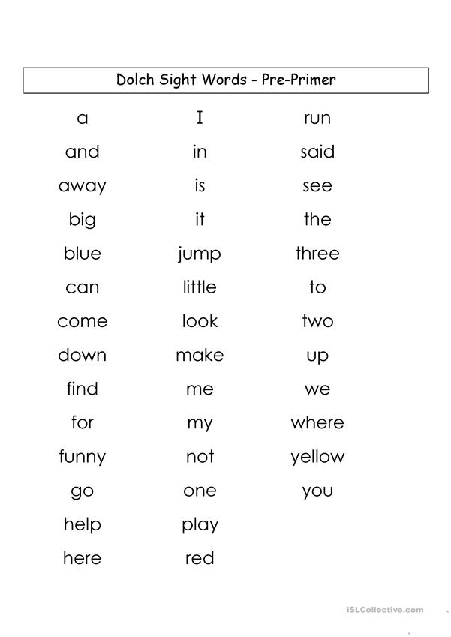

Slide 6
Who benefits?
Our sensory sight word walk benefits kids from preschool to 2nd grade. Our kids who are in RTI also really enjoy the sight word wall because they can trace the words with their finger and they can also visualize the words.

Slide 7
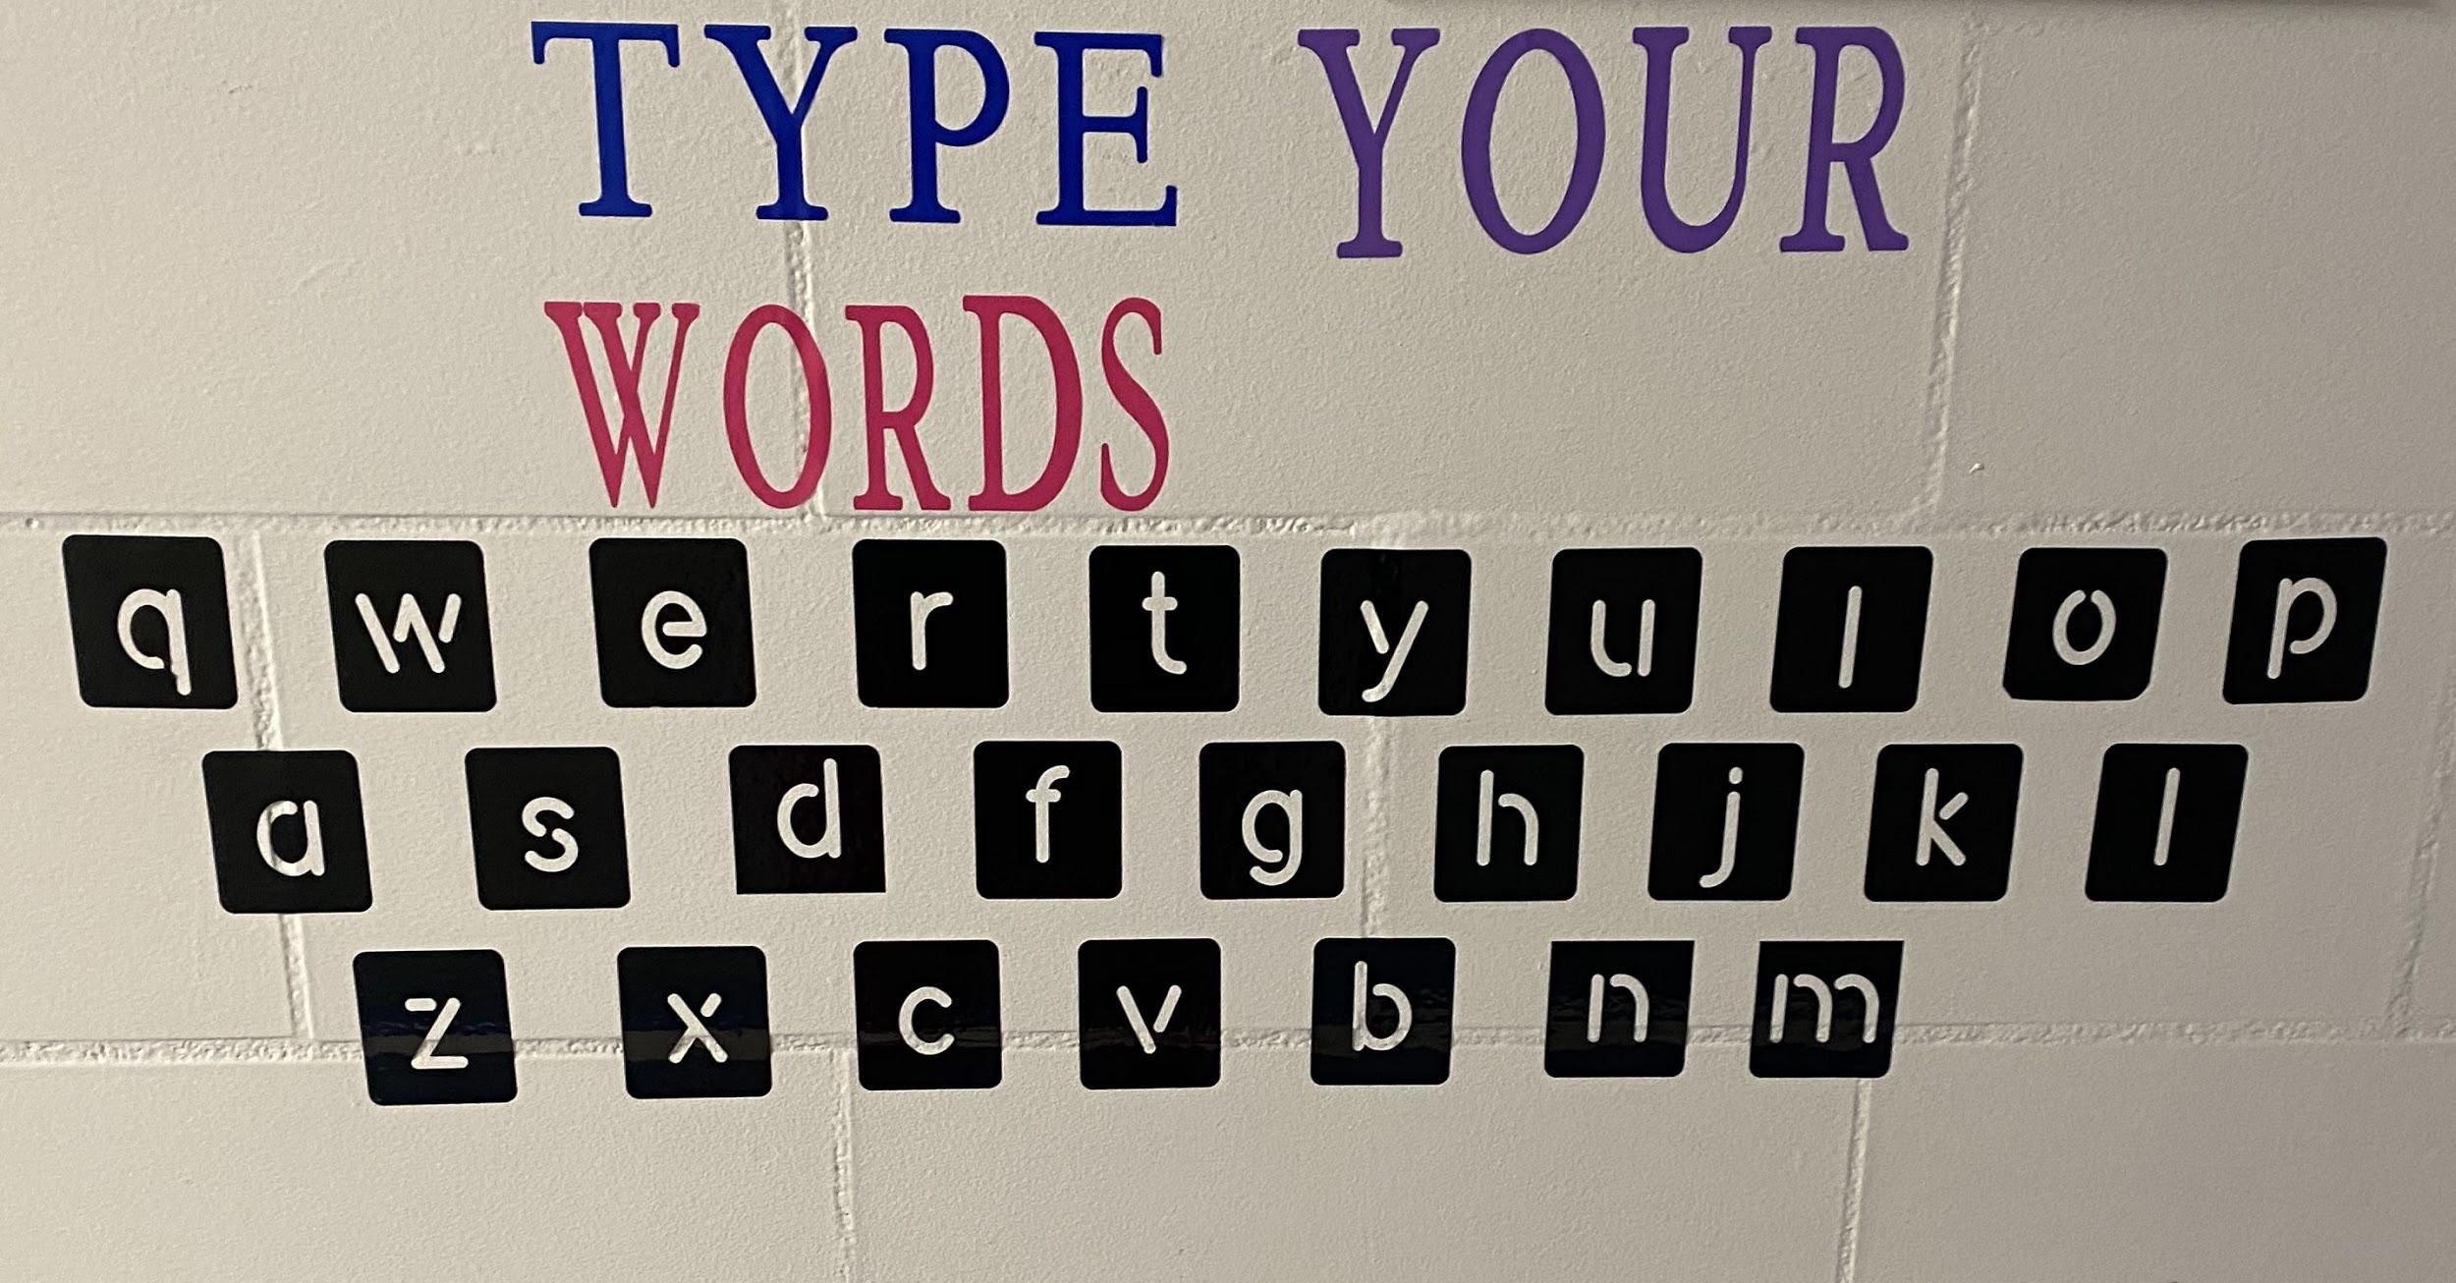

Slide 8
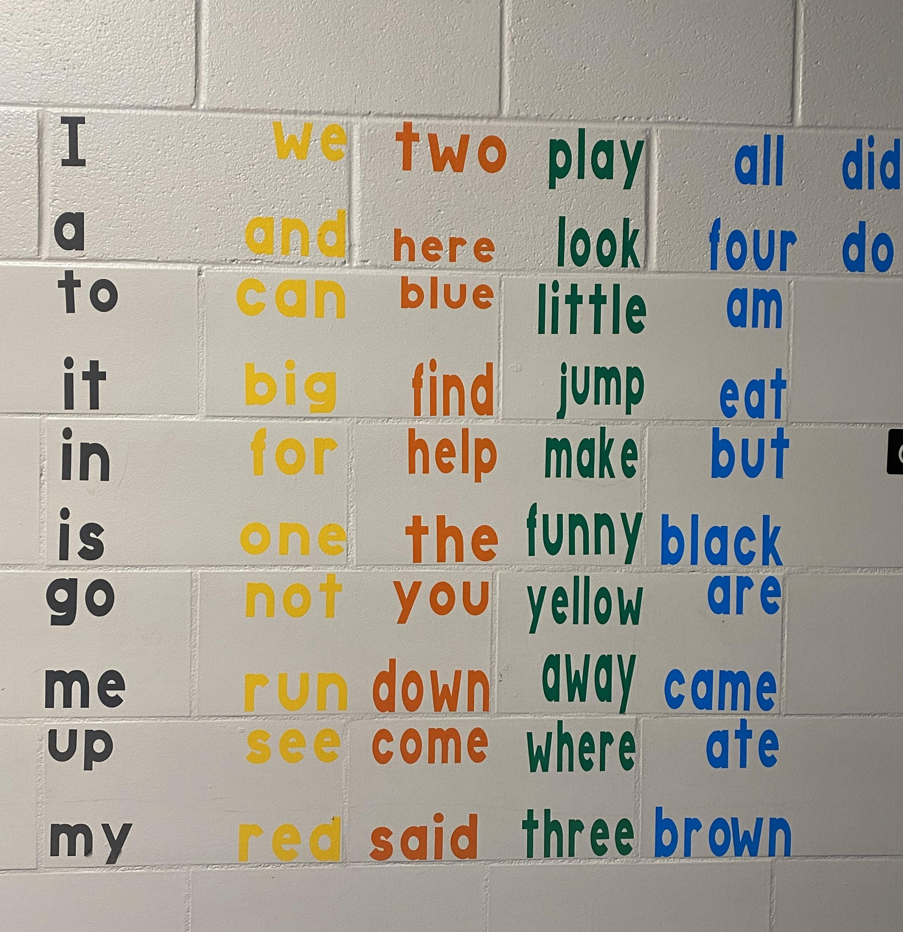

Slide 9
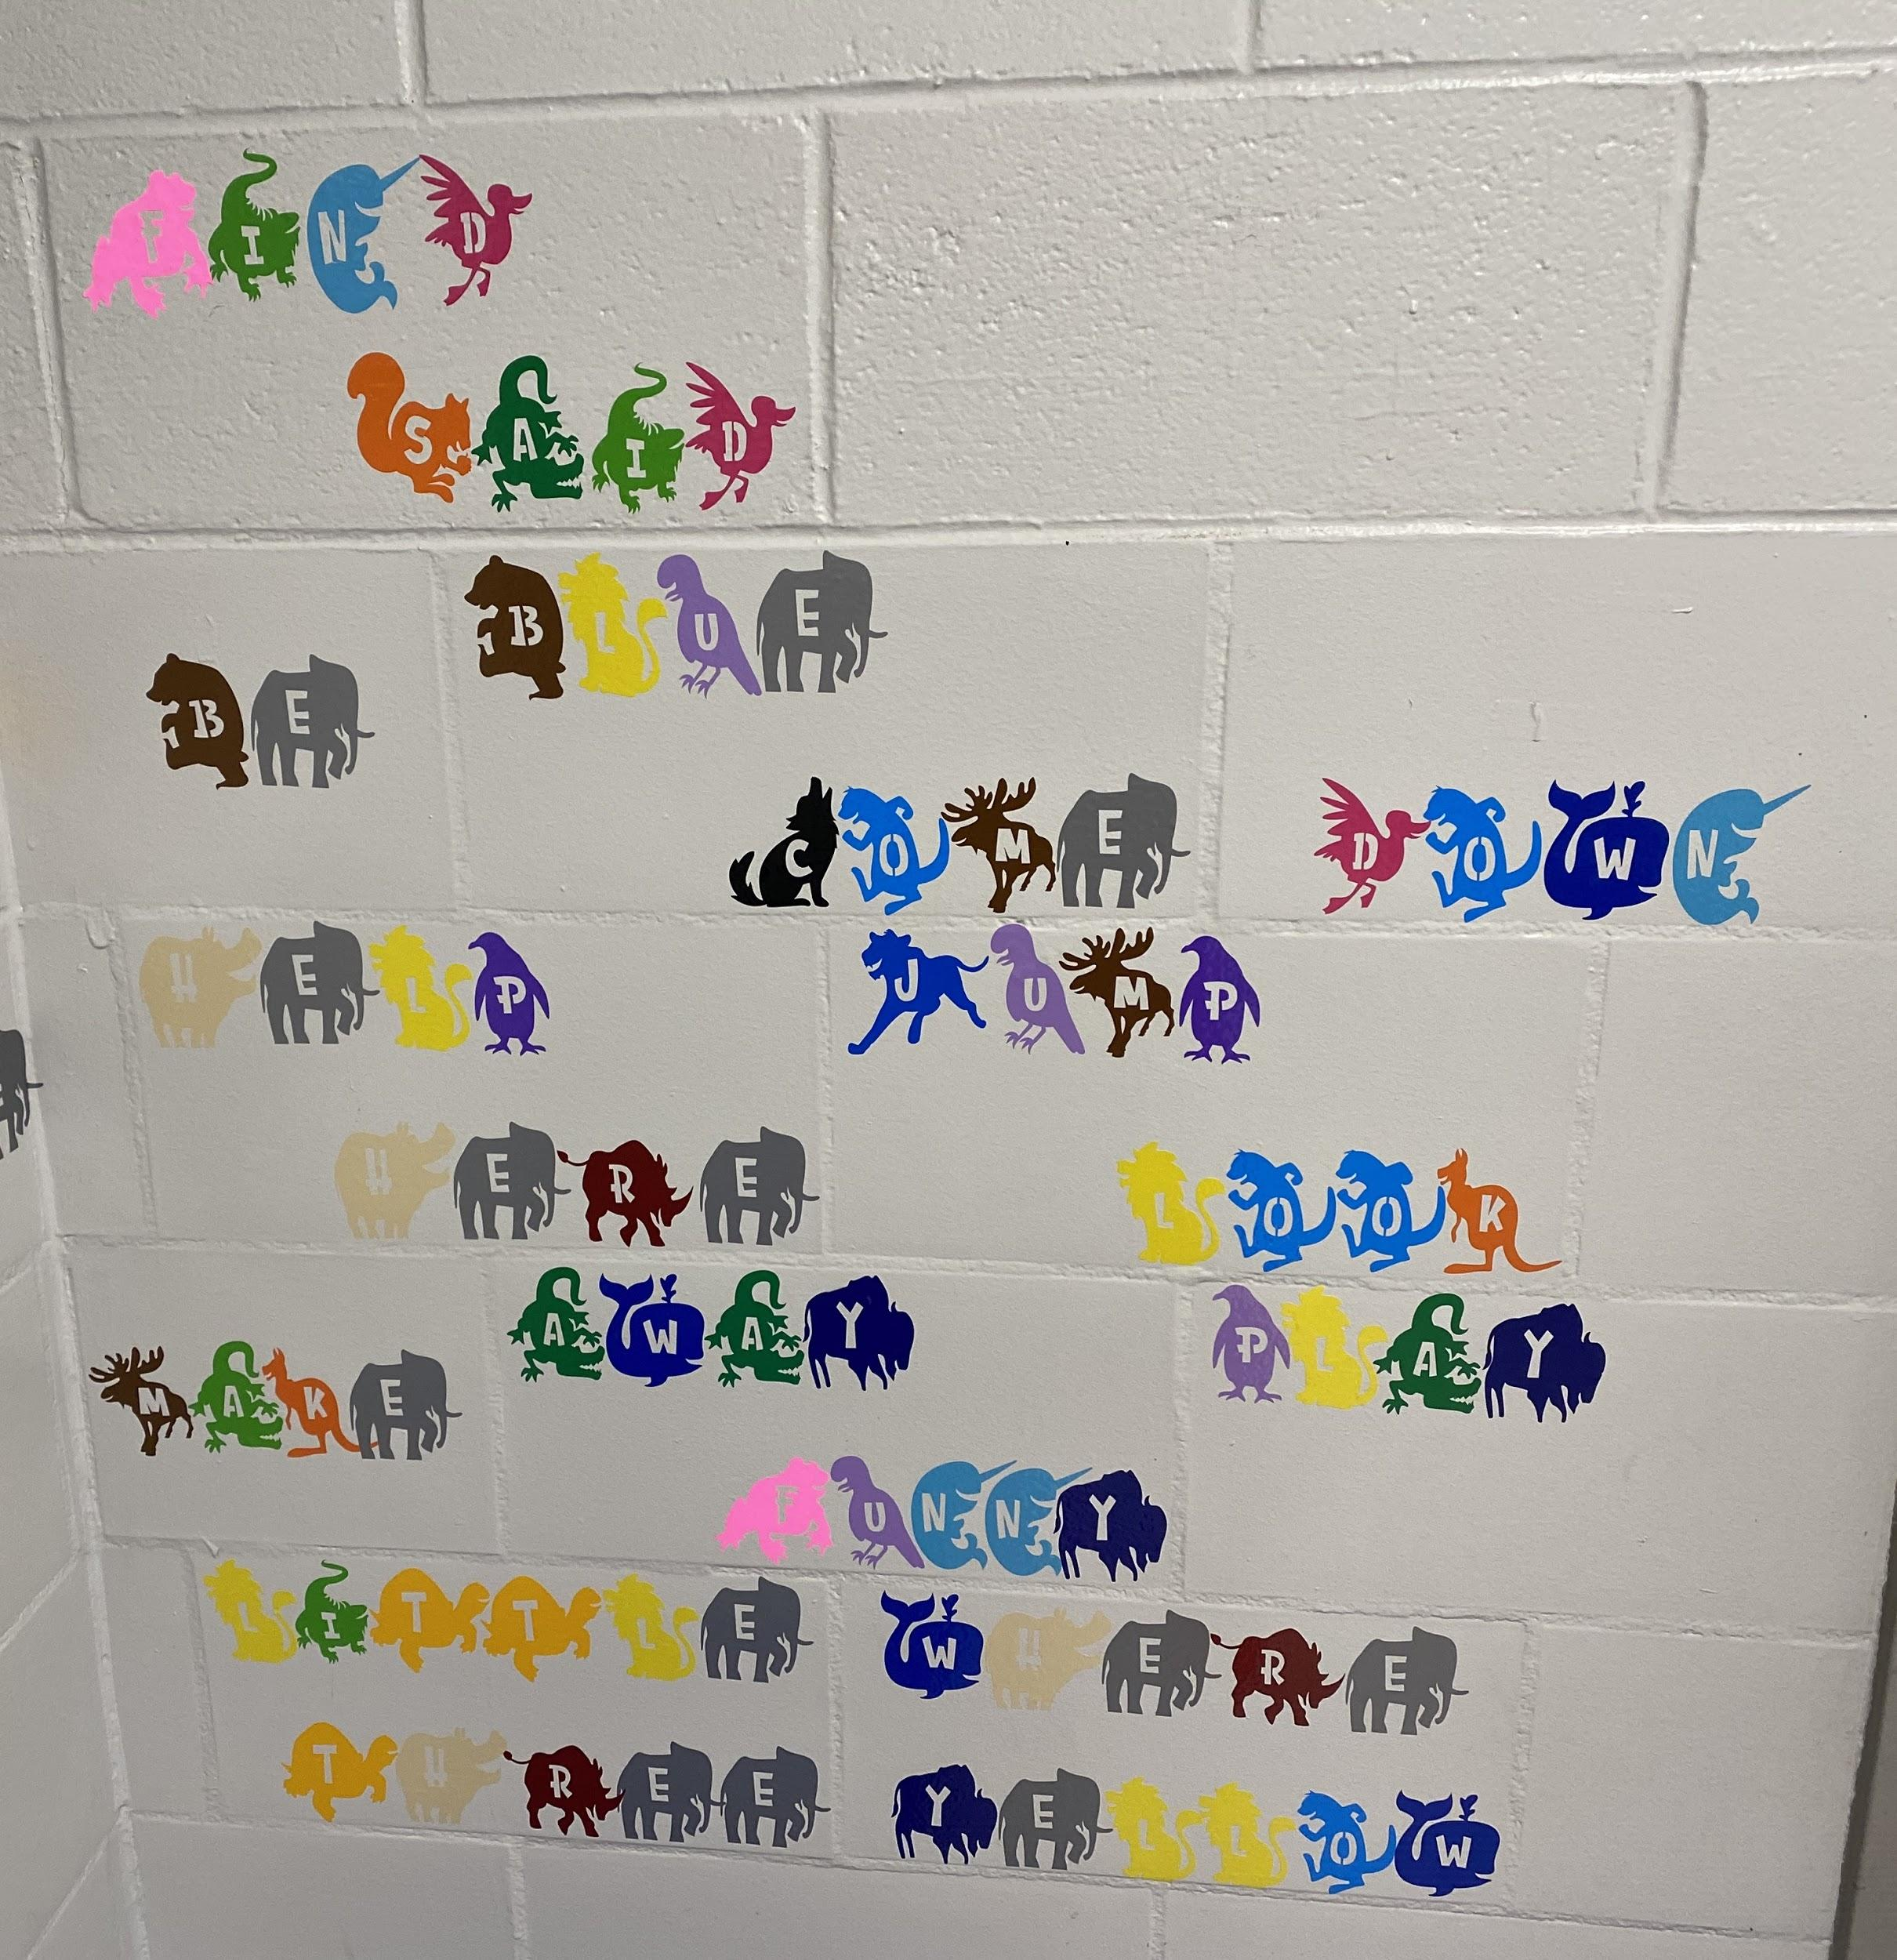

Slide 10
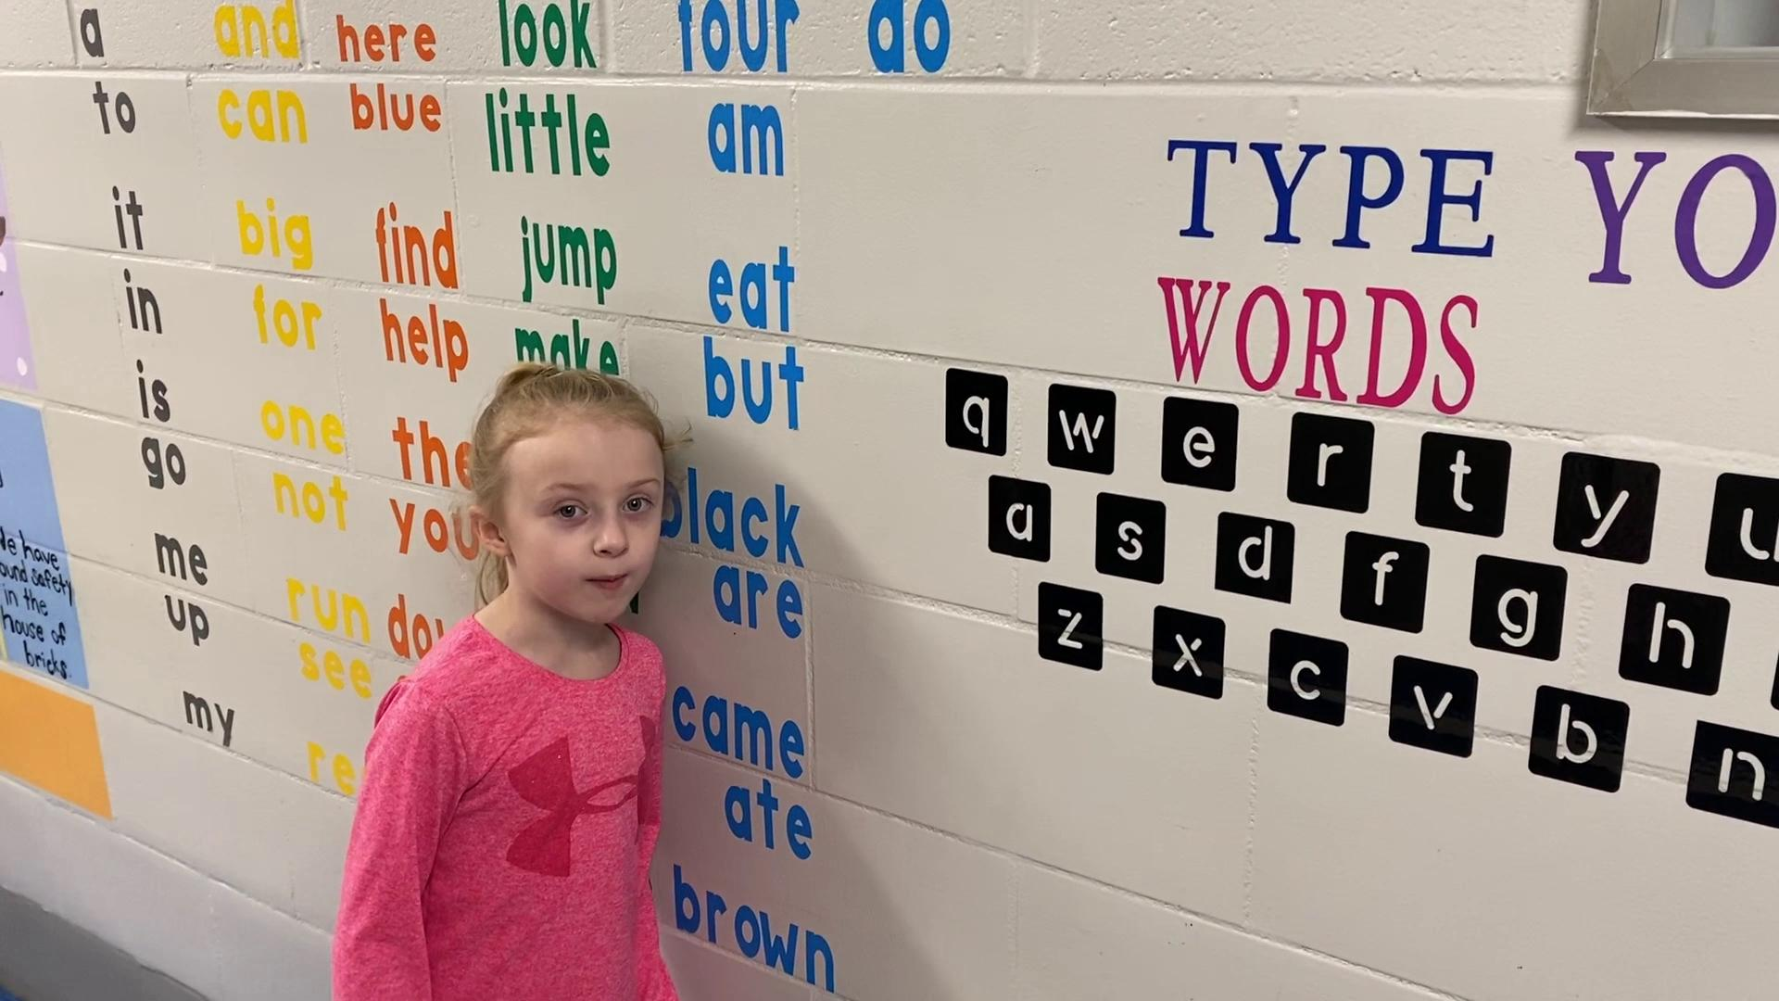

Slide 11
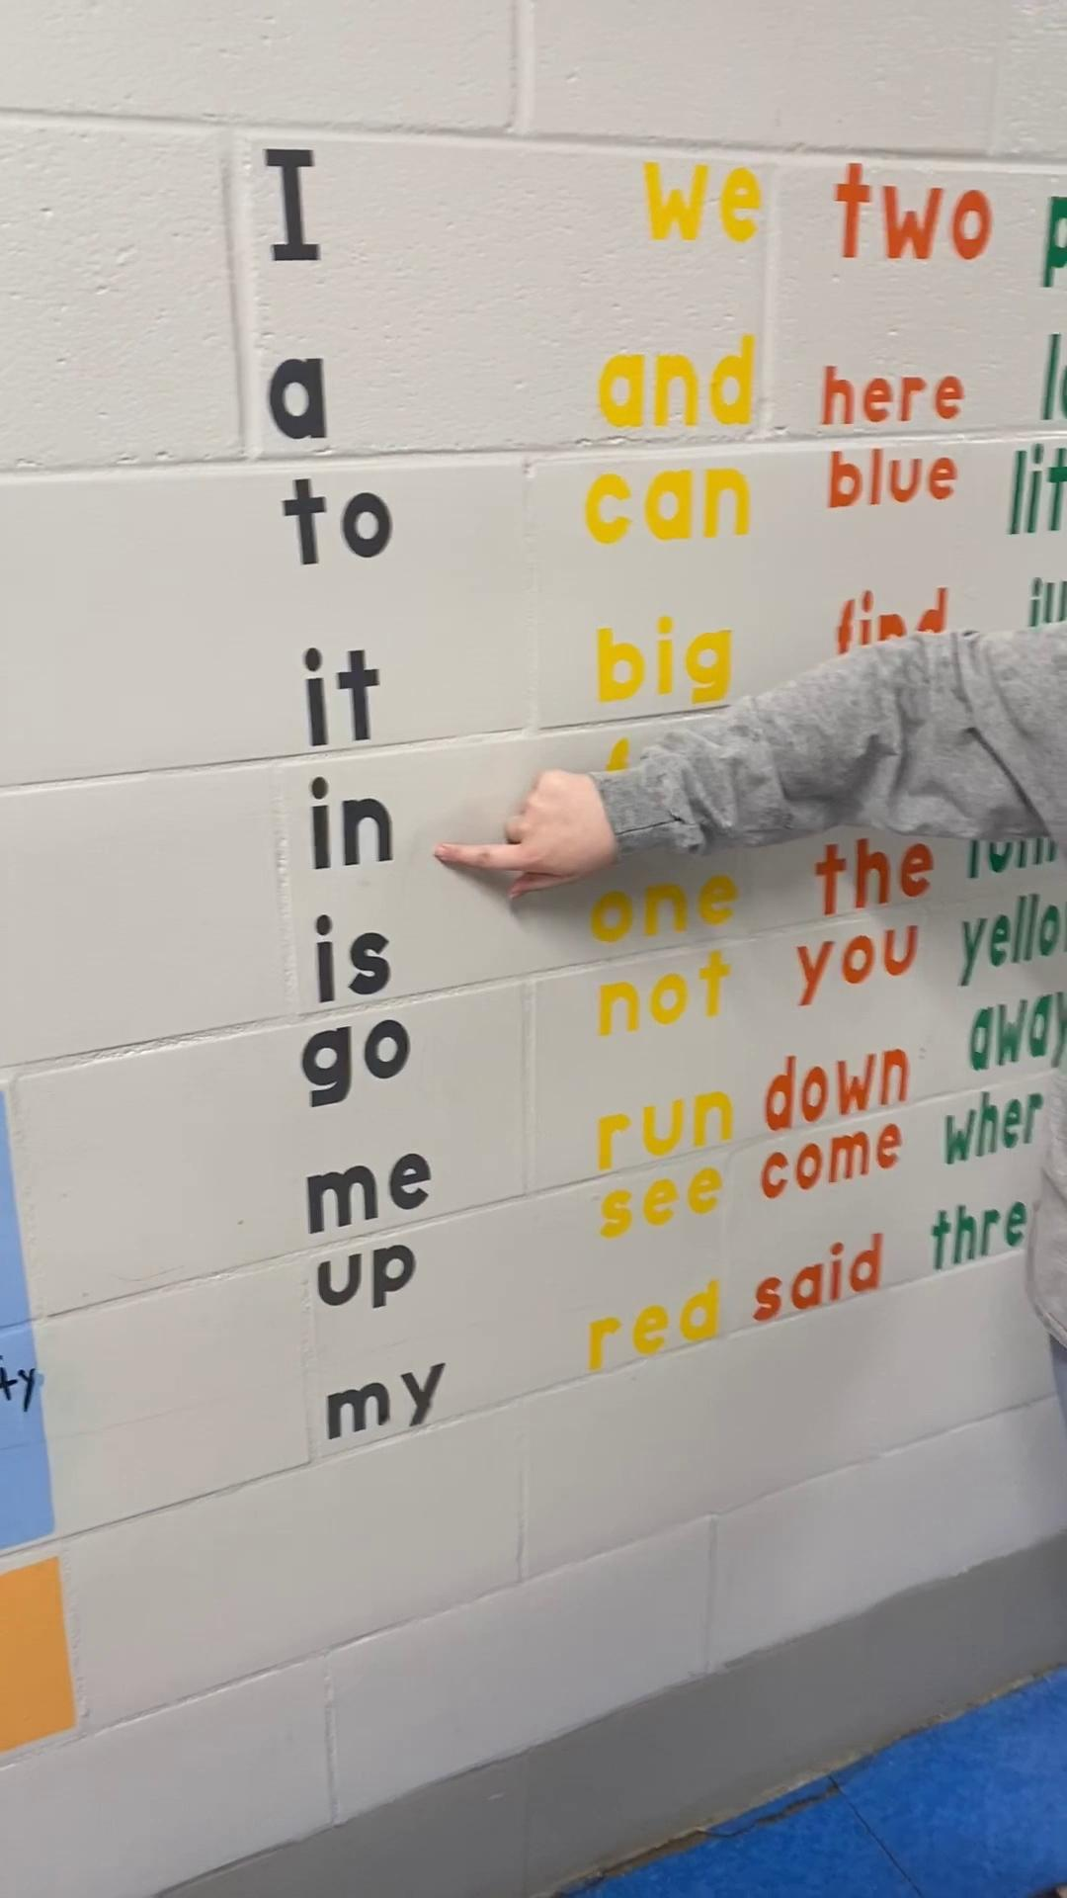

Slide 12
Data collected each 6 weeks indicates a substantial level of growth in sight word fluency from the beginning of the year with no sight word sensory walk to now with the sensory walk. 80 percent of both kindergarten classes earned their sight word karate green belts which is made up of the required kindergarten dolch sight words for their grade level. Our common assessments that are district mandated are given each 6 weeks and our exit criteria has seen significant growth in reading fluency and sight word fluency.
Students are also becoming more and more confident in their ability to recognize required sight words and read simple sentences made primarily of their sight words. Being able to see their sight words displayed each day and have a common place to come and say them and practice them makes a really big difference.

