Slide 1
Intervention Team: Positive Behavior Intervention System
Emily Kincer

Slide 2
What is PBIS?...
PBIS is a positive behavior intervention system. This system is designed to decrease behavior issues and discipline referrals by implementing positive approaches.

Slide 3
What are our PBIS guidelines?...
Be Safe
Be Responsible
Be Respectful

Slide 4
What is our goal?...
The Intervention Team is built upon the idea of working to reduce the number of behavior issues at LCCHS and improve the environment of our student body. Our aim to bring down the number of ISS/AE referrals by working with students on an individual level, establishing a line of communication, reteaching correct behavior, and improving our overall environment through the PBIS system.

Slide 5
How are students referred?...
Any of our principals can refer students to our program once they have reviewed their cases and deem it as appropriate for the team.
Possible referral types:
-Back talking
-Outbursts
-Tardies
-Unruliness
-Preparedness
-Behavior
-Bullying

Slide 6
What is our plan?...
When a student is referred to our program a team member will be assigned to the student. The team member will hold an intake meeting with the student to setup their sessions together. Teachers are emailed to inform them of their placement in the program and what their role will be in their success. Once student has worked through all three levels they cannot be referred back to the team until the next calendar year at which point they will be given another opportunity to attempt our interventions.

Slide 7
Referrals…
Referral #1:
-Remediation: talking out the issues cause the student to now be in trouble, looking at strategies for the future
-2 consecutive days of sessions with Intervention Team member
Referral #2:
-Self Monitoring: creating a behavior goal custom fitted to the student to be monitored by students and teachers involved in the misbehavior (behavior goal examples and monitoring checklists are provided)
-4 sessions over a two-week period with Intervention Team member (students pick which days to meet and held accountable)
Referral #3:
-Parent Meeting and Higher Level Interventions: meeting to be held ASAP after the incident with parent, principal, intervention team member, student, teacher (if involved), resource office (if behavior is applicable for involvement)
-4 sessions in consecutive days
1 session means…
-10 minutes AM (before classes begin)
-10 minutes PM (between 6th and 7th period)

Slide 8
What resources do we use?...
Our goal for utilizing resources was to keep it as simple as possible. By allowing it to be student friendly it also allows it to be teacher friendly as well. By having concise methods in place we are able to insure accuracy and efficiency.

Slide 9
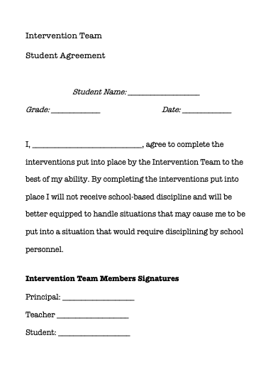
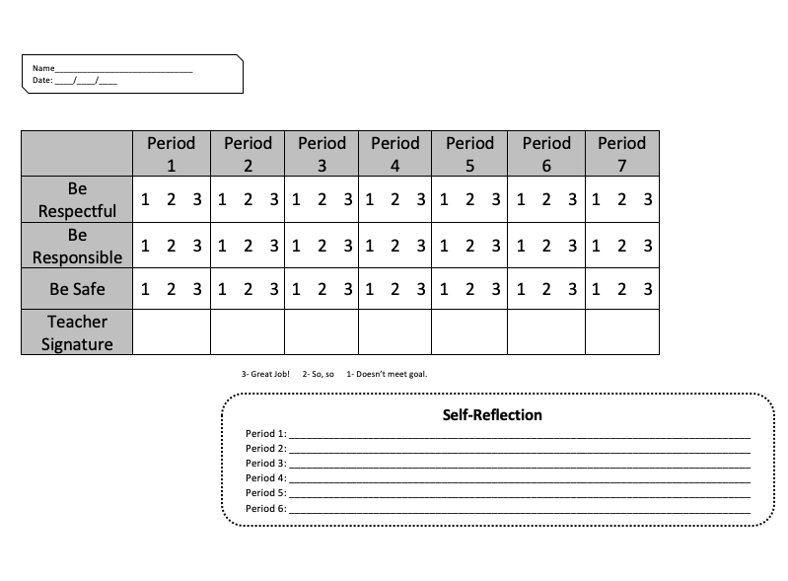
What resources do we use?...

Slide 10
Who is on the Intervention Team?...
Special Education Teachers
(2 female, 2 male)
Principals

Slide 11
How we evaluate ourselves and the Intervention Team program?...
Student who go through our team are interviewed by non-participating staff to assess the impact of the program. This will allow honesty, a way to improve upon components of the program, and a view from a student.

Slide 12
Want more information?...
Emily.kincer@letcher.kyschools.us

