Slide 1
Paintsville Elementary
ACT Team
Full STEAM Ahead
Katie Webb - Principal
Pam Blankenship - Teacher Representative
Cindy Tackett - Teacher Representative
Jessica Davis - Community Engagement Leader

Slide 2
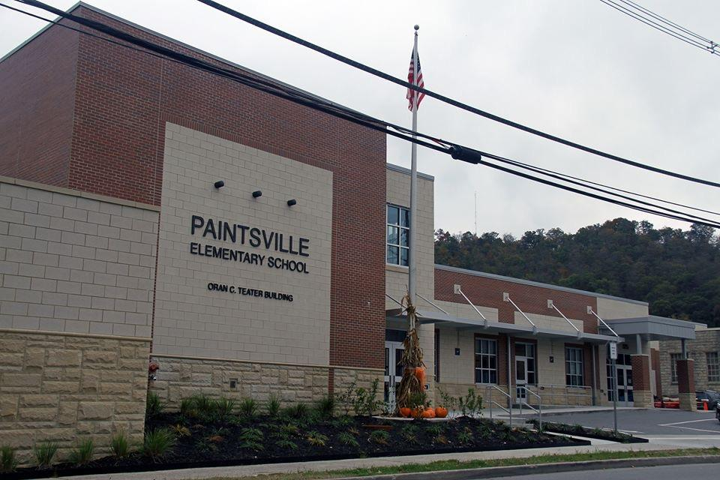
K-6 ELEMENTARY
ALSO HOUSES HEADSTART
SELF-CONTAINED K-2; GRADES 3-6 DEPARTMENTALIZED
55% FREE/REDUCED LUNCH
READING:
2013: 47% P/D
2019: 72% P/D
MATH:
2013: 32% P/D
2019: 66% P/D

Slide 3
Problem of Practice
Based on data gathered through a variety of sources it has been recognized that the overall problem solving skills of our students are not being successfully addressed. As a result, our students are not able to think critically in all subject areas. This is preventing the students from working through their own thoughts.
Notes:
MAP, KPRE, Teacher Surveys, PLC reports, Student Feedback

Slide 4
Theory of Action Linking Statement
We will intentionally focus on professional learning opportunities and the acquisition of problem solving resources within a STEAM classroom in order for our teachers to gain better proficiency and comfort in teaching critical thinking so that our students will benefit from more research based strategies.

Slide 5
Long-Term Impacts for Students
As students transition to middle school, high school and on to college and careers, our goal is that each student who leaves the elementary has been provided with the instruction, strategies, and knowledge needed to build their critical thinking skills to the level for the utmost success in every situation and endeavor. They will be able to not only think deeply and critically but be able to effectively relate those thoughts and ideas into all subject matters.

Slide 6
Short-Term Impacts
Students will be able to problem solve across all subjects and think critically in their daily life. This will be observed daily in class and periodically during assessments. The end-of-year assessment will be further evidence that students are advancing toward the desired outcome.

Slide 7
Implementation of STEAM
All Grades put an emphasis on inquiry based learning in all subjects.
Several teachers attended trainings both in person and virtually throughout the school year dealing with STEAM in the classroom.
Kindergarten used virtual field trips to emphasize the science behind their learning.
3rd Grade and 5th Grade had huge emphasis on inquiry based learning in the science and social studies classroom
6th grade focused on inquiry based learning in math, science and language arts
The gifted and talented teacher focused on STEAM at all levels from Ozobots to Drones

Slide 8
Implementation of STEAM
The entire school participated in the 3rd Annual Science day - Members of the community came in to do hands-on learning STEAM learning with students.
The entire school was planned to participate in the Kentucky Science Center assembly and walk-up stations.

Slide 9
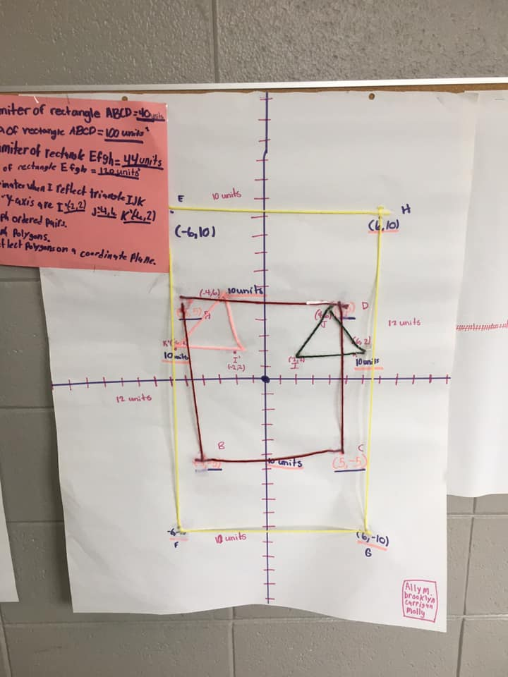
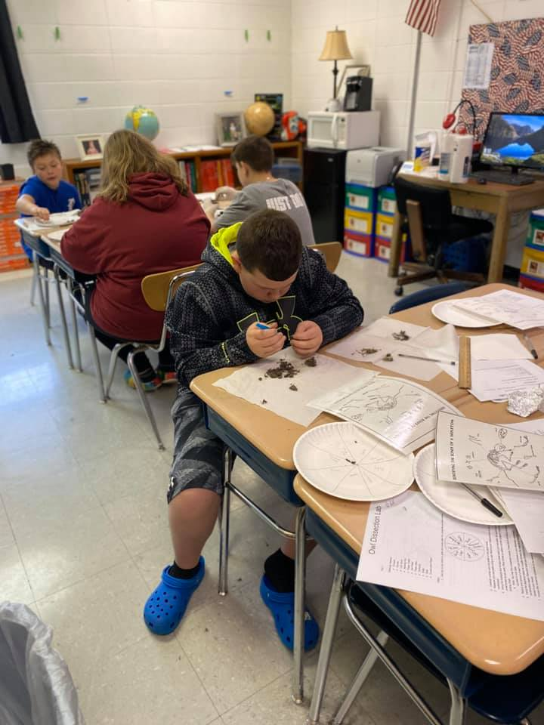
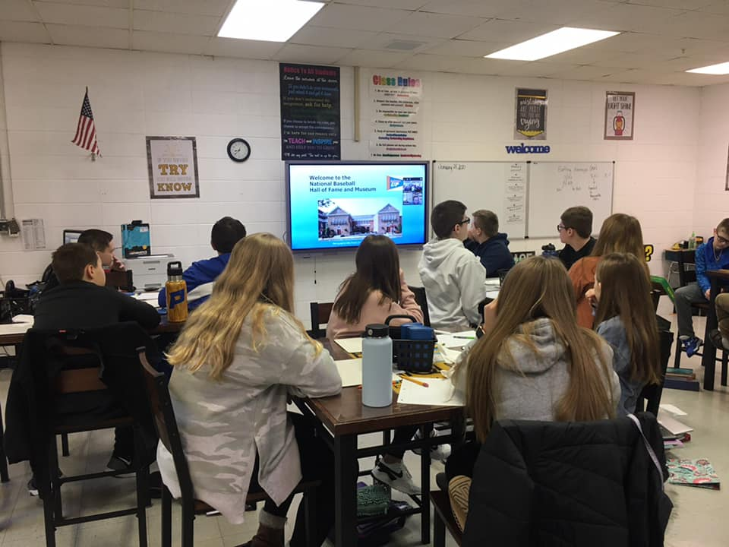
Implementation of STEAM

Slide 10
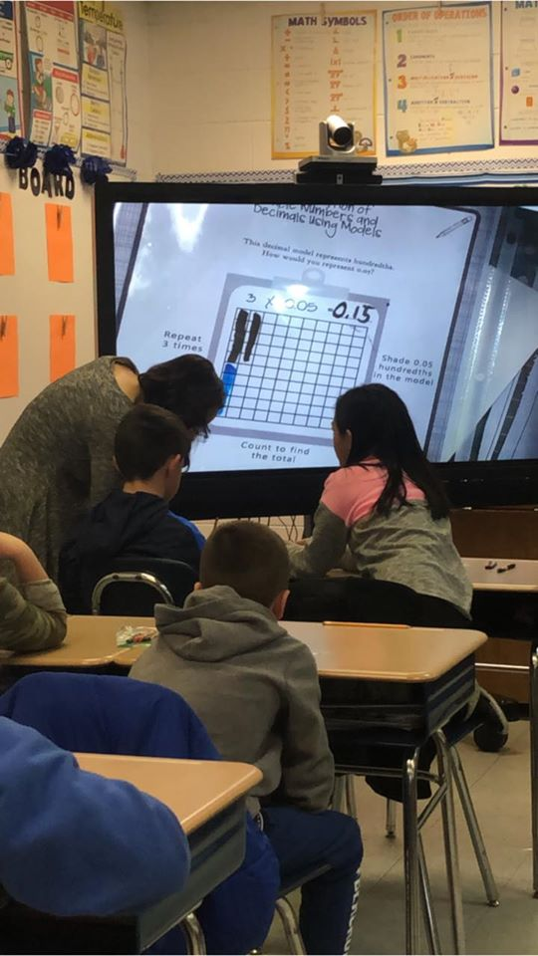
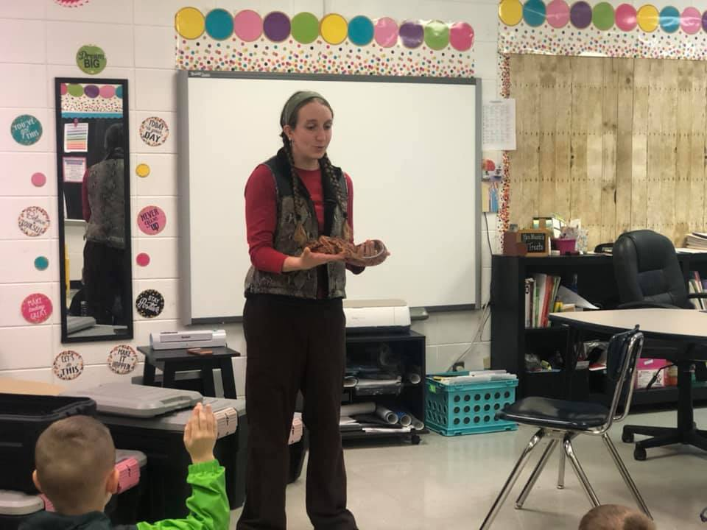
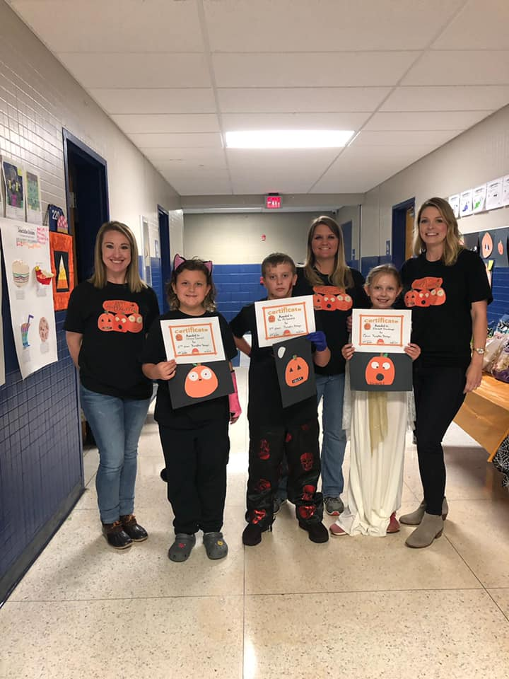
Implementation of STEAM

Slide 11
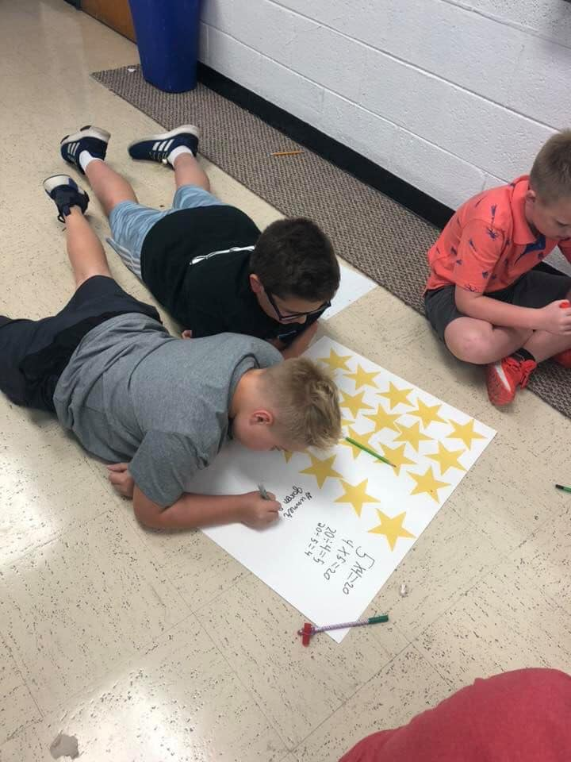
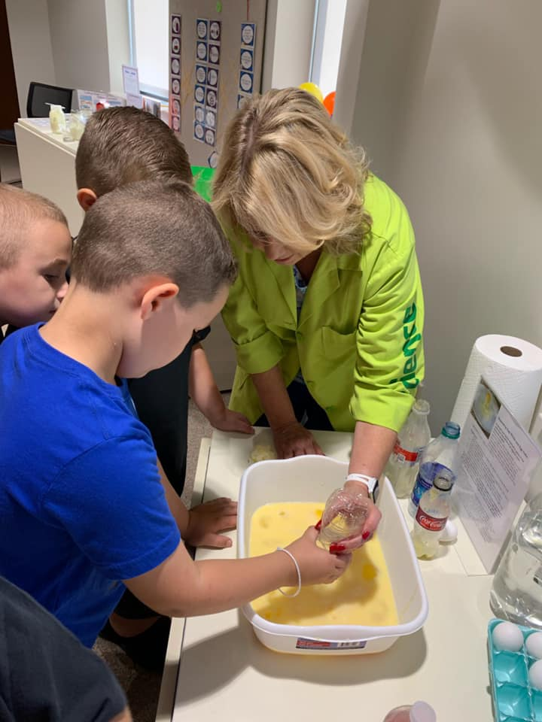
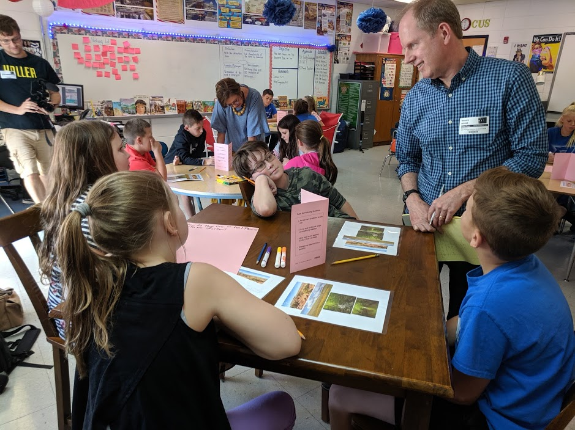
Implementation of STEAM

Slide 12
