Slide 1
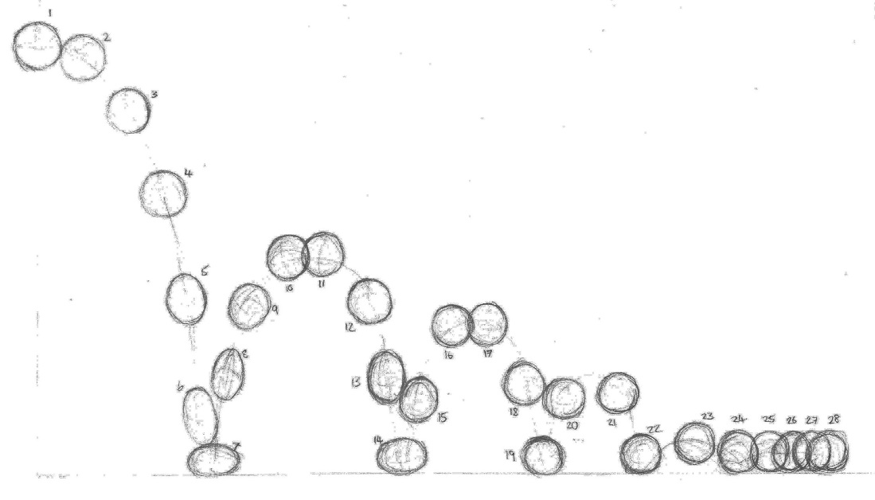
Old School Innovation – Animation
Mr. Shannon D. Shepherd
Betsy Layne High School

Slide 2
Art in motion = Animation

Slide 3
First we looked at the past and learned how it began and who helped it to begin.

Slide 4
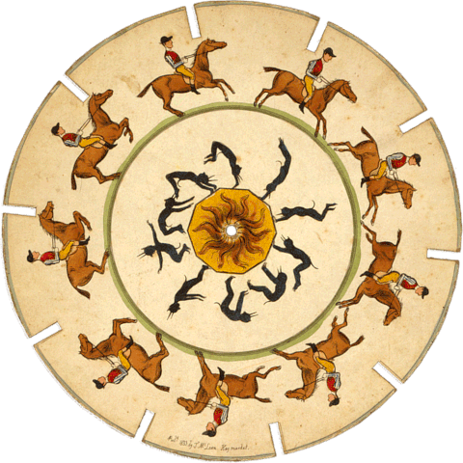
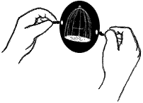
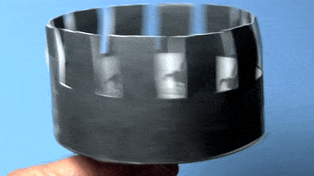
The beginnings
Although earlier predecessors of 2d animation such as shadow play and magic lanterns exist, the earliest form of what we can call animation by our modern standards is the Thaumatrope in 1825. This was a cardboard circle connected to a string with one drawing on each side, and when twirled around would create the illusion of one image comprised of both sides. Soon, the Phenakistiscope and Zoetrope would be invented using a paper circle (or a paper cylinder in the case of the zoetrope) with drawings on them, and being spun rapidly to create the illusion of motion. In 1868 the flip book was created, which would later evolve in to traditional hand drawn animation.

Slide 5
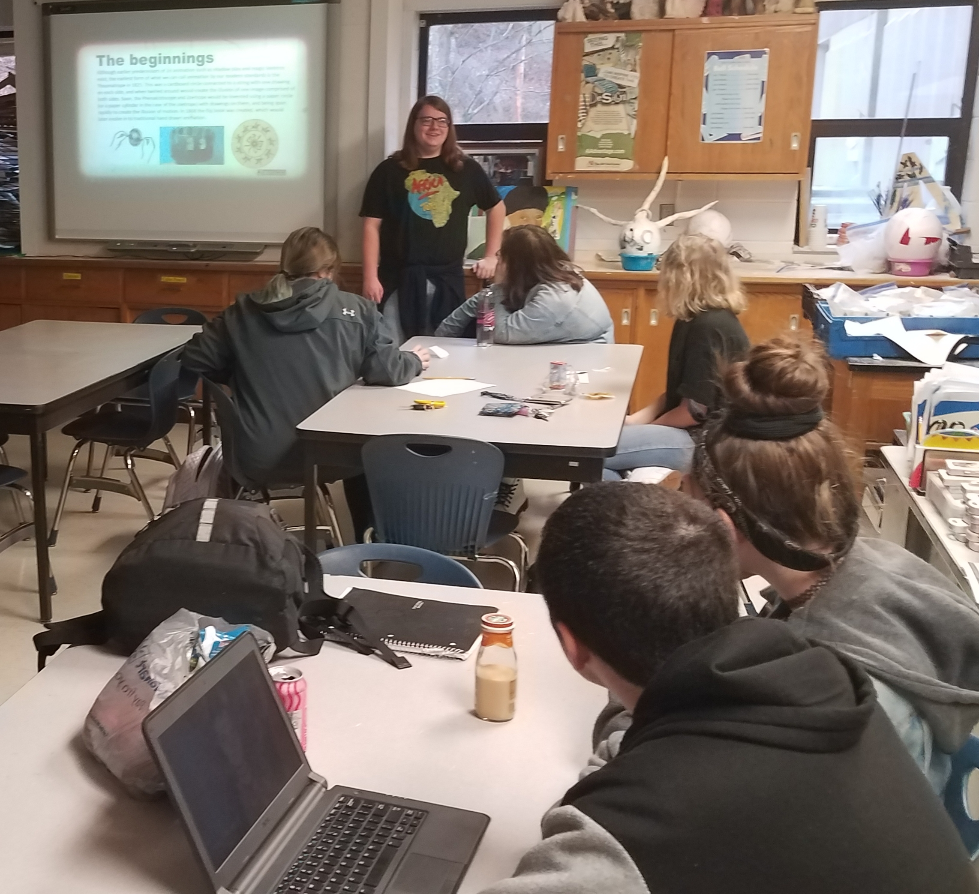
Chandler Hall helps us to understand the beginnings of animation. He also introduced us to The 12 Principles of Animation.

Slide 6
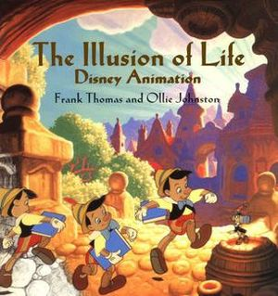
On our Journey we discovered The 12 Principles of Animation
“What are they?’
The 12 principles of animation are 12 basic rules developed by classical Disney animators as to produce realistic, believable motion; these principles of animation were introduced in the 1981 book “The Illusion of Life”, written by animation veterans Frank Thomas and Ollie Johnston.

Slide 7
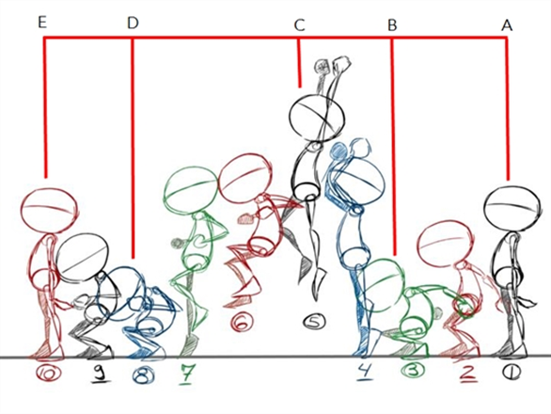
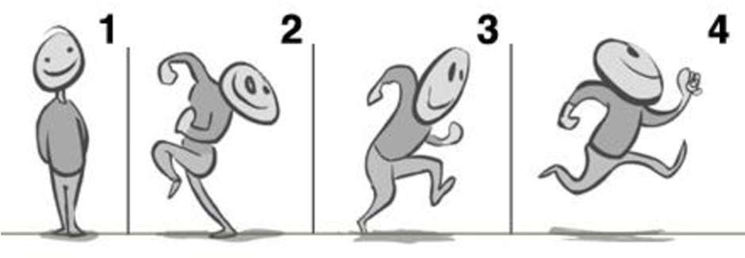
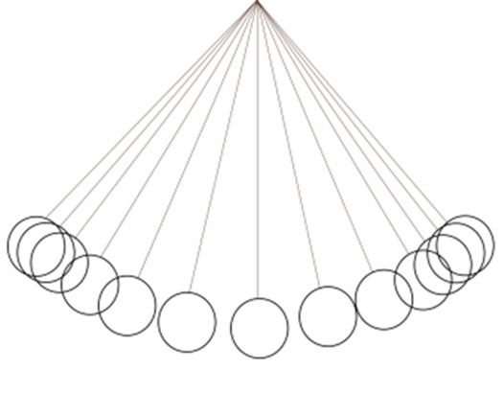
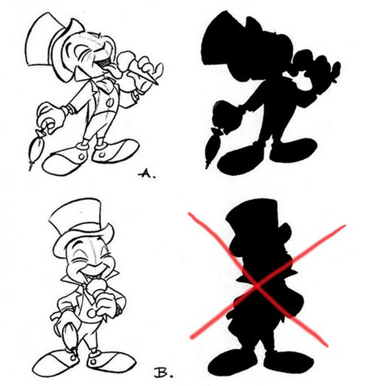
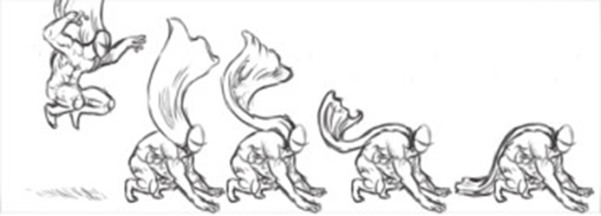
We work on figuring these out……

Slide 8
We also looked at 5 kinds of animation
Traditional animation
2D Vector-based animation
3D computer animation
Motion graphics
Stop motion

Slide 9
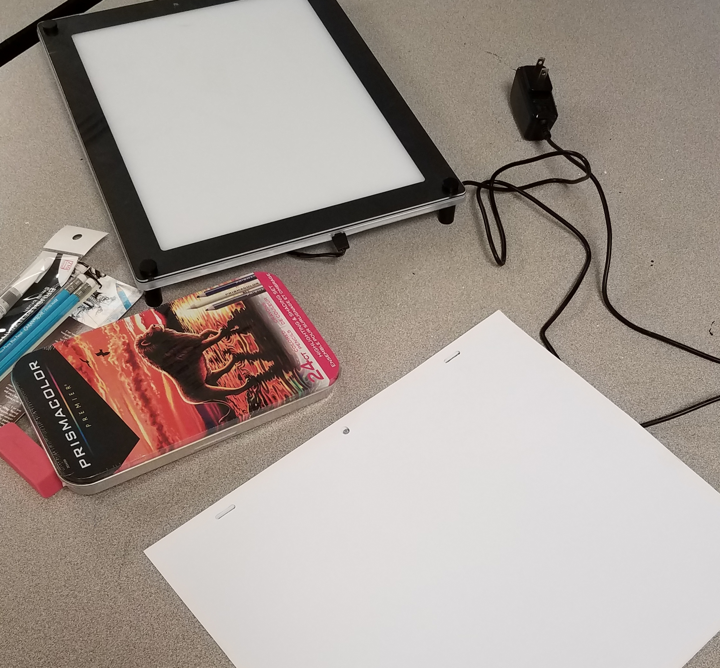
Students get the materials

Slide 10
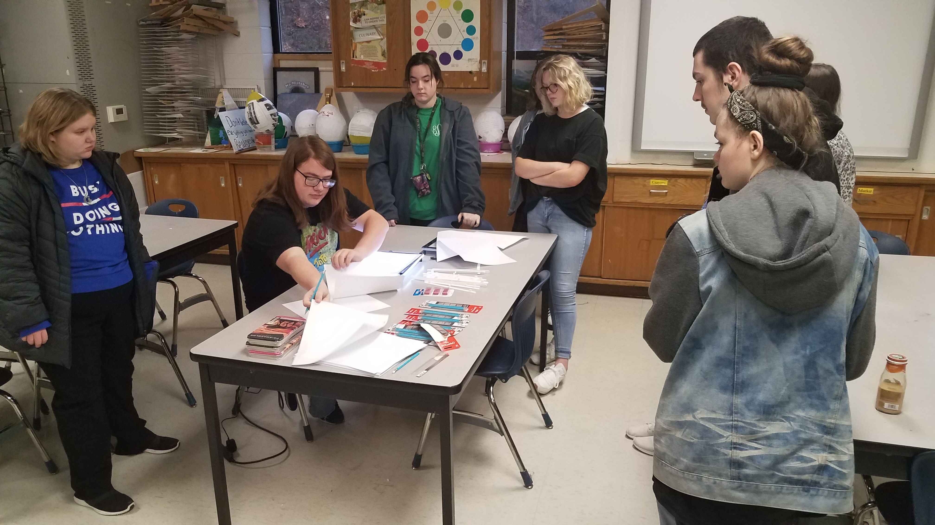
This is what we have and what you do….

Slide 11
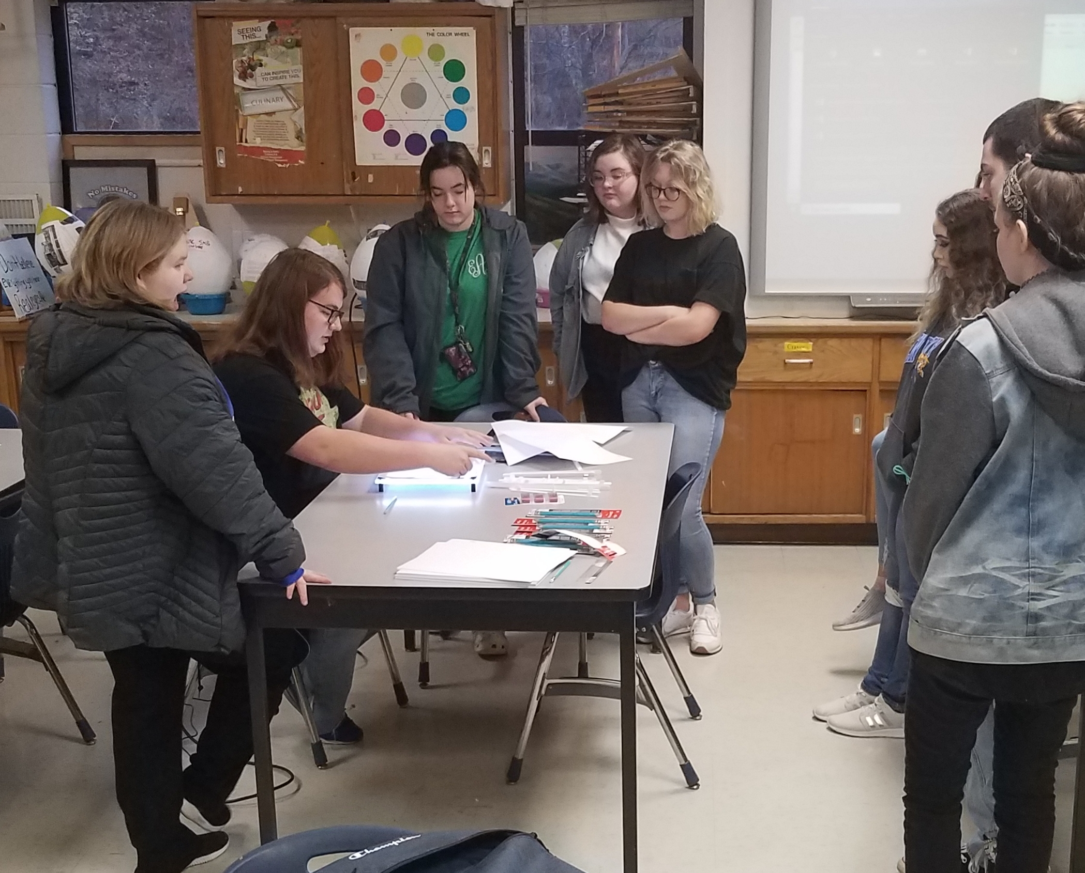
One frame at a time… little movement by little movement.

Slide 12
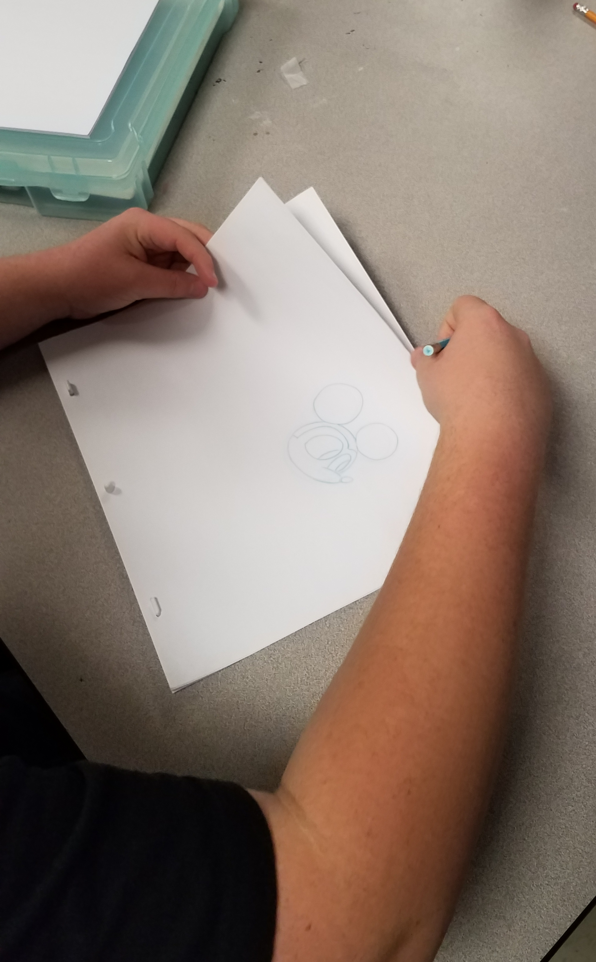
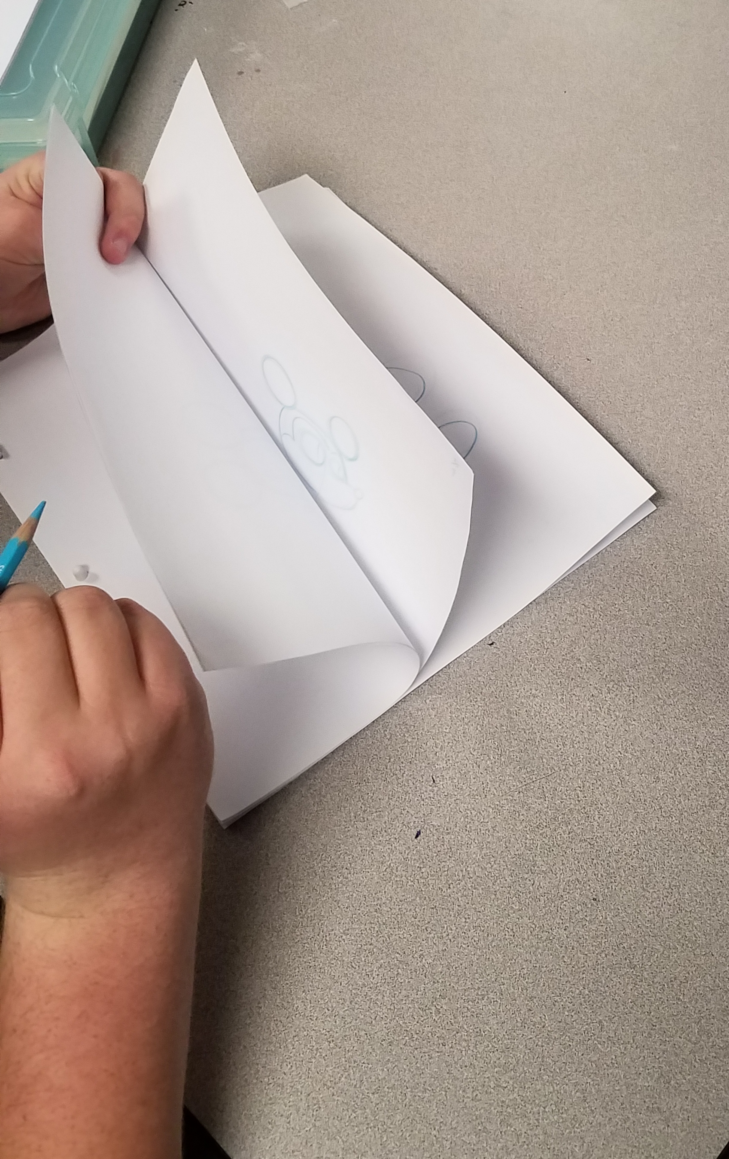
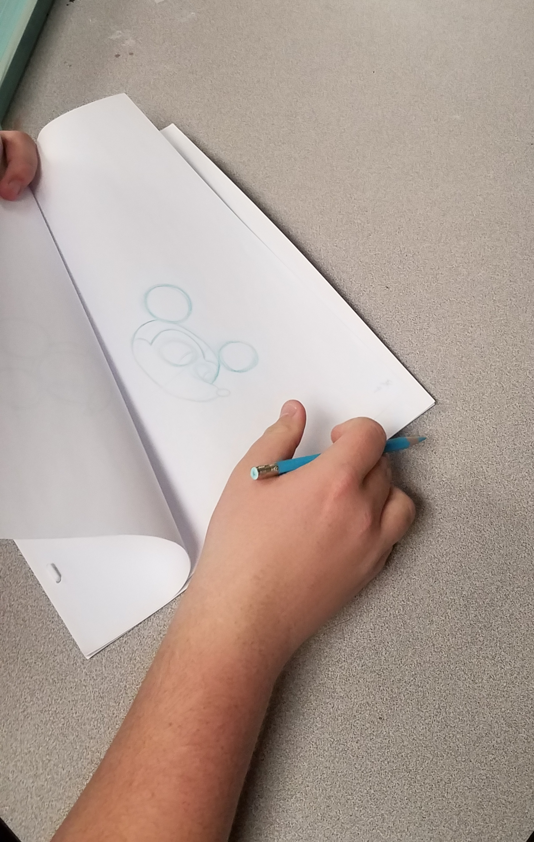

Slide 13
Students took the materials home and began working on their animations…… (guided practice)
Several students have finished 10 second aminations…. And a couple have moved on to digital animation.

Slide 14
Outcomes
Students learned about old school animation.
Students created individual animations.
We learned that animation is all around us in different art forms.
The students who really wanted to know about animation before this have learned a lot and been so active in their drawing pads….
.

Slide 15
Reflection – we should have stated earlier. We didn’t get started until January….
The students have the material and are investigating at home and creating at home.

Slide 16
THINK….BELIEVE….DREAM….and DARE…. By Walt Disney

