Slide 1
Mending Hearts without breaking ribs
Melissa Waddell
Knott Co ATC

Slide 2
What is your problem of practice?
Students are unaware of their compression depth and rate during Basic Life Support skills practice.

Slide 3
What research question will guide your study of this innovation?
Are my students able to apply their BLS skills, with the help of the monitoring system within the manikins, to perform life-saving procedures in the real world?

Slide 4
How do you know this is a problem?
Students are being assessed on this skill and are showing varying degrees of depth during the assessment

Slide 5
Budget
Description of Item/Activity | Projected Amount
Laerdal Resusci Baby QCPR | $979.00
Laerdal Resusci Anne QCPR (4 pack) | $920.00
AED Trainer (4 pack) | $770.00
CPR Training valves, replacement airways, and AED pads for adult and child | $331.00
Projected Budget Detail:
Total Amount Requested: ___ _$3000.00______________________

Slide 6
What strategy will you implement this year to address the problem?
I purchased BLS manikins with a light up/Bluetooth capable monitoring system that gaged their compression depth and rate which has helped my students to see if their efforts are successful.

Slide 7
QCPR Manikin-First Practice

Slide 8
Students Teaching students

Slide 9
What resources and personnel do you need to implement your strategy?
I required the use of the new manikins, with the compression monitoring system as well as the American Heart Association, to license the students within the course.

Slide 10
What outcomes will prove that your innovation has succeeded?
100% student licensure through AHA for BLS healthcare provider.

Slide 11
How will you measure those outcomes?
Number of students licensed out of total students in course.

Slide 12
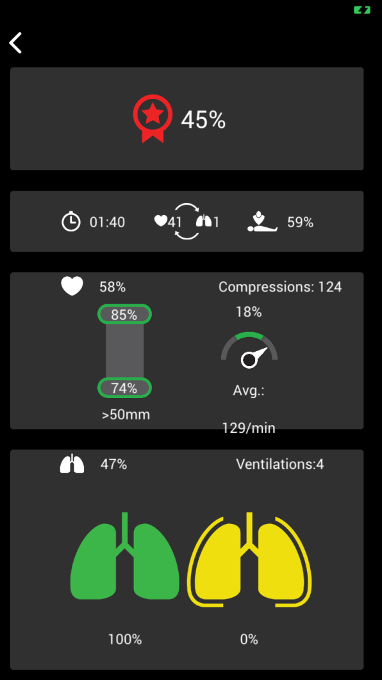
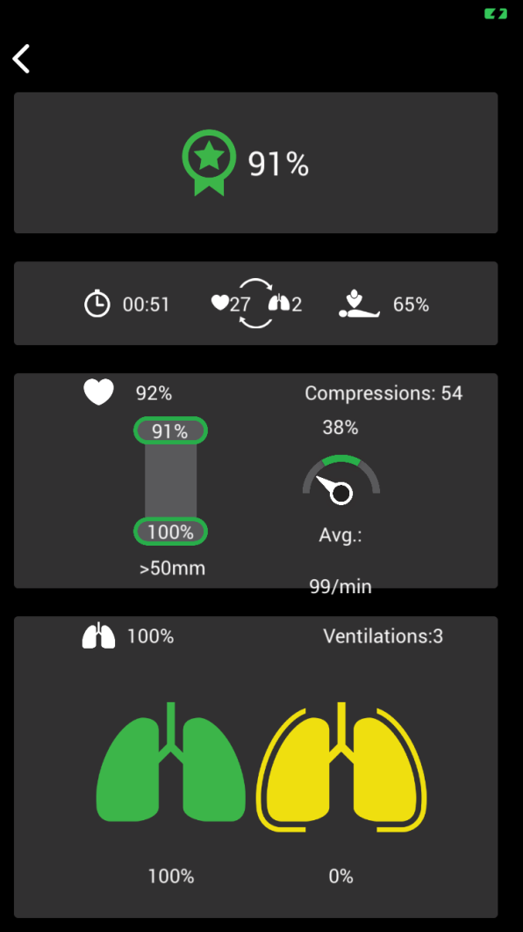
QCPR Bluetooth App

Slide 13
How can you be sure that any positive outcomes on these measures are actually due to your innovation and not something else?
The use of the compression monitoring system will enhance my students ability to provide life-saving techniques through repetition of immediate and visible feedback from the devices. Their compression depth and rate will be more accurate and effective because of this device.

