Slide 1
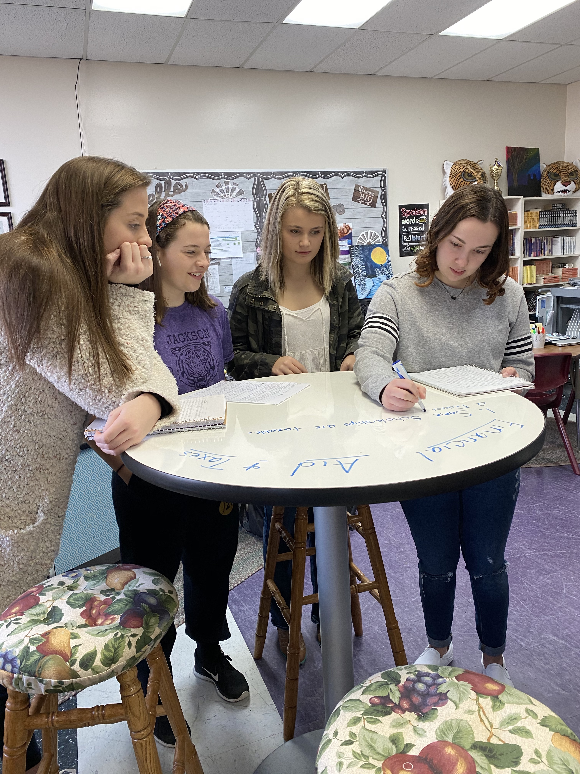
Write ON!!
Missy Henson Little
6th, 7th, 8th grade ELA
Senior Seminar Class
Jackson City School
Jackson Independent School District
melissa.henson@jacksonind.kyschools.us

Slide 2
What did you do?
Purchased some dry erase classroom tables. Two were round high-top tables and one was a standard rectangle table.
Utilized these tables in my daily classroom instruction and with student activities. They also served as regular seating for students in my classroom.
Notes:
Refer back to your grant -

Slide 3
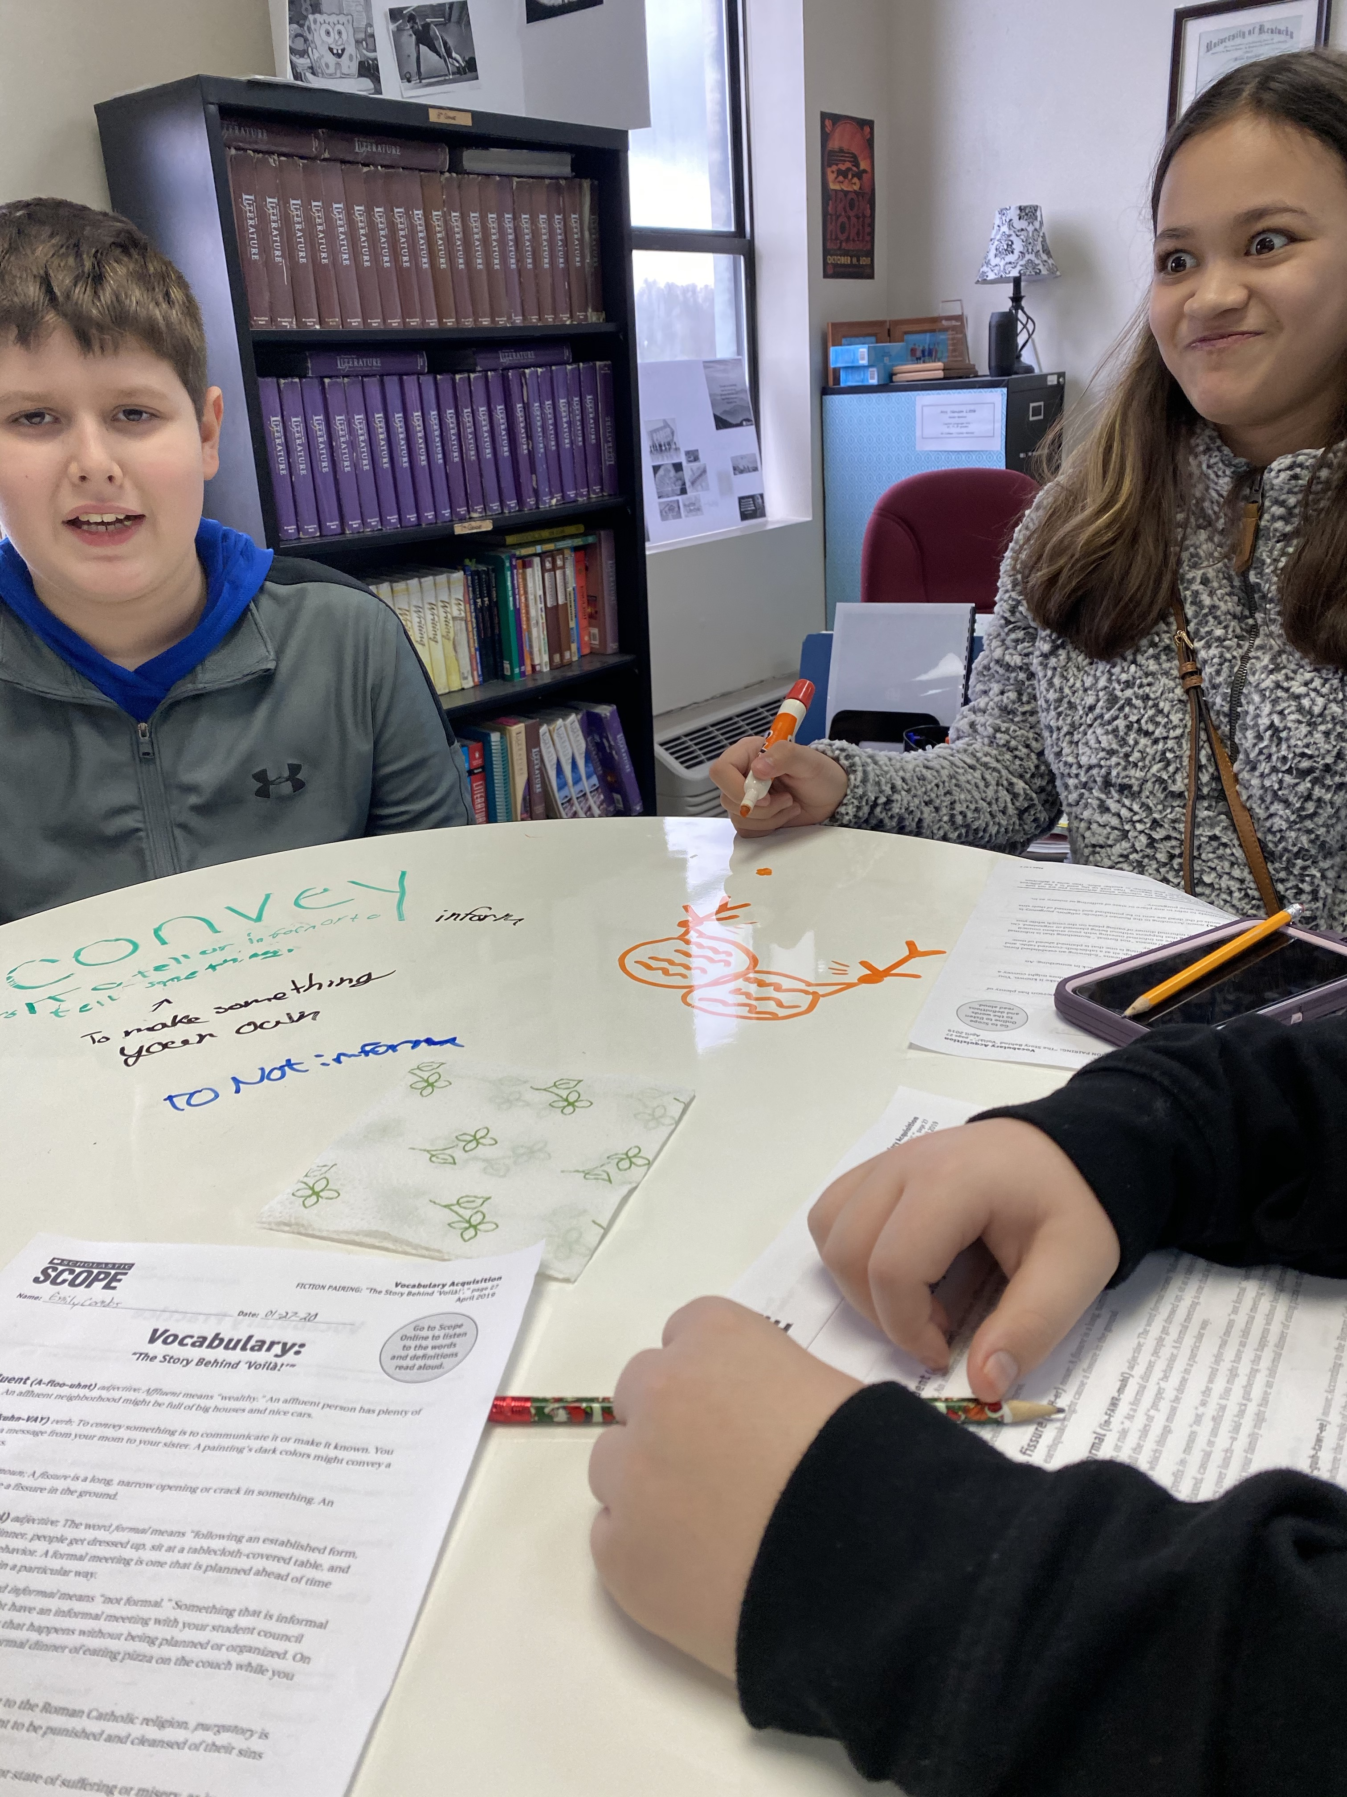
Why did you do it?
To study the impact of visual thinking and literacy strategies on achievement in the classroom.
To promote collaboration and discussion between student and teacher and among students.
To improve student engagement and to teach thinking and planning strategies for reading and writing.
Notes:
Refer back to your grant – What was the need?

Slide 4
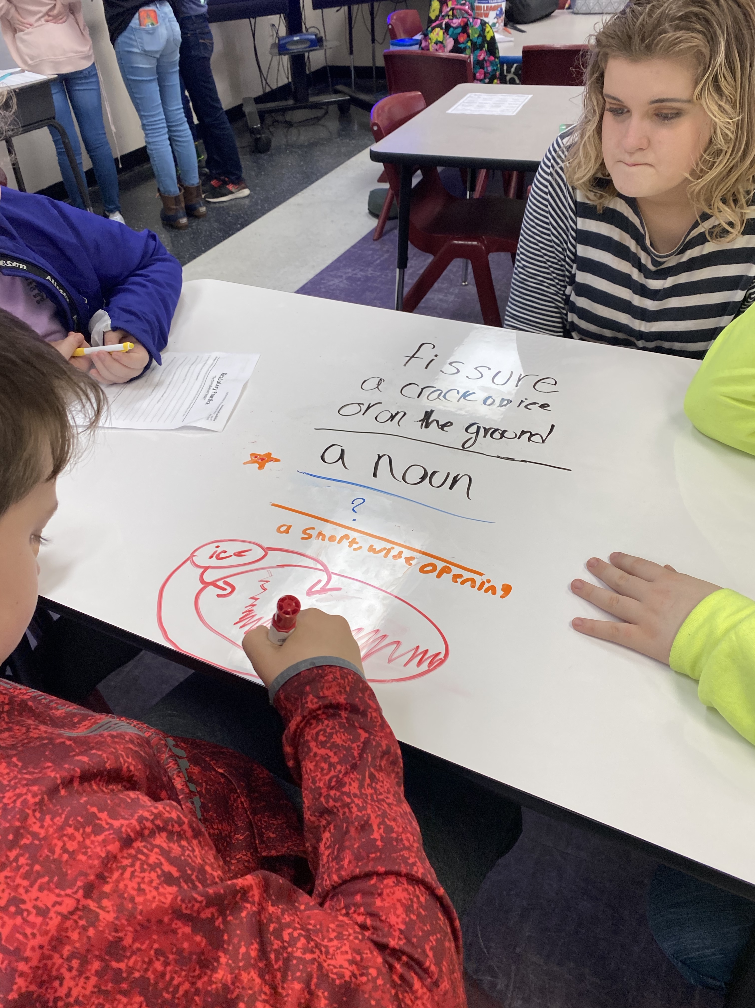
How did it work?
My students loved our dry erase tables, especially the high tops! A big thank you to our school maintenance staff for putting them together for me.
We used the tables during close reading activities to analyze text. Students could draw graphic organizers and charts, and then rotate around and view others.
Students were able to visually share ideas to plan for writing. I was able to provide instant feedback, or have students provide feedback to each other.
The use of our tables promoted classroom discussion and engagement. The only negative was that I wish I was able to afford more of them! Students had to take turns using them.
Notes:
Provide examples, add photos, maybe student statements, data tables, etc…

Slide 5
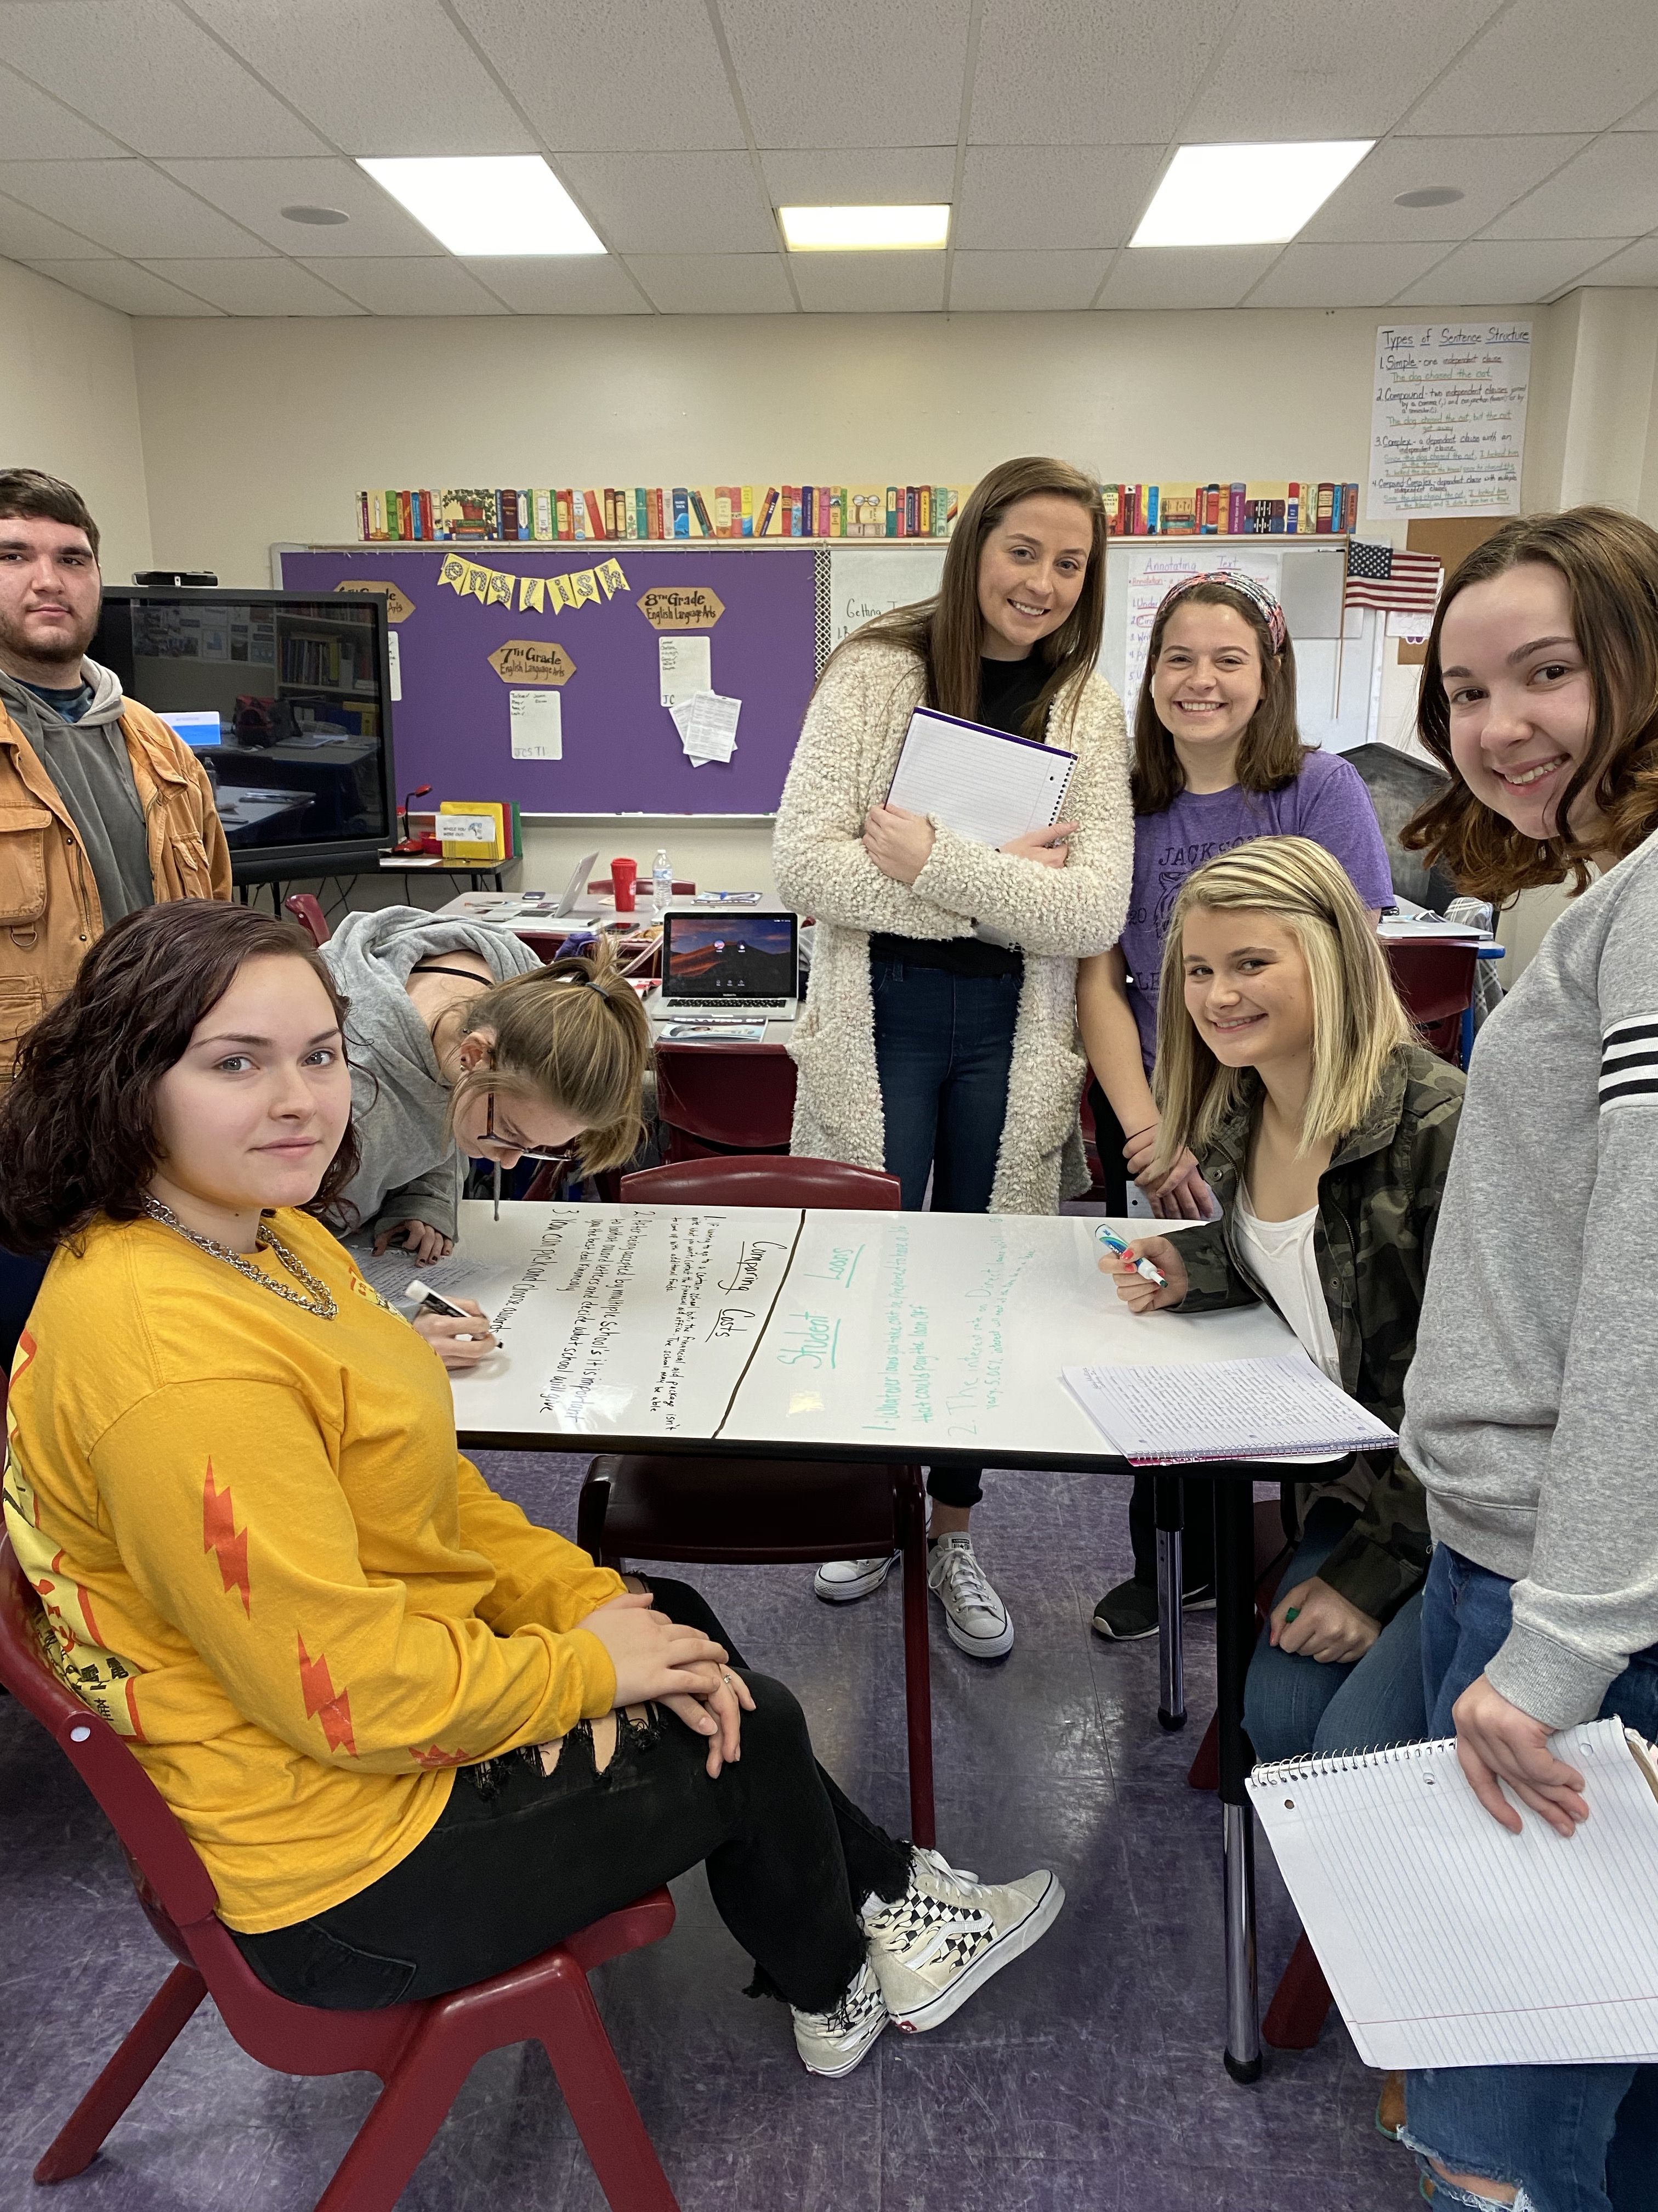
How did it impact student learning?
The dry erase tables were very successful at promoting student participation! Students loved sitting at the tables and writing on them. Students who typically struggled paying attention were now engaged. The high top tables also provided flexible seating opportunities. They could stand if they wanted or sit on the bar stool.
I observed greater engagement when completing close reading activities and prewriting strategies. Students took on a more active role in their learning because they loved writing on the tables.
Students were able to use the tables to visual their ideas. We used them during vocabulary strategies to learn meanings of new words. We used them to brainstorm ideas for writing. We used them to complete tasks in group activities.
As a result of increased student engagement and visualization of literacy strategies, student achievement was positively impacted. Due to school closing for Covid-19, we were unable to gain more specific data to prove this. However, direct observation and assessment results indicate a positive connection.
Notes:
Talk about the impact it had on your students, if you didn’t get to finish your grant then tell what will be the benefits for students. How does this help students in the long run.

Slide 6
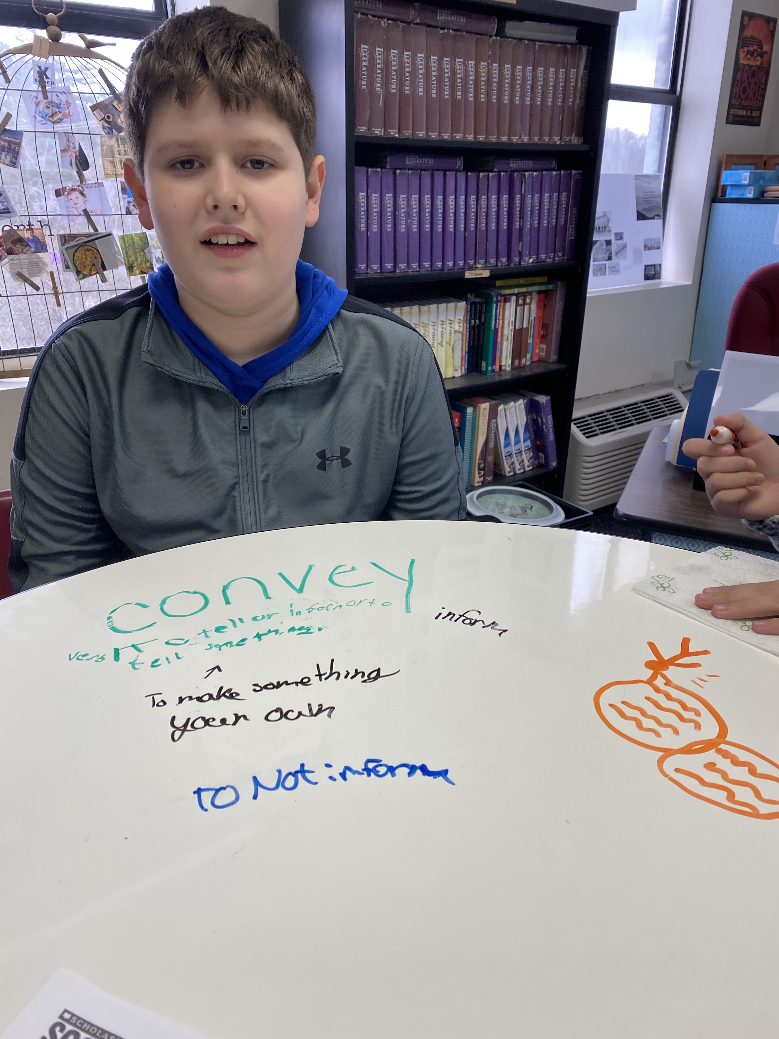
Share a student experience
A 7th grade student who has typically been a reluctant and unfocused learner was allowed to sit at the high top dry erase table. She suddenly became more attentive and was able to take turns standing or sitting while completing her work. I also used time with dry erase markers on the table as a reward. These strategies were effective in increasing her participation and achievement.
8th grade students were able to list claims and evidence on the tables when learning about argumentative writing. As a class, students rotated and gave each other feedback. As a result, the final writings were better supported.
Notes:
Talk about the impact it had on your students, if you didn’t get to finish your grant then tell what will be the benefits for students. How does this help students in the long run.

Slide 7
What did you learn?
I learned that the use of dry erase tables can be very beneficial in learning literacy strategies in middle school classrooms by allowing students to visualize ideas.
I learned that dry erase tables can increase student engagement and provide opportunities for flexible seating.
I learned that a cheaper alternative to add to dry erase tables is the purchase and use of dry erase lapboards so that all students have an area to write.
I learned that the dry erase tables promoted positive collaboration and discussions. Effective use also resulted in higher achievement on writings and assessments.
Notes:
Add (Evidence may include: data, photographs, student work, tools, video, etc.). Talk about good and bad.

Slide 8
Can this be used with future classes?
Absolutely!!! These tables are a great addition to my permanent classroom. This grant opportunity has enhanced my classroom instruction and atmosphere from now on. I consider my students lucky to have them. They will continue to be utilized to promote student participation and achievement in literacy. Thank you, KVEC and ARI Learning Innovation Grant supporters!
Notes:
Talk about how this will benefit

Slide 9
THANK YOU
Notes:
Don’t forget to Thank them for the experience

